Slide 1




DRCR Retina Network
Home OCT Monitoring System: Feasibility Study
(Protocol AK)
Protocol Chair: Kevin Blinder, MD

Slide 2
Background
Treatment of neovascular AMD (nAMD) with anti-VEGF therapy is a major improvement but at a very high treatment burden and cost for patients and the healthcare system
The ability to perform daily monitoring of intraretinal fluid and subretinal fluid using a home optical coherence tomography (OCT) system offers the opportunity to obtain a detailed assessment of fluid over time
Understanding fluid dynamics for an individual patient may allow customization of treatment that may reduce treatment burden and improve long-term outcomes

Slide 3
Notal Vision Home OCT
Notal Vision has developed an OCT system for at-home use, called Home OCT system
  The Notal Home OCT is an investigational device not cleared for clinical use
Patient self-images daily
  Process takes less than one minute per eye
  Dense 88 B-scans spaced 30 µm in 3x3 mm field of view visualizes small amounts of fluid
  Automatic data transmission to cloud

Slide 4
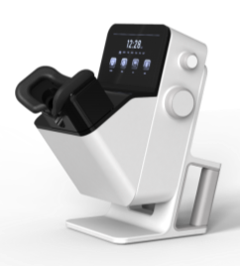
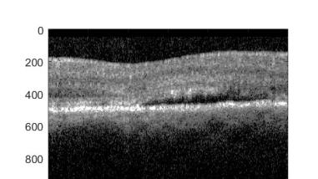

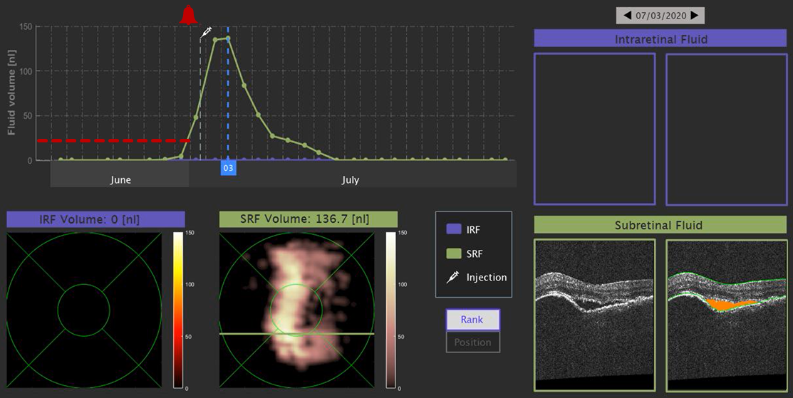
Notal Vision Home OCT
Home OCT Device
Monitoring center performs AI based quantification and tracking of intra- and subretinal fluid volume
Retina specialist
  sets fluid volume thresholds and is notified by monitoring center when criteria are met
  has 24/7 access to all images and data
  bills for data review every 30 days
Home OCT Image

Slide 5
Prior Notal Vision Studies
In-Clinic Study
  196 AMD patients (mean age 77 years) with VA >20/400
  90% were able to self-operate the Notal Home OCT system and capture analyzable images following a 2 min tutorial
  >60% reported the self-scan method was quick and easy to understand and complete, and that the headrest was comfortable and easy to use
  The accuracy of the Notal OCT Analyzer (NOA) vs. retina specialists was 91%±7%, sensitivity was 92%±6%, and specificity was 91%±6% for detecting fluid presence (142 cube scans)

Slide 6
Prior Notal Vision Studies
At-Home Study
  4 participants (mean age 73.8 years) with nAMD (one or both eyes) completed daily self-imaging at home for 1 month
  87.9% of imaging attempts were successful, 97.6% were satisfactory quality
  The NOA and human determination of presence of fluid agreed in 94.7% of cases
  From a subset of 24 scans with fluid, for agreement between NOA and human fluid volume measurements, the correlation coefficient was 0.996 and mean absolute difference was 1.5 nl (vs. 0.995 and 1.2 nl, respectively, for interhuman agreement)

Slide 7
Critical Questions for Home OCT
Can the use of Home OCT monitoring reduce visit and treatment burden and at least maintain or possibly improve VA outcomes?
  Need large RCT to determine its role in clinical practice
  No such trial currently planned – will be FDA approved as a device with no efficacy trial required
What amount of recurrent fluid should be used as a threshold to prompt a follow up visit with a retina specialist?
Will AI be sufficient for screening for recurrent activity?
Logistics and how would interface with DRCR Retina Network not well understood
  Need feasibility study

Slide 8
Protocol AK: Home OCT Feasibility Study
Observational Study of 15 participants from 3 sites
  Inclusion Criteria:
    Best corrected E-ETDRS VA 20/20 to 20/320
    Ability to take daily Home OCT scans
    Active choroidal neovascularization (CNV) due to AMD in at least one eye in which the investigator intends to treat with anti-VEGF
      AMD defined as presence of at least one large drusen in either eye
      Active CNV defined as presence of intraretinal or subretinal fluid
  Exclusion Criteria:
    History of CNV or treatment for CNV in the study eye
Participants will take daily Home OCT scans for 6 months
Follow-up visits will occur as normally seen with standard care
Any OCT scans obtained on the study eye (none are mandated by the study) will be uploaded to the Coordinating Center for grading & comparison with Home OCT scan taken same day

Slide 9
What We Will Learn
Methods and logistics of image/data interpretation and transfer from Notal
Willingness of patients to participate in and complete a program requiring home OCT monitoring
Ability of clinic and Notal staff to educate patient
Better understand fluid dynamics associated with treatment
Agreement between Reading Center assessment of fluid on in-office OCT versus NOA fluid determinations from Home OCT scans

