Slide 1
Diabetic Retinopathy Severity on
Ultra-Widefield Fluorescein Angiography versus Color Photography and Association with Risk of Disease Worsening
(Protocol AA)
Paolo S. Silva, MD

Slide 2
Financial Disclosures
Research Support
  Optos
  Optomed
  Kubota Vision
Consulting and speaking fees
  Abbvie, Novartis, Bayer, Roche, Optos, Optomed

Slide 3
Background
Both the DCCT and ETDRS compared FA with stereoscopic fundus photography and identified additional lesions and risk factors on FA.
  At the time the studies were conducted, only a limited area of the posterior retina was evaluated
  Additional lesions and risk factors present on FA did not provide enough additional benefit in the management of the patients
However, there is no widely adopted FA grading scale for DR severity that has been validated in multicenter prospective trials.

Slide 4
Study Rationale
Currently, it is unknown how the grading scale for DR severity on color imaging applies to DR severity on FA, or whether FA grading might provide the same or more accurate disease stratification.
This study compared DR evaluation of UWF-Color and UWF-FA images using ETDRS color grading scales and determined agreement rates between both imaging modalities across a broad range of DR severity levels.

Slide 5
Objectives
To evaluate the differences in DRSS grades assessed from UWF-color and UWF-FA images
To explore the effect of baseline DRSS level determined by the UWF-FA images on the risk of DR disease worsening over time
To investigate the association between disease worsening over time and the differences in baseline DR grades on UWF-FA and UWF-color images

Slide 6
Outcome Measure
Assessment of DR severity
  UWF-Color (optomap color rg): Color ETDRS DRSS
  UWF-FA: Color ETDRS DRSS applied to FA images
Primary Outcome: Disease Worsening
  The proportion of eyes experiencing DRSS worsening by 2 or more steps from baseline or receipt of DR treatment through 4 years
    Outcome assessed within the ETDRS fields on UWF-color images
    Data from eyes after receiving treatment with anti-VEGF, steroid, or vitrectomy for conditions other than DR were censored

Slide 7
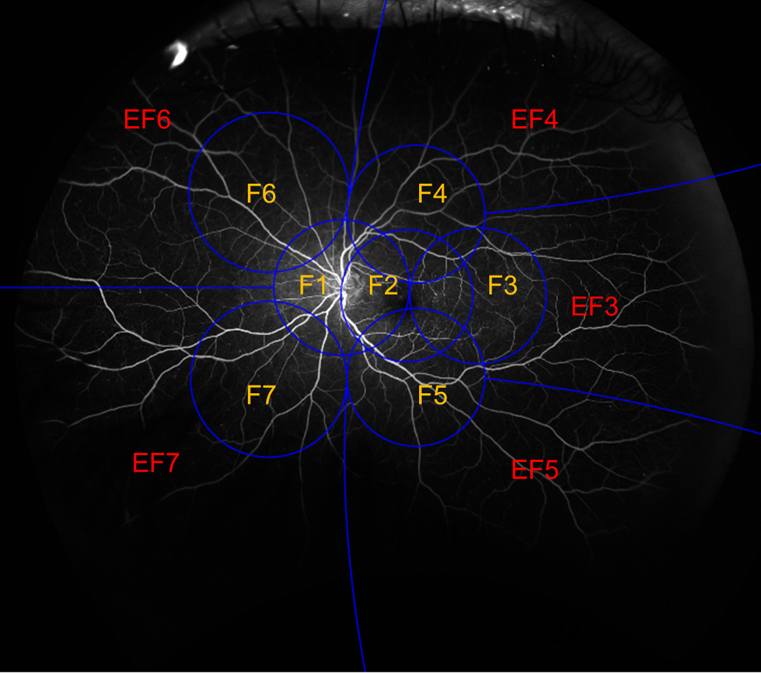
Protocol AA: Image Evaluation for DR Severity
Standardized ETDRS photo templates were digitally overlaid on UWF images based on disc and foveal location
Distribution and location of lesions determined based on overlay
Evaluation was performed at a centralized reading center
Notes:
Standardized ETDRS photo templates were digitally overlaid on UWF images based on disc and foveal location. The distribution and location of lesions were determined based on this ETDRS grid overlay. Evaluation was performed at a centralized reading center.

Slide 8
Evaluation of 3-Field FA DRSS
Assess affect on FA grading of nonUWF-FA
Idealized 3-Field area representing the images captured non-UWF-FA
H/Ma and IRMA: Field 2 only
VB: Field 3 only
For other lesion types, grades for lesion severity from Field 1-3 (if applicable) were included in the calculation of an overall DRSS score
1F
2F
3F

Slide 9
Agreement Between
UWF-FA vs. UWF-Color in the Assessment of DRSS

Slide 10
 | DRSS on Masked UWF-FA
DRSS on Masked UWF-Color | N | 1 | 2 | 3 | 4 | 5 | 6 | 7 | 8 | 9 | 10 | 11 | 12
 | 1 |  |  | 3 | 2 | 1 | 1
 | 2 | 1 |  | 4 | 1 | 1 | 1
 | 3 | 2 |  | 136 | 127 | 192 | 111 | 22 | 12 | 5
 | 4 |  |  | 25 | 56 | 173 | 124 | 32 | 11
 | 5 |  |  | 5 | 13 | 93 | 129 | 22 | 11
 | 6 |  |  | 1 | 7 | 101 | 184 | 60 | 20
 | 7 |  |  | 2 | 2 | 3 | 16 | 93 | 19 | 3 |  |  | 2
 | 8 |  |  | 2 | 1 | 8 | 10 | 22 | 11 | 2 |  |  | 1
 | 9 |  |  |  |  |  | 5 | 1 | 2 | 7
 | 10 |  |  |  |  | 1 |  |  |  | 2
 | 11
 | 12 |  |  |  |  |  |  |  |  | 1 |  |  | 1
57% with more severe DR on FA
Kappa Statistics
Baseline: 0.53
Year 1: 0.44
Year 4: 0.40
12% with more severe DR on Color
Abbreviations: 1 = DR absent (Level 10/12); 2 = DR questionable (Level 14/15) or Microaneurysms only (Level 20); 3 = Mild NPDR (Level 35); 4 = Moderate NPDR (Level 43); 5 = Moderately Severe NPDR (Level 47); 6 = Severe and Very Severe NPDR (Level 53); 7 = Inactive PDR (Level 60) or Mild PDR (Level 61); 8 = Moderate PDR (Level 65); 9 = High-Risk PDR (Level 71); 10 = High-Risk PDR (Level 75); 11 = Advanced PDR (Level 81); 12 = Advanced PDR (Level 85).

Slide 11
 | DRSS on Unmasked UWF-FA
DRSS on Masked UWF-Color | N | 1 | 2 | 3 | 4 | 5 | 6 | 7 | 8 | 9 | 10 | 11 | 12
 | 1 |  |  | 3 | 1 | 1 | 1 | 1
 | 2 |  |  | 4 | 1 |  | 2 |  | 1
 | 3 | 2 |  | 95 | 111 | 204 | 142 | 31 | 17 | 5
 | 4 |  |  | 20 | 37 | 164 | 146 | 41 | 13
 | 5 |  |  | 5 | 11 | 87 | 132 | 26 | 12
 | 6 |  |  | 1 | 6 | 95 | 175 | 73 | 23
 | 7 |  |  | 2 |  | 3 | 18 | 90 | 22 | 3 |  |  | 2
 | 8 |  |  | 2 |  | 7 | 11 | 23 | 11 | 2 |  |  | 1
 | 9 |  |  |  |  |  | 5 | 1 | 2 | 7
 | 10 |  |  |  |  | 1 |  |  |  | 2
 | 11
 | 12 |  |  |  |  |  |  |  |  | 1 |  |  | 1
62% with more severe DR on FA
Kappa Statistics
Baseline: 0.45
Year 1: 0.38
Year 4: 0.34
11% with more severe DR on Color
Abbreviations: 1 = DR absent (Level 10/12); 2 = DR questionable (Level 14/15) or Microaneurysms only (Level 20); 3 = Mild NPDR (Level 35); 4 = Moderate NPDR (Level 43); 5 = Moderately Severe NPDR (Level 47); 6 = Severe and Very Severe NPDR (Level 53); 7 = Inactive PDR (Level 60) or Mild PDR (Level 61); 8 = Moderate PDR (Level 65); 9 = High-Risk PDR (Level 71); 10 = High-Risk PDR (Level 75); 11 = Advanced PDR (Level 81); 12 = Advanced PDR (Level 85).

Slide 12
 | DRSS on Unmasked UWF-FA
DRSS on Masked UWF-Color | N | 1 | 2 | 3 | 4 | 5 | 6 | 7 | 8 | 9 | 10 | 11 | 12
 | 1 |  |  | 3 | 1 | 1 | 1 | 1
 | 2 |  |  | 4 | 1 |  | 2 |  | 1
 | 3 | 2 |  | 95 | 111 | 204 | 142 | 31 | 17 | 5
 | 4 |  |  | 20 | 37 | 164 | 146 | 41 | 13
 | 5 |  |  | 5 | 11 | 87 | 132 | 26 | 12
 | 6 |  |  | 1 | 6 | 95 | 175 | 73 | 23
 | 7 |  |  | 2 |  | 3 | 18 | 90 | 22 | 3 |  |  | 2
 | 8 |  |  | 2 |  | 7 | 11 | 23 | 11 | 2 |  |  | 1
 | 9 |  |  |  |  |  | 5 | 1 | 2 | 7
 | 10 |  |  |  |  | 1 |  |  |  | 2
 | 11
 | 12 |  |  |  |  |  |  |  |  | 1 |  |  | 1
Mild to Moderately-Severe NPDR (Levels 35-47)
80% with more severe DR on FA
Suggests that UWF-FA is more sensitive in detecting early microvascular changes and peripheral lesions that may be overlooked by UWF-color
Abbreviations: 1 = DR absent (Level 10/12); 2 = DR questionable (Level 14/15) or Microaneurysms only (Level 20); 3 = Mild NPDR (Level 35); 4 = Moderate NPDR (Level 43); 5 = Moderately Severe NPDR (Level 47); 6 = Severe and Very Severe NPDR (Level 53); 7 = Inactive PDR (Level 60) or Mild PDR (Level 61); 8 = Moderate PDR (Level 65); 9 = High-Risk PDR (Level 71); 10 = High-Risk PDR (Level 75); 11 = Advanced PDR (Level 81); 12 = Advanced PDR (Level 85).

Slide 13
Disease Worsening Over 4 Years by Baseline DRSS on UWF-FA
(Masked, Unmasked, and Field 1-3 UWF-FA)

Slide 14
Disease Worsening Over Time by Baseline DRSS on Masked UWF-FA
53%
50%
31%
21%
Mild NPDR | 91 | 78 | 67 | 60 | 52
Moderate NPDR | 74 | 70 | 57 | 38 | 32
Mod. Severe NPDR | 168 | 146 | 127 | 99 | 82
Sev./Very Sev. NPDR | 144 | 132 | 99 | 71 | 48

Slide 15
Disease Worsening Over Time by Baseline DRSS on Unmasked UWF-FA
50%
48%
29%
21%
Mild NPDR | 68 | 59 | 49 | 44 | 37
Moderate NPDR | 69 | 64 | 52 | 35 | 29
Mod. Severe NPDR | 172 | 149 | 129 | 101 | 87
Sev./Very Sev. NPDR | 153 | 140 | 111 | 80 | 56

Slide 16
Disease Worsening Over Time by Baseline DRSS on Field 1-3 UWF-FA
100%
51%
39%
33%
Mild NPDR | 227 | 200 | 174 | 139 | 114
Moderate NPDR | 148 | 133 | 102 | 76 | 62
Mod. Severe NPDR | 139 | 124 | 94 | 66 | 51
Sev./Very Sev. NPDR | 4 | 4 | 3 | 3 | 0

Slide 17
Disease Worsening Over 4 Years by Baseline Differences
Between UWF-FA and UWF-Color
(Lesion-level Grades)

Slide 18
Disease Worsening by Presence of More Severe Baseline Lesion Grade on Masked UWF-FA vs. Masked UWF-Color
P = .003
P = 0.04
No. of Eyes | 366 176 | 370 169 | 485 57 | 494 45

Slide 19
Disease Worsening by Presence of More Severe Baseline Lesion Grade on Unmasked UWF-FA vs. Masked UWF-Color
P < .001
P = 0.60
No. of Eyes | 315 227 | 357 182 | 470 72 | 491 48

Slide 20
Disease Worsening by Presence of More Severe Baseline Lesion Grade on Unmasked UWF-FA vs. Field 1-3 UWF-FA
P < .001
P = 0.47
No. of Eyes | 192 349 | 201 340 | 479 63 | 486 56

Slide 21
Disease Worsening Over 4 Years by Baseline Differences
Between UWF-FA and UWF-Color
(Overall DRSS Level)

Slide 22
Disease Worsening by Difference in Baseline DRSS
on UWF-FA vs. Masked UWF-Color
P < .001
P < .001
HR = 2.06
(95% CI: 1.47 - 2.88)
HR = 2.37
(95% CI: 1.61 - 3.48)
No. of Eyes | 267 275 | 235 307

Slide 23
Disease Worsening by Difference in Baseline DRSS
on Field 1-3 UWF-FA vs. Masked UWF-Color
P < .001
HR = 1.78
(95% CI: 1.31 - 2.43)
No. of Eyes | 432 109

Slide 24
Disease Worsening by Difference in Baseline DRSS
on Field 1-3 UWF-FA vs. UWF-FA
P = .08
P = .10
HR = 1.38
(95% CI: 0.97 - 1.96)
HR = 1.39
(95% CI: 0.94 - 2.06)
No. of Eyes | 166 352 | 133 385

Slide 25
Summary
Compared with UWF-color, UWF-FA identify more disease in over 50% of images
  Most evident in early levels of DR (i.e., less than level 53).
Eyes with worse baseline DR lesion on UWF-FA compared to color images had higher rates of disease worsening over 4 years
  Most evident in IRMA and NVE
Eyes with worse baseline DRSS on UWF-FA compared to color images had higher rates of disease worsening over 4 years.

Slide 26
Conclusions
These exploratory analyses suggest that UWF-FA is superior to UWF-color in detecting subtle and peripheral DR lesions, potentially leading to more accurate DR severity grading and risk stratification for disease progression.
These findings highlight the need for updated DR grading criteria to fully leverage the prognostic value of UWF-FA.

Slide 27
Thank you!

