Slide 1
Progression of Dark-Adapted Visual Fields over Three Years in the Rate of Progression in USH2A-related Retinal Degeneration (RUSH2A) Study

Slide 2
Citation, Funding, Disclaimer
Citation
Birch DG, Duncan JL, Samarakoon L, Melia M, Audo I, Ayala AR, Cheetham JK, Durham TA, Huckfeldt RM, Maldonado R, Michaelides M, Pennesi ME, Stingl K; Foundation Fighting Blindness Clinical Consortium Investigator Group. Progression of Dark-Adapted Visual Fields Over 3 Years in the Rate of Progression in USH2A-Related Retinal Degeneration (RUSH2A) Study. Invest Ophthalmol Vis Sci. 2025 Aug 1;66(11):27. doi: 10.1167/iovs.66.11.27.
Funding
This study was funded by Foundation Fighting Blindness
Disclaimer
The source of the data is the Foundation Fighting Blindness Clinical Consortium, but the analyses, content and conclusions presented herein are solely the responsibility of the authors/presenters and may not reflect the views of the Foundation Fighting Blindness.

Slide 3
Background
Dark adapted visual field (DAVF) testing is an ancillary study created for the purpose of studying rod function, beginning at the 12-month RUSH2A visit in six selected sites
This study measures rod-mediated visual field thresholds using DAVF with two-color dark-adapted chromatic (DAC) perimetry

Slide 4
Background
Purpose
  In those with evidence of rod function on their initial DAVF test: What is the annual rate of change in sensitivity in rod-mediated regions as measured by cyan mean sensitivity?
  Explore longitudinal relationships between DAVF measures and rod function based on ERG and FST results

Slide 5
Methods: Testing
Study eye dark adapted for 45 minutes
  Phenylephrine 2.5% and tropicamide 1.0% administered
Stimulus parameters:
  1.72⁰ stimulus size
  200 ms presentation
  400 ms response time
  Inter-stimulus interval of 1.1 s
  Maximum red (625 nm) luminance of 4.64 cd/m²
  Maximum cyan (505 nm) luminance of 12.58 cd/m²
  Dynamic range of 75 dB
Grid parameters:
  75 test points
  Points separated by 12⁰
  132⁰ across temporal to nasal field
  78⁰ across superior to inferior field

Slide 6
Methods: Measures of Visual Function
Cyan - Red Sensitivity (used to define DAVF Rod Function)
  Conducted starting at 12M and annual follow-up visits on study eye
  Medmont DAC perimeter used with cyan and red grids
    Investigator review determined the presence of at least one cluster (location with three or more adjacent rod-mediated points) of rod-mediated points in the visual field
    DAVF Rod function assumed if Cyan sensitivity 5 dB greater than Red sensitivity in a cluster
    Locations showing rod-mediated thresholds analyzed by Hill of Vision software

Slide 7
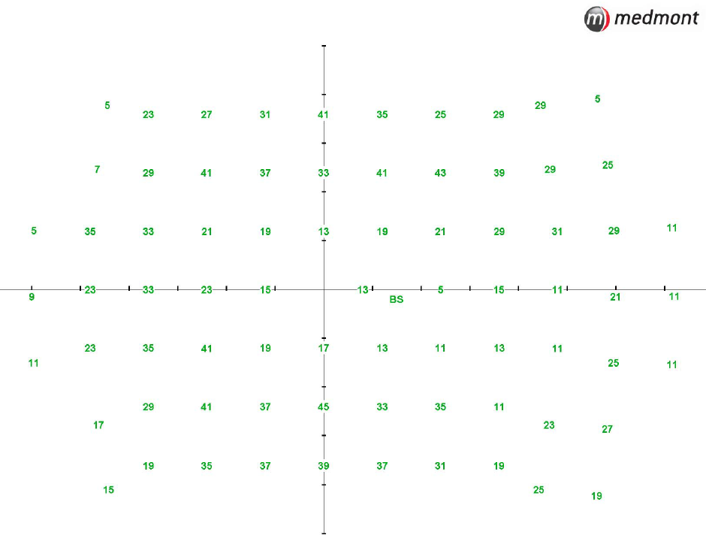
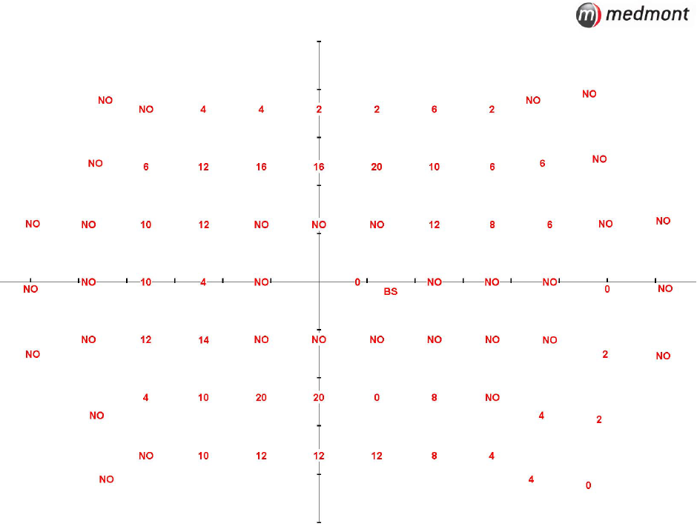
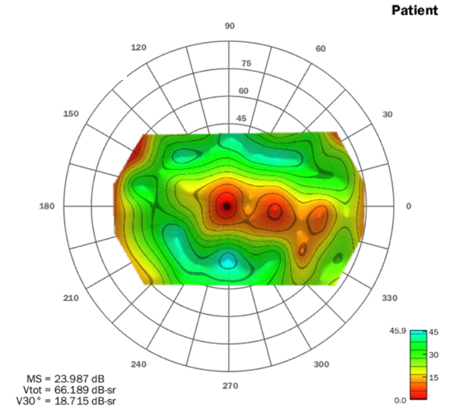
Visual Field Modeling and Analysis
Cyan
Red
Hill of Vision

Slide 8
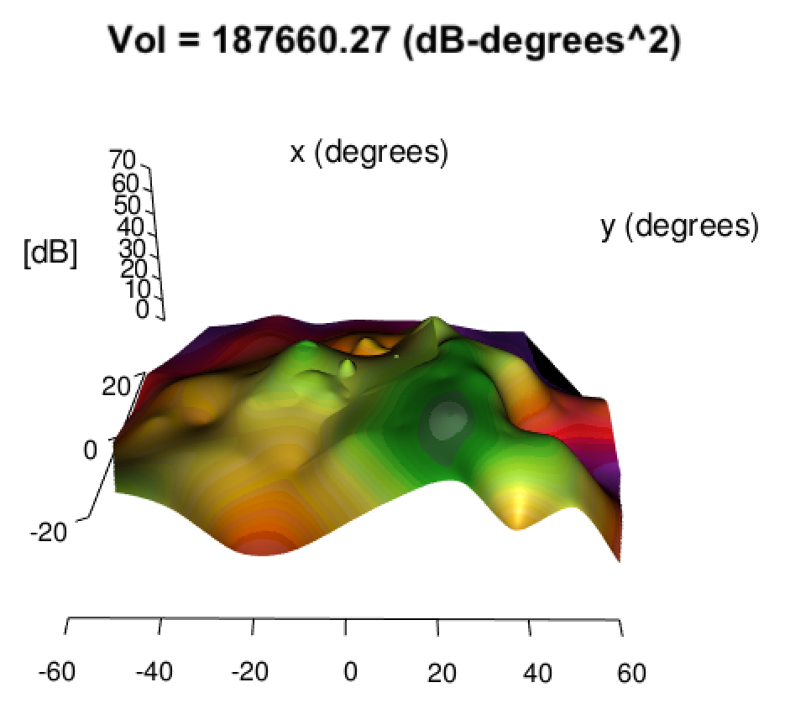
DAVF Measures
Number of rod loci
Maximum sensitivity
Mean full-field sensitivity
Hill of Vision calculations:
V_{TOT}
V₃₀
Mean Sensitivity
= 57.2 dB-sr

Slide 9
Methods: Statistical
Mixed effect models with a random intercept were used to estimate annual rates of change
  Also fit model with outliers down-weighted according to individual participant slopes
  Models with covariates were adjusted for baseline DAVF measure and interaction between baseline measure and covariate
Spearman correlations were used to assess associations among change in DAVF measures with change in other visual function measures

Slide 10
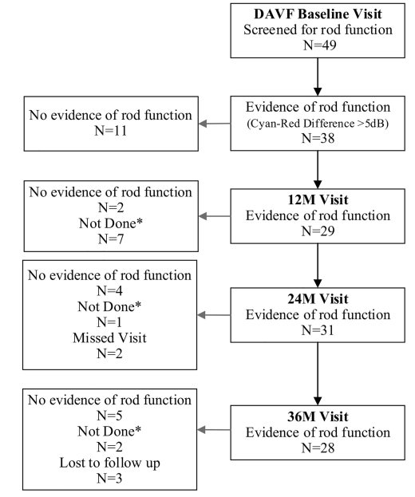
Results: Participant Disposition
*Not done reasons include virtual visits (6) and other reasons including use of wrong grid (4)

Slide 11
Results: Cohort Characteristics
Participants screened for rod function at DAVF Baseline N=49, Evidence of rod function in 38/49 (78%) participants
Baseline Cohort N=38
  Participant summary – 55% female; 95% white
  Median participant age – 37 years [IQR: 28 , 49]
  Median disease duration – 13 years [IQR: 7 , 20]
  Participants diagnosed with Usher syndrome type 2a (USH2) vs non-syndromic RP (ARRP) – 19 (50%) vs 19 (50%)

Slide 12
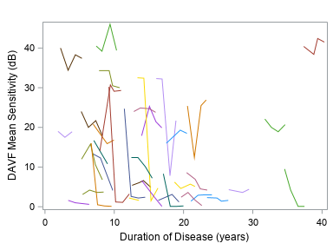
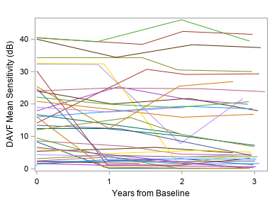
Change Over 4 Years:
DAVF Mean Sensitivity
P<0.01
  LONGITUDINAL MODEL ANNUAL RATE OF CHANGE
  (95% CI) dB
  Equally weighted
  -1.55 (-2.39, -0.71)
  Outliers down-weighted
  -1.06 (-1.66, -0.47)
DISEASE DURATION YEARS FROM BASELINE
P<0.01
P<0.01

Slide 13
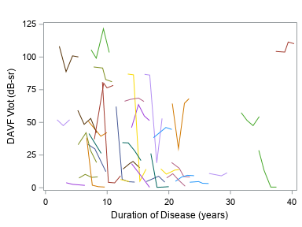
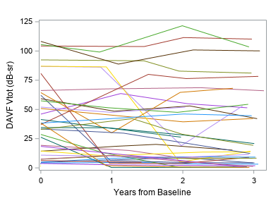
Change Over 4 Years:
DAVF V_{TOT}
P<0.01
  LONGITUDINAL MODEL ANNUAL RATE OF CHANGE
  (95% CI) dB-sr
  Equally weighted
  -4.01 (-6.23, -1.79)
  Outliers down-weighted
  -2.68 (-4.28, -1.09)
DISEASE DURATION YEARS FROM BASELINE
P<0.01
P<0.01

Slide 14
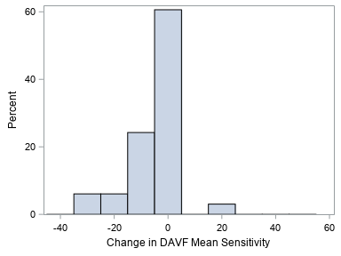
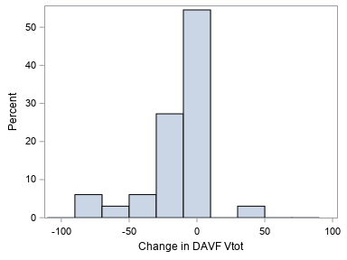
DAVF Results:
Distribution of Change Over 4 Years
P<0.01
P<0.01
P<0.01

Slide 15
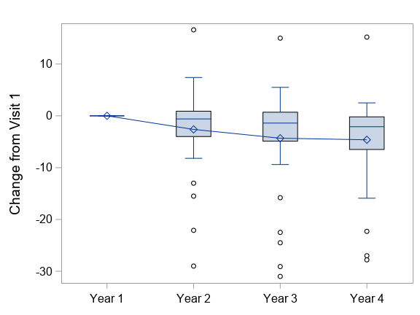
Mean Change in
DAVF Mean Sensitivity Over 4 Years

Slide 16
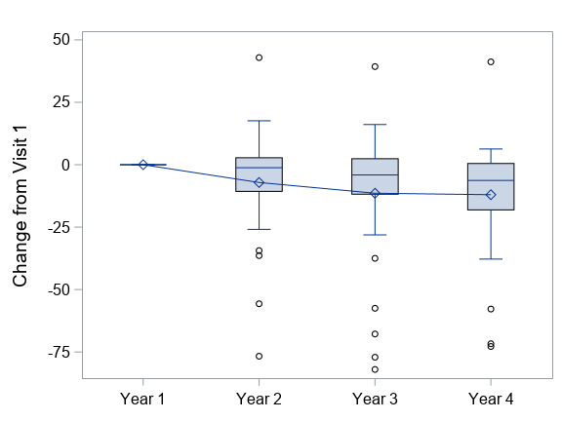
Mean Change in
DAVF V_{TOT} Over 4 Years

Slide 17
Spearman Correlation of 3-Year Change in DAVF with Change in Other Measures
Visual Measures | Mean Sensitivity | V_{TOT} | V₃₀ | Rod Loci | Maximum Sensitivity | Full field rod mean sensitivity
BCVA | 0.17 | 0.20 | 0.24 | 0.09 | 0.12 | 0.18
SP mean sensitivity | 0.13 | 0.14 | 0.15 | 0.06 | 0.13 | 0.03
SP V_{TOT} | 0.08 | 0.11 | 0.11 | 0.07 | 0.09 | -0.07
SP V₃₀ | 0.19 | 0.20 | 0.21 | 0.15 | 0.13 | 0.04
MP mean sensitivity | -0.03 | -0.05 | -0.07 | -0.08 | -0.07 | 0.10
FST (white) | -0.07 | -0.07 | -0.17 | -0.16 | -0.05 | 0.01
Ellipsoid Zone Area | 0.03 | 0.02 | -0.01 | -0.32 | -0.44 | 0.36
Central Subfield Thickness | -0.46 | -0.43 | -0.32 | -0.18 | 0.23 | -0.24
DA 0.01 ERG | 0.60 | 0.59 | 0.65 | 0.02 | 0.37 | 0.79
Significant correlations (P<0.05) are highlighted

Slide 18
Association of Baseline Characteristics with Changes in DAVF Measures
USH2 participants have a greater change in DAVF measures over time, compared to ARRP participants
Change in DAVF measures over time is associated with enrollment age. Younger participants have a greater change over time.
Dietary supplement use showed significant benefit, but caution is warranted
Note: analyses adjusted for baseline DAVF measures
Notes:
Dietary supplement use has about the same effect size as being older or in the ARRP group. More analysis is necessary on this, as is replication.

Slide 19
DAVF Discussion
Two-color DAVFs reliably identify rod-mediated function in the majority of patients with USH2A mutations, even though many show no evidence of rod ERG function
Average yearly change in mean DAVF sensitivity = 1.55 dB
  Comparable to the rate of change for FST
  Much faster change than light-adapted mean sensitivity
DAVF testing may be noisy

Slide 20

Questions?

