Slide 1
Self-reported functional vision in USH2A-associated retinal degeneration as measured by the Michigan Retinal Degeneration Questionnaire

Slide 2
Citation, Funding, Disclaimer
Citation
Parekh B, Duncan JL, Samarakoon L, Melia M, Abalem MF, Andrews CA, Audo I, Ayala AR, Bradley C, Cheetham JK, Dagnelie G, Durham TA, Huckfeldt RM, Lacy GD, Malbin B, Michaelides M, Musch DC, Peck-Dimit N, Stingl K, Weng CY, Zmejkoski AZ, Jayasundera KT; Foundation Fighting Blindness Clinical Consortium Investigator Group. Self-Reported Functional Vision in USH2A-Associated Retinal Degeneration as Measured by the Michigan Retinal Degeneration Questionnaire. Invest Ophthalmol Vis Sci. 2024 Jun 3;65(6):5. doi: 10.1167/iovs.65.6.5.
Funding
This study was funded by Foundation Fighting Blindness
Disclaimer
The source of the data is the Foundation Fighting Blindness Clinical Consortium, but the analyses, content and conclusions presented herein are solely the responsibility of the authors/presenters and may not reflect the views of the Foundation Fighting Blindness.

Slide 3
Background
The Michigan Retinal Degeneration Questionnaire (MRDQ) is a validated, FDA-guideline based PRO instrument used to measure vision functioning in patients with rod-cone, cone/cone-rod, or macular dystrophy.
Domains of functional vision (FV) that segregate according to retinal function (e.g., color, contrast, photopic, peripheral)

Slide 4
Background
Purpose
  To evaluate the performance of MRDQ functional vision scores (FVS) in patients with USH2A-associated retinal degeneration.
  Correlate MRDQ functional vision with visual function measures at 4-year study follow up.
  MRDQ administered at RUSH2A study 4 Year visit only

Slide 5
Methods: PRO
 | Difficulty | Accommodations
CENTRAL VISION | Reading books, magazines, or mail? Reading on a computer or tablet? Reading on cell phone screens? Reading the newspaper, food labels, price tags, or medication labels? Reading direction signs? Reading store names? | Scan a page or line of text to find the “right spot” to read? Adjust the amount of room light to read? Move closer to objects to read? Use vision aids for close reading (i.e. magnifying glasses, zoom function)? Use vision aids for distance reading (i.e. telescopes or bioptics)?
COLOR | Distinguishing between colors of similar shades (i.e., blues & blacks, browns & blues, or tones of pastel)? Distinguishing bright colors (i.e., stop lights or cross walk signs)? | Ask for help to distinguish colors? Adjust the light/brightness to help distinguish colors?
CONTRAST | Recognizing faces? Finding a white object on a white table? Chopping an onion on a light-colored board? Eating rice and chicken on a white plate? Seeing doorways? Seeing curbs, sidewalks, or uneven ground? | Ask for help to find a white object on a white table?

Slide 6
Methods: PRO
 | Difficulty | Accommodations
SCOTOPIC | Adapting to the dark (i.e., moving from a well-lit room to a darker room)? Finding a seat in a poorly lit restaurant? Finding a seat in a movie theatre? Peripheral vision during the night? Seeing children or pets outside of your central vision during the night? Seeing stairs or steps during the night? Taking the garbage outside during the night? Crossing the street during the night? Walking in crowded areas during the night? | Ask for help with finding objects outside of your visual field during the night? Touch things around you to move during the night? Use someone’s arm to walk during the night?
MESOPIC PERIPHERAL | Peripheral vision in poorly lit areas? Seeing children or pets outside of your central vision in poorly lit areas? Seeing stairs or steps in poorly lit areas? Taking the garbage outside in poorly lit areas? Crossing the street in poorly lit areas? Walking in crowded areas in poorly lit areas? | Ask for help with finding objects outside of your visual field in poorly lit areas? Touch things around you to move in poorly lit areas? Use someone’s arm to walk in poorly lit areas?

Slide 7
Methods: PRO
 | Difficulty | Accommodations
PHOTOPIC PERIPHERAL | Peripheral vision during the day? Seeing children or pets outside of your central vision during the day? Seeing stairs or steps during the day? Taking the garbage outside during the day? Crossing the street during the day? Walking in crowded areas during the day? | Ask for help with finding objects outside of your visual field during the day? Touch things around you to move during the day? Use someone’s arm to walk during the day?
PHOTO-SENSITIVITY | Sensitivity to bright lights? Sensitivity to fluorescent lights in a store or office? Sensitivity to oncoming headlights? Sensitivity to bright sunlight? | Use tinted/transition lenses, sunglasses or hats when outdoors because you are bothered by bright light? Squint your eyes when not using sunglasses because you are bothered by bright light? Worry about seeing in places with bright fluorescent lights when you are alone?

Slide 8
Methods: Statistical
Mixed effect models with a random intercept were used to estimate annual rates of change
Coefficient of repeatability was calculated using mixed models
Spearman correlations were used to assess associations among change in FVS with change in other visual function measures
One way ANOVA was used to compare the mean domain scores by subgroups such as clinical diagnosis

Slide 9
Results: Cohort Characteristics
Baseline Cohort – N=105
48M Cohort
  Excluded 3 participants that took part in treatment trials
  Other participants lost to follow-up
  MRDQ Completed N=95
  Median participant age – 38 years [IQR: 28 , 45]
  Median disease duration – 13 years [IQR: 7 , 20]

Slide 10
Results: Associations with Age and Disease Duration
 |  | Central Vision | Color Vision | Contrast | Scotopic | Photopic Peripheral | Mesopic Peripheral | Photo- sensitivity
Age at Enrollment (N=93) | Slope | 0.02 | 0.01 | 0.01 | 0.01 | 0.01 | 0.01 | 0.02
 | P-value | <0.001 | 0.06 | 0.006 | 0.16 | 0.02 | 0.05 | 0.004
Disease Duration (N=92) | Slope | 0.02 | 0.02 | 0.01 | 0.01 | 0.01 | 0.01 | 0.01
 | P-value | 0.01 | 0.01 | 0.26 | 0.03 | 0.10 | 0.04 | 0.28

Slide 11
Results: Spearman Correlation of Domains with Other Vision Measures
Visual Measures | Central Vision | Color Vision | Contrast | Scotopic | Photopic Peripheral | Mesopic Peripheral | Photo- sensitivity
BCVA | -0.42 | -0.49 | -0.39 | -0.40 | -0.39 | -0.34 | -0.33
SP MS_{CW} | -0.44 | -0.36 | -0.52 | -0.54 | -0.73 | -0.62 | -0.39
SP V_{TOT} | -0.36 | -0.29 | -0.36 | -0.49 | -0.66 | -0.56 | -0.30
SP V₃₀ | -0.41 | -0.32 | -0.50 | -0.52 | -0.68 | -0.58 | -0.38
SP V_{PERIPH} | -0.36 | -0.26 | -0.37 | -0.51 | -0.65 | -0.57 | -0.29
MP MS | -0.42 | -0.39 | -0.52 | -0.45 | -0.53 | -0.52 | -0.42
FST White | 0.29 | 0.49 | 0.26 | 0.46 | 0.29 | 0.41 | 0.18
OCT EZ Area | -0.48 | -0.17 | -0.44 | -0.23 | -0.33 | -0.23 | -0.003
OCT CST | -0.28 | -0.35 | -0.27 | -0.50 | -0.32 | -0.55 | -0.29
Disease Duration | 0.25 | 0.31 | 0.14 | 0.27 | 0.22 | 0.24 | 0.16
Significant correlations (P<0.05) are highlighted

Slide 12
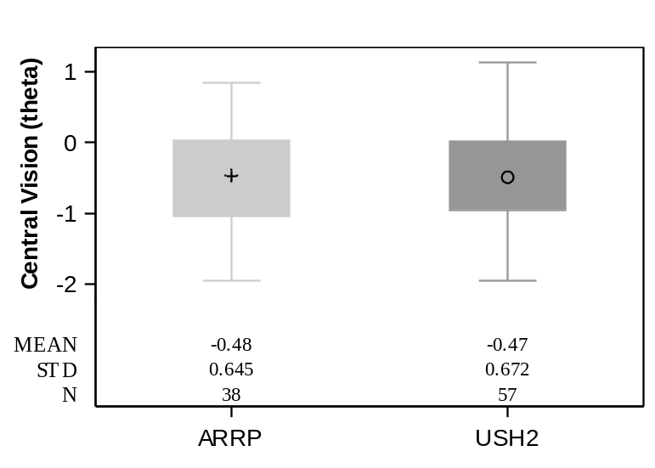
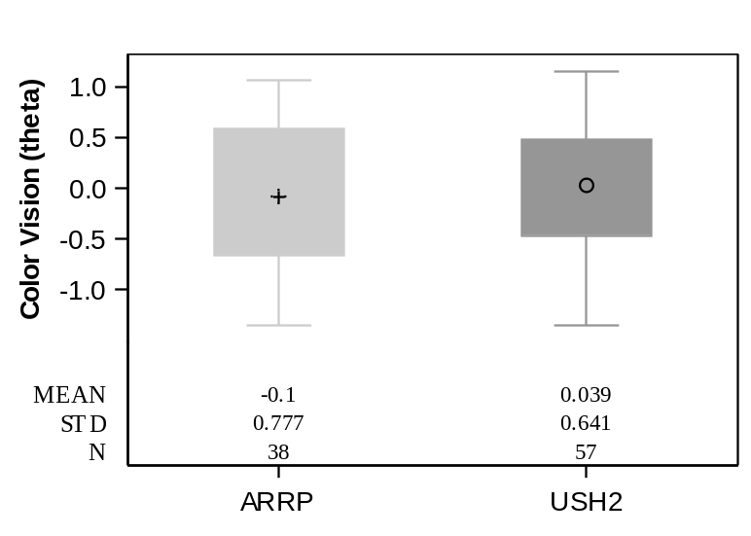
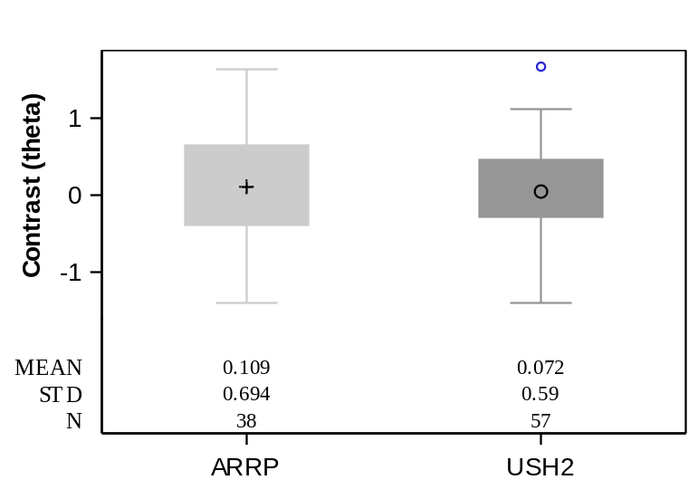
MRDQ Results by Clinical Diagnosis
(USH2A N=57, ARRP N=38)
CENTRAL VISION
-0.01 (P=0.93)
COLOR VISION
-0.14 (P=0.33)
CONTRAST
0.04 (P=0.78)

Slide 13
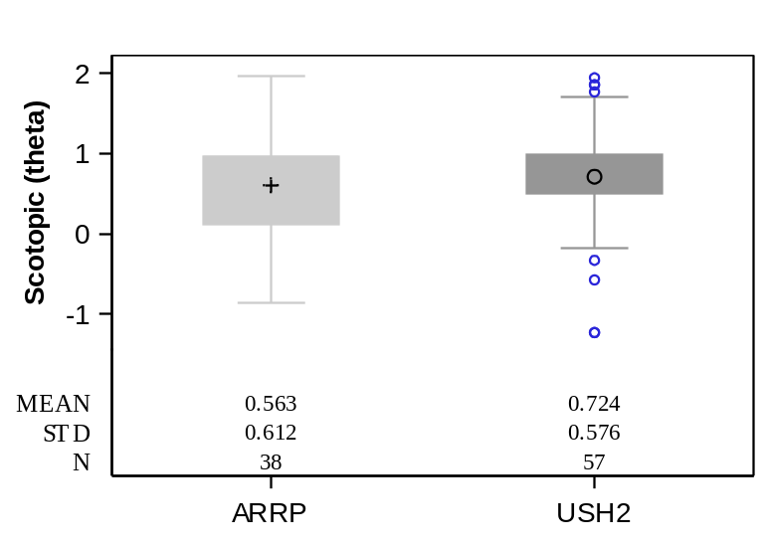
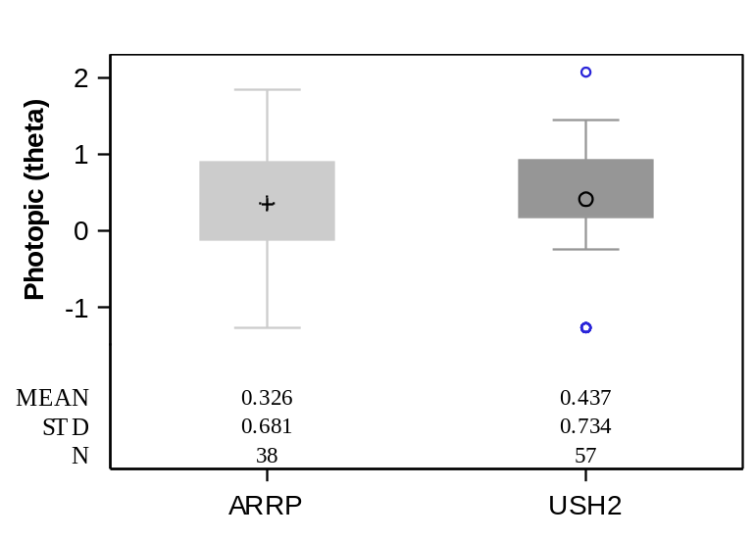
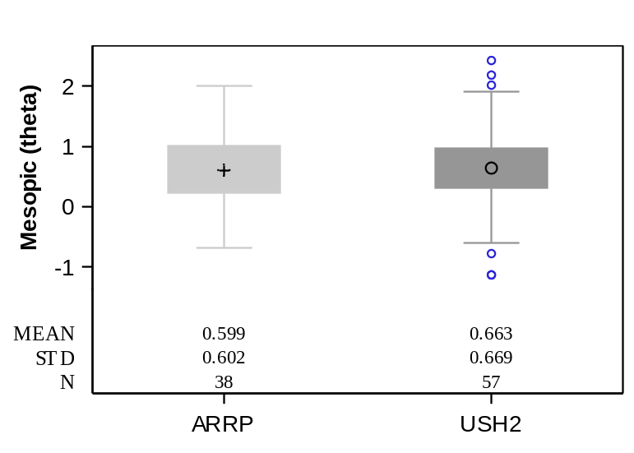
MRDQ Results by Clinical Diagnosis
(USH2A N=57, ARRP N=38)
SCOTOPIC
-0.16 (P=0.20)
PHOTOPIC
-0.11 (P=0.46)
MESOPIC
-0.06 (P=0.64)

Slide 14
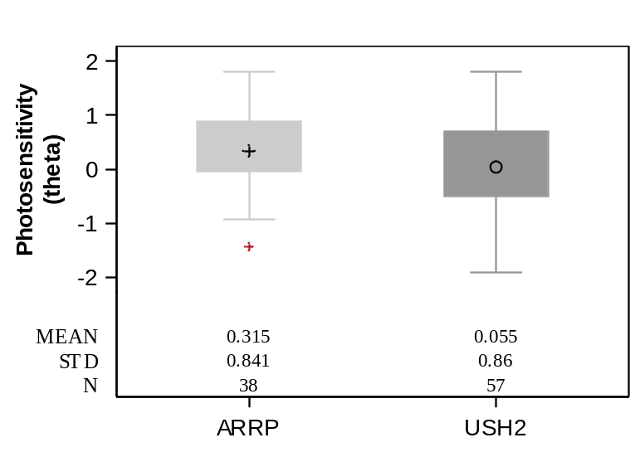
MRDQ Results by Clinical Diagnosis
(USH2A N=57, ARRP N=38)
PHOTOSENSITIVITY
0.26 (P=0.15)
No significant difference in FVS between clinical diagnosis groups for any domain

Slide 15
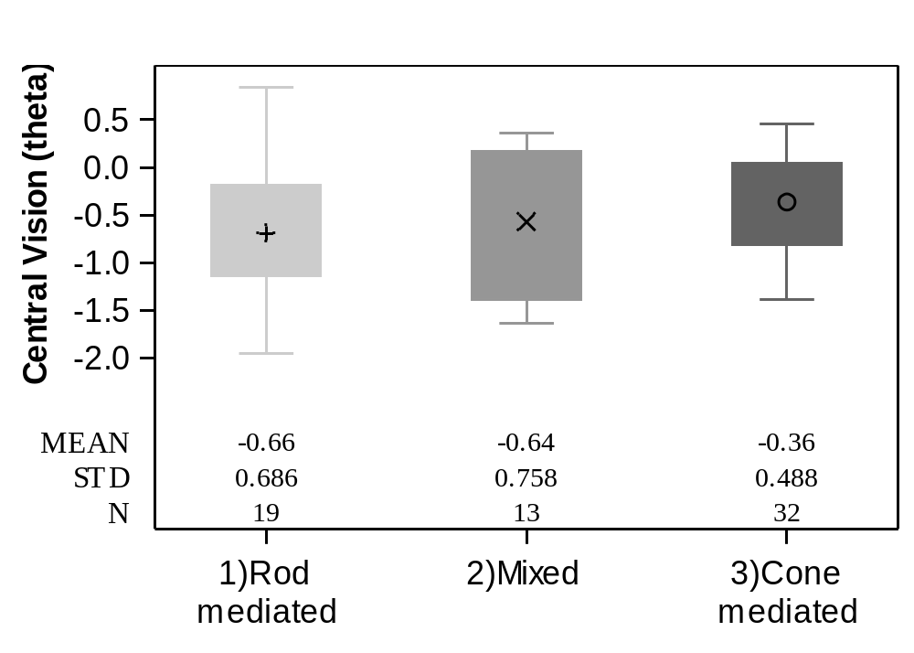
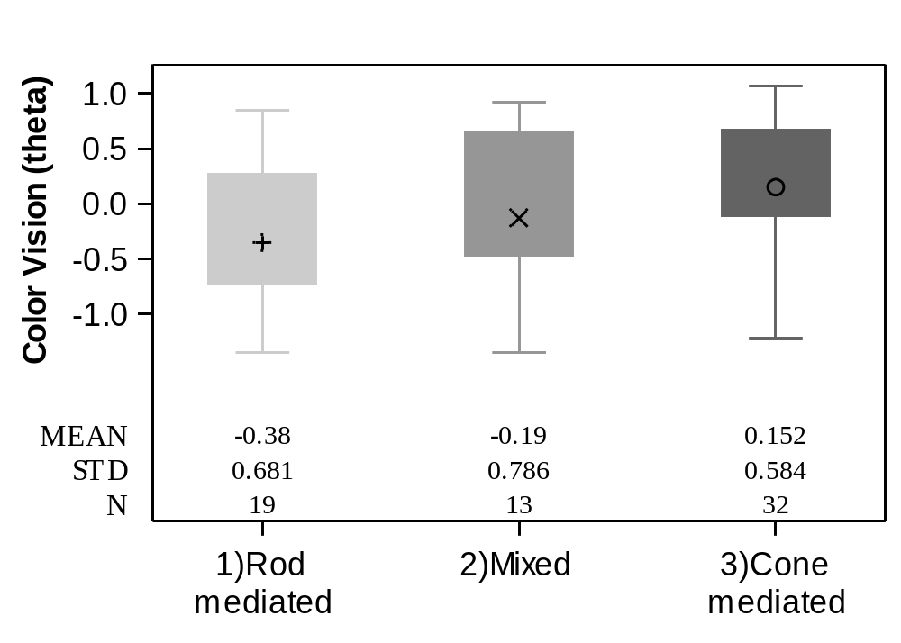
MRDQ Results by FST Mediation
(Rod N=19, Mixed N=13, Cone N=32)
CENTRAL VISION
(ROD vs. CONE): -0.30 (P=0.11)
COLOR VISION
-0.54 (P=0.007)

Slide 16
MRDQ Results:
Definition of FST Blue-Red Mediation
Rod Mediation
  |FST Blue – Red| > 20 dB
Mixed Mediation
  |FST Blue – Red| 10-20 dB
Cone Mediation
  |FST Blue – Red| <10dB

Slide 17
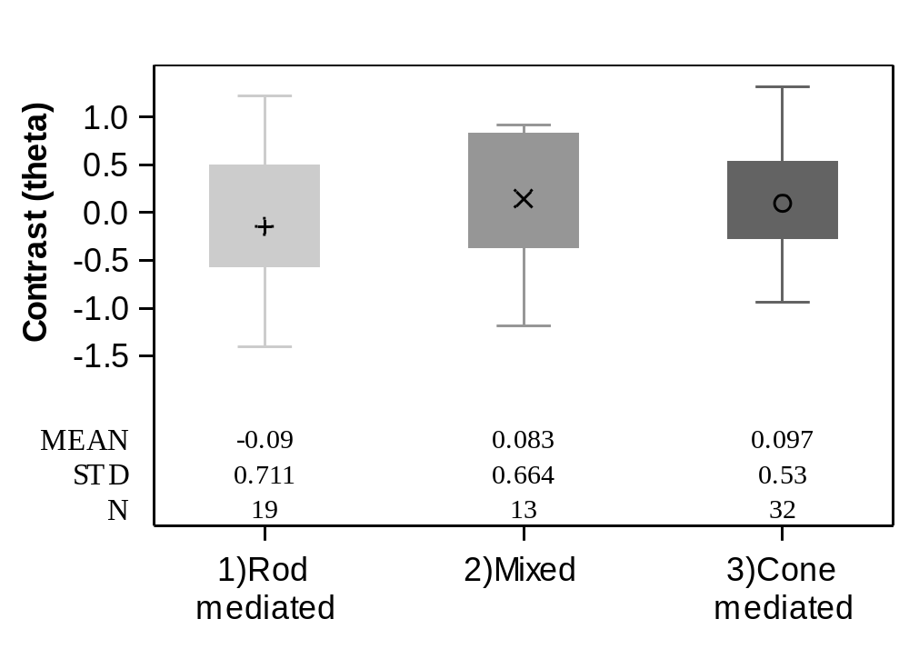
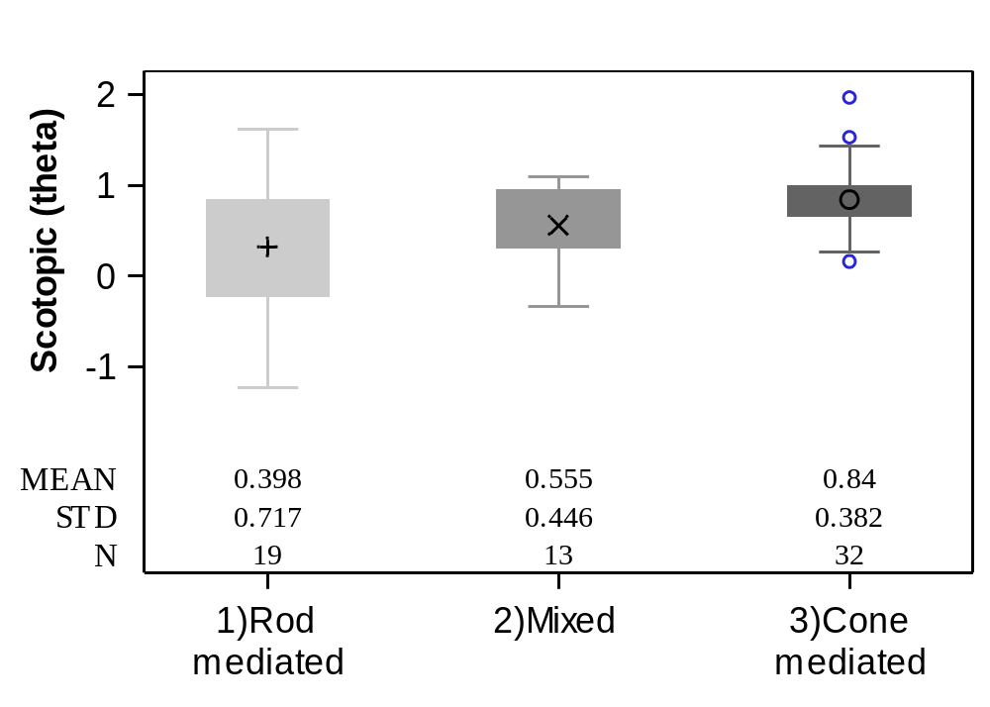
MRDQ Results by FST Mediation
(Rod N=19, Mixed N=13, Cone N=32)
CONTRAST
(ROD vs. CONE): -0.19 (P=0.33)
SCOTOPIC
-0.44 (P=0.02)

Slide 18
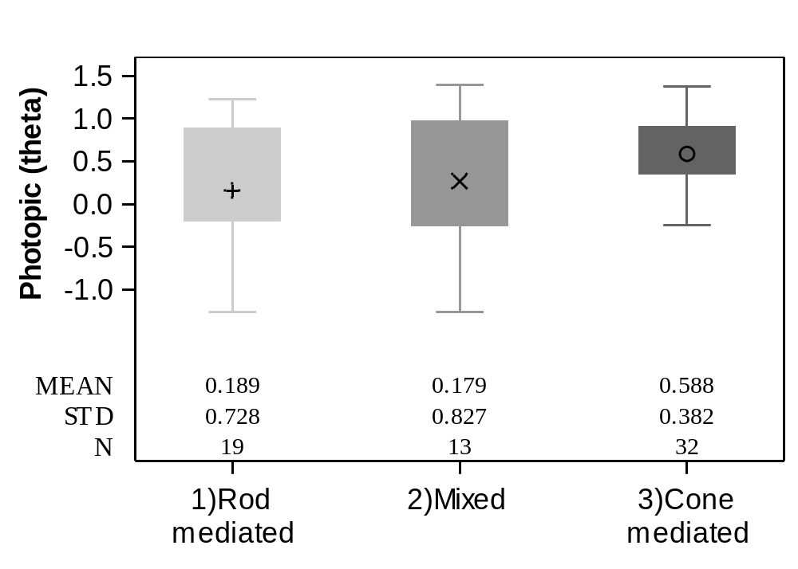
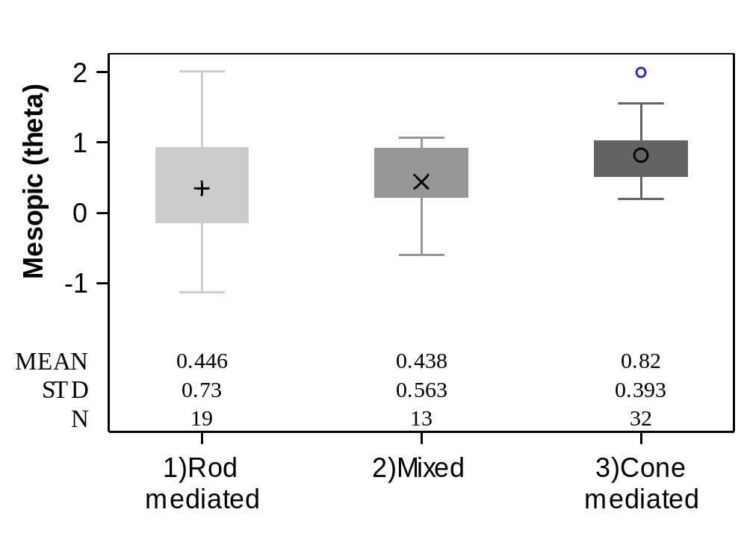
MRDQ Results by FST Mediation
(Rod N=19, Mixed N=13, Cone N=32)
PHOTOPIC
(ROD vs. CONE): -0.40 (P=0.04)
MESOPIC
-0.37 (P=0.04)

Slide 19
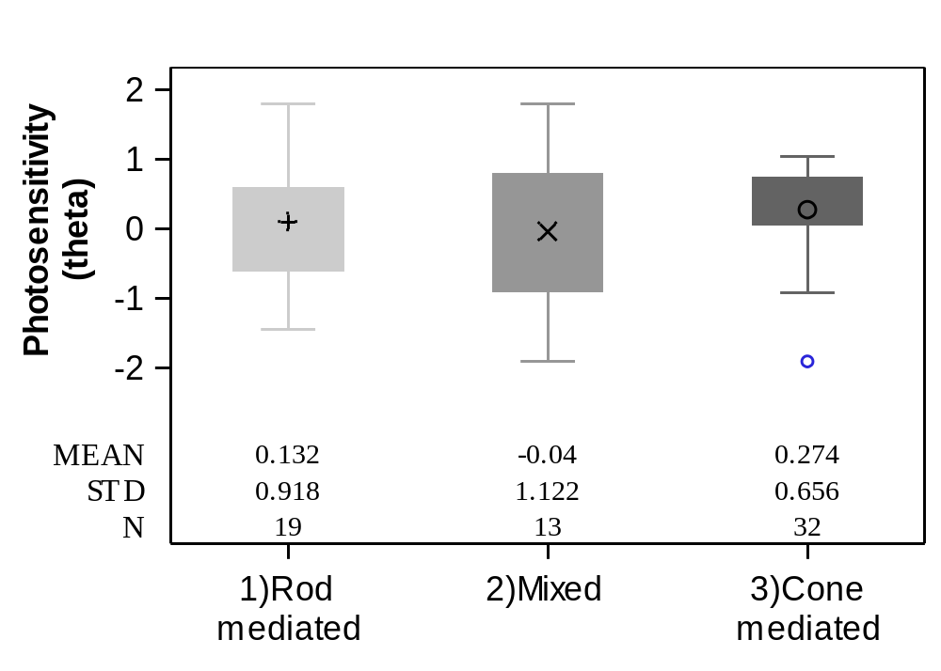
MRDQ Results by FST Mediation
(Rod N=19, Mixed N=13, Cone N=32)
PHOTOSENSITIVITY
(ROD vs. CONE): -0.14 (P=0.56)
Significant difference in FVS between rod vs cone mediated groups for color vision, scotopic, photopic peripheral and mesopic peripheral domains

Slide 20
Discussion
RUSH2A participants had least difficulty with activities requiring central vision and most difficulty with activities requiring scotopic and mesopic vision
Many MRDQ domains have significant correlations with other visual measures
MRDQ shows promise as a reliable and sensitive measure of patient reported outcomes in IRD

