Slide 1
Functional vision assessment over 4 years in USH2A using the Veteran Affairs Low-Vision Visual Functioning Questionnaire.

Slide 2
Citation, Funding, Disclaimer
Citation
Parekh B, Peck-Dimit N, Duncan JL, Samarakoon L, Abalem MF, Andrews CA, Audo I, Ayala AR, Bradley C, Cheetham JK, Dagnelie G, Durham TA, Huckfeldt RM, Lacy GD, Malbin B, Michaelides M, Musch DC, Stingl K, Weng CY, Zmejkoski AZ, Melia M, Jayasundera KT; Foundation Fighting Blindness Clinical Consortium Investigator Group. Functional Vision Assessment Over 4 Years in USH2A Using the Veteran Affairs Low-Vision Visual Functioning Questionnaire. Invest Ophthalmol Vis Sci. 2025 May 1;66(5):39. doi: 10.1167/iovs.66.5.39.
Funding
This study was funded by Foundation Fighting Blindness
Disclaimer
The source of the data is the Foundation Fighting Blindness Clinical Consortium, but the analyses, content and conclusions presented herein are solely the responsibility of the authors/presenters and may not reflect the views of the Foundation Fighting Blindness.

Slide 3
Background
Veteran Affairs Low-Vision Visual Functioning Questionnaire (VALVVFQ-48) quantifies function based on 48 questions split over four domains (reading, mobility, visual information processing, and visual motor)
Initially developed to measure functional vision (FV) of veterans enrolled in low-vision programs. Used in the RUSH2A study with some modifications.

Slide 4
Background
Purpose
  To evaluate the perfomance of VALVVFQ-48 functional vision scores (FVS) in patients with USH2A-associated retinal degeneration.
  Correlate changes in VALVVFQ-48 functional vision with changes in visual function measures at 4-year study follow up.
VALVVFQ-48 administered at RUSH2A study Baseline, 2 Year and 4 Year visits

Slide 5
Methods: PRO
Domain | Question
READING | Is it difficult to read newspaper headlines? Is it difficult to read newspaper or magazine articles? Is it difficult to read mail? Is it difficult to read menus? Is it difficult to read small print on a package label? Is it difficult to keep your place while reading? Is it difficult to read street signs and store names? Is it difficult to read signs (e.g., grocery store aisle)? Is it difficult to read print on TV?
MOBILITY | Is it difficult to do yard work? Is it difficult to get around outdoors in places you know? Is it difficult to get around in unfamiliar places? Is it difficult to go down steps in dim light? Is it difficult to go out at night? Is it difficult to get around in a crowd? Is it difficult to avoid bumping into things? Is it difficult to cross street at a traffic light? Is it difficult to use public transportation? Is it difficult to find public restrooms? Is it difficult to play sports? Is it difficult to adjust to bright light?

Slide 6
Methods: PRO
Domain | Question
VISUAL MOTOR | Is it difficult to play table and card games? Is it difficult to work on your favorite hobby? Is it difficult to make out a check? Is it difficult to sign your name? Is it difficult to take a message? Is it difficult to identify food on a plate? Is it difficult to fix a snack? Is it difficult to prepare meals? Is it difficult to use appliance dials? Is it difficult to groom yourself? Is it difficult to eat and drink neatly? Is it difficult to clean the house?
VISUAL INFORMATION | Is it difficult to see photos? Is it difficult to find something on a crowded shelf? Is it difficult to identify medicine? Is it difficult to identify money? Is it difficult to tell time? Is it difficult to watch TV? Is it difficult to recognize people up close? Is it difficult to recognize people from across the room? Is it difficult to handle finances? Is it difficult to match clothes?

Slide 7
Methods: Statistical
Mixed effect models with a random intercept were used to estimate annual rates of change
Coefficient of repeatability was calculated using mixed models
Spearman correlations were used to assess associations among change in FVS with change in other visual function measures
One way ANOVA was used to compare the mean domain scores by subgroups such as clinical diagnosis

Slide 8
Results: Cohort Characteristics
Baseline Cohort – N=102
48M Cohort
  Excluded 3 participants that took part in treatment trials
  Other participants lost to follow-up
  VALVVFQ-48 Completed N=91
  Median participant age – 38 years [IQR: 30 , 45]
  Median disease duration – 13 years [IQR: 7 , 20]

Slide 9
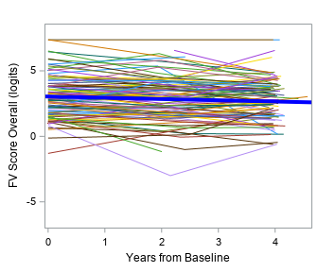
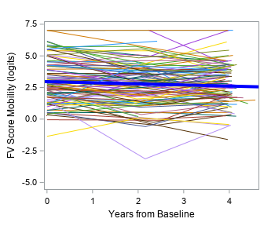
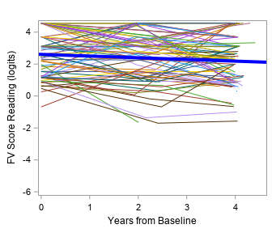
Results: Change in FVS Over 4 Years
OVERALL FV
-0.09 (-0.15, -0.04)
MOBILITY
-0.09 (-0.15, -0.02)
READING
-0.10 (-0.18, -0.02)

Slide 10
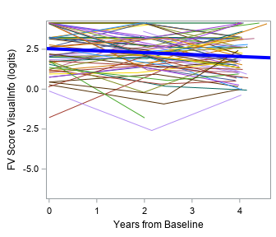
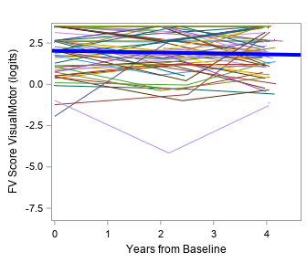
Results: Change in FVS Over 4 Years
VISUAL INFORMATION PROCESSING
-0.11 (-0.18, -0.04)
VISUAL MOTOR
-0.03 (-0.12, 0.05)

Slide 11
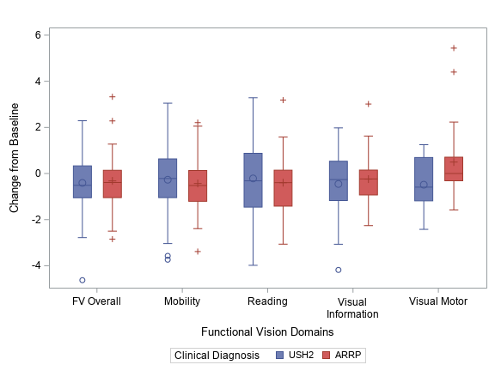
Results: Change in FVS Over 4 Years by Clinical Diagnosis
No significant differences between diagnosis groups, except in Visual Motor domain (attributed to outliers)
Sample sizes different in domains due to multiple participants answering at the highest category (‘no difficult’) on all questions to a domain, resulting in missing data

Slide 12
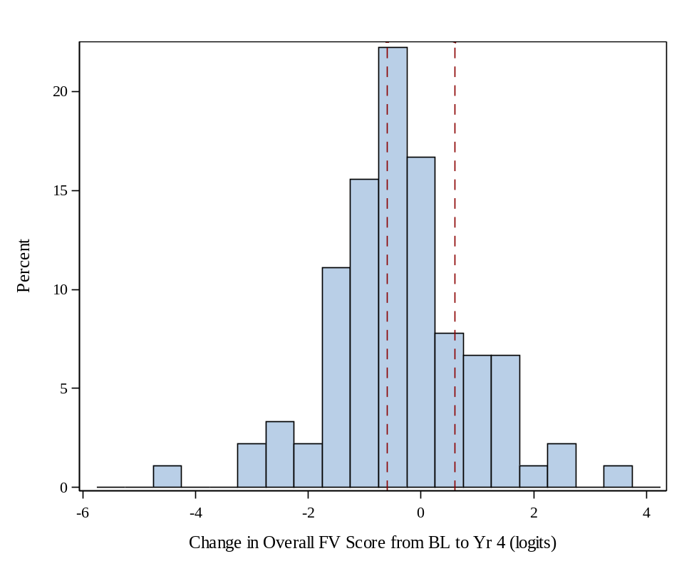
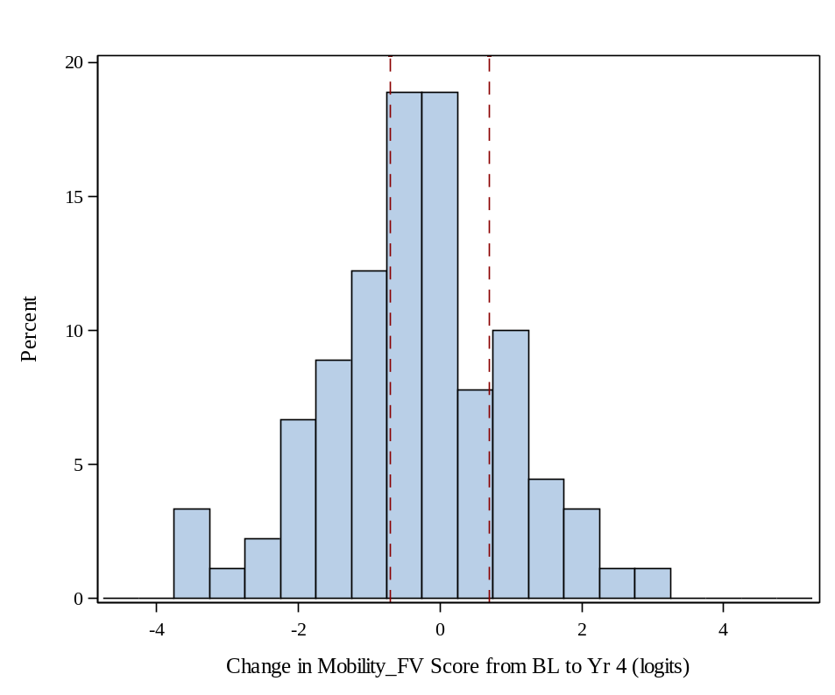
Results: Distribution of FVS Change Over 4 Years
Worse than CoR
46%
Better than CoR
19%
Worse than CoR
37%
Better than CoR
23%

Slide 13
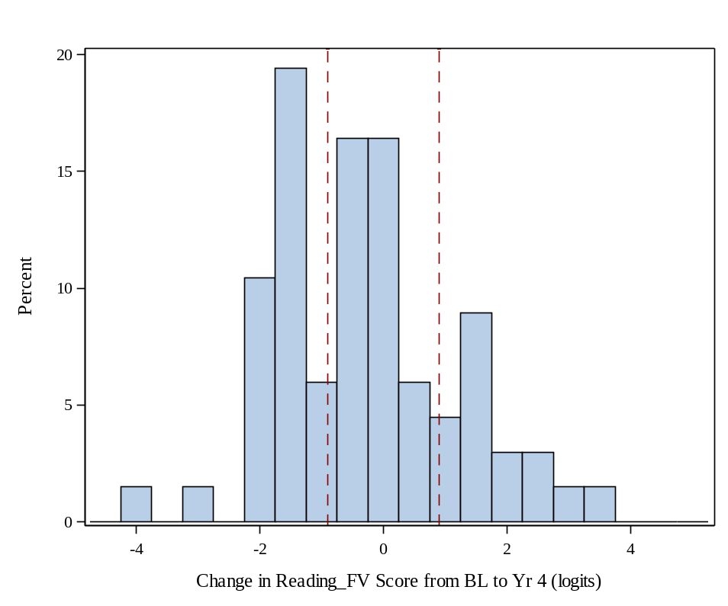
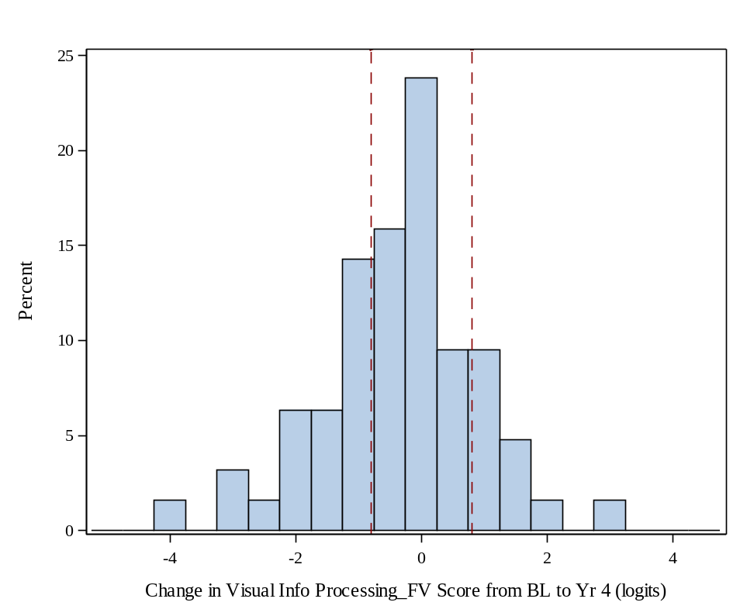
Results: Distribution of FVS Change Over 4 Years
Worse than CoR
37%
Better than CoR
22%
Worse than CoR
35%
Better than CoR
17%

Slide 14
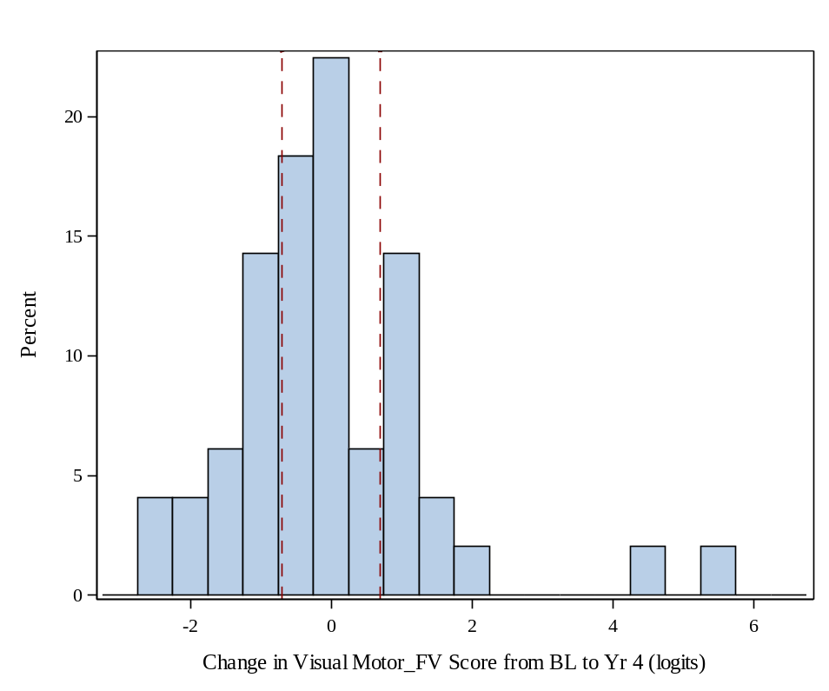
Results: Distribution of FVS Change Over 4 Years
Proportion of participants with improvement or worsening beyond CoR ranged from 17-46% across all domains
Worse than CoR
35%
Better than CoR
27%

Slide 15
Results: Spearman Correlation of 4-Year Change in FVS with Change in Other Measures
Visual Measures | Overall | Mobility | Reading | Visual Information | Visual Motor
BCVA | -0.04 | -0.17 | 0.04 | 0.33 | 0.26
SP MS_{CW} | 0.20 | 0.18 | 0.26 | 0.15 | 0.04
SP V_{TOT} | 0.16 | 0.16 | 0.14 | 0.02 | 0.07
SP V₃₀ | 0.16 | 0.18 | 0.23 | 0.09 | -0.07
SP V_{PERIPH} | 0.17 | 0.20 | 0.18 | 0.08 | 0.18
SP PSD | 0.28 | 0.25 | 0.26 | 0.26 | 0.13
MP MS | 0.33 | 0.23 | 0.41 | 0.38 | 0.19
FST White | -0.24 | -0.17 | -0.06 | -0.58 | -0.04
OCT EZ Area | 0.13 | 0.18 | 0.31 | 0.27 | 0.26
OCT CST | -0.08 | -0.05 | -0.15 | 0.05 | 0.06
Significant correlations (P<0.05) are highlighted

Slide 16
Results: Estimated Change in FVS (logits/year) per Unit Change in Visual Measures
Visual Measures | Overall | Mobility | Reading | Visual Information | Visual Motor
BCVA | 0.012 | -0.026 | 0.028 | 0.070 | 0.065
SP MS_{CW} | 0.12 | 0.12 | 0.10 | 0.13 | 0.059
SP V_{TOT} | 0.025 | 0.025 | 0.018 | 0.026 | 0.017
SP V₃₀ | 0.11 | 0.064 | 0.086 | 0.13 | 0.068
SP V_{PERIPH} | 0.029 | 0.030 | 0.019 | 0.028 | 0.02
SP PSD | 0.13 | 0.08 | 0.09 | 0.14 | 0.09
MP MS | 0.12 | 0.11 | 0.15 | 0.010 | 0.026
FST White | -0.33 | -0.34 | -0.20 | -0.37 | -0.019
OCT EZ Area | 0.093 | 0.036 | 0.13 | 0.055 | 0.12
OCT CST | 0.0018 | 0.0020 | -0.010 | 0.0050 | -0.00054
Significant correlations (P<0.05) are highlighted

Slide 17
Association of Baseline Characteristics with Changes in FVS
Baseline FVS had significant association with change in all FVS (overall and all domains)
Participants with better FV at baseline experienced greater decline in score over four years
Visual motor scores of participants with USH2 diagnosis declined more over 4 years compared to those with ARRP diagnosis

Slide 18
Discussion
Changes in FVS had low to moderate correlation with changes with other vision measures
FVS decreased on average 0.10 logits per year
Reasons for relative lack of decline in FVS over time could be due to adaptation / ceiling effects/ lack of sensitivity in the instrument to changes in the IRD population

