Slide 1
Change in Cone Structure Over 24 Months in USH2A-Related Retinal Degeneration

Slide 2
Citation, Funding, Disclaimer
Citation
Duncan JL, Liang W, Maguire MG, Porco TC, Wong J, Audo I, Cava JA, Grieve K, Kalitzeos A, Kreis J, Michaelides M, Norberg N, Paques M, Carroll J; Foundation Fighting Blindness Consortium Investigator Group. Change in Cone Structure Over 24 Months in USH2A-Related Retinal Degeneration. Am J Ophthalmol. 2023 Aug;252:77-93. doi: 10.1016/j.ajo.2023.03.006.
Funding
This study was funded by Foundation Fighting Blindness
Disclaimer
The source of the data is the Foundation Fighting Blindness Clinical Consortium, but the analyses, content and conclusions presented herein are solely the responsibility of the authors/presenters and may not reflect the views of the Foundation Fighting Blindness.

Slide 3
Background
Prior studies have not described cone structure with high-resolution images of USH2A-related retinal degeneration
AOSLO
  Non-invasive method
  Visualize cone photoreceptors with high resolution
  4 RUSH2A centers with AOSLO expertise:
    UCSF, MCW, Moorfields, Paris

Slide 4
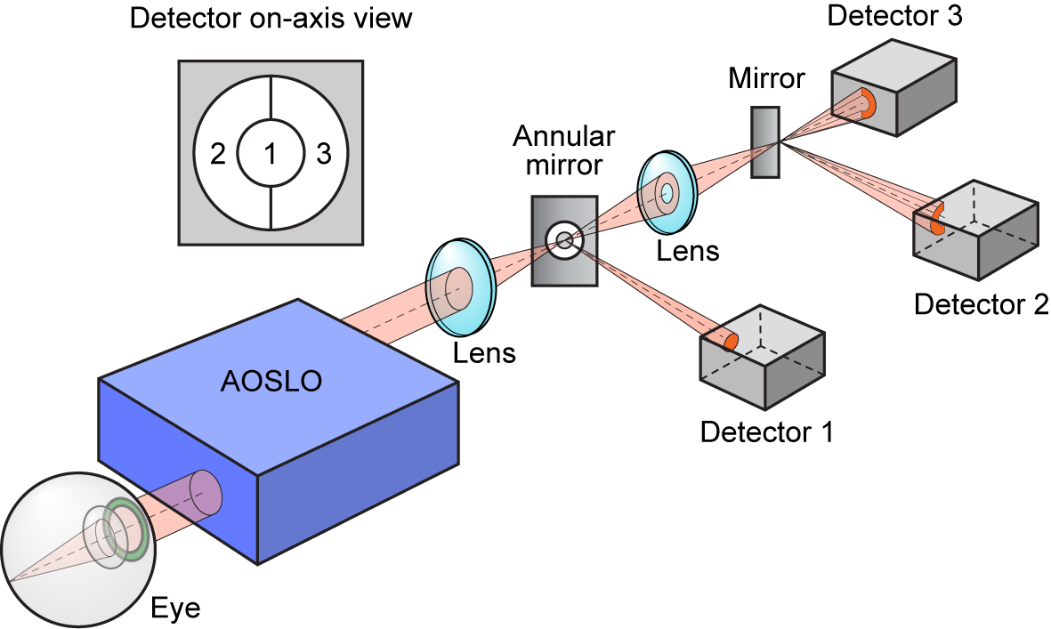
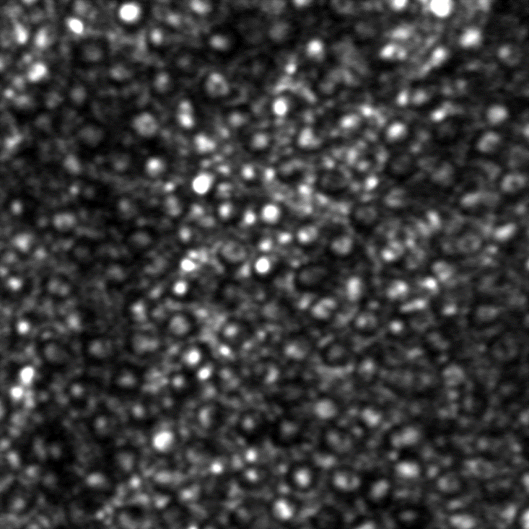
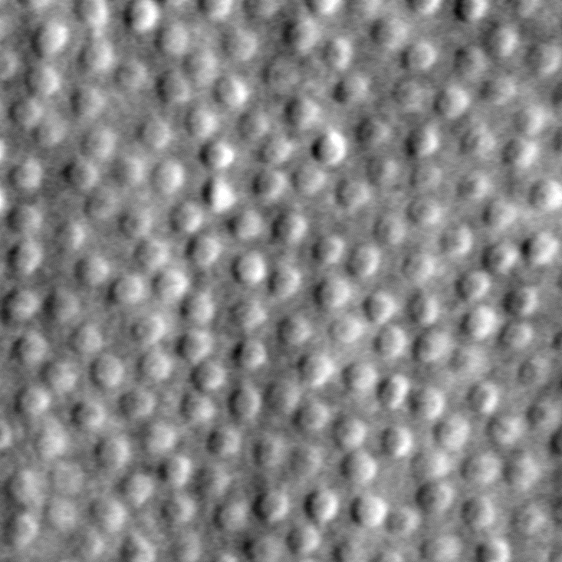
Adaptive Optics: Imaging Individual Cones
Confocal AOSLO:
Rejects light from any layer not conjugate to the plane
Cone IS/OS junction waveguides light when OS/RPE is intact
I₂ - I₃
I₂ + I₃
Split Detector AOSLO:
Collects multiply scattered light
Reveals structure from all layers
Mitochondria in IS scatter strongly
50 μm

Slide 5
Objectives
To describe baseline cone spacing (at RUSH2A 12 mo visit)
To explore inter-grader and inter-test variability
To describe cone structure changes overtime
  AOSLO twice at baseline
  1-year AOSLO images
  2-year AOSLO images
To compare cone spacing in USH2 vs ARRP patients

Slide 6
Methods
Two baseline AOSLO montages of the cone mosaic were obtained from each of 14 participants with USH2A-related retinal degeneration
  32 participants were eligible
  Goal:
    2 baseline AOSLO montages
    1 AOSLO montage at each annual visit

Slide 7
Methods
Two graders masked to disease category measured
  Cone spacing
  Cone density
  Image quality score (1= poor, 5= excellent)
Poor quality images (image quality score = 0) were confirmed not gradable by a masked clinician.

Slide 8
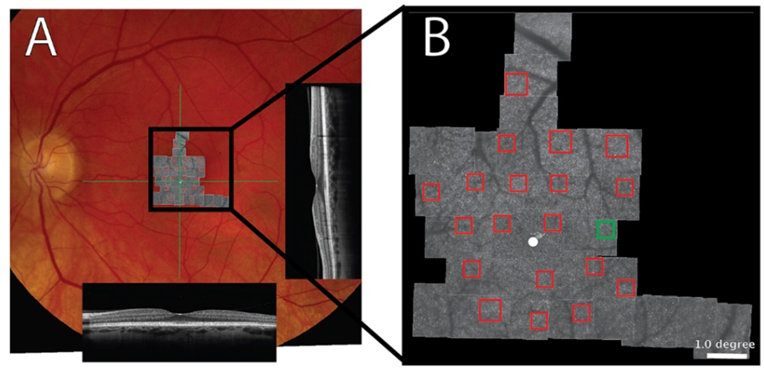
AOSLO Examples
A) Color fundus photo
  AOSLO montage
  SD-OCT B-scans through the fovea (green lines)
B) Magnified AOSLO montage
  Regions of interest (ROIs) in red boxes
  Green box: ROI magnified on next slides

Slide 9
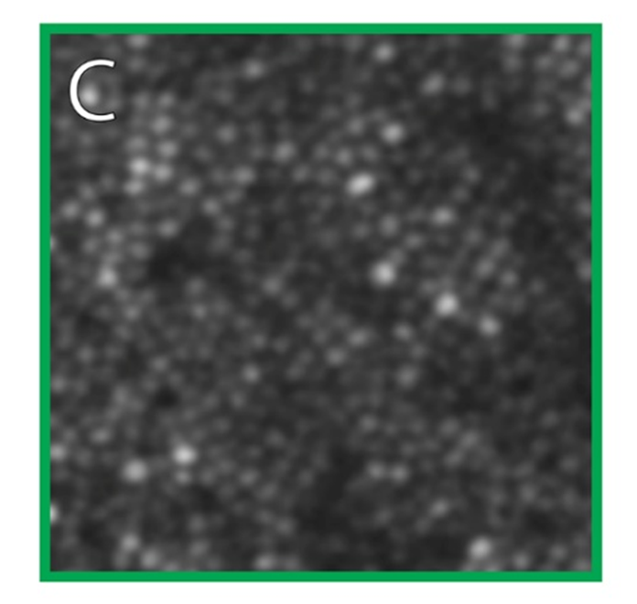
AOSLO Examples
Cone mosaic: cone profiles of varying reflectivity

Slide 10
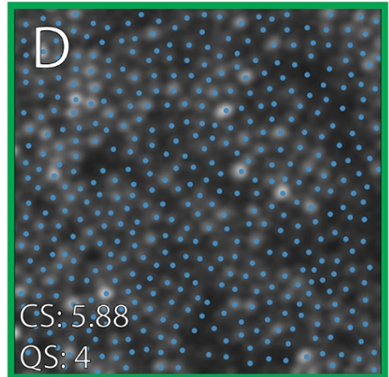
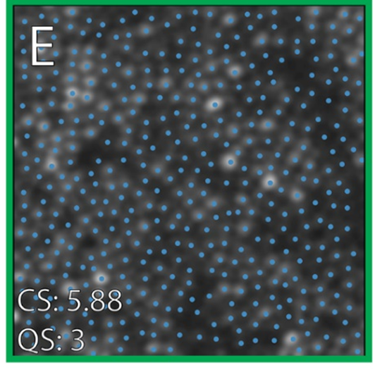
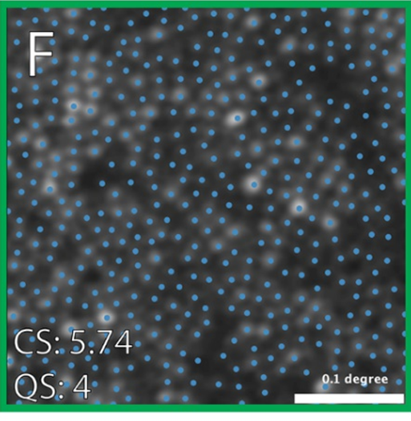
AOSLO Examples
Cones marked by 3 independent graders
  Cone spacing (CS, average nearest neighbor in arcminutes)
  Quality score (QS) assessments by each grader
  Scale bar, 0.1 degree

Slide 11
Statistical Methods
Cone spacing -> robust measure of cone structure
Cone spacing measures were converted to Z-scores
  Z-scores were based on cone spacing at the same location among 40 normal people aged 18 to 82
Inter-test and inter-grader variability were evaluated using intraclass coefficient (ICC) and Bland-Altman plots
Cone spacing was compared with clinical characteristics using weighted linear mixed effects regression
  Weights were determined using quality score as the inverse Root-Mean Square Deviation (RMSD)

Slide 12
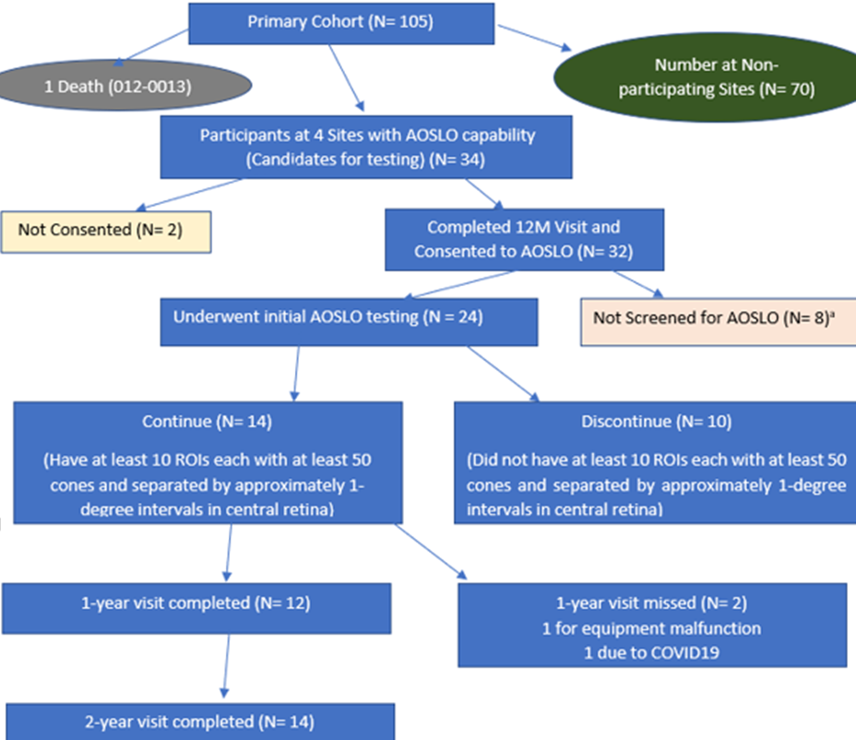
Study Participant Count Summary
32 pts consented
14 continued
  USH2: 6
  ARRP: 8

Slide 13
Study Cohort
Characteristic | Overall N-4
Gender
Male | 10 (71%)
Race/Ethnicity
White | 11 (79%)
Hispanic | 1 (7%)
Asian | 2 (14%)
Enrollment area
United States/Canada | 8 (57%)
Europe/UK | 6 (43%)

Slide 14
Slide Header
Characteristic | Overall N=14
Age at enrollment, years
Median (IQR) | 38 (27, 48)
Age of onset, years
Median (IQR) | 21 (14, 42)
Duration of Disease, years
Median (IQR) | 12 (6, 16)

Slide 15
Association Between Z-score and Participant Characteristics at Baseline
Column Heading | Model Estimate (Weighted) | Z-score Univariate P value | Adjusted P value
Clinical diagnosis (ARRP) | -1.40 | 0.21
Sex (Male) | -0.41 | 0.75
Grader | -0.09 | 0.21
Test number | 0.04 | 0.56
Site | -0.27 | 0.13
Eccentricity (degree) | -1.21 | <0.001 | <0.001
Quality score | -0.18 | 0.008 | 0.004
Disease duration, years | 0.19 | 0.007 | 0.02
Number of regions of interest (ROIs) | -0.22 | 0.14

Slide 16
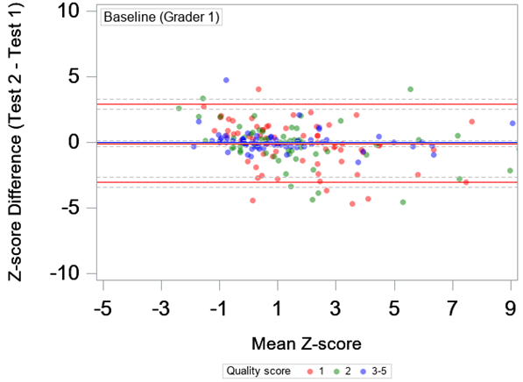
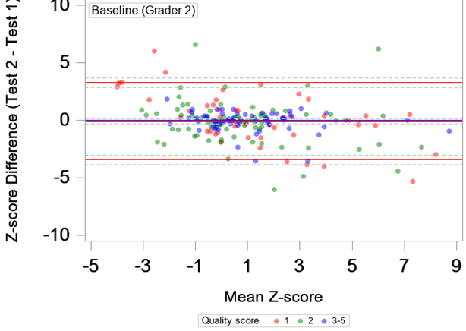
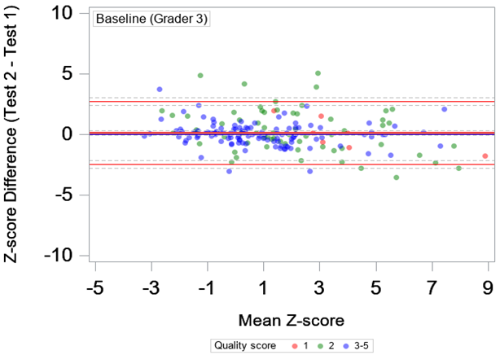
BL Inter-test Variability (Z-scores)
ICC = 0.76

Slide 17
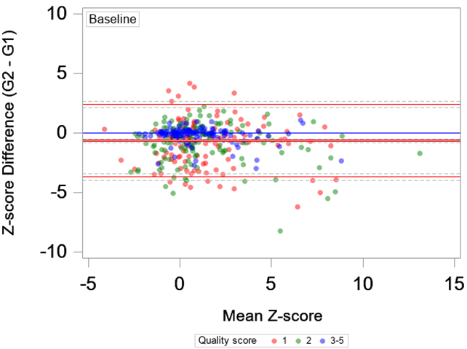
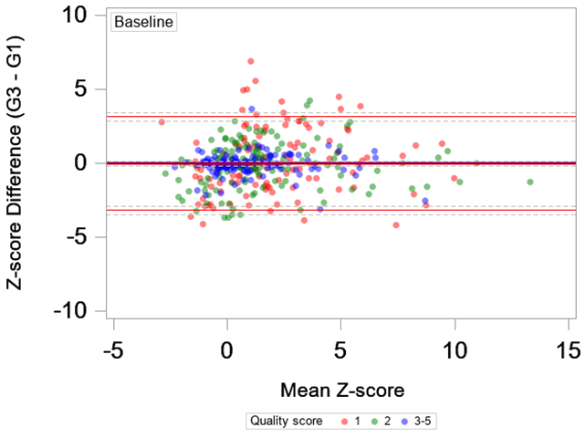
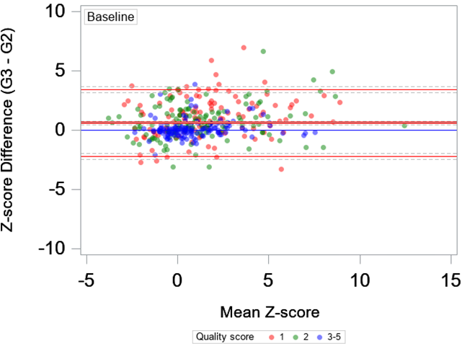
BL Inter-grader Variability (Z-scores)
ICC = 0.70

Slide 18
Cone Spacing (arcmin) Over 24 Months
Outcome | Baseline (N=763) | 12M (N=254) | 24M (N=292)
Mean (SD) | 1.36 (0.23) | 1.39 (0.25) | 1.37 (0.23)
Median (IQR) | 1.33 (1.20, 1.48) | 1.36 (1.22, 1.49) | 1.33 (1.20, 1.46)
Range | 0.72 to 2.26 | 0.89 to 2.26 | 0.80 to 2.04

Slide 19
Cone Density (cones/mm2)
Over 24 Months
Outcome | Baseline (N=763) | 12M (N=254) | 24M (N=292)
Mean (SD) | 22827 (8752.4) | 20173 (7830.6) | 21835 (8334.0)
Median (IQR) | 21457 (16936, 27311) | 19028 (14529, 23954) | 20411 (15983, 26765)
Range | 2252 to 64616 | 4682.0 to 52298 | 8082.0 to 55206
Cone density had a significant negative correlation with cone spacing (-0.74 with 95% CI -0.76 to -0.71).

Slide 20
Cone Spacing (Z-score) over 24 months
Outcome | Baseline (N=763) | 12M (N=254) | 24M (N=292)
Mean (SD) | 1.36 (2.55) | 1.53 (2.57) | 1.80 (2.78)
Median (IQR) | 0.86 (-0.27, 2.45) | 1.09 (-0.24, 2.90) | 1.22 (0.01, 2.92)
Range | -4.37 to 13.95 | -3.13 to 12.95 | -3.12 to 15.27

Slide 21
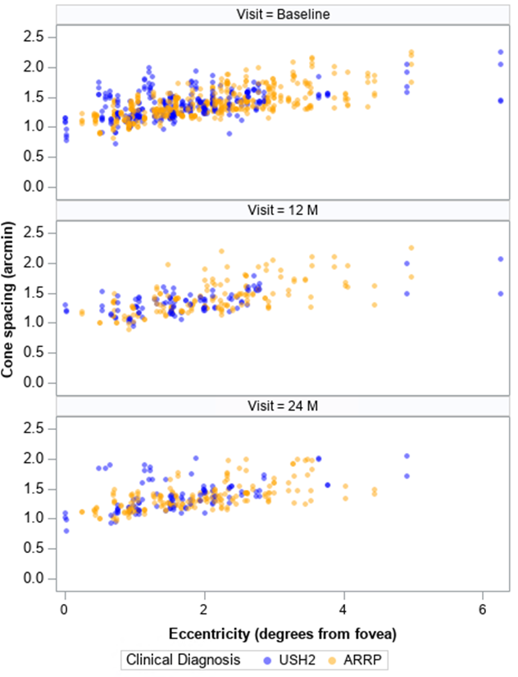
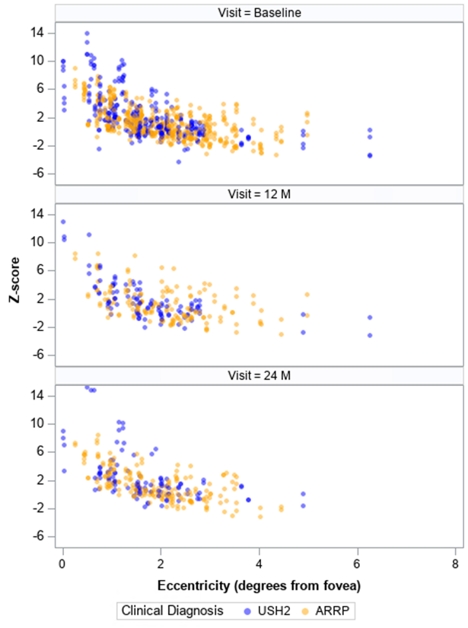
Cone Spacing (arcmin or Z-score) vs Eccentricity
Arcmin
Z-score

Slide 22
Estimated Average Annual Change
Outcomes | Z-score
 | Entire cohort (N=14, n=1309) | Univariate P value
Cone spacing
Annual change | 0.14 | <0.001
95% Conf. Interval | (0.07, 0.21)
Number of ROIs
Annual change | -0.18 | <0.001
95% Conf. Interval | (-0.23, -0.12)

Slide 23
Z-score and Other Measurements
Correlation between Z-score with below measurements were explored
  BCVA
  FST
  OCT EZ Area
  MP mean sensitivity
No significant correlation (cross-sectional or longitudinal)

Slide 24
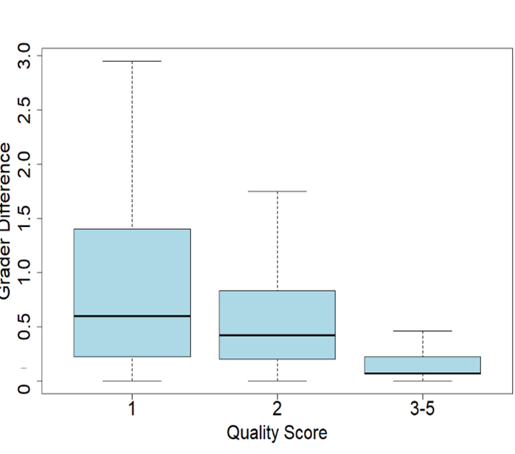
Quality Score
Intergrader variation (Z-score) difference
  Greater at ROIs with image quality scores of 1 and 2 vs 3-5
  Median 1.50 vs 1.18 vs 0.69 (P < 0.001)
Lower image quality was associated with greater difference between graders
  mean increase = 0.13 arcmin/1 point quality score decrease
  P=0.005

Slide 25
Discussion
At baseline:
  Cone spacing and density correlated with eccentricity
  Cone spacing correlated with disease duration
    Longer disease duration results in fewer cones remaining
Cone spacing was not significantly different between USH2 and ARRP participants that were eligible for AOSLO imaging

Slide 26
Discussion
Image quality was significantly lower for the second baseline montage, suggesting one baseline image is sufficient
Adding a qualitative image quality score can be a useful approach to handle inter-grader inconsistencies while minimizing the loss of data

Slide 27
Discussion
Although cone spacing and density did not change significantly over 24 months,
Cone spacing Z score increased (+0.14, 95% confidence interval 0.07 to 0.21, P < 0.001)
Correcting for eccentricity, distance between cones increased during 24 months follow up
We observed a significant reduction of gradable ROIs with remaining cones
  -0.18 ROIs/year, 95% confidence interval -0.23 to -0.12
  P < 0.001

Slide 28
Conclusions
Longer disease duration was associated with greater cone spacing
Image quality was lower with repeat imaging at baseline
We observed a significant increase in cone spacing Z-score over 24 months
The number of gradable ROIs with remaining cones declined over 24 months
We did not find a significant difference between USH2 and ARRP participants at baseline, or in the rate of change

