Slide 1
RUSH2A Change in Cone Structure Over 24m in USH2A-related Retinal Degeneration
FFB Clinical Consortium

Slide 2
Background
Prior studies have not described cone structure with high-resolution images of USH2A-related retinal degeneration
AOSLO
Non-invasive method
Visualize cone photoreceptors with high resolution
4 RUSH2A centers with AOSLO expertise:
UCSF, MCW, Moorfields, Paris

Slide 3
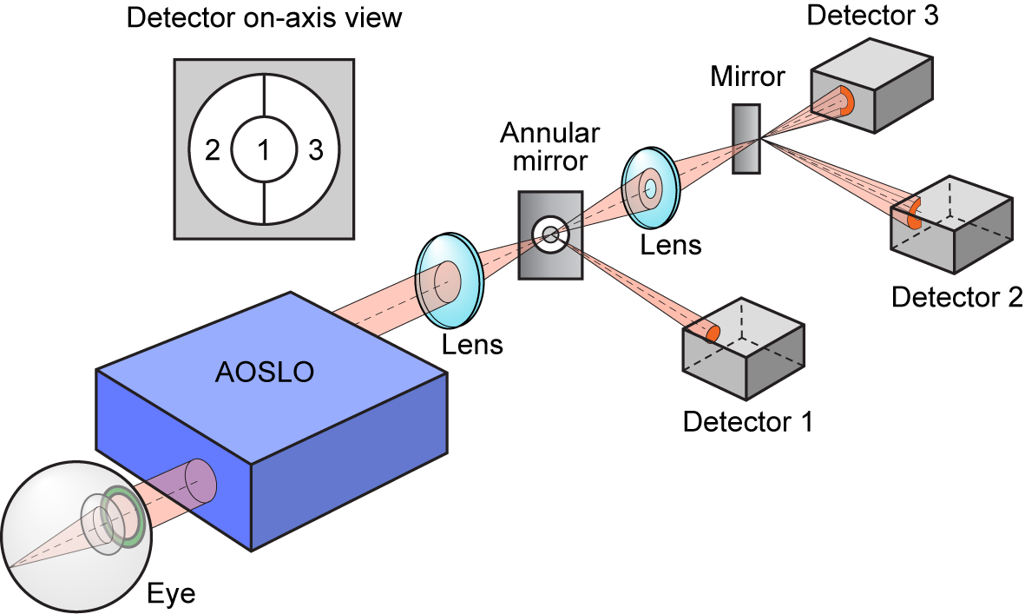
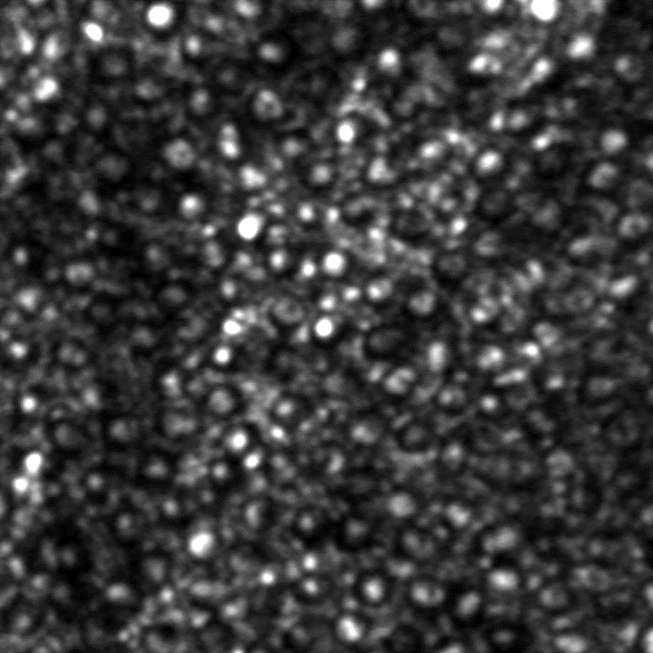
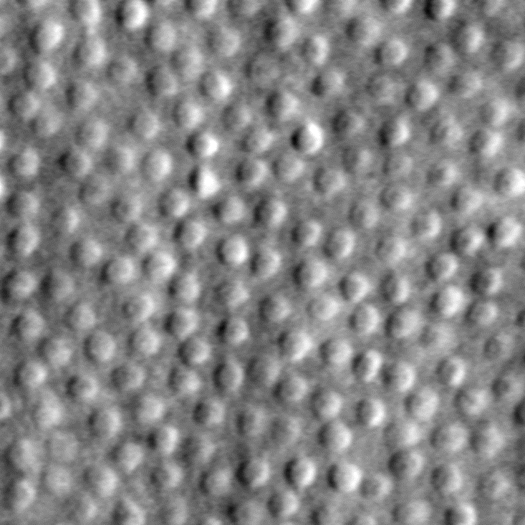
Adaptive Optics: Imaging Individual Cones
Confocal AOSLO:
Rejects light from any layer not conjugate to the plane
Cone IS/OS junction waveguides light when OS/RPE is intact
I₂ - I₃
I₂ + I₃
Split Detector AOSLO:
Collects multiply scattered light
Reveals structure from all layers
Mitochondria in IS scatter strongly
50 μm

Slide 4
Objectives
To describe baseline cone spacing (at RUSH2A 12 mo visit)
To explore inter-grader and inter-test variability
To describe cone structure changes overtime
AOSLO twice at baseline
1-year AOSLO images
2-year AOSLO images
To compare cone spacing in USH2 vs ARRP patients

Slide 5
Methods
Two baseline AOSLO montages of the cone mosaic were obtained from each of 14 participants with USH2A-related retinal degeneration
32 participants were eligible
Goal:
2 baseline AOSLO montages
1 AOSLO montage at each annual visit

Slide 6
Methods
Two graders masked to disease category measured
Cone spacing
Cone density
Image quality score (1= poor, 5= excellent)
Poor quality images (image quality score = 0) were confirmed not gradable by a masked clinician.

Slide 7
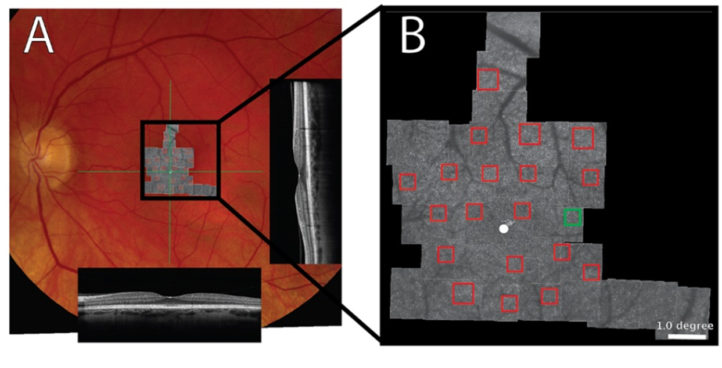
AOSLO Examples
A) Color fundus photo
AOSLO montage
SD-OCT B-scans through the fovea (green lines)
B) Magnified AOSLO montage
Regions of interest (ROIs) in red boxes
Green box: ROI magnified on next slides

Slide 8
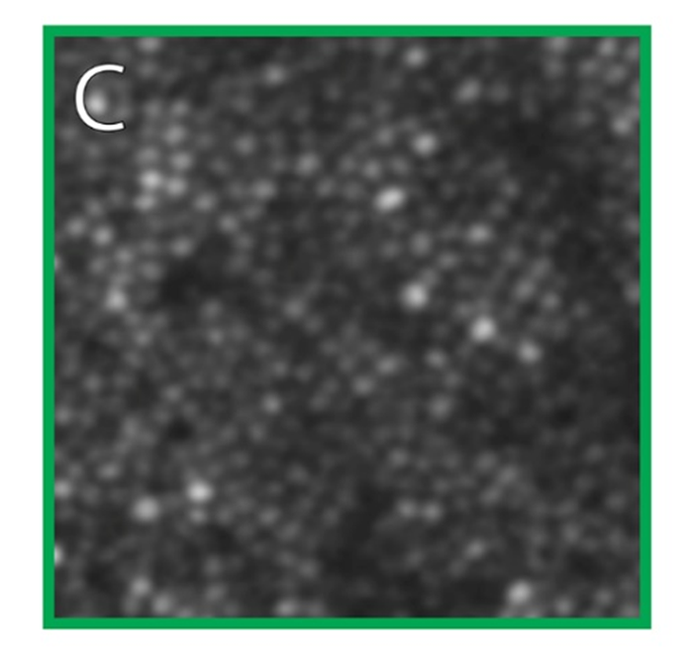
AOSLO Examples
Cone mosaic: cone profiles of varying reflectivity

Slide 9
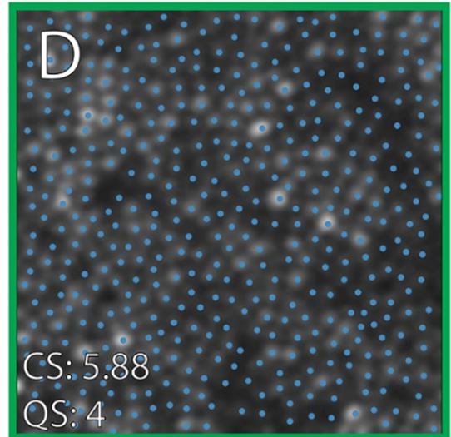
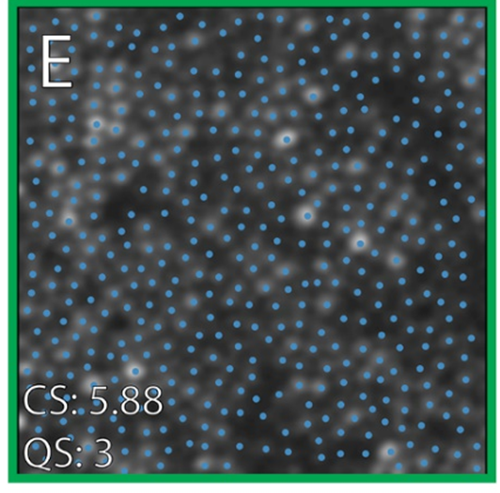
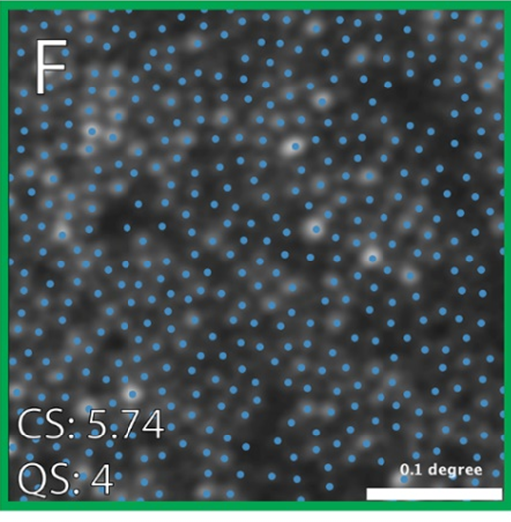
AOSLO Examples
Cones marked by 3 independent graders
Cone spacing (CS, average nearest neighbor in arcminutes)
Quality score (QS) assessments by each grader
Scale bar, 0.1 degree

Slide 10
Statistical Methods
Cone spacing -> robust measure of cone structure
Cone spacing measures were converted to Z-scores
Z-scores were based on cone spacing at the same location among 40 normal people aged 18 to 82
Inter-test and inter-grader variability were evaluated using intraclass coefficient (ICC) and Bland-Altman plots
Cone spacing was compared with clinical characteristics using weighted linear mixed effects regression
Weights were determined using quality score as the inverse Root-Mean Square Deviation (RMSD)

Slide 11
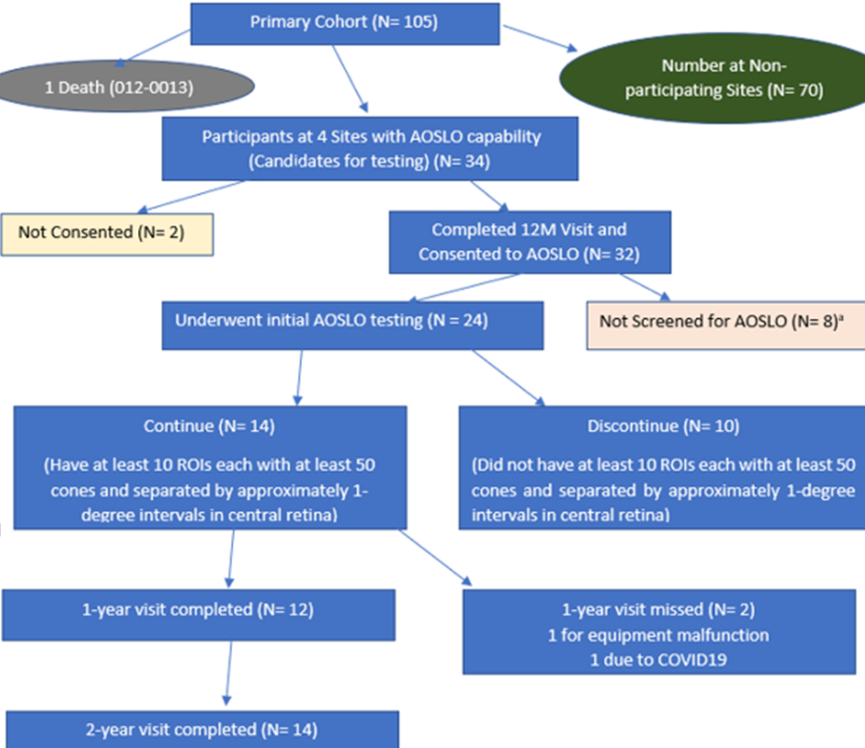
Study Participant Count Summary
32 pts consented
14 continued
USH2: 6
ARRP: 8

Slide 12
Study Cohort
Characteristic | Overall N-4
Gender
Male | 10 (71%)
Race/Ethnicity
White | 11 (79%)
Hispanic | 1 (7%)
Asian | 2 (14%)
Enrollment area
United States/Canada | 8 (57%)
Europe/UK | 6 (43%)

Slide 13
Slide Header
Characteristic | Overall N=14
Age at enrollment, years
Median (IQR) | 38 (27, 48)
Age of onset, years
Median (IQR) | 21 (14, 42)
Duration of Disease, years
Median (IQR) | 12 (6, 16)

Slide 14
Association Between Z-score and Participant Characteristics at Baseline
Column Heading | Model Estimate (Weighted) | Z-score Univariate P value | Adjusted P value
Clinical diagnosis (ARRP) | -1.40 | 0.21
Sex (Male) | -0.41 | 0.75
Grader | -0.09 | 0.21
Test number | 0.04 | 0.56
Site | -0.27 | 0.13
Eccentricity (degree) | -1.21 | <0.001 | <0.001
Quality score | -0.18 | 0.008 | 0.004
Disease duration, years | 0.19 | 0.007 | 0.02
Number of regions of interest (ROIs) | -0.22 | 0.14

Slide 15
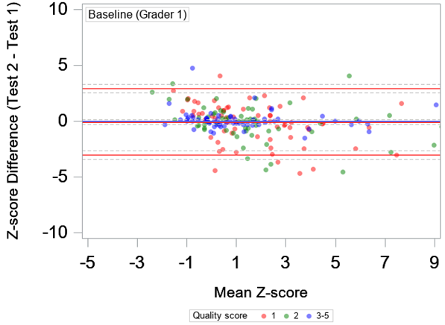
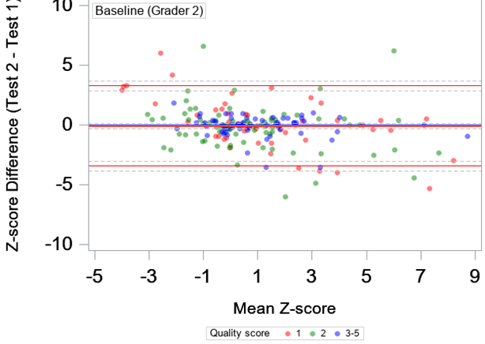
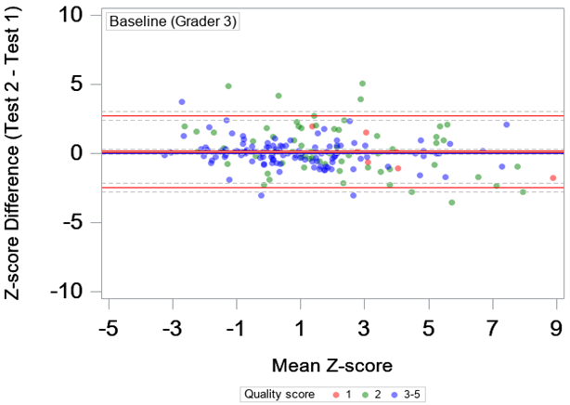
BL Inter-test Variability (Z-scores)
ICC = 0.76

Slide 16
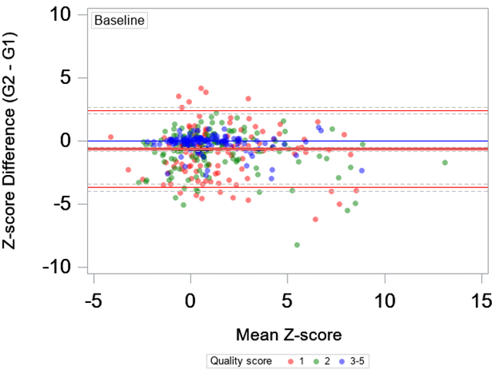
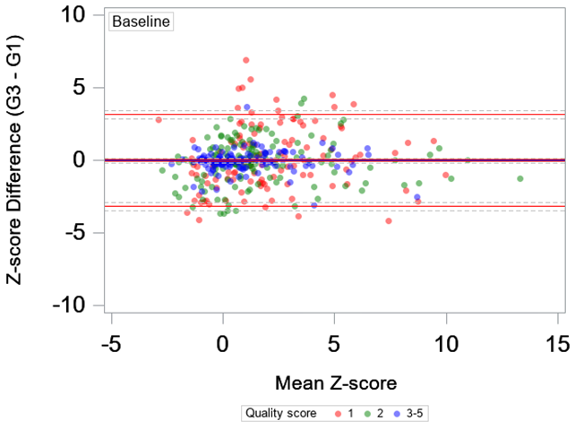
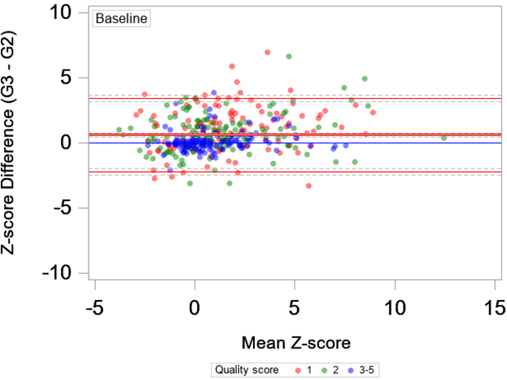
BL Inter-grader Variability (Z-scores)
ICC = 0.70

Slide 17
Cone Spacing (arcmin) Over 24 Months
Outcome | Baseline (N=763) | 12M (N=254) | 24M (N=292)
Mean (SD) | 1.36 (0.23) | 1.39 (0.25) | 1.37 (0.23)
Median (IQR) | 1.33 (1.20, 1.48) | 1.36 (1.22, 1.49) | 1.33 (1.20, 1.46)
Range | 0.72 to 2.26 | 0.89 to 2.26 | 0.80 to 2.04

Slide 18
Cone Density (cones/mm2) Over 24 Months
Outcome | Baseline (N=763) | 12M (N=254) | 24M (N=292)
Mean (SD) | 22827 (8752.4) | 20173 (7830.6) | 21835 (8334.0)
Median (IQR) | 21457 (16936, 27311) | 19028 (14529, 23954) | 20411 (15983, 26765)
Range | 2252 to 64616 | 4682.0 to 52298 | 8082.0 to 55206
Cone density had a significant negative correlation with cone spacing (-0.74 with 95% CI -0.76 to -0.71).

Slide 19
Cone Spacing (Z-score) over 24 months
Outcome | Baseline (N=763) | 12M (N=254) | 24M (N=292)
Mean (SD) | 1.36 (2.55) | 1.53 (2.57) | 1.80 (2.78)
Median (IQR) | 0.86 (-0.27, 2.45) | 1.09 (-0.24, 2.90) | 1.22 (0.01, 2.92)
Range | -4.37 to 13.95 | -3.13 to 12.95 | -3.12 to 15.27

Slide 20
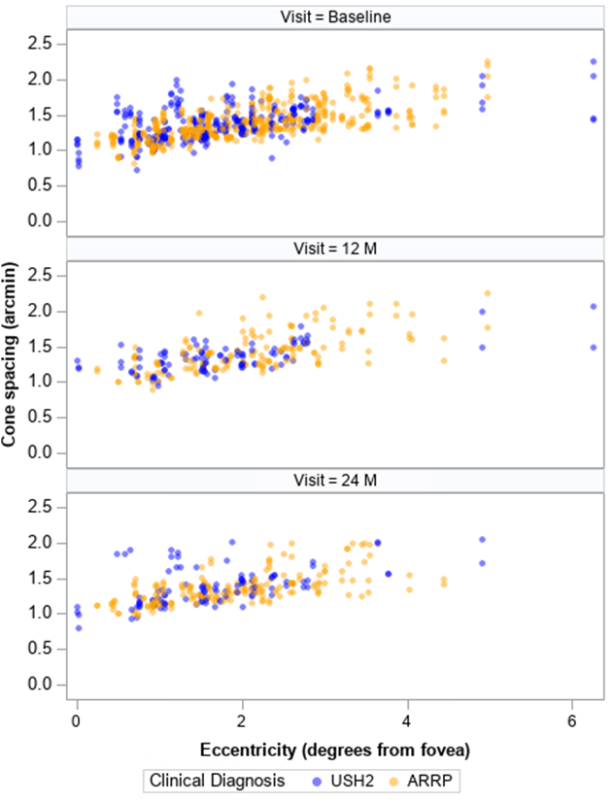
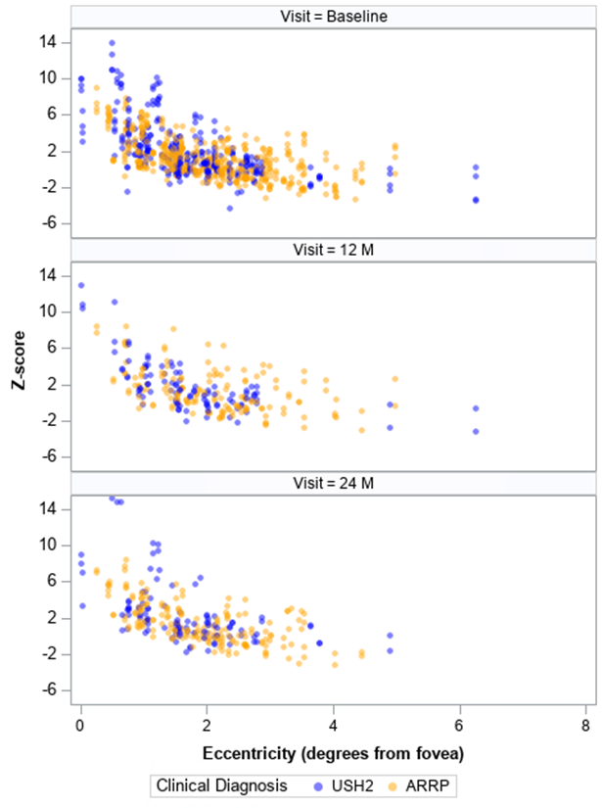
Cone Spacing (arcmin or Z-score) vs Eccentricity
Arcmin
Z-score

Slide 21
Estimated Average Annual Change
Outcomes | Z-score
 | Entire cohort (N=14, n=1309) | Univariate P value
Cone spacing
Annual change | 0.14 | <0.001
95% Conf. Interval | (0.07, 0.21)
Number of ROIs
Annual change | -0.18 | <0.001
95% Conf. Interval | (-0.23, -0.12)

Slide 22
Z-score and Other Measurements
Correlation between Z-score with below measurements were explored
BCVA
FST
OCT EZ Area
MP mean sensitivity
No significant correlation (cross-sectional or longitudinal)

Slide 23
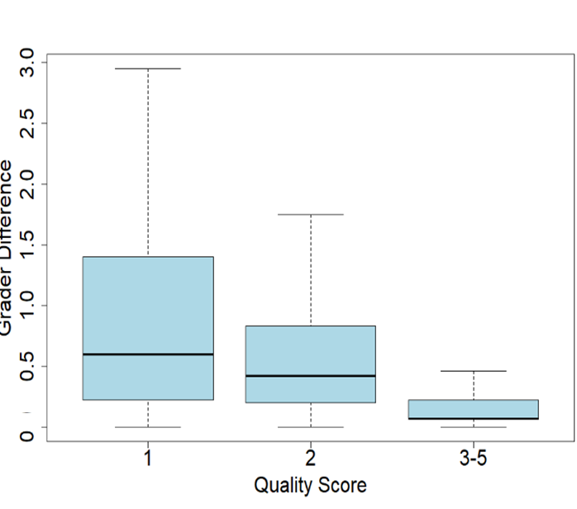
Quality Score
Intergrader variation (Z-score) difference
Greater at ROIs with image quality scores of 1 and 2 vs 3-5
Median 1.50 vs 1.18 vs 0.69 (P < 0.001)
Lower image quality was associated with greater difference between graders
mean increase = 0.13 arcmin/1 point quality score decrease
P=0.005

Slide 24
Discussion
At baseline:
Cone spacing and density correlated with eccentricity
Cone spacing correlated with disease duration
Longer disease duration results in fewer cones remaining
Cone spacing was not significantly different between USH2 and ARRP participants that were eligible for AOSLO imaging

Slide 25
Discussion
Image quality was significantly lower for the second baseline montage, suggesting one baseline image is sufficient
Adding a qualitative image quality score can be a useful approach to handle inter-grader inconsistencies while minimizing the loss of data

Slide 26
Discussion
Although cone spacing and density did not change significantly over 24 months,
Cone spacing Z score increased (+0.14, 95% confidence interval 0.07 to 0.21, P < 0.001)
Correcting for eccentricity, distance between cones increased during 24 months follow up
We observed a significant reduction of gradable ROIs with remaining cones
-0.18 ROIs/year, 95% confidence interval -0.23 to -0.12
P < 0.001

Slide 27
Conclusions
Longer disease duration was associated with greater cone spacing
Image quality was lower with repeat imaging at baseline
We observed a significant increase in cone spacing Z-score over 24 months
The number of gradable ROIs with remaining cones declined over 24 months
We did not find a significant difference between USH2 and ARRP participants at baseline, or in the rate of change

Slide 28
Writing Committee Members
Jacque Duncan (Lead)
Allison Ayala
Isabelle Audo
Joseph Carroll
Jenna Cava
Janet Cheetham
Todd Durham
Kate Grieve
Angelos Kalitzeos
Joseph Kreis
Wendi Liang
Maureen Maguire
Michel Michaelides
Nathaniel Norberg
Michel Paques
Travis Porco
Jessica Wong

