Slide 1
Auditory and olfactory findings in patients with USH2A-related retinal degeneration – Findings at baseline from the rate of progression in USH2A-related retinal degeneration natural degeneration natural history study (RUSH2A)

Slide 2
Citation, Funding, Disclaimer
Citation
Iannaccone A, Brewer CC, Cheng P, Duncan JL, Maguire MG, Audo I, Ayala AR, Bernstein PS, Bidelman GM, Cheetham JK, Doty RL, Durham TA, Hufnagel RB, Myers MH, Stingl K, Zein WM; Foundation Fighting Blindness Consortium Investigator Group. Auditory and olfactory findings in patients with USH2A-related retinal degeneration-Findings at baseline from the rate of progression in USH2A-related retinal degeneration natural history study (RUSH2A). Am J Med Genet A. 2021 Dec;185(12):3717-3727. doi: 10.1002/ajmg.a.62437.
Funding
This study was funded by Foundation Fighting Blindness
Disclaimer
The source of the data is the Foundation Fighting Blindness Clinical Consortium, but the analyses, content and conclusions presented herein are solely the responsibility of the authors/presenters and may not reflect the views of the Foundation Fighting Blindness.

Slide 3
Background
Usher syndrome
  A leading cause of autosomal recessive deaf-blindness
  A ciliopathy characterized by retinitis pigmentosa (RP) with sensorineural hearing loss (SNHL)
  Clinically can be divided into 3 types based on the severity and onset of hearing loss

Slide 4
Background (Cont)
Types of Usher Syndrome
  Type 1: profound congenital hearing loss, absent vestibular responses, and retinitis pigmentosa (RP) beginning in the first decade of life
  Type 2: moderate to severe congenital sensorineural hearing loss (SNHL) with a sloping configuration, normal vestibular function and RP beginning in the first or second decade
  Type 3: progressive hearing loss, variable vestibular responses, and variable onset of RP
Notes:
This report focuses on USH2.

Slide 5
Background (Cont)
Among multiple genes associated with USH2, the most commonly implicated is USH2A
Mutations in USH2A are also among the most common causes of non-syndromic autosomal recessive RP (ARRP)
Congenital SNHL is a defining feature in USH2, but less is known about hearing in persons with USH2A-related ARRP
The reports on olfaction deficits in USH2 patients provided conflicting results
Olfaction deficits have not been evaluated in USH2A-associated ARRP

Slide 6
Background (Cont)
The Rate of Progression of USH2A-related Retinal Degeneration (RUSH2A) study is an ongoing multicenter, international, longitudinal natural history study to collect data from both USH2 and ARRP patients
Hearing and olfaction data were collected at study baseline
The RUSH2A study afforded the opportunity to investigate hearing and olfaction in patients with USH2A-related retinal degeneration

Slide 7
Methods – Study Design
Participants had to be at least 8 years old with a rod-cone degeneration associated with at least 2 disease-causing USH2A sequence variants
Participants with USH2 or with ARRP with homozygous or compound heterozygous USH2A variants inherited in trans were enrolled (N=127)
Participants were separately into two visual cohorts based on best corrected visual acuity letter score, central kinetic visual field III4e isopter and fixation status
Both cohorts are combined in this baseline cross-sectional report

Slide 8
Methods – Audiology
Hearing outcomes in this report include the pure-tone thresholds and word recognition scores (WRS)
A four frequency (0.5, 1, 2 and 4 kHz) pure tone average (4F-PTA) was calculated for each ear and the mean value from two ears was used for analyses
The type of loss was determined by calculating the difference between the three frequency (0.5, 1 and 2 kHz) pure-tone averages (3F-PTA) for air and bone conduction (i.e., air-bone gap)
A third PTA (WR-PTA) comprising the average of thresholds at 0.5, 1, 2 and 3 kHz was used for plotting the comparison between pure-tone thresholds with WRS

Slide 9
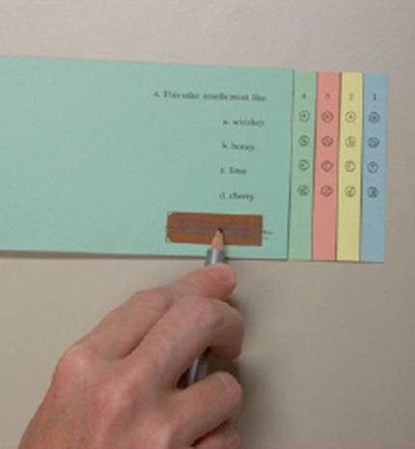
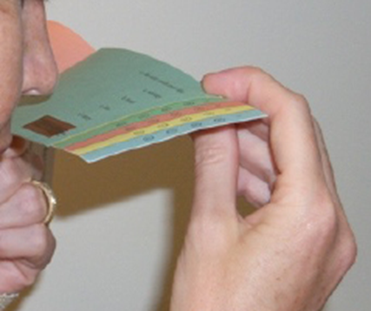
Methods – Olfaction
The University of Pennsylvania Smell Identification Test (UPSIT) was performed in all 127 participants Sub-Bullet
  4 different 10-page booklets, total 40 questions
  Microencapsulated odorant embedded in a “scratch and sniff” strip on each page
  Scents released using a pencil tip
  Test score is number of correct answers from 40 questions

Slide 10
Methods – Statistical
Distributions of 4F-PTA data and UPSIT scores were summarized using means and standard deviations (SDs)
4F-PTA was compared with age- and gender-matched percentile bands of normative data from ISO standards for USH2 and ARRP participants separately
Associations between participant characteristics and 4F-PTA thresholds within USH2 and ARRP groups were assessed separately by linear regression models

Slide 11
Methods – Statistical
UPSIT scores from RUSH2A participants were compared to healthy historical controls from an UPSIT database using a linear regression model with adjustment for age and gender
Linear regression models were also used to assess the association between study participant characteristics and UPSIT scores
Correlations between UPSIT scores, 4F-PTA thresholds, and selected visual functional and structural measures were assessed with Spearman partial correlations adjusted for age

Slide 12
Study Population (N=127)
 | USH2 (N=80) | ARRP (N=47)
Age at Enrollment (years) Median (IQR) | 37 (27, 44) | 44 (36, 50)
Age at Onset of Vision Loss (years) Median (IQR) | 16 (13,22) | 32 (20, 41)

Slide 13
Study Population (Cont)

Slide 14
Degree of hearing loss based on 4F-PTA by clinical diagnosis
Notes:
Five USH2 participants had missing 4F-PTA data – 3 excluded due to cochlear implants, 2 excluded due to missed the hearing examination.

Slide 15
Hearing loss type
Hearing Loss Type | USH2 (N=75) | ARRP (N=12)
SNHL | 74 | 11
Mixed | 1 | 0
Conductive | 0 | 1
Notes:
Hearing loss type among those participants who had hearing loss.

Slide 16
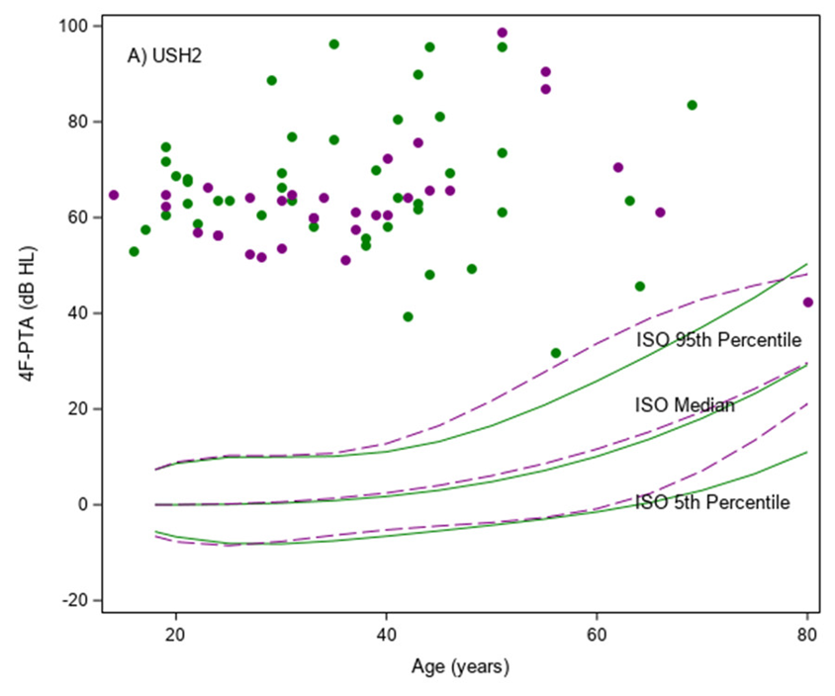
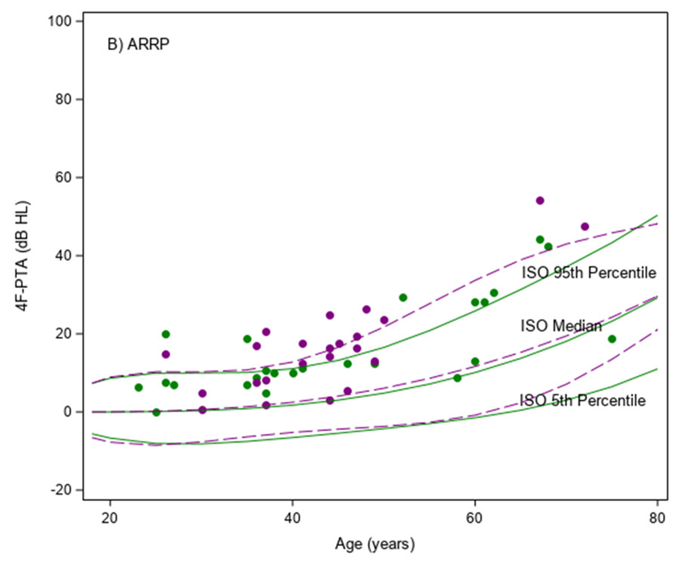
4F-PTA vs Age

Slide 17
Difference in 4F-PTA by age
 | USH2 (N=80) | ARRP (N=47)
Difference in 4F-PTA (dB HL/year) | Mean (95% C.I.)
Female | -0.01 (-0.34, 0.32) |  | 0.54 (0.31, 0.78)
Male | 0.19 (-0.09, 0.46) |  | 0.99 (0.65, 1.32)

Slide 18
Association Between 4F-PTA and Participant Characteristics by Clinical Diagnosis
Characteristic | USH2 (N=75) |  |  | ARRP (N=47)
 | N | Mean ± SD (dB HL) | P-value | N | Mean ± SD (dB HL) | P-value
Age at Enrollment (years) |  |  | 0.46 |  |  | <0.001
<30 | 24 | 63 ± 8 |  | 6 | 9 ± 7
30-39 | 20 | 64 ± 10 |  | 13 | 9 ± 6
40-49 | 18 | 67 ± 14 |  | 16 | 15 ± 6
50-59 | 7 | 77 ± 24 |  | 3 | 21 ± 11
≥60 | 6 | 61 ± 15 |  | 9 | 34 ± 14
Gender |  |  | 0.40 |  |  | 0.87
Female | 43 | 67 ± 14 |  | 24 | 16 ± 12
Male | 32 | 64 ± 11 |  | 23 | 17 ± 13
Race/Ethnicity |  |  | 0.79 |  |  | 0.60
Non-Hispanic White | 65 | 65 ± 13 |  | 43 | 17 ± 13
Other | 10 | 67 ± 17 |  | 4 | 13 ± 8
Duration of Disease (years) |  |  | 0.11 |  |  | 0.03
<10 | 19 | 65 ± 6 |  | 17 | 13 ± 6
10-19 | 25 | 63 ± 14 |  | 21 | 17 ± 13
≥20 | 31 | 68 ± 16 |  | 8 | 25 ± 15
Daily Smoker Ever |  |  | 0.27 |  |  | 0.16
Yes | 19 | 63 ± 13 |  | 13 | 21 ± 15
No | 56 | 67 ± 13 |  | 34 | 15 ± 11

Slide 19
Self-Reported Newborn Hearing Screening

Slide 20
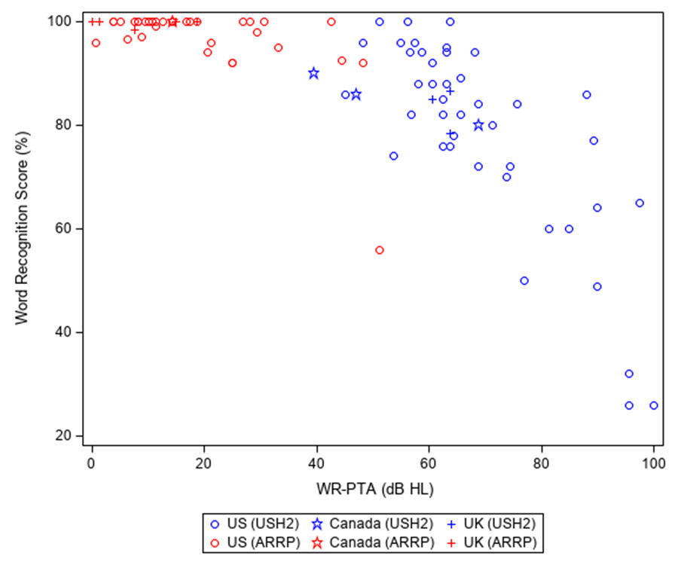
Mean WRS vs WR-PTA Averaged From Both Ears

Slide 21
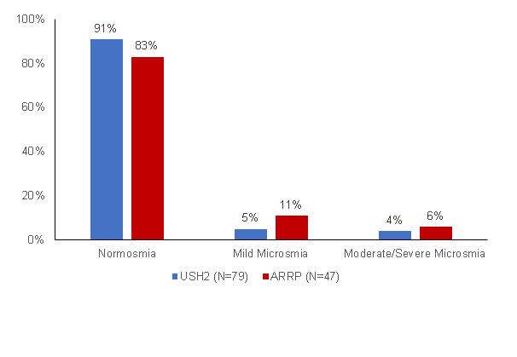
Smell Function Loss Severity by Clinical Diagnosis

Slide 22
Smell function for RUSH2A cohort vs healthy control
 | RUSH2A (N=127) | Historical Control (N=77) | P-value
UPSIT Total Score
Mean ± SD | 35 ± 3 | 34 ± 3 | NA
Mean Adjusted Difference (RUSH2A – Control) | 0.39 |  | 0.39
95% C.I. Adjusted Difference (RUSH2A – Control) | (-0.50, 1.28) |  | NA

Slide 23
UPSIT total score vs participant characteristics
Characteristic | N | UPSIT Score | Univariate P-value
 |  | Mean ± SD
All | 127 | 35 ± 3 | NA
Clinical Diagnosis |  |  | 0.55
USH2 | 80 | 35 ± 3
ARRP | 47 | 34 ± 4
Age at Enrollment (yrs) |  |  | 0.90
<30 | 30 | 34 ± 4
30-39 | 34 | 34 ± 3
40-49 | 37 | 35 ± 3
50-59 | 11 | 34 ± 5
≥60 | 15 | 35 ± 3
Gender |  |  | 0.34
Female | 68 | 35 ± 4
Male | 59 | 34 ± 3
Race/Ethnicity |  |  | 0.63
Non-Hispanic White | 113 | 34 ± 3
Other | 14 | 35 ± 3
Duration of Disease (yrs) |  |  | 0.38
<10 | 37 | 34 ± 4
10-19 | 46 | 34 ± 4
≥20 | 43 | 35 ± 3
Daily Smoker Ever |  |  | 0.23
Yes | 33 | 34 ± 3
No | 94 | 35 ± 3
Country |  |  | 0.02
Canada | 4 | 38 ± 1
France | 13 | 34 ± 5
Germany | 11 | 36 ± 2
Netherlands | 10 | 32 ± 3
UK | 10 | 33 ± 3
US | 79 | 35 ± 3

Slide 24
Visual Function Measures | Correlation with UPSIT Score (95% C.I.) | P-value
Visual Acuity | -0.05 (-0.22, +0.13) | 0.57
Full-field Stimulus Threshold
White Stimulus | +0.07 (-0.13, +0.27) | 0.49
Blue Stimulus | +0.06 (-0.14, +0.27) | 0.55
Red Stimulus | +0.11 (-0.09, +0.31) | 0.28
Full-field Electroretinography
DA 0.01 ERG Response | -0.11 (-0.28, +0.07) | 0.21
DA 3.0 ERG Response | -0.14 (-0.30, +0.04) | 0.13
LA 3.0 Flicker ERG Response | -0.12 (-0.29, +0.06) | 0.19
Kinetic Perimetry
I4e Seeing Area | -0.08 (-0.25, +0.10) | 0.37
III4e Seeing Area | -0.09 (-0.26, +0.08) | 0.30
V4e Seeing Area | -0.12 (-0.29, +0.06) | 0.20
Ellipsoid Zone Area on Optical Coherent Tomography | -0.10 (-0.27, +0.08) | 0.26
Static Perimetry
Full-field Hill of Vision | -0.11 (-0.28, +0.07) | 0.23
30 Degree Hill of Vision | -0.11 (-0.29, +0.07) | 0.21
Mean Sensitivity | -0.10 (-0.27, +0.08) | 0.26
Microperimetry Mean Retinal Sensitivity | -0.11 (-0.31, +0.10) | 0.32
Spearman correlation between UPSIT total score and visual measures

Slide 25
Discussion
Hearing loss observed previously in patients with USH2A-related USH2 ranged from mild to severe, and was sensorineural, bilaterally symmetrical, and gently down-sloping from low to high frequencies, these features are confirmed by the RUSH2A data
The 4F-PTAs in ARRP group show that hearing thresholds are slightly elevated above age- and gender-based normative levels, suggesting that there may be a subtle effect of USH2A mutations on the auditory system
Results of newborn hearing screenings in our small dataset suggest that hearing loss may be present at birth in some and that it may have a delayed onset in others with USH2A mutations

Slide 26
Discussion (cont)
The mean UPSIT score for all RUSH2A participants was not significantly different from normal and there was no significant difference between USH2 and ARRP participants
Cases of impaired smell function in conjunction with USH2A mutations are possible, they appear to be relatively uncommon and rarely severe
Neither olfaction nor SNHL parameters were significantly associated with age, sex, race/ethnicity or smoking status at study baseline (with the exception that age was significantly associated with 4F-PTAs in ARRP participants)
Olfaction was not associated with any visual functional or structural measures
There was no correlation between UPSIT and 4F-PTA thresholds

