Slide 1
Functional Vision in Patients with Bi-allelic USH2A Variants

Slide 2
Citation, Funding, Disclaimer
Citation
Heon E, Melia M, Bocchino LE, Samarakoon L, Duncan JL, Ayala AR, Audo I, Bradley C, Cheetham JK, Dagnelie G, Durham TA, Hoyng CB, Jain N, Jayasundera KT, Pennesi ME, Weng CY; Foundation Fighting Blindness Consortium Investigator Group. Functional Vision in Patients With Biallelic USH2A Variants. Am J Ophthalmol. 2024 Apr;260:200-211. doi: 10.1016/j.ajo.2023.12.009.
Funding
This study was funded by Foundation Fighting Blindness
Disclaimer
The source of the data is the Foundation Fighting Blindness Clinical Consortium, but the analyses, content and conclusions presented herein are solely the responsibility of the authors/presenters and may not reflect the views of the Foundation Fighting Blindness.

Slide 3
Background
Rod and cone degeneration impact patient Quality of Life (QoL) and functional vision (FV)
Patient Reported Outcomes (PROs) derived from questionnaires reflect patient's perception of own functional status and wellbeing, and used as outcome to measure patient QoL and FV

Slide 4
Background
Purpose
  Describe baseline VALVVFQ-48 FV in patients with USH2A-associated retinal degeneration.
  Evaluate relationship of baseline VALVVFQ-48 FV with other baseline characteristics and vision measures
  Validate combining of questionnaire data across languages

Slide 5
Methods: PRO
Original PRO modified to replace easiest 3 items with different questions
PRO administered in multiple languages
Items rated difficult for non-visual reasons were excluded from analysis

Slide 6
Methods: Statistical
Rasch analysis using the method of successive dichotomizations (MSD)
Analysis of covariance used to assess associations between FV and baseline characteristics
Linear regression model and Pearson correlations used to describe relationships between FV and other vision measures
Mediation analysis conducted on VA and V_{TOT}

Slide 7
Results: Cohort Characteristics
Baseline Cohort – N=121
  Diagnosis - N=75 (62%); ARRP – N=45 (38%)
  Normal or mild hearing loss – N= 46 (37%)
  Female – N=65 (54%); White – 109 (90%)
  Median participant age – 41 years [IQR: 31 , 48]
  Median age at onset – 19 years [IQR: 15, 30]
  Median disease duration – 15 years [IQR: 9 , 24]

Slide 8
Results: FV Score Association with Baseline Characteristics
No difference in mean FV scores between diagnosis groups, gender, cohort, language or presence of comorbidities (after adjustment for baseline VA, V_{TOT}, age and disease duration)
Significant association between mean FV and disease duration (mediated by VA and V_{TOT})

Slide 9
Results: Distribution of Participant Responses
Least difficult Item– ‘Fix a snack’
Most difficult Item– ‘Go out at night’

Slide 10
Results: FV Scores by Domain
Domain | Number of Items | No imputation | Imputation: 0.2 + max | Imputation: 1.0 + max.
Visual Motor (Missing Scores* N= 38) | 12 | 2.1 (0.8, 3.5) | 3.4 (1.5, 3.7) | 3.4 (1.5, 4.5)
Visual Information Processing (Missing Scores* N= 27) | 10 | 2.6 (1.3, 3.2) | 3.2 (1.8, 4.1) | 3.2 (1.8, 4.1)
Mobility (Missing Scores* N= 0) | 12 | 2.5 (1.4, 4.0) | 2.5 (1.4, 4.0) | 2.5 (1.4, 4.0)
Reading (Missing Scores* N= 9) | 9 | 2.4 (1.2, 3.7) | 3.1 (1.3, 4.6) | 3.1 (1.3, 4.6)
*Domain scores are missing for a participant when all questions in the domain were answered with the higher rating category
Higher scores denote better FV

Slide 11
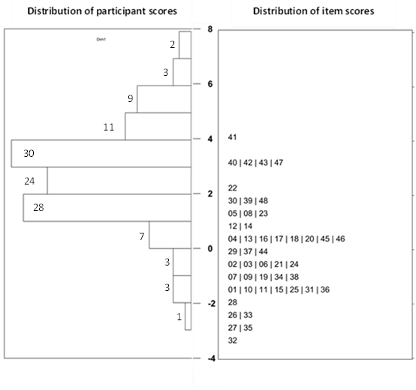

Results: Rasch scores
Mismatch in range of scores for participants vs item scores indicate the PRO is somewhat mistargeted for this population

Slide 12
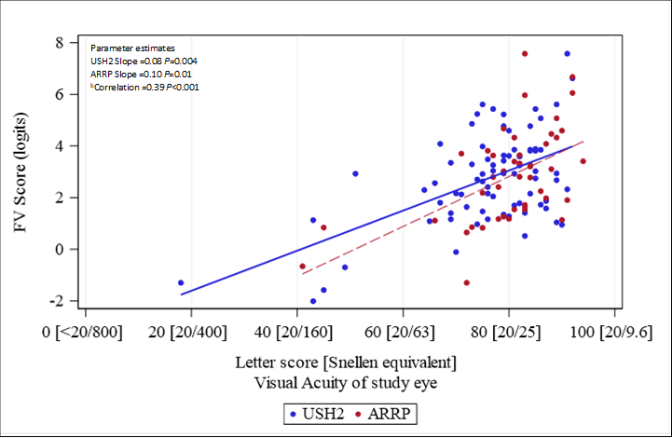
Results: FV association with VA by Clinical Diagnosis

Slide 13
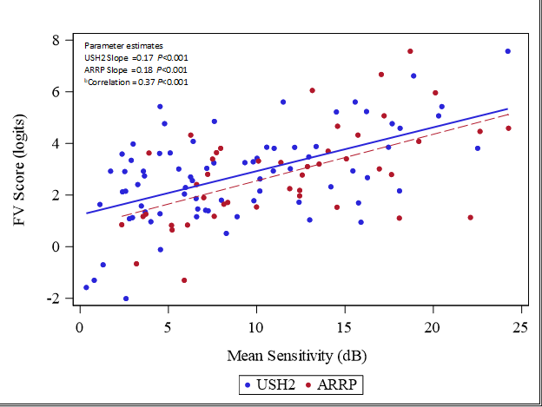
Results: FV association with SP MS by Clinical Diagnosis

Slide 14
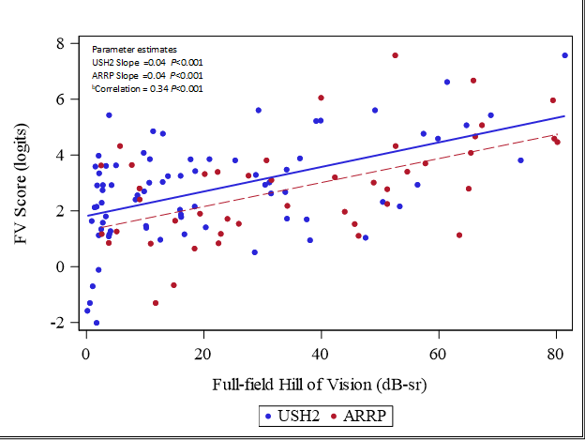
Results: FV association with V_{TOT} by Clinical Diagnosis

Slide 15
Discussion
ARRP participants had similar FV to USH2 despite presence of hearing loss in USH2
Overall FV scores had significant correlations with SP MS, VA, and V_{TOT}
FV was mediated by VA and V_{TOT}
Questionnaire was somewhat mistargeted for the USH2/ARRP population
Most participants had little difficulty with questionnaire items
  FV scores skewed to positive values (range: -2.0 , 7.6)

