Slide 1
The RUSH2A Study: Best-Corrected Visual Acuity, Full-Field Electroretinography Amplitudes and Full-Field Stimulus Thresholds at Baseline

Slide 2
Citation, Funding, Disclaimer
Citation
Birch DG, Cheng P, Duncan JL, Ayala AR, Maguire MG, Audo I, Cheetham JK, Durham TA, Fahim AT, Ferris FL 3rd, Heon E, Huckfeldt RM, Iannaccone A, Khan NW, Lad EM, Michaelides M, Pennesi ME, Stingl K, Vincent A, Weng CY; Foundation Fighting Blindness Consortium Investigator Group. The RUSH2A Study: Best-Corrected Visual Acuity, Full-Field Electroretinography Amplitudes, and Full-Field Stimulus Thresholds at Baseline. Transl Vis Sci Technol. 2020 Oct 8;9(11):9. doi: 10.1167/tvst.9.11.9.
Funding
This study was funded by Foundation Fighting Blindness
Disclaimer
The source of the data is the Foundation Fighting Blindness Clinical Consortium, but the analyses, content and conclusions presented herein are solely the responsibility of the authors/presenters and may not reflect the views of the Foundation Fighting Blindness.

Slide 3
Background
Variants in the USH2A gene are common causes of inherited retinal degenerations (IRDs)
Biallelic variants can result in:
  Usher syndrome type 1 (USH2)
  Non-syndromic autosomal recessive RP (ARRP)
The Rate of Progression of USH2A-related Retinal Degeneration (RUSH2A) study is a multicenter, international, longitudinal natural history study to collect data from both USH2 and ARRP patients

Slide 4
Background (cont)
Existing clinical data from patients with USH2A variants comes primarily from cross-sectional and retrospective analyses
Visual Acuity
  ↓ one to two lines at age 30 years; median age to legal blindness = 65 years (Sandberg et al., 2008)
  Acuity better than 20/50 into the 50’s (Calzetti et al., 2018)
  Acuity better in non-syndromic patients than syndromic patients at the same age (Hendriks et al., 2017)

Slide 5
Background (cont)
Full-field Electroretinography (ERG)
  ERG non-detectable by age 26 years (Schwartz et al., 2005)
  One (age 17 years) of 18 patients had detectable rod ERG (Calzetti et al., 2018)
Full-field Stimulus Threshold (FST)
  Not reported previously
Notes:
These are all Usher patients. Nobody show whether Usher differ to non-syndromic RP.

Slide 6
Background (cont)
Objectives
  To describe best corrected visual acuity (BCVA), ERG, and FST measures at baseline in the RUSH2A study
  To evaluate correlations between these visual functional measures
  To evaluate their associations with baseline participant characteristics

Slide 7
Methods – Visual Functional Measures
Best Corrected Visual Acuity (BCVA)
  Conducted at baseline and annual follow-up visits on both eyes
  Used electronic visual acuity tester (EVA) or ETDRS charts
Full-field Electroretinography (ERG)
  Conducted at baseline and 48M on study eye
  Three ERG measures included in current analyses
    Amplitude of the b-wave from the dark-adapted dim-flash 0.01 cd.s/m2 ERG response (DA 0.01 ERG)
    Amplitude of the b-wave of the dark-adapted standard flash 3.0 cd.s/m2 ERG (DA 3.0 ERG)
    Trough-to-peak amplitude of the light-adapted 30 Hz flicker (LA 3.0 flicker ERG)

Slide 8
Methods – Visual Functional Measures (cont)
Full-field Stimulus Threshold (FST)
  Conducted at baseline and annual follow-up visits on study eye
  Performed on Diagnosys Espion where available
  White, blue and red stimuli were used
  Measured in triplicates for each color at each visit

Slide 9
Methods - Statistical
Main Bullet
  BCVA outcome: study eye only
  FST outcomes: averaged over 3 measurements for each color
  Spearman correlation coefficients calculated between BCVA, ERG and FST measures
  Linear regression models were used to assess participant characteristics associated with BCVA and FST measures
  Generalized linear regression models for the Tweedie distribution and a log link function were used to assess participant characteristics associated with ERG measures
  Stepwise selection method used to determine candidates in the final model for each outcome

Slide 10
Study Population (N=127)
 | USH2 (N=80) | ARRP (N=47)
Age at Enrollment (years) Median (IQR) | 37 (27, 44) | 44 (36, 50)
Age at Onset of Vision Loss (years) Median (IQR) | 16 (13,22) | 32 (20, 41)
 | N=75 | N=47
Moderate or Worse Hearing Loss (%) | 73 (97%) | 4 (9%)

Slide 11
Study Population (cont)

Slide 12
BCVA at Baseline
 | Overall (N=127) | USH2 (N=80) | ARRP (N=47) | P-value
Visual Acuity Letter Score (Study Eye)
<69 (<20/40) | 14 (11%) | 11 (14%) | 3 (6%)
69-73 (20/40) | 14 (11%) | 9 (11%) | 5 (11%)
74-78 (20/32) | 24 (19%) | 17 (21%) | 7 (15%)
79-83 (20/25) | 33 (26%) | 18 (23%) | 15 (32%)
≥84 (≥20/20) | 42 (33%) | 25 (31%) | 17 (36%)
median (IQR) | 80 (75, 85) | 79 (74, 85) | 82 (77, 87) | <0.001*
*p value calculated using linear regression model, adjusting for age.

Slide 13
Participant Characteristics Associated with BCVA
 | N | BCVA Letter Score Median (Q1, Q3) | Univariable Analysis p value | Multivariable Analysis p value
All | 127 | 80 (75, 85)
Clinical Diagnosis |  |  | 0.03 | 0.09
USH2 | 80 | 79 (74, 85)
ARRP | 47 | 82 (77, 87)
Age at Enrollment (years) |  |  | <0.001 | 0.04
<30 years | 30 | 82 (77, 89)
30-<40 years | 34 | 80 (76, 84)
40-<50 years | 37 | 82 (77, 85)
≥50 years | 26 | 72 (64, 79)
Gender |  |  | 0.09 | 0.01
Female | 68 | 80 (73, 84)
Male | 59 | 80 (75, 86)
Duration of Disease (years) |  |  | <0.001 | 0.004
<10 | 37 | 83 (77, 87)
10-<20 | 46 | 81 (76, 86)
≥20 | 43 | 75 (66, 82)
Factors with p values >0.05 in the stepwise selection process were not included in the final multivariable model, including race/ethnicity, smoking status and dietary supplement use.

Slide 14
ERG at Baseline
 | Overall (N=126) | USH2 (N=79) | ARRP (N=47) | P-value
DA 0.01 ERG amplitude (µV)
Zero response, n (%) | 59 (47%) | 40 (51%) | 19 (40%)
median (IQR) | 0.7 (0.0, 7.4) | 0.0 (0.0, 5.0) | 6.6 (0.0, 19.0) | <0.001*
DA 3.0 ERG amplitude (µV)
Zero response | 44 (35%) | 30 (38%) | 14 (30%)
median (IQR) | 6.2 (0.0, 15.5) | 5.0 (0.0, 11.8) | 11.6 (0.0, 64.0) | <0.001*
LA 3.0 flicker ERG Amplitude (µV)
Zero response | 37 (29%) | 25 (32%) | 12 (26%)
median (IQR) | 2.0 (0.0, 7.7) | 1.5 (0.0, 5.5) | 3.1 (0.0, 20.0) | 0.001*
Column Heading | Column Heading
Content | Content
Content | Content
Content | Content
Content | Content
*p value calculated using generalized linear regression model with Tweedie distribution, adjusting for age.

Slide 15
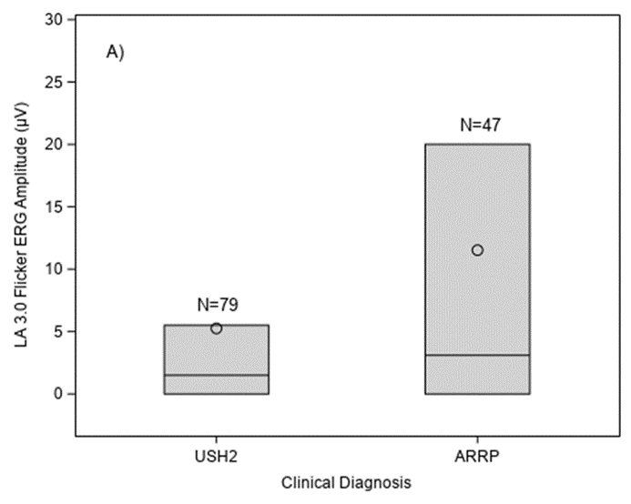
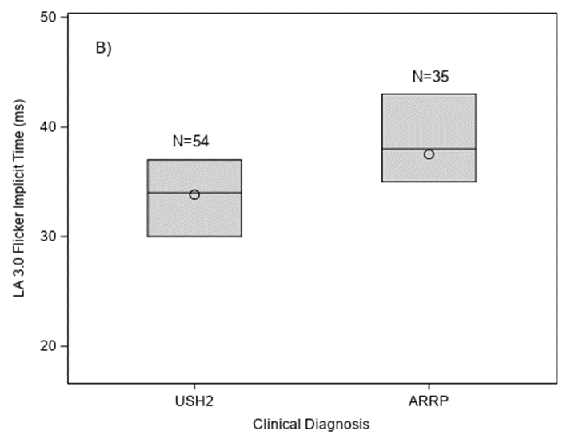
Light-adapted 3.0 Flicker ERG Response by Clinical Diagnosis
A) Amplitude (p=0.004)
B) Implicit time (p=0.005)
Notes:
None of other participant characteristics was significantly associated with LA 3.0 flicker ERG amplitude.

Slide 16
FST at Baseline
 | Overall (N=93) | USH2 (N=56) | ARRP (N=37) | P-value
FST (dB), mean ± SD
White Stimulus | -32 ± 13 | -26 ± 10 | -39 ± 13 | <0.001*
Blue Stimulus | -36 ± 14 | -31 ± 11 | -45 ± 14 | <0.001*
Red Stimulus | -25 ± 7 | -23 ± 6 | -28 ± 8 | <0.001*
*p value calculated using linear regression model, adjusting for age.

Slide 17
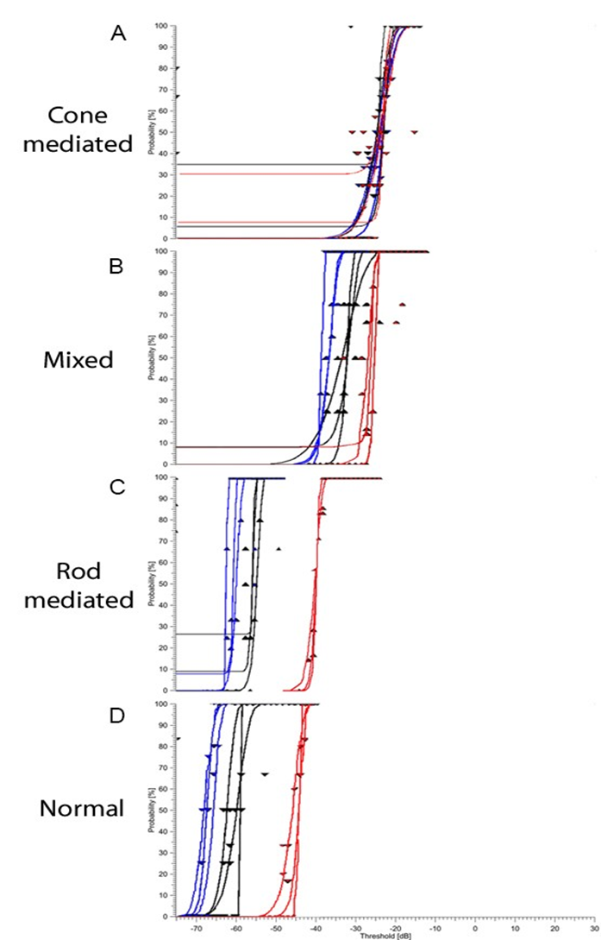
FST Results from Three RUSH2A Participants and One Normal Subject
  Black, blue and red colors represent responses from white, blue and red stimuli respectively. A) Cone-mediated (USH2, age 55 years); B) Mixed (USH2, age 19 years); C) Rod-mediated (USH2, age 61); D) Normal (age 25).
Notes:
Each graph shows the probability of a positive response against the stimulus intensity.

Slide 18
Participant Characteristics Associated with FST White Stimulus
 | N | FST White Stimulus (dB) Mean ± SD | Univariable Analysis p value | Multivariable Analysis p value
All | 93 | -32 ± 13
Clinical Diagnosis |  |  | <0.001 | <0.001
USH2 | 56 | -26 ± 10
ARRP | 37 | -39 ± 13
Gender |  |  | 0.53 | 0.04
Female | 51 | -31 ± 12
Male | 42 | -32 ± 14
Duration of Disease (years) |  |  | <0.001 | <0.001
<10 | 27 | -40 ± 11
10-<20 | 33 | -33 ± 11
≥20 | 33 | -22 ± 9
Factors with p values >0.05 in the stepwise selection process were not included in the final multivariable model, including age at enrollment, race/ethnicity, smoking status and dietary supplement use.
Notes:
In the final multivariable regression model, mean adjusted gender difference (Female – Male) was 4.3 dB (95% C.I.: 0.2 ─ 8.5).

Slide 19
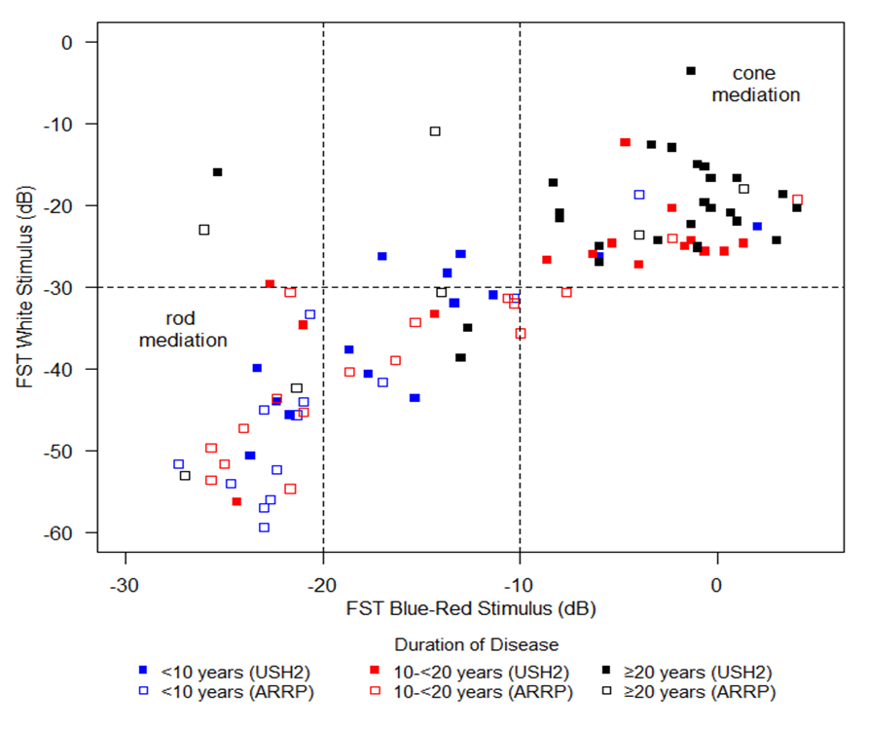
FST White vs Blue-Red by Duration of Disease and Clinical Diagnosis

Slide 20
Correlation among BCVA, ERG and FST Measures
 | Best Corrected Visual Acuity | Electroretinogram (ERG) |  |  | Full-field stimulus threshold (FST)
 | (BCVA) | DA 0.01 ERG | LA 3.0 flicker | DA 3.0 ERG | White | Blue | Red
 | (N=127)* | (N=126) | (N=126) | (N=126) | (N=93) | (N=93) | (N=93)
BCVA
Correlation | 1.0 | +0.17 | +0.30 | +0.30 | -0.60 | -0.56 | -0.58
p value |  | 0.06 | <0.001 | <0.001 | <0.001 | <0.001 | <0.001
DA 0.01 ERG
Correlation |  | 1.0 | +0.61 | +0.69 | -0.40 | -0.40 | -0.45
p value |  |  | <0.001 | <0.001 | <0.001 | <0.001 | <0.001
LA 3.0 flicker ERG
Correlation |  |  | 1.0 | +0.82 | -0.55 | -0.52 | -0.42
p value |  |  |  | <0.001 | <0.001 | <0.001 | <0.001
DA 3.0 ERG
Correlation |  |  |  | 1.0 | -0.64 | -0.62 | -0.59
p value |  |  |  |  | <0.001 | <0.001 | <0.001
FST White
Correlation |  |  |  |  | 1.0 | +0.96 | +0.83
p value |  |  |  |  |  | <0.001 | <0.001
FST Blue
Correlation |  |  |  |  |  | 1.0 | +0.76
p value |  |  |  |  |  |  | <0.001
FST Red
Correlation |  |  |  |  |  |  | 1.0
p value

Slide 21
Disease Asymmetry
BCVA letter scores between right eye and left eye were similar
Mean difference (OD – OS): -1.0 letters (95% C.I.: -2.3 – 0.3)
Intraclass correlation coefficient: 0.85
Disease asymmetry not influenced by gender, duration of disease and clinical diagnosis

Slide 22
Discussion
Baseline data consistent with previous cross-sectional studies
  Median age = 40 years
  Median acuity 82 letters (20/25) in ARRP; 79 (20/25) in USH2
  Rod ERG unmeasurable in approximately 50% of patients
  Cone ERG unmeasurable in approximately 30% of patients
Notes:
ERG not being the best outcome measures.

Slide 23
Discussion (cont)
ERG and FST measures were worse in USH2 than ARRP
Majority of participants have rod function by FST
FST shows strong relationship to duration of disease
Notes:
FST more sensitive and non-invasive.

