Slide 1
Baseline Microperimetry and OCT in the RUSH2A Study: Structure-Function Association and Correlation with Disease Severity

Slide 2
Citation, Funding, Disclaimer
Citation
Lad EM, Duncan JL, Liang W, Maguire MG, Ayala AR, Audo I, Birch DG, Carroll J, Cheetham JK, Durham TA, Fahim AT, Loo J, Deng Z, Mukherjee D, Heon E, Hufnagel RB, Guan B, Iannaccone A, Jaffe GJ, Kay CN, Michaelides M, Pennesi ME, Vincent A, Weng CY, Farsiu S; Foundation Fighting Blindness Consortium Investigator Group. Baseline Microperimetry and OCT in the RUSH2A Study: Structure-Function Association and Correlation With Disease Severity. Am J Ophthalmol. 2022 Dec;244:98-116. doi: 10.1016/j.ajo.2022.08.013.
Funding
This study was funded by Foundation Fighting Blindness
Disclaimer
The source of the data is the Foundation Fighting Blindness Clinical Consortium, but the analyses, content and conclusions presented herein are solely the responsibility of the authors/presenters and may not reflect the views of the Foundation Fighting Blindness.

Slide 3
Background
USH2A
Biallelic disease-causing variants in USH2A are the most common cause of Usher Syndrome Type II and ARRP.
Retinal degeneration in USH2A disorders is a slowly progressive rod, then cone, photoreceptor dysfunction and eventual photoreceptor death, resulting in vision loss.
Retinal degeneration is more severe in patients with USH2 than USH2A-related ARRP.

Slide 4
Objectives
To describe RUSH2A baseline data on OCT and mesopic MP in participants with USH2A-related USH2 compared to ARRP
Explore macular structure-function associations and relationships with baseline participant characteristics
To evaluate correlations among different visual functional and structural measures

Slide 5
Study Design
Multicenter, longitudinal, international natural history study
16 clinical sites
Canada, France, Germany, UK, and US
Usher syndrome type 2 (congenital mild-moderate hearing loss with progressive rod-cone degeneration, USH2)
Autosomal Recessive Retinitis Pigmentosa (ARRP)

Slide 6
Methods
MP
  Optional for sites with MAIA
  Primary cohort only
  Study eye only
OCT
  All RUSH2A subjects
  Performed on both eyes

Slide 7
Methods
MP-OCT overlay
  A semi-automated software program was developed to register the infrared (IR) fundus image acquired during OCT imaging to the microperimetry fundus image
  A reader identified and selected pairs of corresponding points at various locations on the IR image and MP image (usually at prominent vessel bifurcations or crossings and over as wide an area as possible).
  A second reader reviewed the registered images and identified and selected additional pairs of corresponding points to improve the registration where necessary and possible.

Slide 8
Statistical Methods
Repeatability in the 3 MP tests was evaluated using intra-class correlation coefficients (ICC) and Bland-Altman plot
General linear models were used to assess the association of baseline characteristics with MP mean sensitivity and OCT EZ area.
The associations between MP mean sensitivity and OCT EZ area with other functional and structural measures were evaluated using Spearman correlation coefficients.

Slide 9
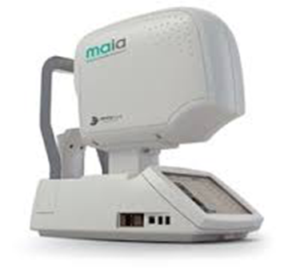
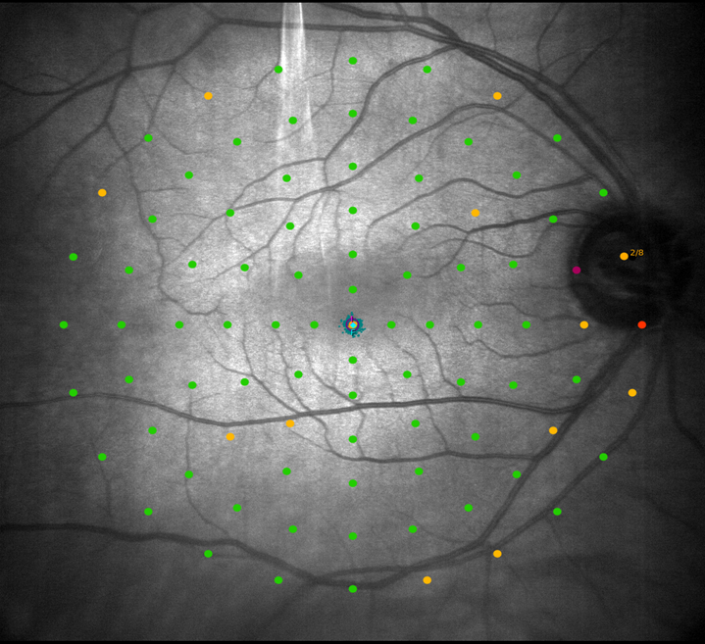
Microperimetry (MP) in RUSH2A
MAIA (CenterVue)
Mesopic/standard MAIA, 4-2 projection strategy
Size-III Stimulus
Custom 30 deg wide grid

Slide 10
MP Data
 | All | Clinical Diagnosis |  | P-value
 | N = 87 | USH2 N= 52 | ARRP N= 35
MP Sensitivity (dB) |  |  |  | 0.12
Median (IQR) | 4.2 (2.3, 8.5) | 3.5 (2.1, 8.4) | 5.1 (2.9, 9.0)
[Min, Max] | [0.0, 22.2] | [0.0, 22.2] | [0.6, 19.5]
95% BCEA area (deg²) |  |  |  | 0.28
Median (IQR) | 1.5 (0.8, 2.8) | 1.3 (0.8, 2.8) | 1.7 (0.8, 2.8)
[Min, Max] | [0.2, 57.2] | [0.2, 57.2] | [0.2, 15.5]

Slide 11
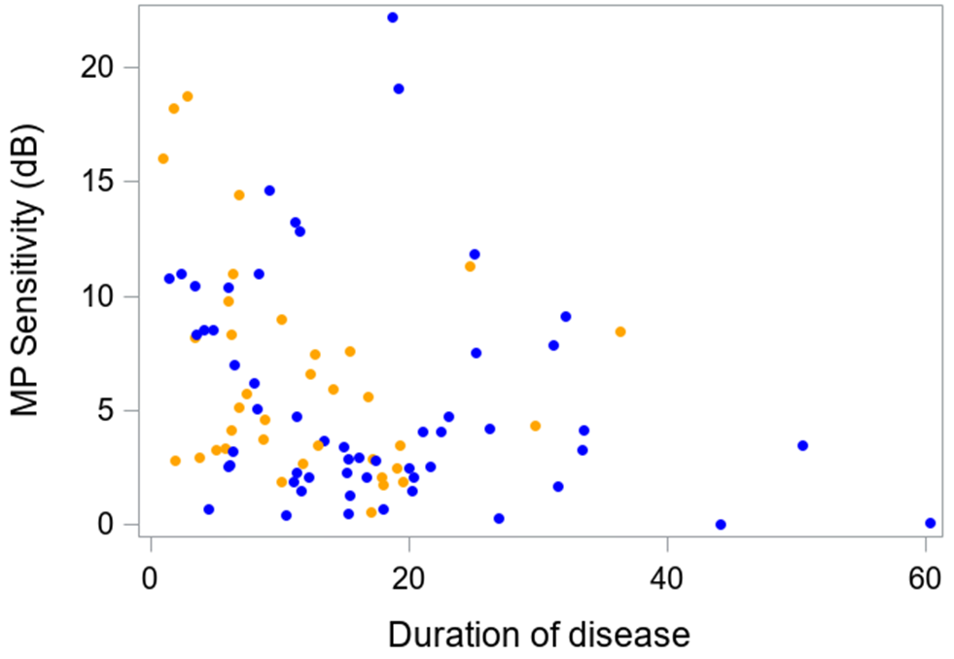
MP Sensitivity
USH2: blue
ARRP: orange
Duration of disease: P = 0.01

Slide 12
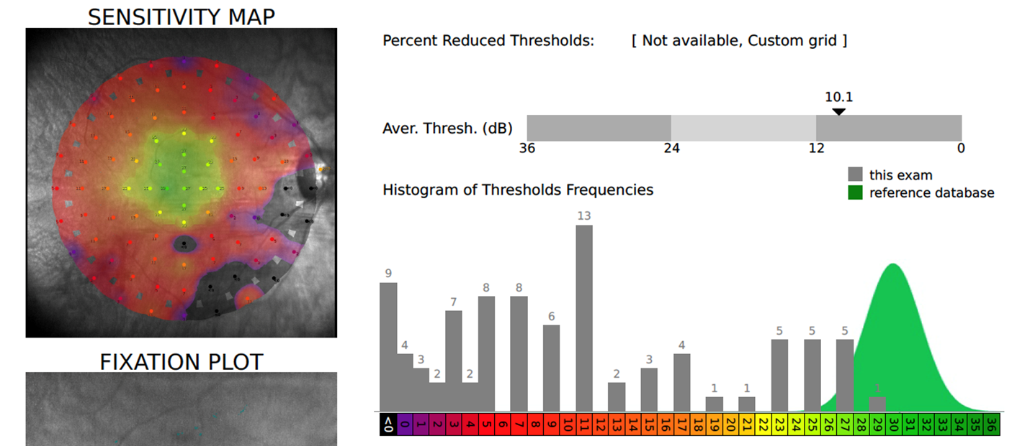
MP Data (Cont.)
 | All | Clinical Diagnosis |  | P-value
Number of loci with absolute scotoma <0 dB black (not seen) | N = 87 | USH2 N= 52 | ARRP N= 35
Median (IQR) | 44 (22, 59) | 46 (23, 63) | 43 (22, 56) | 0.33
[Min, Max] | [1, 83] | [1, 83] | [1, 80]

Slide 13
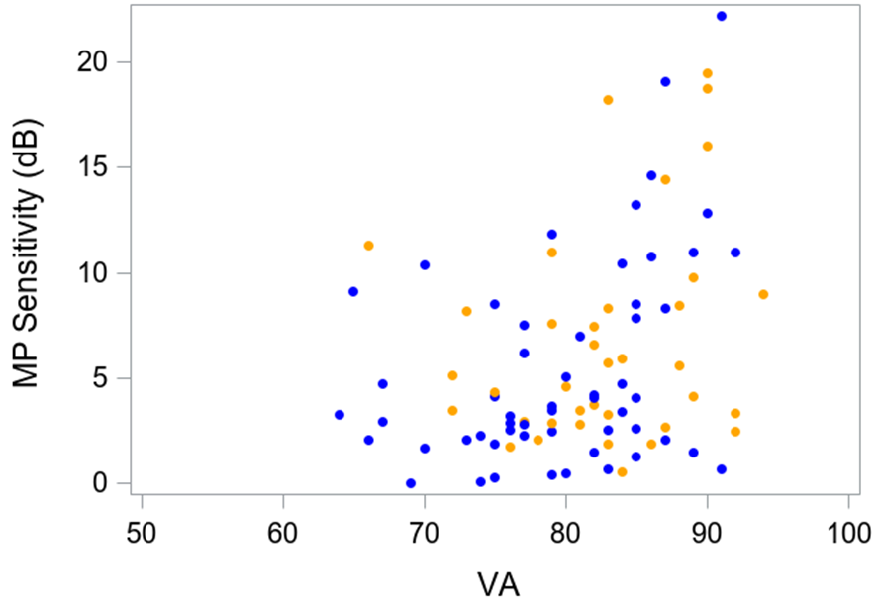
VA correlated with MP sensitivity
Better VA -> Higher MP sensitivity
USH2: blue
ARRP: orange
Spearman correlation
r= 0.34 (95% CI: 0.13, 0.51)
P = 0.001

Slide 14
OCT VARIABLES

Slide 15
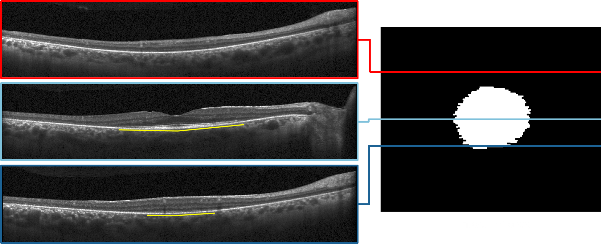
Segmentation of EZ on OCT
Intact EZ area

Slide 16
OCT Data
 | All | Clinical Diagnosis
 | N = 127 | USH2 N= 80 | ARRP N= 47
Central Subfield Thickness (μm)
Median (IQR) | 253 (228, 285) | 247 (223, 280) | 261 (246, 288)
[Min, Max] | [137, 519] | [137, 519] | [175, 323]
EZ Area (mm²)
Median (IQR) | 1.5 (0.5, 3.5) | 1.4 (0.4, 3.1) | 2.3 (0.7, 5.7)
[Min, Max] | [0.0, 33.4] | [0.0, 33.4] | [0.0, 21.3]

Slide 17
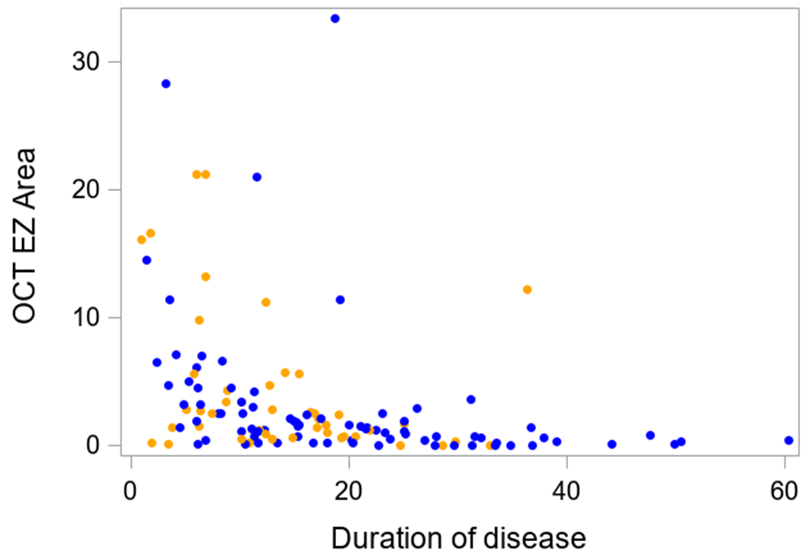
Disease duration with OCT EZ area
USH2: blue
ARRP: orange
Duration of disease: P <0.001

Slide 18
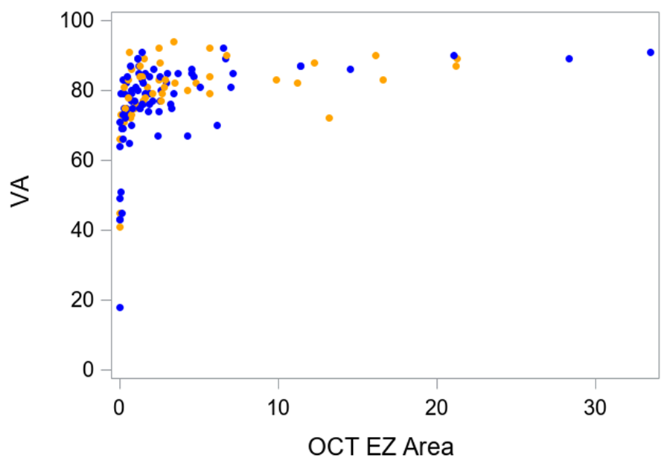
VA correlated with OCT EZ area
Better VA -> Greater OCT EZ area
USH2: blue
ARRP: orange
Spearman correlation
r= 0.61 (95% CI: 0.48, 0.71)
P < 0.001

Slide 19
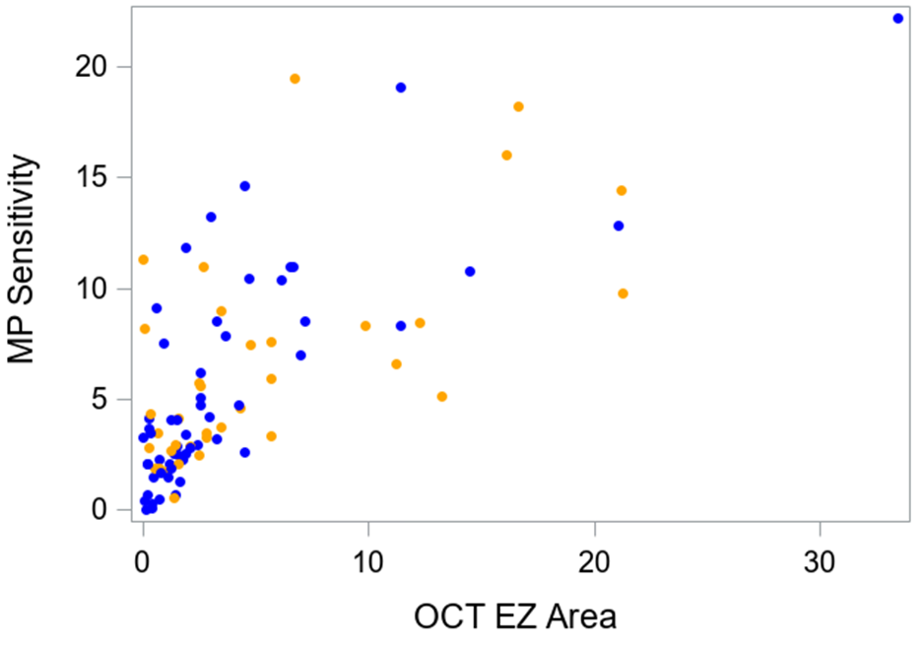
Structure-function correlation:
OCT EZ with MP sensitivity
Greater OCT EZ area -> Higher average threshold
USH2: blue
ARRP: orange
Spearman correlation
r= 0.68 (95%: 0.55, 0.78)
P < 0.001

Slide 20
MP-OCT Correlation
 | All | Clinical diagnosis
 | N = 83 | USH2 N= 51 | ARRP N= 32
Average sensitivity (interpolated) within intact EZ area
Median (IQR) | 21 (19, 24) | 21 (18, 23) | 22 (20, 24)
Average sensitivity (interpolated) outside intact EZ Area
Median (IQR) | 2 (1, 5) | 2 (1, 5) | 2 (1, 4)

Slide 21
Conclusions
Longer disease duration correlated with more severe retinal structure and function abnormalities
There were associations between MP and OCT metrics
Monitoring changes in retinal structure-function relationships during disease progression will provide important insights into disease mechanism in USH2A-related retinal degeneration

