Slide 1
Tissue‐Specific Genotype–Phenotype Correlations Among USH2A‐Related Disorders in the RUSH2A Study

Slide 2
Citation, Funding, Disclaimer
Citation
Hufnagel RB, Liang W, Duncan JL, Brewer CC, Audo I, Ayala AR, Branham K, Cheetham JK, Daiger SP, Durham TA, Guan B, Heon E, Hoyng CB, Iannaccone A, Kay CN, Michaelides M, Pennesi ME, Singh MS, Ullah E; Foundation Fighting Blindness Consortium Investigator Group. Tissue-specific genotype-phenotype correlations among USH2A-related disorders in the RUSH2A study. Hum Mutat. 2022 May;43(5):613-624. doi: 10.1002/humu.24365.
Funding
This study was funded by Foundation Fighting Blindness
Disclaimer
The source of the data is the Foundation Fighting Blindness Clinical Consortium, but the analyses, content and conclusions presented herein are solely the responsibility of the authors/presenters and may not reflect the views of the Foundation Fighting Blindness.

Slide 3
Outline
Background
Study Design
Participants and Methods
Results
Discussion

Slide 4
Background
USH2A
Biallelic disease-causing variants in USH2A are the most common cause of Usher Syndrome Type II and ARRP.
Retinal degeneration in USH2A disorders is a slowly progressive rod, then cone, photoreceptor dysfunction and eventual photoreceptor death, resulting in vision loss.
Retinal degeneration is more severe in patients with USH2 than USH2A-related ARRP.

Slide 5
Study Design
Multicenter, longitudinal, international natural history study
  16 clinical sites
  Canada, France, Germany, UK, and US
Usher syndrome type 2 (congenital mild-moderate hearing loss with progressive rod-cone degeneration) (USH2)
Autosomal Recessive Retinitis Pigmentosa (ARRP)
2 pathogenic or likely pathogenic variants in USH2A

Slide 6
Participants and Methods
127 study participants with retinal degeneration associated with USH2A sequence variants
  47 ARRP
  80 USH2
USH2A variant analysis was performed by two reviewers independently with standardized classification to ACMG/AMP 2015 criteria. Discordant results were resolved by an independent adjudicator.

Slide 7
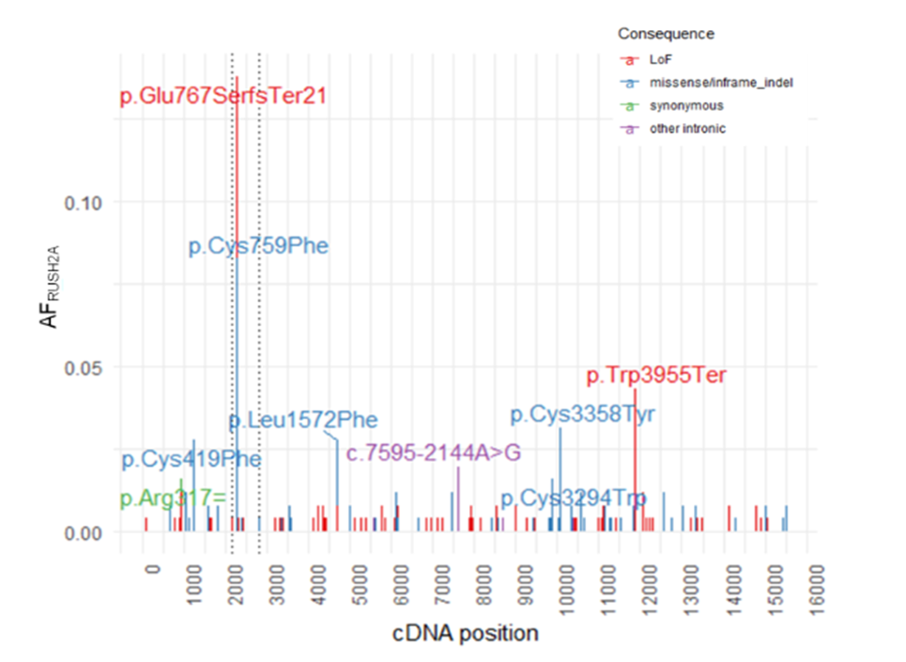
Results
RUSH2A USH2A variants
RUSH2A cohort allele frequencies (AF)
140 unique variants, 128 SNV/indel
Truncating variants most common (44%)
Highest AF – c.2299delG frameshift
Most frequent missense – p.Cys759Phe
41 of 128 variants are recurrent in RUSH2A
30 statistically enriched vs gnomAD

Slide 8
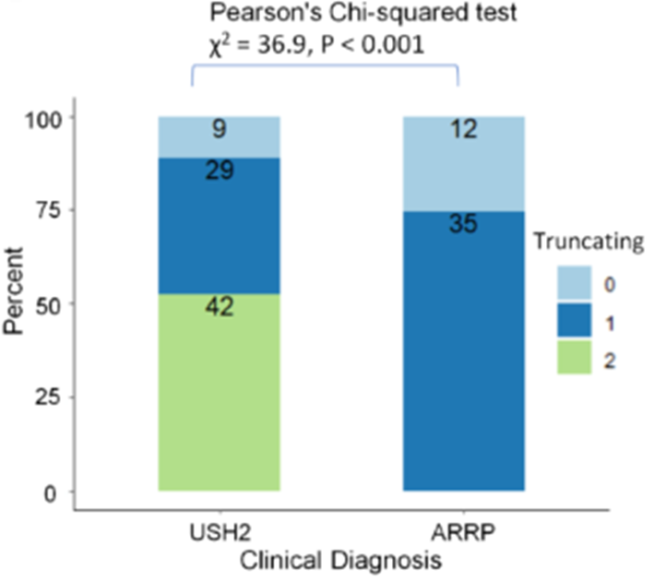
Results
RUSH2A USH2A variants
Truncating:
Nonsense
Frameshift
Canonical splicing site (+/-2)
RNA/minigene-confirmed intronic

Slide 9
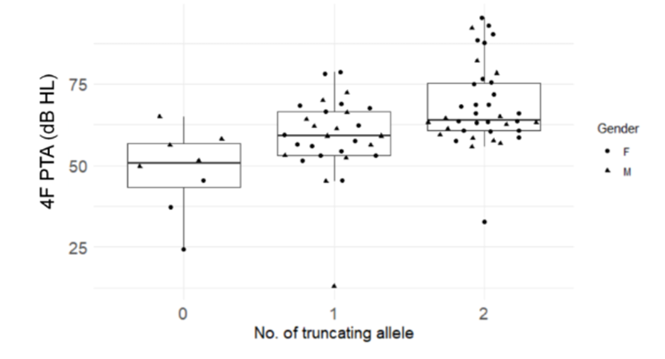
Truncating Alleles: Hearing Loss
The number of truncating alleles is associated with both diagnosis and degree of hearing loss.
  Hartel et al, Hearing Research (2016) 339:60-68: more severe hearing loss in patients with two truncating alleles

Slide 10
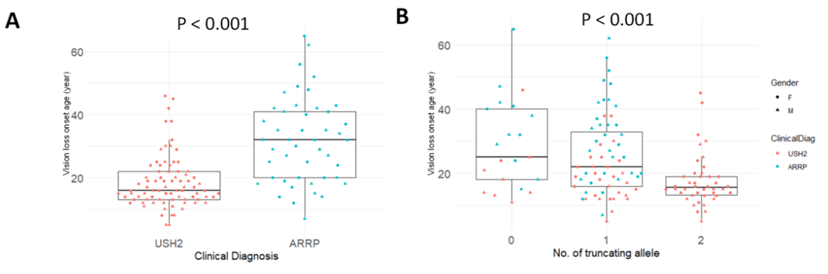
Truncating Alleles:
Vision Loss Age of Onset
Vision loss onset is earlier in patients with Usher syndrome and truncating allele number.
Onset x truncating effect was not noted in the Usher subgroup (not shown).
Pierrache et al, Ophthalmology (2016) 123(5):1151-1160: earlier visual acuity impairment in syndromic USH2A disease

Slide 11
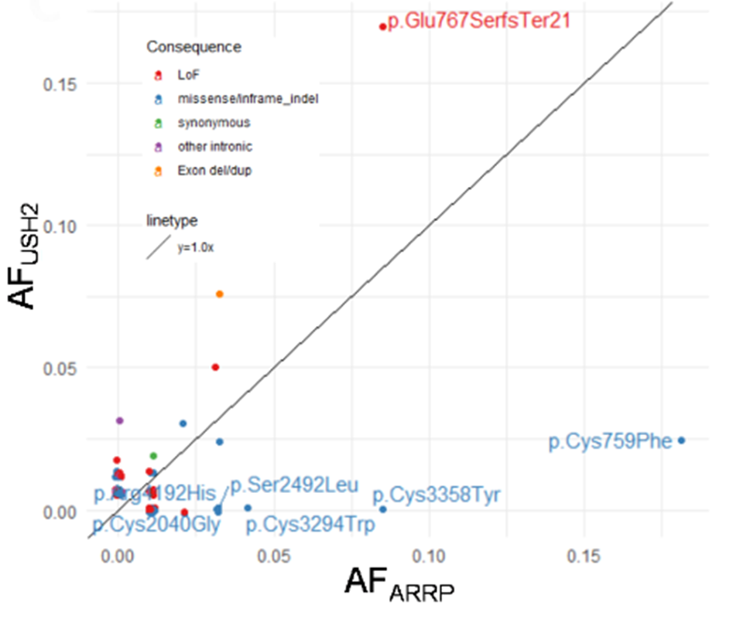

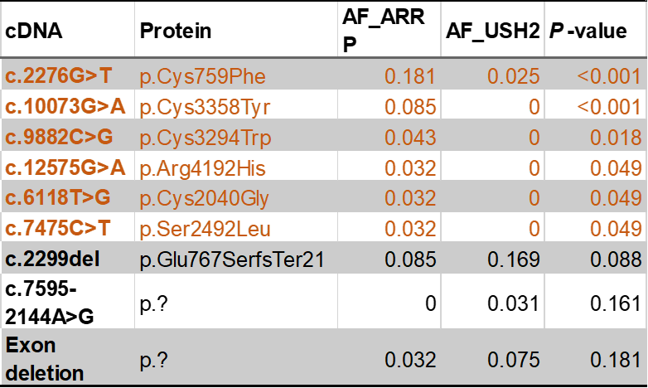
Missense alleles are enriched in RP
Nonsyndromic RP-enriched missense alleles
Reported as nonsyndromic-associated:
Lenassi et al, EJHG (2015) 23:1318-1327

Slide 12
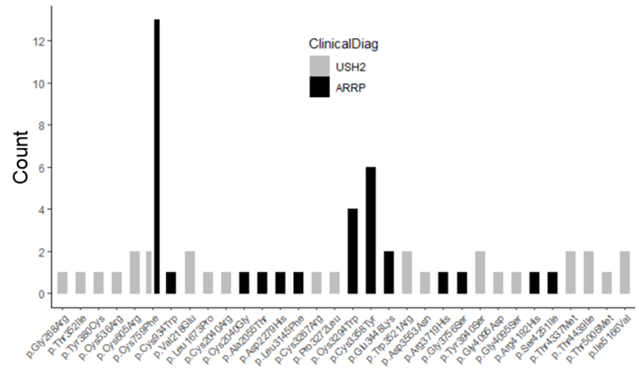
Missense hotspots for USH2 and ARRP
Inter-fibronectin domain
ARRP cluster
N-terminus
USH2 cluster

Slide 13
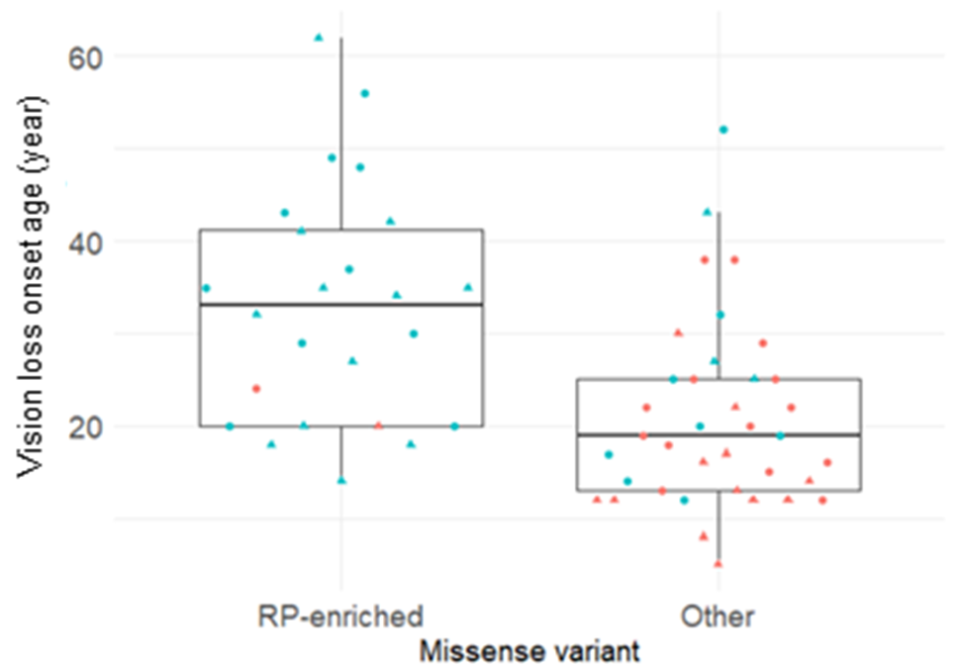
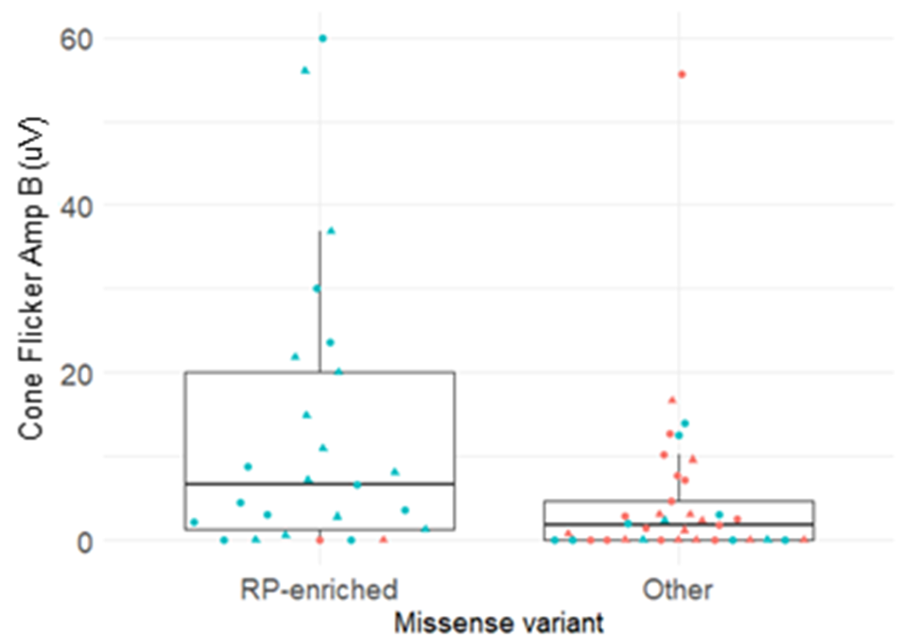
Missense Alleles: Visual Function
P < 0.001
P < 0.05
Age-of-vision loss and cone flicker amplitudes are increased in the RP-associated missense subgroup.

Slide 14
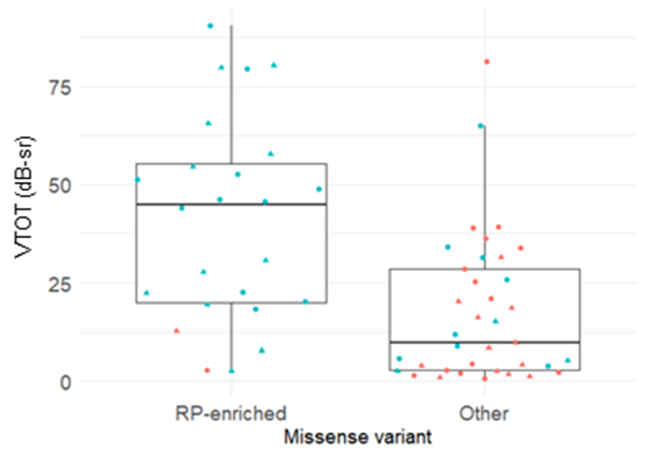
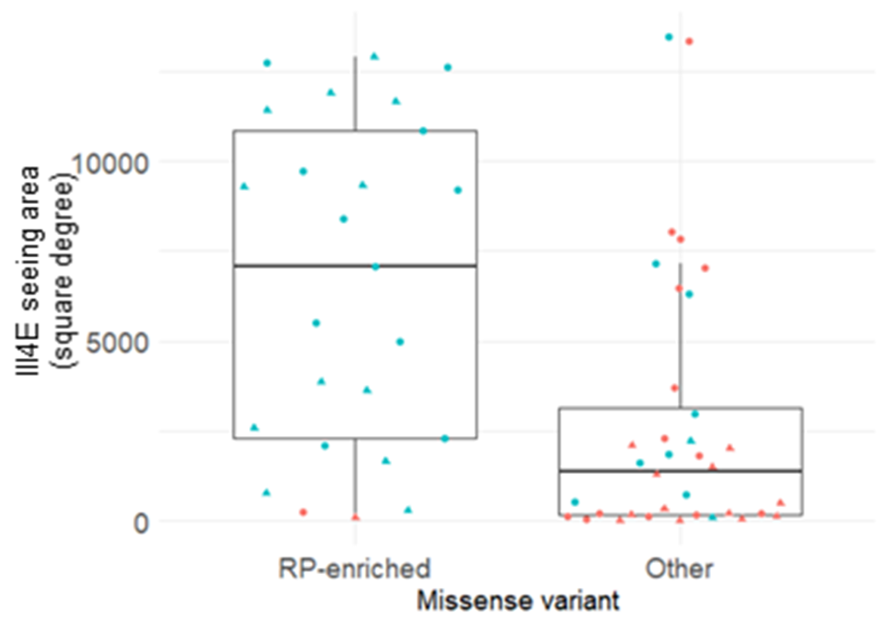
Missense Alleles: Visual Fields
P < 0.001
P < 0.001
Full-field hill of vision and III4e visual field are larger in the RP-associated missense variant subgroup

Slide 15
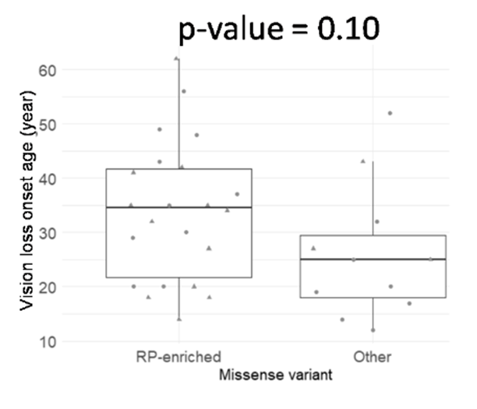
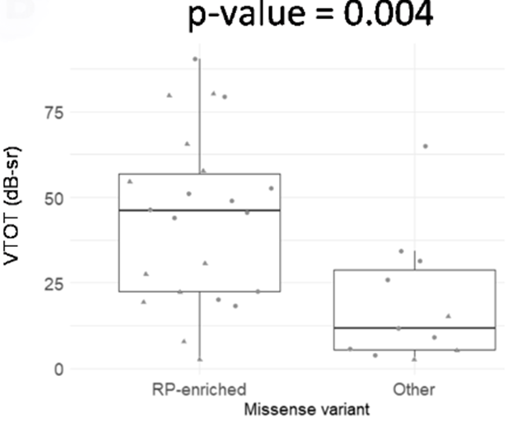
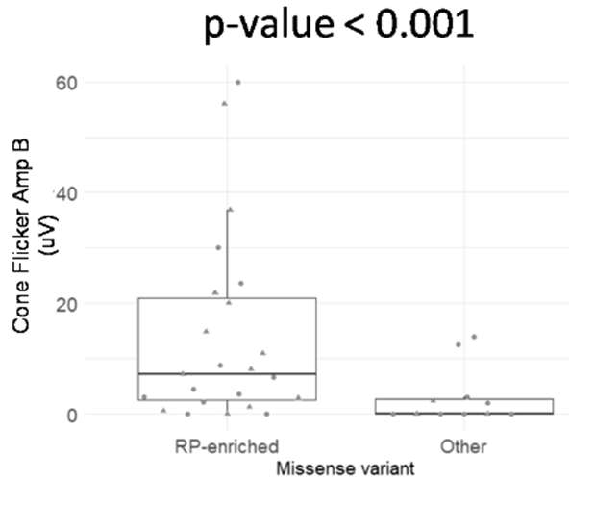
Missense Alleles: ARRP Subgroup
Full-field hill of vision is larger and cone flicker amplitudes are higher in the ARRP RP-associated missense variant subgroup (III4E area not shown).

Slide 16
Discussion
USH2A truncating alleles were associated with USH2 and had a dose-dependent effect on hearing loss severity with no effect on visual loss severity within the USH2 subgroup.
A group of missense alleles in an inter-fibronectin domain appeared to be hypomorphic in ARRP. These alleles were associated with later age of onset, larger visual field area, better sensitivity thresholds, and better electroretinographic responses.
No effect of genotype on the severity of olfactory deficits was observed.
This study unveils a unique, tissue-specific USH2A allelic hierarchy with important prognostic implications for patient counseling and treatment trial endpoints.
These findings may inform clinical care or research approaches in others with allelic disorders or pleiotropic phenotypes.

