Slide 1
Baseline Visual Field Findings in the RUSH2A Study: Associated Factors and Correlation with Other Measures of Disease Severity

Slide 2
Citation, Funding, Disclaimer
Citation
Duncan JL, Liang W, Maguire MG, Audo I, Ayala AR, Birch DG, Carroll J, Cheetham JK, Esposti SD, Durham TA, Erker L, Farsiu S, Ferris FL 3rd, Heon E, Hufnagel RB, Iannaccone A, Jaffe GJ, Kay CN, Michaelides M, Pennesi ME, Sahel JA; Foundation Fighting Blindness Consortium Investigator Group. Baseline Visual Field Findings in the RUSH2A Study: Associated Factors and Correlation With Other Measures of Disease Severity. Am J Ophthalmol. 2020 Nov;219:87-100. doi: 10.1016/j.ajo.2020.05.024.
Funding
This study was funded by Foundation Fighting Blindness
Disclaimer
The source of the data is the Foundation Fighting Blindness Clinical Consortium, but the analyses, content and conclusions presented herein are solely the responsibility of the authors/presenters and may not reflect the views of the Foundation Fighting Blindness.

Slide 3
Outline
Background and Objectives
Study Design and Methods
Results
  Static perimetry (SP) testing results
  SP vs baseline characteristics
  SP vs visual function measures
  Kinetic perimetry (KP) testing results
Discussion
Notes:
Today I will present the background and objectives of the RUSH2A study, study design and methods, results of static perimetry and kinetic perimetry, and discuss the findings.

Slide 4
Natural History of USH2A-related Retinal Degeneration
Limited natural history data about USH2A-related retinal degeneration
Preceding studies did not use current standard methods
  Spectral-domain optical coherence tomography (SD-OCT) ellipsoid zone area
  Quantitative static perimetry – Hill of Vision (HOV)
  Patient-reported outcomes (PROs)
Natural History studies are critical for designing clinical trials
  Identify accurate, precise, meaningful endpoints
  Improved endpoints may reduce clinical trial duration
Notes:
Mutations in the USH2A gene are responsible for the majority of patients with Usher syndrome type 2 and also autosomal recessive retinitis pigmentosa
--However, there are few natural history studies of retinal degeneration due to mutations in the USH2A gene
--and prior studies did not include quantitative standard measures
--such as ellipsoid zone area, the hill of vision or patient reported outcomes
--Natural history studies enable development of clinical treatment trials
--by identifying accurate, precise, meaningful endpoints
--that may reduce the time it takes to show a new treatment is safe and effective in preserving vision.

Slide 5
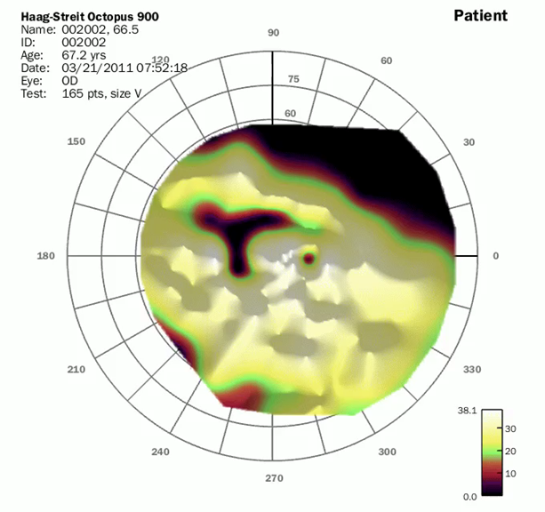
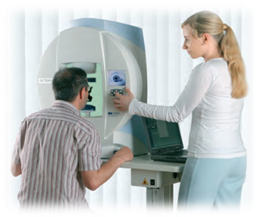
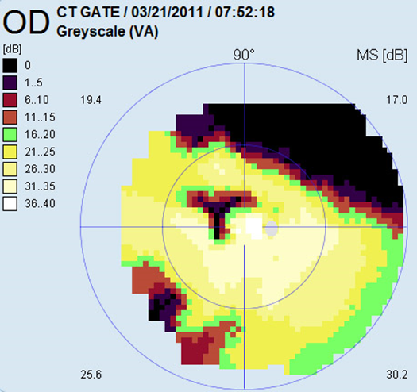
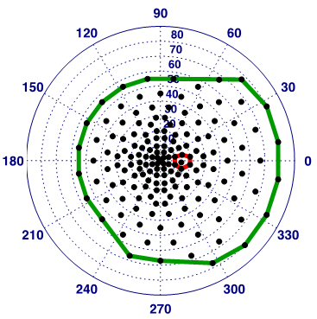
Full-field Static Perimetry
Haag-Streit Octopus 900
Patient Exam
Manufacturer’s printout
VFMA HOV
Exam grid
Notes:
This is a slide Dick Weleber showed at a meeting on clinical trial endpoints at the NEI in 2016.
--it demonstrates the type of visual field measures that the full field Hill of vision (Vtot) provides

Slide 6
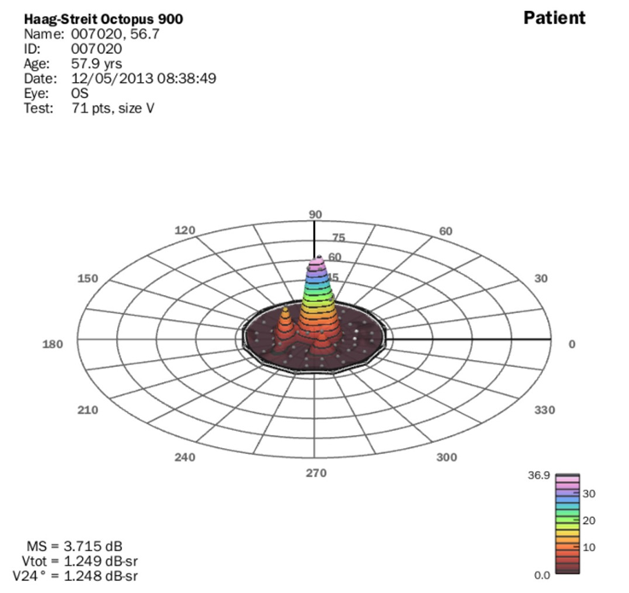
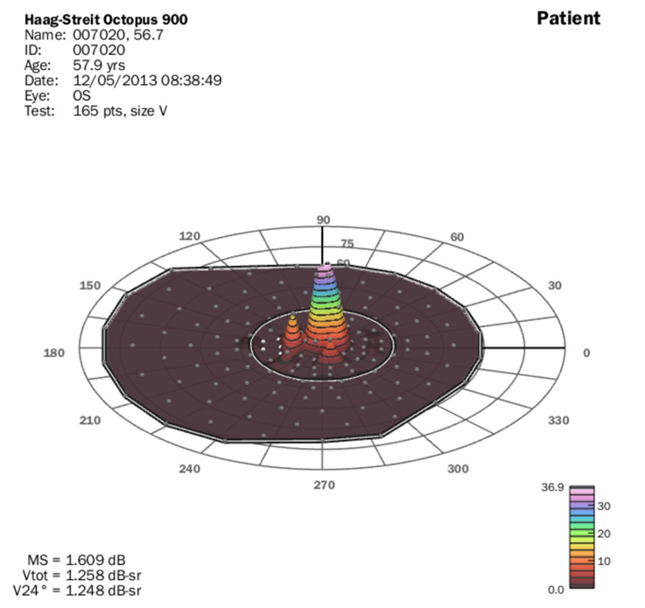
Static Perimetry Full-field Hill of Vision
(HOV) Volume (VTOT)
Exam protocol: Central field
Exam protocol: Full field
Notes:
This is a slide Dick Weleber showed at a meeting on clinical trial endpoints at the NEI in 2016.
--it demonstrates the type of visual field measures that the full field Hill of vision (Vtot) provides
(The mean sensitivity value depends on the protocol: it is much lower when using the full field protocol than V30 when only the central visual field remains.)
The volume depends on the quantity of sensitivity
This patient has the same quantity of sensitivity in both protocols, which can only be seen by the volume

Slide 7
HOV Volume is Consistent Across Protocols
Mean sensitivity (MS) is a summary measure
MS = 3.7 dB
MS = 1.6 dB
V_{TOT} = 1.3 dB-sr
Total HOV volume (V_{TOT}) is a physical quantity
V_{TOT} = 1.3 dB-sr
In both cases, patient has same “quantity” of visual field
Notes:
Same patient, same day, two different exam protocols
The MS value depends on the protocol: the mean sensitivity is much lower when using the full field protocol than V30 when only the central visual field remains.
but the total HOV volume, Vtot, is the same.

Slide 8
Objectives
To describe perimetry data of RUSH2A patients by clinical diagnosis at study baseline
To evaluate baseline patient characteristics associated with full field HOV (VTOT)
To correlate visual functional and structural measures
Notes:
The objectives of this study were
--to describe perimetry data in RUSH2A participants at baseline
--to evaluate baseline characteristics associated with the Hill of Vision
--and to evaluate correlations among different functional and structural measures

Slide 9
Study Design
Multicenter, longitudinal, international natural history study
  16 clinical sites
  Canada, France, Germany, UK, and US
Usher syndrome type 2 (congenital mild-moderate hearing loss with progressive rod-cone degeneration) (USH2)
Autosomal Recessive Retinitis Pigmentosa (arRP)
2 pathogenic or likely pathogenic variants in USH2A
Primary cohort: visual acuity > 20/80, followed annually x 4 y
Secondary cohort: visual acuity < 20/80, studied at baseline
Notes:
RUSH2A is a multicenter, prospective, longitudinal, international natural history study
--comprising 16 clinical sites
--in Canada, France, Germany, the United Kingdom and the United States.
--all participants had Usher syndrome type 2, with mild-moderate congenital hearing loss and progressive retinal degeneration
--or autosomal recessive retinitis pigmentosa
--with at least 2 pathogenic or likely pathogenic variants in the USH2A gene
--The primary cohort included patients with visual acuity better than or equal to 20/80 and at least 10 degrees diameter visual field; these patients will be studied annually for 4 years
--the secondary cohort included patients with visual acuity worse than 20/80 or with less than 10 degrees visual field diameter and were studied only at baseline.

Slide 10
Methods
Static Perimetry (SP)
  Octopus 900 (Haag-Streit, Mason Ohio)
  Perform three times at baseline in primary cohort in the study eye
  One time in secondary cohort
  SP total HOV (VTOT, dB-sr) - graded by Casey Reading Center (CRC)
Kinetic Perimetry (KP)
  Octopus perimetry EyeSuite software calculated areas
  I4e, III4e, and V4e isopter targets - graded by CRC
  Perform once at baseline in both eyes
Notes:
Visual function was characterized by Static and kinetic perimetry
--in the primary cohort, Static perimetry was done 3 times at baseline in the better eye,
--in the secondary cohort this was done only once at baseline
--Kinetic perimetry was completed once at baseline in both eyes of all participants in both cohorts.

Slide 11
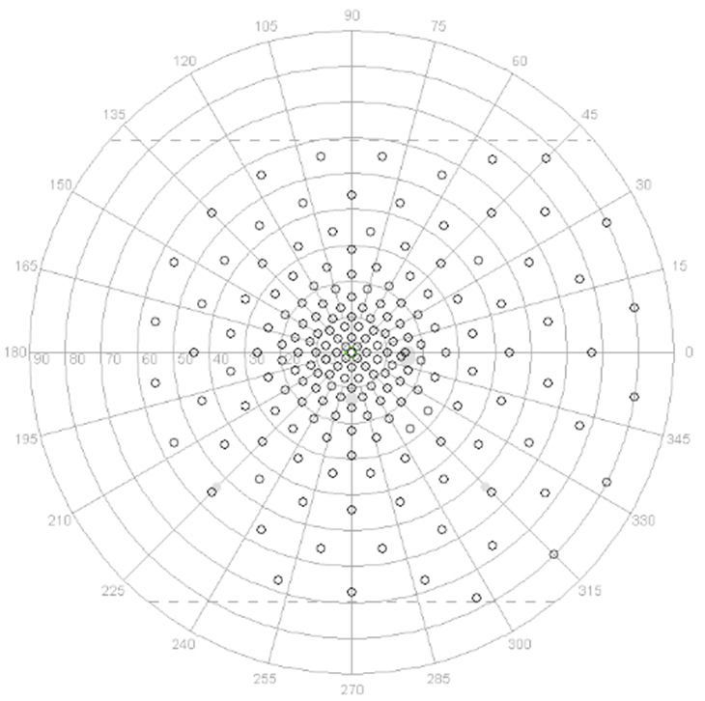
Static Perimetry Grids Used
Full field Octopus 900 “RP 185 point” grid
VTOT, dB-sr
Notes:
This slide shows the Full field Hill of Vision, or Vtot, grid used to measure Static Perimetry in the RUSH2A Study

Slide 12
Statistical Methods
In primary cohort, the average of the three VTOT and three V30 tests was used
KP seeing area = Isopter – Scotoma
General linear models
ICC
Repeatability Coefficient
Bland-Altman plots
Notes:
General linear models were used to assess the association of baseline factors with V_{TOT}
Intra-class coefficients, repeatability Coefficient, and Bland-Altman plots were used to assess test-retest reproducibility, left vs right eye symmetry and correlation with other visual function measurements

Slide 13
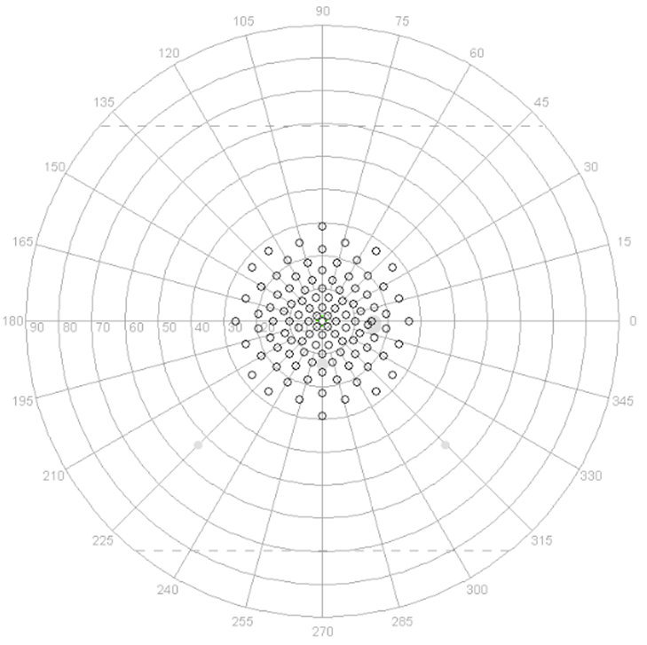
Static Perimetry Grids Used
Central 30-degree grid (V30)
30 degree Octopus 900 grid
Value derived from full 185 point grid at baseline
Notes:
While the central 30 degree is shown here.
--at baseline the V30 result was derived from the central points tested in the 185point Vtot grid
--but patients with no measurable points outside the central 30 degrees at baseline will be tested using the V30 grid shown here for follow up visits.

Slide 14
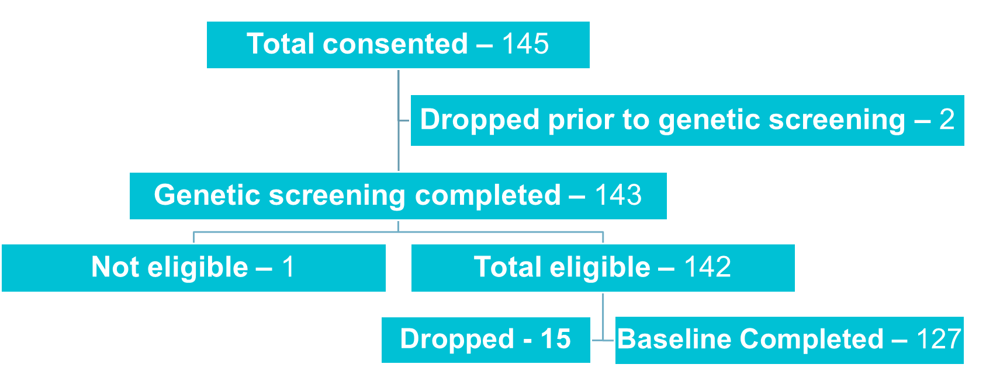
Enrollment Flow
Notes:
What happened to the 141-127 = 14 patients that were eligible but did not complete baseline? There were 15 eligible after genetic screening but dropped prior to baseline. 142-15=127

Slide 15
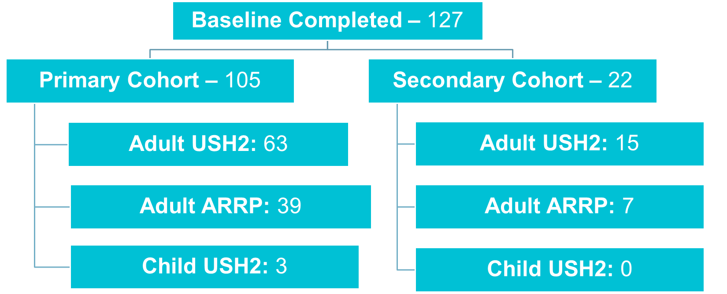
Enrollment Flow
Notes:
127 patients completed baseline, with 105 in the primary cohort and 22 in the secondary cohort.
-----Very few children enrolled in the study, all Usher syndrome.

Slide 16
Diagnosis
 | Investigator review | Audiologist review
Usher syndrome | 81 | 80
Non-syndromic RP | 46 | 47
* One participant was categorized as “Usher syndrome” based on investigator diagnosis, but the audiologist reviewer determined that participant was non-syndromic RP based on normal 4F-PTA results
*4F-PTA: four frequency air conduction threshold pure-tone average based on 0.5, 1, 2, and 4 kHz

Slide 17

Study Cohort
Characteristic | All N=127 | USH2 N=80 | ARRP N=47
Gender (Female) | 68 (54%) | 44 (55%) | 24 (51%)
Race (White) | 113 (89%) | 70 (88%) | 43 (91%)
Severity of hearing loss
Characteristic | All | Clinical Diagnosis
Mild | 10 (8%) | 2 (3%) | 8 (17%)
Moderate | 58 (48%) | 54 (72%) | 4 (9%)
Severe | 15 (12%) | 15 (20%) | 0
Profound | 4 (3%) | 4 (5%) | 0
Clinical Diagnosis
Notes:
Patients with Usher syndrome were similar to patients with arRP at baseline in all characteristics except for hearing loss
--The majority of Usher patients had moderate hearing loss, but some had mild, severe and profound hearing loss.
--74% of arRP patients had normal hearing, but 17% showed mild and 9% showed moderate hearing loss
Unadjusted p-value:
Hearing loss --by 4F-PTA<0.001
Gender: 0.67
Race: 0.07

Slide 18
Study Cohort
Characteristic | All N=127 | USH2 N=80 | ARRP N=47
Age at enrollment, yrs
Median | 40 | 37 | 44
IQR | (30, 48) | (27, 44) | (37, 50)
Age of onset, yrs
Median | 19 | 16 | 32
IQR | (14, 30) | (13, 22) | (20, 41)
Duration of Disease, yrs
Median | 15 | 16 | 12
IQR | (8, 23) | (9, 26) | (6, 18)
Clinical Diagnosis
Notes:
--In addition, Usher patients were significantly younger at enrollment: (p=0.005):
--Usher patients had significantly earlier onset of visual symptoms P<0.001:
-- and Usher patients had significantly longer disease duration (Duration of disease: 0.02)
--than patients with ARRP
Unadjusted p-value:
Age at enrollment: 0.005: usher patients were significantly younger than nonsynd
Age of onset: <0.001: Usher patients had earlier onset of visual symptoms
Duration of disease: 0.02: Usher patients had significantly longer disease duration

Slide 19
Static Perimetry
Average of 3 fields | All N=127 | USH2 N=80 | ARRP N=47 | P value
V_{TOT} , dB-sr |  |  |  | <0.001
Median (IQR) | 20.6 (7.7, 46.3) | 16.0 (3.6, 35.2) | 32.8 (15.1, 54.6)
V₃₀ , dB-sr |  |  |  | 0.13
Median (IQR) | 8.3 (3.8, 12.8) | 7.5 (2.7, 12.7) | 9.3 (5.1, 13.3)
SP mean sensitivity, dB |  |  |  | 0.02
Median (IQR) | 9.3 (5.2, 14.6) | 7.8 (4.3, 13.8) | 12.1 (7.0, 16.9)
Clinical Diagnosis
Notes:
Vtot and mean sensitivity for the full field HOV was significantly greater in arRP vs USH2A patients,
--but V30 was not significantly different between the 2 groups.
--suggests macular function is preserved until later stages of disease

Slide 20
Static Perimetry
 | All |  | USH2 |  |  | ARRP |  | P value
Characteristic | N=126 | V_{TOT} Mean (SD) | N=80 | V_{TOT} Mean (SD) | V_{TOT} Mean (SD) | N=46 | V_{TOT} Mean (SD)
Age at enrollment, yrs |  |  |  |  |  |  |  | 0.03
<35 | 44 | 35.7 (23.0) |  | 36 | 33.1 (20.0) | 8 | 47.6 (32.5)
35-45 | 43 | 23.9 (22.4) |  | 25 | 18.3 (20.1) | 18 | 31.8 (23.6)
45 years or older | 39 | 23.1 (24.2) |  | 19 | 7.8 (15.3) | 20 | 37.8 (22.0)
Duration of Disease, yrs |  |  |  |  |  |  |  | <0.001
<10 | 36 | 40.5 (22.6) |  | 20 | 34.3 (20.0) | 16 | 48.2 (23.9)
[10,20) | 46 | 28.5 (21.9) |  | 25 | 28.7 (23.5) | 21 | 28.3 (20.4)
>=20 | 43 | 15.0 (18.2) |  | 35 | 11.2 (14.8) | 8 | 31.5 (23.4)
Notes:
By clinical diagnosis
Vtot was greatest for patients enrolled at younger ages in both groups;
--this reflects that a number of young USH2A patients are enrolled in the study.
--Vtot was greatest for those with shortest disease duration for both groups

Slide 21
Reproducibility of SP
The test-retest reproducibility results will be covered in the tolerance limit presentation following this talk
“Real Change” for VTOT = 13.7 dB-sr
  If Vtot decrease is greater than 13.7, we are confident that the sensitivity decrease observed over time is not due to retest variation

Slide 22
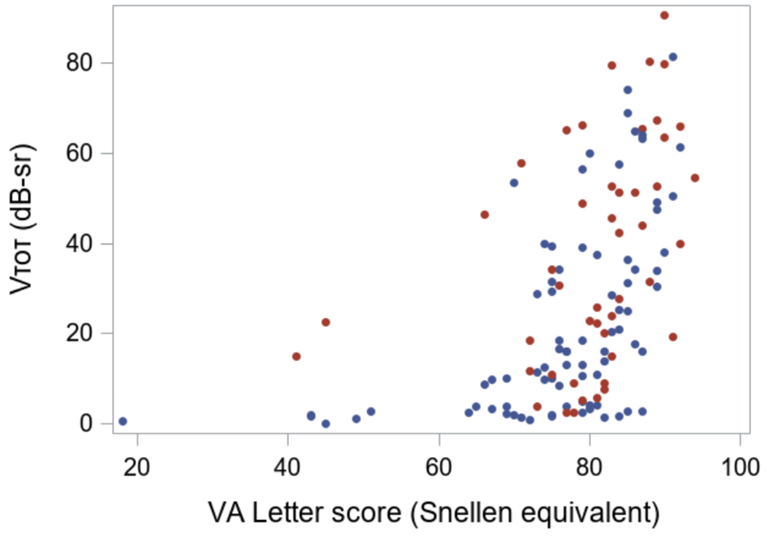
Visual Acuity Correlated with
Hill of Vision (VTOT)
Better VA higher VTOT
USH2: blue
ARRP: red
Spearman correlation
r = 0.59 P < 0.001
Notes:
In both USH2 and ARRP patients, best-corrected visual acuity correlated with Vtot
--but there is a ceiling effect:
--lots of patients had excellent vision despite a range of Vtot values

Slide 23
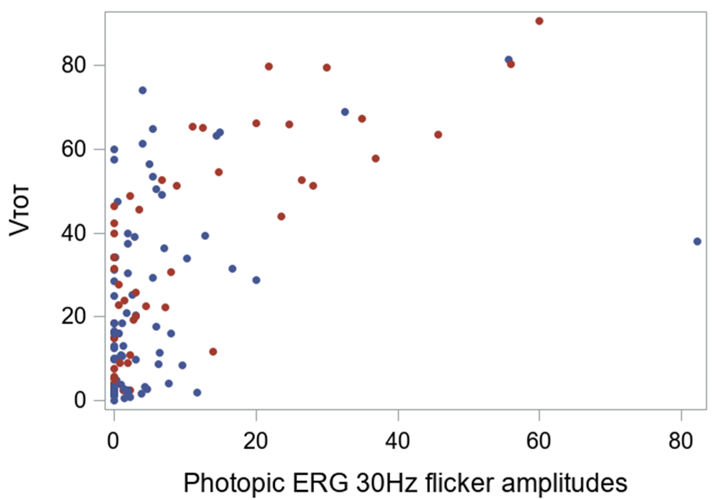
30Hz Flicker Correlated with VTOT
Greater photopic ERG 30Hz flicker amplitudes higher VTOT
USH2: blue
ARRP: red
Spearman correlation
r = 0.54 P < 0.001
Notes:
In both Usher syndrome and arRP patients,
--full field ERG photopic 30 Hz flicker amplitudes correlated with Vtot
--like visual acuity but with floor effect:
--lots of patients had unrecordable 30 Hz flicker amplitudes despite range of Vtot

Slide 24
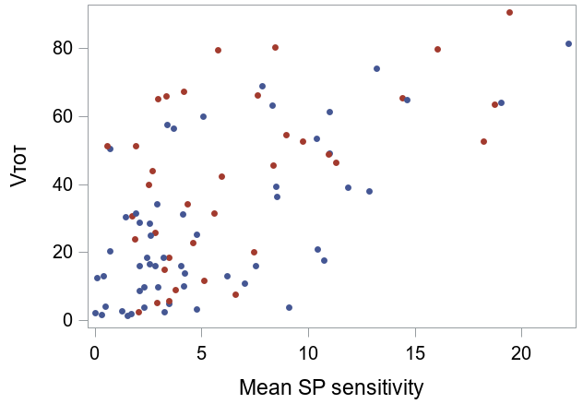
Static Perimetry: Mean Sensitivity Correlated with VTOT
Higher mean SP sensitivity higher VTOT
USH2: blue
ARRP: red
Spearman correlation r = 0.55 P < 0.001
Notes:
In both USH2 and arRP patients,
--the correlation between static perimetry mean sensitivity and Vtot is only 0.55
--Patients with visual field limited to the central 30 degrees show much lower MS because zero values are averaged in.
--the Hill of Vision measured as Vtot only characterizes volume of seeing vision, and is not impacted by nonseeing area/zero values

Slide 25
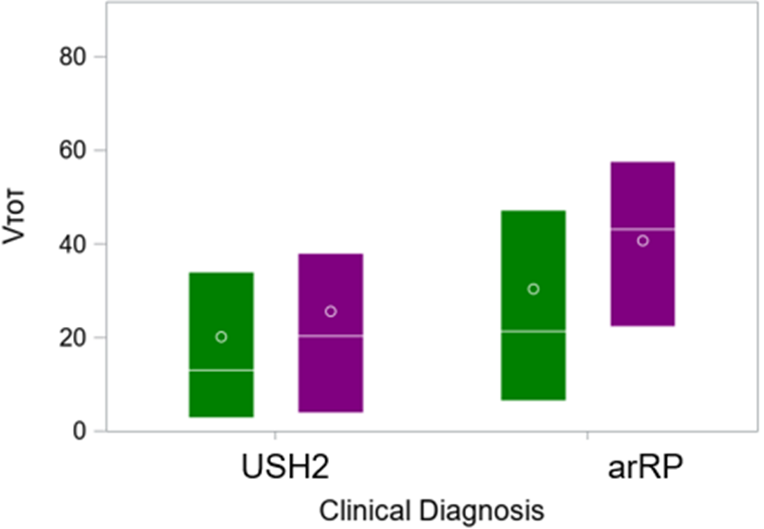
Cystoid Macular Edema Correlated with Lower VTOT
Absence of macular cysts Higher VTOT
Presence of Cysts
  Yes: Green
  No: Purple
P = 0.03
Notes:
In both USH2 and ARRP patients,
--cystoid macular edema was associated with lower visual field in both groups

Slide 26
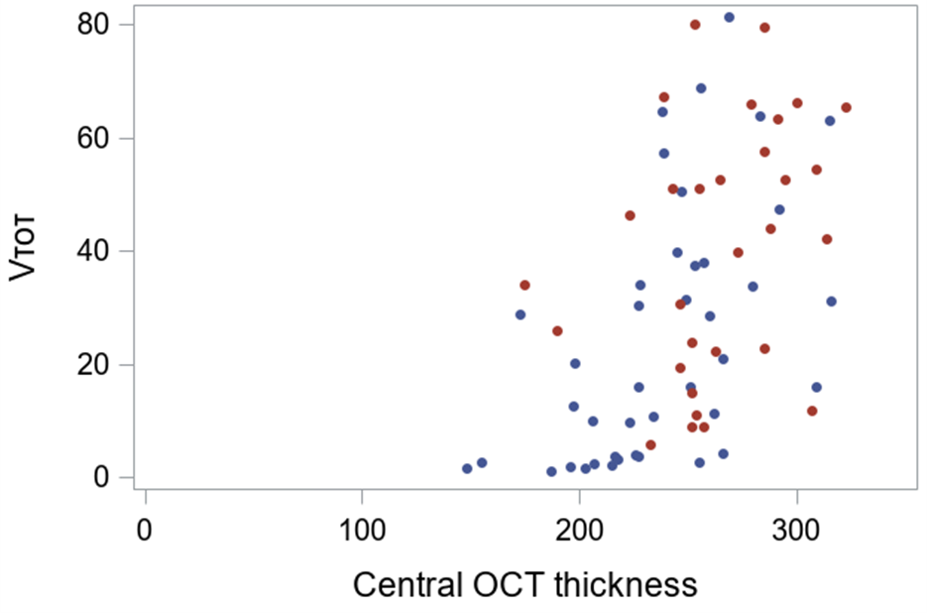
Central OCT Thickness Correlated with Greater VTOT
Higher Central Subfield Thickness Higher V_{TOT}
USH2: blue
ARRP: red
Spearman correlation r = 0.48 P < 0.001
Notes:
Excluding all participants with CME at any location,
--central retinal thickness measured by OCT correlated with improved visual field measured by total hill of vision, or Vtot

Slide 27
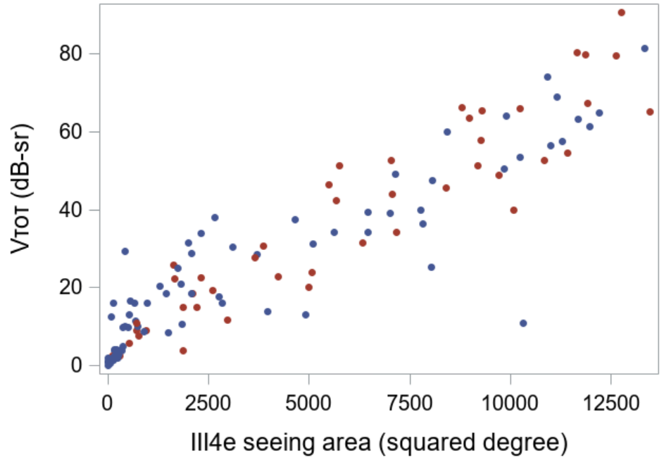
Kinetic III4e Isopter Correlated with VTOT
Greater III4e area Higher V_{TOT}
USH2: blue
ARRP: red
Spearman correlation r = 0.92 P < 0.001
Notes:
And kinetic perimetry area to the III4e isopter correlated strongly with the Vtot hill of vision in both groups

Slide 28
Kinetic Perimetry Area Was Lower in the Usher Syndrome Group
Seeing area (deg2) | All | Clinical Diagnosis |  | P Value
 | N=127 | USH2 N=80 | ARRP N=47
I4e |  |  |  | 0.004
Median | 86 | 61 | 188
IQR | (22, 607) | (13, 289) | (27, 1770)
III4e |  |  |  | <0.001
Median | 2455 | 1363 | 5723
IQR | (432, 8064) | (226, 6466) | (2113, 9708)
V4e |  |  |  | <0.001
Median | 8799 | 5913 | 11062 | 0.004
IQR | (2619, 12344) | (842, 11521) | (7389, 13035)
Notes:
Kinetic perimetry was significantly greater in autosomal recessive RP than the Usher syndrome type 2 patients, for all 3 isopters tested

Slide 29
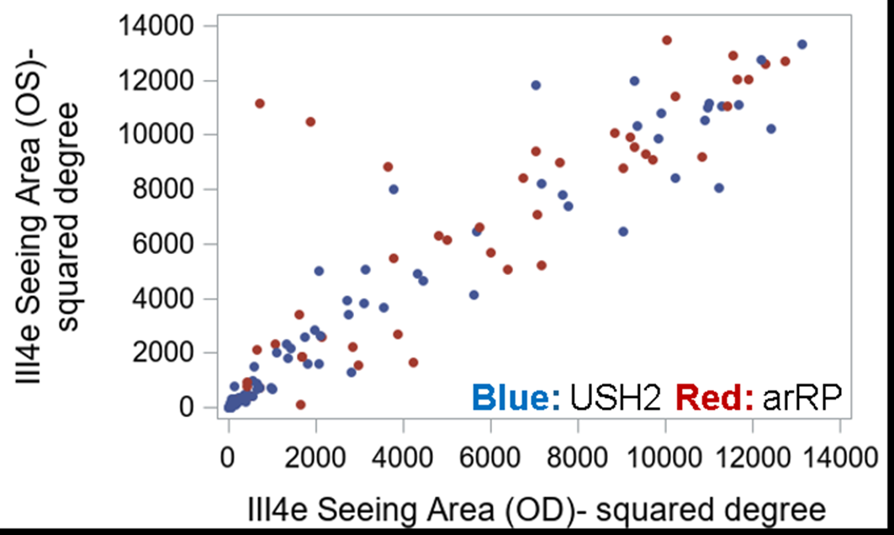
Interocular Symmetry of
Kinetic Perimetry
Mean KP III4e isopter area:
Left eye: 4561 ±4426 deg2
Right eye: 4215 ±4300 deg2
Spearman correlation r= 0.94
P < 0.001 (N=126)
*BOTH groups showed lower mean
III4e isopter area than normal
(lower limit of 12799 deg2)
Notes:
Kinetic perimetry was measured in both eyes of all participants in both cohorts at baseline
--and showed significant interocular symmetry.
--although mean seeing area was lower than normal in both groups.

Slide 30
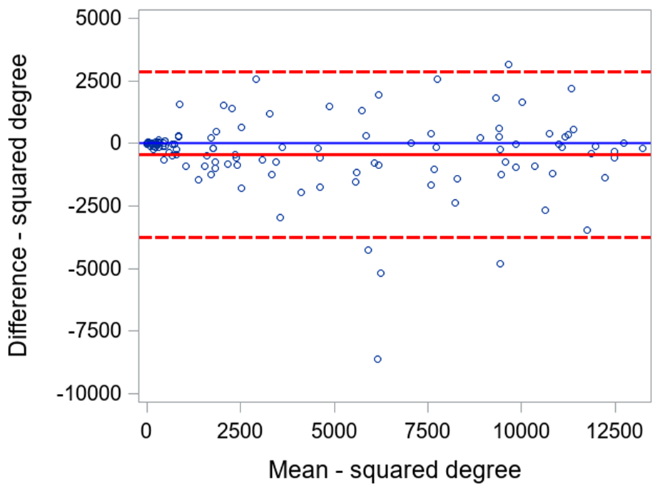
Symmetry
Notes:
Bland Altman plot shows difference on Y axis vs mean area on X axis-good interocular symmetry at all areas of visual field

Slide 31
Conclusions
Participants with USH2A-related Usher syndrome had more severe visual field loss than the non-syndromic arRP group
VTOT was highly reproducible and strongly correlated with other functional and structural measures
VTOT may be a useful outcome measure of disease severity in patients with USH2A-related retinal degeneration
Notes:
In summary:
--Participants with USH2A-related Usher syndrome had more severe visual field loss than participants with USH2A-related autosomal recessive RP,
--after adjusting for duration of disease and age of enrollment.
--The volumetric measure of VTOT was highly reproducible and strongly correlated with other functional and structural metrics, suggesting it may be a good summary measure of disease severity in patients with USH2A-related retinal degeneration.

