Slide 1
Visual Acuity, Full-Field Stimulus Thresholds and ERG for 4-Yr in the RUSH2A Study

Slide 2
Background
Best Corrected Visual Acuity (BCVA)
  Impaired VA associated with decreased quality of life
Full-Field Stimulus Threshold (FST)
  Reflects the response of photoreceptors with the greatest dark-adapted sensitivity
  FST chromatic threshold measures can identify the receptor type mediating visual perception
Full-field Electroretinogram (ERG)
  Commonly used in the assessment of patients with IRDs
  Previous studies in patients with USH2A-associated RP have found undetectable rod responses and greatly reduced cone responses by young adulthood

Slide 3
Purpose of this Talk
Provide methods for BCVA, FST, and ERG in RUSH2A
Describe the statistical methods for analyzing the data
Present 48-month analysis of BCVA, FST, and ERG
Investigate correlations among visual function measures
Evaluate each measure as an outcome measure for future clinical trials

Slide 4
Study Design
127 participants enrolled between August 2017 - December 2018 at 16 clinical sites in Europe & North America
The primary cohort included 105 participants with a baseline Early Treatment of Diabetic Retinopathy Study (ETDRS) letter score of 54 or greater (20/80 or better) in the better eye, central visual field at least 10 degrees diameter, and stable fixation
A secondary cohort of 22 participants with worse visual function was enrolled to complete a baseline visit only

Slide 5
Methods: BCVA
Best-corrected visual acuity (BCVA) measured with the Early Treatment of Diabetic Retinopathy Study (ETDRS) eye charts or the electronic visual acuity (EVA) equivalent
BCVA measured in each eye once per visit by study-certified personnel

Slide 6
Methods: FST
Full-field stimulus threshold (FST) performed on the Espion E3
White, blue and red stimuli
A two parameter Weibull function used for determining the actual threshold
Thresholds measured in triplicate for each color and averaged for analyses
The value of 0 dB was set to -1 log cd/m²
Subtract 1 log unit (10 dB) to give threshold in log cd.s/m²

Slide 7
Methods: ERG
Full-field ERG was performed at baseline and 4 years
  International Society for Clinical Electrophysiology of Vision (ISCEV)
The ERG measures were the amplitudes of
  B-wave from the dark adapted (DA) dim-flash 0.01 cd.s/m² response (DA 0.01 ERG)
  B-wave from the DA standard flash 3.0 cd.s/m² response (DA 3.0 ERG)
  Light-adapted 30 Hz flicker (LA 3.0 flicker) [trough-to-peak amplitude]
Undetectable ERGs were defined as: b-wave amplitude <1.0µV for DA 0.01 ERG and DA 3.0 ERG, and <0.3µV for LA 3.0 flicker ERG

Slide 8
Statistical Methods
Eyes with test results for at least 2 of the 5 time points (baseline and 1 to 4 years) were included in analyses for BCVA and FST
ERG analysis limited to eyes with testing at baseline and 4Y
  Testing was not performed by sites at the Year 4 visit for approximately half of the eyes because of undetectable results at baseline, machine malfunction, or clinic error
FST thresholds reported in log cd.s/m² were converted from dB:
log cd.s/m² = dB/10 – 1.0

Slide 9
Statistical Methods (cont.)
Annual rates of change estimated by mixed effects models with random intercept
%Change in FST sensitivity can be calculated from estimated change in – dB:
$$\%change in sensitivity=100×({10}^{∆/10}−1)$$
Where ∆ = estimated annual change in – dB
%Change in visual acuity based on MAR can be calculated from estimated change in BCVA letters:
$$\%change in VA=100×({10}^{−0.02δ}−1)$$
Where 𝜹 = estimated annual change in BCVA letter score

Slide 10
Statistical Methods (cont.)
Additional models performed by down-weighting outlier rates of change in mixed effects models
  Weights computed from robust regression modeling of estimated rate of decline from each participant
Spearman correlation coefficients calculated to assess the association of results from different tests

Slide 11
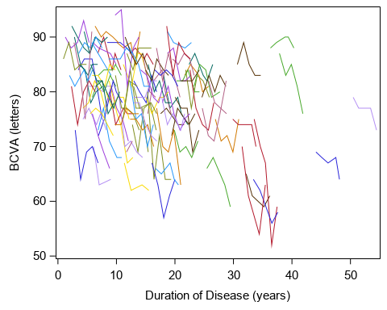
BCVA Findings
N=103
Change over 4 years for each patient in best corrected visual acuity (BCVA)

Slide 12
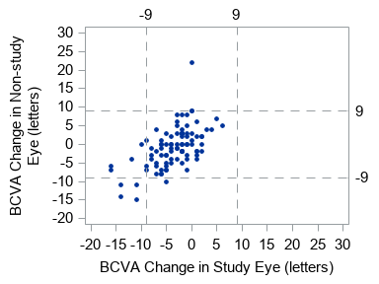
BCVA Findings
Scatter plot for BCVA change from baseline to 4-years in study eye and non-study eye
Reference lines represent the repeatability coefficient of 9 letters for BCVA when visual acuity is ≥ 20/100
Spearman Correlation = 0.57
P < 0.001

Slide 13
Estimated Annual Rates of Change for BCVA
 | Change in Letter Score |  | %Change in MAR
 | Equally weighted model | Outliers down-weighted | Equally weighted model | Outliers down-weighted
 | N=103 | N=103 | N=103 | N=103
BCVA
Slope Estimate | -0.83 | -0.80 | 3.9% | 3.7%
95% CI | (-1.02, -0.65) | (-0.97, -0.62) | (3.1%, 4.8%) | (2.9%, 4.6%)

Slide 14
Change in BCVA at 4 Years - Study Eye
Change in Letters | N | %
Decrease ≥15 | 2 | 2%
Decrease 10-14 | 6 | 6%
Decrease 5-9 | 28 | 29%
Change less than 5 | 57 | 60%
Increase 5-9 | 2 | 2%
Total | 95 | 100%

Slide 15
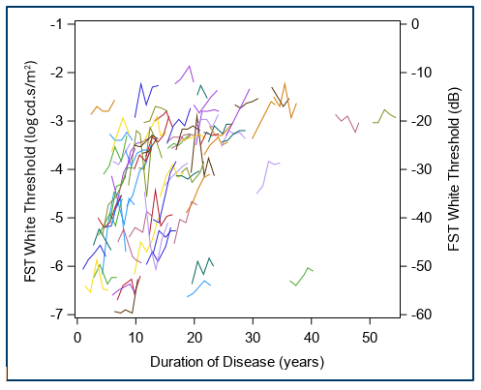
FST Findings
N=77
Full-field stimulus threshold (FST) for white stimulus
The left y-axis presents the values in log cd.s/m²; the right y-axis is in dB

Slide 16
Estimated Annual Rates of Change for FST
 | Change in log cd.s/m² |  | %Change in log cd.s/m²
 | Equally weighted model | Outliers down-weighted | Equally weighted model | Outliers down-weighted
FST Sensitivity | N=77 | N=77 | N=77 | N=77
White Stimulus
Slope Estimate | 0.09 | 0.09 | 22.6 | 22.2
95% CI | (0.07, 0.11) | (0.07, 0.11) | (17.3, 28.1) | (17.2, 27.4)
Blue Stimulus
Slope Estimate | 0.10 | 0.09 | 26.1 | 24.4
95% CI | (0.08, 0.12) | (0.08, 0.11) | (20.3, 32.1) | (19.4, 29.5)
Red Stimulus
Slope Estimate | 0.05 | 0.05 | 12.3 | 11.6
95% CI | (0.04, 0.06) | (0.03, 0.06) | (8.7, 16.0) | (8.3, 15.0)

Slide 17
FST Mediation Type
 |  | Year 4
 |  | Rod Mediated | Cone Mediated
Baseline | Rod Mediated | 27 (73%) | 10 (27%)
 | Cone Mediated | 0 (0%) | 29 (100%)
Based on FST white sensitivity
Rod mediated:
FST white threshold ≤ -4.0 log cd/m²
Cone mediated:
FST white threshold > -4.0 log cd/m²
Based on FST blue - red sensitivity
Rod mediated:
blue - red > -2.0 log cd/m²
Mixed:
between -2.0 and -1.0 cd/m²
Cone mediated:
blue - red < -1.0 log cd/m²
 |  | Year 4
 |  | Rod Mediated | Intermediate | Cone Mediated
Baseline | Rod Mediated | 19 (76%) | 5 (20%) | 1 (4%)
 | Mixed | 0 (0%) | 8 (57%) | 6 (43%)
 | Cone Mediated | 0 (0%) | 0 (0%) | 27 (100%)

Slide 18
ERG Findings – DA 0.01 ERG
DA 0.01 ERG | Baseline (N=46) | Year 4 (N=46)
Un-detectable, n (%) | 14 (30%) | 17 (37%)
B-wave Amplitude (µV) | N=32 | N=29
Median (IQR) | 16.8 (5.8, 38.1) | 11.0 (5.8, 26.3)
Range | 1.2 to 163.6 | 1.2 to 133.4
Implicit Time (msec) | N=32 | N=29
Median (IQR) | 99 (84, 108) | 97 (86, 104)
Range | 58 to 122 | 71 to 122

Slide 19
ERG Findings – DA 3.0 ERG
DA 3.0 ERG | Baseline (N=46) | Year 4 (N=46)
Un-detectable, n (%) | 3 (7%) | 9 (20%)
B-wave Amplitude (µV) | N=43 | N=37
Median (IQR) | 16.0 (5.8, 65.0) | 14.7 (4.2, 46.0)
Range | 1.2 to 189.1 | 1.3 to 168.2
Implicit Time (msec) | N=43 | N=37
Median (IQR) | 58 (51, 64) | 59 (50, 63)
Range | 37 to 76 | 31 to 71

Slide 20
ERG Findings – LA 3.0 Flicker ERG
LA 3.0 ERG | Baseline (N=46) | Year 4 (N=46)
Un-detectable, n (%) | 2 (4%) | 6 (13%)
B-wave Amplitude (µV) | N=44 | N=40
Median (IQR) | 9.6 (2.6, 22.7) | 6.7 (3.0, 16.8)
Range | 0.6 to 82.2 | 1.2 to 48.4
Implicit Time (msec) | N=44 | N=40
Median (IQR) | 36 (32, 40) | 35 (31, 42)
Range | 25 to 45 | 27 to 49

Slide 21
Discussion – BCVA
BCVA values were stable over 4 years, with 91% of study eyes having less than 10 letters (two lines) change
Since the average change in acuity was less than 1 letter/year, BCVA is not a sensitive measure of progression over 4 years
No study eyes had BCVA improvement from baseline to Year 4 exceeding the CoR
  Improvement in BCVA exceeding the CoR might be a useful measure for detecting a beneficial treatment effect

Slide 22
Discussion – FST
Relative to changes in other measures of visual function
  Changes in FST were consistent across eyes
  Variability of results within eyes was low
For FST white threshold, 31 (47%) study eyes had change from baseline to Year 4 exceeding the CoR of 0.39 log cd.s/m²
  47% is much higher than that from BCVA
  FST is a more sensitive outcome measure than BCVA

Slide 23
Discussion – ERG
Approximately 50% in RUSH2A had unmeasurable rod-mediated ERG responses at baseline
This is similar to previous reports of few patients with measurable responses beyond early adulthood
ERG may not be a suitable measure for following patients with intermediate RP

Slide 24
Conclusion
BCVA is not a sensitive measure of disease progression in USH2A patients over a 4-year period.
FST demonstrated a significant decline over 4 years in USH2A-related retinal degeneration, with no floor effect, strong reproducibility, and low Coefficient of Repeatability (CoR).
FST appears to be a more sensitive outcome measure than BCVA and may serve as a valuable tool for tracking vision loss in USH2A-related retinal degeneration.
ERG may not be suitable for monitoring patients with intermediate-stage retinitis pigmentosa (RP).

Slide 25
Writing Committee Members
David Birch (Lead) |  | Rachel Huckfeldt
Allison Ayala |  | Maureen Maguire​
Janet Cheetham​​ |  | Michele Melia
Peiyao Cheng |  | Michel Michaelides
Nicole Doucet |  | Mark Pennesi​
Jacque Duncan​​ |  | José-Alain Sahel​
Todd Durham |  | Katarina Stingl
Abigail Fahim |  | Ajoy Vincent
Rick Ferris |  | Christina Y. Weng

