Slide 1
Natural History of Microperimetry and Optical Coherence Tomography in the RUSH2A Study

Slide 2
Methods
MP
Only at sites with MAIA
Primary cohort only
ETDRS VA ≥ 54 (20/80 or better)
Central visual ﬁeld at least 10 diameter
Stable fixation
Study eye only for all visits
Performed 3 times at baseline and 1 time at follow-up visits
OCT
At all sites
Performed on both eyes for all RUSH2A subjects at baseline
Performed on study eye for primary cohort subjects at follow-up visits

Slide 3
Microperimetry Grids and Measures
Mesopic/standard MP, 4-2 projection strategy
Size-III Stimulus
Custom 30 deg wide grid
Number of tested loci: 89
MAIA (CenterVue)

Slide 4
48M Statistical Methods
Entire Analysis Cohort:
Study eyes that have test results for at least 2 of the 5 time points up (baseline, 12M, 24M, 36M, and 48M)
Preserved Cohort
MP: Eyes in entire analysis cohort with baseline MP mean sensitivity >1 dB
EZ: Eyes in the entire analysis cohort with baseline EZ area >3 mm²

Slide 5
48M Statistical Methods (cont.)
Annual rates of change estimated by mixed effects models with random intercept
Mixed effects models applied to both the entire analysis cohort and the preserved cohort
Model with down-weighting outlier rates of change was explored
Spearman correlation calculated among 4-year change in MP and OCT measures with 4-year change in other visual measures

Slide 6
48M Statistical Methods (cont.)
Defining Functional Transition Points (FTPs)
FTPs are MP loci near the inner edge of the functional transition zone, identified by ≥7 dB sensitivity drops between adjacent loci along radial "pathways" from the fovea to the periphery.
Criteria: Candidate FTPs required baseline sensitivity ≥8 dB and ranking based on % of qualifying adjacent loci (100%–25%).
Selection: Top-ranked candidate FTPs (starting with 100% agreement) were chosen until 5 FTPs per eye were identified; eyes with <5 were excluded.
Outcome: Mean Sensitivity of FTPs (MSFTP) was calculated for each eye at each visit.

Slide 7
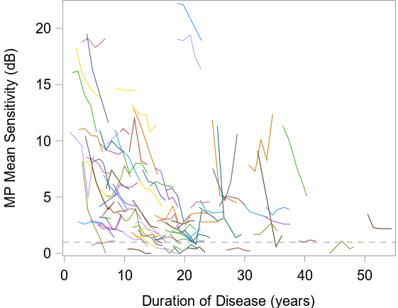
Spaghetti plot for MP MS Over Time
MP MS decreased over time.
Floor effect was identified in subjects with baseline MP MS < 1dB.

Slide 8
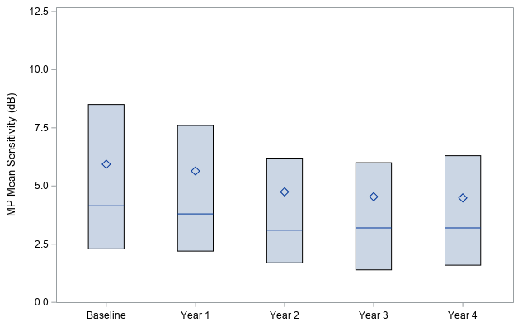
Boxplots for MP MS Over Time
N=96
N=85
N=98
N=96
N=85
N=87
N=82
N=78
N=86
N=85
N=81
N=98
N=100
N=87
Notes:
Mean sensitivity decreased (mean: Diamonds on the graph: 6.0 5.5 4.7 4.5 4.5)

Slide 9
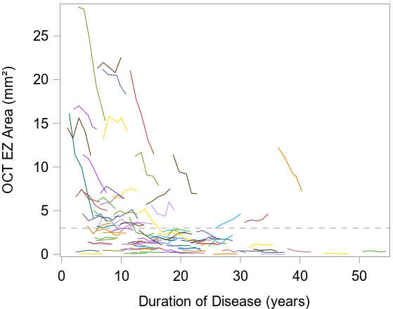
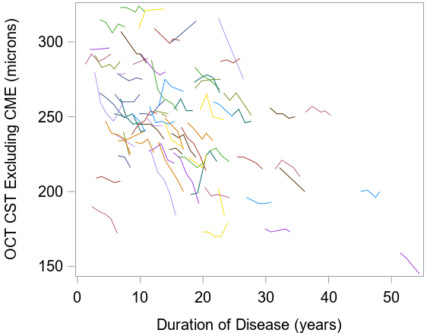
Spaghetti plot for OCT Measures Over Time
EZ Area
CST
Floor effect was identified in subjects with baseline EZ area < 3 mm².
Notes:
For EZ area, there are a number of eyes that started near 0 and showed no further decline. This is why we had a preserved group of eyes for some of the analyses of EZ area – only eyes that had room for the EZ area to become smaller.

Slide 10
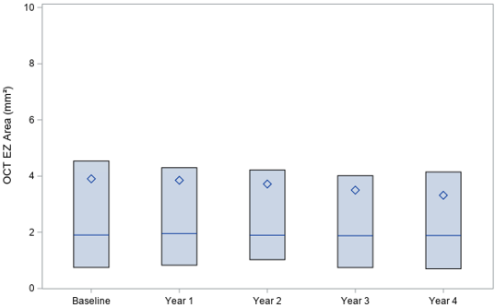
Boxplots for OCT EZ Over Time
N=98
N=96
N=85
N=98
N=96
N=85
N=101
N=100
N=63
N=59
N=86
N=96
N=93
N=98
N=96
N=100
N=87
N=85
Notes:
Mean EZ area decreased at follow-up visits (Mean: 3.9 3.9 3.7 3.5 3.3)

Slide 11
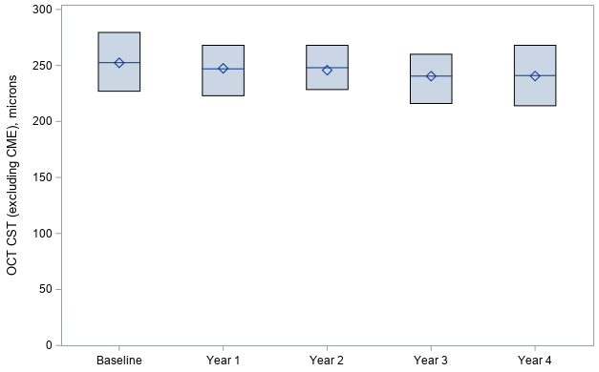
Boxplots for OCT CST (without CME) Over Time
N=98
N=96
N=85
N=98
N=96
N=85
N=64
N=63
N=52
N=60
N=59
N=98
N=96
N=102
N=100
N=87
N=85
Notes:
CST values were similar () – Only OCTs for eyes without CME were included (mean: 2.5 247 245 240 240)

Slide 12
Estimated Annual Rates of Change
Outcomes | Entire cohort | Preserved cohort | Outliers down-weighted
MP Mean Sensitivity | N=94 | N=86 | N=86
Estimate (dB/year) | -0.39 | -0.42 | -0.35
95% CI | (-0.47, -0.31) | (-0.51, -0.33) | (-0.42, -0.27)
OCT EZ Area | N=101 | N=33 | N=33
Estimate (mm²/year) | -0.18 | -0.53 | -0.34
95% CI | (-0.24, -0.12) | (-0.70, -0.37) | (-0.47, -0.22)
OCT CST | N=72 | N=72 | N=72
Estimate (microns/year) | -2.14 | -2.14 | -2.05
95% CI | (-2.66, -1.63) | (-2.66, -1.63) | (-2.50, -1.59)
Notes:
All 3 measures declined. However, by looking at the confidence interval, we see that the EZ area was barely statistically significantly different from 0 decline
Outliers were down-weighted using weighted mixed-effects model, weights were computed from robust regression modelling of estimated rate of decline from each participant.

Slide 13
Spearman Correlation Coefficients (95% CI) Among Change in MP and OCT Measures from BL to 48M (Preserved Cohort)
 | MP Mean Sensitivity | OCT EZ Area | OCT CST
MP Mean Sensitivity, dB | 1.00
OCT EZ Area, mm² | 0.63 (0.33, 0.82) | 1.00
OCT CST, microns | -0.19 (-0.49, 0.15) | 0.17 (-0.36, 0.61) | 1.00
Notes:
Change in EZ area was correlated with the change in MP

Slide 14
Spearman Correlation Coefficients (95% CI) Change in MP and OCT Measures vs SP and FST Measures from BL to 48M (Preserved Cohort)
 | MP Mean Sensitivity | OCT EZ Area | OCT CST
Vtot, dB-sr | 0.36 (0.12, 0.56) | 0.16 (-0.22, 0.51) | 0.01 (-0.31, 0.32)
V30, dB-sr | 0.52 (0.31, 0.68) | 0.44 (0.10, 0.69) | -0.14 (-0.43, 0.17)
FST White | -0.21 (-0.45, 0.07) | 0.42 (-0.01, 0.72) | -0.25 (-0.55, 0.09)
FST Blue | -0.37 (-0.58, -0.11) | 0.10 (-0.35, 0.51) | -0.29 (-0.58, 0.05)
FST Red | -0.13 (-0.38, 0.15) | 0.15 (-0.30, 0.55) | -0.03 (-0.37, 0.31)
Notes:
Changes in CST were not correlated with changes in SP or FST. Changes in MP and EZ were moderately correlated for the perimetry measures, except for EZ with Vtot and FST Blue.

Slide 15
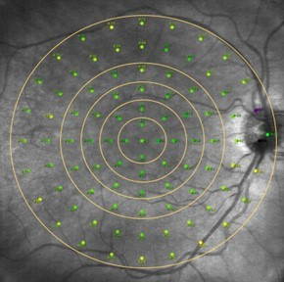
MP Pointwise Sensitivity over Time by Distance (“rings”) from the Foveal Center
 | Pointwise Sensitivity |  | Slope Estimate 95% CI
 | Baseline Mean ± SD, dB | Change at Year 4 Mean ± SD, dB
1)Points 1-5 | 22.28 ± 5.14 | -0.39 ± 4.94 | -0.09 (-0.18, -0.001)
2)Points 6-13 | 15.15 ± 9.15 | -1.78 ± 6.36 | -0.40 (-0.49, -0.30)
3)Points 14-25 | 8.17 ± 9.21 | -2.28 ± 5.70 | -0.52 (-0.59, -0.46)
4)Points 26-41 | 6.98 ± 7.89 | -2.33 ± 6.01 | -0.54 (-0.60, -0.49)
5)Points 42-89 | 2.87 ± 6.09 | -1.70 ± 4.71 | -0.39 (-0.42, -0.37)
(Preserved Cohort)

Slide 16
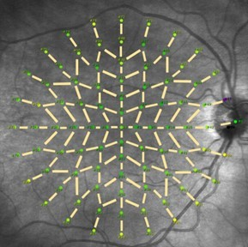
Functional Transition Zone (FTZ) Analysis
Metric | Value
Range of FTPs per eye | 5 to 18 (Median = 8)
Eyes with ≥5 FTPs (100% qualifying) | 78 eyes (89.7%)
Eyes excluded due to <5 FTPs | 3 eyes
Coefficient of Repeatability (CoR) | 5.29 dB
Baseline MP MSFTP | 17.9 dB
MP MSFTP at Year 4 | 10.8 dB
Avg. change (4 years) | -6.92 ± 7.58 dB (Median = -6.0 dB)
Standardized rate of decline | -1.79 dB/year (CI: -1.97, -1.61)
Eyes with meaningful loss at 2 years | 19%
Eyes with meaningful loss at 4 years | 46%
Eyes worsening beyond CoR | 60%
Eyes with meaningful improvement | 0% (at both 2 and 4 years)

Slide 17
Discussion: EZ Area
Declined over time, especially when baseline EZ ≥ 3.0 mm².
Strong inter-eye symmetry (ICC = 0.84)
Suitable for tracking early-stage progression or treatment response.
Greater decline in participants with <10 years disease duration and in the preserved cohort (–0.53 mm²/year).

Slide 18
Discussion: CST
Small decline (–2.14 µm/year), similar between USH2 and ARRP.
~40% of eyes had cystoid changes at baseline and Year 4.

Slide 19
Discussion: MP
MP MS declined over time, but only a small proportion of eyes (5%) showed clinically meaningful decline (≥7 dB) at 4 years, limiting its utility as a functional endpoint.

Slide 20
Discussion: PWS
Largest decline in paracentral rings (rings 3 & 4), suggesting these regions may be optimal for monitoring change.
Functional Transition Points (FTP):Novel, FDA-compliant metric defined to track disease at EZ boundary.
MS_{FTP} showed greatest decline among all MP metrics (–1.79 dB/year).46% of eyes experienced clinically meaningful decline (≥7 dB) by Year 4.

Slide 21
Conclusion
All 3 measures declined on average over 4 years
MP sensitivity and EZ area were subject to floor effects
Change in EZ area was correlated with the change in MP
The MS_{FTP} is a novel, robust parameter that showed clinically meaningful change over time and is a promising tool to monitor treatment efficacy in clinical trials.

Slide 22
Writing Committee Members
Ajoy Vincent (Lead) |  | ​​Rachel Huckfeldt​​
Allison Ayala |  | ​Glenn Jaffe
Paul Bernstein​​ |  | ​Nora Lad
David Birch​​ |  | ​​Wen​di Liang
Joseph Carroll​​ |  | ​Jessica Loo
Janet Cheetham​​ |  | ​Maureen Maguire
Jacque Duncan​​ |  | Mark Pennesi
​​Todd Durham |  | José-Alain Sahel​
​​Sina Farsiu |  | Mandeep Singh​
Carel Hoyng |  | Zane Zemborian

