Slide 1
Characterization of Visual Field Loss
Over 4 Years in the Rate of Progression
in USH2A-Related Retinal Degeneration
(RUSH2A) Study

Slide 2
Citation, Funding, Disclaimer
Citation
Duncan JL, Maguire MG, McDaniel LS, Doucet NR, Audo I, Ayala AR, Cheetham JK, Cheng P, Durham TA, Huckfeldt RM, Hufnagel RB, Jayasundera KT, Khan N, Malbin B, Maldonado RS, Michaelides M, Pennesi ME, Weng CY, Zmejkoski A, Aravind S, Ishikawa H, Birch DG; Foundation Fighting Blindness Clinical Consortium Investigator Group. Characterization of Visual Field Loss Over 4 Years in the Rate of Progression in USH2A-Related Retinal Degeneration (RUSH2A) Study. Am J Ophthalmol. 2025 Aug;276:9-21. doi: 10.1016/j.ajo.2025.03.039.
Funding
This study was funded by Foundation Fighting Blindness
Disclaimer
The source of the data is the Foundation Fighting Blindness Clinical Consortium, but the analyses, content and conclusions presented herein are solely the responsibility of the authors/presenters and may not reflect the views of the Foundation Fighting Blindness.

Slide 3
Background
USH2A: most common genetic cause of Usher syndrome type 2 and autosomal recessive RP
Patients experience progressive loss of night vision, then side vision, then central vision
RUSH2A: identify measures of disease progression
  Candidate primary outcome measures: Change in static perimetry through 4 years

Slide 4
Baseline
Summary of Static Perimetry Findings
Participants with USH2A-related Usher syndrome had more visual field loss than the non-syndromic RP group
V_{TOT} (Volume under the hill of vision) was highly reproducible and correlated with other functional and structural metrics
V_{TOT} decreased with disease duration and age at enrollment
V_{TOT} may be a good summary measure of disease severity in patients with USH2A-related retinal degeneration
Duncan et al, American Journal of Ophthalmology, 2020 Nov;219:87-100

Slide 5
Static Perimetry Methods
SP performed using
  Octopus 900 (Haag-Streit, Mason Ohio)
  German Adaptive Thresholding Estimation (GATE) strategy
SP performed 3 times at study baseline and 1 time at each follow-up visit

Slide 6
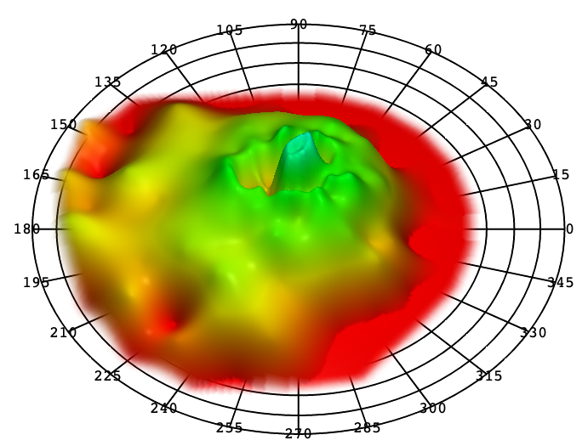
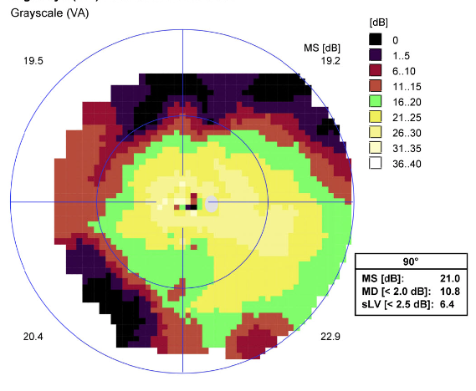
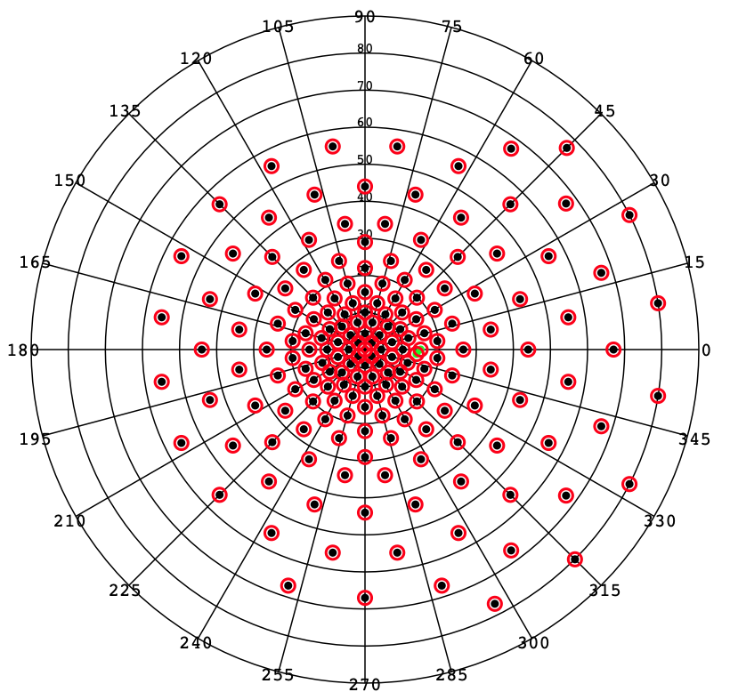
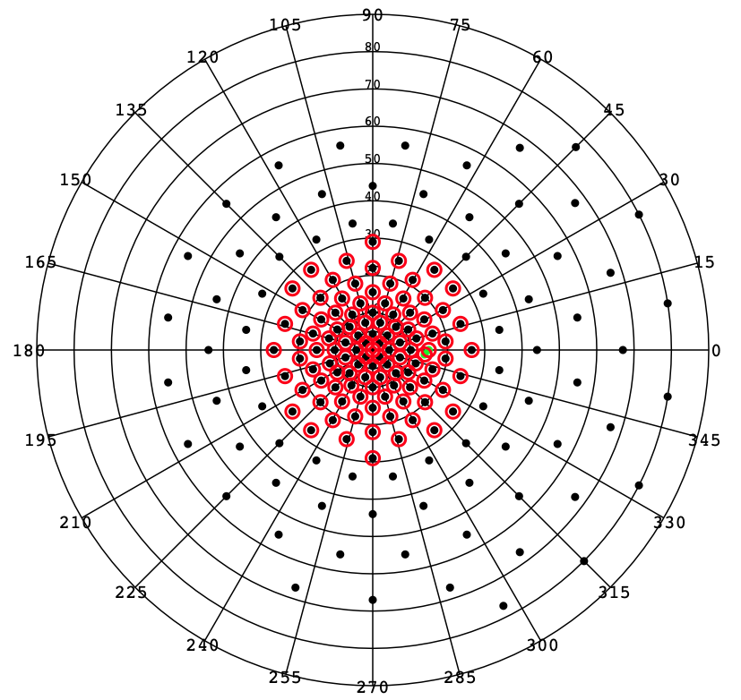
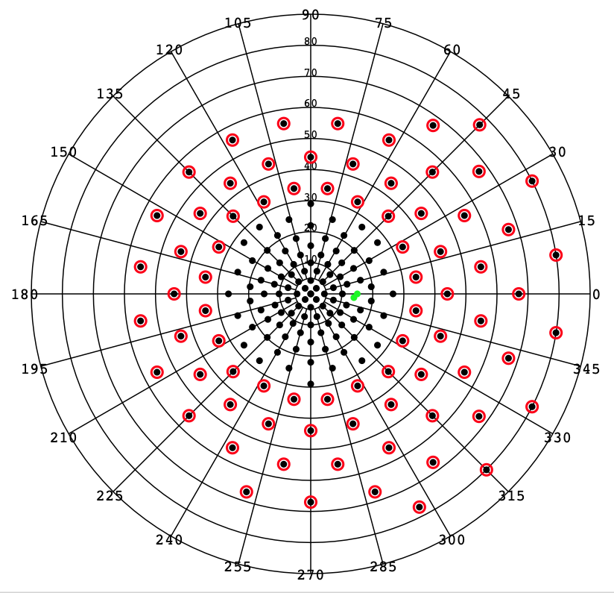
Static Perimetry Grids and Measures
SP MS_{CW} (dB)
Numerical average of all points tested including zeros
V_{TOT} (dB-sr)
Custom 186-point grid
Full Field Hill of Vision
V₃₀ (dB-sr)
30-degree radius
Derived from full grid
V_{PERIPH} (dB-sr)
V_{TOT} – V₃₀
Notes:
Static Perimetry Grids Used for RUSH2A Study

Slide 7
Kinetic Perimetry Methods
Octopus 900
  EyeSuite software
  Seeing area in degree²
  Graded by Casey Reading Center
6 reaction-time vectors
  1 repetition
  Horizontal, vertical, diagonal, from 10 degree and 30 degree eccentricity

Slide 8
Kinetic Perimetry Methods (cont.)
Scotomas
  Mapped at 2 degree/section angular velocity originating from the assumed center
Seeing Areas
  Calculated by subtracting scotomatous areas from the total area for each isopter

Slide 9
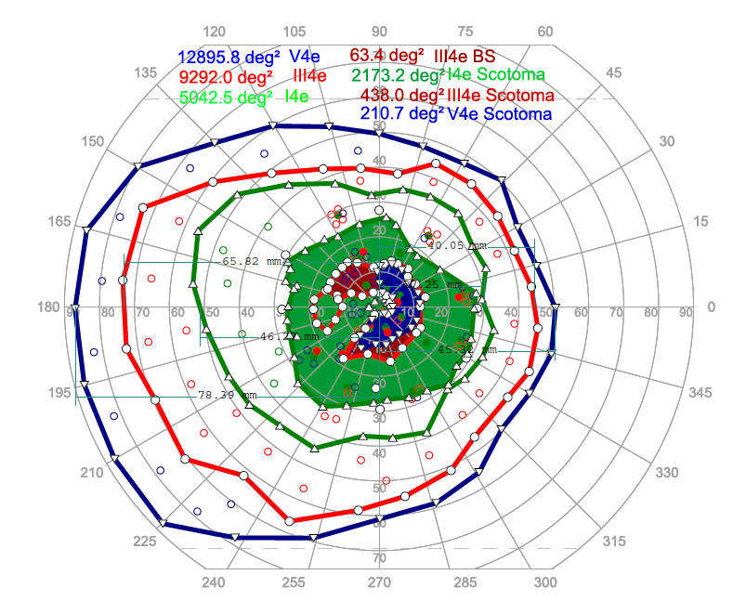
Kinetic Perimetry Methods (cont.)
KP Measures (deg²)
  I4e seeing area
  III4e seeing area
  V4e seeing area

Slide 10
Analysis Cohorts
Entire Analysis Cohort (N=103):
  Study eyes that have test results at 2 or more time points (baseline and years 1-4)
Preserved Cohorts:
  Study eyes with baseline
  V_{TOT} > 5 dB-sr (N=91)
  V₃₀ > 3 dB-sr (N=91)
  V_{PERIPH} > 5 dB-sr (N=79)
  SP MS_{CW} > 4 dB (N=93)
Duncan et al, American Journal of Ophthalmology, 2025 Aug; 276:9-21

Slide 11
Statistical Methods
Annual rates of change estimated by mixed effects models with random intercept
Annual percentage rates of change estimated by modeling on log transformed data
Additional analyses performed on the preserved cohorts
  Excluding unreliable test results (false positive ≥ 15%)
  Down-weighting outlier rates of change
Spearman correlation coefficient calculated for change in SP and KP measures and with change in other visual measures

Slide 12
Trajectory of Static Perimetry Measures over 4 Years
V_{TOT}
SP MS_{CW}
N=12 (12%)
Floor effect
5
4
N=10 (10%)
Floor effect
V₃₀
V_{PERIPH}
N=12 (12%)
Floor effect
3
N=24 (23%)
Floor effect
5
Notes:
Although we used only the preserved cohort eyes for each SP measure, you can see that the eyes with low baseline value generally had less change than eyes with higher baseline values.

Slide 13
Static Perimetry Estimated Annual
Rates of Change
Outcomes | Entire cohort | --------------------Restricted cohort --------------------
 |  | All | False positives <15% | Outliers down-weighted
V_{TOT} (dB-sr/year) | N=103 | N=91 | N=89 | N=91
Slope Estimate | -1.94 | -2.16 | -2.05 | -2.02
95% CI | (-2.25, -1.62) | (-2.51, -1.81) | (-2.36, -1.75) | (-2.33, -1.71)
V₃₀ (dB-sr/year) | N=103 | N=91 | N=90 | N=91
Slope Estimate | -0.54 | -0.63 | -0.56 | -0.54
95% CI | (-0.62, -0.45) | (-0.71, -0.54) | (-0.64, -0.49) | (-0.62, -0.47)
V_{PERIPH} (dB-sr/year) | N=103 | N=79 | N=77 | N=79
Slope Estimate | -1.37 | -1.72 | -1.68 | -1.71
95% CI | (-1.63, -1.11) | (-2.04, -1.40) | (-1.97, -1.40) | (-2.00, -1.41)
Mean Sensitivity (dB/year) | N=103 | N=93 | N=91 | N=93
Slope Estimate | -0.56 | -0.61 | -0.57 | -0.54
95% CI | (-0.64, -0.48) | (-0.70, -0.52) | (-0.64, -0.49) | (-0.61, -0.47)

Slide 14
Static Perimetry Estimated Annual
Percentage Rates of Change
Outcomes | Entire cohort | --------------------Restricted cohort --------------------
 |  | All | False positives <15% | Outliers down-weighted
V_{TOT} (%/year) | N=103 | N=91 | N=89 | N=91
Slope Estimate | -8.6 | -9.0 | -8.4 | -8.0
95% CI | (-10.0, -7.2) | (-10.6, -7.5) | (-9.8, -6.9) | (-9.3, -6.6)
V₃₀ (%/year) | N=103 | N=91 | N=90 | N=91
Slope Estimate | -6.4 | -7.2 | -6.6 | -6.3
95% CI | (-7.5, -5.3) | (-8.2, -6.2) | (-7.6, -5.6) | (-7.2, -5.3)
V_{PERIPH} (%/year) | N=103 | N=79 | N=77 | N=79
Slope Estimate | -13.6 | -12.1 | -11.3 | -12.0
95% CI | (-16.7, -10.4) | (-14.8, -9.3) | (-14.0, -8.5) | (-14.6, -9.3)
Mean Sensitivity (%/year) | N=103 | N=93 | N=91 | N=93
Slope Estimate | -5.6 | -6.0 | -5.6 | -5.4
95% CI | (-6.4, -4.7) | (-6.9, -5.2) | (-6.3, -4.8) | (-6.2, -4.7)

Slide 15
Spearman Correlation Coefficients
Among Change in SP Measures
 | V_{TOT} | V₃₀ | V_{PERIPH} | SP Mean Sensitivity
V_{TOT}, dB-sr | 1.00
V₃₀, dB-sr | 0.64 | 1.00
V_{PERIPH}, dB-sr | 0.96 | 0.48 | 1.00
SP Mean sensitivity, dB | 0.84 | 0.90 | 0.74 | 1.00
Notes:
Changes in V_{TOT} and V_{PERIPH} were highly correlated
Changes in V₃₀ and SP MS_{CW} were highly correlated
All correlations were statistically significant

Slide 16
Spearman Correlation Coefficients (95% CI)
Change in SP Measures vs Other Visual Measures
 | V_{TOT} | V₃₀ | V_{PERIPH} | SP Mean Sensitivity
BCVA, letters | -0.11 | -0.19 | 0.04 | -0.17
FST white, dB | -0.04 | -0.09 | -0.004 | -0.13
FST blue, dB | -0.16 | -0.17 | -0.13 | -0.19
FST red, dB | -0.02 | -0.002 | -0.02 | -0.05
Microperimetry Mean sensitivity, dB | 0.37 | 0.52 | 0.32 | 0.55
Notes:
No or Weak correlation of all the SP measures with VA and FST
Mild to moderate correlations of MP Mean sensitivity with the SP measures, with the highest correlations with V₃₀ and SP MS_{cw}
All MP correlations were significant. No significant correlations with BCVA or FST measures.

Slide 17
Spearman Correlation Coefficients (95% CI)
Change in SP Measures vs Other Visual Measures
 | V_{TOT} | V₃₀ | V_{PERIPH} | SP Mean Sensitivity
OCT Ellipsoid zone area, mm² | 0.17 | 0.45 | 0.11 | 0.38
OCT CST (no CME), microns | 0.01 | -0.15 | 0.10 | -0.06
Notes:
Low correlation between change in SP measures and change in EZ area and CST, except moderate correlation of V₃₀ and SP MS_{cw} change with EZ area change
Statistically significant associations between EZ and SPMS, V30. All others not significant.

Slide 18
Kinetic Perimetry Measures
(Study Eyes)
Measures | Baseline | Year 4 | Year 4 - Baseline
I4e Seeing Area (deg²) | 79 | 79 | 79
Mean ± SD | 1104 ± 2051 | 653 ± 1554 | -451 ± 1118
Median (IQR) | 132 (42, 930) | 75 (18, 328) | -43 (-379, -1)
Annual percent change (95% CI) |  | -13.1 (-18.5, -7.5) %
III4e Seeing Area (deg²) | 78 | 78 | 78
Mean ± SD | 5374 ± 4366 | 4089 ± 4238 | -1285 ± 2055
Median (IQR) | 4982 (772, 9303) | 2335 (381, 7310) | -900 (-2226, -84)
Annual percent change (95% CI) |  | -12.1 (-15.9, -8.1) %
V4e Seeing Area (deg²) | 75 | 75 | 75
Mean ± SD | 9268 ± 4785 | 7489 ± 5089 | -1779 ± 2694
Median (IQR) | 11038 (5675, 13035) | 7445 (2066, 12552) | -1058 (-2904, -133)
Annual percent change (95% CI) |  | -9.2 (-12.0, -6.3) %
Notes:
The percentage change between baseline and 4 years was fairly similar across the 3 targets

Slide 19
Spearman Correlation Coefficients
Among Change in KP Measures
 | I4e Seeing Area | III4e Seeing Area | V4e Seeing Area
I4e Seeing Area | 1.00
III4e Seeing Area | 0.21 | 1.00
V4e Seeing Area | -0.01 | 0.56 | 1.00
Notes:
Change in I4e seeing area was not correlated with change in III4e or V4e area, but
Change in V4e area was moderately correlated with change in III4e area

Slide 20
Spearman Correlation Coefficients
Among Change in SP and KP Measures
 | V_{TOT} | V₃₀ | V_{PERIPH} | SP Mean Sensitivity
I4e Seeing Area | 0.28 | 0.46 | 0.16 | 0.45
III4e Seeing Area | 0.51 | 0.38 | 0.42 | 0.46
V4e Seeing Area | 0.25 | 0.11 | 0.27 | 0.16
Notes:
There were moderate correlations between KP change in area and SP measures that are highlighted, the others were more weakly correlated. Changes in III4e were moderately correlated the changes in all of the SP measures.

Slide 21
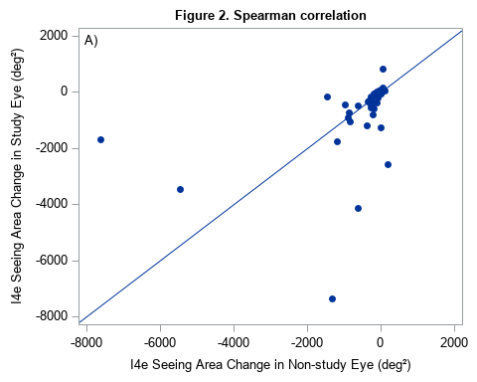
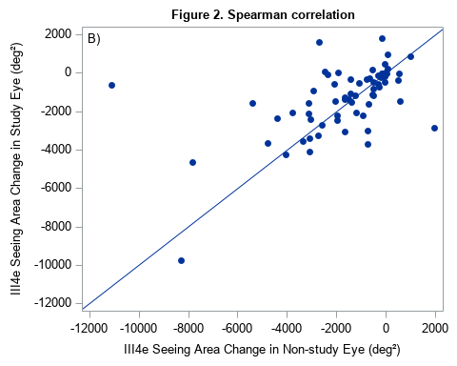
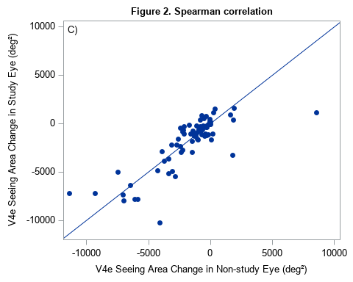
High Correlation of Change in KP Measures between Study and Non-Study Eyes
Change in I4e Area
Change in III4e Area
Change in V4e Area
Spearman Correlation = 0.74
P < 0.001
Spearman Correlation = 0.64
P < 0.001
Spearman Correlation = 0.79
P < 0.001
Notes:
We observed symmetry between the right and left eyes in KP measures

Slide 22
Comparison of SP Measures
Features of Outcome Measures | V_{TOT} | V₃₀ | V_{PERIPH} | SP MS_{CW}
Standardized rate of change, (95% confidence interval) | -1.34 (-1.66, -1.08) | -1.54 (-1.82, -1.31) | -1.28 (-1.68, -0.99) | -1.58 (-1.86, -1.35)
Eyes worsening ≥ CoR at 2 yr | 8% | 8% | 9% | 12%
(95% confidence interval) | (4%, 16%) | (4%, 16%) | (4%, 18%) | (6%, 21%)
Eyes improving ≥ CoR at 2 yr | 1% | 1% | 1% | 1%
Eyes worsening ≥CoR at 4 yr | 21% | 24% | 27% | 19%
(95% confidence interval) | (13%, 31%) | (16%, 34%) | (18%, 39%) | (12%, 29%)
Eyes improving ≥ CoR at 4 yr | 0% | 0% | 1% | 0%
Notes:
When we standardize the rates of change to account for the different scale of measurement and the different variability in the estimates of slopes, the 4 SP measures are fairly similar with a numeric advantage for V₃₀ and SP MS_{cw} for sensitivity of change when we look at slopes. When looking at the percentages that exceed the Coefficient of Repeatability (CoR) the 3 HOV measures have 21-27% change and SP MS_{cw} is a little lower at 19%. Aside from 1 eye for V_{PERIPH}, eyes did not show improvement greater than the CoR.

Slide 23
Static Perimetry: Functional Transition Points
FDA defines meaningful progression as an average change of 7 dB in 5 or more points
Functional Transition Points (FTPs) selected from points with baseline sensitivity at least 8 dB
FTP selected if more peripheral neighbors have 7 dB worse sensitivity
Always select at least 5 points in each eye

Slide 24
Static Perimetry: Functional Transition Points
Percent with Meaningful Change from Baseline to 4 Years
Point Subset | N | Points | Meeting FDA Criterion (95% CI)
Entire Grid | 91 | 185 | 5% (2%, 12%)
Central 30⁰ | 91 | 108 | 9% (5%, 16%)
FTPs | 91 | 5-30 | 45% (35%, 55%)
Average Annual Change
Point Subset | N | Annual Change (dB) (95% CI) | Standardized Rate of Change (95% CI)
Entire Grid | 102 | -0.51 (-0.58, -0.44) | -1.42 (-1.49, -1.35)
Central 30⁰ | 102 | -0.53 (-0.61, -0.45) | -1.29 (-1.37, -1.21)
FTPs | 102 | -1.50 (-1.65, -1.35) | -1.94 (-2.09, -1.79)
Notes:
Top is change from baseline to 4 years, so N is based on eyes with results at baseline and 4 years
Bottom is modeled annual change using a mixed model, so any eye with two observations is included

Slide 25
Static Perimetry: Summary of Results
RUSH2A visual field measures showed significant change over 48 months
The greatest annual rates of change were observed in V_{TOT} and V_{PERIPH}
But the standardized rates of change were somewhat higher for V₃₀ and SP Mean Sensitivity
FTPs are more likely to change significantly over 4 years

Slide 26
Kinetic Perimetry: Summary of Results
Changes in 3 KP measures from baseline to 4 years in study eyes were strongly correlated with the changes in non-study eyes
The annual percentage rates of change in both I4e seeing area and V4e seeing area were significantly associated with their corresponding baseline values
Change in III4e seeing area most correlated with change in FST measures

Slide 27
Discussion
SP demonstrated significant but modest change in several SP parameters at both 2 years and 4 years
Overall, all perimetry measures, both SP and KP, decreased over time
Annual rates of change and percent rates of change at 4 years were similar to those observed at 2 years for all SP measures

Slide 28
Discussion (cont.)
Most of the changes in SP measures were moderately correlated with the changes in KP measures
The most sensitive retinal function may reside in regions corresponding to the III4e area which may include contributions from rod function

Slide 29
Conclusion
Quantitative perimetry measures declined significantly over 4 years in USH2A-related retinal degeneration
Rates of change were greatest in participants with sufficiently preserved baseline visual fields
More eyes progress beyond FDA threshold when only Functional Transition Points are considered

