Slide 1
Static Perimetry in the Rate of Progression in USH2A-Related Retinal Degeneration (RUSH2A) Study: Assessment Through Two Years

Slide 2
Citation, Funding, Disclaimer
Citation
Duncan JL, Cheng P, Maguire MG, Ayala AA, Birch DG, Cheetham JK, Durham TA, Fahim AT, Hoyng CB, Ishikawa H, Michaelides M, Pennesi ME, Sahel JA, Stingl K, Weng CY; Foundation Fighting Blindness Consortium Investigator Group. Static Perimetry in the Rate of Progression in USH2A-related Retinal Degeneration (RUSH2A) Study: Assessment Through 2 Years. Am J Ophthalmol. 2023 Jun;250:103-110. doi: 10.1016/j.ajo.2023.02.002.
Funding
This study was funded by Foundation Fighting Blindness
Disclaimer
The source of the data is the Foundation Fighting Blindness Clinical Consortium, but the analyses, content and conclusions presented herein are solely the responsibility of the authors/presenters and may not reflect the views of the Foundation Fighting Blindness.

Slide 3
Background
Disease-causing variants in the USH2A gene are among the most common causes of photoreceptor degeneration
Biallelic variants can result in:
  Usher syndrome type 1 (USH2)
  Non-syndromic autosomal recessive RP (ARRP)
Treatments for USH2A-related USH2 and ARRP have been more challenging than other autosomal recessive retinal degenerations to deliver
To inform the design and interpretation of clinical trials for USH2A-related retinal degeneration, natural history studies of disease progression are essential

Slide 4
Background (Cont)
The Rate of Progression of USH2A-related Retinal Degeneration (RUSH2A) study is a multicenter, international, longitudinal natural history study to collect data from both USH2 and ARRP patients
Here we present change in static perimetry (SP) and other measures of retinal function and structure after 2 years, midway through the 4-year study period
The 2-year results may help to inform interpretation of treatment trial results and shape study design of future clinical trials for patients with USH2A-related USH2 and ARRP

Slide 5
Methods for SP
SP performed using
  Octopus 900 (Haag-Streit, Mason Ohio)
  German Adaptive Thresholding Estimation (GATE) strategy
  A custom centrally-condensed 186-point grid
SP performed 3 times at study baseline and 1 time at each follow-up visit on better seeing eye
Graded by Casey Reading Center

Slide 6
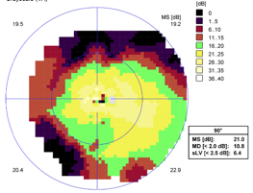
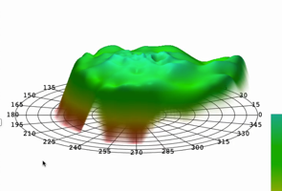
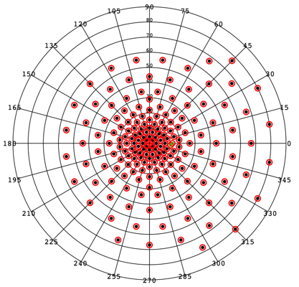
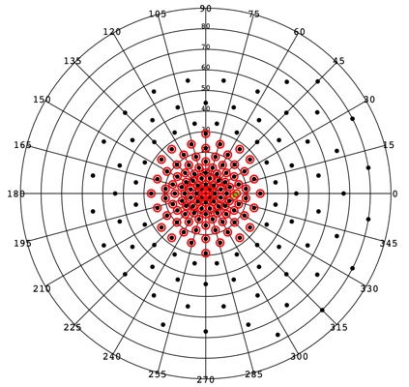
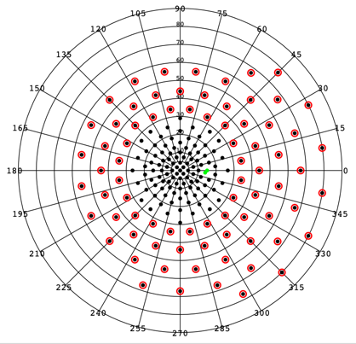
Static Perimetry Grids and Measures
Manufacturer’s printout
MS_{CW} (dB)
Center Weighted Numerical Averages all points tested in field including zeros
V_{TOT} (dB-sr)
Custom RP 186-point grid
Full Field Hill of Vision
V₃₀ (dB-sr)
30 degree radius
(60 degree solid angle)
V_{PERIPH} (dB-sr)
V_{TOT} - V₃₀

Slide 7
Statistical Methods
Entire Analysis Cohort (N=102):
  Study eyes that have test results for at least 2 of the 3 time points up (baseline, 1 year and 2 year)
Preserved Visual Field (VF) Cohort (N=88):
  Study eyes from the entire analysis cohort with baseline VTOT > 5 dB-sr

Slide 8
Statistical Methods (Cont)
Annual rates of change estimated by mixed effects models with random intercept
Annual percentage rates of change estimated by modeling on log transformed data
Mixed effects models applied to both the entire analysis cohort and the restricted cohort
Additional models performed on the restricted cohort
  Excluding unreliable test results (false positive ≥ 15%, N=8)
  Down-weighting outlier rates of change
Spearman correlation calculated among change in SP measures and with change in other visual measures

Slide 9
Participant Visit Flowchart
Baseline:
105 Completed in the Primary Cohort
1 Patient Death
Year 1 Visit:
102 Completed (11 out of +/- 4-week window)
2 Missed
Year 2 Visit:
88 Completed (33 out of +/- 4-week window)
13 Remote Visit (Patient-Reported Outcome Only)
3 Missed
During the COVID-19 pandemic

Slide 10
Baseline Characteristics (N=102)
 | N (%)
Clinical Diagnosis
USH2 | 64 (63%)
ARRP | 38 (37%)
Female | 58 (57%)
Non-Hispanic White | 91 (89%)
Age (yrs) Mean ± SD | 37 ± 13
Duration of Disease (yrs) Median (IQR) | 13 (7, 20)

Slide 11
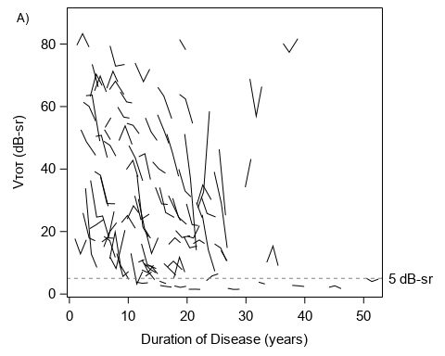
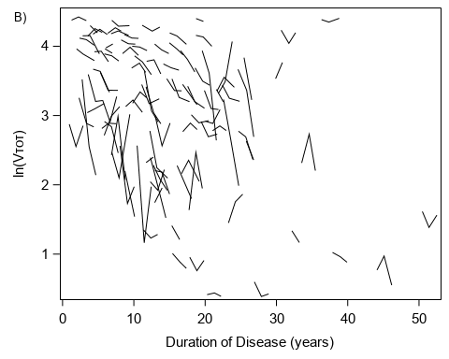
Spaghetti Plot for VTOT by Duration of Disease

Slide 12
SP Measures at Each Visit
Outcomes | Baseline | Year 1 | Year 2
V_{TOT} (dB-sr) | N= 98 ª | N=96 | N=85
Mean ± SD | 33.1 ± 23.5 | 30.9 ± 23.4 | 29.0 ± 22.6
Range | 1.5 to 90.5 | 1.5 to 84.5 | 1.5 to 87.5
V₃₀ (dB-sr) | N=102 | N=100 | N=87
Mean ± SD | 10.2 ± 5.6 | 9.8 ± 5.5 | 9.2 ± 5.4
Range | 1.5 to 22.7 | 1.5 to 22.3 | 1.5 to 21.8
V_{PERIPH} (dB-sr) | N= 98 ª | N=96 | N=85
Mean ± SD | 22.8 ± 18.8 | 21.0 ± 18.8 | 19.7 ± 18.1
Range | 0.0 to 70.8 | 0.0 to 65.5 | 0.0 to 66.1
Mean Sensitivity (dB) | N= 98 ª | N=96 | N=85
Mean ± SD | 11.7 ± 5.8 | 11.1 ± 5.7 | 10.6 ± 5.5
Range | 2.4 to 24.6 | 2.1 to 24.3 | 2.2 to 24.6
ª Four participants had missing data due to wrong grid being used

Slide 13
Estimated Annual Rates of Change
Outcomes | Entire cohort (N=102) | ---------------------Restricted cohort -----------------------
 |  | All (N=88) | False positives <15% (N=80) | Outliers down-weighted (N=88)
V_{TOT} (dB-sr/year)
Slope Estimate | -2.05 | -2.25 | -2.27 | -2.03
95% CI | (-2.70, -1.40) | (-2.96, -1.54) | (-2.92, -1.62) | (-2.57, -1.49)
V₃₀ (dB-sr/year)
Slope Estimate | -0.48 | -0.56 | -0.52 | -0.52
95% CI | (-0.65, -0.32) | (-0.73, -0.40) | (-0.67, -0.37) | (-0.65, -0.38)
V_{PERIPH} (dB-sr/year)
Slope Estimate | -1.53 | -1.68 | -1.75 | -1.56
95% CI | (-2.08, -0.97) | (-2.29, -1.07) | (-2.31, -1.18) | (-2.02, -1.10)
Mean Sensitivity (dB/year)
Slope Estimate | -0.55 | -0.60 | -0.58 | -0.54
95% CI | (-0.71, -0.40) | (-0.77, -0.43) | (-0.73, -0.43) | (-0.67, -0.41)

Slide 14
Estimated Annual Percentage Rates of Change
Outcomes | Entire cohort (N=102) | ---------------------Restricted cohort -----------------------
 |  | All (N=88) | False positives <15% (N=80) | Outliers down-weighted (N=88)
V_{TOT} (%/year)
Slope Estimate | -8.3 | -8.8 | -8.3 | -7.3
95% CI | (-11.1, -5.5) | (-11.7, -5.7) | (-11.3, -5.2) | (-9.7, -4.8)
V₃₀ (%/year)
Slope Estimate | -5.2 | -5.9 | -5.5 | -5.0
95% CI | (-7.4, -3.0) | (-7.9, -4.0) | (-7.4, -3.5) | (-6.8, -3.3)
V_{PERIPH} (%/year)
Slope Estimate | -16.0 | -13.6 | -13.2 | -9.7
95% CI | (-22.0, -9.5) | (-19.2, -7.7) | (-19.1, -6.9) | (-13.7, -5.5)
Mean Sensitivity (%/year)
Slope Estimate | -5.1 | -5.4 | -5.1 | -4.9
95% CI | (-6.7, -3.5) | (-7.1, -3.7) | (-6.8, -3.4) | (-6.3, -3.5)

Slide 15
Spearman Correlation Coefficients (95% CI)
Among Change in SP Measures
 | V_{TOT} | V₃₀ | V_{periph} | SP Mean sensitivity
V_{TOT}, dB-sr | 1.00
V₃₀, dB-sr | 0.66 (0.52, 0.77) | 1.00
V_{PERIPH}, dB-sr | 0.98 (0.96, 0.98) | 0.52 (0.35, 0.66) | 1.00
SP Mean sensitivity, dB | 0.86 (0.79, 0.91) | 0.91 (0.87, 0.94) | 0.76 (0.66, 0.84) | 1.00

Slide 16
Spearman Correlation Coefficients (95% CI)
Change in SP Measures vs Other Visual Measures
 | V_{TOT} | V₃₀ | V_{periph} | SP Mean sensitivity
BCVA, letters | 0.12 (-0.09, 0.33) | 0.06 (-0.15, 0.27) | 0.12 (-0.09, 0.33) | 0.07 (-0.15, 0.28)
FST white, -dB | 0.11 (-0.14, 0.35) | -0.10 (-0.15, 0.33) | 0.05 (-0.20, 0.29) | 0.10 (-0.15, 0.34)
FST blue, -dB | -0.02 (-0.27, 0.23) | 0.07 (-0.17, 0.31) | -0.07 (-0.31, 0.18) | 0.04 (-0.21, 0.28)
FST red, -dB | 0.14 (-0.11, 0.38) | 0.07 (-0.18, 0.31) | 0.11 (-0.14, 0.35) | 0.09 (-0.16, 0.33)
Microperimety Mean sensitivity, dB | 0.12 (-0.12, 0.35) | 0.25 (0.02, 0.46) | 0.08 (-0.16, 0.32) | 0.19 (-0.05, 0.41)

Slide 17
Spearman Correlation Coefficients (95% CI)
Change in SP vs Other Visual Measures
 | V_{TOT} | V₃₀ | V_{periph} | SP Mean sensitivity
OCT Ellipsoid zone area, mm² | 0.28 (0.07, 0.47) | 0.40 (0.21, 0.57) | 0.24 (0.02, 0.43) | 0.38 (0.18, 0.55)
OCT CST (no CME), microns | 0.38 (0.09, 0.62) | 0.24 (-0.06, 0.50) | 0.40 (0.10, 0.62) | 0.34 (0.04, 0.59)

Slide 18
Summary of Results
RUSH2A visual field measures showed significant change over 24 months
The greatest annual rates of change were observed in V_{TOT} and V_{PERIPH}
The lowest annual rates of change were in V₃₀ and Mean Sensitivity

Slide 19
Discussion
V_{TOT} and V_{PERIPH}
  Side vision lost earliest in USH2A-related retinal degeneration
  Regions where rods are predominant
  More prone to change
V₃₀ and Mean Sensitivity
  Central vision preserved longest in USH2A-related retinal degeneration
  Regions where cones are predominant
  Less prone to change

Slide 20
Challenges
Substantial inter-individual variability in progressive VF loss over 2 years
Low follow-up completion rate at 24M:
  N=105 at baseline
  N= only 88 with limited follow up during COVID-19 pandemic

Slide 21
Conclusions
Significant rates of decline in all 4 SP metrics (V_{TOT,} V_{PERIPH,} V₃₀ and Mean Sensitivity) over 24 months
Strong internal correlation among SP measures
Mild correlation with OCT EZ area and CST (and V₃₀ with MP)
4 Year data will be helpful (improve “signal to noise” – less variability around estimates of rates of change)

