Slide 1
The RUSH2A Study: Dark-Adapted Visual Fields (DAVF) in patients with retinal degeneration associated with biallelic variants in the USH2A gene

Slide 2
Citation, Funding, Disclaimer
Citation
Birch DG, Samarakoon L, Melia M, Duncan JL, Ayala AR, Audo I, Cheetham JK, Durham TA, Iannaccone A, Pennesi ME, Stingl K; Foundation Fighting Blindness Consortium Investigator Group. The RUSH2A Study: Dark-Adapted Visual Fields in Patients With Retinal Degeneration Associated With Biallelic Variants in the USH2A Gene. Invest Ophthalmol Vis Sci. 2022 Mar 2;63(3):17. doi: 10.1167/iovs.63.3.17.
Funding
This study was funded by Foundation Fighting Blindness
Disclaimer
The source of the data is the Foundation Fighting Blindness Clinical Consortium, but the analyses, content and conclusions presented herein are solely the responsibility of the authors/presenters and may not reflect the views of the Foundation Fighting Blindness.

Slide 3
Background
The Rate of Progression of USH2A-related Retinal Degeneration (RUSH2A) study is an ongoing multicenter, international, longitudinal natural history study to collect data from both Usher syndrome type 2 (USH2) and non-syndromic autosomal recessive (ARRP) patients
The RUSH2A study incorporates rod electroretinogram (ERG) and full-field sensitivity testing (FST) to study progression of rod loss. However,
  ERG is not measurable in most patients at baseline
  FST does not provide topographical information on rod loss
Dark adapted visual field (DAVF) testing is an ancillary study created for the purpose of studying rod function, beginning at the 12-month RUSH2A visit in selected sites
This study measures rod-mediated visual field thresholds using DAVF with two-color dark-adapted chromatic (DAC) perimetry

Slide 4
Background
Objectives:
  Estimate proportion of patients with evidence of rod function at initial testing (12 months)
  Estimate correlation with other rod function measures
  Study association of rod function with age or duration of disease, and diagnosis (USH2 vs ARRP)

Slide 5
Methods – Measures of Visual Function
Cyan - Red Sensitivity (used to define DAVF Rod Function)
  Conducted starting at 12M and annual follow-up visits on study eye
  Medmont DAC used with cyan and red grids
    Investigator review determined the presence of at least one cluster (location with three or more adjacent rod-mediated points) of rod-mediated points in the visual field.
    DAVF Rod function defined by Cyan - red sensitivity by 5dB at a cluster
DAVF Measures
  Images from Medmont DAC processed to calculate:
  Sub-Bullet
    Vtot, V30, Mean sensitivity, Number of Rod Loci, Full field Rod Mean Sensitivity, and Maximum Sensitivity

Slide 6
Methods – Measures of Visual Function
Full-field Electroretinography (ERG)
  Conducted at baseline and 48M on study eye
  ERG measures included in current analyses
    Amplitude of the b-wave from the dark-adapted dim-flash 0.01 cd.s/m2 ERG response (DA 0.01 ERG)
    Amplitude of the b-wave of the dark-adapted standard flash 3.0 cd.s/m2 ERG (DA 3.0 ERG)
Full-field Stimulus Threshold (FST)
  Conducted at baseline and annual follow-up visits on study eye
  Performed on Diagnosys Espion where available
  White, blue and red stimuli were used
  Measured in triplicate for each color at each visit

Slide 7
Methods – Measures of Visual Function
Vtot (Full field Hill of Vision)
  Conducted at baseline and annual follow-up visits on study eye
  Measured in triplicate
V30 (central 30-degree Hill of Vision)
  Conducted at baseline and annual follow-up visits on study eye
  Measured in triplicate

Slide 8
Methods - Statistical
Logistic regression models used to assess rod function by DAVF between USH2 and ARRP groups
Fisher exact test used to assess difference in proportion of patients with rod function by DAVF among age and disease duration groups
Linear regression models used to estimate rate of decline of DAVF continuous measures as a function of disease duration
Spearman correlation coefficients calculated between continuous DAVF measures and standard summary measures of visual field
Kappa statistics calculated to measure agreement between rod function by DAVF vs other modalities (FST white/blue stimulus, ERG rod b-wave)

Slide 9
Study Population (N=49)
Primary cohort – N=105
Participants screened for rod function – N=49
Participants diagnosed with Usher syndrome type 2a (USH2) vs non-syndromic RP (ARRP) – 28 (57%) vs 21 (43%)
Participant summary (N=49) – 60% female; 90% white; and 63% from US/Canada
Median participant age – 37 years [IQR: 30 , 48]
Median age at onset – 19 years [IQR: 14 , 27]
Median disease duration – 14 years [IQR: 7 , 21]
Evidence of rod function by DAVF – N=38 (78%)

Slide 10
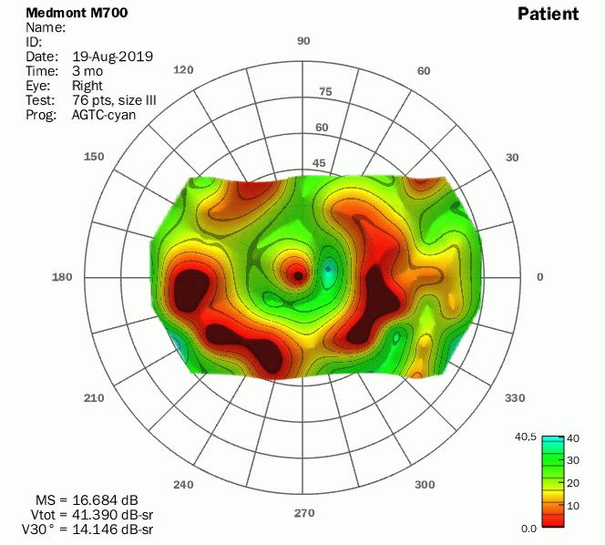
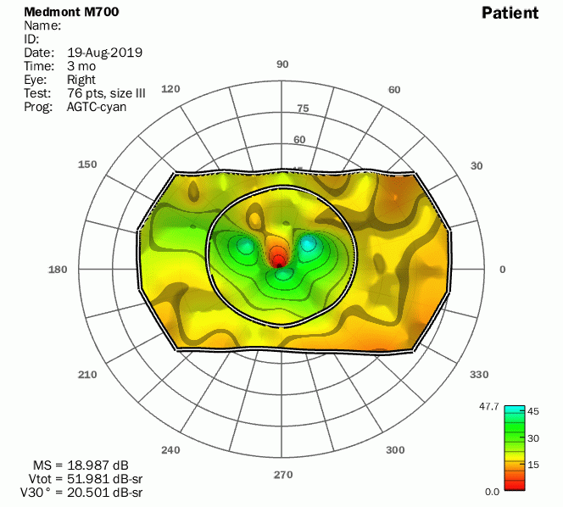
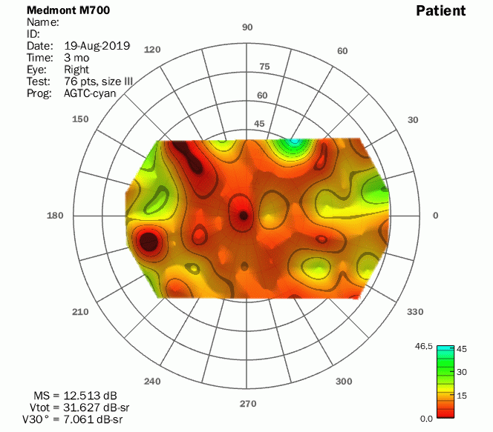
Results – Representative DAVF

Slide 11
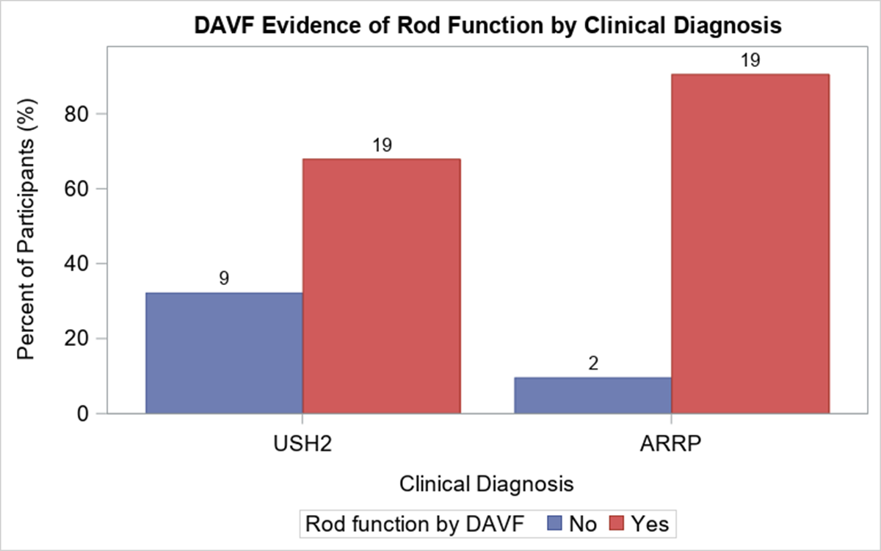
DAVF Rod Function and Diagnosis
No significant difference in DAVF Rod Function by Diagnosis
*P=0.09
*Adjusted for disease duration
Notes:
-Higher percent of participants with evidence of rod function in ARRP group vs USH2A group – Tested this difference for significance
- P=0.09 - no conclusive evidence for a difference, possibly due to small sample size

Slide 12
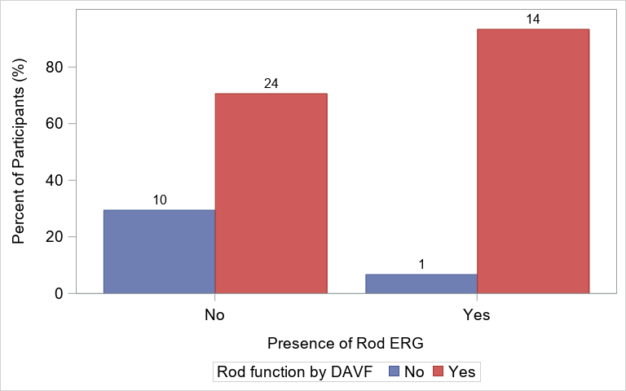
DAVF Rod Function and Rod ERG
DAVF Rod Function was measurable in More Patients than ERG Rod Function
Measurable rod ERGs - 15/49 (31%)
Measurable rod DAVF – 38/49 (78%)

Slide 13
Proportion with DAVF Rod Function by Clinical Diagnosis and Disease Duration
Proportion with DAVF Rod Function appears to be lower in patients with longer disease duration
 | USH2 |  | ARRP
 | <15 years (N=13) | ≥15 years (N=15) | <15 years (N=12) | ≥15 years (N=9)
Evidence of Rod Function | 10 (77%) | 9 (60%) | 12 (100%) | 7 (78%)
Notes:
-15 years of disease duration used for stratifying since it is close to median disease duration

Slide 14
Proportion with DAVF Rod Function by Clinical Diagnosis and Age
Proportion with DAVF Rod Function appears to be lower in older patients (40 years and above)
 | USH2 |  | ARRP
 | <40 years (N=20) | ≥40 years (N=8) | <40 years (N=8) | ≥40 years (N=13)
Evidence of Rod Function | 15 (75%) | 4 (50%) | 8 (100%) | 11 (85%)

Slide 15
Agreement of Rod Function by DAVF with FST White Stimulus and ERG Rod B-wave
Rod Function by: | Rod Function by: | Rod Function by :
 | FST White Stimulus* |  |  | ERG Rod B-wave**
DAVF | No N (%) | Yes N (%) | Κ*** (95% CI) | No N (%) | Yes N (%) | K *** (95% CI)
No (N=11) | 10 (22%) | 0 (9%) | 0.38 (0.18, 0.58) | 10 (20%) | 1 (2%) | 0.16 (0.004, 0.31)
Yes (N=38) | 15 (33%) | 21 (46%) |  | 24 (49%) | 14 (29%)
*FST White thresholds below -30 indicates rod mediation
** Amplitude b-wave rod response greater than 0 indicates rod mediation
*** Kappa measure of agreement
Notes:
Rod function by DAVF defined as at least one cluster of rod-mediated points in visual field where cyan relative to red sensitivity is > 5 dB
There is a high number of patients with evidence of rod function and no rod ERGS, but lower number of patients with no evidence of rod function and rod ERGs present
Agreement regarding evidence of rod function relatively poor for both FST white (k=0.35) and ERG Rod (k=0.16)

Slide 16
Maximum DAVF Sensitivity Correlates with FST White and Blue Stimulus
(In Eyes w/ Evidence of Rod Function by DAVF)
 | Mean Sensitivity |  | V_{TOT} |  | V₃₀
Standard Measures | r | P-value | r | P-value | r | P-value
Octopus Mean Sensitivity | 0.37 | 0.023 | 0.38 | 0.020 | 0.38 | 0.020
Octopus - V_{TOT} | 0.40 | 0.014 | 0.40 | 0.015 | 0.33 | 0.048
Octopus - V₃₀ | 0.31 | 0.062 | 0.33 | 0.048 | 0.37 | 0.025
FST White | -0.71 | <.0001 | -0.72 | <.0001 | -0.61 | <.0001
FST Blue | -0.78 | <.0001 | -0.78 | <.0001 | -0.64 | <.0001
Notes:
DAVF measures highly inversely correlated with FST white and FST Blue

Slide 17
Correlation of DAVF with Additional Standard Measures at Baseline (N=38)
Baseline Measures | DAVF Measures | r | P-value
FST White | Maximum Sensitivity | -0.80 | <.0001
FST Blue | Maximum Sensitivity | -0.85 | <.0001
ERG* | V_{TOT} | 0.43 | 0.006
ERG* | Full Field Rod Mean Sensitivity | 0.41 | 0.010
*The amplitude of the b-wave from the dark-adapted dim-flash 0.01 cd.s/m² ERG response
Notes:
DAVF Max sensitivity highly inversely correlated with FST white and FST Blue.
ERG moderately correlated with full field hill of vision and full field rod mean sensitivity

Slide 18
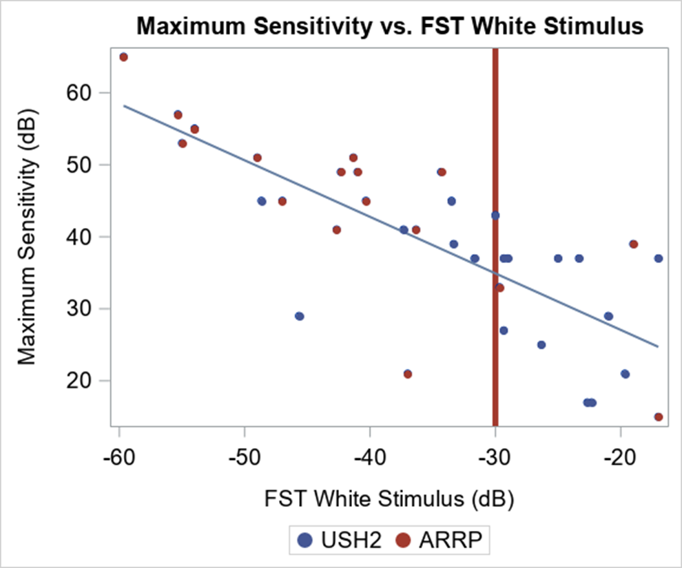
Maximum DAVF Sensitivity was significantly lower in patients with higher FST White Stimulus
(In Eyes w/ Evidence of Rod Function by DAVF)
N | Estimate | P-value
38 | -0.78 | <.0001

Slide 19
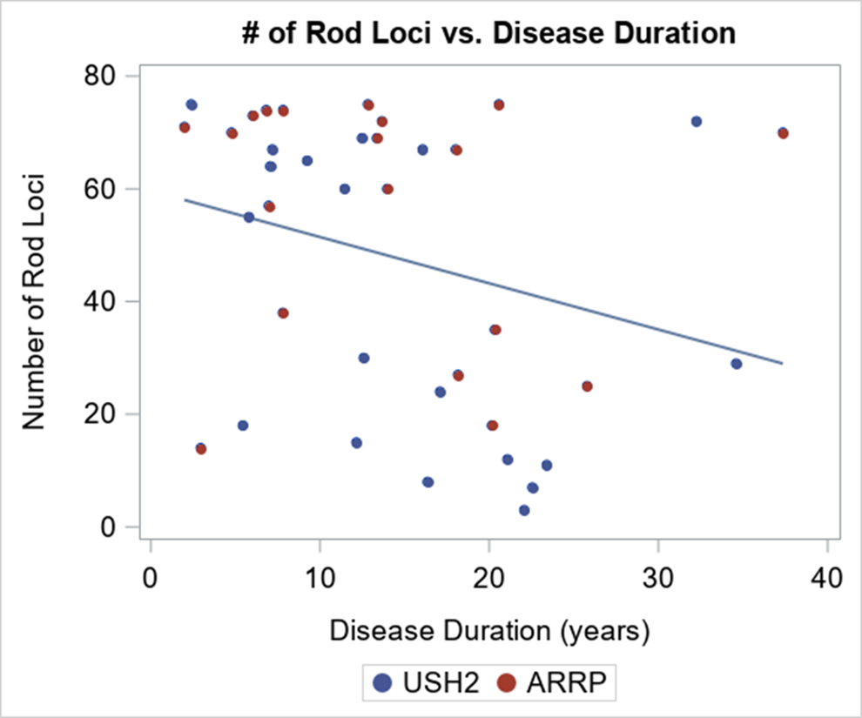
Number of Rod Loci was somewhat, but not significantly, lower in patients with longer Disease Duration
(In Eyes w/ Evidence of Rod Function by DAVF)
N | Estimate | P-value
38 | -0.82 | 0.0849

Slide 20
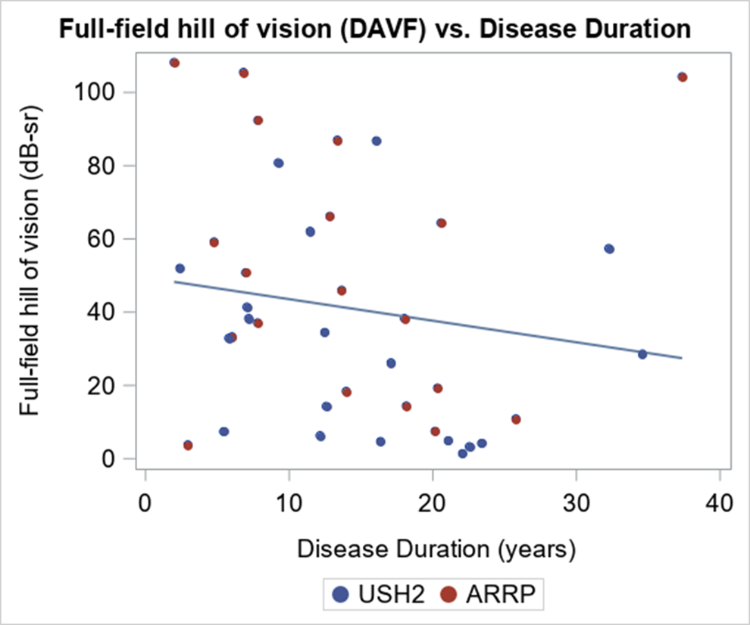
Full Field Hill of Vision was somewhat, but not significantly, lower in patients with longer Disease Duration
(In Eyes w/ Evidence of Rod Function by DAVF)
N | Estimate | P-value
38 | -0.59 | 0.3384

Slide 21
Discussion
Two-color dark-adapted perimetry reliably identifies rod-mediated function in the majority of patients with USH2A mutations, even though many show no evidence of rod ERG function
Maximum rod sensitivity from DAVF is highly correlated with FST sensitivity to a white stimulus, consistent with both measuring the most sensitive region
The volume of the rod Hill of Vision reflects both the topography and the extent of remaining rod function

