Slide 1
Endpoints and Design for Clinical Trials in
USH2A-Related Retinal Degeneration:
Results and Recommendations
From the RUSH2A Natural History Study

Slide 2
Citation, Funding, Disclaimer
Citation
Maguire MG, Birch DG, Duncan JL, Ayala AR, Ayton LN, Cheetham JK, Cheng P, Durham TA, Ferris FL 3rd, Hoyng CB, Huckfeldt RM, Jaffe GJ, Kay C, Lad EM, Leroy BP, Liang W, McDaniel LS, Melia M, Michaelides M, Pennesi ME, Sahel JA, Samarakoon L; REDI Working Group and the Foundation Fighting Blindness Clinical Consortium Investigator Group. Endpoints and Design for Clinical Trials in USH2A-Related Retinal Degeneration: Results and Recommendations From the RUSH2A Natural History Study. Transl Vis Sci Technol. 2024 Oct 1;13(10):15. doi: 10.1167/tvst.13.10.15.
Funding
This study was funded by Foundation Fighting Blindness
Disclaimer
The source of the data is the Foundation Fighting Blindness Clinical Consortium, but the analyses, content and conclusions presented herein are solely the responsibility of the authors/presenters and may not reflect the views of the Foundation Fighting Blindness.

Slide 3
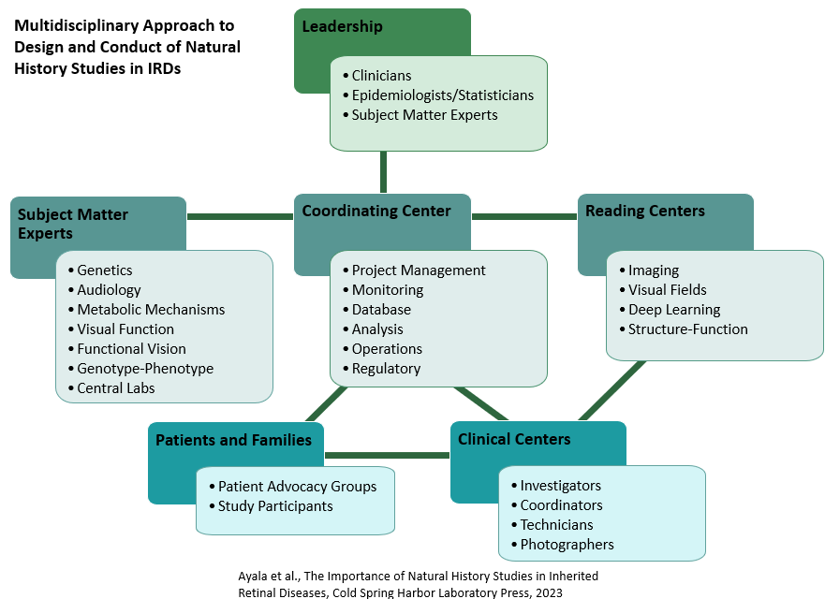

Consortium Overview
International consortium of clinical centers with expertise in inherited retinal degenerations (IRDs)
Goal: Accelerate development of treatments for IRDs
43 sites in 15 countries
Notes:
Founded in 2016; Modeled on DRCR Retina Network
Multidisciplinary approach is critical
We collaborate on studies, collect data, make it freely available
Ultimate goal is to advance development of treatments for IRDs,

Slide 4
Regulatory Endpoints and Trial Design for IRDs (REDI) Working Group
      Mission: Collaborate with a wide range of subject matter experts to identify and propose best endpoints and study design methods for IRD clinical trials, obtain input from industry and regulatory representatives, and disseminate recommendations.
      Endpoint Approach:
        Use Consortium NHS data to evaluate functional and structural measures of progression
        Develop candidate endpoints, including modification of existing and creation of new
        Compare properties of candidate endpoints, including repeatability, sensitivity, correlation with disease stage/progression, floor/ceiling effects, patient burden, degree of subjectivity, and clinical benefit
        Identify best candidate endpoints relative to various trial considerations, including study phase and goal of intervention (reverse/slow/stop disease)

Slide 5
REDI Initiative #1: RUSH2A Endpoints
    RUSH2A: Rate of Progression in USH2A-related Retinal Degeneration
      Four-year prospective study with annual visits
Study chair: Jacque Duncan, MD
Eligibility criteria included:
  Clinical diagnosis of rod-cone degeneration (ARRP or USH2)
  Biallelic USH2A variants
Primary cohort:
  ETDRS score ≥ 54 letters (Snellen equivalent 20/80; all participants ≥ 20/50)
  Central visual field ≥ 10° diameter on kinetic perimetry
    Assessments performed
    Functional
      Visual acuity, static perimetry, microperimetry, full-field stimulus testing, electroretinography
    Structural
      Ellipsoid zone area on OCT
    Patient-reported outcomes
      Visual function questionnaires (VALVVFQ-48 and MRDQ)
N=103 participants
with at least one follow-up visit included in analyses presented today
ARRP: Nonsyndromic autosomal recessive RP; USH2: Usher syndrome type 2

Slide 6
Methods
Annual rates of change estimated by mixed effect models with random intercept using data from all visits
Annual percentage rates of change estimated by modeling on log transformed data
Additional analyses performed on restricted cohorts
  Excluding unreliable test results
  Down-weighting outliers
Spearman correlation coefficient calculated for association of change in visual measures
Data presented within a “preserved cohort” when applicable
    When a floor effect existed for a given measure, a preserved cohort was created to limit analyses to participants who have room to progress
  Data presented from study eye (eye with better visual acuity at baseline)

Slide 7
Ideal Endpoint Properties
Large magnitude of change relative to variability in change
  Large “signal to noise” → Standardized rate of change
Change exceeds measurement variability
  “Real” change → Coefficient of repeatability (CoR)
Sensitive to change in most of a population
  Lack of floor or ceiling effect
Relevant to how a patient feels or functions
  Clinically meaningful

Slide 8
Primary Endpoint Results

Slide 9
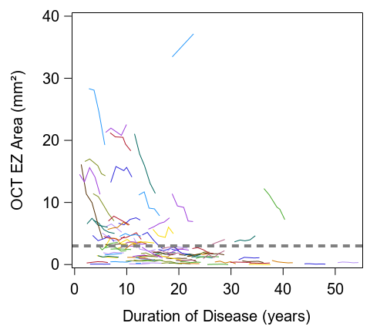
VA and EZ Area Have Limitations as Endpoints in USH2A-related IRD
Visual acuity
Slow progression
  Annual mean change ≤ 1 letter - not clinically meaningful
  Only 12% had change exceeding CoR at Year 4
  Only 2% exceed FDA threshold of 15 letters
Ellipsoid zone area
Floor effect (<3mm²) impacted 67% of cohort
Among those with EZ>3mm², standardized rate of change was lower (less change/more variability) than all other measures except BCVA
Change from Baseline (ETDRS letters) | Year 2 | Year 4
Baseline, ETDRS letters | (N=88) | (N=93)
≥ 15 | 0 (0%) | 0 (0%)
10 to 14 | 1 (1%) | 0 (0%)
5 to 9 | 3 (3%) | 2 (2%)
-4 to +4 | 65 (74%) | 55 (59%)
-9 to -5 | 15 (17%) | 28 (30%)
-14 to -10 | 4 (5%) | 6 (6%)
≤ -15 | 0 (0%) | 2 (2%)
CoR: 8.8 letters
CoR: Coefficient of repeatability; EZ: Ellipsoid zone

Slide 10
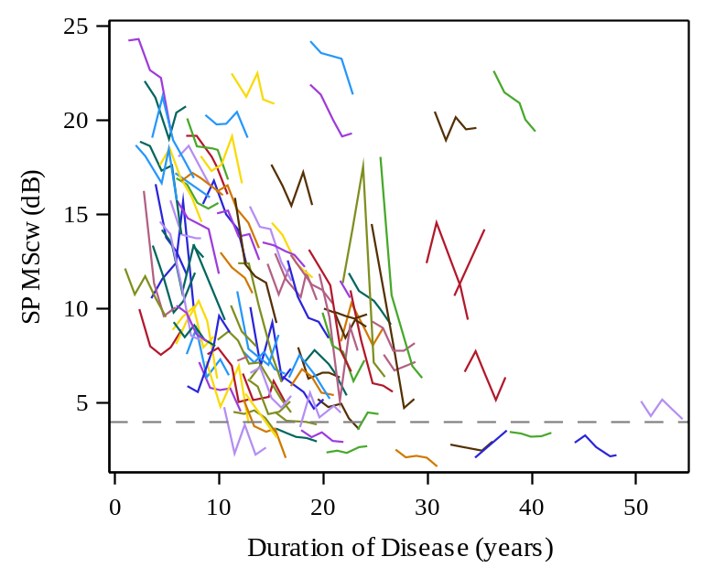
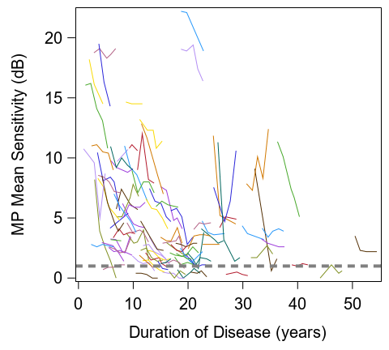
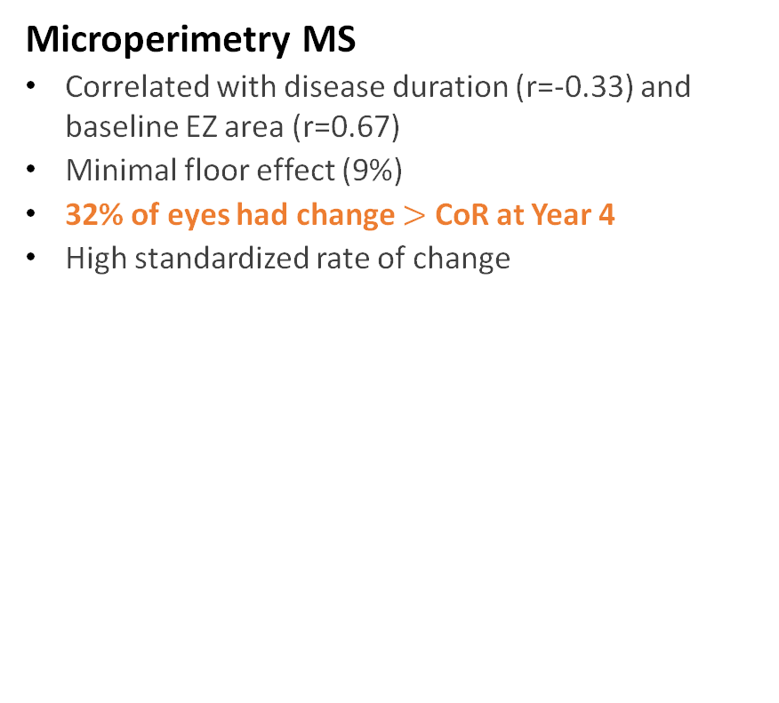
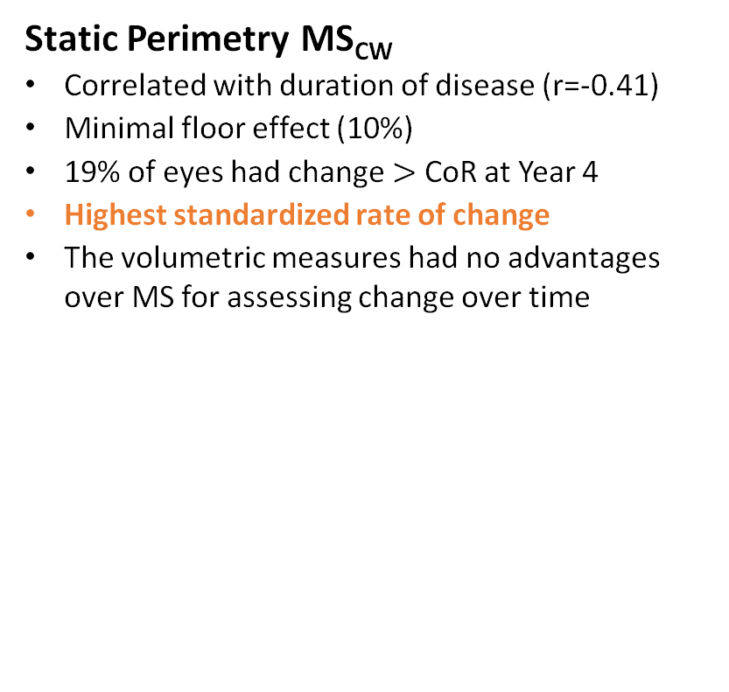
Visual Field Mean Sensitivity (MS) has Favorable Endpoint Properties in USH2A-related IRD
Static Perimetry MS_{CW}
Correlated with duration of disease (r=-0.41)
Minimal floor effect (10%)
19% of eyes had change $>$ CoR at Year 4
Highest standardized rate of change
The volumetric measures had no advantages over MS for assessing change over time
Microperimetry MS
Correlated with disease duration (r=-0.33) and baseline EZ area (r=0.67)
Minimal floor effect (9%)
32% of eyes had change $>$ CoR at Year 4
High standardized rate of change
CoR: 3.5 dB
CoR: 2.2 dB
CoR: Coefficient of repeatability
MS: Mean sensitivity

Slide 11
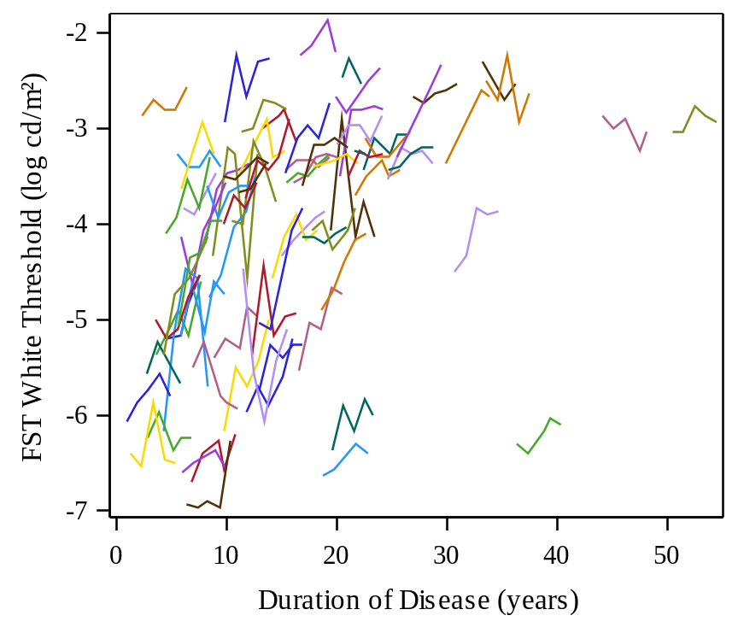
Full-field Stimulus Testing (FST) has Desirable Endpoint Qualities in USH2A-related IRD
Correlated with baseline EZ area (r=-0.73) and disease duration (r=0.51)
Negligible floor effect
High standardized rate of change
Low test-retest variability
Highest percentages of eyes exceeding CoR at Year 2 (30%) and Year 4 (47%)
CoR = 0.39 log cd.s/m²
CoR: Coefficient of repeatability

Slide 12
Exploratory Endpoint - Functional Transition Points (FTPs)
FTP patent pending
Contact FFB for licensing information

Slide 13
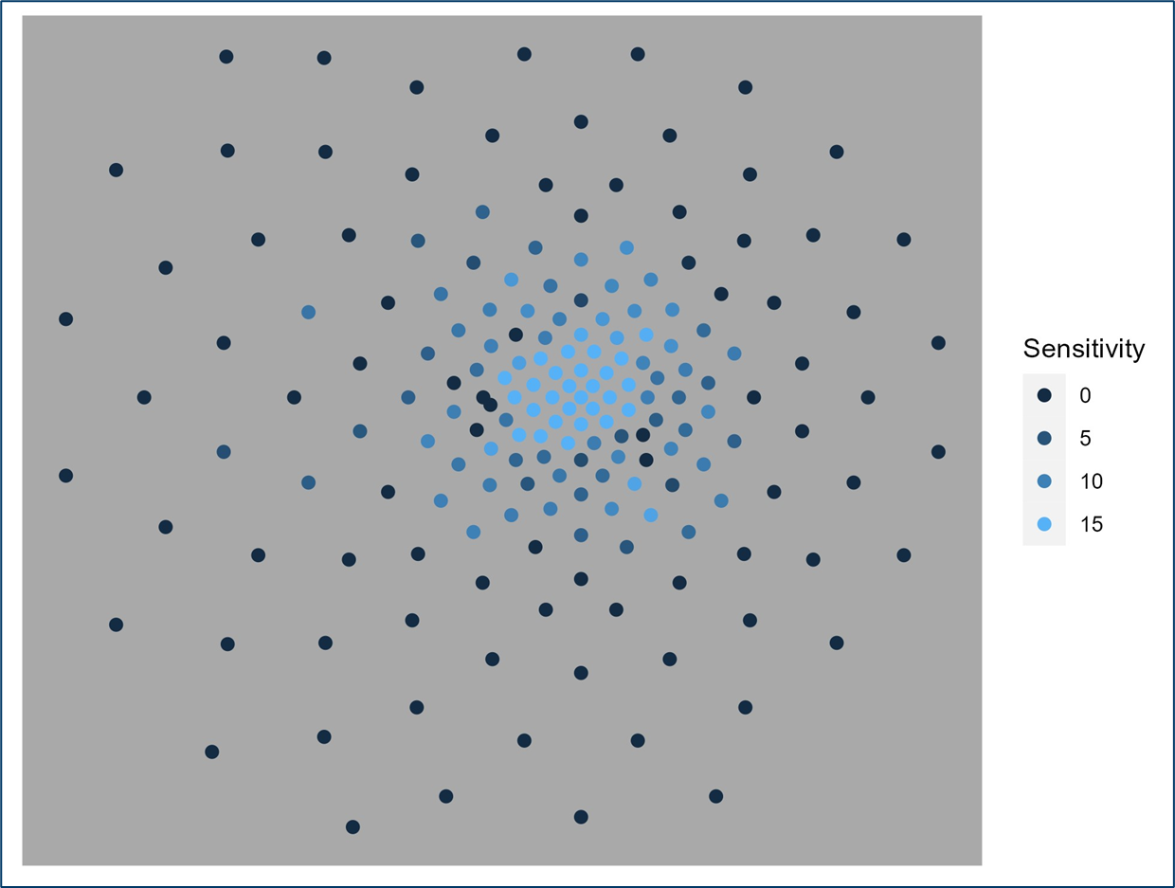
Functional Transition Points
Perimetry endpoint accepted by FDA: Mean change ≥ 7 dB in ≥ 5 pre-specified points
Not a viable endpoint choice in RUSH2A cohort for progression-slowing intervention
Static perimetry grid
 | Static Perimetry |  |  | Microperimetry
Points used → | All points | Central 30° | FTPs | All points | FTPs
2 Years | 2% | 0% | 31% | 0% | 19%
4 Years | 5% | 9% | 45% | 5% | 46%
Can we maximize the chance of meeting the FDA-approved outcome?
Basic idea: Identify ≥ 5 points at baseline with the highest chance of losing function over time*
* Modeled after work by Hood and Birch 2011
Notes:
Modeled after work by Hood and Birch 2011

Slide 14
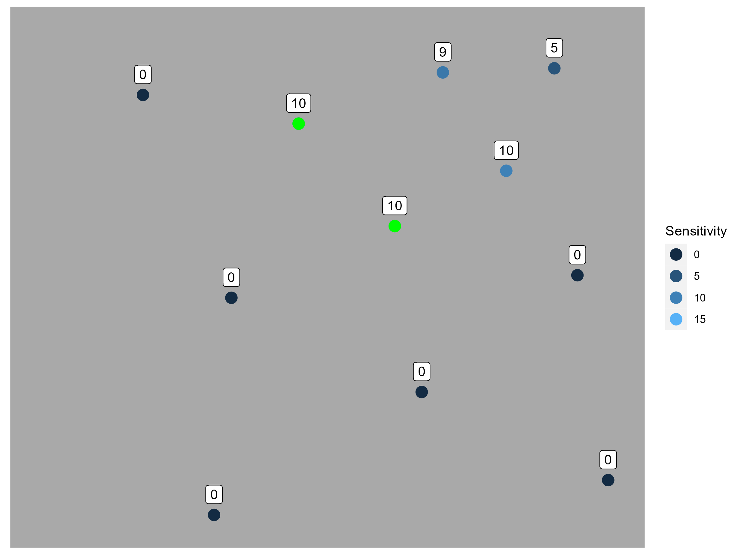
Functional Transition Points
Perimetry endpoint accepted by FDA: Mean change ≥ 7 dB in ≥ 5 pre-specified points
Not a viable endpoint choice in RUSH2A cohort for progression-slowing intervention
Assessing sensitivity difference
 | Static Perimetry |  |  | Microperimetry
Points used → | All points | Central 30° | FTPs | All points | FTPs
2 Years | 2% | 0% | 31% | 0% | 19%
4 Years | 5% | 9% | 45% | 5% | 46%
Can we maximize the chance of meeting the FDA-approved outcome?
Basic idea: Identify ≥ 5 points at baseline with the highest chance of losing function over time*
* Modeled after work by Hood and Birch 2011
Notes:
Modeled after work by Hood and Birch 2011

Slide 15
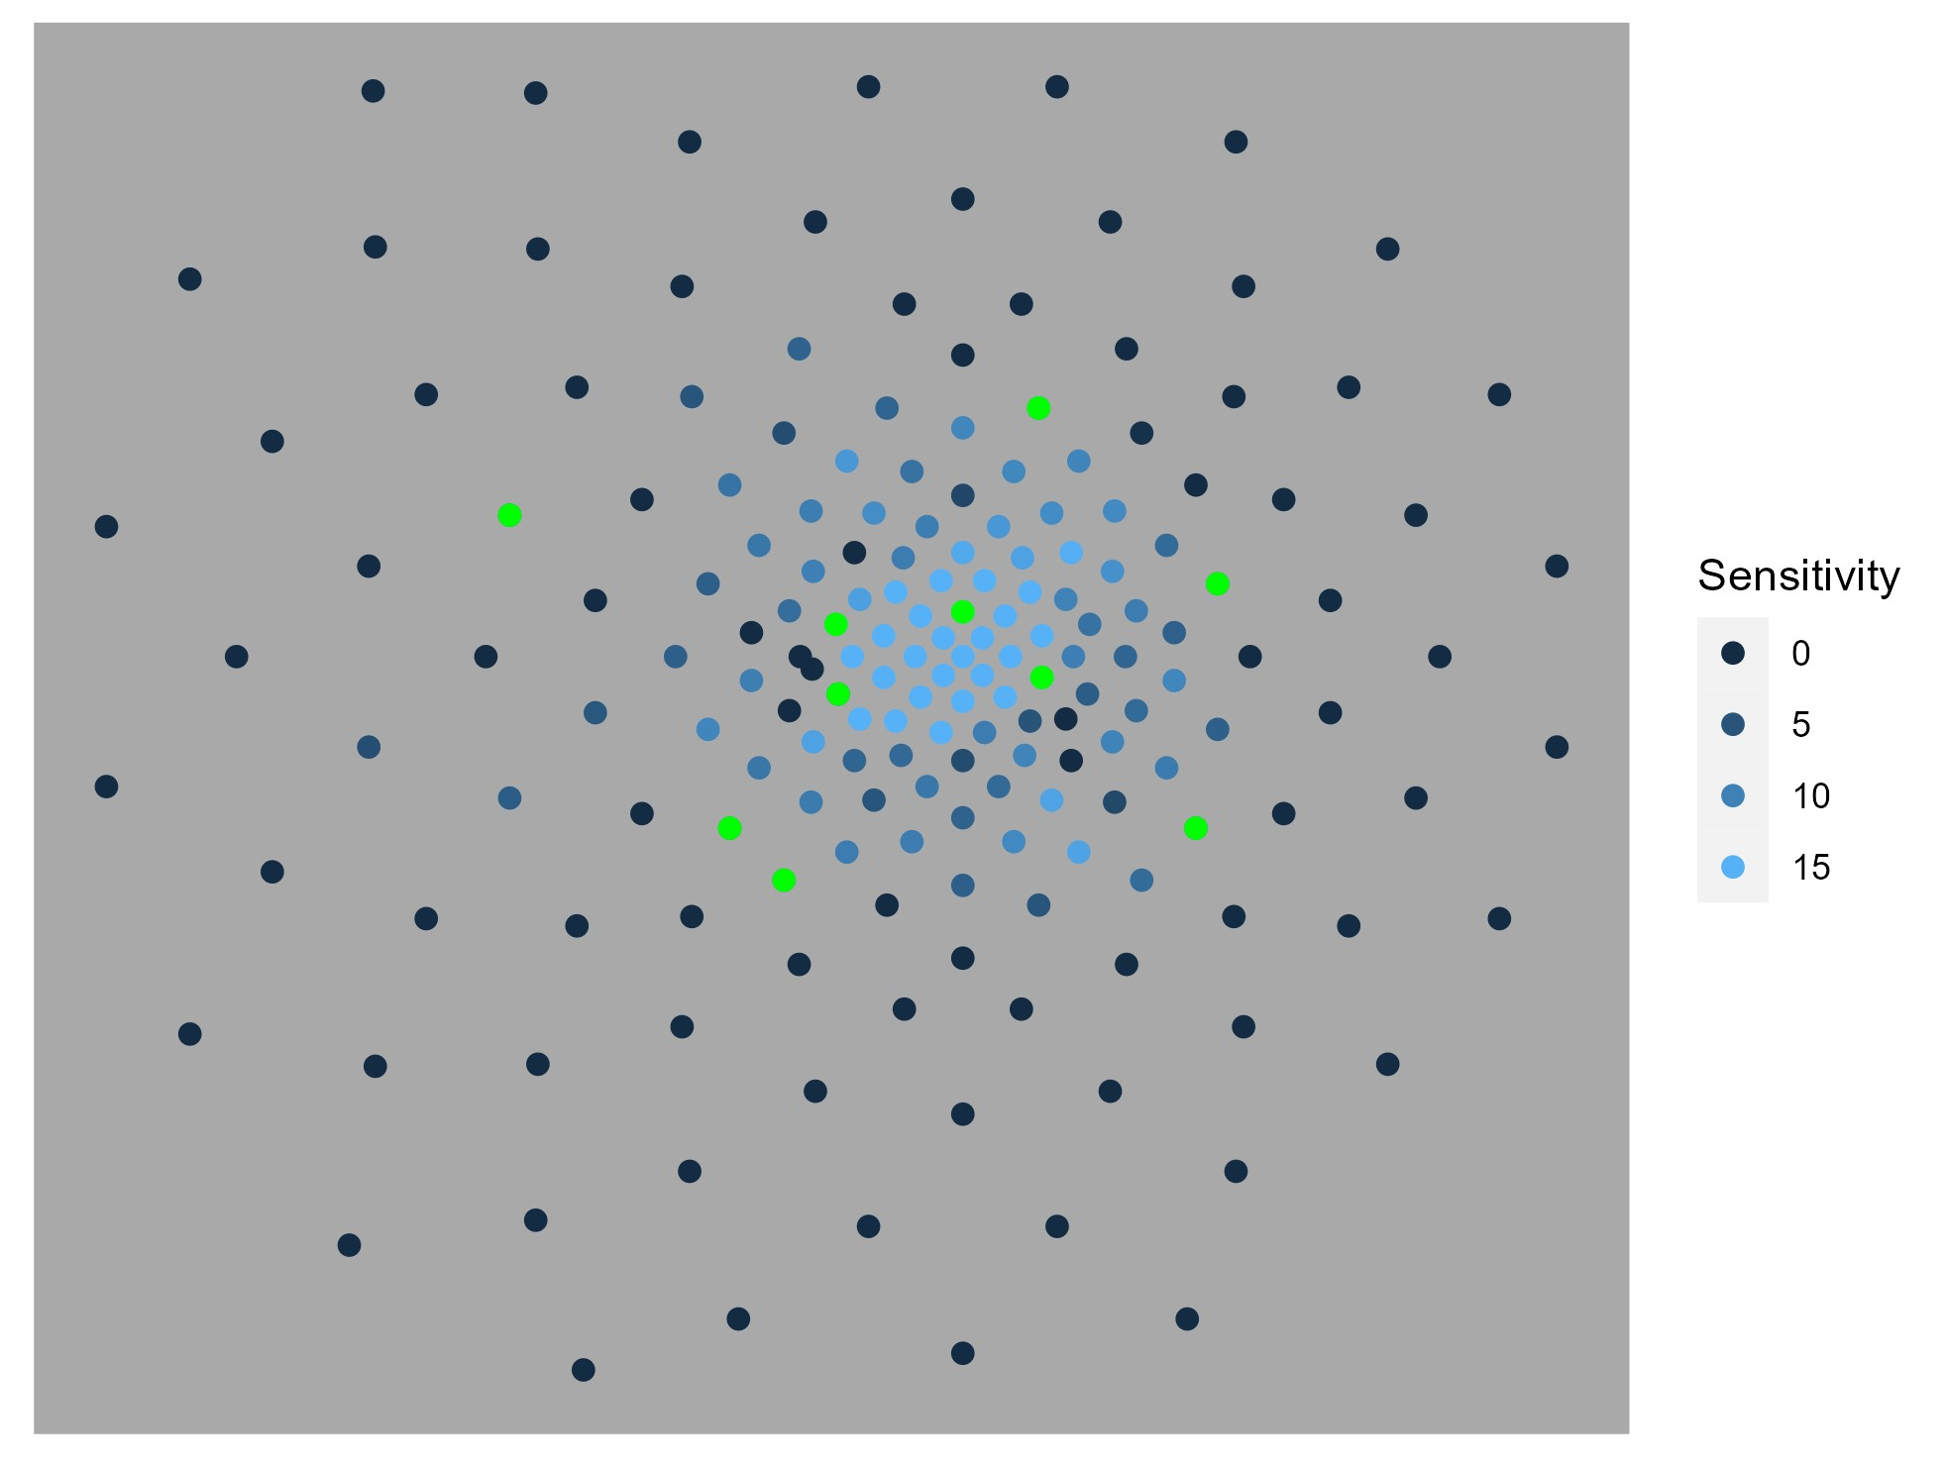
Functional Transition Points
Perimetry endpoint accepted by FDA: Mean change ≥ 7 dB in ≥ 5 pre-specified points
Not a viable endpoint choice in RUSH2A cohort for progression-slowing intervention
Functional transition points (green)
 | Static Perimetry |  |  | Microperimetry
Points used → | All points | Central 30° | FTPs | All points | FTPs
2 Years | 2% | 0% | 31% | 0% | 19%
4 Years | 5% | 9% | 45% | 5% | 46%
Can we maximize the chance of meeting the FDA-approved outcome?
Basic idea: Identify ≥ 5 points at baseline with the highest chance of losing function over time*
* Modeled after work by Hood and Birch 2011
Notes:
Modeled after work by Hood and Birch 2011

Slide 16
Functional Transition Points
Perimetry endpoint accepted by FDA: Mean change ≥ 7 dB in ≥ 5 pre-specified points
Not a viable endpoint choice in RUSH2A cohort for progression-slowing intervention
Functional transition points (green)
 | Static Perimetry |  |  | Microperimetry
Points used → | All points | Central 30° | FTPs | All points | FTPs
2 Years | 2% | 0% | 31% | 0% | 19%
4 Years | 5% | 9% | 45% | 5% | 46%
Can we maximize the chance of meeting the FDA-approved outcome?
Basic idea: Identify ≥ 5 points at baseline with the highest chance of losing function over time*
* Modeled after work by Hood and Birch 2011
Notes:
Modeled after work by Hood and Birch 2011

Slide 17
Mock Trial Scenarios – Impact of Design Choices
Notes:
Let’s take a look at how these findings impact sample size for a clinical trial design

Slide 18
Impact of Primary Endpoint Selection on Sample Size
For any given primary endpoint being considered, the following will impact sample size/power calculations
Expected rate of decline
  Natural history → control group
Expected treatment effect
  By how much will the endpoint measure a difference in slowing progression or improvement
Continuous (slope) vs binary outcome

Slide 19
Sample Size – Continuous Outcome
Control Group Standardized Rate of Worsening | Example Measures | Treated Group Relative Reduction
 |  | 30% | 60% | 100%
2 Year Follow-up
0.40 | BCVA, EZ | 2181 | 546 | 197
0.70 | MP MS, FST | 712 | 178 | 65
0.80 | V_{TOT}, SP MS_{CW} | 546 | 137 | 50
4 Year Follow-up
1.00 | MP MS, FST, EZ | 349 | 88 | 32
1.25 | V_{TOT} | 224 | 56 | 21
1.50 | SP MS_{CW} | 156 | 39 | 14
More effective treatment
OR
Faster progression
→ Smaller sample size
Assumes two groups, equal allocation between treatment and control, 80% power, alpha 0.05.
Numbers shown are total sample size.

Slide 20
Sample Size – Binary Outcome
Control Group % Eyes Worsening more than CoR | Example Measures | Treated Group Relative Reduction
 |  | 30% | 60% | 100%
2 Year Follow-up
5% | BCVA | 5676 | 1176 | 304
10% | SP MS_{CW} | 2711 | 566 | 147
30% | FST | 734 | 159 | 43
4 Year Follow-up
20% | V_{TOT}, SP MS_{CW} | 1229 | 261 | 69
30% | MP MS_{CW} | 734 | 159 | 43
45% | FST | 405 | 91 | 25
More effective treatment
OR
Faster progression
→ Smaller sample size
Assumes two groups, equal allocation between treatment and control, 80% power, alpha 0.05.
Numbers shown are total sample size.

Slide 21
Sample Sizes Based on Slopes vs Proportions
Example: Sample sizes for mean sensitivity on static perimetry for a treatment that stops progression (100% reduction)
Outcome for Comparison | Length of Trial
 | 2 Years | 4 years
% Worsening > CoR (binary) | 147 | 69
Rate of worsening (continuous/slope) | 50 | 14
Notes:
It is hard to digest everything in the previous couple of slides.
Here is an example to get the general idea of the impact of designing a trial to compare slopes vs comparing proportions
Just for the example’s sake this is considering a treatment that stops progression and using SP Mean sensitivity as the outcome
(trial with annual visits, 80% power, 5% alpha)
The sample sizes are about 3-4 times larger if using proportions
Longer follow-up also allows much smaller sample size

Slide 22
Summary and Conclusions

Slide 23
Summary
Leading contenders for sensitive outcome measures in USH2A-related RD
Continuous Outcomes (Slopes)
  Static Perimetry Mean Sensitivity (entire field)
  Static Perimetry Mean Sensitivity (restricted to FTPs)
  Microperimetry Mean Sensitivity (restricted to FTPs)
  Binary Outcomes (Proportion with Change)
    Full-field stimulus testing change > CoR
    Microperimetry Mean Sensitivity change > CoR
    Static Perimetry FTP Mean Sensitivity > FDA guideline (≥ 7dB)
    Microperimetry FTP Mean Sensitivity > FDA guideline (≥ 7dB)

Slide 24
Recommendations in USH2A-related RD
Rates of change (slopes) are more sensitive to change than the proportions of eyes exceeding a threshold – generally the top choice for primary efficacy outcome measures.
Rate of change in SP MS as estimated through longitudinal regression methods is sensitive to change. Volumetric measures have similar properties but offer no advantage over SP MS.
Eyes enrolled in clinical trials for treatment of USH2A need to have an EZ area large enough (at least 3 mm²) to detect change in EZ area over time.
MP is better than SP in detecting the proportion of eyes changing by the CoR. MP and SP detected similar percentages with change according to criteria recommended by FDA when considering only FTPs after 4 years.
FST test results are sensitive to change over time, particularly for the proportion of eyes changing by more than the CoR.

Slide 25
REDI Initiative #1: RUSH2A Endpoints
Milestones
  Dec 2022: Completion of RUSH2A Year 4 Visits
  March 2023: Meeting with working group and industry
  June 2023: Meeting with FDA
  Q3-Q4 2023: Modifications based on regulatory input
  Q1-Q2 2024: Review with Consortium Investigators (ASGM)
  May 2024: ARVO Special Session
  June 2024: ERN-EYE multi-stakeholder meeting
  Sept 2024: Forum for Collab Research multi-stakeholder meeting
  Oct 2024: Published recommendations in TVST
Maguire MG, Birch DG, Duncan JL, Ayala AR, Ayton LN, Cheetham JK, Cheng P, Durham TA, Ferris FL, Hoyng CB, Huckfeldt RM, Jaffe GJ, Kay C, Lad EM, Leroy BP, Liang W, McDaniel LS, Melia M, Michaelides M, Pennesi ME, Sahel JA, Samarakoon L for the REDI Working Group and the Foundation Fighting Blindness Clinical Consortium Investigator Group. Endpoints and Design for Clinical Trials in USH2A-related Retinal Degeneration: Results and Recommendations from the RUSH2A Natural History Study. Transl. Vis. Sci. Technol. 2024 Oct 1;13(10):15. doi: 10.1167/tvst.13.10.15. PMID: 39382872; PMCID: PMC11469320.

Slide 26
REDI Initiative #1: RUSH2A Endpoints
REDI Working Group
Working Group Members established objectives, developed analyses and interpretations, pursued regulatory and industry input, and made final decisions about recommendations, with oversight from the Consortium Executive Committee (EC) and REDI Leadership (L)
REDI RUSH2A Manuscript Writing Committee Members (WC) – on behalf of the REDI Working Group and the Foundation Fighting Blindness Consortium Investigator Group
Maureen Maguire (REDI Co-chair, EC, L, WC)
David Birch (REDI Co-chair, L, WC)
Shobana Aravind
Allison Ayala (EC, L, WC)
Lauren Ayton (WC)
Janet Cheetham (EC, L, WC)
Peiyao Cheng (WC)
Jacque Duncan (EC, L, WC)
Todd Durham (EC, L, WC)
Fredrick Ferris (EC, L, WC)
Sandeep Grover
Carel Hoyng (EC, L, WC)
Rachel Huckfeldt (EC, L, WC)
Hiroshi Ishikawa
Glenn Jaffe (L, WC)
K. Thiran Jayasundera
Christine Kay (WC)
Eleonora Lad (L, WC)
Bart Leroy (WC)
Wendi Liang (WC)
Lee McDaniel (WC)
Michele Melia (L, WC)
Michel Michaelides (EC, WC)
Audra Miller
Mark Pennesi (EC, L, WC)
José-Alain Sahel (EC, L, WC)
Lassana Samarakoon (WC)
Mandeep Singh
Katarina Stingl
Notes:
Snapshot of who participated in the REDI working group at the time of the RUSH2A Endpoints initiative

Slide 27
REDI Initiative #1: RUSH2A Endpoints
Other Acknowledgements
All RUSH2A Clinical Center Staff
All RUSH2A Participants
External Representatives*
*Individuals with industry or regulatory background were invited to attend REDI workshops and were given the opportunity to review and comment on materials and recommendations. All final decisions were made by the Working Group. Affiliations at the time of the workshop are listed.
Jean Bennett (CAROT), Wiley Chambers (FDA), Dan Chung (Sparing Vision), Anna Demetriades (VedereBio), Aniz Girach (ProQR), Jami Kern (Nacuity), Jonathan Lu (SalioGen), Robert MacLaren (Oxford), George Magrath (Lexitas), Ali Murad (Alnylam), Mike Murtagh (VedereBio), Erin O’Neil (CHOP), Glenn Noronha (MSGN CA), Laura Pardon (Atsena), David Rousso (Spark Therapeutics), Susan Schneider (AGTC), Rachel Smith (Atsena), Nadia Waheed (AGTC).
Notes:
Snapshot of who participated in the industry/regulatory discussions at the time of the RUSH2A Endpoints initiative

Slide 28
Extra Slides –Condensed Description and Takeaways

Slide 29
Regulatory Endpoints and Trial Design for IRDs (REDI) Working Group
      Mission: Collaborate with a wide range of subject matter experts to identify and propose best endpoints and study design methods for IRD clinical trials, obtain input from industry and regulatory representatives, and disseminate recommendations.
      Endpoint Comparison Approach: Use Consortium NHS data to evaluate functional and structural measures of progression and compare ideal properties of candidate endpoints
  Large magnitude of change relative to variability in change (large “signal to noise”)
  Change exceeds measurement variability (many eyes exceed “real” change)
  Sensitive to change in most of a population (lack of floor or ceiling effect)
  Relevant to how a patient feels or functions (clinically meaningful)

Slide 30
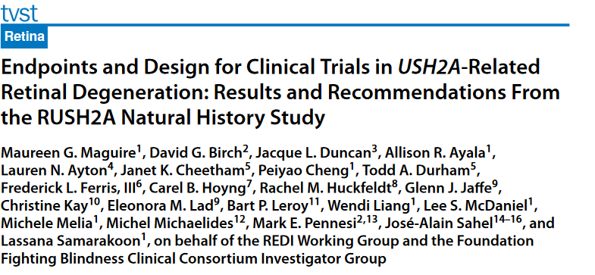
REDI Initiative #1: RUSH2A Endpoints
Key Takeaways
    RUSH2A: Rate of Progression in USH2A-related Retinal Degeneration
    N=103 participants with BCVA ≥ 54 letters and biallelic USH2A variants
    Four-year prospective study, annual visits, structural and functional measures
  In USH2A-related retinal degeneration:
Visual Acuity
Changes by 1 letter/year
EZ area
  Floor effect in 2/3 participants (at around 3mm²)
  Eyes enrolled in clinical trials for USH2A need to have an EZ area large enough to detect change in EZ area over time
Microperimetry and Static Perimetry Mean Sensitivity
  Slopes are more sensitive to change than the proportions of eyes exceeding a threshold – top choice for USH2A endpoint!
Full-field stimulus testing (FST)
  Sensitive even in eyes with early disease
Maguire MG et al Transl Vis Sci Technol 2024; 13(10): 15; PMID: 39382872

Slide 31
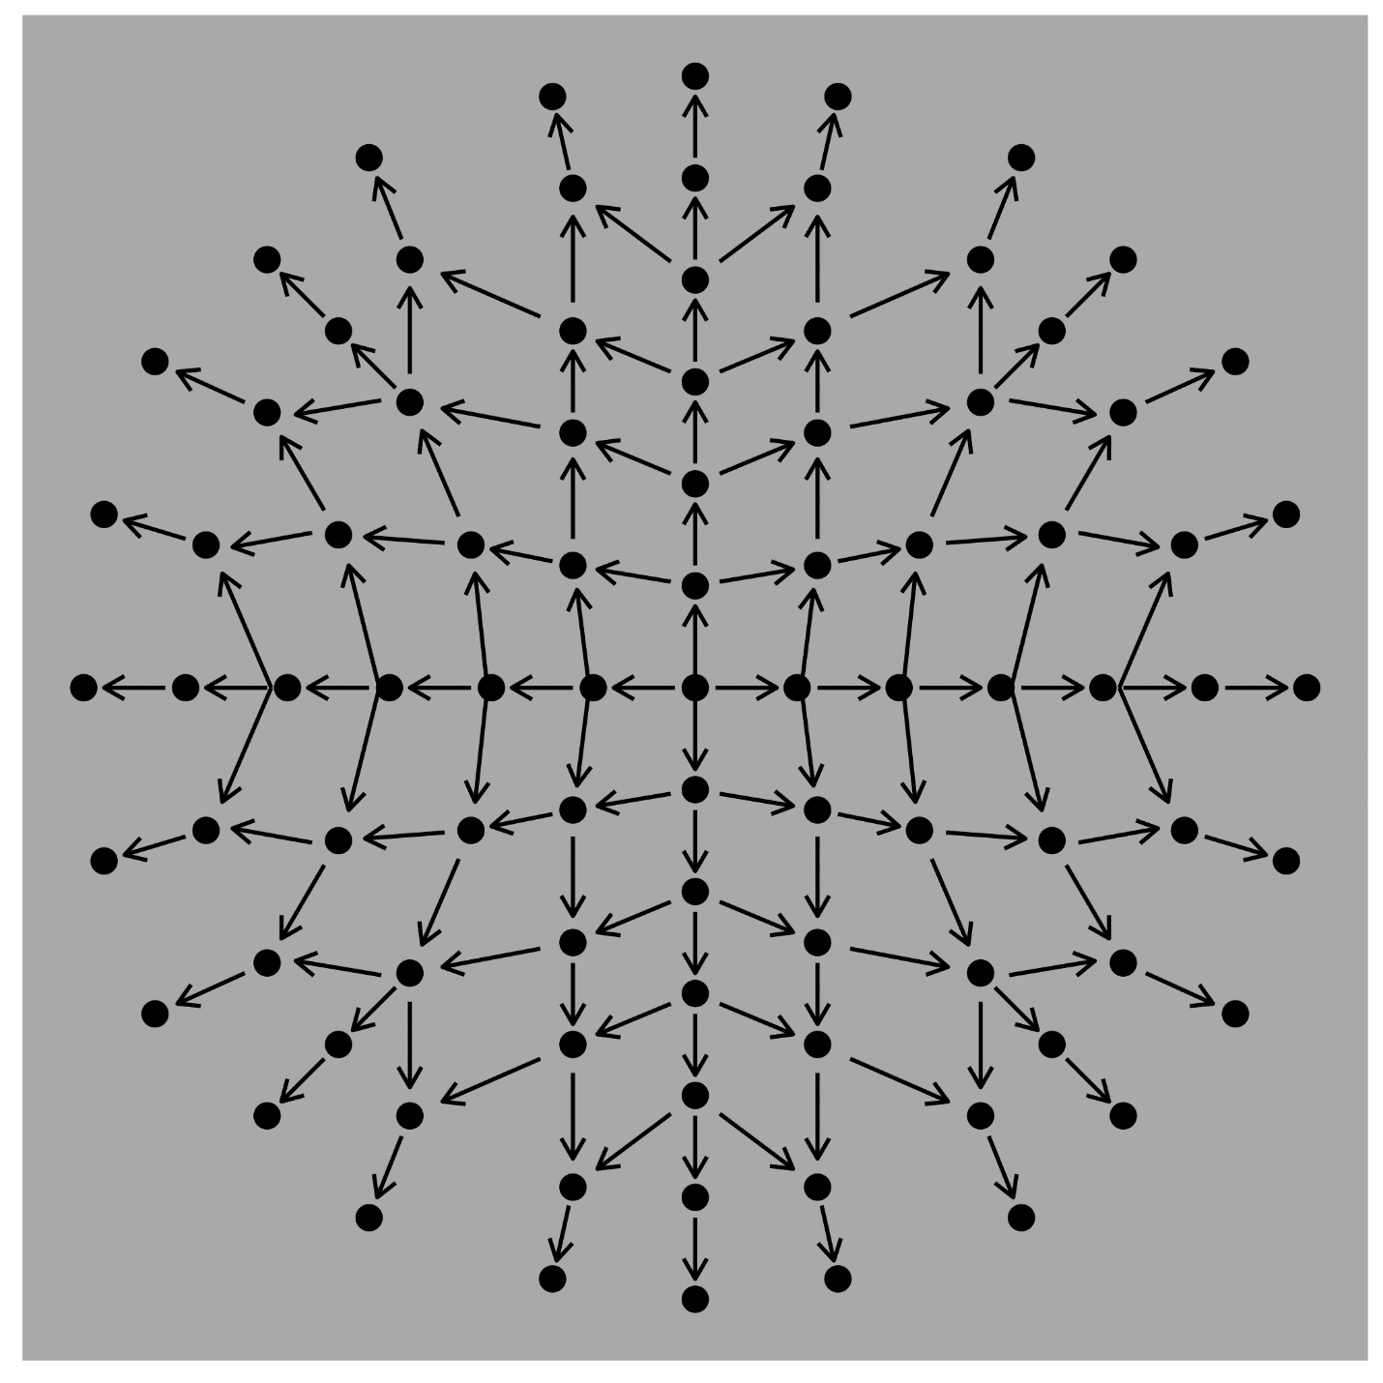
Functional Transition Points
Perimetry endpoint accepted by FDA: Mean change ≥ 7 dB in ≥ 5 pre-specified points
Not a viable endpoint choice in RUSH2A cohort for progression-slowing intervention
Can we maximize the chance of meeting an outcome that follows the FDA guideline for meaningful change?
Basic idea: Identify five or more points in each patient at baseline that have the highest chance of losing function over time
Modeled after work by Hood and Birch 2011
Test | Static Perimetry |  |  | Microperimetry
Points used → | All points | Central 30° | FTPs | All points | FTPs
2 Years | 2% | 0% | 31% | 0% | 19%
4 Years | 5% | 9% | 45% | 5% | 46%
Decrease of ≥7db from an inner point to the more peripheral adjacent point qualified the inner point as a candidate FTP.
Candidate points that were qualified by 100% of adjacent points were selected as an FTP.
If the selected number of selected points was less than 5, then points with next highest percentage of qualifying points were included.

Slide 32
(Additional FTP slide content to pull from)
FTP algorithm
Microperimetry grid
FTPs were identified by comparing each point to the 1 to 4 more peripheral adjacent points on the testing grid.
A decrease in sensitivity of ≥7db from an inner point to the more peripheral adjacent point qualified the inner point as a candidate FTP.
Candidate FTPs were ordered by the percentage of qualifying adjacent points, from 100% to 25%.
Candidate points that were qualified by 100% of adjacent points were selected as an FTP.
If the selected number of selected points was less than 5, then points with next highest percentage of qualifying points were included.

