Slide 1
Regulatory Endpoints and Trial Design for IRDs
(REDI) Working Group – Overview Slides
Please inform the coordinating center if you plan to present any of these slides [ffb@jaeb.org]

Slide 2
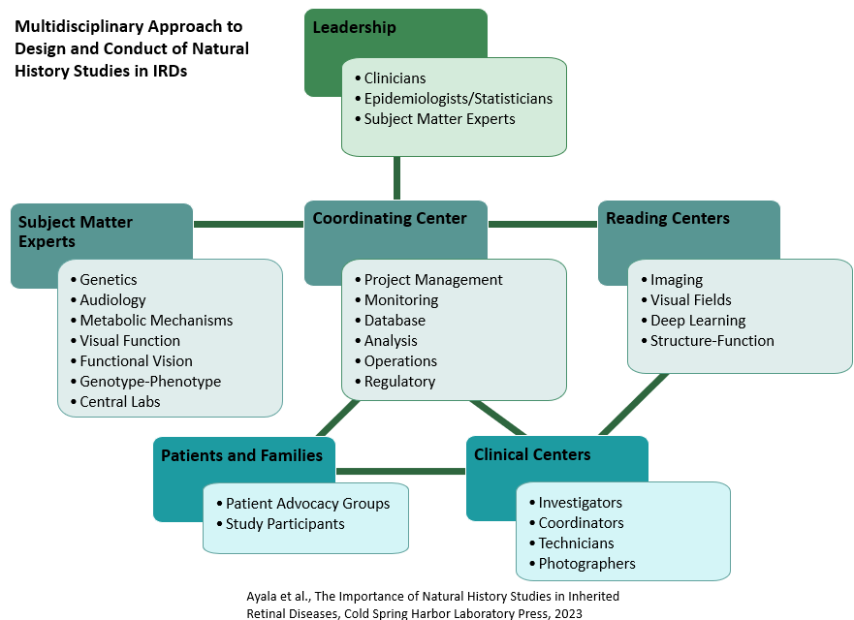

Consortium Overview
International consortium of clinical centers with expertise in inherited retinal degenerations (IRDs)
Goal: Accelerate development of treatments for IRDs
43 sites in 15 countries
Notes:
Founded in 2016; Modeled on DRCR Retina Network
Multidisciplinary approach is critical
We collaborate on studies, collect data, make it freely available
Ultimate goal is to advance development of treatments for IRDs,

Slide 3
REDI Working Group Mission Statement
Collaborate with a wide range of subject matter experts to identify and propose best endpoints and study design methods for IRD clinical trials, obtain input from industry and regulatory bodies, and disseminate recommendations

Slide 4
Scope
    Scientific
        Primary (endpoint comparisons)
        Exploratory (novel and optimized endpoint development)
        Trial Design (lit review, lessons learned, mock trial design, simulations)
    Collaboration
      Scientific - ERN-EYE, ODF
      Industry
      Regulatory - FDA, EMA
    Impact Efforts
      Consensus documents
      Legislative efforts
      Regulatory acceptance
ERN: European Reference Network
ODF: Ocular Disease Forum (UC Berkley Forum for Collaborative Research)
FDA: Food and Drug Administration
EMA: European Medicines Agency

Slide 5
REDI Organizational Chart
Executive Committee
REDI Chair
Rachel Huckfeldt
REDI Working Group
Collaboration
Science
Impact
Scientific
Industry
Regulatory
Primary Endpoints
Exploratory Endpoints
Trial Design
Consensus documents
Legislative efforts
Regulatory acceptance
ERN-EYE
ODF
Workshops
Consulting
FDA
EMA
Primary Endpoint Comparisons
Novel and Optimized Endpoints
Lit Reviews
Lessons Learned
Mock CT Designs/ Simulations
ERN: European Reference Network
ODF: Ocular Disease Forum (UC Berkley Forum for Collaborative Research)
FDA: Food and Drug Administration
EMA: European Medicines Agency

Slide 6
REDI Working Group Members
Working Group Members establish objectives, develop analyses and interpretations, pursue regulatory and industry input, and make final decisions about recommendations, with oversight from the Consortium Executive Committee (EC).
REDI Chair: Rachel Huckfeldt (EC) Principal Statistician: Lee McDaniel Tomas Aleman Shobana Aravind Allison Ayala (EC) Lauren Ayton David Birch Janet Cheetham (EC) Art Cideciyan Jacque Duncan (EC) Todd Durham (EC) | Fredrick Ferris (EC) Sandeep Grover Carel Hoyng Glenn Jaffe K. Thiran Jayasundera Christine Kay Eleonora Lad Bart Leroy Yu-Fen Li | Michel Michaelides (EC) Audra Miller Mark Pennesi (EC) José-Alain Sahel (EC) Lassana Samarakoon Mandeep Singh Katarina Stingl Wei Tian
Inaugural REDI Co-Chairs: Maureen Maguire and David Birch

Slide 7
Approach for Endpoints
      Use FFB Consortium NHS data to evaluate functional and structural measures of progression
      Develop candidate endpoints, including modification of existing endpoints and creation of new endpoints
      Compare properties of candidate endpoints, including repeatability, sensitivity, correlation with disease stage/progression, floor/ceiling effects, patient burden, degree of subjectivity, and clinical benefit
      Identify best candidate endpoints relative to various trial considerations, including study phase and goal of intervention (reverse/slow/stop disease)

Slide 8
Outcome Measures
Structural
  Spectral-domain optical coherence tomography EZ area, fundus autofluorescence
Functional
  Static perimetry, microperimetry, full-field stimulus threshold, electroretinography, visual acuity, contrast sensitivity, color vision
Patient-reported outcomes
  Visual function questionnaires and quality-of-life questionnaires

Slide 9
REDI Working Group Manuscripts
Topic | Lead Author* | Journal
REDI – RUSH2A Endpoints | Maureen Maguire | TVST 2024
*for the FFB Clinical Consortium Investigator Group
Notes:
Update in Consortium overview slides also

Slide 10
REDI Working Group Presentations
Topic | Presenter* | Conference
REDI - Endpoints and Trial Design | Maureen Maguire Jacque Duncan and Rachel Huckfeldt Multiple Presenters† Jacque Duncan | Johns Hopkins RD&VE Conf 2023 ARVO Symposium 2025 ARVO SIG 2025 – Pending AAO Retina Subspecialty Day 2025– Pending
REDI-1 (RUSH2A Endpoints) | Rachel Huckfeldt Jacque Duncan Rachel Huckfeldt José Alain-Sahel Multiple Presenters‡ Rachel Huckfeldt Jacque Duncan Rachel Huckfeldt Rachel Huckfeldt Jacque Duncan | RD 2023 FFB Innovations Summit 2023 Macula Society 2024 Young Hadassah Eye & Vision 2024 ARVO Special Session 2024 ERN-EYE 2024 ODF2 2024 Mary Tyler Moore Vision Initiative 2024 ARVO Frontiers in Ocular GT Res 2024 FFB Innovations Summit 2025
REDI-2 (FTPs) | Allison Ayala Rachel Huckfeldt Lee McDaniel | ERN-EYE 2024 Macula Society 2025 ARVO 2025
REDI-5 (FST Data Rev) | David Birch David Birch | ERN-EYE 2024 ODF2 2024
†Rachel Huckfeldt, David Birch, Jacque Duncan, Todd Durham
‡Rachel Huckfeldt, Jacque Duncan, Ajoy Vincent, Eleonora Lad, David Birch, Thiran Jayasundera, and Allison Ayala
*for the FFB Clinical Consortium Investigator Group
Notes:
Update in Consortium overview slides also

Slide 11
Extra Slides –Condensed Description and Takeaways

Slide 12
Regulatory Endpoints and Trial Design for IRDs (REDI) Working Group
      Mission: Collaborate with a wide range of subject matter experts to identify and propose best endpoints and study design methods for IRD clinical trials, obtain input from industry and regulatory representatives, and disseminate recommendations.
      Endpoint Comparison Approach: Use Consortium NHS data to evaluate functional and structural measures of progression and compare ideal properties of candidate endpoints
  Large magnitude of change relative to variability in change (large “signal to noise”)
  Change exceeds measurement variability (many eyes exceed “real” change)
  Sensitive to change in most of a population (lack of floor or ceiling effect)
  Relevant to how a patient feels or functions (clinically meaningful)

