Slide 1
Characterizing the genetic basis for inherited retinal disease: Lessons learned from the Foundation Fighting Blindness Clinical Consortium’s Gene Poll

Slide 2
Citation, Funding, Disclaimer
Citation
Branham K, Samarakoon L, Audo I, Ayala AR, Cheetham JK, Daiger SP, Dhooge P, Duncan JL, Durham TA, Fahim AT, Huckfeldt RM, Hufnagel RB, Kohl S, Maldonado RS, Melia M, Michaelides M, Pennesi ME, Sahel JA, Sallum JMF, Singh MS, Sharon D, Stepien K, Jones K, Weng C for the Foundation Fighting Blindness Clinical Consortium Investigator Group. Characterizing the Genetic Basis for Inherited Retinal Disease: Lessons Learned From the Foundation Fighting Blindness Clinical Consortium’s Gene Poll. Invest. Ophthalmol. Vis. Sci. 2025;66(2):12. doi: 10.1167/iovs.66.2.12.
Funding
This study was funded by Foundation Fighting Blindness
Disclaimer
The source of the data is the Foundation Fighting Blindness Clinical Consortium, but the analyses, content and conclusions presented herein are solely the responsibility of the authors/presenters and may not reflect the views of the Foundation Fighting Blindness.

Slide 3
Background
The FFB Consortium Gene Poll database was created to capture an annual snapshot of the number of patients with mutations in 387 IRD genes at each of our Consortium sites
  Once the counts have been entered the first year, they will pre-populate in future years (sites just update any changes)
  There is also a short survey on how genetic testing is obtained and other clinical practices

Slide 4
Methodology
Sites provide counts of patients and families for genes that are the cause of retinal disease
  Family # can be entered as zero when unknown
Genes counted as cause of retinal disease if :
  If the causative gene is Autosomal Recessive, patient should have at least two disease-causing variants (i.e., Pathogenic or likely pathogenic)
  If the causative gene is Autosomal Dominant, X-linked, or Mitochondrial, patient should have at least one disease-causing variant (i.e., Pathogenic or likely pathogenic)
Only count cases known to be affected with a retinal dystrophy (e.g., syndromic retinal dystrophy genes can cause disease that may or may not include retinal findings)
Phase does not need to be documented for the purposes of the gene poll

Slide 5
Results of 2022 Gene Poll
30/41 Consortium sites responded to the 2022 Gene Poll
Respondents reported 33,834 patients with mutations from 27,561 families
Patients were reported to have mutations in 293/387 retinal dystrophy genes
  94 genes were not reported as cause of disease

Slide 6
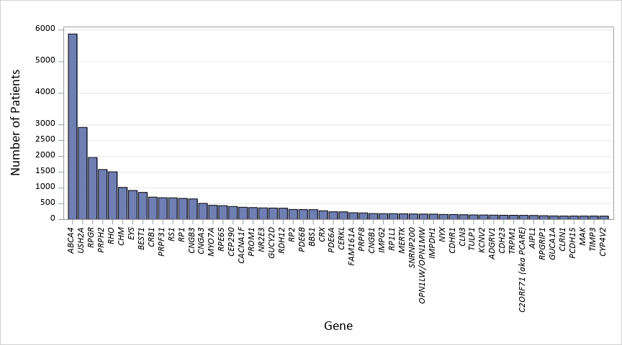
Gene Tally - Disease Causing Genes Found in 100 or More Patients
54 genes found in 100 or more patients

Slide 7
Changes from 2021 to 2022 - Overall
 | 2021 | 2022
Number of participating sites | 32/38 (84%) | 30/41 (73%)
Genes analyzed | 366 | 387
# of disease-causing genes found in 100 or more patients | 46 | 54
# of disease-causing genes found in zero patients | 95 | 94
Total participants | 27090 | 33834
Total families | 21817 | 27561
% of top 5 genes | 40.2% of total patients | 40.9% of total patients
Top 5 genes | ABCA4, USH2A, RPGR, PRPH2, RHO

Slide 8
Changes from 2021 to 2022
Top Genes Across Regions
Region | 2021 # Sites | 2021 Top Genes | 2022 # Sites | 2022 Top Genes
All sites | 32 | ABCA4, USH2A, RPGR, PRPH2, RHO | 30 | ABCA4, USH2A, RPGR, PRPH2, RHO
North America | 23 | ABCA4, USH2A, RPGR, RHO, PRPH2 | 21 | ABCA4, USH2A, RPGR, RHO, PRPH2
South America | 2 | ABCA4, RHO, USH2A, EYS, CEP90 | 2 | ABCA4, USH2A, RPGR, RHO, EYS
Europe | 6 | ABCA4, USH2A, PRPH2, RPGR, RHO | 6 | ABCA4, USH2A, RPGR, PRPH2, RHO
*Data from Asia and Australia not shown since there is only data from a single site in that grouping

Slide 9
Gene Tally - Disease Causing Genes Found in Zero Patients
GENE LIST (N=94)
ACBD1 | CCT2 | CRB2 | GDF6 | LRRTM4 | MT-TD | MT-TQ | PEX11B | PSEN1 | TMEM67
ACBD5 | CEP104 | DACT2 | GPR125 | LZTFL1 | MT-TE | MT-TR | PEX14 | SIX6 | TRIM32
AHR | CEP120 | DDR1 | GPR45 | MIR204 | MT-TF | MT-TS1 | PEX16 | SMARCA4 | USP45
ATOH7 | CEP19 | DHX32 | HKDC1 | MT-ATP8 | MT-TG | MT-TT | PEX19 | TCTN1 | WDPCP
B9D1 | CEP41 | DNAJ17 | HMX1 | MT-CO1 | MT-TH | MT-TW | PEX3 | TCTN3
B9D2 | CEP83 | DSCAML1 | IFT43 | MT-CO2 | MT-TI | MT-TY | PEX5 | TEAD1
BBIP1 | CISD2 | ENSA | IFT80 | MT-CO3 | MT-TK | NEUROD1 | PGK1 | TMED7
C2CD3 | CLN5 | ESPN | INVS | MT-ND2 | MT-TL2 | OPN1SW | PISD | TMEM107
C5AR2 | CLN8 | EXOSC2 | KIAA0556 | MT-RNR2 | MT-TM | PDE6D | PPP2R3C | TMEM138
CCDC188 | COL9A2 | FBN3 | KIF3B | MT-TC | MT-TN | PEX10 | PROS1 | TMEM216

Slide 10
Why reported in zero patients in the cohort?
Novel/very rare cause of disease reported in small number of families in literature
Gene associated with syndromic condition known to cause retinal findings (Joubert Syndrome , Refsum disease, mitochondrial genes, etc), but not all patients with syndrome will have retinal degeneration
  Retinal exam not done

Slide 11
Cumulative Patient Tallies
(Total Genes = 387)
Top Genes | Cumulative Number of Patients | Cumulative % of Patients
Top 5 Genes | 13,850 | 40.9%
Top 20 Genes | 22,982 | 67.4%
Top 100 Genes | 31,953 | 94.3%
Half (193) Genes | 33,588 | 99.2%

Slide 12
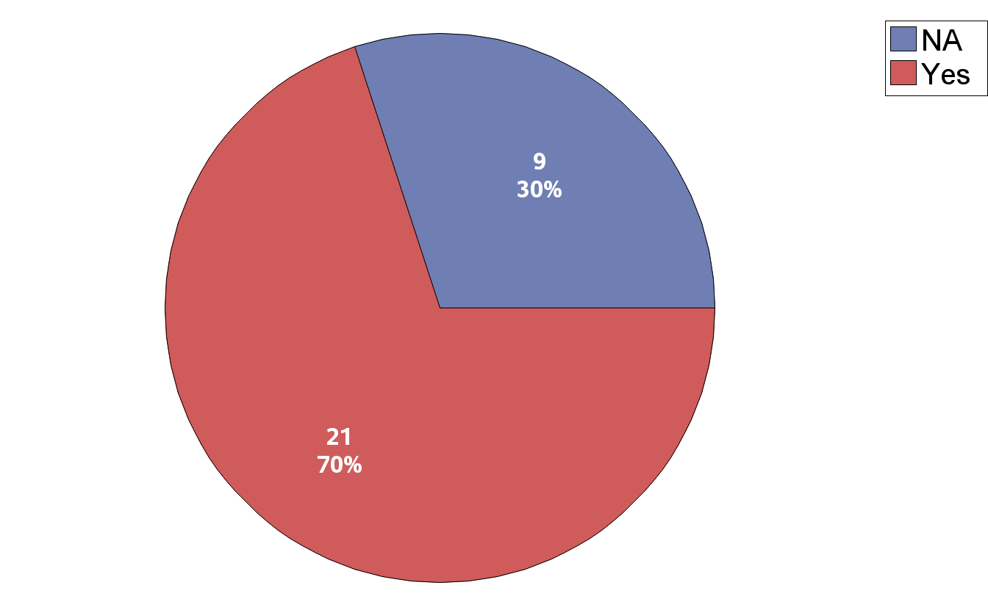
Is your site currently participating in (or planning to in the future) the My Retina Tracker Program Panel or the My Retina Tracker Genetic Testing Study?
*NA group are non-US sites
Notes:
2 sites in brazil and 2 sites in europe also answered 'yes' to this question. They are grouped as 'NA' for this plot
Note that total North american sites are 24 - where 21 are in the US. Others are 2 in canada and 1 in mexico

Slide 13
How is your site currently obtaining genetics data on your patients?
(*Check all that apply)
Notes:
-Sites that used other methods included:
GeneDx, research lab, research whole genome sequencing (not clia), Variantyx whole genome sequencing, Illumina whole genome, PreventionGenetics

Slide 14
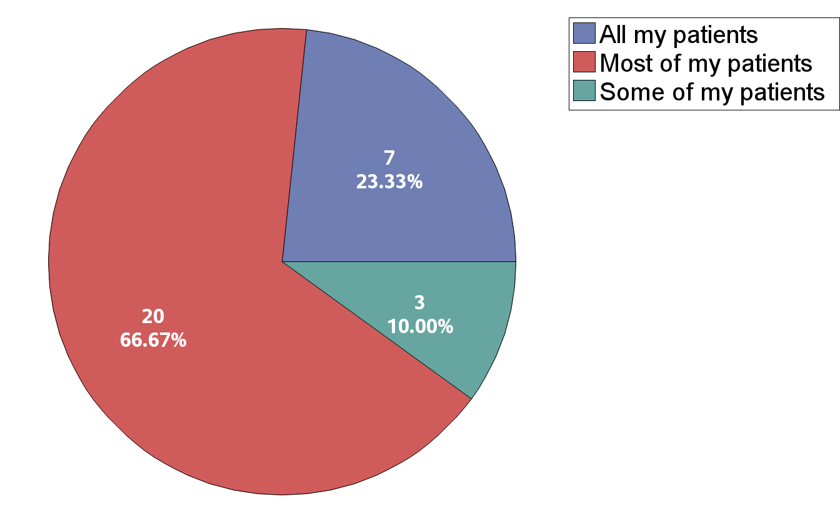
Approximately what portion of your IRD patients have received comprehensive gene panel test results in the last 5 years?

Slide 15
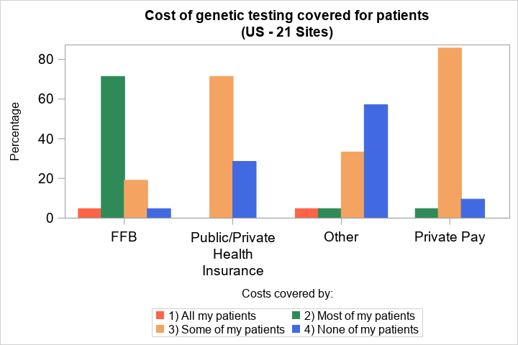
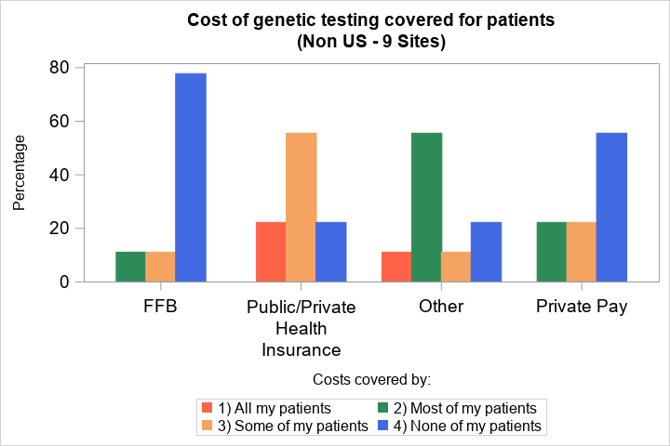
Who tends to cover the cost of your patients’ genetic testing?
*Non-US Sites include 5 sites in Europe, 2 in Brazil and 1 in Israel
*Non-US Sites include 5 sites in Europe, 2 in Brazil and 1 in Israel

Slide 16
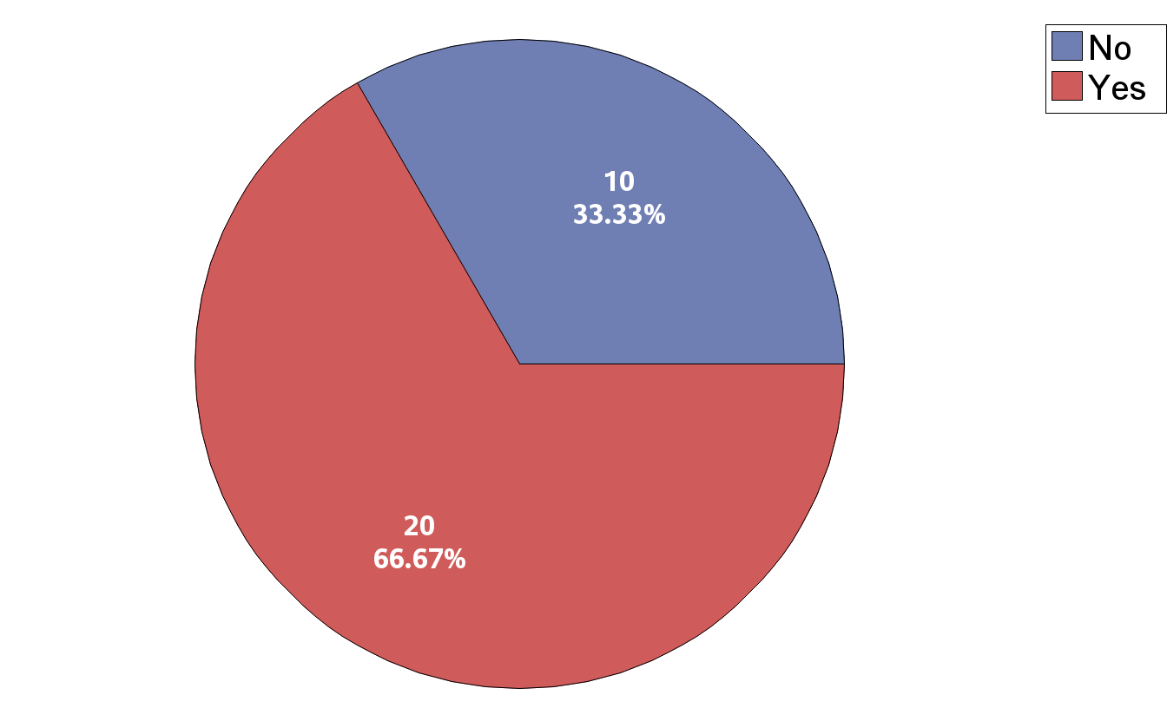
Does your practice have a genetic counselor who talks to your IRD patients about their genetic test results?

Slide 17
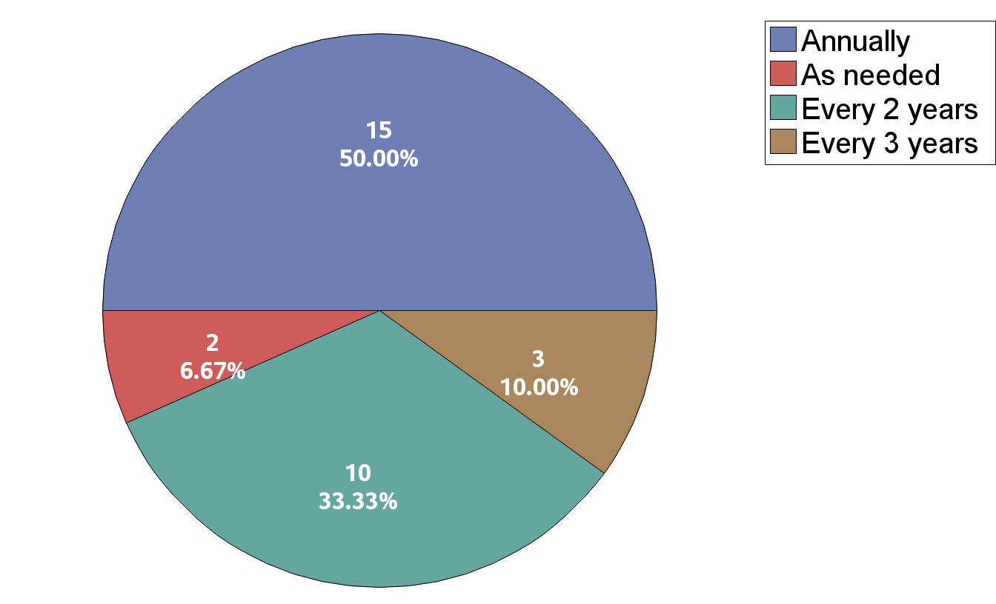
What is the typical frequency that you see your IRD patients?

Slide 18
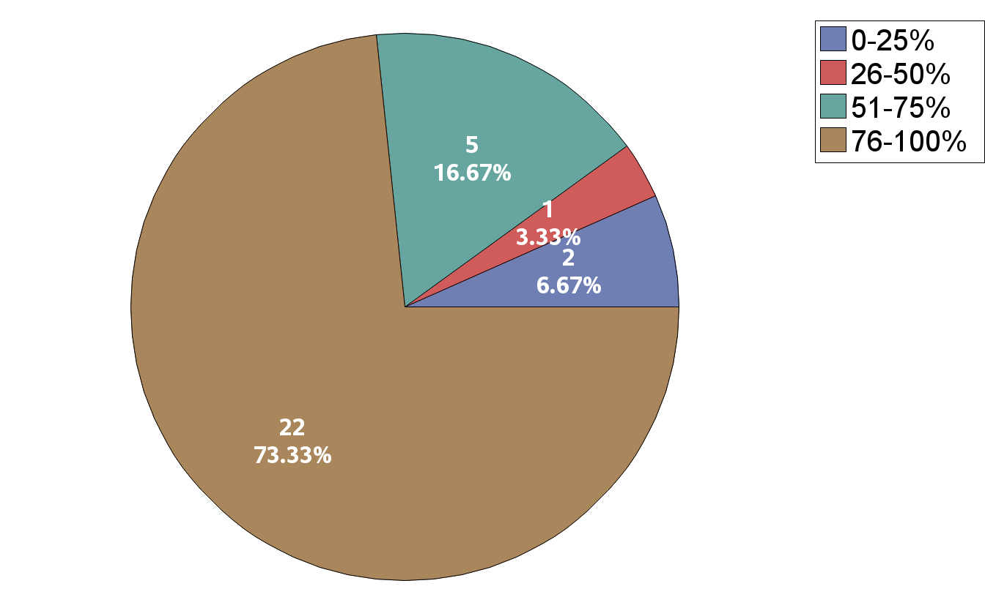
Approximately what percent of your patients’ exams are covered by insurance?

Slide 19
For NEW AND FOLLOW-UP IRD patient evals at your clinic, what tests do you typically obtain as part of your routine clinical practice? (*Check all that apply)

Slide 20
Discussion
ABCA4, USH2A, and RHO were the most common disease-causing genes across US, Brazilian, and European sites.
Access to genetic testing varies globally: nearly all US sites relied on sponsored testing programs, while non-US sites more often used public/private insurance or research agencies.
The top 5 genes account for 40.5% of disease burden, the top 20 for 67.7%, and the top half of all genes for 99.2% — confirming that a small number of genes explain most cases, though broad panels remain essential for the ~11,000 patients outside the top 20.
This is the largest genetic study of IRD patients to date and will help guide natural history study design and identify patient populations best suited for emerging gene-based treatments.

