Slide 1
Bariatric Surgery Access:
Why is there a problem?
Bruce M. Wolfe, MD
Professor of Surgery
Oregon Health and Science University

Slide 2
Disclosures
EnteroMedics – Research Contract

Slide 3
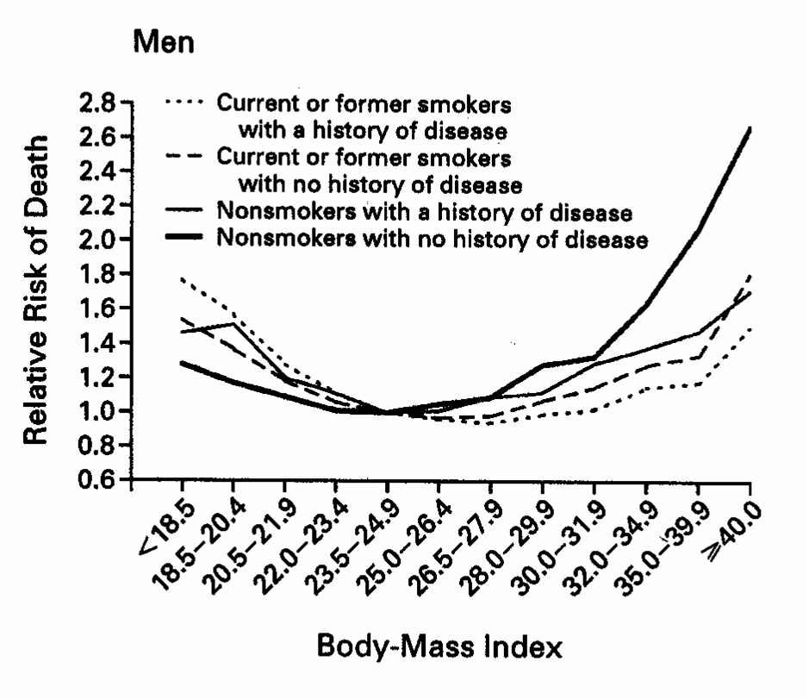
BMI and Risk of Death: (Men)
Calle: N Engl J Med 1999;341:1097

Slide 4
Complications or Comorbidities of Obesity
Diabetes
Hypertension
Dyslipidemia
Pulmonary
  Sleep apnea
  Obesity hypoventilation
  Asthma

Slide 5
Comorbidity Prevalence within BMI Groups

Slide 6
Comorbidity Prevalence within BMI Groups
LABS: Surg Obes Relat Dis 2008;4:474-480

Slide 7
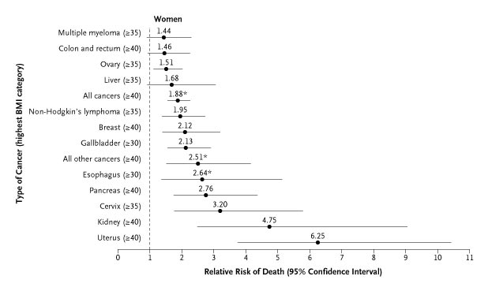
Obesity: Cancer
Calle: N Engl J Med 2003;348:17

Slide 8
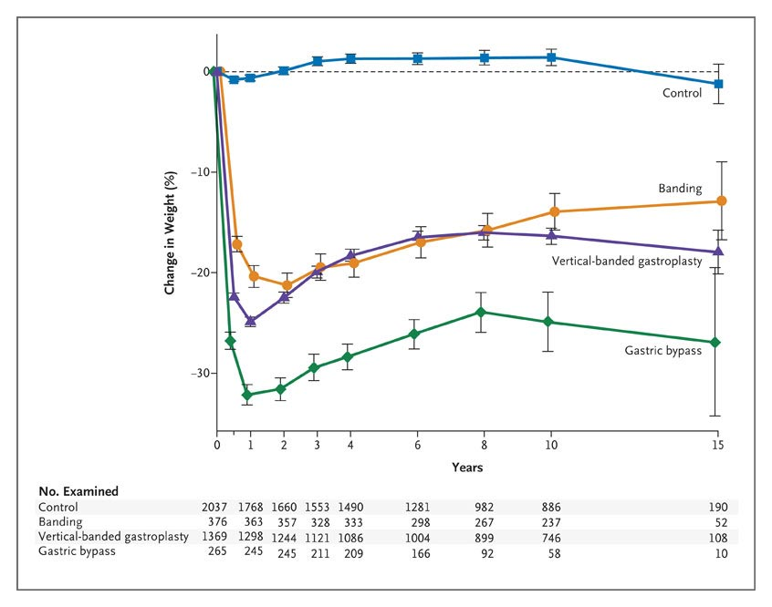
Mean Percent Weight Change during a 15-Year Period
Sjostrom: N Engl J Med 2007;357:741-52

Slide 9
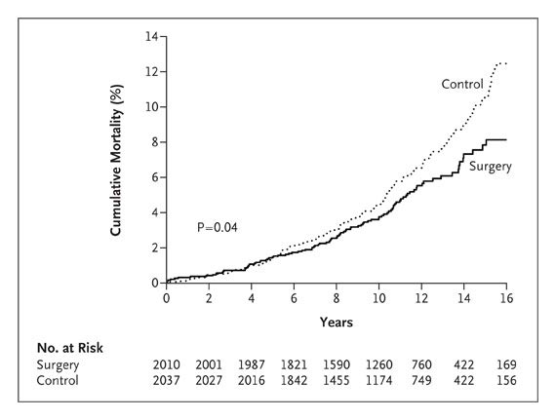
Unadjusted Cumulative Mortality
Sjostrom: N Engl J Med 2007;357:741-52

Slide 10
Gastric Bypass Co-Morbidity Resolution
Comorbidity | Change
Diabetes | 83.8% resolved
Hypertension | 75.4% resolved
Hyperlipidemia | 93.6% improved
Sleep apnea | 86.6% resolved
Buchwald: JAMA 2004:292;1724

Slide 11
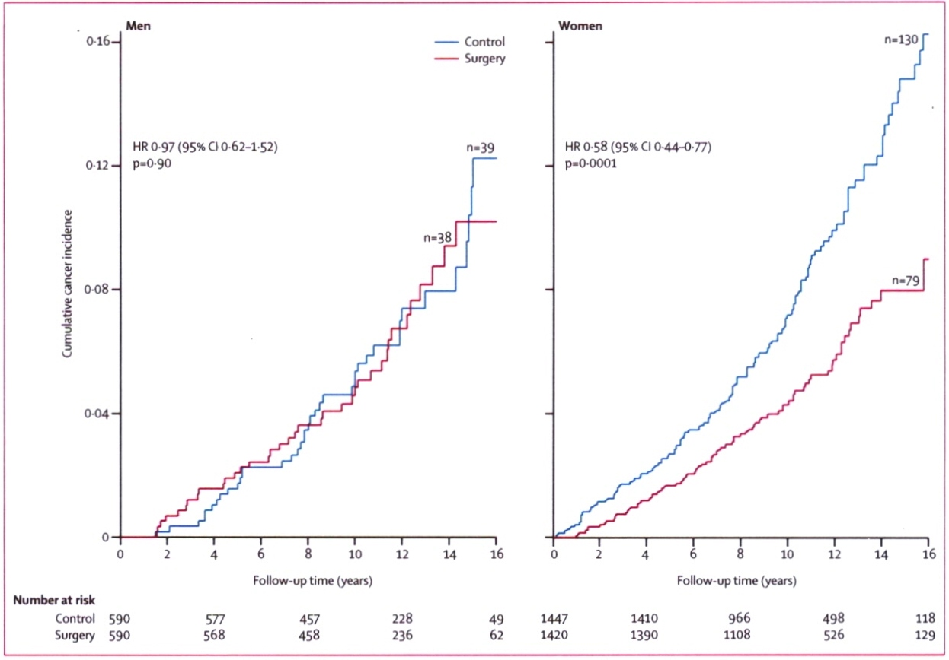
Fatal and Non-fatal Cancer Incidence: SOS

Slide 12
Bariatric Surgery: Safety Concerns
Flum: Mortality ≈2%
Insurance claims
Media reports
Volume/outcome relationship

Slide 13

LABS 1: Mortality
0.3% | All patients
0.2% | Laparoscopic gastric bypass
2.1% | Open gastric bypass
0% | Laparoscopic adjustable gastric banding

Slide 14
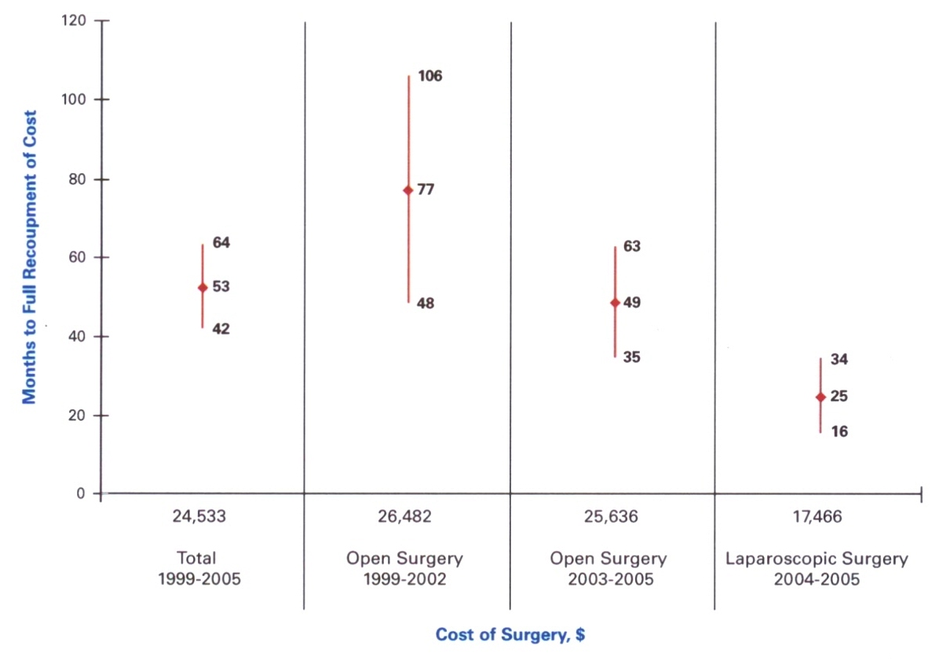

Slide 15
Bariatric Surgery
The application of bariatric surgery to qualified patients is remarkably low – approximately 1-2% per year in the U.S.

Slide 16
Possible Explanations
Limited access
  Provider capacity
  Insurance coverage
Information gap
  Patients
  Physicians/providers
Fear of complication
  Patients
  Physicians/providers

Slide 17
Obesity Discrimination
Stereotypes, Bias
↓
Stigma
↓
Prejudice
↓
Discrimination
↓
Adverse Outcomes

Slide 18
Obesity Discrimination
Fundamental problems
  Obese individuals are responsible
  Obesity under personal control
  Stigma tool to motivate

Slide 19
Obesity in the Workplace
Less likely to be hired
Worse employment outcomes
↑ reports of employment discrimination
Lower wages for same work

Slide 20
Obesity Stigma: Health Care
Experience disrespect
Blame obesity for adverse health
Low screening for cancer
Low preventive care

Slide 21
PCP Practices and Attitudes Regarding Care of Extremely Obese Patients
66% | Dealing with obesity frustrating
45% | Inadequate reimbursement
34% | Pessimistic regarding weight loss
71% | Want easy way out

Slide 22
Why Don’t They Believe Us?
(Our Data)
“They”
  Patients
  Providers
  Employers
  Insurers
  Government
  Media

Slide 23
Why Don’t They Believe Us?
Data imperfect
Some don’t want to believe us
It is okay to discriminate against obesity

Slide 24
Clinical Practice Guidelines
2700 – AHRQ Clearinghouse
6800 – Guidelines International Network

Slide 25
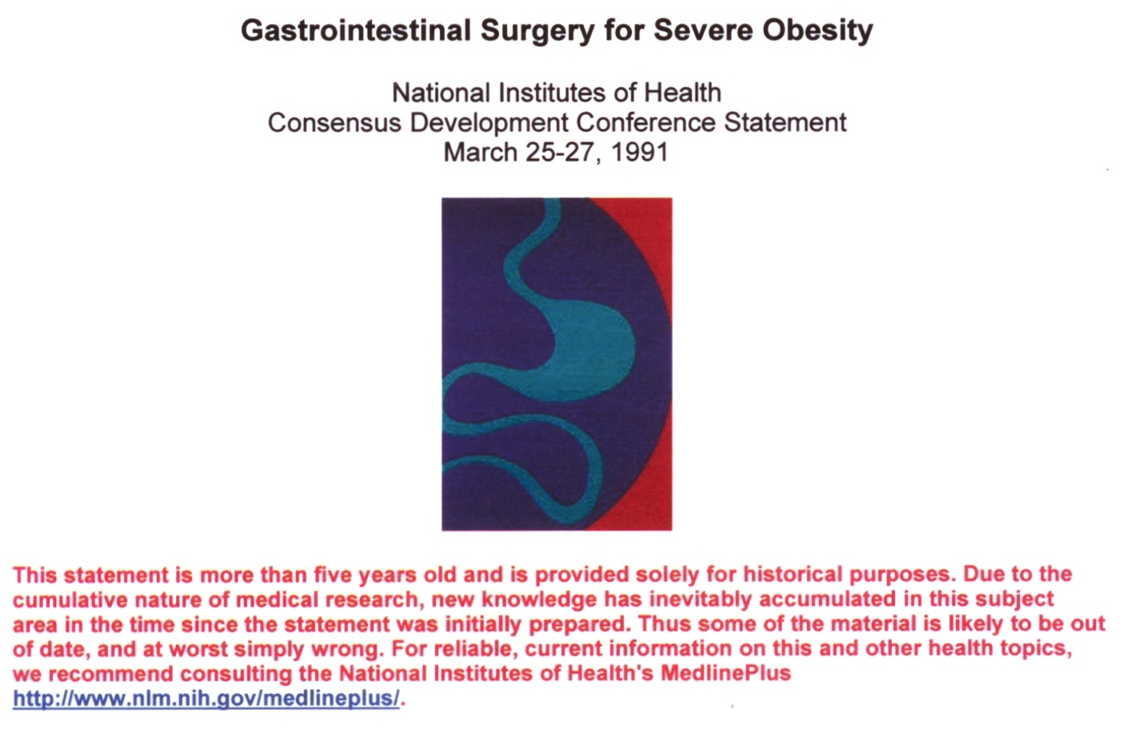

Slide 26
NIH Guidelines: Obesity
1991 | Consensus conference surgery
1998 | Clinical Guidelines
2011-12 | Clinical Guidelines update

Slide 27
NIH Guidelines: Update 2012
1991, 1998 – out of date
Establish evidence base
  Literature search
  Inclusion/exclusion criteria
  Methodologist rates quality
  Evidence tables
Statements, recommendations

Slide 28
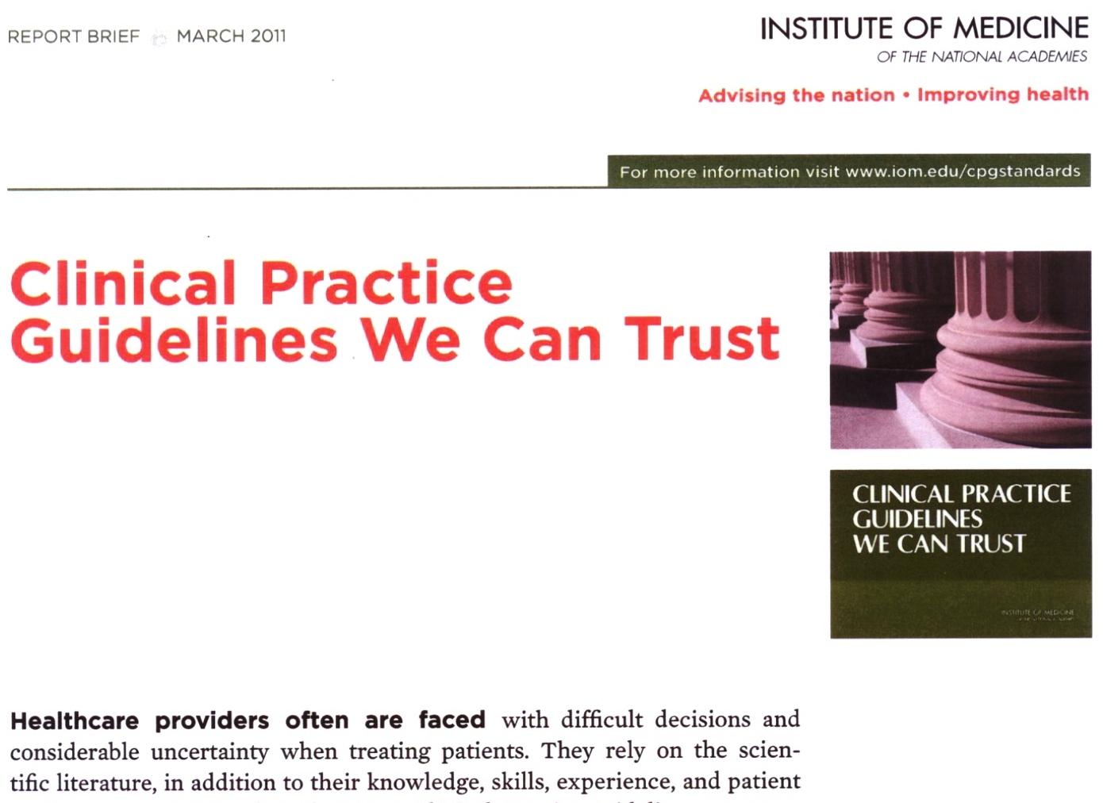

Slide 29
Sleeve Coverage: CMS
2010 | ASMBS meets with CMS Must reopen NCD
2011 | CMS opens NCD to consider sleeve only: public request
2012 | CMS requests more data

Slide 30
The Feds pushed essential benefit decisions to the State level and each State is required to select a “Benchmark Plan” from one of the following:
Largest plan by enrollment in any of the 3 largest small group insurance products in the State’s small group market
Any of the largest 3 State employee health benefit plans by enrollment
Any of the largest 3 nation FHEBP (Federal employees) plan options by enrollment
The largest insured commercial non-Medicaid Health Maintenance Organization (HMO) operating in the State

