Slide 1
Pathophysiology of Metabolic Syndrome in Obese Patients: Why Does Gastric Bypass Work
Robin Blackstone, MD, FACS, FASMBS
President, American Society for Metabolic and Bariatric Surgery

Slide 2
Disclosures
Enteromedics PI for Multi-center Maestro Trial of Vagal Blocking Device
Ethicon Endosurgery Consultant
Scottsdale Healthcare Bariatric Center Medical Director
American Society for Metabolic and Bariatric Surgery – President
American College of Surgeons Board of Governors

Slide 3
Metabolic Syndrome (MetS)
Central Obesity
Insulin Resistance – increased insulin receptors
Dyslipidemia (Free Fatty Acids)
Hypertension
Non Alcoholic Fatty Liver Disease –
  oxidative stress – free fatty acid poisoning of ER in mitochondria
Poly Cystic Ovarian Syndrome
Proinflammatory State
Notes:
Increasing risk of MetS being driven by obesity epidemic

Slide 4
Obesity
Metabolic Programming – effect of epigenetic inheritance
Chronic state of inflammation
High incidence of Insulin Resistance
Fatty Liver
Genetic inheritance and culture influence microbial processing of food
Notes:
In a study of Pima Indians exposure to a diabetic intrauterine environment was responsible for 40% of Type 2 Diabetes in 5-19 year old children. 70% of Pima Indians with prenatal exposure have Type 2 Diabetes by 25-34 years of age
Dabelea D. Effect of Diabetes in Pregnancy on Offspring:
Follow-up Research in the Pima Indians. Journal of Maternal-Fetal Medicine 2000 9:83-88.

Slide 5
NHANES Data
In 2009-2010 the age-adjusted mean BMI was 28.7 (95% CI, 28.3-29.1) for men and also 28.7 (95% CI, 28.4-29.0) for women.
Median BMI was 27.8 (interquartile range [IQR], 24.7-31.7) for men and 27.3 (IQR, 23.3-32.7) for women.
The age-adjusted prevalence of obesity was 35.7% (95% CI, 31.9%-39.2%) among adult men and 35.8% (95% CI, 34.0%-37.7%) among adult women.
Over the 12-year period from 1999 through 2010, obesity showed no significant increase among women overall (age- and race-adjusted annual change in odds ratio [AOR], 1.01; 95% CI, 1.00-1.03; P = .07)
increases were statistically significant for non-Hispanic black women (P = .04) and Mexican American women (P = .046).
For men, there was a significant linear trend (AOR, 1.04; 95% CI, 1.02-1.06; P < .001) over the 12-year period.
For both men and women, the most recent 2 years (2009-2010) did not differ significantly (P = .08 for men and P = .24 for women) from the previous 6 years (2003-2008).
Trends in BMI were similar to obesity trends.
Flegal KM, Carroll MD, Kit BK, Ogden, CL Prevalence of obesity and Trends
in the Distribution of Body mas Index Among US adults, 1999-2010 JAMA 2012:
doi: 10.1001/jama.2012.39

Slide 6
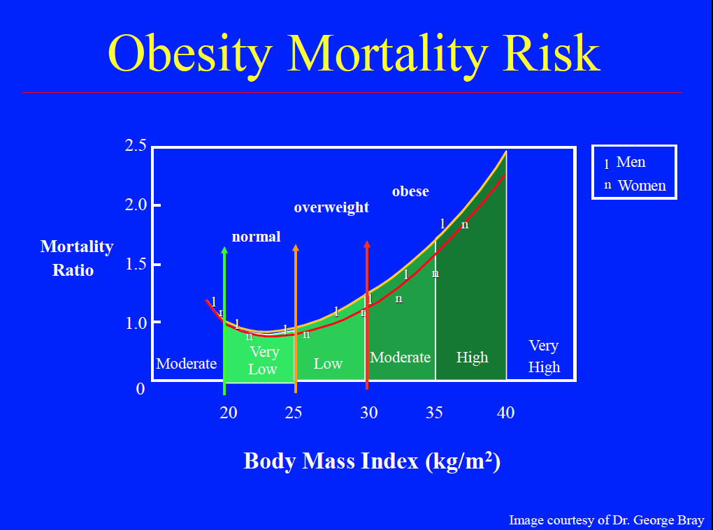

Slide 7
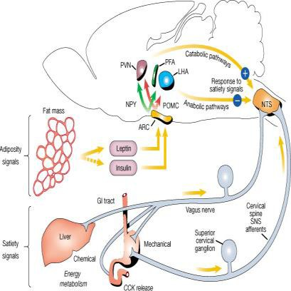

Slide 8
Leptin: a hormone made by the fat cell
Leptin Resistance
As your fat percent increases your leptin level increases
At some point of “fatness” the ability of leptin to increase you metabolism stops – “leptin resistance”
As weight loss occurs (from whatever means) the percent of fat is important to promote the coupling of leptin to metabolism in the hypothalamus
Primary defects of hormone function exist in obese patients

Slide 9
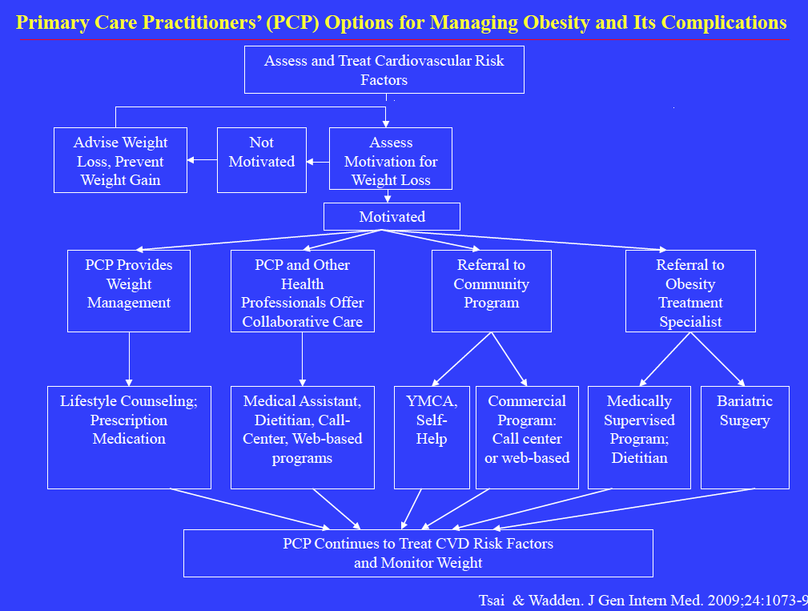

Slide 10
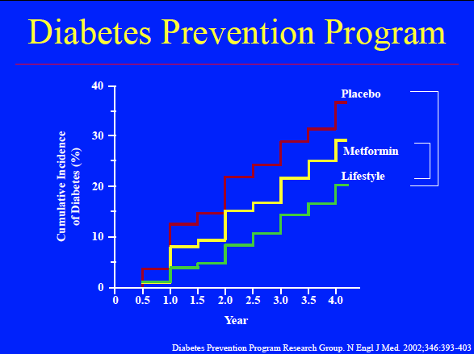
The Legacy Effect

Slide 11
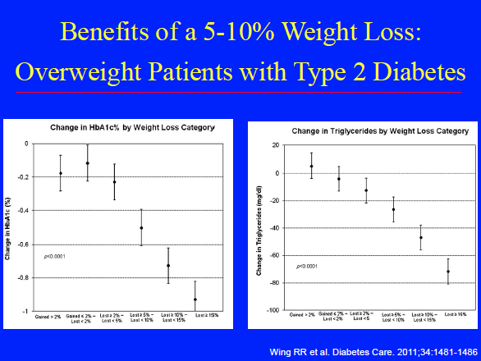

Slide 12
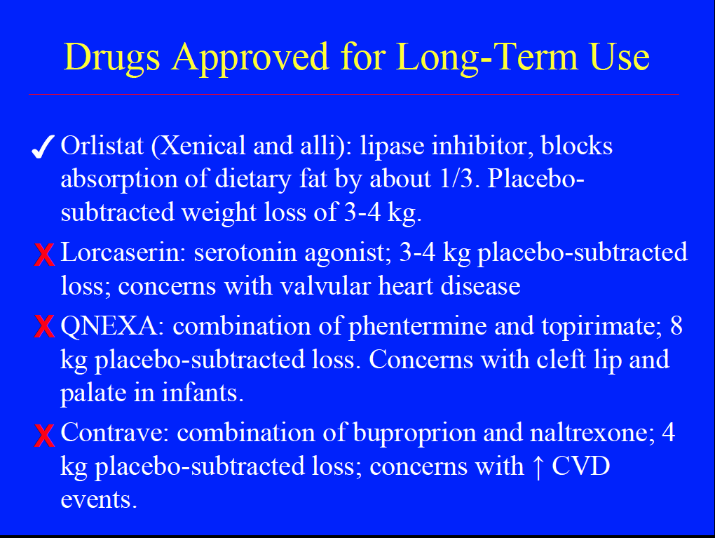

Slide 13
50 overweight or obese patients without diabetes in a 10-week weight-loss program
Weight loss (mean [±SE], 13.5±0.5 kg) led to significant reductions in levels of leptin, peptide YY, cholecystokinin, insulin (P<0.001 for all comparisons), and amylin (P=0.002) and to increases in levels of ghrelin (P<0.001), gastric inhibitory polypeptide (P=0.004), and pancreatic polypeptide (P=0.008).
There was also a significant increase in subjective appetite (P<0.001).
One year after the initial weight loss, there were still significant differences from baseline in the mean levels of leptin (P<0.001), peptide YY (P<0.001), cholecystokinin (P=0.04), insulin (P=0.01), ghrelin (P<0.001), gastric inhibitory polypeptide (P<0.001), and pancreatic polypeptide (P=0.002), as well as hunger (P<0.001).
One year after initial weight reduction, levels of the circulating mediators of appetite that encourage weight regain after diet-induced weight loss do not revert to the levels recorded before weight loss.
Long-term strategies to counteract this change may be needed to prevent obesity relapse.
Priya Sumithran, M.B., B.S., Luke A. Prendergast, Ph.D., Elizabeth Delbridge, Ph.D., Katrina Purcell, B.Sc., Arthur Shulkes, Sc.D., Adamandia Kriketos, Ph.D., and Joseph Proietto, M.B., B.S., Ph.D. Long-Term Persistence of Hormonal Adaptations
to Weight LossN Engl J Med 2011; 365:1597-1604
Notes:
We enrolled 50 overweight or obese patients without diabetes in a 10-week weight-loss program for which a very-low-energy diet was prescribed.
At baseline (before weight loss), at 10 weeks (after program completion), and at 62 weeks, we examined circulating levels of leptin, ghrelin, peptide YY, gastric inhibitory polypeptide, glucagon-like peptide 1, amylin, pancreatic polypeptide, cholecystokinin, and insulin and subjective ratings of appetite.
Weight loss (mean [±SE], 13.5±0.5 kg) led to significant reductions in levels of leptin, peptide YY, cholecystokinin, insulin (P<0.001 for all comparisons), and amylin (P=0.002) and to increases in levels of ghrelin (P<0.001), gastric inhibitory polypeptide (P=0.004), and pancreatic polypeptide (P=0.008).
There was also a significant increase in subjective appetite (P<0.001).
One year after the initial weight loss, there were still significant differences from baseline in the mean levels of leptin (P<0.001), peptide YY (P<0.001), cholecystokinin (P=0.04), insulin (P=0.01), ghrelin (P<0.001), gastric inhibitory polypeptide (P<0.001), and pancreatic polypeptide (P=0.002), as well as hunger (P<0.001).
One year after initial weight reduction, levels of the circulating mediators of appetite that encourage weight regain after diet-induced weight loss do not revert to the levels recorded before weight loss. Long-term strategies to counteract this change may be needed to prevent obesity relapse.

Slide 14
Bariatric Surgery
Weight loss outcomes
Outcomes of related medical problems – for instance in what percent of people does diabetes resolve
Adverse Events
  Mortality
  Readmissions
  Reoperations
  Major Complications

Slide 15
Mechanism of Action
Mechanical
  Calorie Restriction
  Malabsorption
Physiologic
  Hormones from intestinal track
  Hormones from Fat Cells
  Neuromodulation through changes in signaling of vagus nerve
Weight Dependent effects only – Adjustable Gastric Band
Weight Dependent and Weight Independent effects –
The “Metabolic” operations: Sleeve, Gastric Bypass and Switch

Slide 16
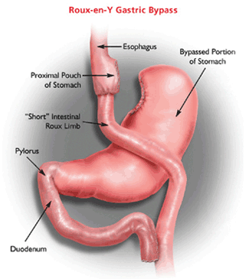
Roux-en-Y gastric bypass (RYGB)
Ghrelin
GLP-1
PYY
Insulinn
Meirelles K. et al. Mechanisms of Glucose Homeostasis after Roux-en-Y Gastric Bypass
Surgery in the obese, insulin-resistant Zucher Rat.
Ann Surg 2009 February;249(2):277-285.

Slide 17
Complications of Gastric Bypass
Death: 0.14% ⁽³⁾
Readmission: 5.4%
Reoperation within 30 days: 5.4%
Leak: Circular Stapler 0.6%; Linear Stapler 0.3%, Hand sewn 0.6%
Stricture: 5.7 – 15.3%
Neuroglycopenia: A rare condition where the patient eats high dose carbohydrates lowering blood sugar (due to GLP1) and causing fainting or dizziness. May require reversal of the bypass. The occurrence is 0.2% of patients after gastric bypass. ⁽⁵⁾
Vitamin/Protein Malnutrition is a result of non-compliance with vitamin recommendations and food sources. Anemia occurs in 0.2% of patients after gastric bypass.
Ulcer: 0 - 8%
    Patient may gets tested for H. pylori and treated prior to surgery ⁽⁶⁾
    Patient may get placed on antacid after surgery for 90 days.
    A small gastric pouch has been shown to decrease the incidence.
    May be related to technique
    Patient factors like the use of non-steroidal anti-inflammatory medications (ibuprofen) after surgery impact incidence.

Slide 18
Efficacy vs. Complication Rate

Slide 19
Weight Loss and Remission of Related Disease of LGBP
Weight Loss: 68% (EWL) at four years ⁽¹⁾ and 75% EWL at 10 years ⁽²⁾
Remission of Co-morbid disease: Hypertension 62%; Type 2 Diabetes (85%) patients “at risk for diabetes” rarely go on to develop diabetes Dyslipidemia 34% normal levels, 38% improved based on 88% follow up. ⁽²⁾⁽³⁾⁽⁴⁾
White S. Long term outcomes after Gastric Bypass. Obes Surg 2005;15(2):155-63.
Birkmeyer NJ et al. Hospital complication rates with Bariatric Surgery in Michigan. JAMA 2010;304(4):435-42.
Sjostrom L et al. Lifestyle, diabetes and cardiovascular risk factors 10 years after bariatric surgery. NEJM 2004Dec23;351(26):2683-93.

Slide 20
Why is Gastric Bypass so effective in treating obesity?

Slide 21
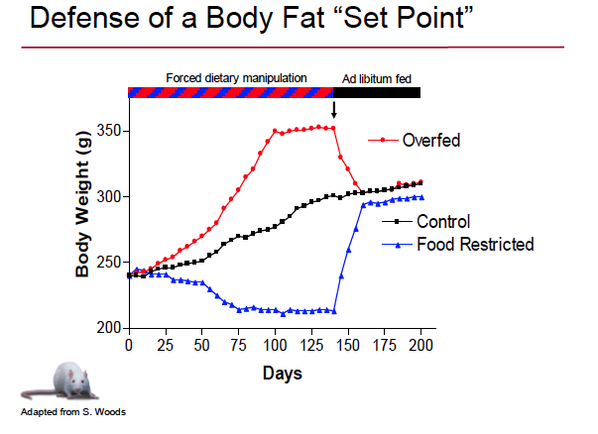
Notes:
When you decrease your food intake, your body adapts the rate of metabolism to a slower rate, so you don’t use up your energy stores as fast. Eventually your hormones kick in and you get very hunger (Ghrelin) and regain your weight to get back to your own individual set point. To change your set point you not only have to lose weight but you have to decrease your body fat percent.

Slide 22
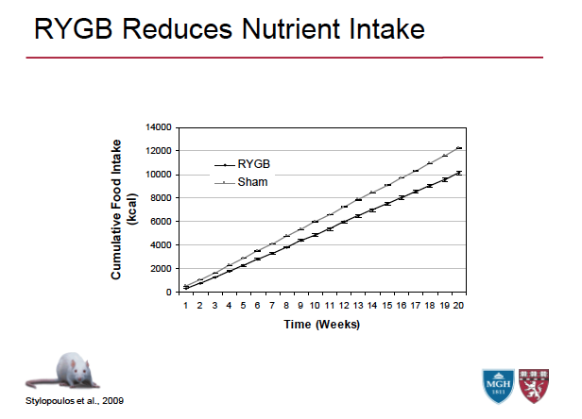

Slide 23
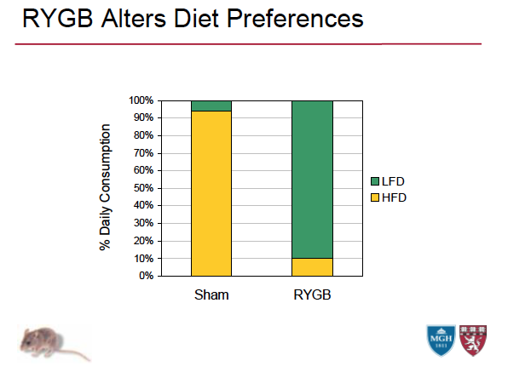

Slide 24
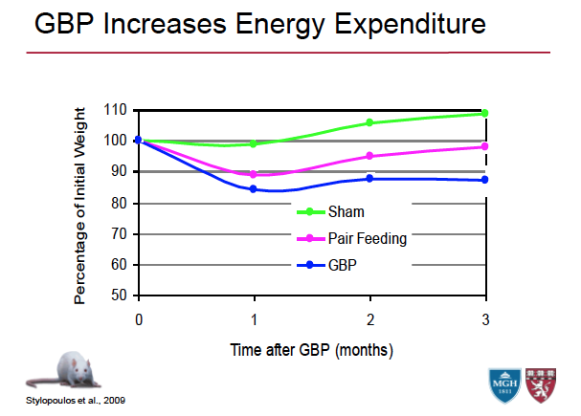
Notes:
In response to eating the same amount of food the weigh of the GBP mouse decreases

Slide 25
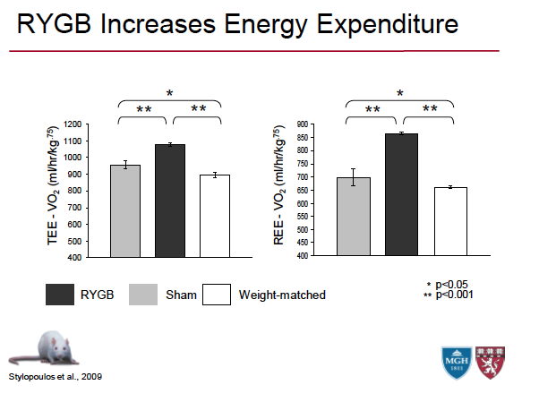

Slide 26
Lipid Oxidation (Human Data)
Skeletal Muscle form extremely obese individuals has impaired capacity for fatty acid oxidation
After a 50 kg weight loss (Gastric Bypass) this defect persisted
Intense exercise significantly improves the lipid oxidation to nearly that seen in lean individuals
Weight loss coupled with intense exercise helps reverse the primary defect in lipid oxidation of skeletal muscle
Berggren JR, Boyle KE, Chapman WH, Houmard JA. Skeletal muscle lipid oxidation
and obesity: influence of weight loss and exercise.
Am J Physiol Endocrinol Metab 293:E726-732, 2008

Slide 27
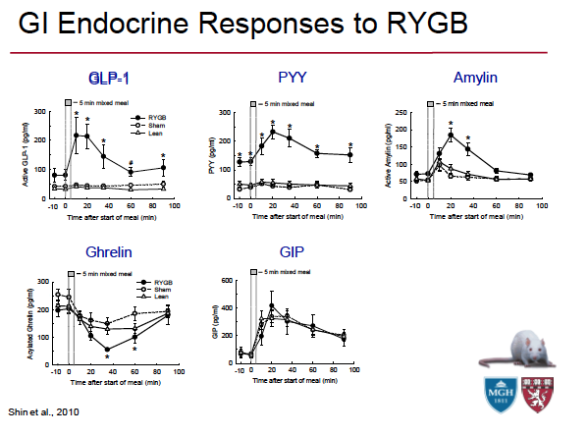

Slide 28
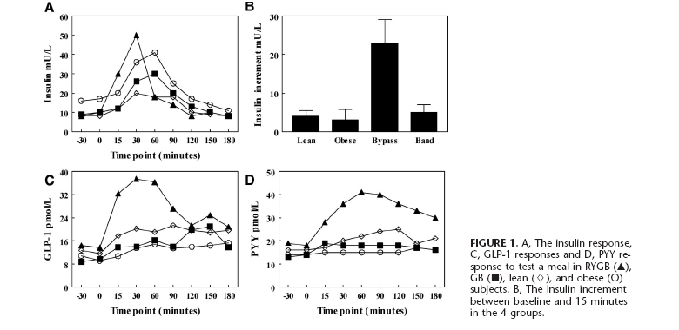

Cross-sectional comparisons of fasting & post-prandial responses
of Insulin, GLP-1 and PYY in post-op BAND v RYGBP and lean & OB controls (post-op = 6-36 mo.)
RY
OB
BAND
Lean
420 kcal mixed meal
RY
RY
Lean
Lean
OB
OB
BAND
BAND
leRoux et al. Ann Surgery 243 :108-114, 2006

Slide 29
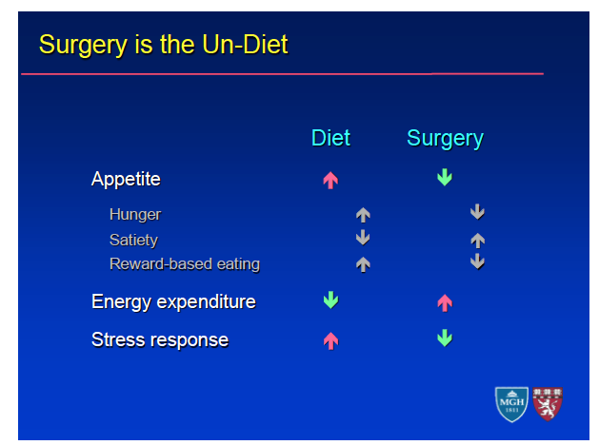
Slide courtesy of Lee Kaplan, Harvard

Slide 30
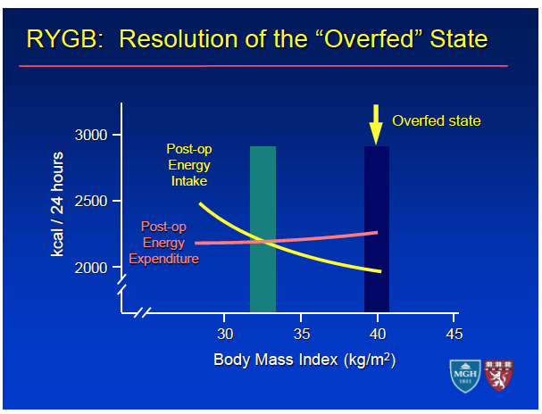
GBP patient migrates to a new body set point–there will still be some weight gain over time
Notes:
GBP results in a new “set point” Not a result of mechanical restriction of food

Slide 31
Reduced incidence of Gestational Diabetes(GDM) with Bariatric Surgery
Retrospective review of 23,594 women who had bariatric surgery between 2002 and 2006
346 women with a delivery prior to bariatric surgery and 354 had a delivery after bariatric surgery
Type of operation: 87% RGBP and 3% AGB
Women with delivery after bariatric surgery had a lower incidence of GDM 8% vs. 27% and C section 28% vs. 43%
Burke AE et al. Reduced Incidence of Gestational Diabetes with Bariatric Surgery
J Am Coll Surg 2010; 211(2) 169-175
Burke AE et al. Reduced Incidence of Gestational Diabetes with Bariatric Surgery
J Am Coll Surg 2010; 211(2) 169-175

Slide 32
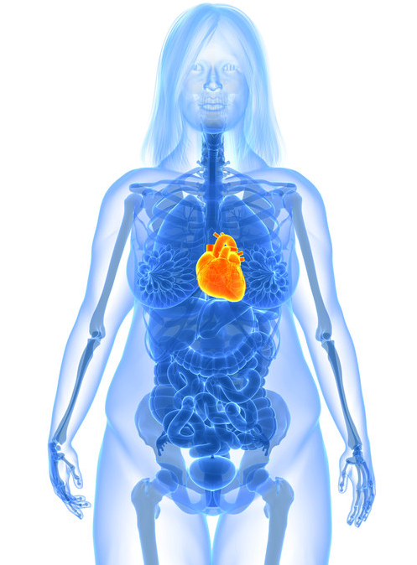
Obesity and Heart Disease
Cardiomyopathy
Heart Failure
Cardiovascular Disease
Atherosclerosis

Slide 33
How Obesity affects the Heart
Obese patients 30% more likely to develop heart failure
Each increase in Body Mass Index increases the risk of heart failure by 5% for men and 7% for women
Left Ventricular hypertrophy (present in 87% of obese patients)
Left Ventricular dilatation present in 8-40%

Slide 34
Mechanism
88 women without identifiable cardiovascular risk factors
BMI 21.2- 45kg/m2
Cardiovascular MRI to determine LV and RV mass and volumes
Overweight is associated with significant LV and RV hypertrophy but no increase in LV and RV Volumes
Significant increase in serum leptin occurred in the BMI 25-29 (pre-obese)
Rider OJ et al. Ventricular hypertrophy and cavity dilatation in relation to body mass index
in women with uncomplicated obesity Heart 2011;97:203-208
Notes:
Rider OJ et al. Ventricular hypertrophy and cavity dilatation in relation to body mass index in women with uncomplicated obesity Heart 2011;97:203-208

Slide 35
Clinical relevance
Hypertrophic response to obesity and leptin may occur independently from dilatation
Leptin increased by 130% in subjects with hypertrophy
Strong relationship between Ventricular dilatation and all cause mortality
Influence of leptin levels on hypertrophy as one mechanism
Leptin receptors are found in myocardium as well as on adipocytes suggesting leptin has specific effects on the myocardium. In tissue culture it induces hypertrophy of the myocyte
CV mortality is higher even in overweight pre-obese individuals than normal weight individuals
Rider OJ et al. Ventricular hypertrophy and cavity dilatation in relation to body mass index
in women with uncomplicated obesity Heart 2011;97:203-208

Slide 36
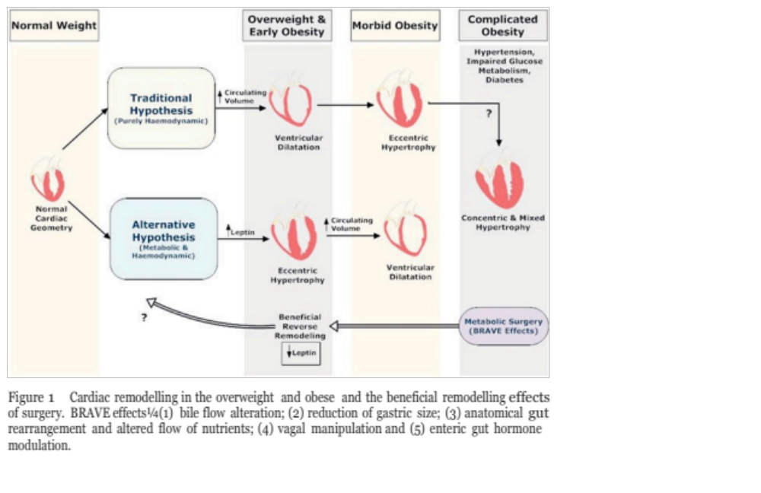
Notes:
Ashrafian H Heart remodeling and obesity Heart February 2011;97(3):171-172

Slide 37
BRAVE effects of Metabolic Surgery
Bile Flow Alteration
Reduction of gastric size
Anatomical gut rearrangement with altered flow of nutrients
Vagal manipulation
Enteric gut hormone modulation
Results in 40 % improved survival
Ashrafian H et al. Metabolic surgery and cancer: Protective
Effects of bariatric procedures. Cancer May 2011;117(9):1788-99.
Notes:
Cancer. 2011 May 1;117(9):1788-99. doi: 10.1002/cncr.25738. Epub 2010 Nov 29.
Metabolic surgery and cancer: Protective effects of bariatric procedures.
Ashrafian H, Ahmed K, Rowland SP, Patel VM, Gooderham NJ, Holmes E, Darzi A, Athanasiou T.

Slide 38
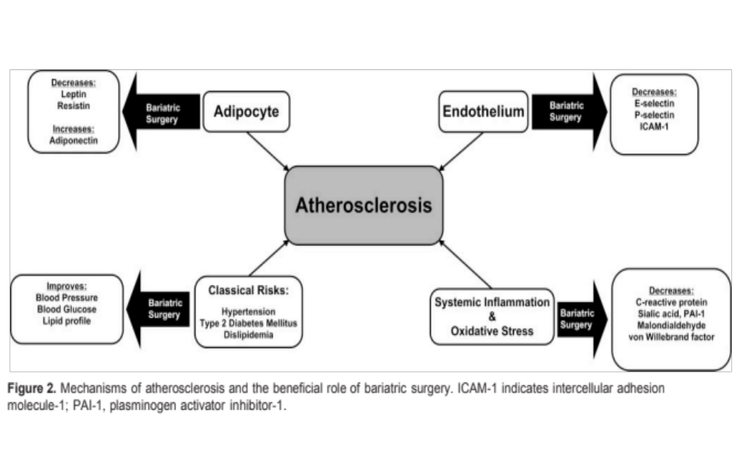
Current Paradigm of the Etiology of Atherosclerosis
Ashrafian H et al. Effects of Bariatric Surgery on Cardiovascular Function
Circulation 2008;118:2091-2102.
Ashrafian H. et al. Effects of Bariatric Surgery on Cardiovascular Function
Circulation 2008;118:2091-2102.
Notes:
Ashrafian H et al. Effects of Bariatric Surgery on Cardiovascular Function Circulation 2008;118:2091-2102.

Slide 39
Swedish Obese Subjects Study

Slide 40
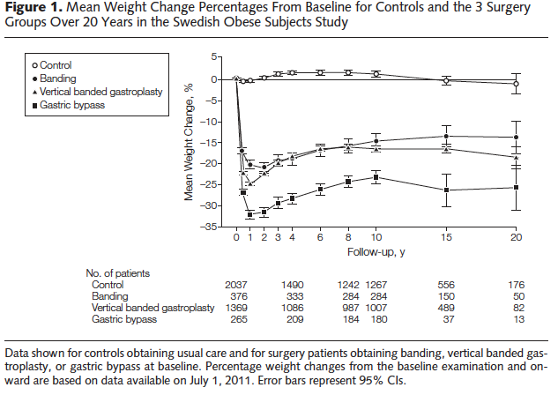

Slide 41
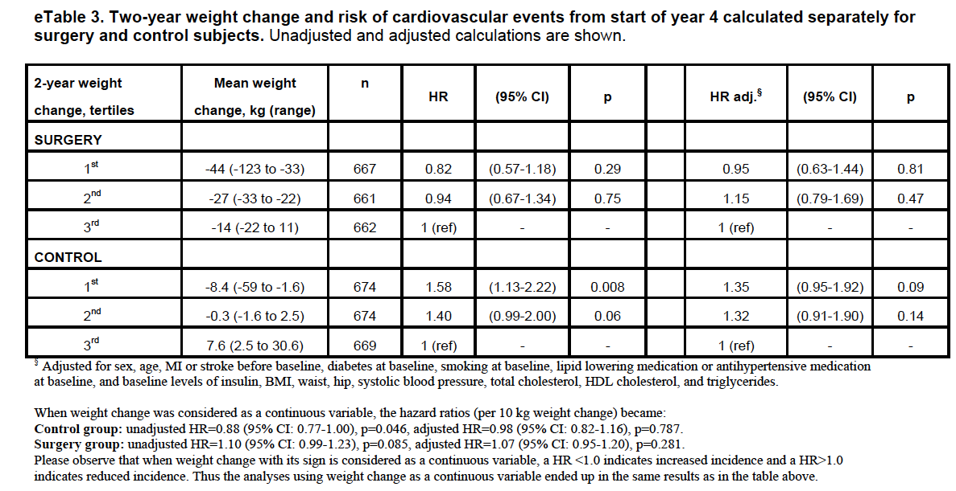

Slide 42
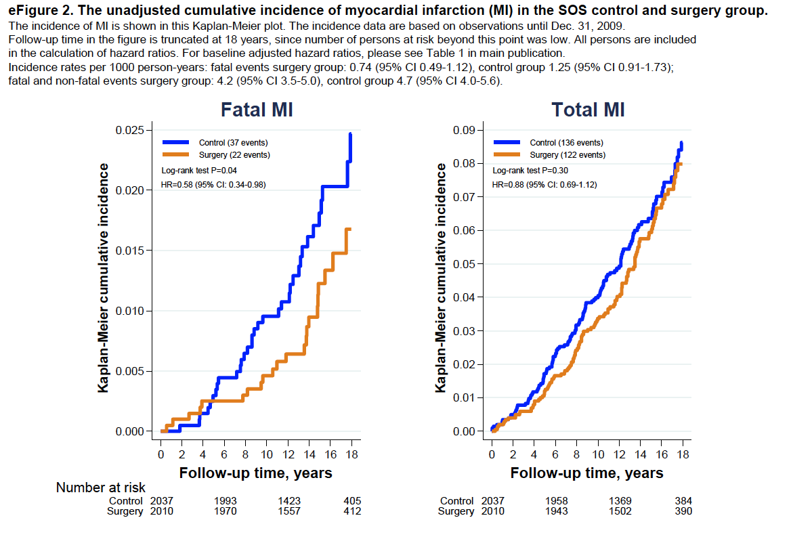

Slide 43
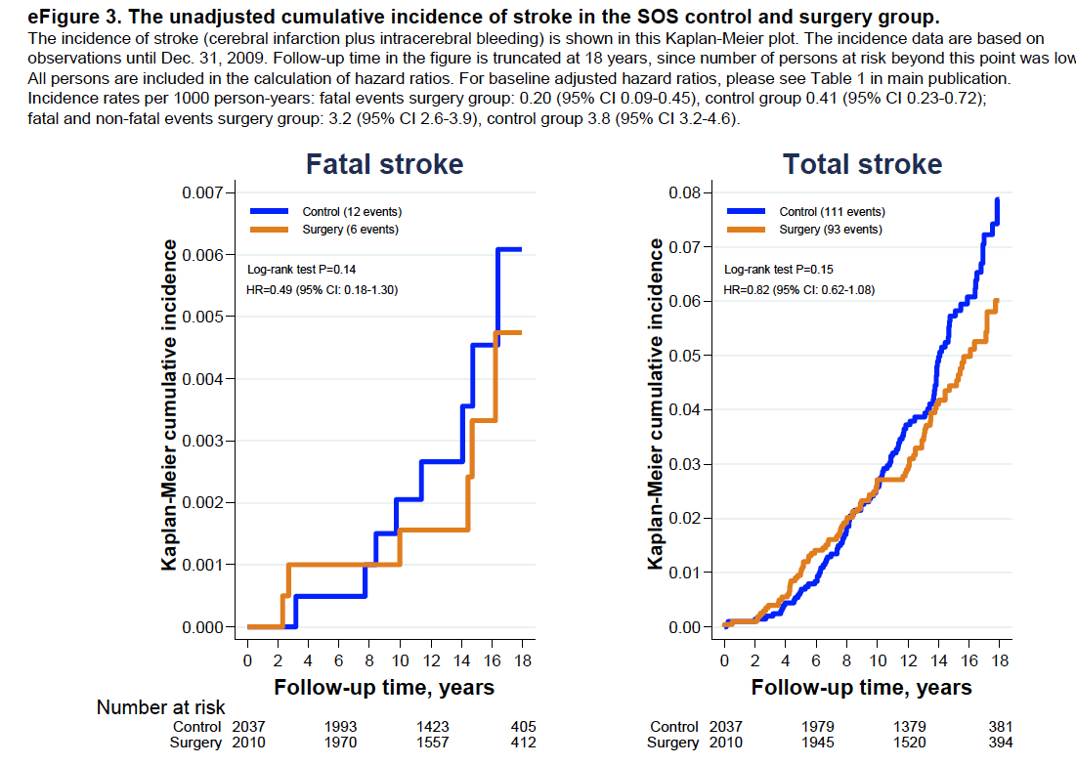

Slide 44
Thank you

