Slide 1

Comparison Framework for Analyzing of LCC of Structural Health Monitoring: Case Study of Anthony Falls Bridge
Paper ID# 127
CIVI 6061 Structural Health Monitoring
Presented by:
Abdulhakim Eshatti
Supervision of:
Prof. Ashutosh Bagchi

Slide 2
Outline
Introduction
Literature Review
Research Methodology
Comparative Analysis
Results and Discussion
Conclusions and Outlook
1

Slide 3
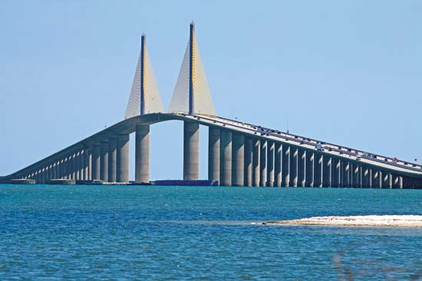
Introduction
Bridge
SHM System
LCCA
2

Slide 4

Objective
Structural Health Monitoring Calculate life cycle cost Analysis Compare with previous results Benefit to Cost Ratio Future Value vs. & Present Value
3

Slide 5
Literature Review
Life cycle cost-benefit analysis of SHM of I-35 W St. Anthony Falls bridge. In this case, study, The author considers life cycle cost analysis (LCCA) was performed to compare cases. 40 years and 65. Life-cycle cost analysis of bridges subjected to fatigue damage. In this case, study, The author considers life cycle cost analysis (LCCA) was To analyze the fragility and costs of fatigued bridges
4

Slide 6
Methodology
Present Value (PV) Present value (PV) is a method of the calculating the current value of a future sum of money or stream of cash flows given a specified rate of return Present Value=FV / (1+r)n​ where: FV=Future Value, r=Rate of return, n=Number of periods​ - Benefit to Cost Ratio (BCR) The benefit-cost ratio (BCR) is a ratio used in a cost-benefit analysis to summarize the overall relationship between the relative costs and benefits of a proposed project. The Benefit Cost Ratio (BCR)= Present Value of Future Benefits / Present Value of Future Costs
5

Slide 7
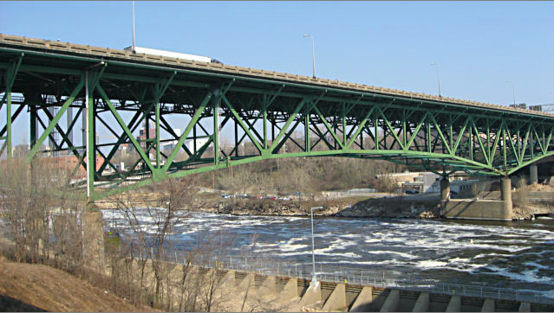
Life Cycle Cost
Clifecycle = Ccapital + Crepair + Cuser + Cfailure + CSHM Clifecycle cost associated during. whole life. Ccapital capital cost. Cuser user cost. Crepair cost associated with the maintenance and rehabilitation. CSHM cost associated with the SHM system.
6

Slide 8
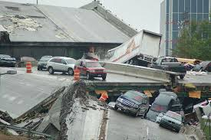
Old I-35 W St. Anthony Falls bridge
Without SHM System
7

Slide 9

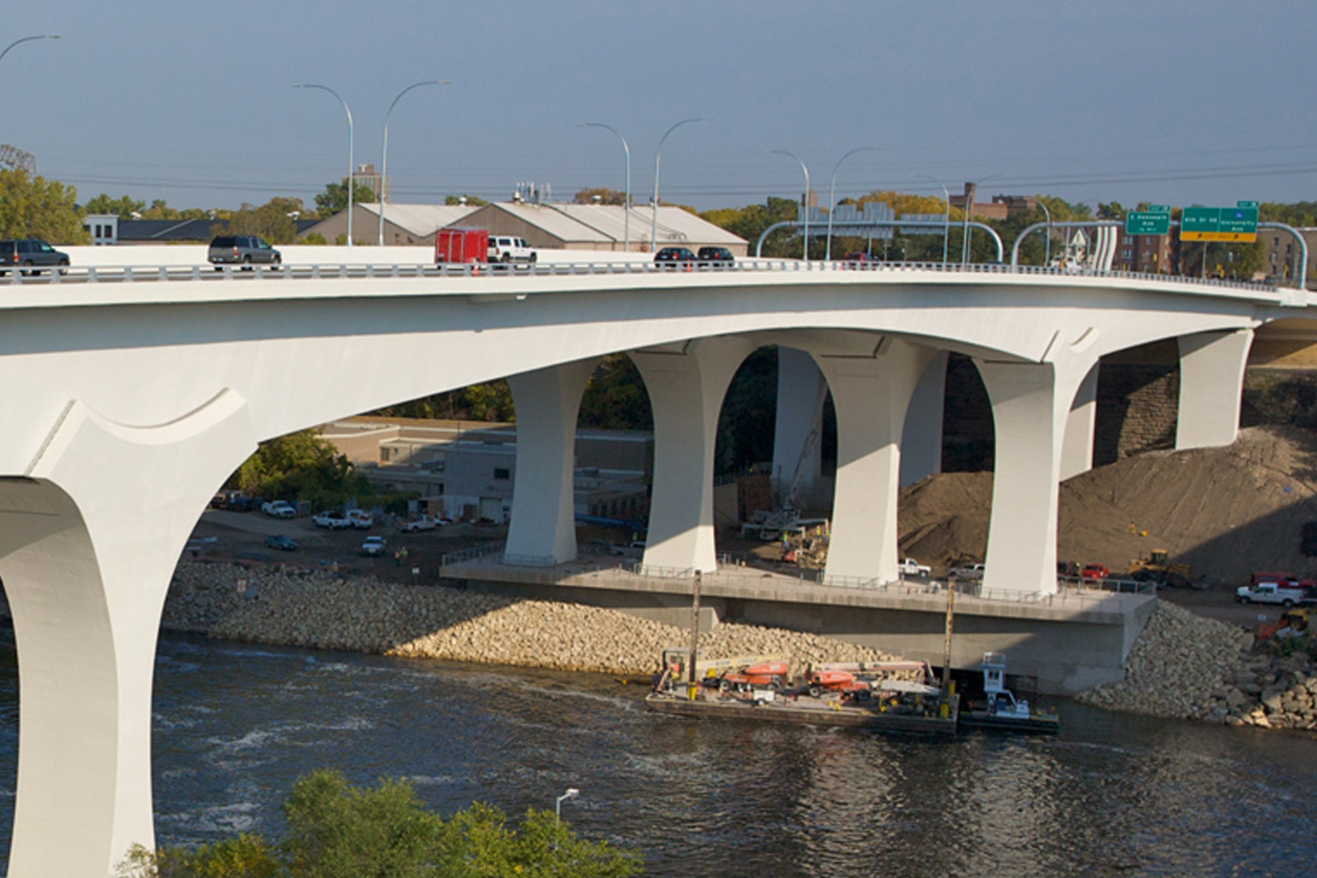

New I-35W Minneapolis bridge
With SHM System
8

Slide 10
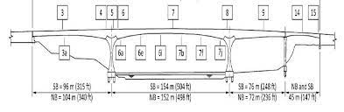
New I-35W Minneapolis bridge
Sensors placed on the bridge.
9

Slide 11
Case Study- I-35 W St. Anthony Falls bridge
Considered in this study. A life cycle cost analysis (LCCA) will be performed to compare cases 45 years and 55 years. Find the benefit-cost ratio for the case of the bridge with SHM and for the bridge without it
10

Slide 12
Results
Results of LCCA.
11

Slide 13
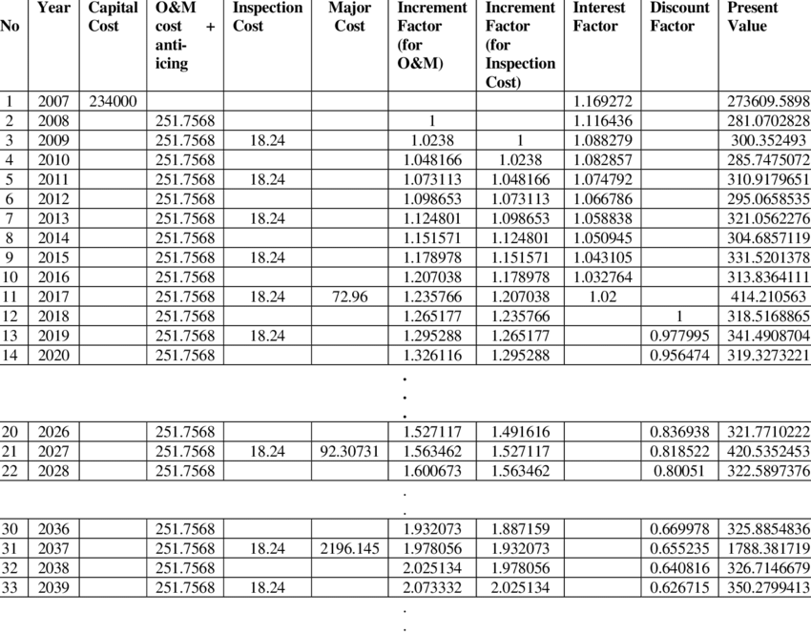
Results
Results of LCCA Cost of Bridge without SHM (in Thousand $.
12

Slide 14
Results
Results Cost Table of Bridge with SHM (in Thousand $)
13

Slide 15
Results
Years | PV of Cost (USD) | PV of Benefit (USD) | Benefit Cost Ratio (%)
40 Yrs without SHM | 282,142,481.2 | 1,351,481,130 | 4.79
55 Yrs with SHM | 301,127,657.6 | 1,543,387,420 | 5.12
65 Yrs with SHM | 313,920,197.1 | 1,766,878,663 | 5.63
70 Yrs with SHM | 316,209,719.3 | 1,793,756,235 | 5.71
Results of bridge benefit with/without SHM between 40-70 years.
14

Slide 16
Conclusion
AVAILABLE OPTION
LCCA
Available
Best
BEST OPTION
Results of bridge benefit with/without SHM between 40-70 years.
15

Slide 17
References
1] Dalia, Z. M., et al. "Life cycle cost-benefit analysis of SHM of I-35 W St. Anthony Falls bridge." strain 9.14 (2018): 15. [2] Dhillon, B. S. Life Cycle Costing for Engineers [3] HNTB Corporation. (2011, January). St. Croix River Crossing Project: Innovative Financing Study. Minnesota Department of Transportation [4] Inaudi, D. (2011). Cost-Benefits Analysis in SHM Projects. 5th International Conference on Structural Health Monitoring of Intelligent Infrastructure (SHMII-5) [5] Hedegaard, B. D., Catherine E. W., Shield, C. K., Stolarski, H. K., and Jilk, B. J. (2013). Instrumentation and Modeling of I35W St. Anthony Falls Bridge. American Society of Civil Engineers [6] [Online]. Available: https://www.mprnews.org/story/2007/09/19/bridgebids [6] Thorp, T. J. (2009). A Critical Analysis of the Saint Anthony Falls (I-35w) Bridge, Minneapolis. Proceedings of Bridge Engineering 2 Conference 2009, University of Bath, Bath, UK [8] Minnesota Department of Transportation. (2017, December). Major Highway Projects, Trunk Highway Fund Expenditures and Efficiencies Report [9] HNTB Corporation. (2011, January). St. Croix River Crossing Project: Innovative Financing Study. Minnesota Department of Transportation [10] [Online]. Available: http://www.dot.state.mn.us/metro/projects/stcroix/pdfs/sdeis/Appendices/Appendix%20E/LiftBridge-PDF-081004- 2.pdf [11] Nelson, S. L. Deterioration Rates of Minnesota Concrete Bridge Decks. Minnesota Department of Transportation Research Services & Library [12] Minnesota Department of Transportation. Economic Impacts of the I-35W Bridge Collapse [13] [Online]. Available: https://fred.stlouisfed.org/series/INTDSRUSM193N [14] Torti, Michela, et al. "Life-cycle management cost analysis of transportation bridges equipped with seismic structural health monitoring systems." Structural Health Monitoring 21.1 (2022): 100-117. [15] Sacconi, Stefano, et al. "Life-cycle cost analysis of bridges subjected to fatigue damage." Journal of Infrastructure Preservation and Resilience 2.1 (2021): 1-13.
16

Slide 18
Thank you

