Slide 1
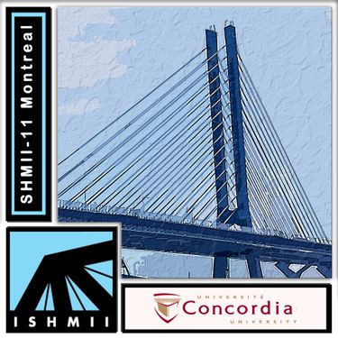

Entropy evaluation of subsurface materials and defects in Concrete Slabs using GPR
Mohammed Abdul Rahmanª, Dipesh Dondaª, Fawzi Latoshª, Alexander Tarussov^{b}, Ashutosh Bagchiª
ªDepartment of Building, Civil and Environmental Engineering, Concordia University, Montreal, ^{b}Radex Detection Inc., 4 Place du Commerce, Suite 101, Verdun
Presenter:
Mohammed Abdul Rahman
Project in collaboration with:

Slide 2
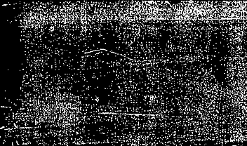

Gpr Background

Slide 3
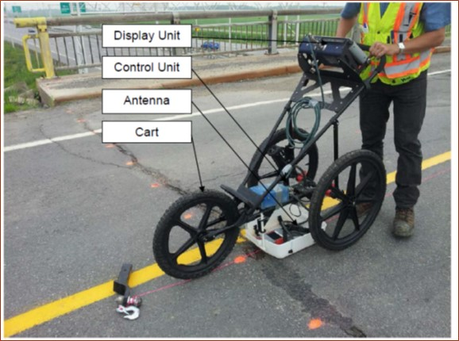
Principle
Processing
Ground Penetrating
Radar (GPR)
Top Layer
Reinforcement Layer
Radar Principle
B –Scan
Recorded Signal
A –scan

Slide 4
Numerical Amplitude Analysis
Picking of rebar location
Condition map

Slide 5

Neglects majority of information in the profile
Various factors like surface anomalies are ignored
Results obtained are noisy, vague and not reliable completely
Improper correlation when compared to actual ground condition
Depth correction is required
Limits of corrosion are subjective
Limitations of Numerical Analysis

Slide 6
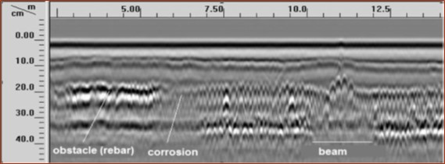
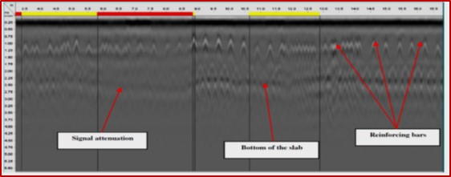
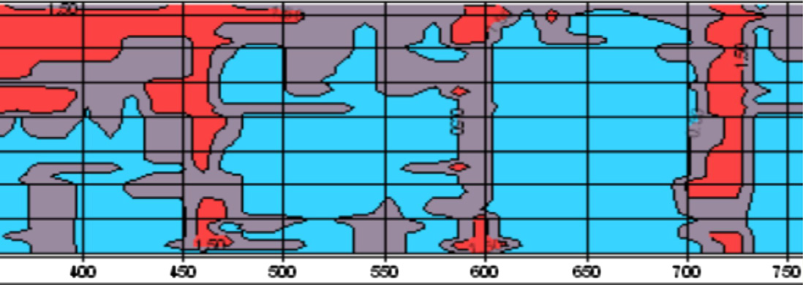
Visual image-based Analysis
Method
Anomaly and corrosion
Marking attenuated areas
Highly subjective
Prone to human error
Slow speed of analysis
Inconsistent results
Condition map
A. Tarussov, M. Vandry, and A. De La Haza, “Condition assessment of concrete structures using a new analysis method: Ground-penetrating radar computer-assisted visual interpretation,” Constr. Build. Mater., vol. 38, pp. 1246–1254, Jan. 2013, doi: 10.1016/j.conbuildmat.2012.05.026.

Slide 7
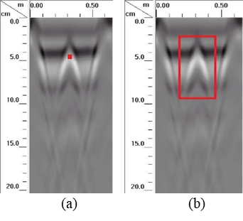

Automated image Analysis
Detect
Entropy
Cluster
Method
$$Entropy = −\sum_{i = 0}^{L−1}{P\left(z_{i}\right) \log_{z}{P\left(z_{i}\right) }}$$
z – random variable representing intensity
P(z_{i}) – respective histogram; i= 0,1,2…., L-1
L- number of distinct intensity levels
Amplitude picking vs. Entropy
M. Abdul Rahman, T. Zayed, and A. Bagchi, “Deterioration Mapping of RC Bridge Elements Based on Automated Analysis of GPR Images,” Remote Sensing, vol. 14, no. 5. 2022, doi: 10.3390/rs14051131.

Slide 8
Experimental Setup

Slide 9
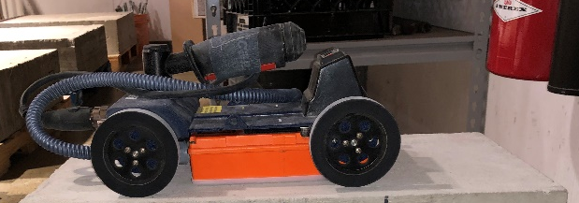
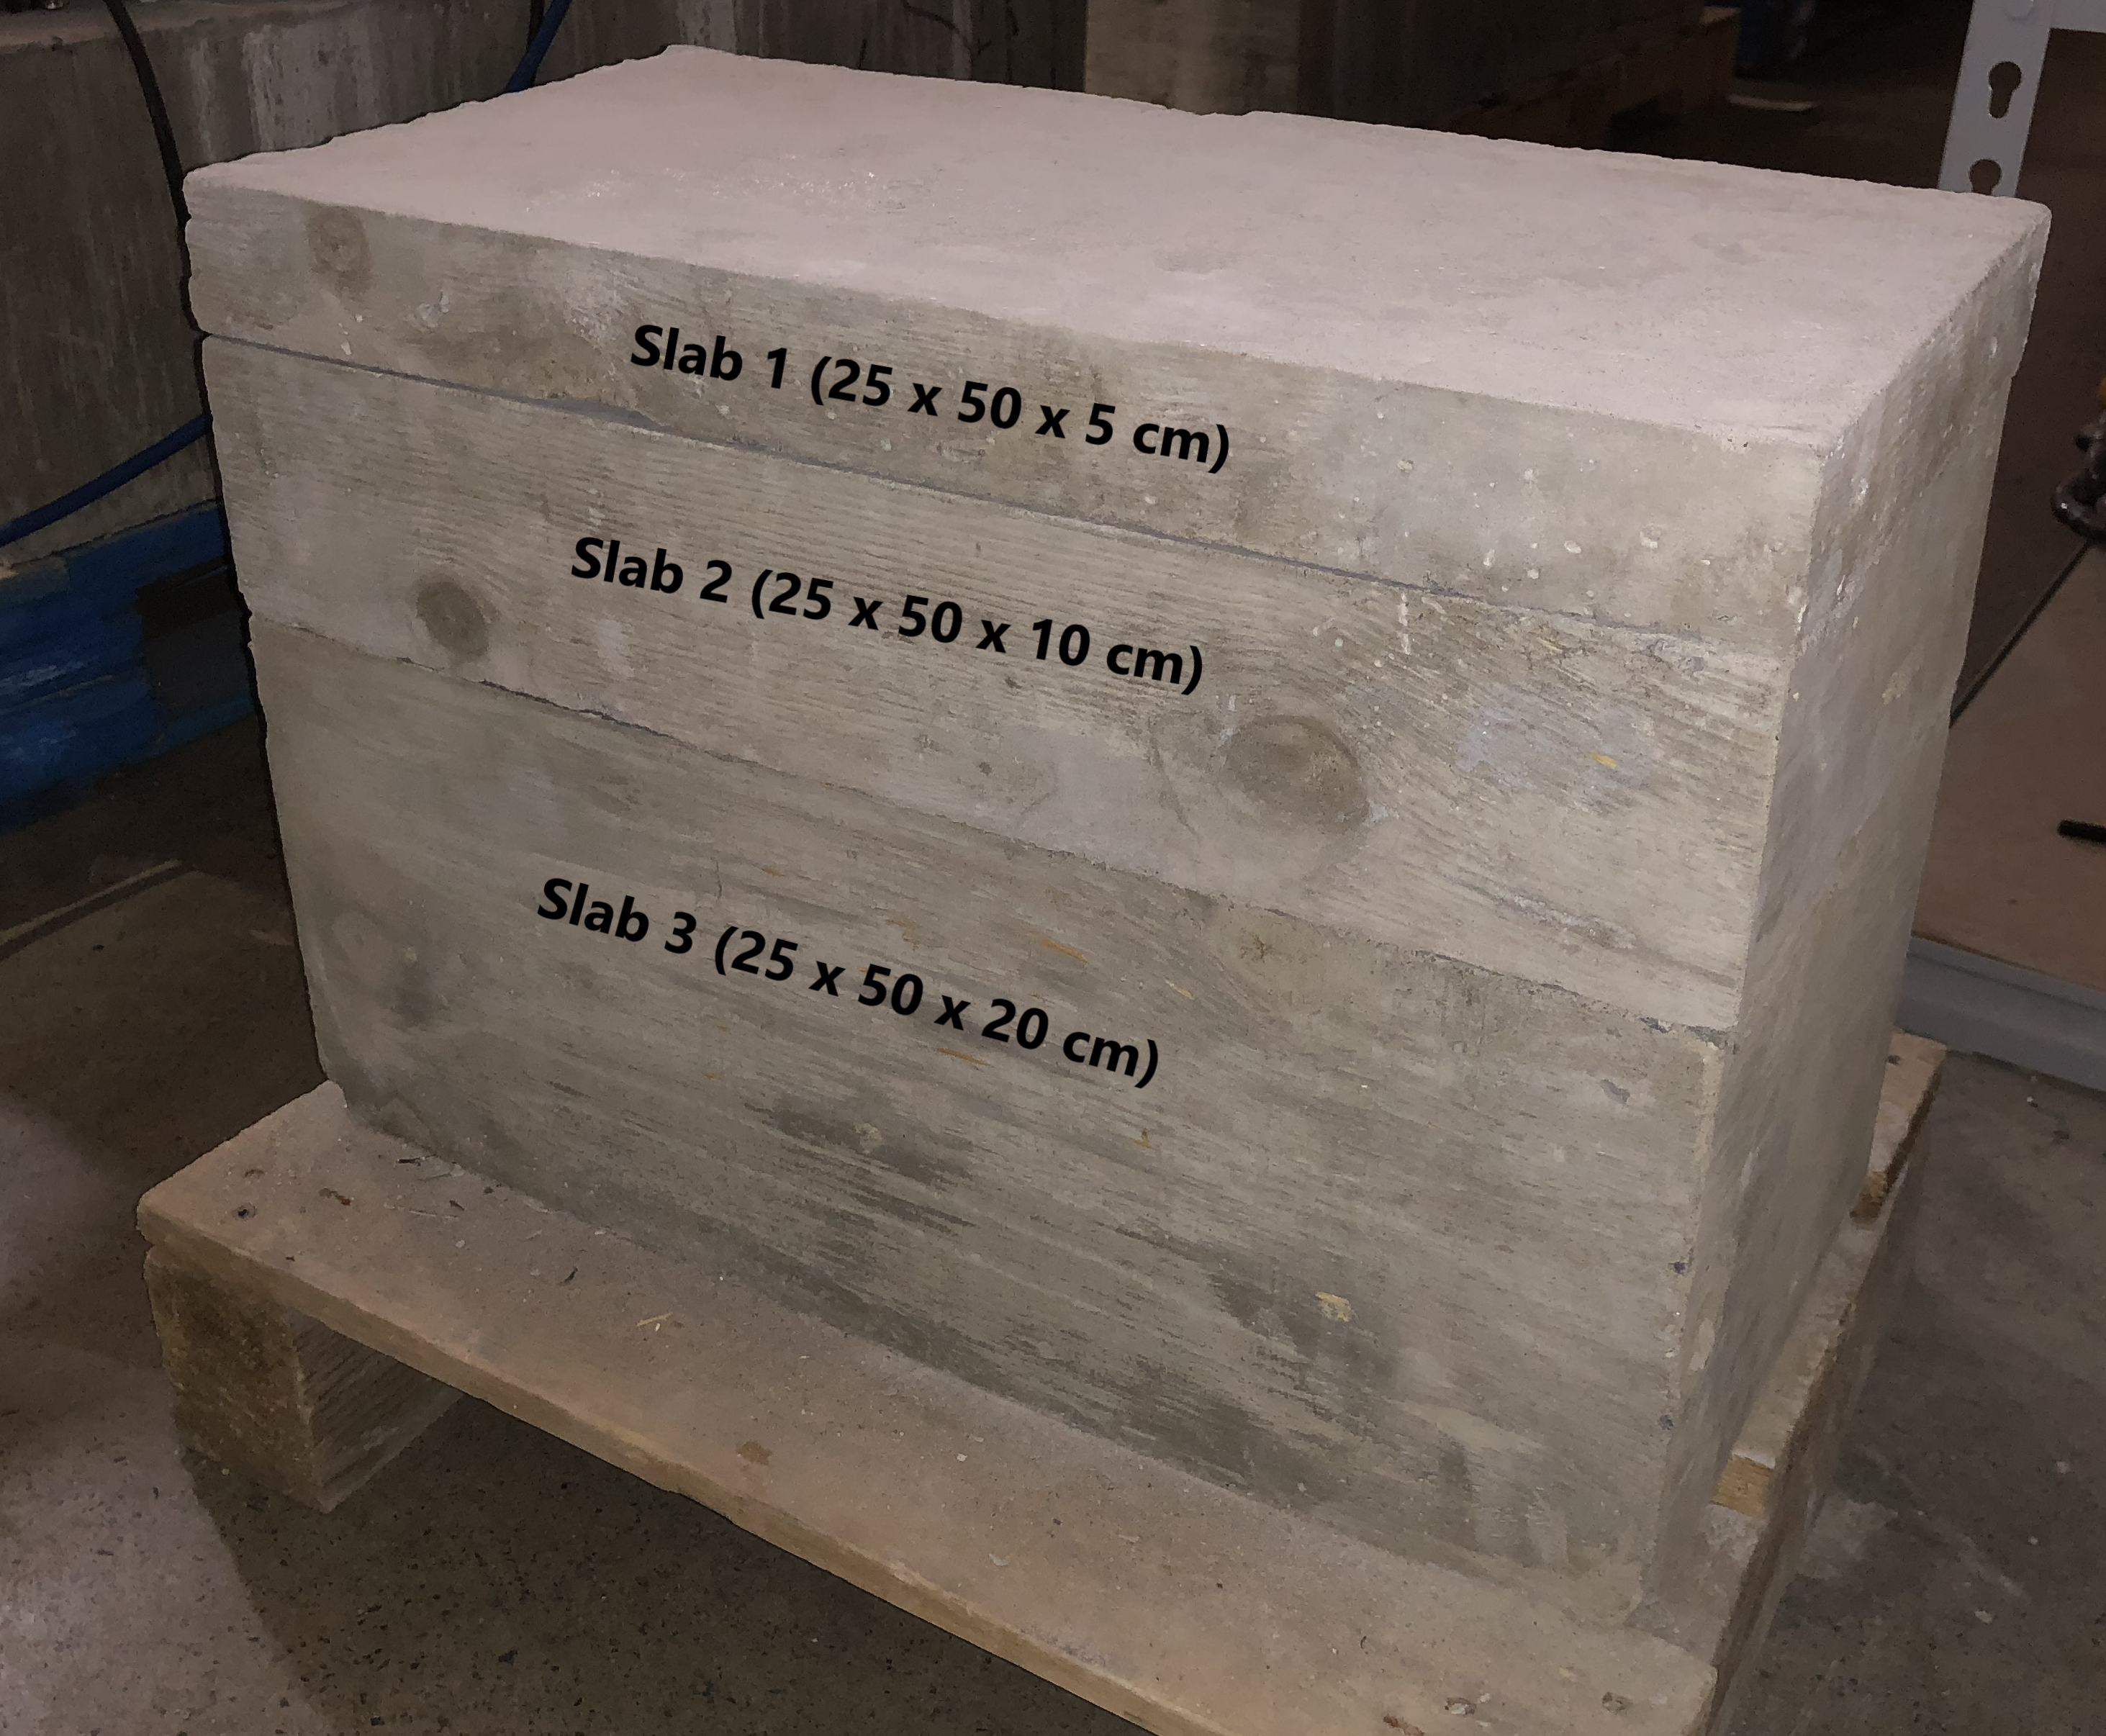
Test Slabs
Scanning parameters
GSSI Model 51600S GPR
Antenna frequency :1600 MHz
Pulse duration: 0.7 ns.
Samples/Scan :512
Bits/sample: 16
Dielectric constant – 6.0;
Depth range – 35 cm.
Handheld mini-cart
Three plain concrete slabs
Compressive strength - 35 MPa.
Three arrangements :
Slab 1 over Slab 3
Slab 2 over Slab 3
Slab 1+2 over Slab 3

Slide 10
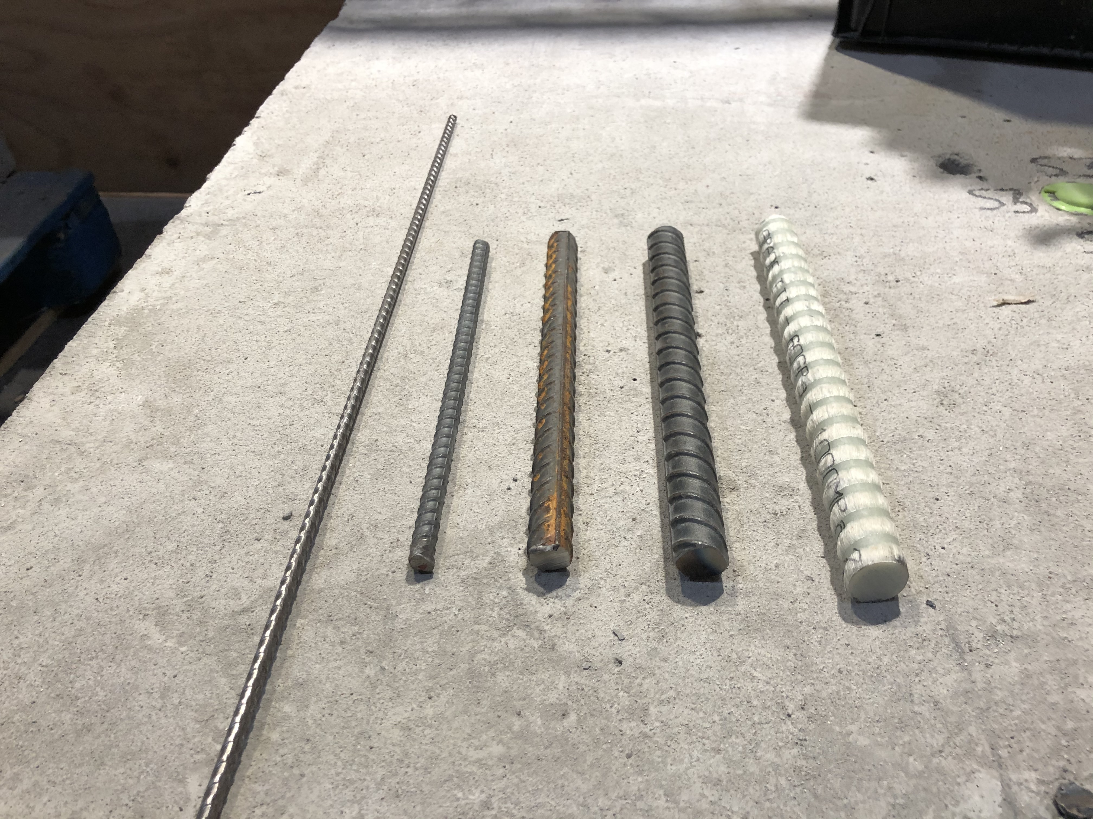
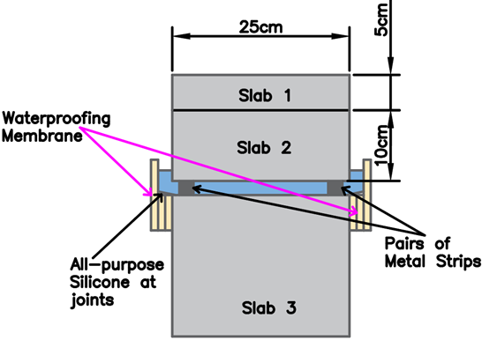
Study of REBARS, Air and Water Gap
(a)
(b)
(a) Various sizes of rebars Used (Left to Right; 6mm, 10mm, 18mm, 20mm, & FRP 21.8 mm)
(b) Schematic diagram showing an arrangement to simulate water and air gap (1 mm, 3 mm, & 4.8 mm )

Slide 11

results

Slide 12
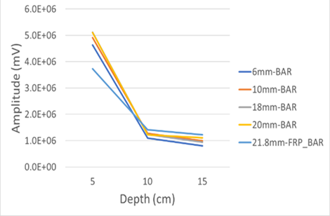
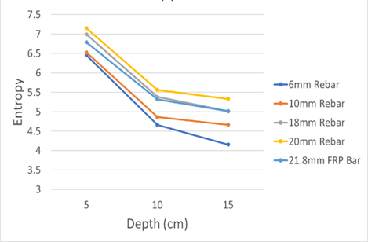
Rebars
Diameter increases, Amplitude & entropy values increases
Average drop with respect to depth
5 cm to 10 cm : 76% (Amplitude), 24% (Entropy)
10 cm to 15 cm: 20% (Amplitude), 6.4% (Entropy)
Size of rebar has less impact, depth has significant impact
Notes:
Three scans were repeated for each rebar size at every depth with the GPR to ensure the conformity of the lab tests.

Slide 13
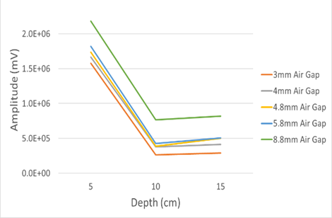
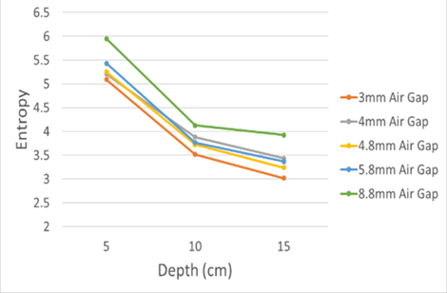
Air gaps
Air gaps increases, increase in both factors (less impact)
Average change with respect to depth
5 cm to 10 cm : 75% (Amplitude), 29% (Entropy)
10 cm to 15 cm: -14% (Amplitude), 11% (Entropy)
Inconsistent rise in amplitude at greater depth unlike entropy
Notes:
Three scans were repeated for each rebar size at every depth with the GPR to ensure the conformity of the lab tests.

Slide 14
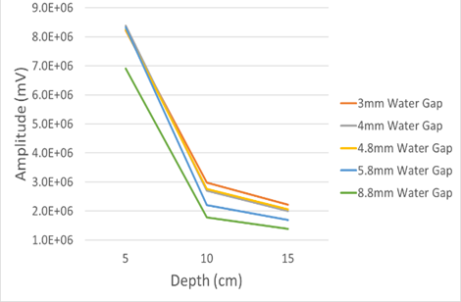
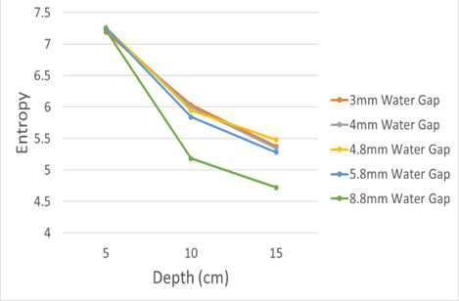
water gaps
3mm to 5.8mm gap, similar across all depths – small gap sizes, less impact
5.8mm to 8.8 mm decreases: 20% (amplitude), 7% (entropy)
Average change with respect to depth
5 cm to 10 cm : 69% (Amplitude), 20% (Entropy)
10 cm to 15 cm: -25% (Amplitude), 10% (Entropy)
Water and/or moisture significantly effect GPR signals consistency
Notes:
Three scans were repeated for each rebar size at every depth with the GPR to ensure the conformity of the lab tests.

Slide 15
Comparison for different materials
Amplitude (mV)
Depth↓ | Rebars | Air Gaps | Water Gaps
5 cm | 4.94 x 10⁶ | 1.80 x 10⁶ | 8.02 x 10⁶
10 cm | 1.21 x 10⁶ | 4.44 x 10⁵ | 2.48 x 10⁶
15 cm | 7.12 x 10⁵ | 5.06 x 10⁵ | 1.87 x 10⁶
With increase in depth, consistent drop in entropy for all materials
Inconsistency in air gaps for amplitude values
Reflection values range: Water > Rebars > Air gaps
Drop higher from 5cm to 10 cm than from 10 cm to 15 cm
High energy loss closer to surface
Entropy values
Depth↓ | Rebars | Air Gaps | Water Gaps
5 cm | 6.78 | 5.39 | 7.23
10 cm | 5.12 | 3.80 | 5.80
15 cm | 4.79 | 3.40 | 5.24

Slide 16


CONCLUSIONS AND FUTURE WORK
GPR can be used to detect and distinguish subsurface materials and defects at differing depths
Entropy yielded consistent results
Limitations: length of the slab, rebars not embedded, and actual cracks/gaps contain other impurities
Future Works: Analyze GPR signals with varying degrees of rebar corrosion, compare with in-situ concrete
Research aim to improve GPR reliance as a condition assessment tool

