Slide 1
From AWS User to Community Champion: Supercharge your tech journey
Closing keynote
Andra Somesan
Mohammed Fazalullah
Solutions Architect
Amazon Web Services
Senior Developer Advocate
Amazon Web Services

Slide 2
Agenda
State of the union
AWS communities and programs overview
Technical competency in communities
Personal stories
A look towards the future

Slide 3
State of the union

Slide 4
Romania and Moldova overview
COMMUNITIEs and EVENTS
5 official AWS User Groups + 1 unofficial cloud meetup
In numbers
AWS GameDay
Over 115 events organized
Over 3400 members
65 participants
CSAT 4.92
Notes:
First AWS UG in Timisoara in 2016
The newest AWS UG is AWS UG Chisinau, launched in January 2023

Slide 5
AWS UG Leaders | Community Builders | Hero
Raul Geana
Lucian Patian
Lucian Revnic
Laszlo Bodor
Catalin Dumitras
Alexandru Dejanu
Traian Ciobanu
Vlad Ionescu
Ion Meitoiu
Irina Margescu
Viktor Ardelean
Ervin Szilagyi
Vlad Onetiu
Roger Murariu
Andrei Petrescu
Stefan Olaru
Amit Tidke
Valentin Despa
Flavius Dinu
Notes:
Raul Geana, Lucian Patian, Catalin Dumitras, Laszlo bodor, Lucian Revnic, Alexandru Dejanu, Ion Meitoiu, Irina Margescu, Vlad Ionescu, Roger Murariu, Valendin Despa, Viktor Ardelean, Ervin Szilagyi, Stefan Olaru, Andrei Petrescu, Vlad Onetiu, Flavius Dinu, Amit Tidke

Slide 6
AWS communities and programs overview

Slide 7
In simpler times…
Developer
Sys admin
Architect

Slide 8
Developers now
Frontend developer
Backend developer
Full stack developer
Cloud developer
Low-code developer
IT admin
DevOps engineer
InfoSec engineer
Cloud engineer
Platform engineer
Software architect
Solutions architect
Enterprise architect
Cloud architect
InfoSec architect
Data engineer
Data scientist
MLOps Engineer
ML engineer
AI engineer

Slide 9
Why join a Community?
Get Peer Support/ Find Mentors
Knowledge Sharing
Networking Opportunities
Upskill Yourself
Affinity to a social group
Swags and more
Get rewarded/ recognized
Enhance public speaking skills

Slide 10
Communities are key
Give members a sense of belonging
Made up of passionate fans
Help us scale
Provide feedback on our services
NOT a channel to amplify sales messages

Slide 11
AWS Builder community tenets
Scale to millions
Be authentic
Create interconnected journeys
Support sustainable growth
Recognise and incentivise
Trust the community
Foster person-to-person interaction

Slide 12
AWS community events growth

Slide 13
Building technical competency in communities

Slide 14
Never underestimate the power of a small group of committed people to change the world. In fact, it is the only thing that ever has.
Margaret Mead

Slide 15
Community competency flywheel

Slide 16
Active participation in communities

Slide 17
What active participation looks like
CREATE
CONNECT
Tech talks, Workshops
Networking events, Forums
Knowledge sharing
Strong community bonds
COACH
COORDINATE
Mentorship programs, Skill-sharing
Meetups, Hackathons, Conferences
Member growth
Community milestones
Be strong in 2, work across all

Slide 18
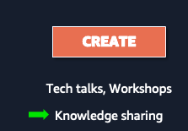
4C Framework - Create
Organize monthly tech talks
Develop hands-on workshops
Produce community newsletters
Craft engaging social media content

Slide 19
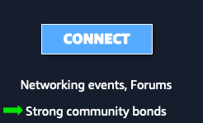
4C Framework - Connect
Run networking sessions at events
Facilitate member introductions
Manage online discussion forums
Arrange cross-community collaborations

Slide 20
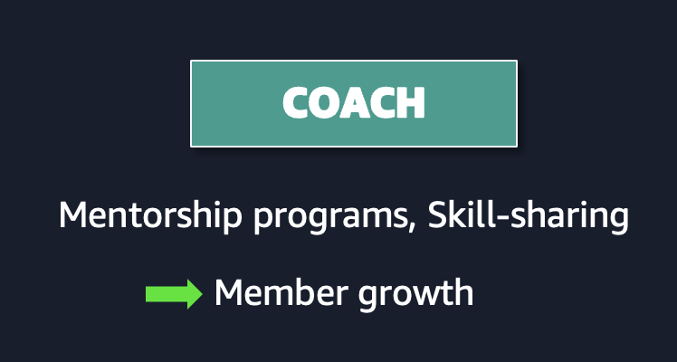
4C Framework - Coach
Lead mentorship programs
Conduct skill-sharing sessions
Guide new members through onboarding
Provide speaker training for community presenters

Slide 21
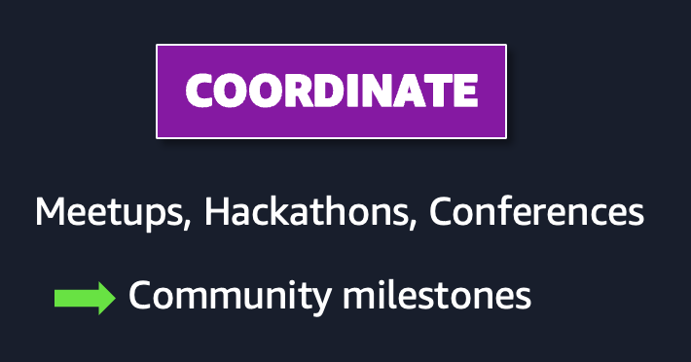
4C Framework - Coordinate
Manage community projects
Organize hackathons or coding challenges
Oversee volunteer teams for events
Plan and execute annual conferences

Slide 22
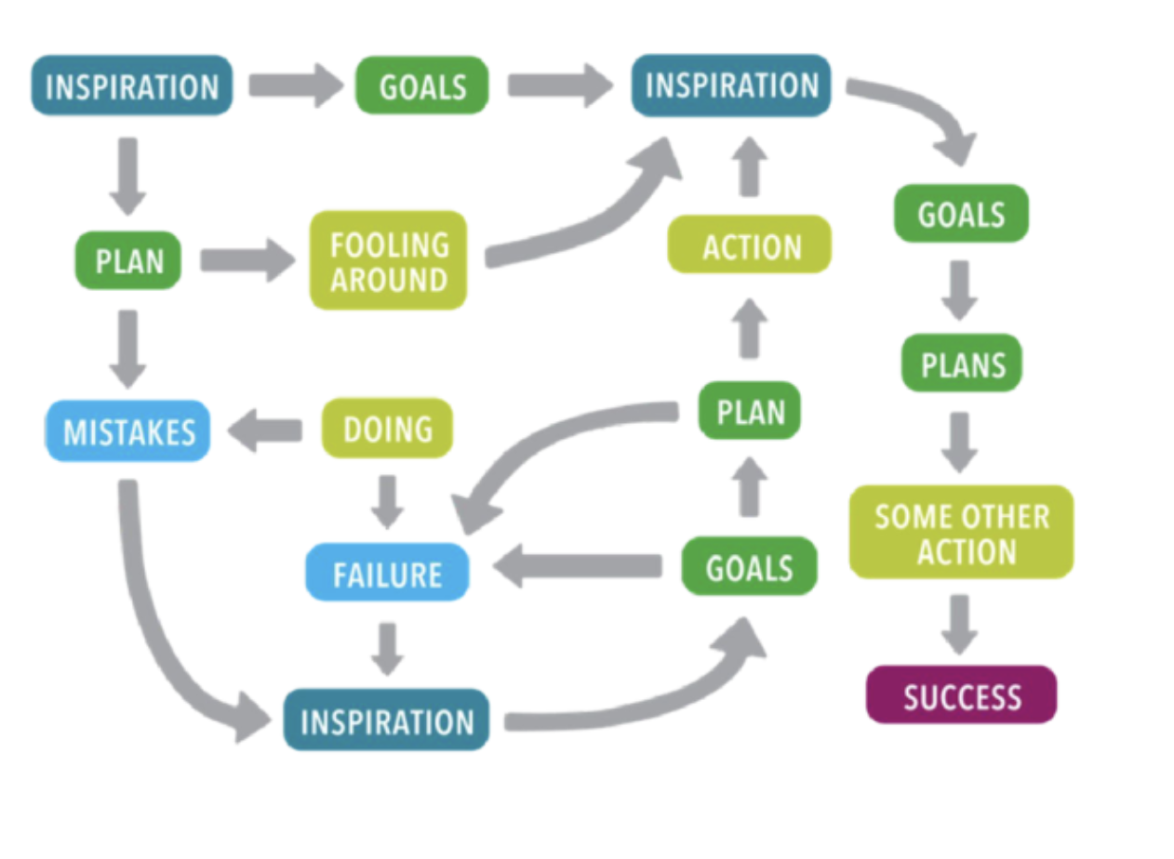
Learning journey
CURIOSITY
LEARNING GOALS
CURIOSITY
LEARNING GOALS
NEW PROJECT
STUDY PLAN
EXPERIMENTING
STUDY PLAN
STUDY PLAN
CONFUSION
PRACTICING
SOME OTHER PATH
LEARNING GOALS
STRUGGLE
CURIOSITY
MASTERY

Slide 23
What makes a strong/thriving community
Thriving Community | Inconsistent Community
Clear mission and values | Undefined purpose
Regular, planned activities | Sporadic, ad-hoc meetups
Diverse engagement opportunities | Limited to occasional talks
Structured growth path for members | No clear member development
Measurable impact on industry | Limited influence beyond members
Strong leadership and succession planning | Dependent on a few individuals
Collaborative projects and initiatives | Passive content consumption
Continuous feedback and improvement | Static or declining engagement

Slide 24
Personal stories

Slide 25
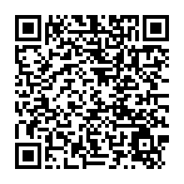
From telco engineer to DevOps and beyond
The Netherlands
Return to Romania
1
3
Transition to IT
2
Communities
4

Slide 26
AI Practitioner AWS Certification Challenge

Slide 27
A look into the future

Slide 28
em:Power Leaders
Workshops to build the next generation of active community participants
Becoming a Community Champion
How to craft an engaging and immersive tech talk
- The art of building deep dive technical articles
- Designing impactful workshops
- Community catalysts for volunteers and co-organizers

Slide 29
Suggest your own activities!
Get a group together and run the following:
- Teach coding skills
- Skills to succeed as a junior developer
- Associate certification study groups
- Architecture and system design discussions
- Skill-up for interviews with coaching and mocks
Don’t wait for recognition to help people!

Slide 30
What’s stopping YOU?

Slide 31
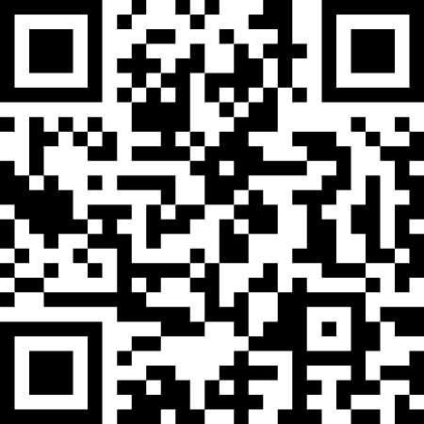
Andra Somesan
Mohammed Fazalullah
andrasom@amazon.ro
Andra Somesan
qudrat@amazon.com
Mohammed Fazalullah

