Slide 1
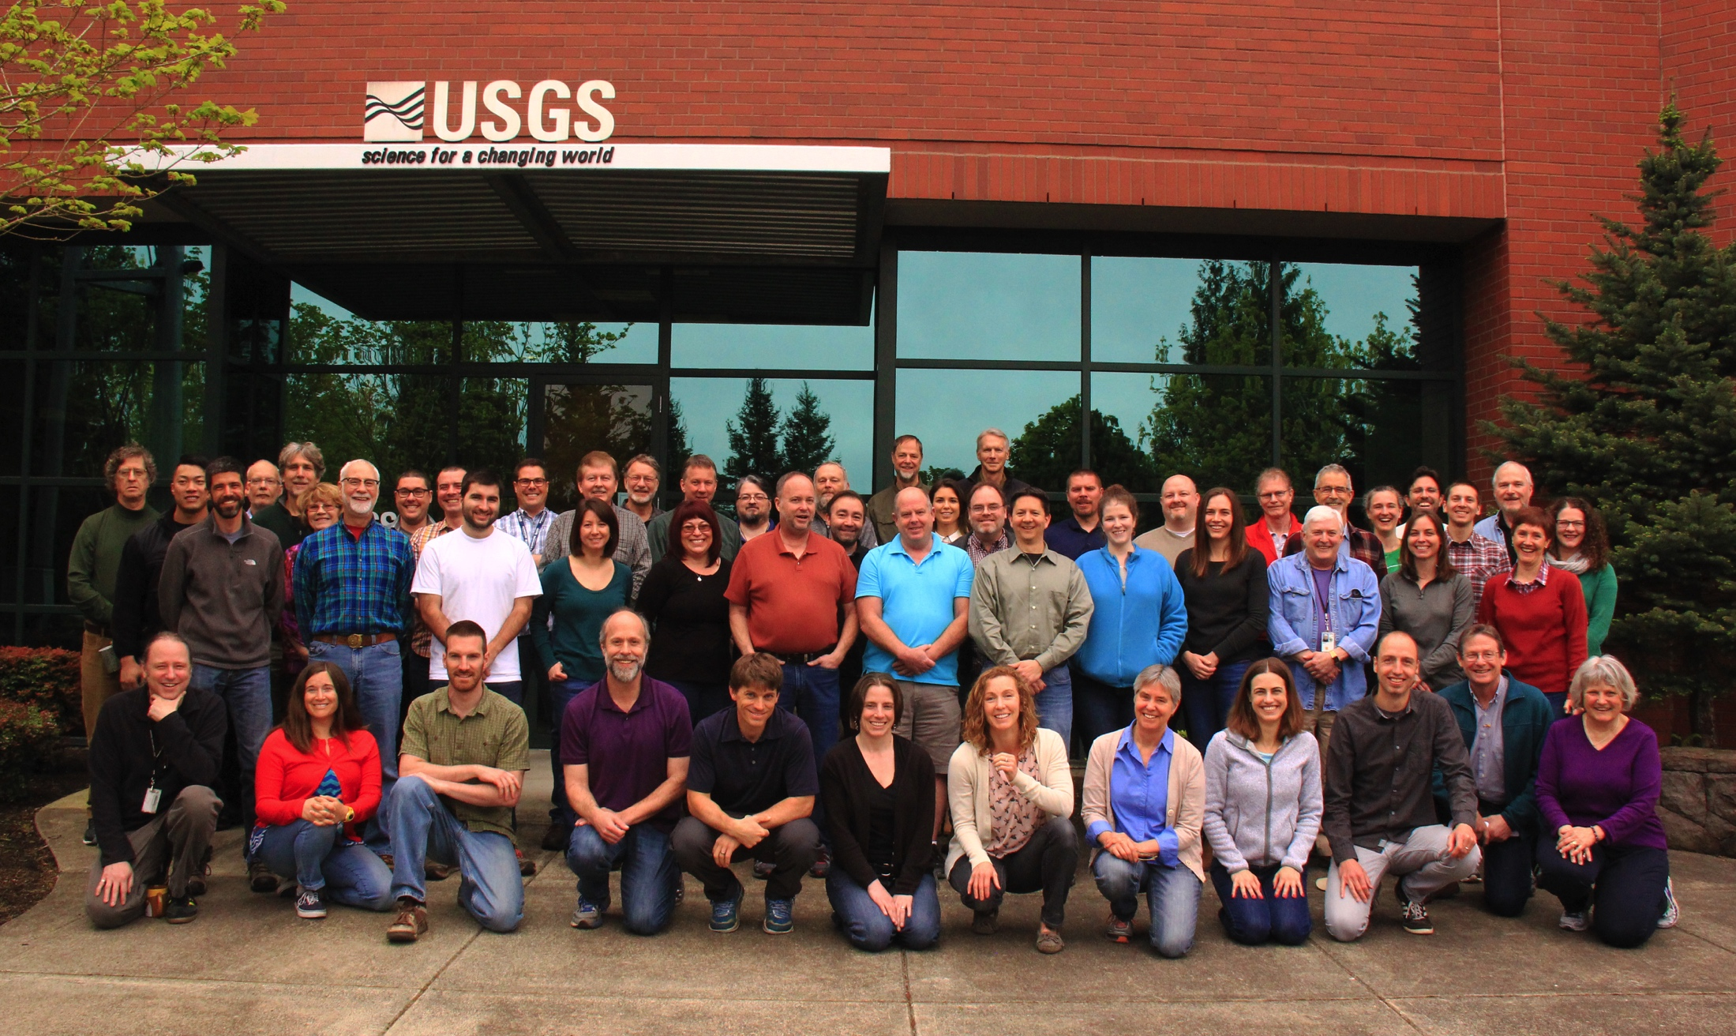
Cascades Volcano Observatory
May 1, 2017

Slide 2
Cascade Volcanoes – Monitoring status, 2017
Baker – 2 seismometers
Glacier Peak – 1 seismometer
Rainier – 9 seismometers, 7 GPS, 2 tilt, 8 AFMs
St. Helens – 20 seismometers, 20 GPS (13 operated by PBO), 3 tilt, 1 gas, 4 AFMs
Hood – 8 seismometers, 2 GPS
3 Sisters – 5 seismometers, 3 GPS
Newberry – 12 seismometers (including 3 from AltaRock), 8 GPS
Crater Lake – 4 seismometers, 4 GPS

Slide 3
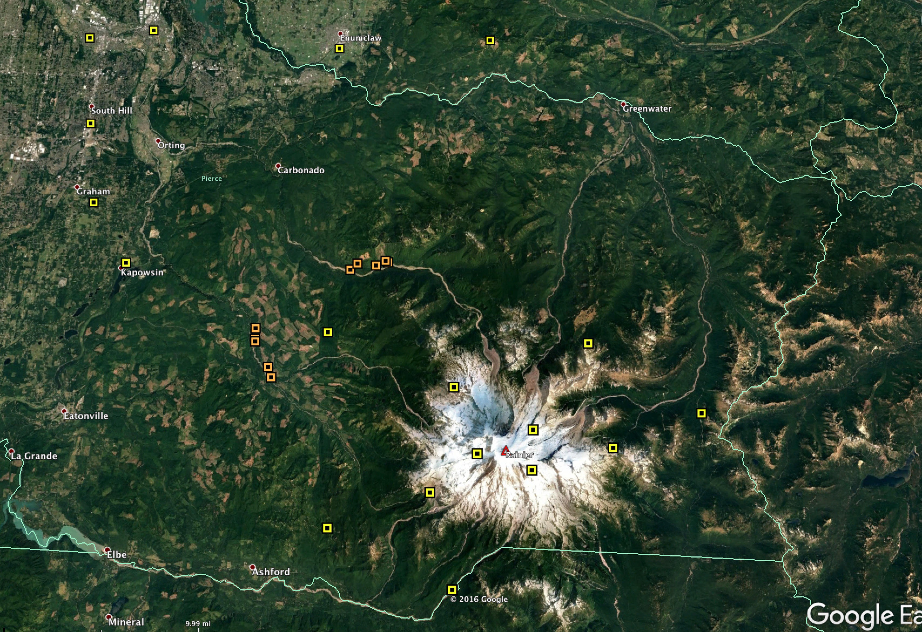
Rainier lahar detection system

Slide 4
Cascade Volcanoes – Monitoring status, 2017
Baker – 2 seismometers
Glacier Peak – 1 seismometer
Rainier – 9 seismometers, 7 GPS, 2 tilt, 8 AFMs
St. Helens – 20 seismometers, 20 GPS (13 operated by PBO), 3 tilt, 1 gas, 4 AFMs
Hood – 8 seismometers, 2 GPS
3 Sisters – 5 seismometers, 3 GPS
Newberry – 12 seismometers (including 3 from AltaRock), 8 GPS
Crater Lake – 4 seismometers, 4 GPS

Slide 5
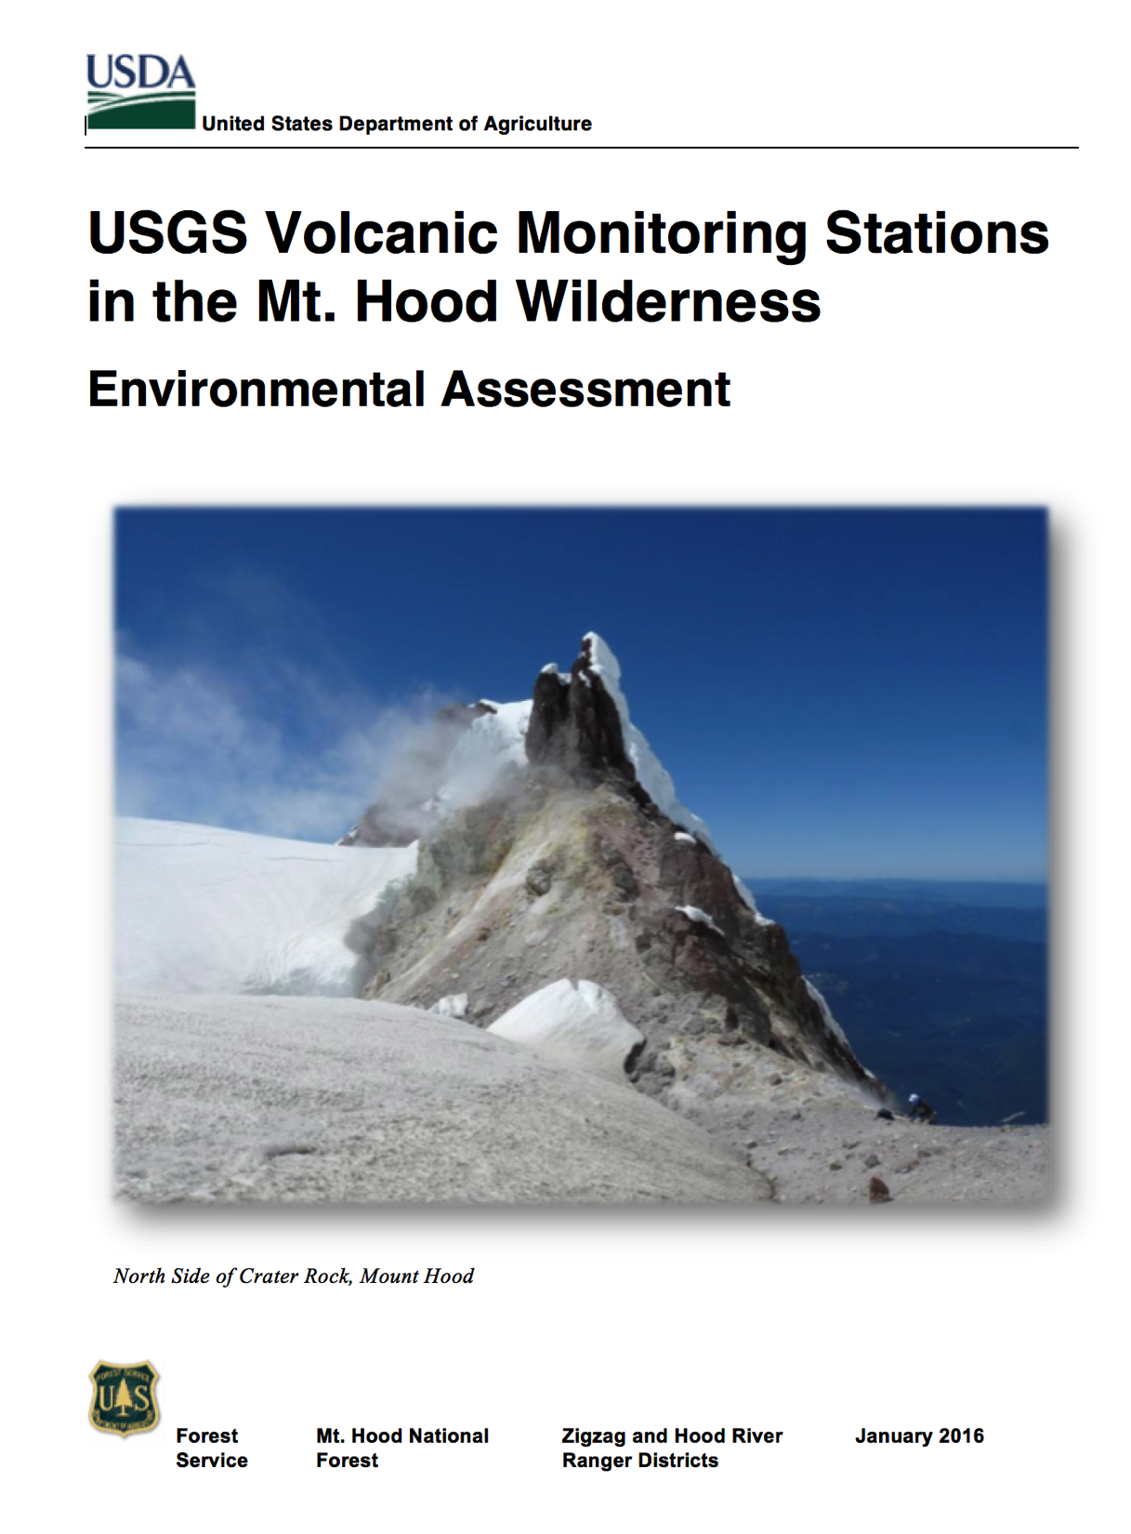
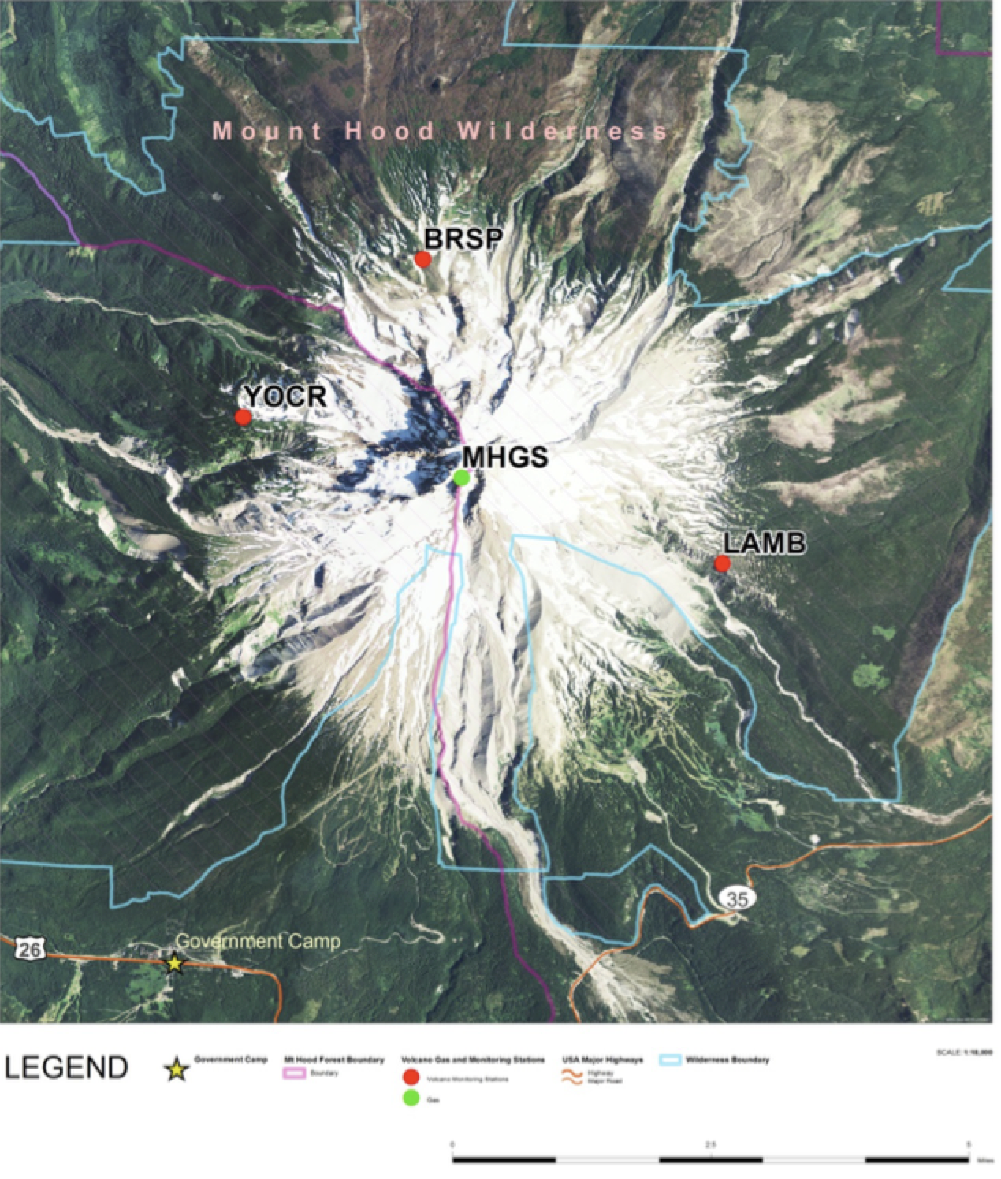
Mount Hood – Permitting & installations, 2017
Mount Hood EA draft, 2016

Slide 6
Cascade Volcanoes – Monitoring status, 2017
Baker – 2 seismometers
Glacier Peak – 1 seismometer
Rainier – 9 seismometers, 7 GPS, 2 tilt, 8 AFMs
St. Helens – 20 seismometers, 20 GPS (13 operated by PBO), 3 tilt, 1 gas, 4 AFMs
Hood – 8 seismometers, 2 GPS
3 Sisters – 5 seismometers, 3 GPS
Newberry – 12 seismometers (including 3 from AltaRock), 8 GPS
Crater Lake – 4 seismometers, 4 GPS

Slide 7
Cascade Volcanoes – Monitoring status, 2017
Baker – 2 seismometers
Glacier Peak – 1 seismometer
Rainier – 9 seismometers, 7 GPS, 2 tilt, 8 AFMs
St. Helens – 20 seismometers, 20 GPS (13 operated by PBO), 3 tilt, 1 gas, 4 AFMs
Hood – 8 seismometers, 2 GPS
3 Sisters – 5 seismometers, 3 GPS
Newberry – 12 seismometers (including 3 from AltaRock), 8 GPS
Crater Lake – 4 seismometers, 4 GPS

Slide 8
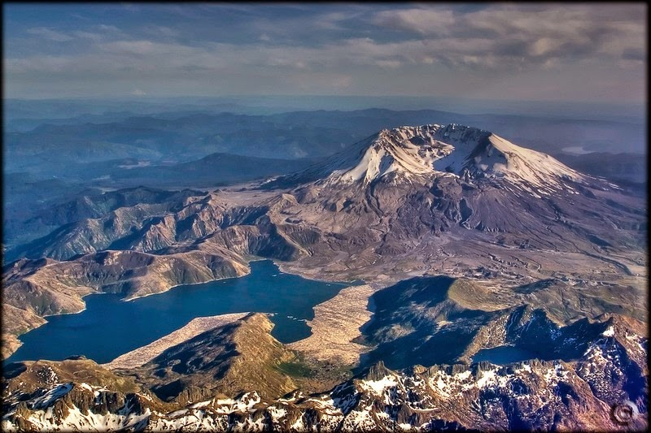
Cascade Volcanoes – Spirit Lake

Slide 9
IAVCEI 2017 Portland – The Meeting that Ate CVO
August 13-17, 2017

