Slide 1
Professor Presentation 2012
We want a simpler world where students aren’t stuck on homework and instructors aren’t buried under student emails – a world where knowledge transfer from instructors, and between students, is rapid, fun and beautifully efficient.

Slide 2
About Piazza
Piazza was founded to take offline study group dynamics online to help students get unstuck faster.
Piazza is online learning reimagined with class engagement at the center.
Profs decide to use Piazza at the class level (no IT dept needed).
Piazza is free -- create your classes, enroll students and you’re done!

Slide 3
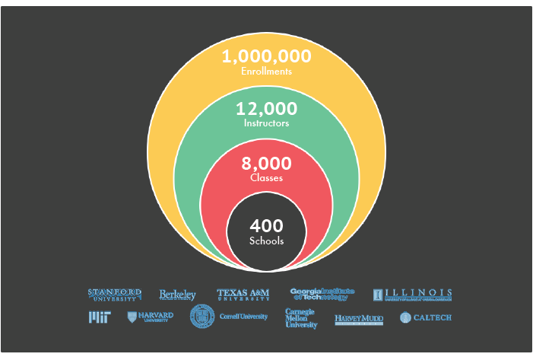
Who’s Using Piazza?

Slide 4
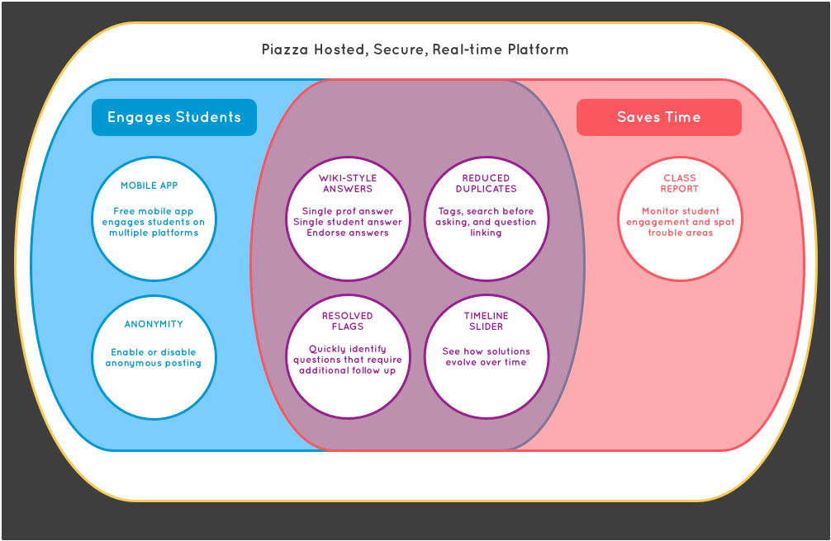
Purpose-Built for You

Slide 5
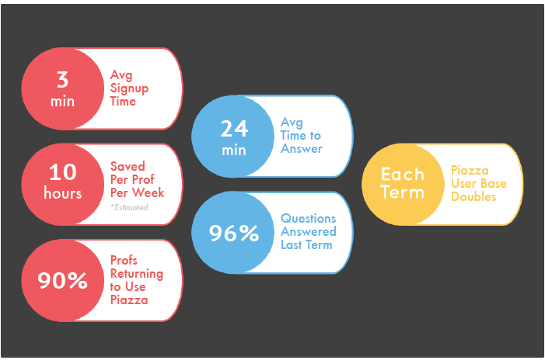
Piazza Works

Slide 6
Profs Love Piazza
“Piazza is the first educational software that actually improves my teaching.”
-Kevin Kelley, MIT
“Piazza has solved all of the communication flow problems I’ve experienced in 19 years of teaching. I used to use 6 programs, now it’s just Piazza.”
- Dan Garcia, UC Berkeley
“After a semester of using Piazza, I can truly say I loved it. The TAs loved it… With Piazza I got a real-time picture of what was going on, and could address some of the really important misunderstandings in class.”
- Kristin Marsicano, Georgia Tech

Slide 7
Get Started with Piazza
Go to www.piazza.com
  Click “Create a Class”
  Signup
  Enroll your students
  Enjoy!
Questions?
  Email team@piazza.com

Slide 8
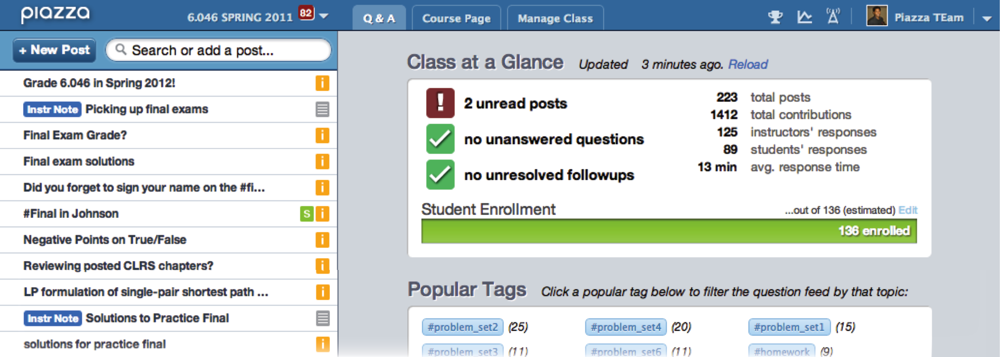
Appendix
Piazza Q&A best explained by Prof. Jesse Heines (UMass):
“Piazza is to Moodle as a chef’s knife is to a Swiss army knife”

Slide 9
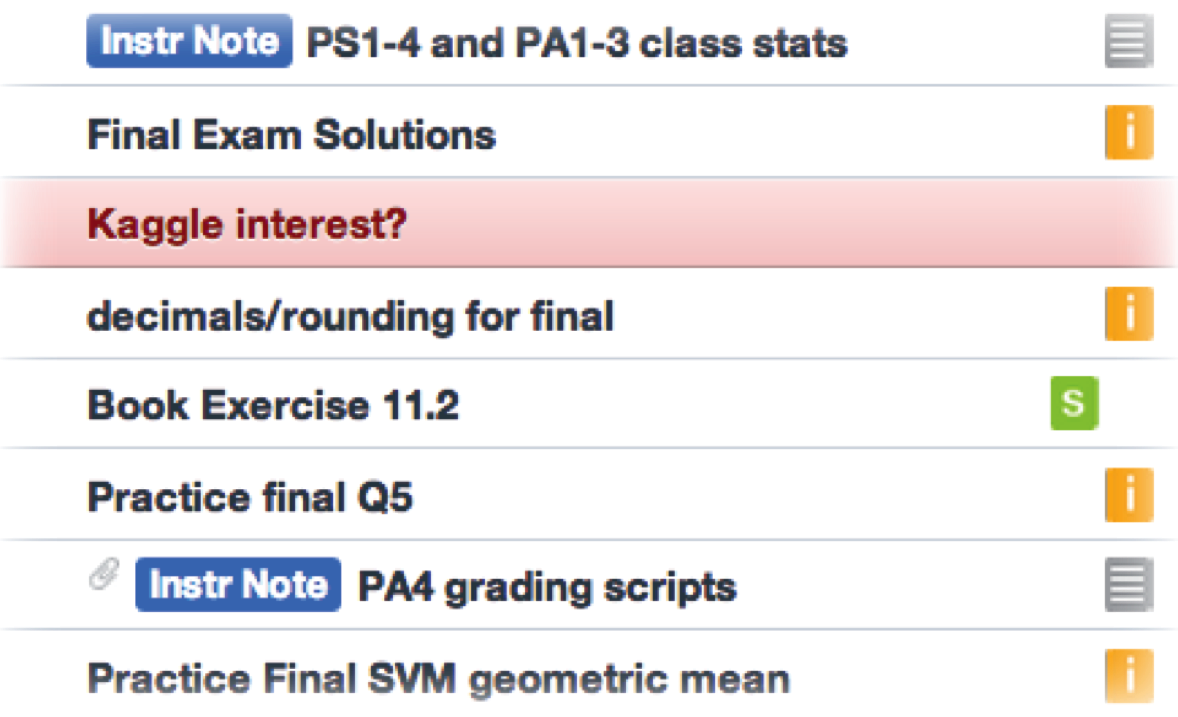
Appendix
Unanswered questions are highlighted in red to capture the attention of instructors

Slide 10
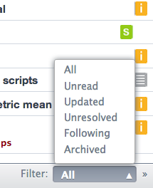
Appendix
Filters allow professors to better manage their time by viewing updated or unresolved posts

Slide 11
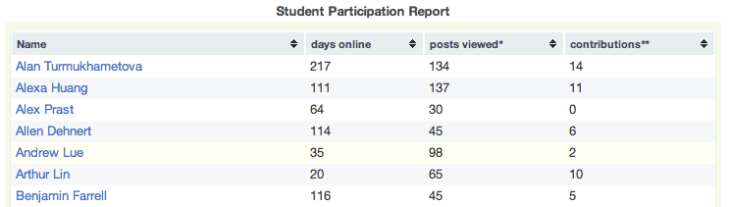
Appendix
Student participation statistics enable instructors to gain insights about their class
(This feature is only visible to instructors)

Slide 12
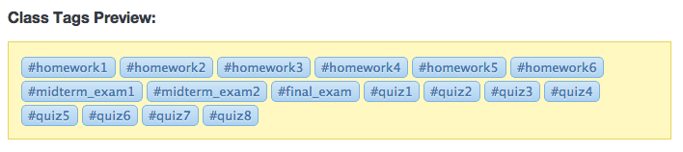
Appendix
Easily manage tags to ensure class content is well organized

