Slide 1
Instructions
November 2, 2018 v.2
Yellow background slides are facilitator instructions, to be deleted before presenting to audience.
Black and white background slides are for instructions for audience in the meeting. Replace [block quotes] with your own text. Adjust times to your needs.
FeedackFrames.ca/templates
(delete this slide)

Slide 2
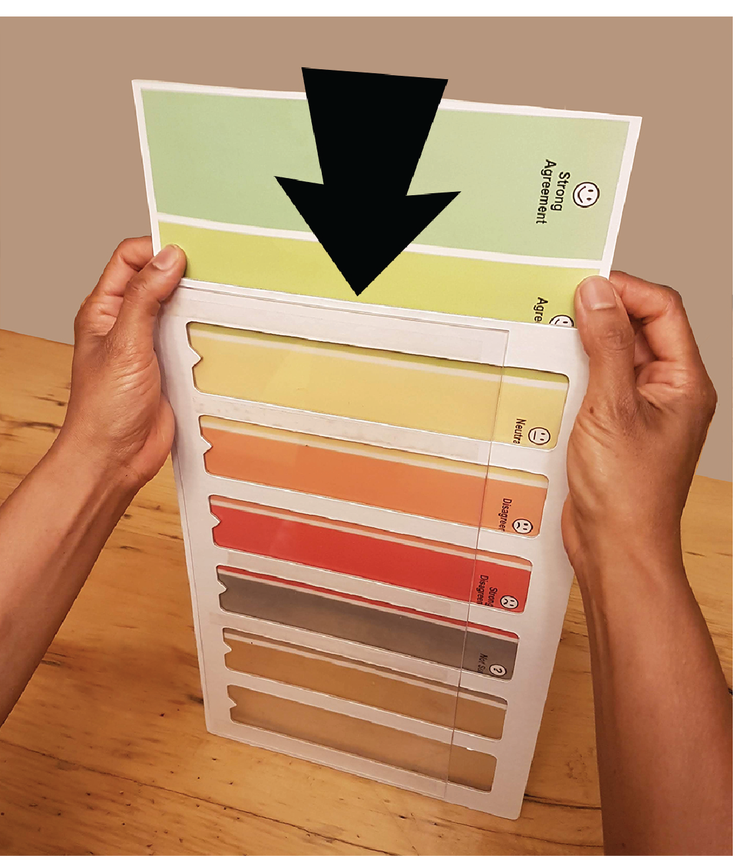
Insert rating scales in frames before meeting
(delete this slide)

Slide 3
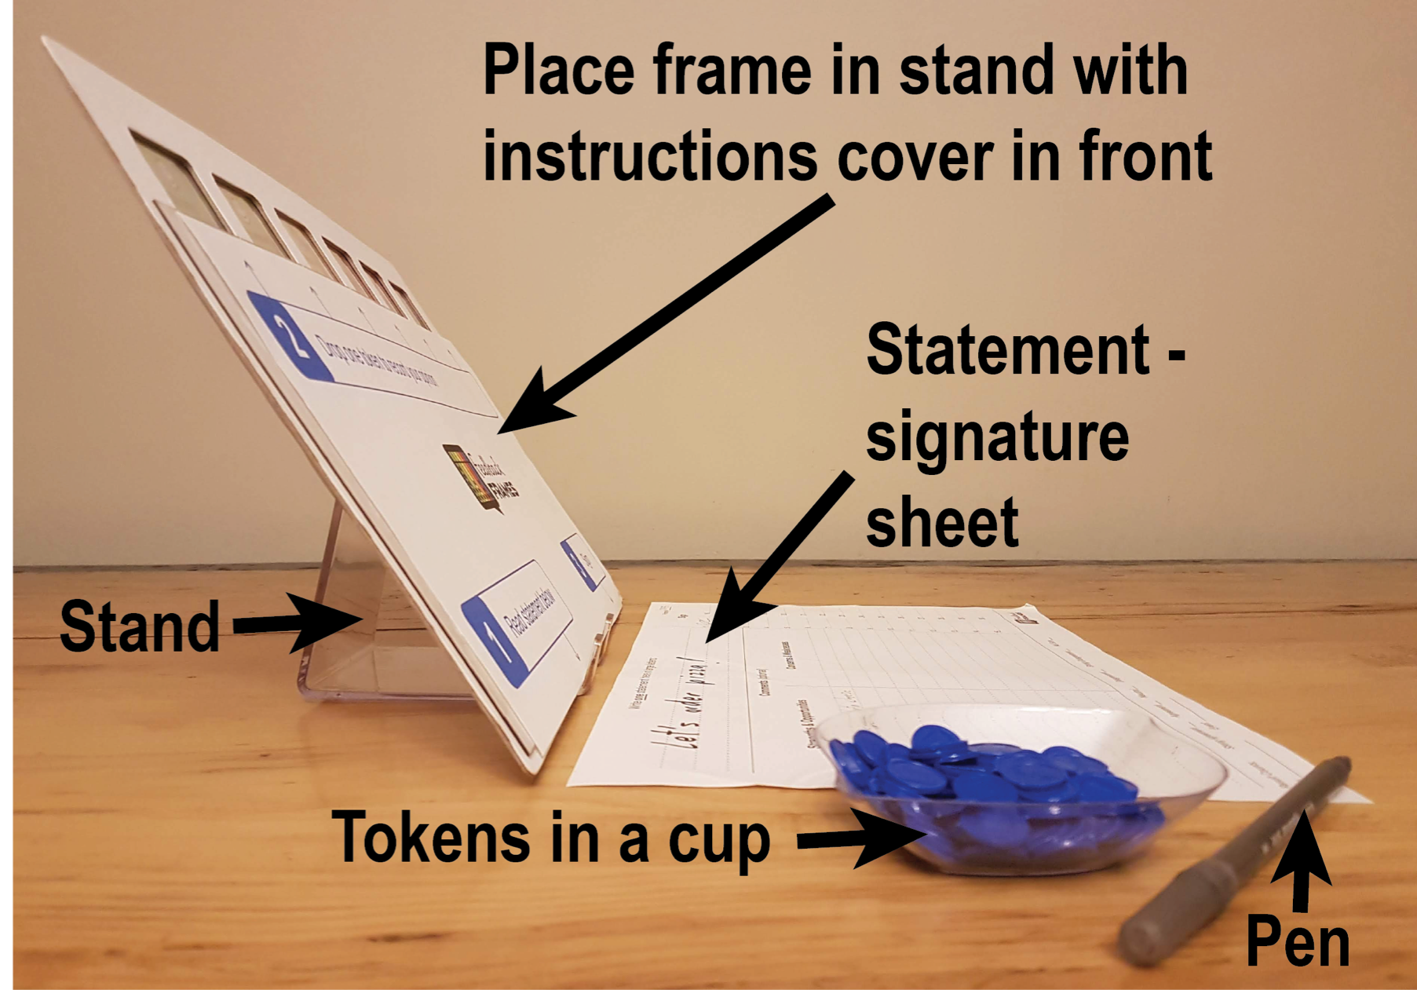
How to set up Feedback Frames
(delete this slide)

Slide 4
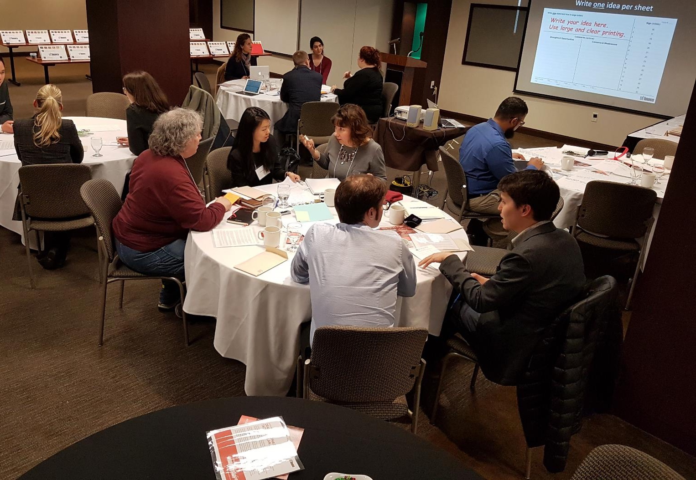
Set up frames on side tables before meeting starts
(delete this slide)

Slide 5
[Name of your project goes here]
Instructions

Slide 6
Step 1
Silently, on scrap paper, individually draft answers…
[Insert you big open ended question here]?
(2-5 minutes)

Slide 7
[Insert you big open ended question here, again]?
We’ll continue once everyone has written their answers

Slide 8
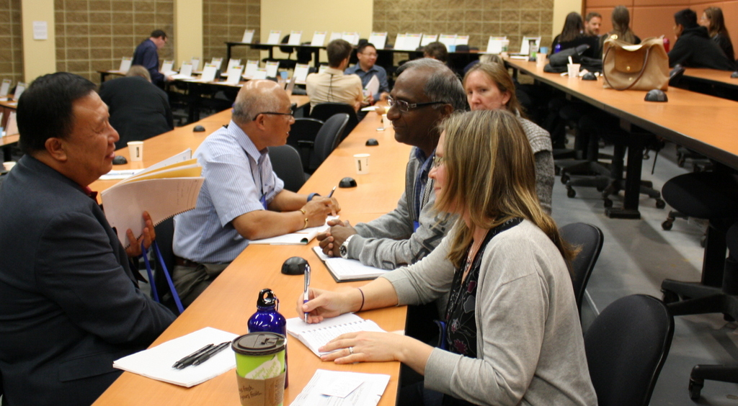
Step 2 In groups of 3-5, read & discuss your ideas (15 min. or more)
Notes:
Both groups will answer the same question

Slide 9
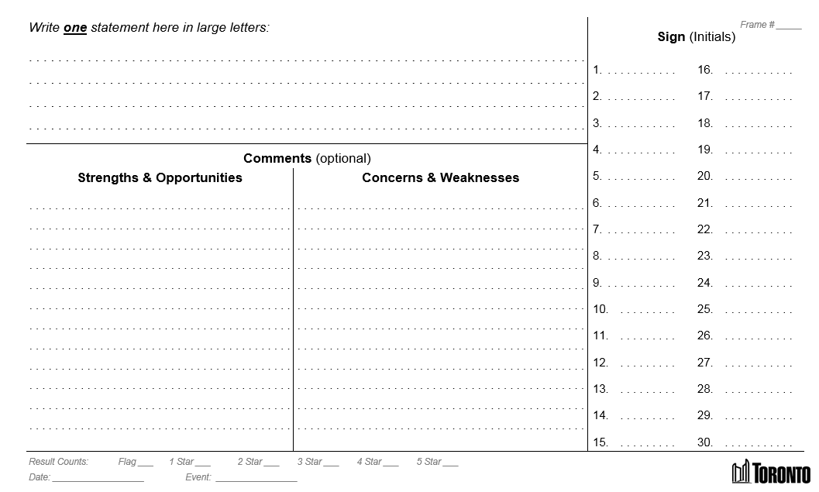
Step 3
In your groups and individually…
Write one idea per sheet
Write your idea here. Use large and clear printing.

Slide 10
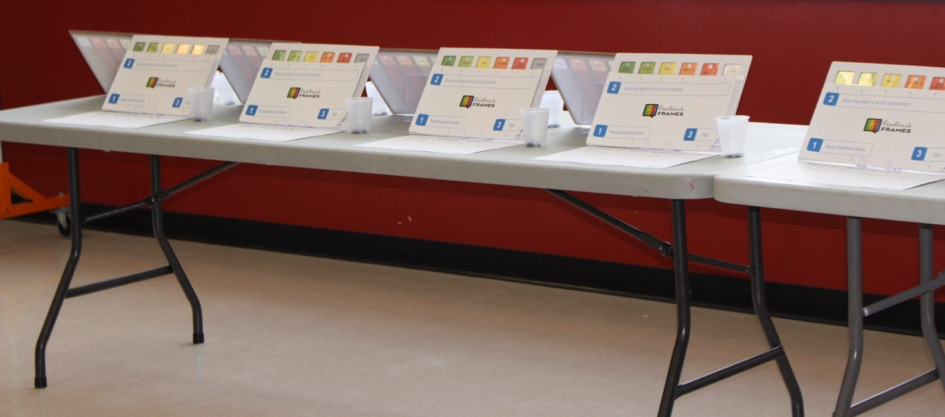
Facilitators will place sheets with ideas on tables in front of Feedback Frames
Facilitators write frame IDs on corresponding statement sheets

Slide 12
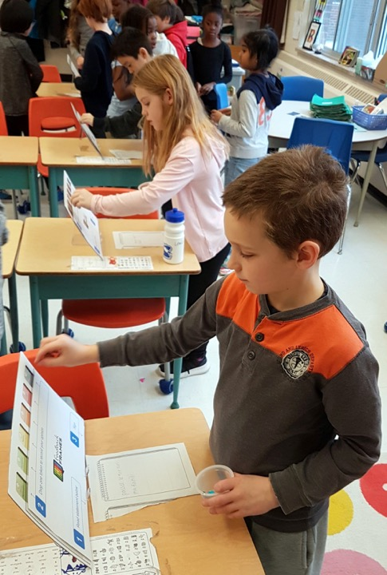
Drop a token in each frame to record your opinion on each statement

Slide 14
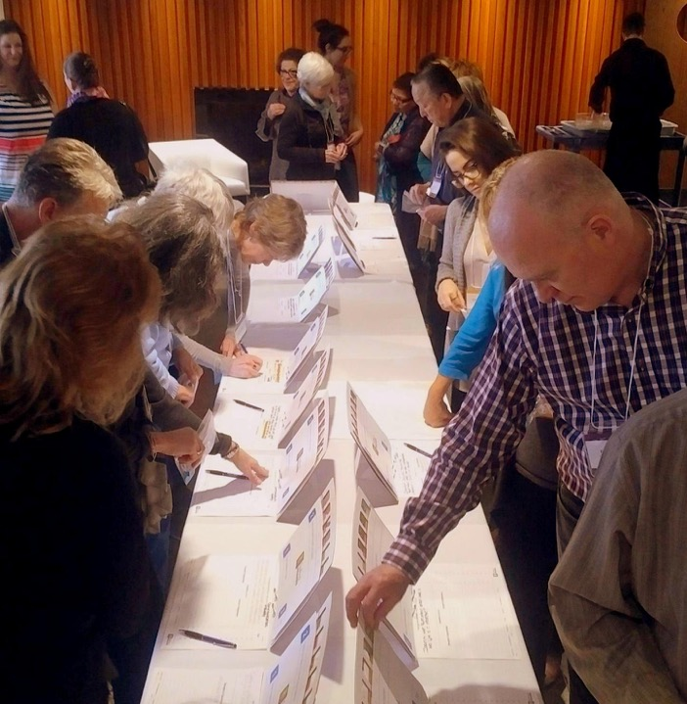
Drop only one token per frame
Remember to sign the sheet every time
Optionally write comments below

Slide 15
Let’s get started! Discuss and write ideas
Write your idea here. Use large and clear printing.

Slide 16
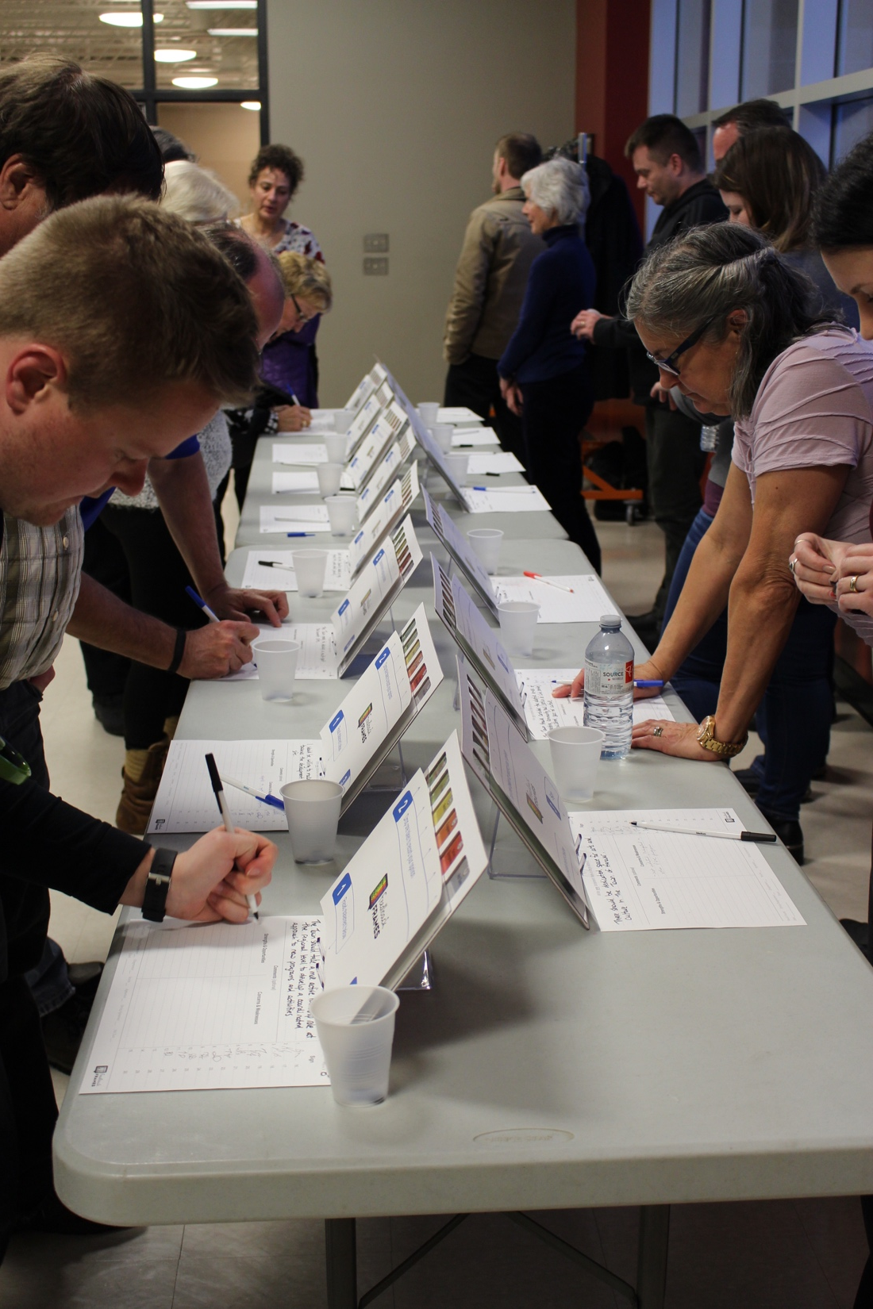
If you have given your written ideas to the facilitator…
Start dropping tokens!
One token per frame
Sign the sheet every time
Optionally write comments below

Slide 17
5 minute warning

Slide 18
One more minute…

Slide 19
Let’s reveal to see what we think!

Slide 20
Review and Discuss Results

Slide 21
All results will be photographed, entered into a spreadsheet, and shared with participants
Thank you!
[Enter your name and contact information here] Email:
Phone:
Web:

Slide 22
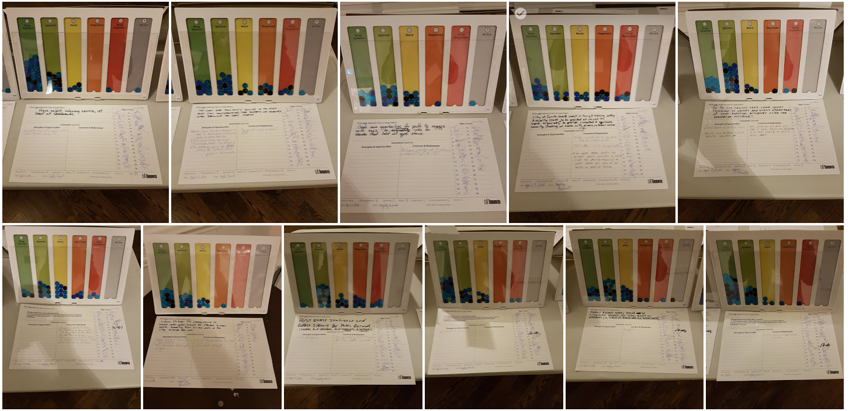
Record token counts at bottom of each sheet
Photograph each result: frame with sheet

Slide 23
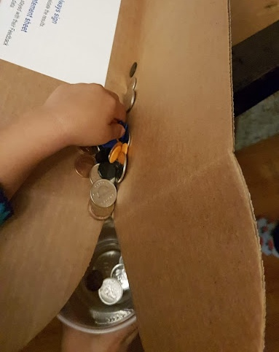
Empty tokens in to a bin or box lid Then pour in to your storage containers

Slide 24
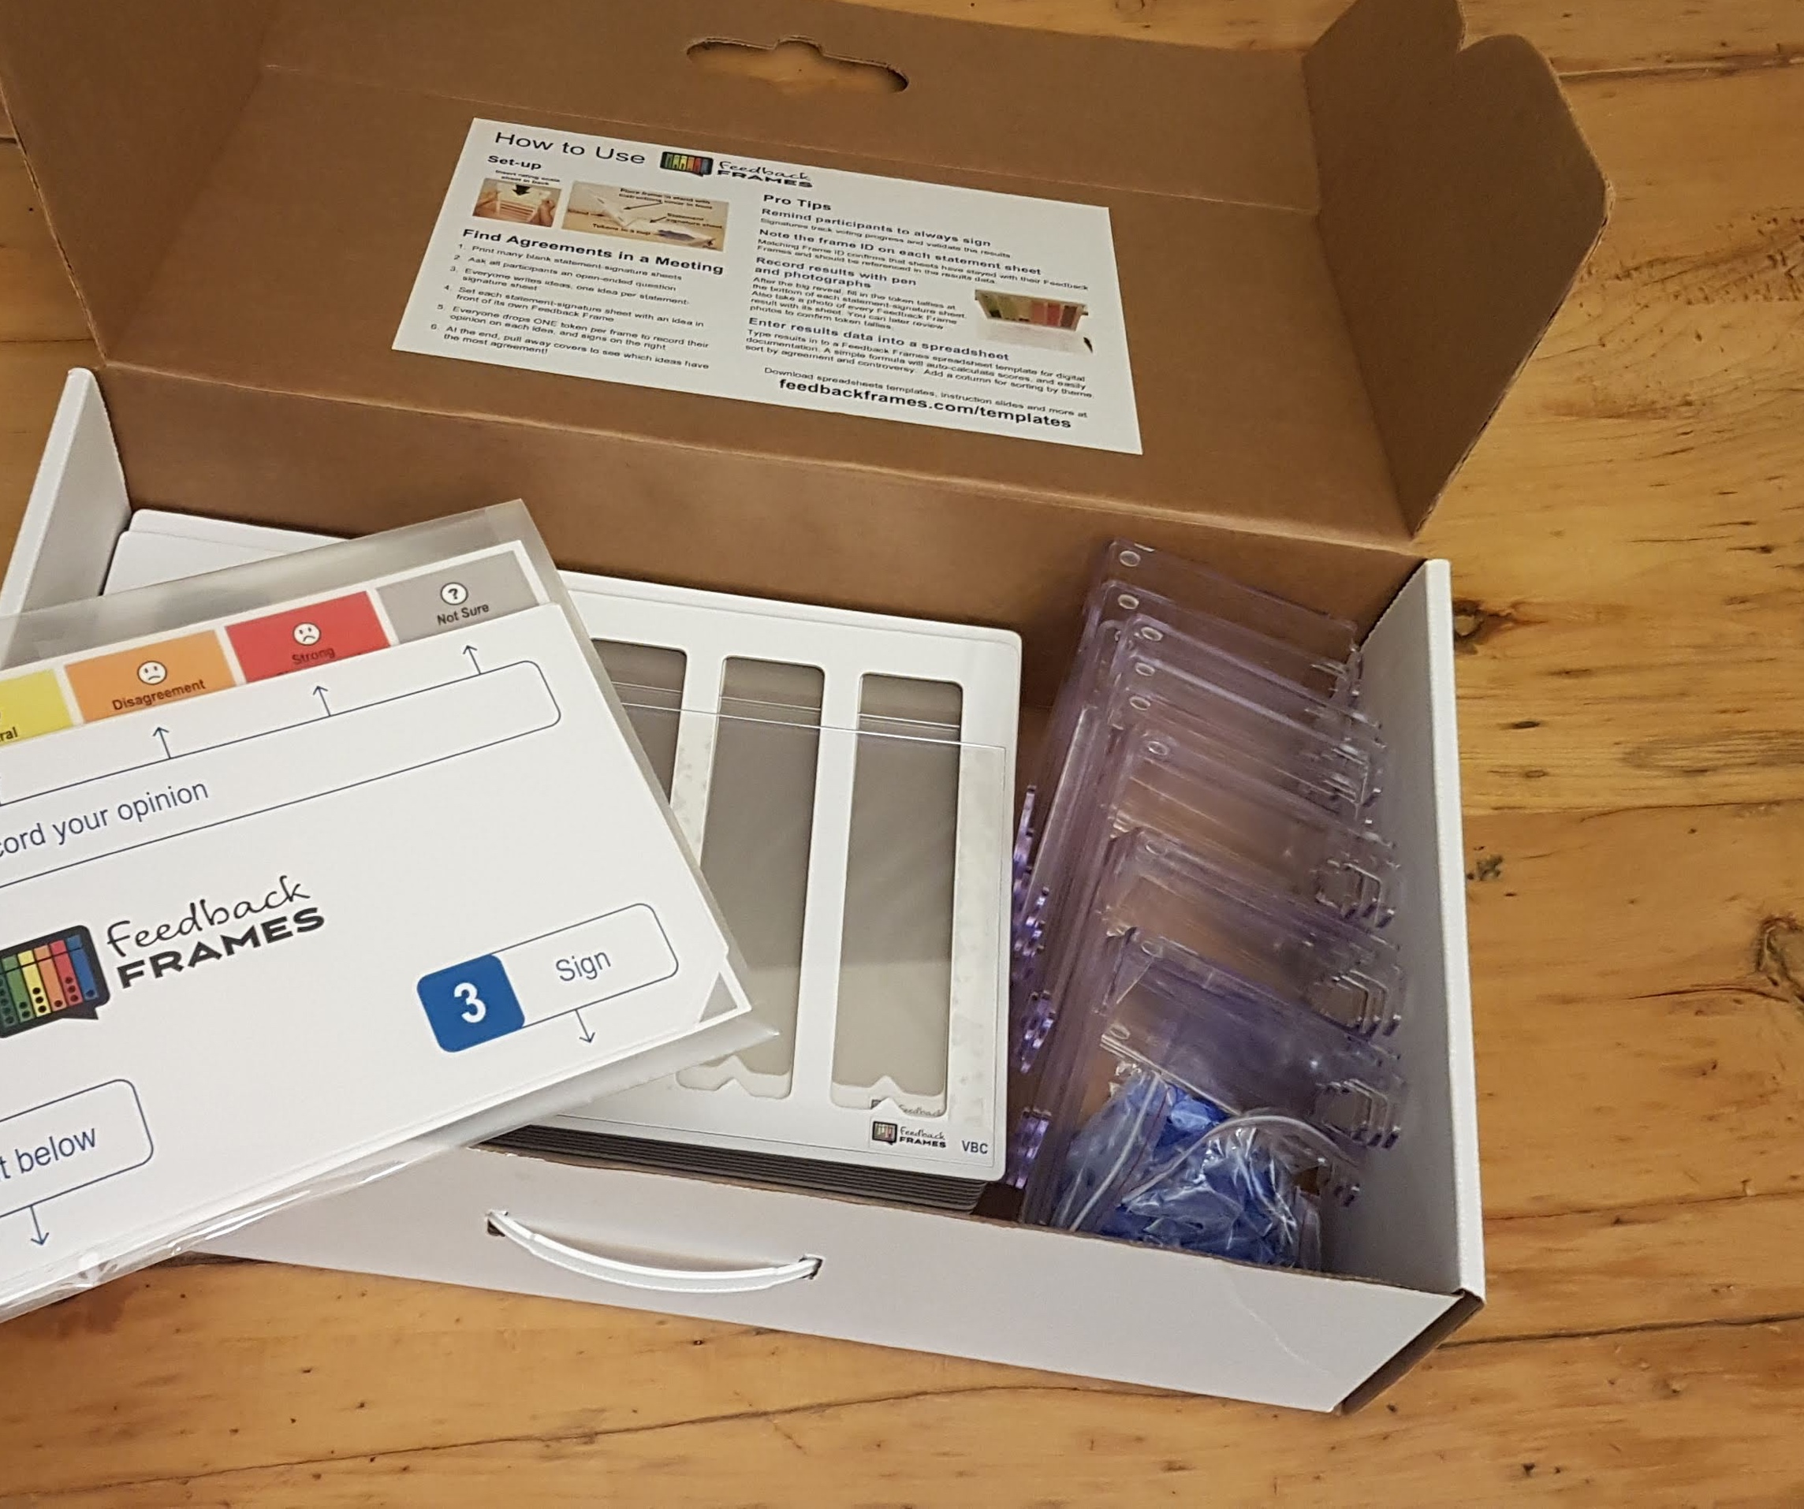
Leave the scales in the frames
Place all covers back in the envelope
Stands nest in stacks of three
Count 15 frames and stands per box

Slide 25
Download spreadsheet template for data-entry feedbackframes.com/templates

