Slide 1


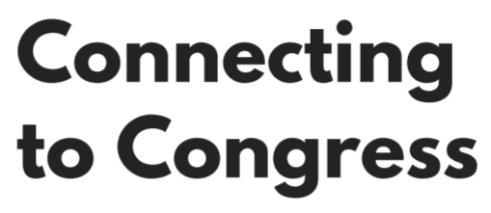
“How I wish this tool had been available when I served in Congress – it could finally change the tenor of our public debate and at last include citizens into Congressional decision making in a meaningful way.”
Rep. Deborah Pryce
(R-OH) 1993-2009
Claire Abernathy Stockton University
Kevin M. Esterling University of California, Riverside
Ryan P. Kennedy University of Houston
Amy Lee The Ohio State University
William Minozzi The Ohio State University
Michael A. Neblo The Ohio State University

Slide 2
Technology for Meaningful Constituent Engagement
Connecting to Congress leverages technology to foster effective and inclusive communication between elected officials and their constituents
We collaborate with congressional offices to host online Deliberative Townhalls bringing constituents and legislators together for substantive and informed exchanges
Constituents report increased trust, approval, and voting for their members
Members gain insights into the informed policy preferences and priorities of a representative group of their constituents

Slide 3
Deliberative Townhalls
Key design elements facilitate constructive, two-way communication:
A representative group of constituents
Single issue to ensure focus, depth, and substance
Non-partisan background information on the issue in advance
Neutral third-party moderator
Real-time candid participation by elected official

Slide 4
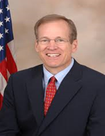

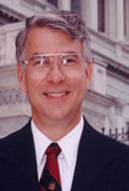
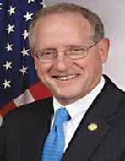
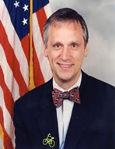
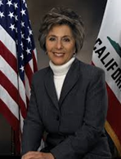
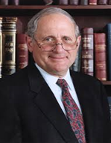
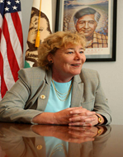
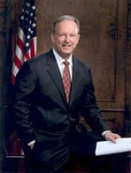
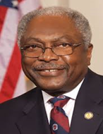

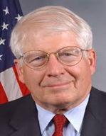
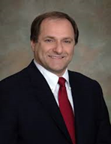
Evaluating Deliberative Online Town Halls
12 Representatives and 1 Senator participated in deliberative online town halls
1 hour sessions
Immigration policy or terrorism policy
Rep. Earl Blumenauer (D-OR)
Rep. Mike Capuano (D-MA)
Rep. Jim Clyburn (D-SC)
Rep. Mike Conaway (R-TX)
Rep. Anna Eshoo (D-CA)
Rep. Jack Kingston (R-GA)
Rep. Zoe Lofgren (D-CA)
Rep. Don Manzullo (R-IL)
Rep. Jim Matheson (D-UT)
Rep. David Price (D-NC)
Rep. George Radonovich (R-CA)
Rep. Curt Weldon (R-FL)
Sen. Carl Levin (D-MI)

Slide 5
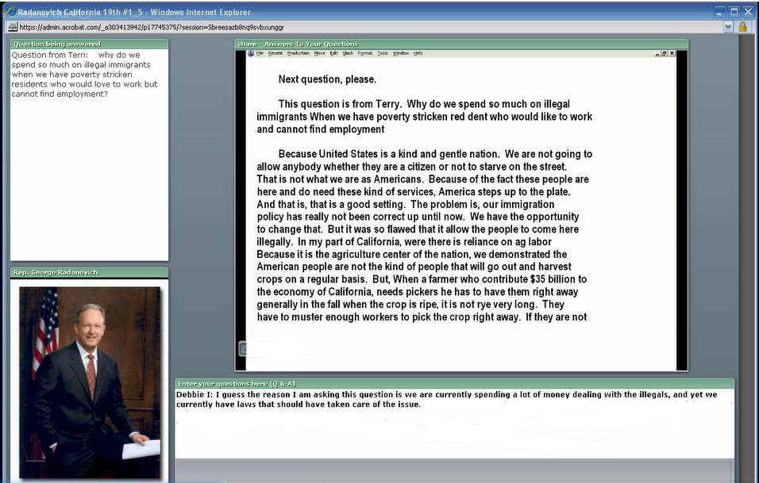
Screenshot of the Experimental Platform
3. Member responded verbally, with text of their responses transcribed
2. Moderator reviewed constituents’ questions and posted them one at a time
1. Constituents typed questions
Click Here for a Short Video of This Session

Slide 6
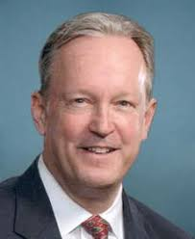
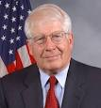
Members Were Enthusiastic
“Excellent questions … I’ve got to tell you, I really enjoy this new technology that … enables me to talk to my constituents back home, and I hope that this is something that we can expand upon.” – George Radonovich (R-CA)
“There’s so much overheated rhetoric about this issue … that it’s really refreshing to see people grappling with it in a serious and civil way.” – David Price (D-NC)

Slide 7
Inclusive & High-Quality Conversations
A representative group of constituents participated, not just the “usual suspects”
The conversations were substantive and high-quality
Constituents learned about the issue and many changed their minds
95% of constituents found the forums “very valuable for our democracy”
97% would like to participate in future sessions

Slide 8
Real Results
Constituents reported:
12% increase in trust in their member
12% increase in approval of their member
10% increase in voting for the member in the next election

Slide 9
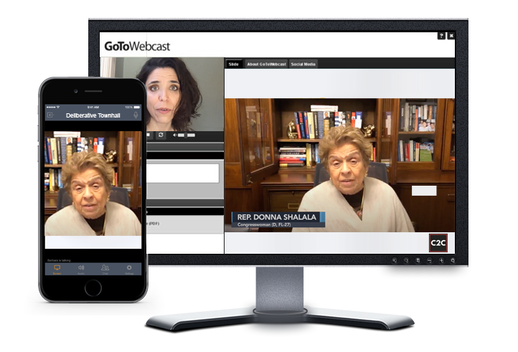
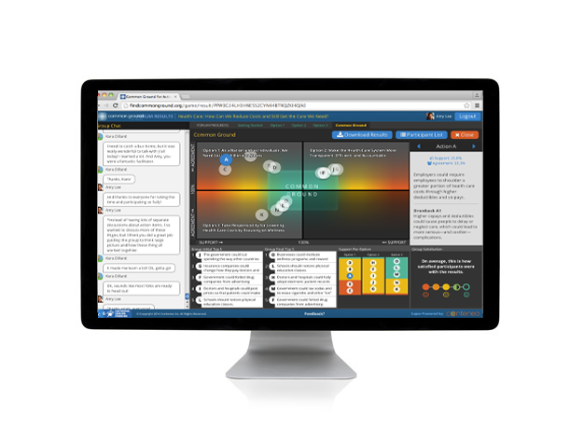
Connecting to Congress in 2020
Connecting to Congress is incorporating these same deliberative principles into new and updated digital tools
Deliberative Townhalls
webinar technology
Deliberative Forums
Common Ground for Action

Slide 10
A Free Service to Congressional Offices
Our team will:
Host and facilitate Deliberative Townhalls, engaging a broad cross-section
of constituents on emerging policy issues
Produce reports that summarize trust and approval of members, and
constituents’ informed opinions, priorities, and motivations on policy
Help offices integrate this information and new technology into office workflows

Slide 11
Learn More
Interested in using deliberative online town halls to engage constituents?
Contact: Amy Lee, Associate Director, Connecting to Congress amy@connectingtocongress.org
Visit our website: www.connectingtocongress.org

