Slide 1
ANEMIA
Kelly Smith-Riggleman, PA-C MPAS
Hematology/Oncology APP
WV Cancer Institute
Grant Memorial Hospital WVU Regional Cancer Center
I have no financial relationships to disclose.

Slide 2
Disclaimer
This lecture is intended for informational purposes only. Individuals should use sound clinical judgment when evaluating all patients with hematological issues and air on the side of caution with any patient presenting with potential life-threatening hematologic complaints.

Slide 3
Learning Objectives
discuss how to identify anemia
discuss the various causes of anemia
discuss typical laboratory and clinical findings
identified treatment options for anemia
identify when to refer to hematology

Slide 4
What is anemia?
Anemia is the reduction in one or more of the red blood cell (RBC) measurements obtained as part of a complete blood count (CBC)
Hemoglobin and hematocrit
Normal ranges
Females hemoglobin >11.7 g/dL and hematocrit greater than 35%
Males hemoglobin >13.6 g/dL and hematocrit greater than 40%
Anemia is one of the most common findings in clinical practice
Anemia may be straightforward with a single cause but in many cases the cause is not readily apparent and multiple conditions may be contributing (MULTIFACTORIAL)

Slide 5
Anemia classifications
MCV<80 microcytic
MCV 80-100 normocytic
MCV >100 macrocytic

Slide 6
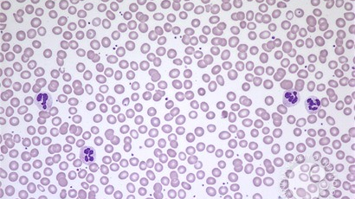
Normal peripheral smear

Slide 7
The Basics
Hemoglobin: Concentration of hemoglobin in whole blood
binds to oxygen and delivers to tissues
Hematocrit: Percentage of blood volume occupied by RBCs
Mean Corpuscular Volume (MCV): Average volume of RBCs
Mean Corpuscular Hemoglobin (MCH) and Mean Corpuscular Hemoglobin Concentration (MCHC)
Average hemoglobin content/concentration per RBC
Reticulocyte Count
Elevated in anemia (bone marrow increases the rate of RBC production in response to anemia)

Slide 8
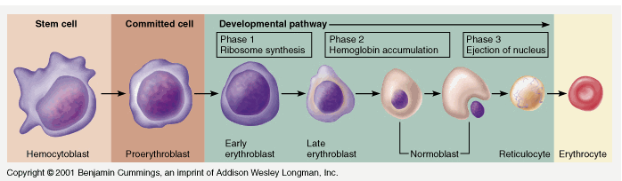
Stages of RBC development
It is important to understand that all of us have reticulocyte circulating in our peripheral blood. But a reticulocyte count of more than 1.8% should raise concern for anemia.

Slide 9
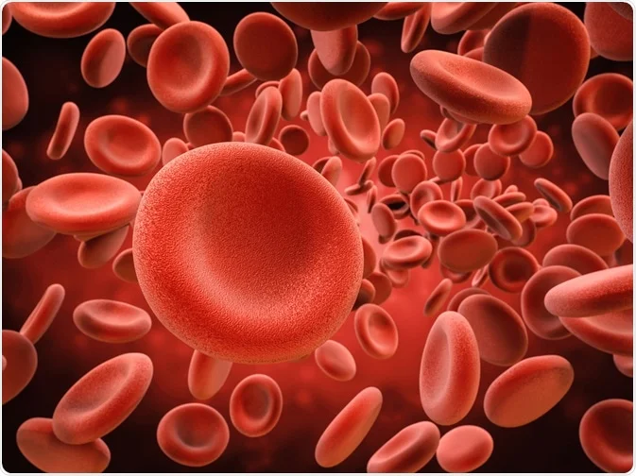
What can cause anemia?

Slide 10
Iron Deficiency Anemia-most common cause of anemia
Etiology: usually dietary deficiency, absorption issue, or blood loss
Decreased iron levels → decreased heme synthesis → decreased hemoglobin → microcytic anemia
Lab Findings
Microcytic (MCV <80), hypochromic RBCs with increased RDW
Decreased serum iron, iron saturation, ferritin, and increased TIBC/transferrin
Treatment: iron supplementation

Slide 11
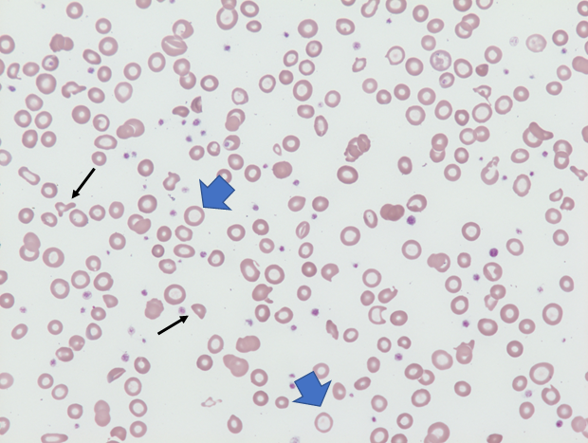
Hypochromic microcytic smear
Hypochromic red blood cells (examples shown with blue arrows) in a 24-year-old woman with severe iron deficiency anemia. Note the occasional fragmented red cell (black arrows). These cells, which are commonly seen in patients with severe iron deficiency anemia have retained their central pallor

Slide 12
Case Study #1
34-year-old female presents in clinic for anemia. She reports that she has been dealing with anemia since childhood. She was never told the reason for her anemia from a young age. Her anemia was stable until after her pregnancy. She had a vaginal delivery and unfortunately lost a large amount of blood from a vaginal tear. At that time, her hemoglobin dropped to 6.0. She did not have a blood transfusion. She continued to deal with chronic anemia, which remained mild. Approximately 6 months ago she started to experience increasing fatigue. She went to her PCP and underwent lab work which revealed:
Hemoglobin 10.9 (normal >/= 11.7)
Hematocrit 33.3% (normal >/= 35%)
MCV 78.8 (normal between 80 and 100)
Platelet count 320,000
Iron saturation 15% (normal >/= 20%)
Ferritin 33 (normal >/= 40)
TSH 1.30
She was then instructed to take OTC oral iron once daily which she did for 2 weeks. She was unable to tolerate her oral iron supplement due to constipation, bloating, gas pains. She was then referred to hematology for further evaluation of her iron deficiency anemia and to be evaluated for IV iron replacement therapy.

Slide 13
IDA- common causes
menorrhagia
DUB/uterine fibroids/endometriosis
gastrointestinal blood loss
peptic ulcer disease (PUD)
arteriovenous malformations (AVMs) of the small bowel
ulcerative colitis
hemorrhoids/anal fissures
hiatal hernia (Cameron’s erosions)
colon cancer
genitourinary blood loss
malabsorption
irritable bowel syndrome(IBS)/celiac disease
gastric bypass surgery
chronic proton pump inhibitors use/gastritis/H. pylori infection
pregnancy
Other more rare causes beyond scope of this lecture

Slide 14
Laboratory findings IDA
microcytosis (MCV < 80)
hypochromia (low MCH or MCHC)
reactive thrombocytosis (platelet count greater than 400,000)
normal, borderline low, or high WBC
iron saturation less than 20%
"iron in your blood" or checking or debit account
severe less than 10%
ferritin less than 40 ng/mL
"iron reserves" or savings account
severe less than 10 ng/mL
elevated TIBC
“lots of empty buckets trying to collect iron from your blood”
elevated soluble transferrin receptor or transferrin (for patients with chronically elevated ferritin secondary to acute phase reactant)**

Slide 15

Symptoms…..NO ENERGY

Slide 16
Clinical findings-IDA
Fatigue/lethargy
Skin pallor
Brittle, spoon-shaped fingernails
Hair loss
Brain fog/short-term memory loss
Shortness of breath on exertion
Dizziness and lightheadedness
Headaches
PICA (ice, dirt, uncooked rice, chalk, flour, etc)
Restless legs/muscle cramping
Tachycardia

Slide 17
Treatment options
iron supplementation-OTC or prescription pills/liquid
Pros: Convenient for patient, more cost effective, not time-consuming
Cons: Some patients cannot tolerate due to side effects (constipation, upset stomach, diarrhea, nausea/vomiting), not effective for severe iron deficiency or iron deficiency secondary to malabsorption
comparing formulations
numerous oral iron formulations are available and are almost equally effective
polysaccharide iron complex and heme iron are more expensive but lack metallic taste
avoid enteric-coated or sustained-release capsules (poorly absorbed due to iron released too far distally in intestinal tract)
administration
possible improved absorption when taken with vitamin C
avoid ingesting with food
take 2 hours before or 4 hours after ingestion of antacids

Slide 18
IV iron
Pros: Side effects rare (nausea/diarrhea/headache/muscle cramps/joint pain for 1 to 2 days after infusion), effective for patients with malabsorption, no need for daily consumption of oral iron, effective for severe iron deficiency
Cons: not cost effective, time-consuming and typically requires time off from work, higher chance of infusion reaction for patients with autoimmune disorders/asthma/multiple drug allergies
No evidence that dose above 1000 mg of elemental iron is clinically useful
prevents iron overload
Exception! is for severe ongoing blood loss
IM iron
Can raise iron level, but route of administration is painful, skin staining, and variable absorption
Transdermal iron
no clinical evidence of effectiveness or safety thus far in humans

Slide 19
Response to iron supplementation
PICA* disappears almost as soon as oral or IV iron therapy has begun
Restless legs with complete or near complete relief within 72 hours of IV iron
Hemoglobin will rise slowly starting 1 to 2 weeks after treatment
Will rise approximately 2g/dL over the next 3 weeks
Hemoglobin deficit halved in approximately 4 weeks
Hemoglobin level normal by 6 to 8 weeks

Slide 20
Approaching treatment options with patients
iron deficiency associated with no ongoing blood loss and is NOT secondary to malabsorption
try oral iron (1 tablet/day, 1tab QOD, or 1 tab BID) with vitamin C for 3 months then recheck labs
if no improvement refer to hematology for IV iron
if iron deficiency is associated with ongoing blood loss
mild iron deficiency: Try oral iron as above
severe: Referral to hematology for IV iron

Slide 21
Case Study #1 cont.
She reports that her menstrual cycles are regular and currently last 7 days. Previously her periods were only lasting 5 days. She goes through 1 pad every 2-3 hours for the first 4 days of her menstrual cycle.
She received 4 Venofer 200 mg infusions which made her feels so much better. Labs after her infusions revealed:
Hgb 12.6
Hct 38.2%
Ferritin 80
Iron sat 29%
She then followed up with her GYN and started OCPs.

Slide 22
Iron Infusions
Venofer-iron sucrose, takes up to 5 doses over 14 days
Injectafer-ferric carboxymaltose, given in 2 doses in 7 days
Feraheme-ferumoxytol, given in 2 doses within 3-7 days
Infed-dextran-nobody gives anymore, largely due to test dosing, takes longer (1000mg takes all day to infuse)
Ferrlecit-sodium ferric gluconate 125mg/dose, can take 8 doses to deliver 1000mg
*please do not send patients for iron infusion if you have not discussed oral iron AND put it in your note, and if you have not checked a CBC, iron panel, and ferritin
AND furthermore H&H alone doesn't cut it! need MCV and MCH... PLEASE!

Slide 23
Iron Infusion Reactions
Anaphylactic reactions are RARE
Other infusion reactions are tolerable
Nausea, abdominal pain last 24-48 hrs, Zofran helps
Headaches, Tylenol usually takes care of it
Flu-like symptoms
Low grade fevers
Hypotension
Myalgia, joint pain which lasts less than 24hrs and responds to Tylenol.
Metallic taste sometimes occurs
Low phosphorus can occur
HYPERSENSITIVITY RXNS
*Asthmatics* because they are more susceptible to reactions, I consider methylprednisolone and famotidine premeds and slow infusion rate

Slide 24
Anticoagulation and iron deficiency
patients on chronic anticoagulation can have increased risk for developing iron deficiency
warfarin
3.8% rate of hospitalization for uncontrolled bleeding (age greater than 66)
lowering INR does not decrease risk of bleeding
DOAC (apixaban, rivaroxaban)
0.8% risk of major bleeding
increasing the dose level correlates with increased bleeding risk
Aspirin*June 2023: an analysis of a randomized trial in older adults assigned to daily low-dose aspirin or placebo. It documented a small but statistically significant increase in the rate of anemia (51 per 1000 in the aspirin group versus 43 per 1000 with placebo) and iron deficiency (13% with aspirin versus 10% with placebo)
I recommend for your patients on chronic oral anticoagulation therapy to have an iron panel and ferritin checked at least once a year due to their increased risk of bleeding

Slide 25
Case Study #2
51-year-old female presents for recently diagnosed iron deficiency anemia. She reports that she has had decreasing energy levels for the past several years. Most recently, she has been dealing with intermittent chest pain for the past few months. She underwent cardiac workup which was negative. She was diagnosed with iron deficiency anemia earlier this year. She started on oral iron supplementation for approximately 6 months but stopped due to constipation. She underwent lab work which revealed:
Ferritin of 15 (normal>/=40)
Iron saturation 10% (normal>/=20)
Serum folate 18.3
TSH 2.36
Hemoglobin 14.6
Hematocrit 41.8
B12 level 446

Slide 26
Case Study #2-continued
Past medical history significant for gastric sleeve surgery and hiatal hernia repair performed 10 years ago. She unfortunately had her hiatal hernia re-appear with worsening of her reflux. She then underwent gastric bypass surgery in 2019 and surgical repair of hiatal hernia. She has seen GI since and underwent her last EGD in which was only remarkable for GERD. She underwent colonoscopy which was also normal. she continues to take oral B12 supplement daily for B12 deficiency.
She received 2 Feraheme infusions which she tolerated well.
Follow-up labs reveal:
Hemoglobin 15.6
Hematocrit 44.4%
MCV 89
Ferritin 139
Iron saturation 32%
MUCH IMPROVED

Slide 27
Malabsorption syndromes
duodenum is the site of maximal iron absorption
vitamin B12 and folate is absorbed via a complex mechanism in the stomach, duodenum, jejunum, and ileum
common causes
disorders affecting the mucosal cells responsible for iron absorption
bariatric surgery- gastric bypass/sleeve, duodenal switch, Lap-Band
celiac disease
atrophic/autoimmune gastritis
Helicobacter pylori
chronic proton pump inhibitor (PPI) use
iron and folate need an acidic environment to be absorbed
irritable bowel syndrome (IBS)

Slide 28
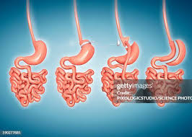
Gastric Band-Bypass-Sleeve

Slide 29
Anemia secondary to malabsorption syndromes
iron deficiency
may not respond to oral iron supplementation or have intolerance to it
likely will need IV iron replacement therapy lifelong if found to have iron deficiency
on average, patients receive IV iron every 12 to 18 months
average time from bariatric surgery to the need of iron replacement therapies varies, but on average it is 5 years or less
about 50% of patients with malabsorption to iron will also have vitamin B12 and folate deficiencies
oral B12 (tablet or sublingual) effective in raising B12 levels
Or B12 injections can be given

Slide 30
Case study #3
67-year-old female with past medical history significant for gastric sleeve surgery greater than 5 years ago, presents with extreme fatigue, increased mental fogginess, and cravings to eat various types of foods for the past year. She has never been diagnosed with iron deficiency anemia or thrombocytosis in the past. She underwent lab work with her bariatric provider which revealed:
WBC 8.7
Hemoglobin 9.3 (normal>/= 11.9)
Hematocrit 28.9 (normal>/= 35%)
MCV 75.4
MCH 27.5
MCHC 32.2 (normal between 32.5 and 35.2)
Platelet count of 570,000 (normal between 130,004 100,000)
Ferritin 5 (normal 40 or above)
Iron saturation 7% (normal 20% or above)

Slide 31
Case study #3 continued
She received 2 Feraheme infusions (510mg x 2 in 5 days) which she tolerated well. Follow-up labs performed at her 2-month follow-up visit revealed:
*WBC 7.8
*Hemoglobin 9.7
*Hematocrit 30.5%
*MCV of 85.9%
*Platelet count 445,000
*Ferritin 121
*Iron saturation of 17%
At her 2-month follow-up visit we checked Hemoccult stool which was positive x 3.

Slide 32
Case study #3 continued
She was immediately referred to GI and underwent EGD and colonoscopy which revealed gastritis, esophagitis in the GE junction, gastric sleeve anatomy, sigmoid colon mass which was biopsied, 1 polyp in the cecum and 1 polyp in the transverse colon.
Biopsy of the sigmoid mass was positive for adenocarcinoma
She underwent a robot-assisted sigmoid colectomy with low pelvic anastomosis
Pathology revealed moderately differentiated adenocarcinoma extending through the wall and into the pericolonic adipose tissue.

Slide 33
Case study #4
27-year-old female with past medical history significant for chronic constipation since birth presents with newly diagnosed iron deficiency anemia. She reports that she has never been diagnosed with anemia in the past. Starting about 3 months ago, she noticed that she was feeling more fatigued and short of breath. She followed up with her PCP to complain of the same symptoms and underwent lab work which revealed:
WBC 6.5
Hemoglobin 6.8 (normal>/= 11.9)
Hematocrit 24.2 (normal>/= 35%)
MCV 55.5 (normal between 80 and 100)
MCH 15.7 (normal between 27.0 and 31.0)
MCHC of 28.2 (normal between 32.5 and 35.2
Platelet count 245,000
She was instructed by her PCP to take 1 iron tablet daily and seek hematology consultation

Slide 34
Case study #4 continued
She also complained to her PCP rectal bleeding for the previous 6 months. She reports that she sees blood on the toilet paper after wiping occasionally. She was referred to GI by PCP for further evaluation.
She was seen by GI in the past for chronic constipation workup with no etiology found. She has never undergone any scope examinations.
Her menstrual cycles are nonexistent due to having an IUD.
She received 1 Feraheme infusion but suffered an infusion reaction. She then received 2-3 Venofer infusions which she tolerated without any issues.

Slide 35
Case study #4 continued
She was seen by GI and underwent EGD and colonoscopy which revealed grade 3 esophagitis in the lower third of the esophagus, medium size hiatal hernia, localized ulcerations and erosions of the mucosa with no bleeding in the prepyloric region and antrum, and mass of the sigmoid colon located 20 cm from the rectum. Biopsy was positive for tubular adenoma with high-grade dysplasia.
She underwent robot-assisted laparoscopic low anterior colon resection. Pathology revealed moderately differentiated adenocarcinoma invading entirely through the colonic wall into the subserosal connective tissue, 0/41 lymph nodes positive for metastatic disease.

Slide 36
Colon cancer
approximately 150,000 cases diagnosed in US annually
20% have distant metastatic disease at the time of presentation
common Symptoms/signs
hematochezia or melena
abdominal pain
unexplained iron deficiency
must rule out colon cancer if iron deficiency is found in males
unintentional weight loss
Change in bowel habit
testing
colonoscopy
most accurate and versatile diagnostic test
fecal immunochemical test for occult blood (FIT)
97% sensitive and 1 meta-analysis
flexible sigmoidoscopy
not recommended due to shift and right sided or proximal colon cancers in the past 50 years
screening
US preventative services task force (USPSTF) recommends initiating screening at age 45 and end at age 75
Colonoscopy every 10 years or sooner if colon polyps are removed
FIT for occult blood annually if unable or unwilling to have colonoscopy
Multitarget stool DNA testing (Cologuard)
USPSTF recommends screening every 1 to 3 years
combines fecal markers for hemoglobin and DNA mutation and methylation
more expensive than FIT
Computer Tomography colonography (virtual colonoscopy)
performed every 5 years

Slide 37
Case study #5
64-year-old female with controlled Afib presents with recently diagnosed iron deficiency anemia. She reports that she was hospitalized for pancreatitis and was found to have iron deficiency anemia. She was instructed to take oral iron supplementation twice a day at that time. Despite her oral iron supplementation, her hemoglobin hematocrit continued to be below normal on routine follow-up labs with her PCP. Lab work that was done at her PCP office 4 months ago revealed:
Hemoglobin 11.1
Hematocrit 33.8
MCV 86.7
Platelet count 393,000
Ferritin 121
Labs that were done 3 months later revealed:
Hemoglobin of 11.4
Hematocrit 34.2
MCV 85.6
Platelet count 315,000
Ferritin 77

Slide 38
Case study #5 continued
She has also been following with GI who sees her for chronic diarrhea symptoms as well as iron deficiency. Patient reports that she has been dealing with chronic diarrhea for 20 years with no known etiology. Last colonoscopy was 5 years ago. Her last EGD was 4 years ago And revealed mild chronic gastritis, fundic gland gastric polyps, mild chronic inflammation, reactive epithelial changes. She reports that she has been feeling very fatigued and occasional dizziness with postural changes.
She then underwent follow-up colonoscopy after her consultation visit which revealed 2 polyps but no evidence of acute bleeding. She underwent follow-up labs which revealed:
WBC count 6.4
Hemoglobin 11.1
Hematocrit 33.9
MCV 80
Platelet count 247,000
Ferritin 65
Iron saturation 8%
TIBC 429 (normal between 250 and 425)

Slide 39
Case study #5 continued
She received 5 Venofer 200 mg infusions over 2 weeks which she tolerated well.
She underwent PillCam endoscopy which revealed multiple areas of focal angiectasias in the small bowel, most prominent in the distal small bowel.
AVMs
Occasionally we encounter patients with AVMs of the small bowel. Always consider this if EGD and colonoscopy are negative.
Especially that is above age 60 on ACT.
These patients will need iron supplementation for the rest of their lives.

Slide 40
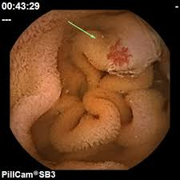
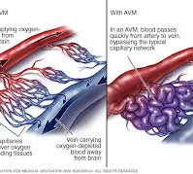

Slide 41
Iron deficiency in pregnancy
commonly causes physiologic or dilutional anemia
maternal red cell mass increases but at the same time plasma volume increases to a greater degree
causes hemoglobin and hematocrit levels to decrease to anemic levels
Normal hemoglobin ranges
1st trimester: Greater than or equal to 11 g/dL
2nd and 3rd trimester: Greater than or equal to 10.5 g/dL
Iron deficiency is a common cause of anemia in pregnancy
Treatment
1st trimester
oral iron (ferrous sulfate most common)
best to take every other day due to reduce GI effects
IV iron contraindicated due to no safety data for first trimester use
2nd and 3rd trimester
oral iron as above
if persistence after oral iron failure -> IV iron (Venofer only product deemed safe)
IV iron is best to use from week 30 onwards due to insufficient time to replete iron orally
avoid IV iron in late third trimester to avoid risk of inducing labor (infusion reactions)
Must rule out other causes of anemia (folate deficiency, B12 deficiency, etc.)

Slide 42
Treating the root cause of IDA
fecal occult blood test (FOBT) to rule out GI blood loss
Referral to specialist (GI/GYN/colorectal surgery)
EGD/colonoscopy/PillCam endoscopy
Surgery for large hiatal hernia
PPI for gastric bleed
Hemorrhoid banding/hemorrhoidectomy
Menorrhagia
oral contraceptives/ tranexamic acid/gonadotropin releasing hormone antagonist (Myfembree)
IUD
Uterine ablation
Partial or total hysterectomy

Slide 43
Case Study #6
64-year-old Asian male presents for recently diagnosed microcytic hypochromic anemia. He reports that he has been anemic for the past 3 years. For those 3 years, he has been taking 1 oral iron tablet daily which he tolerates without any issues. He recently followed up with his PCP and underwent lab work which revealed:
WBC 5.1
Hemoglobin 12.1 (normal>/= 13.6)
Hematocrit 37.5 (normal>/= 40%)
MCV 70 (normal between 80 and 100)
MCH 22 (normal 27 and 31)
MCHC 32 normal (32.5- 35.2)
Platelet count 203,000
Ferritin 97
Iron saturation 42%
TIBC 301
He was referred to hematology for further evaluation of his microcytic hypochromic anemia.

Slide 44
Case Study #6 continued
Thalassemia.
His alpha globin DNA analysis lab test revealed that he was homozygous positive for alpha thalassemia mutation.
He initiated folic acid 1 mg daily and stopped his oral iron supplement.

Slide 45
Thalassemia
One of the most common hemoglobinopathies (second to sickle cell disease)
5% of the world's population has at least one thalassemia variant allele
Alpha thalassemia
highly prevalent in southern China, Malaysia, and Thailand
Mild forms common with African and Asian ancestry
Four alpha globin genes
alpha thalassemia is caused by reduced production of alpha chains and the accumulation of excess beta chains
severity increases with loss of 1, 2, 3, or 4 alleles

Slide 46
Thalassemia cont.
Beta thalassemia-anemia present in Africa
2 beta globin chains
Beta thalassemia caused by reduced production of beta chains and the accumulation of excess alpha chains
transfusion dependent beta thalassemia (beta thalassemia major, Cooley’s anemia, Mediterranean anemia)
Non-transfusion dependent beta thalassemia (beta thalassemia intermedia)
Beta thalassemia minor (beta thalassemia trait)

Slide 47
Management of Thalassemia
Folic acid supplementation for all individuals with thalassemia major or thalassemia intermedia with evidence of chronic hemolysis, use folic acid 1 mg daily
compensate for increased folate requirements associated with increased RBC turnover
Suggest folic acid 4 to 5 mg daily during pregnancy
Need to avoid iron supplementation UNLESS they have documented iron deficiency
increased iron absorption with thalassemia which can lead to iron overload

Slide 48
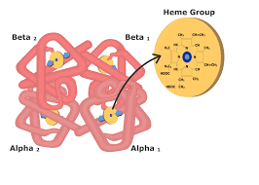
Hemoglobin molecule

Slide 49
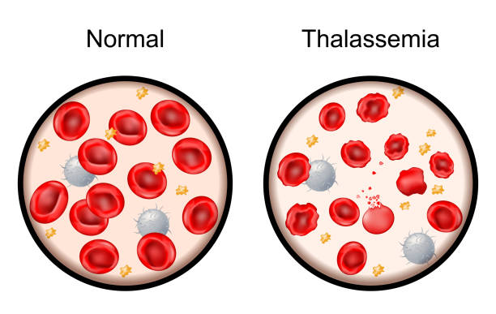
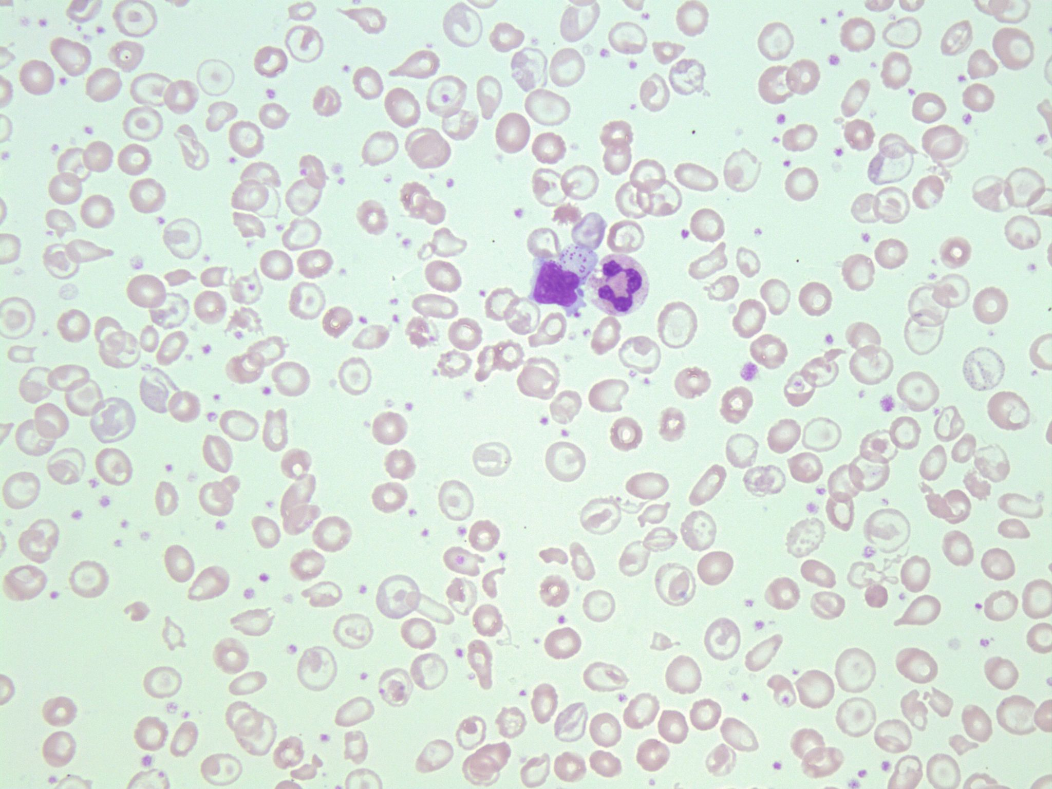
Normal smear vs Thalassemia

Slide 50
Case study #7
60-year-old female presents with recently diagnosed normocytic normochromic anemia. She has Stage IV kidney disease with an EGFR of 18. She underwent lab work at her nephrologist office which revealed:
WBC 9.2
Hemoglobin 9.6
Hematocrit 29.5
MCV 87
Platelet count 202,000
BUN 32
Creatinine 2.89
eGFR 18
We ordered full peripheral laboratory anemia workup which was only remarkable for vitamin B12 deficiency. Thus it was confirmed that her anemia was secondary to anemia of chronic kidney disease and vitamin B12 deficiency.
Initiated Retacrit (ESA) and B12 injections. Hemoglobin improved to as high as 11.4.

Slide 51
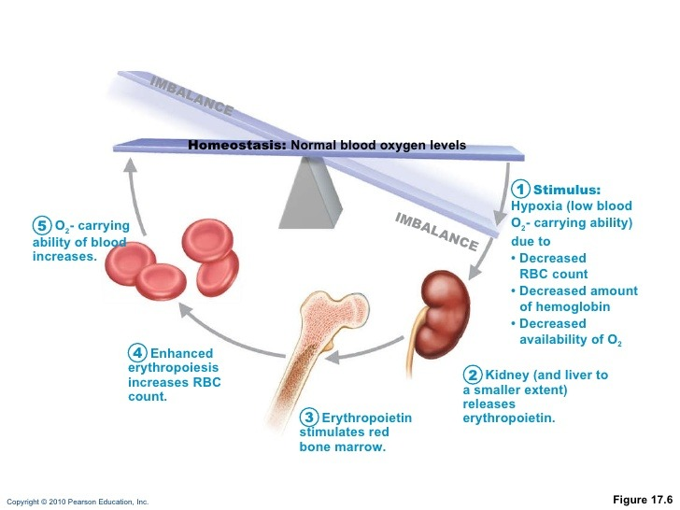
Erythropoetin mechanism

Slide 52
Anemia of CKD
CKD stage III-V (eGFR 59 and under) can cause anemia (normocytic normochromic) secondary to decreased production of erythropoietin
Workup requires hematology referral to rule out other potential causes before confirming that anemia is secondary to kidney disease
treatment consists of erythropoiesis-stimulating agents (ESA) (examples: Procrit, Retacrit, Aranesp)
Side effects: Hypertension, increased risk of clotting (CVA/DVTs)
Relative contraindications: History of CVA/VTE, bedbound status, dementia**
Requirements for initiation at most institutions and by insurance providers:
hemoglobin hematocrit <10 and 30 respectively
ferritin > 100 or iron saturation > 20
After ESA initiation, can continue to administer weekly if H&H is < 11 and 33 and iron studies are at goal
End-stage renal disease (CKD stage V)
ESA therapy will shift to the management of the nephrologist during hemodialysis
Iron deficiency with ESA therapy
can develop functional iron deficiency while on ESA therapy
iron stores may be available but they are released into the circulation may not be rapid enough to support the increased erythropoietic rate
If the patient is found with iron saturation < 30%, supplement with PO or IV iron

Slide 53
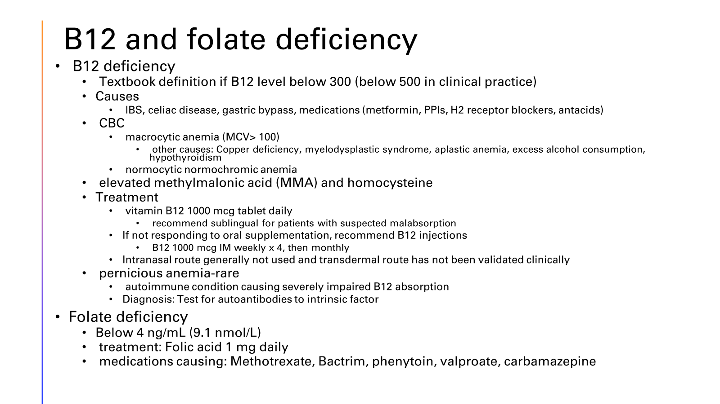

Slide 54
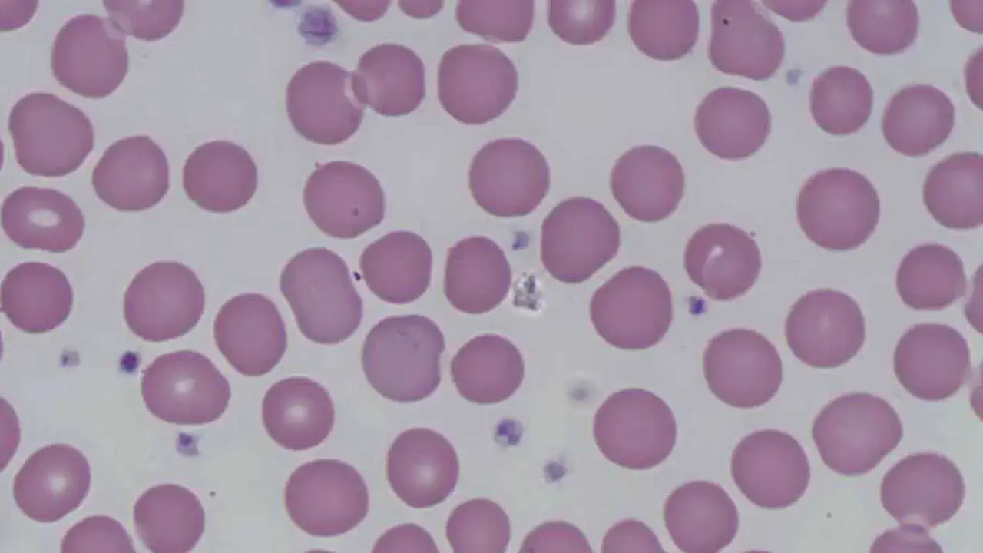
Macrocytic anemia MCV>100

Slide 55
Case Study #8
78-year-old female referred with new onset macrocytic anemia and long history of mild hypercalcemia and hyperparathyroidism. She was also complaining of worsening back pain. Her NP noticed that her serum calcium was climbing to 11.9 and her Hgb was 9.5. MCV 105. She had normal B12/folate levels, normal creatinine.
NP called me and asked if I would see her so I ordered labs ahead.
CRAB criteria for defining myeloma.
Calcium >11.0
Renal insufficiency creatinine greater >2.0
Anemia Hgb <10.0
Bone lytic lesions

Slide 56
Myeloma labs/panel: CBC, CMP, LDH, B2MG, SPEP/IFE, FLC, serum IgG, IgM, IgA
SPEP/IFE, FKLLC, IgG 6282, IgM- low, IgA-low which revealed findings of monoclonal lambda protein (Mspike) at 3.8.
Skeletal survey showed no lytic lesions.
Next step BMB
Aspirate and core, Cytogenetics, Flow cytometry, FISH
Her marrow did show 70% plasma cell neoplasm thus definitely diagnosis multiple myeloma.

Slide 57
Anemia secondary to malignancy
Multiple Myeloma
Myelodysplastic syndrome (MDS) /acute myeloid leukemia (AML)
Normocytic or Macrocytic (most common) anemia
Leukopenia
Prior exposure to chemotherapy agents
Chronic lymphocytic leukemia (CLL)
neutropenia, lymphocytosis, anemia, and thrombocytopenia
Chronic myelogenous leukemia (CML)
anemia, leukocytosis, thrombocytosis, and splenomegaly
Colon cancer
Renal cell carcinoma
normocytic or microcytic anemia
hematuria
Lung cancer
Other Solid tumors can produce anemia by involvement of the bone marrow space with metastasis (typically advanced stages)

Slide 58
Anemia secondary to hemolysis
Causes
Acquired
Liver disease (cirrhosis)
Hypersplenism
Infections (Bartonella, clostridial sepsis, malaria, babesiosis)
Toxins (lead, copper, snake and spider bites)
Hereditary
Sickle cell disease, thalassemia, G6PD deficiency
Immune related
Drug-induced
Hemolytic transfusion reaction (ABO incompatibility)
Autoimmune hemolytic anemia
Paroxysmal nocturnal hemoglobinuria (PNH)
Symptoms/signs
dark urine
Jaundice
Gallstones
Anemia with certain food or drug exposures (fava beans, oxidant drugs)
Labs
* LDH (increased)
Indirect bilirubin (increased)
Haptoglobin (decreased)
Direct Coombs test (DAT) (positive)
Peripheral blood smear (spherocytic RBCs, schistocytes, bite cells)
Treatment
blood transfusion if hemoglobin < 6g/dL
treat the offending agent
Consult hematology

Slide 59
Anemia secondary to autoimmune disorders
Mechanism of action: same as anemia of chronic disease
Systemic lupus erythematosus
mild, normocytic, normochromic anemia, leukopenia, and thrombocytopenia
Rheumatoid arthritis
very common finding prior to treatment, anemia typically resolves after treatment with DMARDs
Medication induced: Methotrexate, sulfasalazine, leflunomide, azathioprine, cyclophosphamide, NSAIDs/glucocorticoids (GI bleeding-> iron deficiency anemia)
Scleroderma
may reveal anemia due to malabsorption, iron deficiency, or gastrointestinal blood loss depending on which organ is involved
Polymyalgia rheumatica
normocytic anemia may be present
Giant cell arteritis
normocytic anemia ( profound) often present and improves after initiation of glucocorticoids
May have reactive thrombocytosis

Slide 60
Sideroblastic anemia-macrocytic
Etiology: ineffective erythropoiesis and presence of ringed sideroblasts in the BM. Ringed refers to accumulation of iron in the mitochondria surrounding nucleus.
Important to note: can be hereditary or acquired!
Can be associated with drugs or toxins-lead, alcohol, INH (TB), zinc toxicity with copper deficiency
Treatment-drug induced are reversible, can treat anemia with ESA’s
Notes:
Sorry this slide is messy, but there are a lot of things that can go into this.

Slide 61
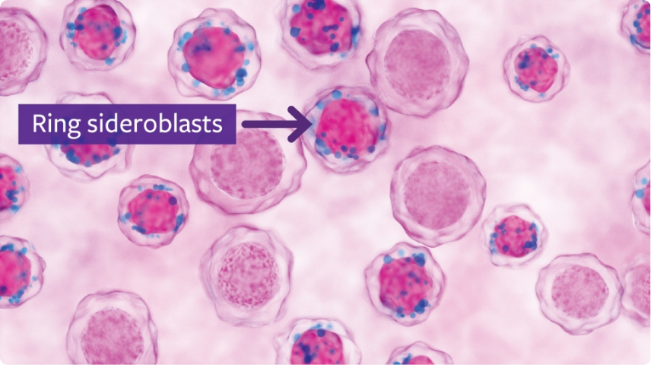
Ringed sideroblasts

Slide 62
Blood transfusions
Blood transfusion indicated typically if hemoglobin is <7 g/dL in the patient is symptomatic (severe shortness of breath, heart palpitations, lethargy, severe weakness, etc.)
If patient is clinically stable, shown to have an iron deficiency and their hemoglobin is less than or around 7, they can be referred to hematology for consideration of iron infusions ASAP
Hematology can order outpatient blood transfusions if necessary, saving the patient an ER visit

Slide 63
Transfusion reactions
We do not premedicate for RBC transfusions
REACTIONS:
MILD-Low grade fever, chills, itching, hives
MORE SEVERE- hypotension, higher fever, respiratory distress
Reaction incidence:
Anaphylactic reaction 1:200,000 incidence
Febrile reaction 1:60
Allergic reaction 1:250
Iron overload 1:100
Always be prepared for reactions...Tylenol, H1, H2 blockers, antiemetics, IV steroids, bronchodilators, epinephrine

Slide 64
Knowledge check
RBCs last in circulation 120 days, transfused RBCs last ~60d
1 unit of PRBCs equals 200-250mg of iron
Chronically transfused patients, >10 transfusions per year will become iron overloaded.
Take home message, check ferritin levels on patients receiving frequent transfusions

Slide 65
RECAP: Approach to Anemia Workup
Questions to answer:
Is there a vitamin deficiency (iron, B12, or folate)?
Is the patient bleeding (now or in the past) ?
Is the bone marrow suppressed?
Is there evidence of hemolysis?
Order appropriate laboratory testing
If malignancy or organ dysfunction is suspected, order imaging
Refer to specialist if necessary for further workup
If cause is reversible treat the underlying cause

Slide 66
Indications for hematology consult
Unexplained anemia
Unexplained microcytosis or macrocytosis
Patient is not responding to oral iron supplementation
Patient meets criteria for IV iron
Severe anemia (hemoglobin < 7)
Concern for malignancy related to anemia
Patient with anemia of chronic kidney disease and persistent hemoglobin/hematocrit of less than 10/30 respectively
Normocytic anemia that has you stumped!

Slide 67
The End
Many thanks to WVAPA for having me.
If you have questions or comments, feel free to email me at kelly.smith-riggleman@wvumedicine.org

Slide 68




Riggleman’s

