Slide 1

Digital devices and Blue light
Alicia Wilson, DMSc, MSPA-C

Slide 2
Objectives
At the end of this presentation, you will learn
The wavelengths of the visible spectrum and how it relates to blue light
The long-term complications of continued exposure to blue light
What you can do to prevent complications from blue light exposure

Slide 3
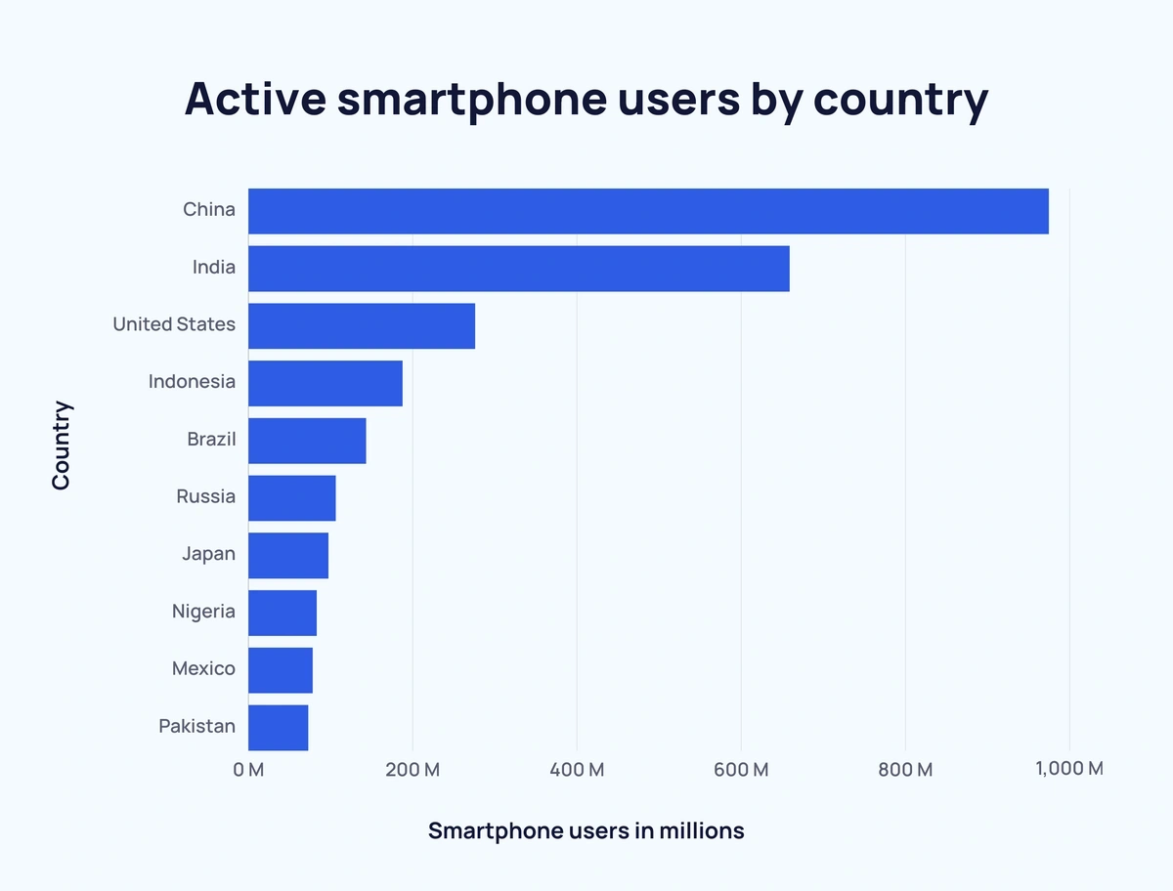
facts¹
As of June 2024, there were over 7.2 billion smartphones in the world.
8 billion population
Some own more than one phone
7.8% higher than the previous year.
China has the most smartphones.
Android is the leading operating system!
Notes:
We are in the electronics age. It’s unheard of to not have a smartphone. My 80 yo Dad has one and uses it, not well, but he uses it. M y phone is my alarm. I wake up and look at it every day. I put it down at night and go to sleep. I have a bit of an advantage, or disadvantage, depending on how attached you are to your phone. I can’t take mine into work. So I probably get less usage than most.
If you look at this graph, you can see that China has the most smartphones uses. But a few interesting facts… While they have the highest ownership, they get an average of 6.56 hours of sleep per night whereas Americans get 2.3 times LESS sleep. But in the waking hours, Americans spend an average of 4hr and 39 mins per day on their phones as compared to the Chinese population at 3 hrs 31 mins. We are getting one hour per day more phone time, that’s 365 more hrs per year.

Slide 4
Year | Number of Smartphone users
2016 | 3.7 billion
2017 | 4.4 billion
2018 | 5.1 billion
2019 | 5.6 billion
2020 | 5.9 billion
2021 | 6.3 billion
2022 | 6.6 billion
2023 | 6.8 billion
2024 | 7.1 billion
2025 | 7.3 billion
2026 | 7.5 billion
2027 | 7.7 billion
Notes:
And no, this is not a lecture on smartphones. It is a lecture on….

Slide 5
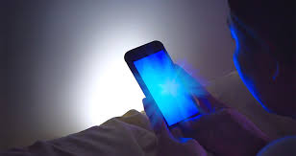
Blue light
Digital screens that use LED emit blue light
Notes:
If you have an LED device, it emits blue light. Televisions, phones, computer monitors, billboards, sunlight. Light bulbs – although the amount varies depending on the bulb type and brightness. Cool white LED’s emit more blue light.

Slide 6
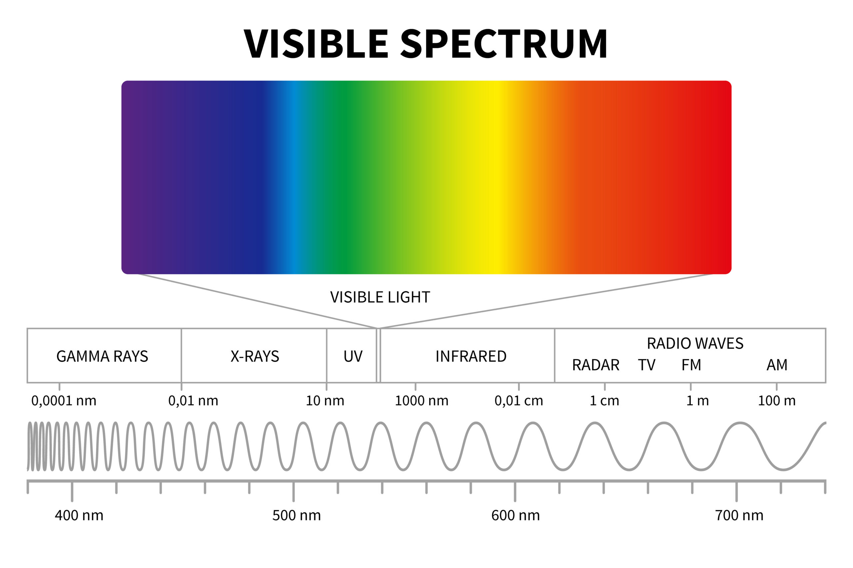
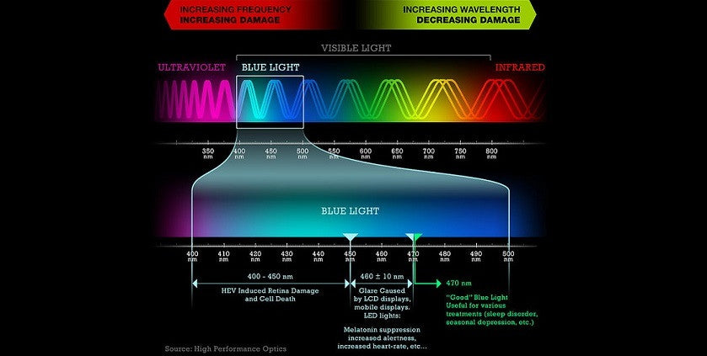
Blue light
The visible light spectrum is the part of the electromagnetic spectrum that we can see.
A human eye can see wavelengths from 380 to 700 (780) nanometers.
Blue light waves are short, between 450-490 nanometers.
Some is necessary for regulating our circadian rhythm and boosting alertness.
The longer the wave, the less energy it emits.
Notes:
The longer the wave, the less energy it emits. Because blue light is made up of short wave, it emits the most energy of the visible spectrum. Why is this important?

Slide 7
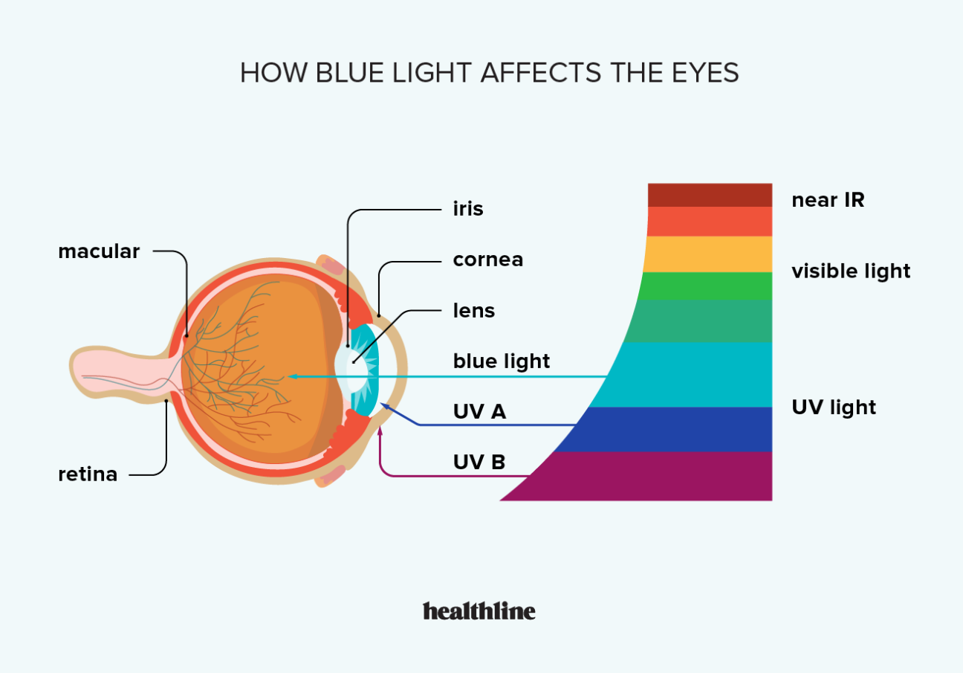
Blue light
Your eye tries to protect you.
Cornea and lens helps protect the retina for damaging UV light
Blue light reaches deeper in the eye than the other colors.
Notes:
The lens has carotenoid lutein and zeaxanthin. These are effective antioxidants, and the only carotenoids found in the lens. They absorb some blue light, before it gets to the retina.

Slide 8
What can blue light do to your eyes
Blurred vision
Headaches
Sleep disorders
Eye Strain
Dry eyes
Cataracts
Macular Degeneration
Neck and shoulder pain

Slide 9
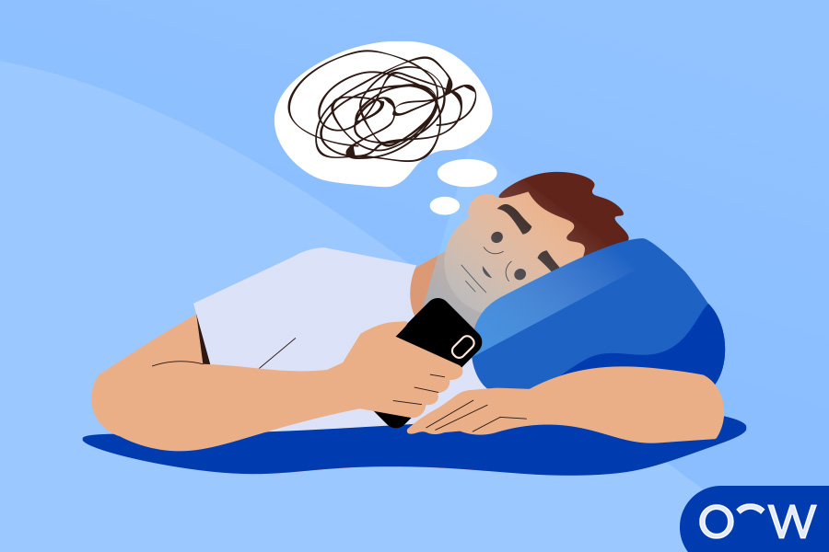
Blue light and sleep
Light sensors in your eyes can perceive the difference between the intense blue light waves of bright daylight and the warmer, more red tones of the sun setting in the sky. When the light around you changes into sunset tones, the sensors in your eyes prompt your body to release natural melatonin, which induces sleep.²
When we try to go to sleep, our brain will continue to “think” as long as we give it a stimulus.
Notes:
So essentially, in the daytime, the blue light from the sun will cause the body to suppress melatonin, keeping you awake. In the night, no sunlight, no blue light. Natural melatonin should help you sleep.

Slide 10
Blue light and eye strain
Dryness
Fatigue
headaches
Notes:
The less harmful complications of prolonged blue light is dryness, eye fatigue and headaches. The dry eyes comes from the ‘stare’ that you do when you are intently looking at your screen. And when you don’t blink, you aren’t spreading your tears over your cornea, in turn causing dry eyes.
When we look at something up close, a process happens in our eyes called accommodation. It causes the lens to fatten which is the reason we are able to see up close (pre-bifocals). If we are in a constant state of accommodation, this will lead to headaches.

Slide 11
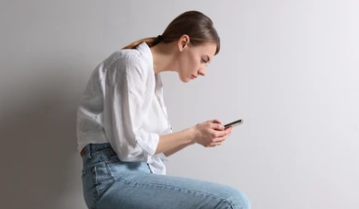
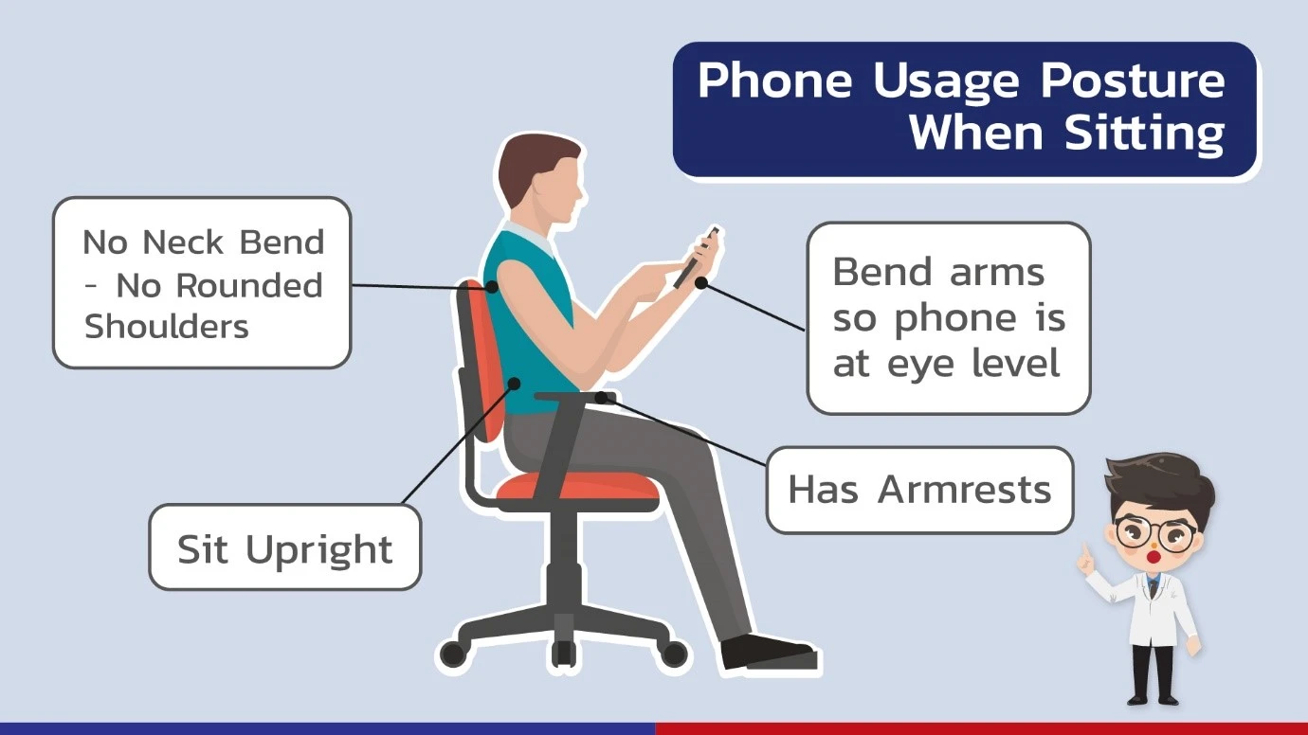
Device usage and muscle aches
Poor posture
Tension in the neck and shoulders
Notes:
Routinely stretch your neck and back. Practice good posture.

Slide 12
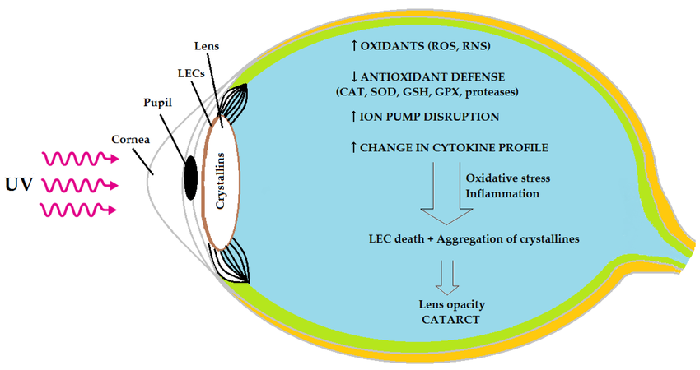
Blue light and cataracts
Blue light can cause the production of reactive oxygen species (ROS) in the eye, which can lead to oxidative stress and damage eye proteins, thereby causing clouding of the lens and vision impairment.
Blue-violet light range of 415-455 nm seem to be effective in generating ROS and causing cell damage.
Notes:
Remember that the lens contains the antioxidants that absorb blue light.
ROS’s are unstable molecules that are highly reactive and contain oxygen. A buildup of ROS can lead to cell death.
In this picture, we can seethe light coming in through the cornea and the lens. This causes the increase in ROS, with causes lens epithelial cell death and aggregation of crystallines, AKA a cloudy lens.

Slide 13
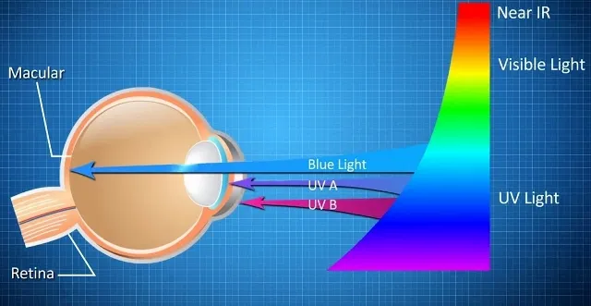
Blue light and macular degeneration (AMD)
ROS causes cell death.
Sunlight, being a significant source of blue light, can cause retinal death, leading to AMD.
Prolonged exposure to blue light from devices can lead to an increase in ROS’s -->cell death.
AMD also has a large genetic component.
Wear sunglasses.
Take a device break.
Notes:
Macular degeneration is the leading cause of blindness in the older population. There is no cure because they don’t know the EXACT science behind all of the cause of cell death.
If you recall the last slide and the ROS’s, remember that they are responsible for cell death.

Slide 14
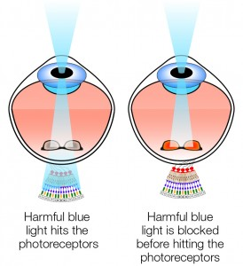
blue light and the macula

Slide 15
What can we do
Take breaks
Adjust screen settings
Practice good posture
The 20-20-20 rule
Notes:
Taking a 20 second break (reduces eye strain), look at something 20 feet away (removes accommodation of lens) every 20 minutes.

Slide 16
How to turn on different modes
Iphone
To turn on and customize night shift mode, go to Settings -> Display & Brightness -> Night shift
To turn on dark mode, go to Settings ->Display & Brightness -> Light/Dark -> Automatic
To use a color filter to block blue light, go to Settings -> Accessibility ->Display and text size -> Color filters -> Pick color tint – move the intensity slider to the far right and hue to the far left which will eliminate blue light
“Hey Siri, turn on grayscale”
“Hey Siri, turn down my brightness”
Android
To turn blue light on and off, go to Settings ->Display -> Eye comfort -> Adaptive – then customize

Slide 17

Thank you!

