Slide 1

Approach to Eye Trauma and Utilization of Ocular POCUS
Kate Lee, MS, PA-C
WVAPA Conference 2025

Slide 2
Disclosures
None

Slide 3
Agenda
Eyelid
Cornea Stuff
Penetrating Trauma
Blood in the eye
Back of the Eye Things
Ultrasound Fun

Slide 4
Do a full eye exam
External (eyelid margins, fat extruding)
Pupil (fixed, dilated, or irregular)
Anterior chamber (hyphema, hypopyon, vitreous detachment, retinal detachment)
Acuity
Fields
Pressure (blood or debri in eye can clog outflow tract causing secondary glaucoma)
Fundo
Ultrasound for the back of the eye

Slide 5
An analysis of 1412 ED ocular emergencies presenting to a single center identified the four most common condition categories:
  ocular trauma in 27%
  conjunctivitis in 15%
  retinal problems in 3.6%
  glaucoma in 2%.

Slide 6
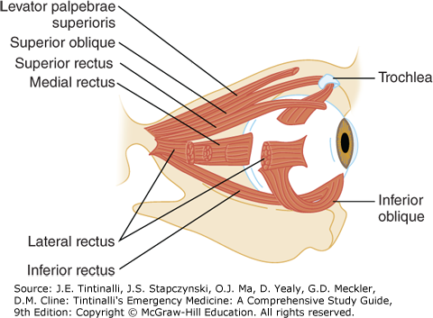
Notes:
Check EOM for occult blow out fracture

Slide 7
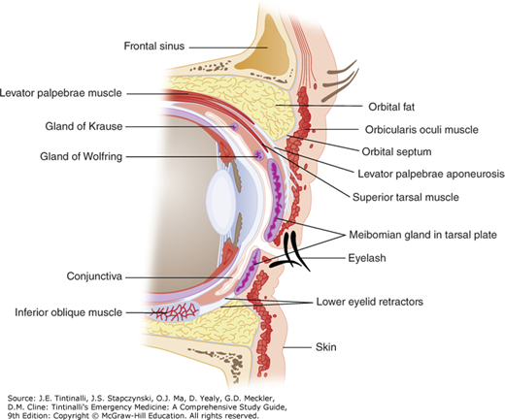
Anatomy

Slide 8
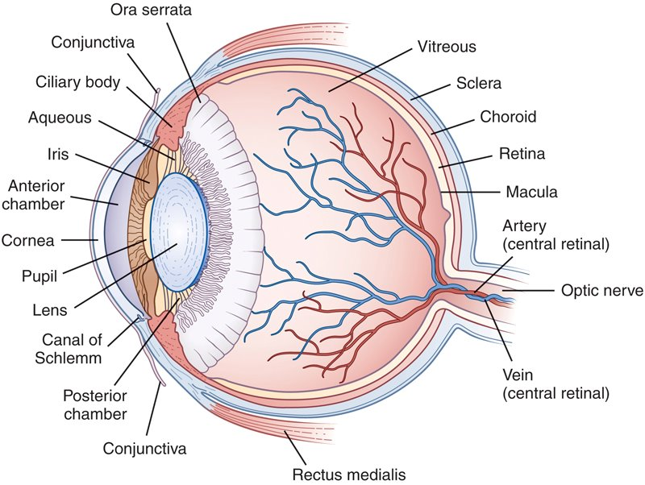
Anatomy Review

Slide 9
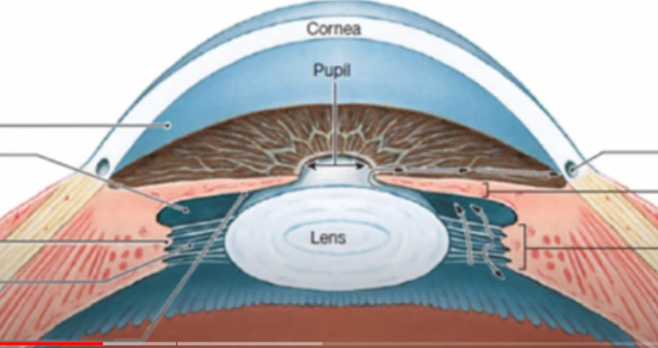

Slide 10
Trauma to the Eye
Corneal Abrasion, Laceration and Foreign Body
Lid Lacerations
Blunt Eye Trauma
  Hyphema
  Orbital Blow Out Fractures
  Ruptured Globe
  Retrobulbar Hematoma

Slide 11
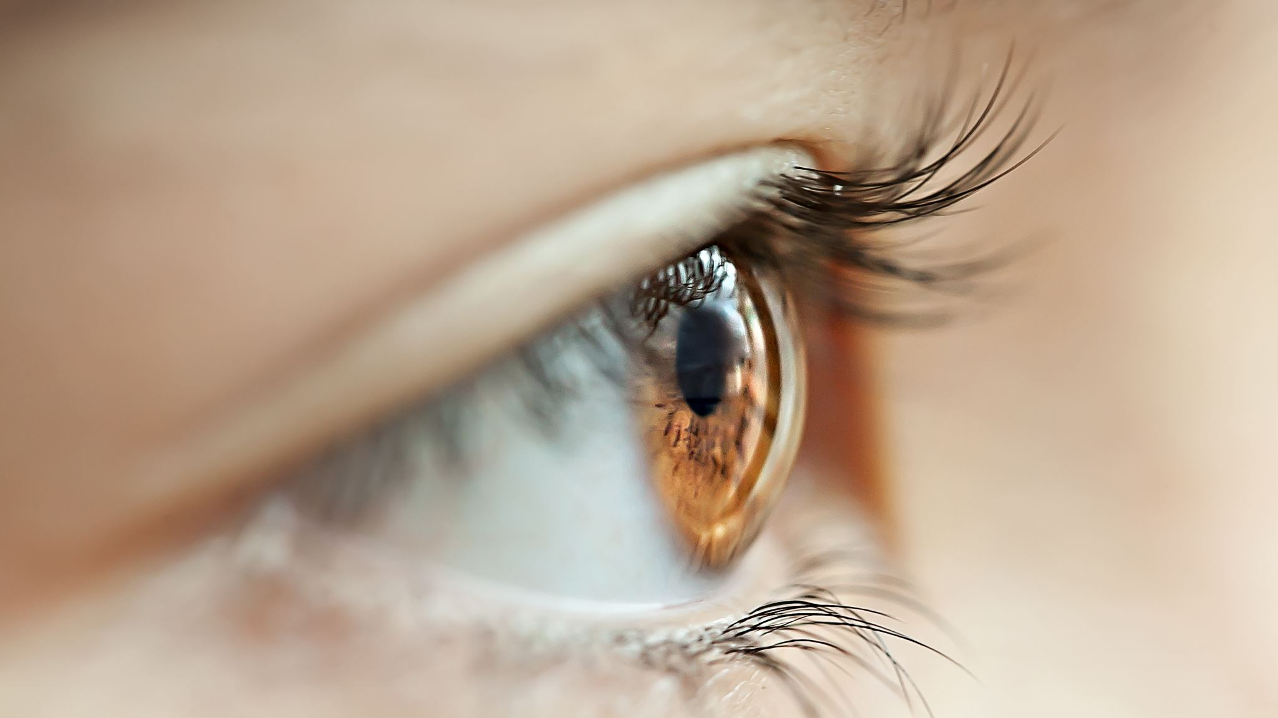

Slide 12
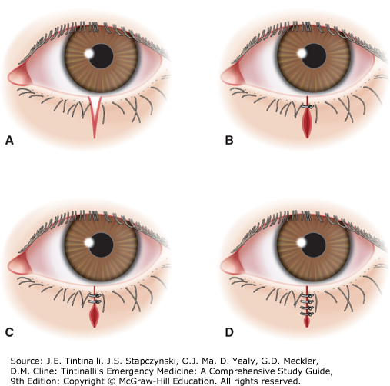
Lid Lacerations 1
Partial Thickness
  Could consider repair in ED and see ophthalmology in 2 days (I favor refer)
Full thickness
  Refer
  Check for globe rupture
  Slit lamp exam

Slide 13
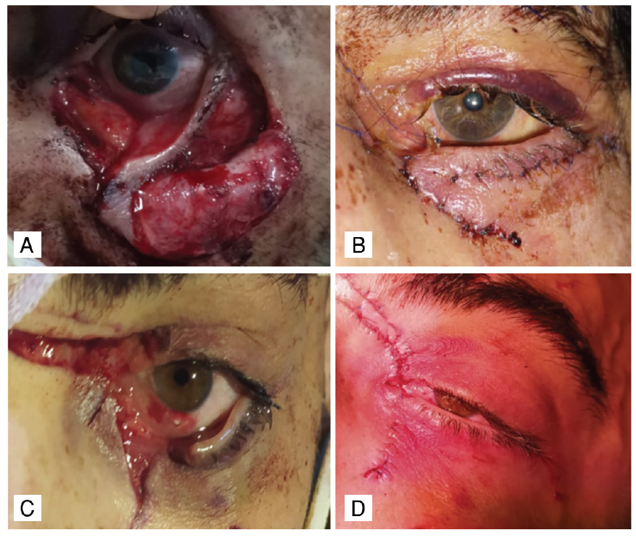
Lid Lacerations 2

Slide 14
Lid Lacerations 3: Referral To Ophthalmology
Eyelid fat
Cannulicula/Sac
Medial Canthus
Eyelid Margin
Ptosis
Notes:
Eyelid Fat
Caunnulicula/sac
Medial canthus
Eyelid margin
Ptosis

Slide 15
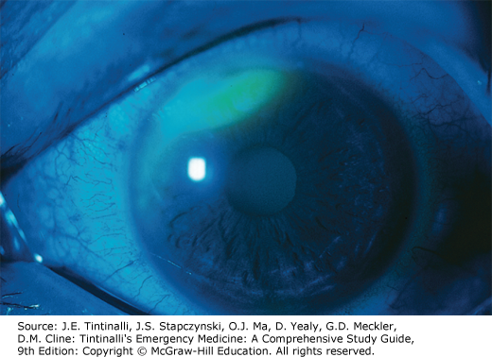
Corneal Abrasion 1
Causes: Many—mainly occupational
10% of eye complaints
MC in young adult
Ask
  Mechanism of injury
Patients present with:
  Intense pain
  FB sensation
  Photophobia
  Tearing

Slide 16
Corneal Abrasion 2
Physical Exam
  Inspection may show conjuntival injection, tearing and lid swelling
  Sometimes decreased visual acuity
  Topical anesthetic
  Evert the eyelids to look for foreign bodies
Diagnosis
  Slit lamp
    Flare and cells from iritis if the abrasion is large and older than a day
    Examine for a full thickness tear
  Seidel test
    negative
  Fluorescein Staining
    Superficial, irregular corneal defect appearing bright green under the cobalt blue light
    Woods lamp

Slide 17
Corneal Abrasion 3
Treatment
  Topical NSAIDS help pain but are expensive and have little advantage over oral NSAIDS
  Topical tetracaine 1% hourly up to 24 hours
  No patching
  Topical Antibiotics
    Non-contact lens wearer: erythromycin 3-4 times a day
    Contact lens wearer: ciprofloxacin, ofloxacin or tobramycin ointment 3-4 times daily
    Organic Source: erythromycin ointment 3-4 times daily

Slide 18
Corneal Foreign Body 1
Often small, superficial and benign
If globe is penetrated can cause loss of vision
Caused by: wood, metal, plastic, etc
Patient Presentation
  FB sensation
  Tearing
  Blurred vision
  Pain
  Photophobia
  Decrease vision or vision loss if globe rupture

Slide 19
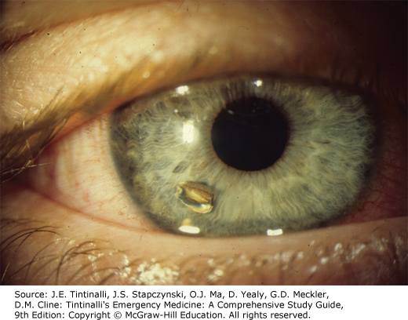
Corneal Foreign Body 2
The presence of a gross hyphema or a microhyphema evident in the anterior chamber on slit lamp examination suggests globe perforation.
Full thickness corneal foreign bodies should be removed by an ophthalmologist
Diagnostics
  May be visible with naked eye
  Evert both lids and look for other foreign bodies
  If metallic object may leave a rust ring
  Siedel Test
  Wood's Lamp
  Slit Lamp

Slide 20
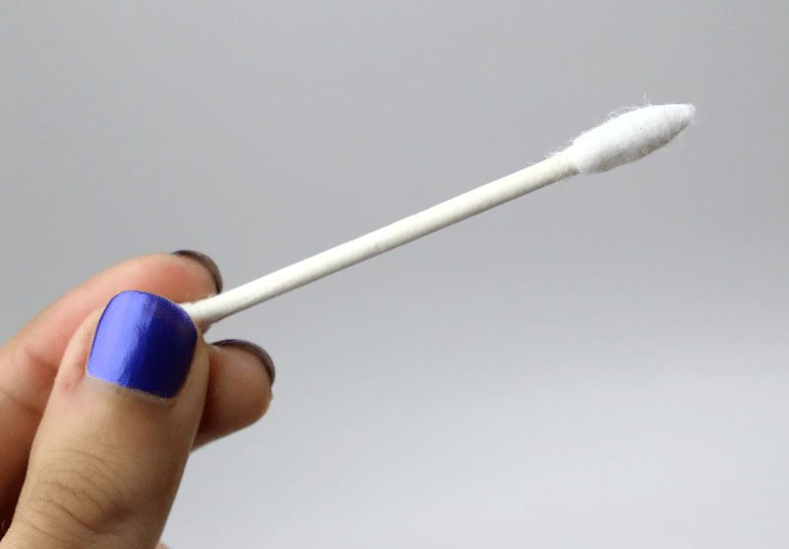
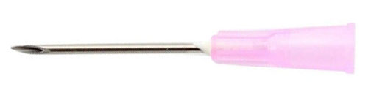
Corneal Foreign Body 3 (Removal)

Slide 21
Corneal Foreign Body 4 (Removal)
Numb the eye (proparacaine or tetracaine)
Irrigate NS
If unable to remove evaluate with slit lamp
Use a 25-gauge needle with bevel up or spud to remove
Burr tool for rust ring removal

Slide 22
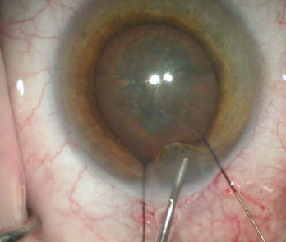
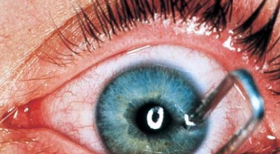
Penetrating Trauma
Be suspicious if they have corneal laceration or iris prolapse
MOI
+ Siedel Sign
Protect Eye

Slide 23
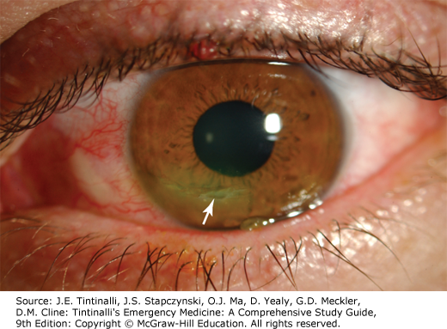

Corneal Lacerations 1
Patient Presentation
  Misshapen iris
  Hyphema
  Pain
  Decrease in visual acuity
  + Sidel test
Diagnostics
  CT of the orbit (sensitivity 51-77%)
  Consult ophthalmology
  Slit lamp exam to evaluate entire thickness of cornea
If diagnosis is delayed endophthalmitis can develop and patient can lose vision

Slide 24
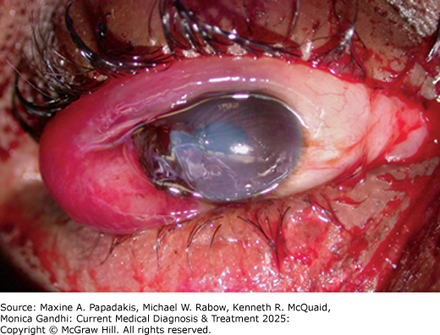
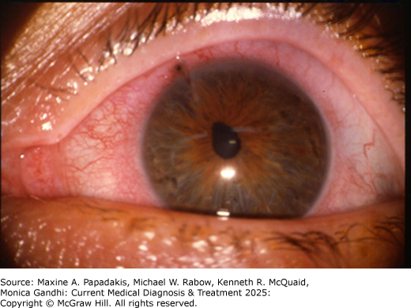
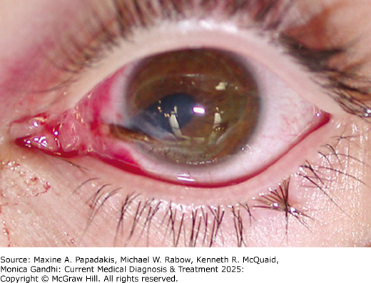
Corneal Lacerations 2

Slide 25
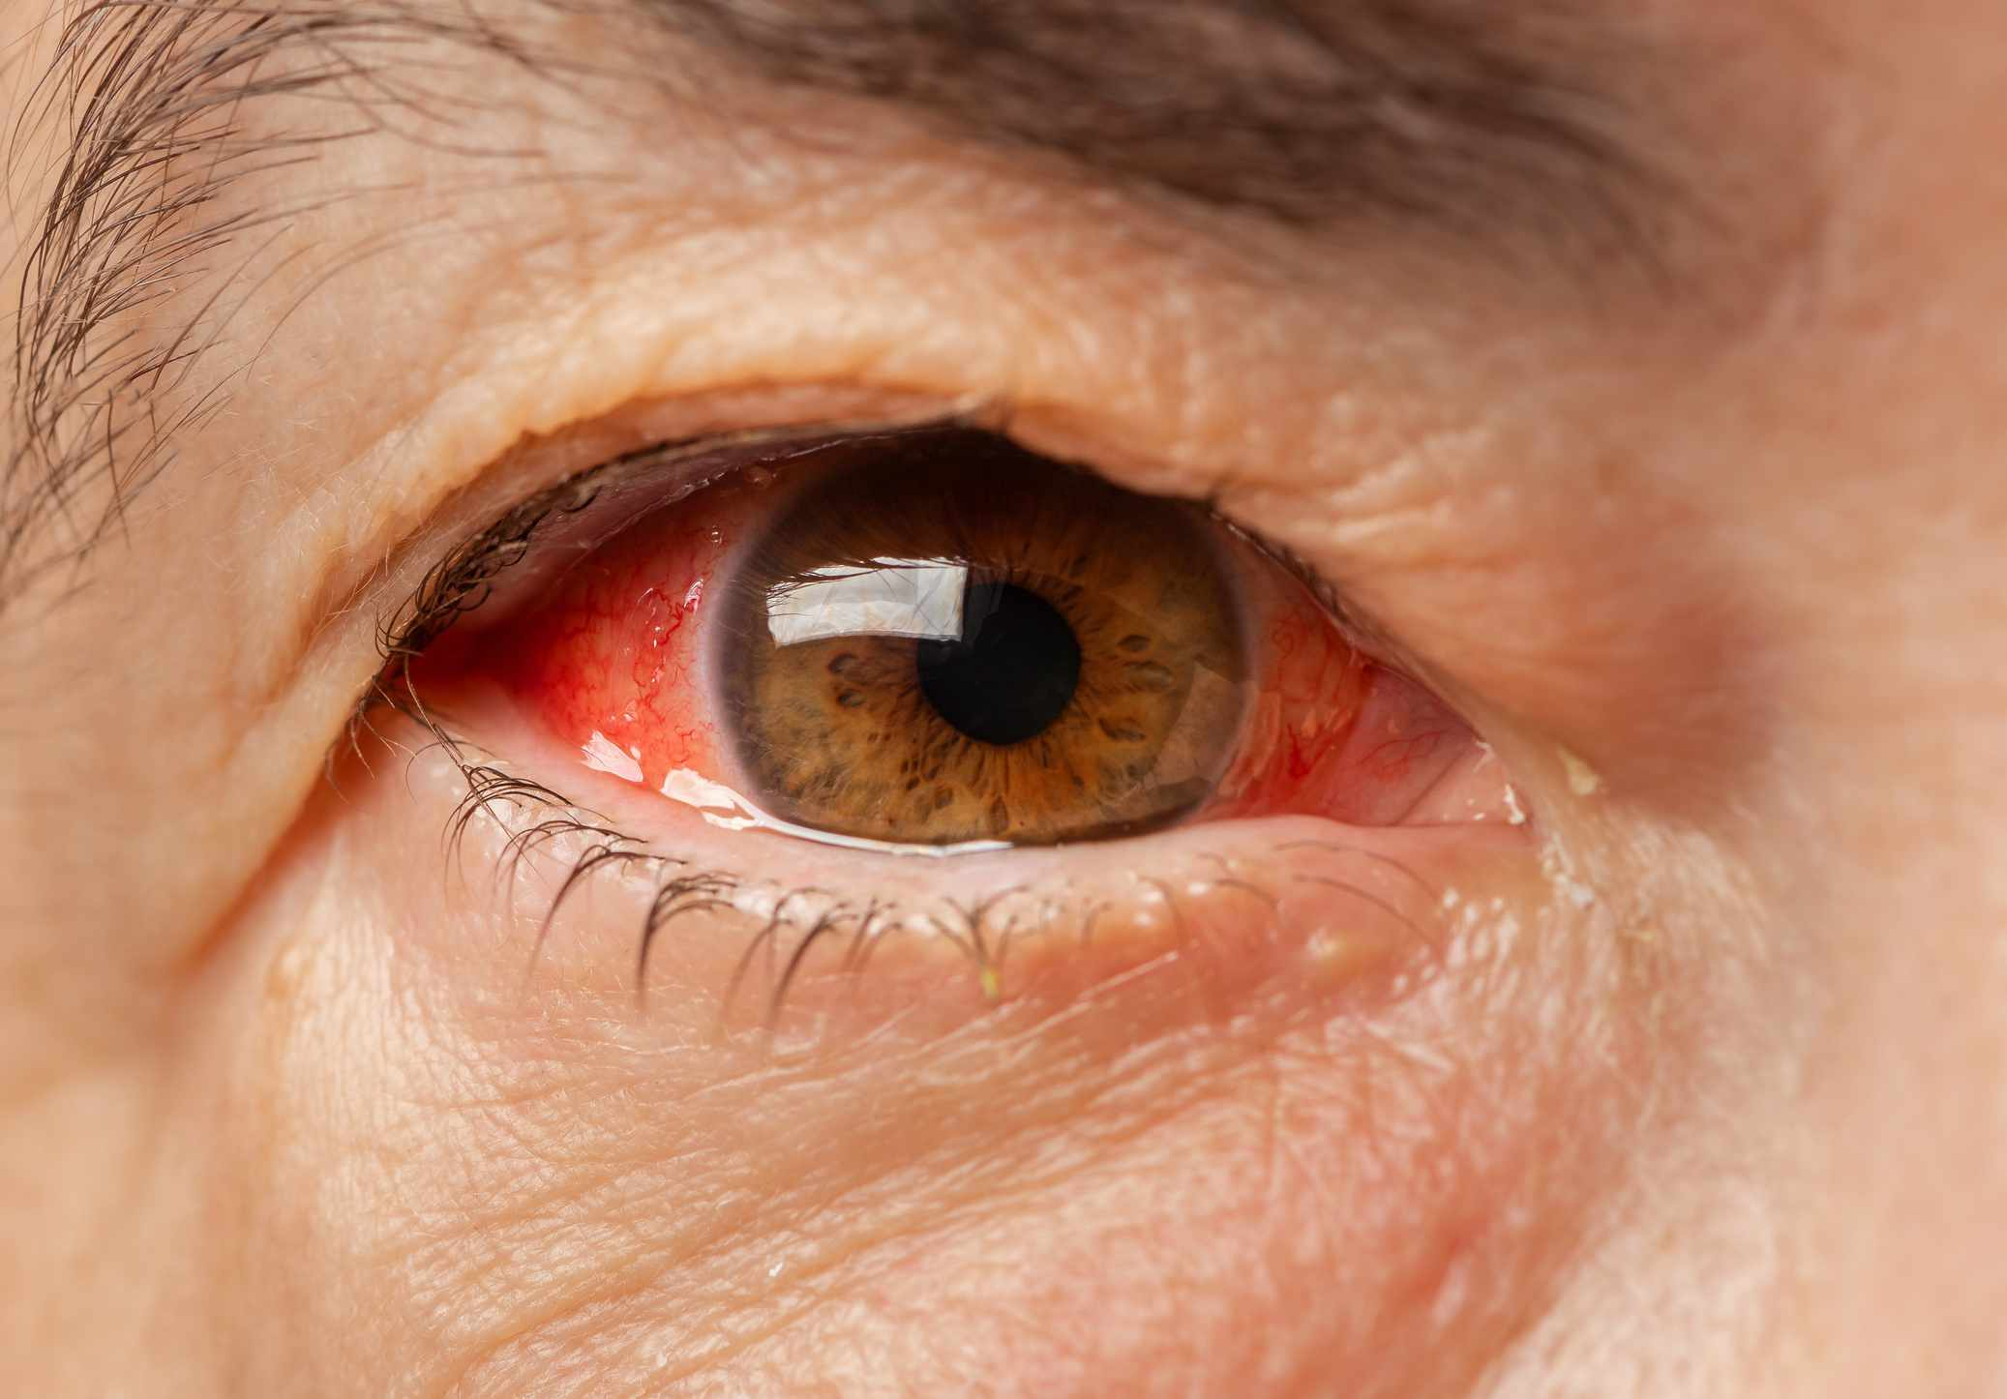
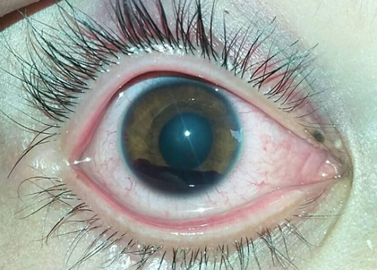
Blood in the Eye

Slide 26
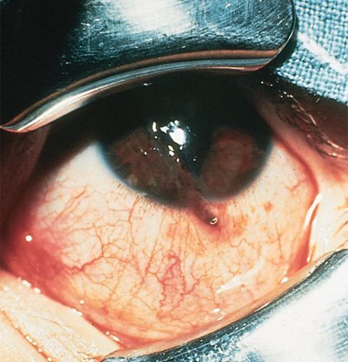
Blunt Eye Trauma 1
The initial evaluation
  Eyelids swell making it hard (eyelid speculum or retracter)
  If anterior chamber flat a globe rupture is certain
  Restricted upgaze or lateral gaze = blow-out fracture
  Slit lamp with fluorescein staining
  Measure intraocular pressure if no signs of ruptured globe
  Ultrasound if no ruptured globe
  Look for pupil irregularities
Notes:
The initial evaluation
Visual acuity
Anterior chamber assessment
Integrity of globe
Eyelids swell making it hard (eyelid speculum or retracter)
If anterior chamber flat a globe rupture is certain
Restricted upgaze or lateral gaze = blow-out fracture
Slit lamp with fluorescein staining
Measure intraocular pressure if no signs of ruptured globe
Ultrasound if no ruptured globe
Look for pupil irregularities

Slide 27
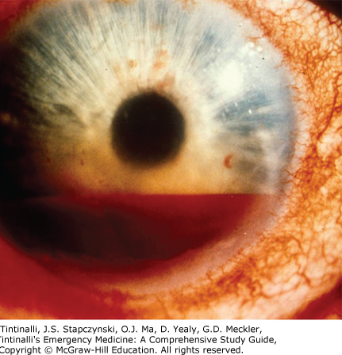
Blunt Eye Trauma 2: Hyphema
Blood or blood clots in the anterior chamber
Can be traumatic or spontaneous (think sickle cell disease patient)
If from trauma usually from a ruptured iris root vessel
Anticoagulation or bleeding problem?
Treatment: prevent re-bleeding and intraocular hypertension (talk to ophthalmologist or refer)
Notes:
Complications from hyphema include increased intraocular pressure, rebleeding, corneal staining, optic atrophy, can develop vision loss

Slide 28
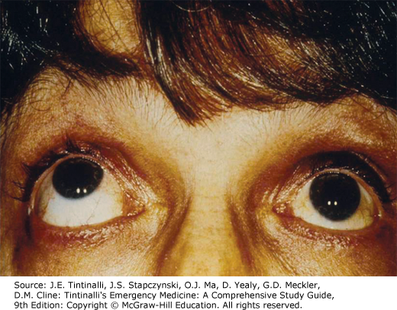
Blunt Eye Trauma 3: Orbital Blowout Fractures
Most frequent site is the inferior wall (maxillary sinus) and medial wall (ethmoid sinus throughout the lamina papyarcea)
Emesis, nausea, bradycardia and hypotension
CT scan, slit lamp, low threshold for transfer/referral
All blow-out fractures with normal initial eye examination in the ED should be referred to an ophthalmologist for dilated examination to rule out any unidentified retinal tears or detachments
Initiating Antibiotics is often recommended due to the presence of sinus wall fractures
Notes:
Most frequent site is the inferior wall (maxillary sinus) and medial wall (ethmoid sinus throughout the lamina papyarcea)
They may have emesis, nausea, bradycardia and hypotension from oculovagal reflex
CT scan, slit lamp, low threshold for transfer/referral
1/3 of blow out fractures are associated with ocular trauma
All blow-out fractures with normal initial eye examination in the ED should be referred to an ophthalmologist for dilated examination to rule out any unidentified retinal tears or detachments.
Initiating Antibiotics is often recommended due to the presence of sinus wall fractures

Slide 29
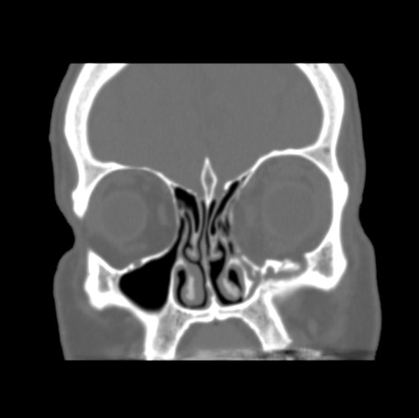
Blunt Eye Trauma 4: Orbital Blow-Out Fracture
CT study shows left orbital floor comminuted fracture results in a large bony defect with subsequent herniation of the intraorbital fat and inferior rectus muscle inferiorly into the left maxillary sinus.
Notes:
Orbital Fat Necrosis: Trauma to the orbital cavity (the bony socket of the eye) can damage the fat and connective tissue that surround the eye. If the fat tissue is deprived of oxygenated blood or becomes infected, necrosis can occur.

Slide 30
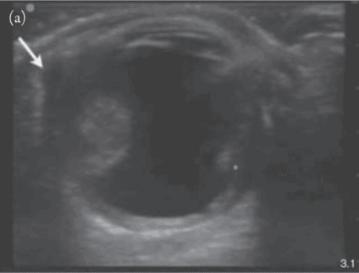
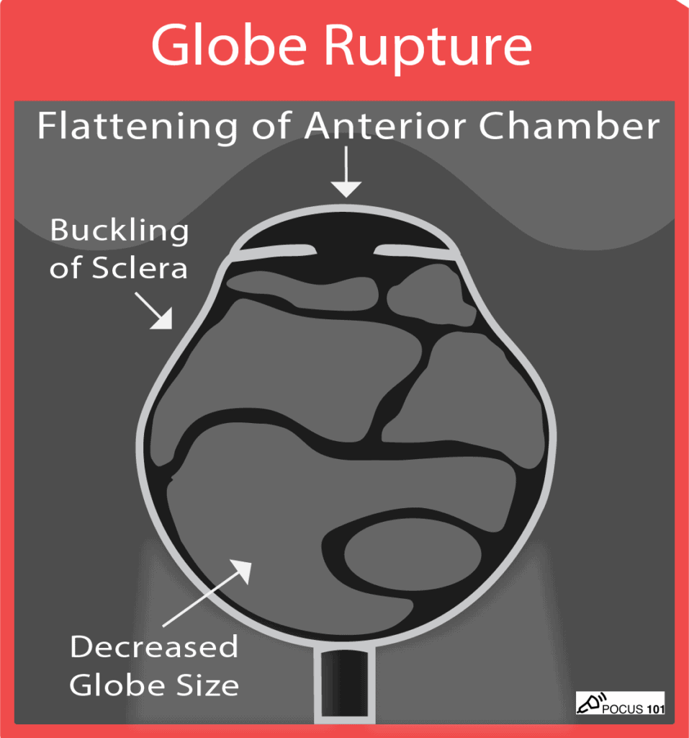
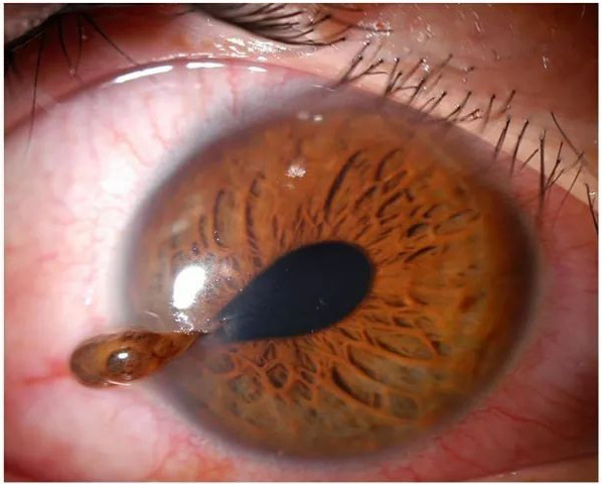
Blunt Eye Trauma 5: Ruptured Globe
  Cover the eye with a metal eye shield or make a shield from a paper cup
  Elevate the bed at 45 degrees
  Vanc and ceftaz
  Update tetanus
  Antiemetics to avoid vomiting
Notes:
Patient will present
With eye pain
But may not have decrease in visual acuity
Easily missed if a small penetrating object
Any projectile injury has the potential for penetrating the eye
cover the eye with a metal eye shield or make a shield from a paper cup
Elevate the bed at 45 degrees
Vanc and ceftaz
Update tetanus
Antiemetics to avoid vomiting

Slide 31
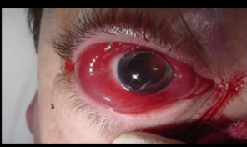
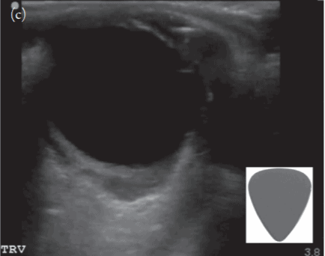
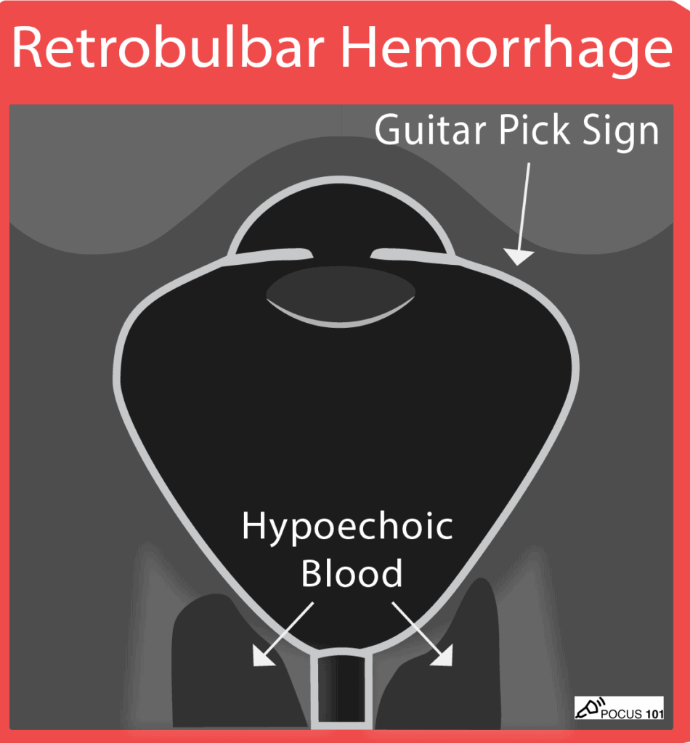
Retrobulbar Hematoma
Orbital compartment syndrome
Emergent consult to ophthalmology
Often diagnosed on CT scan
Patient will present
  Eye pain, Proptosis
  Impaired EOMs
  Decreased vision
  Pupillary defect
  Elevated IOP (>40 mm Hg = emergency lateral canthotomy)
Notes:
On ocular ultrasound, you may see a “Guitar Pick Sign” where the increased pressure from the retrobulbar hematoma distorts the spherical globe into a conical shape (Kilker et al).

Slide 32
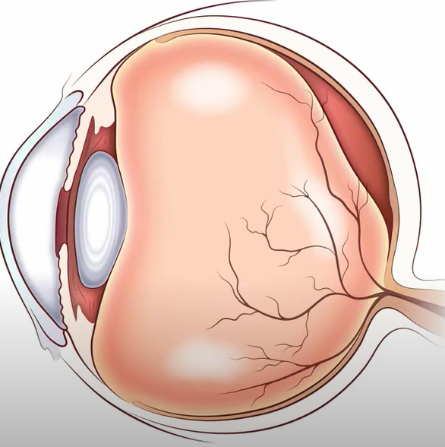
Posterior Vitreous Detachment 1

Slide 33
Posterior Vitreous Detachment 2
R/O Globe Rupture
Ultrasound (slide 44/45)
  Floaters

Slide 34
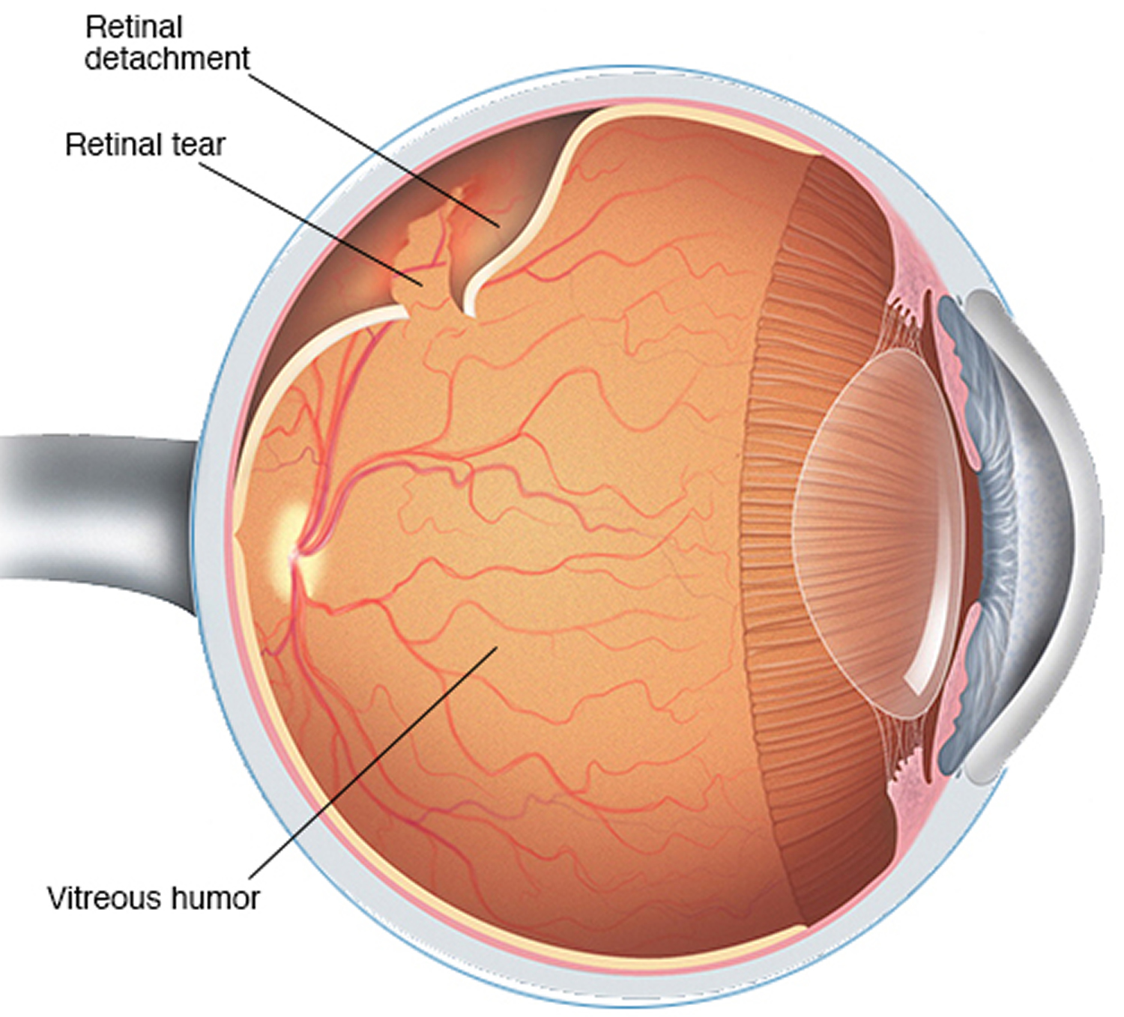
Retinal Detachment
PVD symptoms + visual deficits
Ultrasound (on slides 41/42)

Slide 35
Ocular POCUS
Patient positioning
Indications
Normal findings
Abnormal findings
Contraindications
Complications

Slide 36
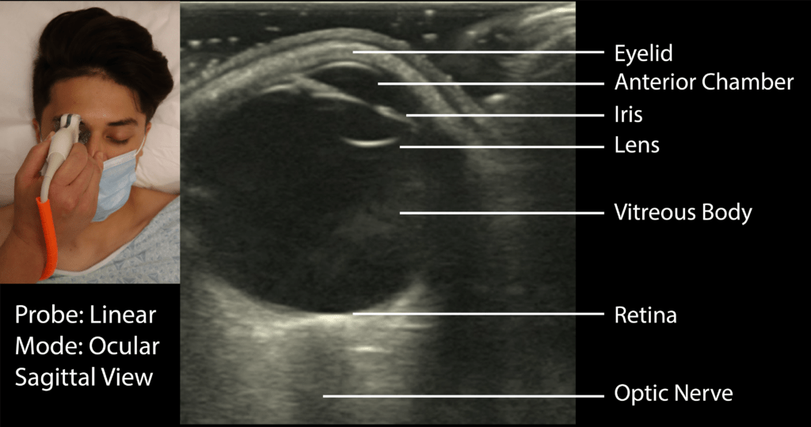
Ocular US: Patient Positioning/Set up
Notes:
High-frequency linear array
It is important to select the “ophthalmic exam setting” or confirm and then adjust the energy output levels of your ultrasound system that are approved for ocular ultrasound.
With the patient lying supine, place a liberal amount of gel on top of the patient’s closed eyelid. The orientation marker should be directed toward the patient’s right for transverse images and cephalad for sagittal images.
The probe should exert little to no pressure on the patient’s eye. This is accomplished by stabilizing your fingers on the bridge of the nose (when imaging the right eye) or the zygomatic arch (for the left eye)

Slide 37
Ocular US: Indications
Vision loss
Ocular Trauma
Eye Pain

Slide 38
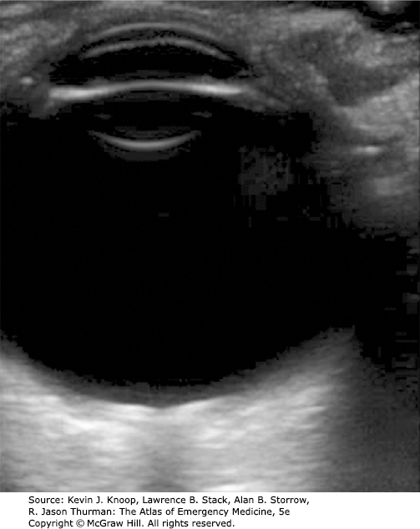
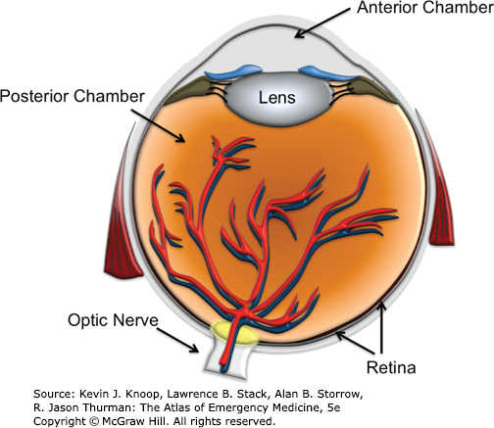
Ocular US: Normal Findings 1
Notes:
Transverse and Sagittal Views
With the indicator pointing toward the patient’s right, identify the anterior chamber, lens, posterior chamber, retina, optic nerve, and retrobulbar space (Fig. 24.125).
The probe should be fanned back and forth to ensure that the entire retina is visualized.
The overall gain should be increased to assess for evidence of hemorrhage or vitreous detachment in the posterior chamber.
If assessing for elevated intracranial pressure, the optic nerve sheath diameter (ONSD) should be measured 3 mm from the retina (Fig. 24.126). If measuring the ONSD, it is essential to ensure that the plane of the ultrasound beam is not tangential to the optic nerve.
The eye should be imaged in both the sagittal and transverse planes to increase the accuracy of detecting pathology, particularly retinal detachment.

Slide 39
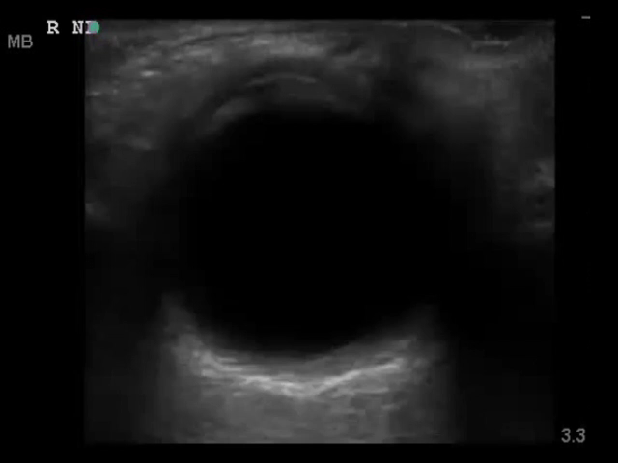
Ocular US: Normal Findings 2

Slide 40
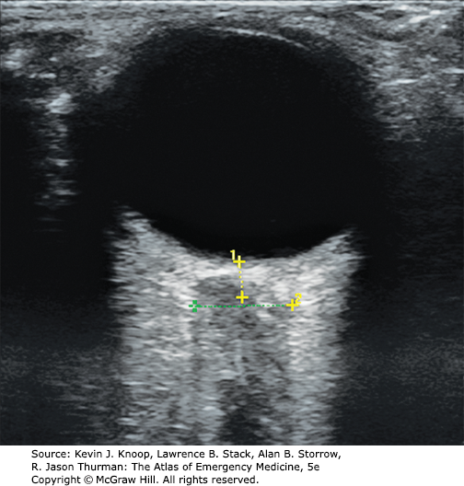
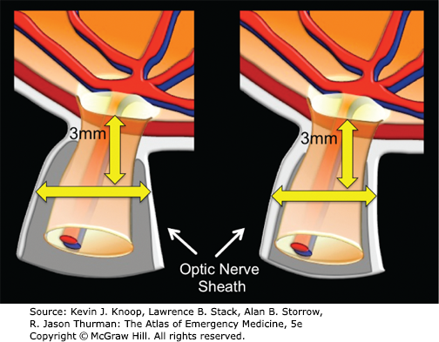
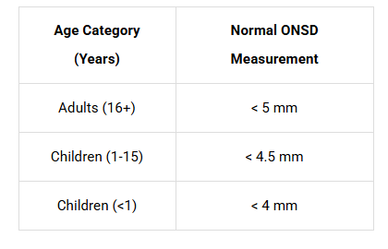
Ocular US: Measuring Optic Nerve Sheath
Notes:
Ocular Ultrasound. The ONSD is measured 3 mm from the retina. The diagram shows representations of a dilated ONSD (left) next to a normal one (right). (Ultrasound contributor Robinson M. Ferre, MD; illustration contributor: Robinson M. Ferre, MD.)

Slide 41
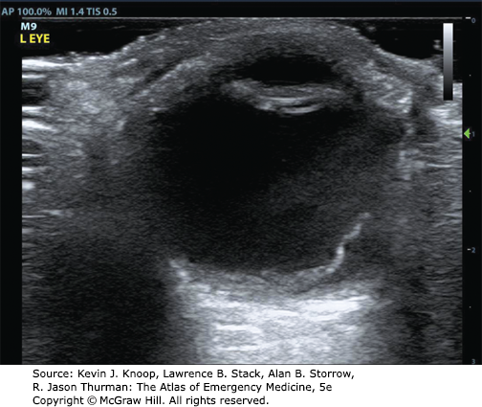
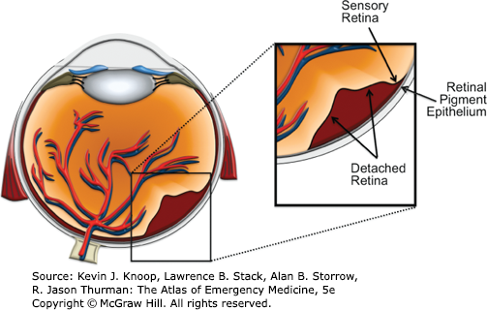
Ocular US: Retinal Detachment 1
Notes:
Retinal detachment: A retinal detachment is the separation of the neurosensory retina from the retinal pigment epithelium. The neurosensory retina is a dense neurovascular structure that is highly reflective of ultrasound and will appear as a bright echogenic line on top of the remaining choroid and retinal pigment epithelium (Fig. 24.127). An acute retinal detachment will appear to “wave” if the patient is asked to move their eyes side to side. An older retinal detachment is more rigid and will often lack this mobility.

Slide 42

Ocular US: Retinal Detachment 2

Slide 43
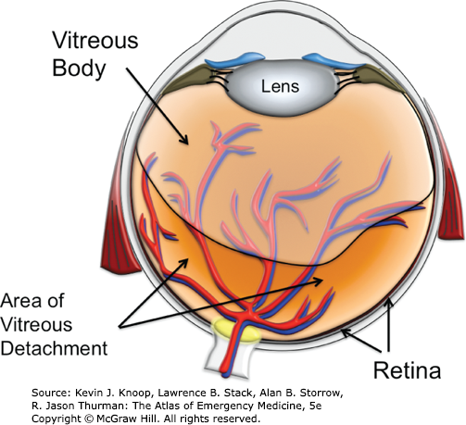
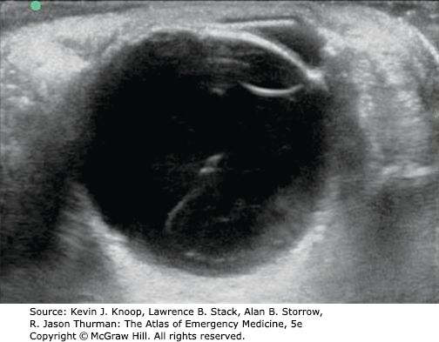
Ocular US: Vitreous Detachment 1
Notes:
Vitreous detachment: The normally anechoic vitreous will demonstrate various echoes that are usually only seen with increasing the gain. These small, filament-like threads of the detached vitreous body will “swirl” around with eye movements (Fig. 24.128).

Slide 44
Ocular US: Vitreous Detachment 2
Notes:
Vitreous detachment: The normally anechoic vitreous will demonstrate various echoes that are usually only seen with increasing the gain. These small, filament-like threads of the detached vitreous body will “swirl” around with eye movements (Fig. 24.128).

Slide 45
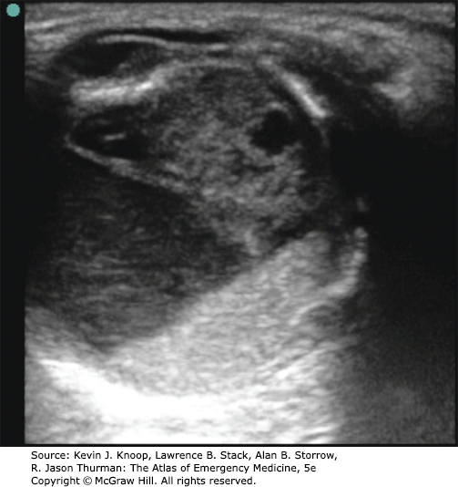
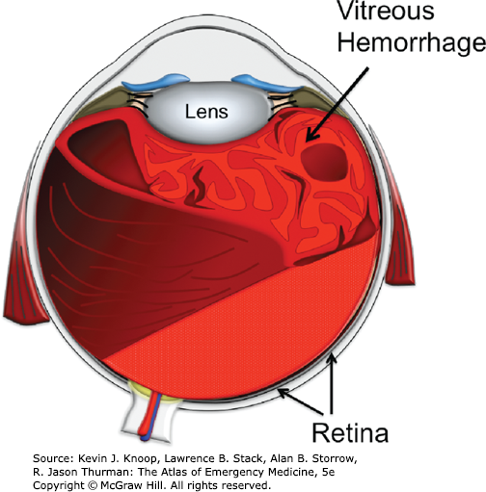
Ocular US: Vitreous Hemorrhage
Notes:
Vitreous hemorrhage: Hyperechoic areas in the vitreous or anterior chamber may represent hemorrhage. It is usually necessary to increase the gain to see posterior vitreous hemorrhage (Fig. 24.129).

Slide 46
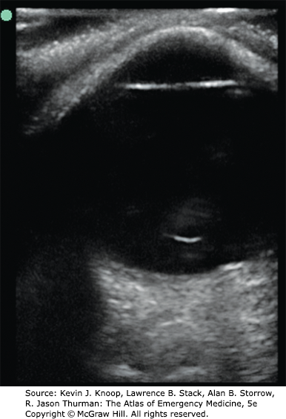
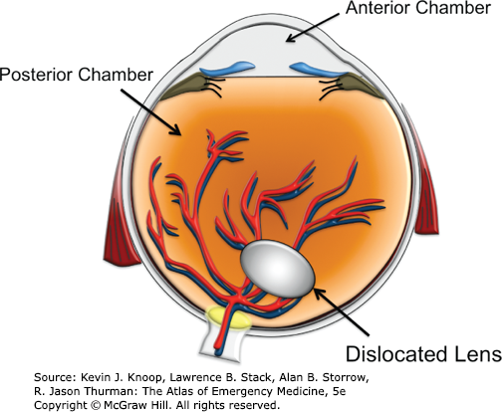
Ocular US: Lens Dislocation 1
Notes:
Dislocated lens: The lens is normally positioned in a central location, immediately under the iris. The anterior convex portion of the normal lens is not seen with ultrasound, but the posterior concave portion is easily seen. A dislocated lens will be absent from its normal position, and a diligent search will reveal its location somewhere in the posterior chamber (Fig. 24.130). A lens subluxation is much more subtle and is visualized as instability of the lens with eye movement.

Slide 47
Ocular US: Lens Dislocation 2

Slide 48
Ocular US: Contraindications
Traditionally, suspected globe ruptures have been a relative contraindication for sonographic evaluation.
Notes:
Point-of-care ocular ultrasound (US) is a valuable tool for the evaluation of traumatic ocular injuries. Conventionally, any maneuver that may increase intraocular pressure (IOP) is relatively contraindicated in the setting of globe rupture. Some authors have cautioned against the use of US in these scenarios because of a theoretical concern that an US examination may cause or exacerbate the extrusion of intraocular contents. This study set out to investigate whether ocular US affects IOP. The secondary objective was to validate the intraocular pressure measurements obtained with the Diaton® as compared with standard applanation techniques (the Tono-Pen®).

Slide 49
Ocular US: Complications
Corneal or eyelid injury
Infection
Discomfort
Inaccurate Results
Misinterpretation
Worsening of ruptured globe
Retinal detachment if too much pressure

Slide 50
Sources
Alotaibi AG, Osman EA, Allam KH, et al: One-month outcome of ocular related emergencies in a tertiary hospital in Central Saudi Arabia. Saudi Med J 32: 1256, 2011. [PubMed: 22159380]
Duncan JL, Parikh NB, Seitzman GD. Ocular Trauma. In: Papadakis MA, Rabow MW, McQuaid KR, Gandhi M. eds. Current Medical Diagnosis & Treatment 2025. McGraw-Hill Education; 2025. Accessed September 10, 2024. https://accessmedicine.mhmedical.com/content.aspx?bookid=3495&sectionid=288476416
Walker RA, Adhikari S. Eye Emergencies. In: Tintinalli JE, Ma O, Yealy DM, Meckler GD, Stapczynski J, Cline DM, Thomas SH. eds. Tintinalli's Emergency Medicine: A Comprehensive Study Guide, 9e. McGraw-Hill Education; 2020. Accessed September 11, 2024. https://accessmedicine.mhmedical.com/content.aspx?bookid=2353&sectionid=222404436
Ocular Ultrasound. In: Baston CM, Moore C, Krebs EA, Dean AJ, Panebianco N. eds. Pocket Guide to POCUS: Point-of-Care Tips for Point-of-Care Ultrasound. McGraw-Hill Education; 2018. Accessed February 25, 2025. https://accessmedicine.mhmedical.com/content.aspx?bookid=2544&sectionid=210344762
Saber M, Inferior orbital blowout fracture. Case study, Radiopaedia.org (Accessed on 11 Sep 2024) https://doi.org/10.53347/rID-86019
POCUS 101

