Slide 1

Hidradenitis Suppurativa
Joshua Winters, MPA, PA-C
April 9th, 2021

Slide 2
Objectives
Definition
Risk Factors/Epidemiology
Pathophysiology
Clinical Manifestations
Labs
Differential Diagnosis
Evidence-based Treatment Guidelines

Slide 3
Hidradenitis Suppurativa (HS) or Acne Inversa
A chronic inflammatory, suppurative, and scarring skin condition affecting apocrine gland bearing skin.
Axillae, anogenital region, submammary region, and skin folds
Notes:
A chronic inflammatory/scarring skin condition affecting apocrine-gland bearing skin

Slide 4
Pathophysiology/Epidemiology
Exact pathophysiology of HS is unknown
Triggered by genetic and environmental factors
Affects women greater than men
Affects all races
Notes:
(Wolff et al., 2017)

Slide 5
Pathophysiology
Genetic Risk Factors
30-40% of HS patients report a family history of nodulocystic acne or HS
Familial studies have shown links to mutations in subunits of the gamma-secretase proteins
Mother to daughter transmission has been observed
Environmental Risk Factors
Cigarette smoking, mechanical friction, obesity/overweight
Notes:
(Wolff et al., 2017)

Slide 6
Pathophysiology
Occlusion of the hair follicle
Innate and adaptive immune dysregulation
Bacterial infection and colonization
Notes:
Big picture
*bacteria is not the primary cause, but does contribute to the disease process

Slide 7
Pathophysiology
Occlusion of the hair follicle
Dilation and rupture, which allows contents like bacteria and keratin to leak into the dermis
Strong inflammatory response from neutrophils and lymphocytes
Inflammatory debris causes abscess formation and leads to destruction of the pilosebaceous unit and other adjacent structures
“Other factors that may contribute to HS include altered expression of antimicrobial peptides, abnormal secretion of apocrine glands, abnormal invaginations of the epidermis leading to sinus tract formation, and deficient numbers of sebaceous glands” (Napolitano et al., 2017).
Notes:
It starts with occlusion of the hair follicle, followed by dilation & rupture, which causes many contents like keratin and bacteria to leak into the dermis causing a brisk inflammatory response by neutrophils and lymphocytes. This leads to abscess formation and destruction of the pilosebaceous unit. Leading to lots of dermal inflammation (deep)

Slide 8
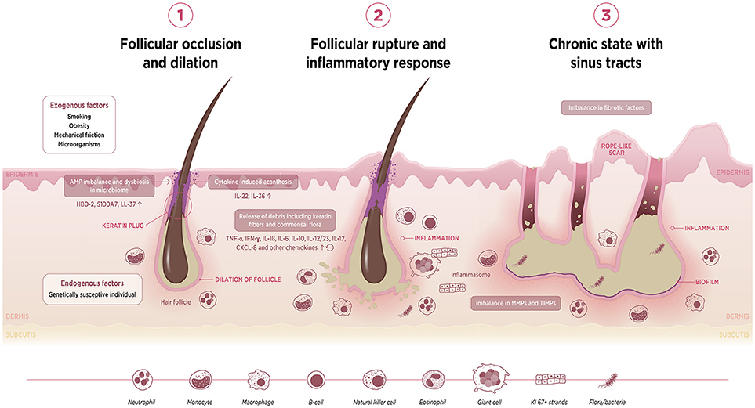
Photo from: https://www.frontiersin.org/files/Articles/427601/fimmu-09-02965-HTML/image_m/fimmu-09-02965-g002.jpg

Slide 9
Pathophysiology
Follicular occlusion has an auto-inflammatory disease component characterized by dysregulation of the gamma-secretase/Notch pathway
Important point: appropriate notch signaling is key for keratin clearance and without it, the hair follicle gets converted to epidermal cysts, the apocrine glands do not function properly, and the immune system gets activated leading to chronic inflammation
Overall, HS is a disease of the hair follicle, keratin clearance disruption, immune system dysfunction, and bacteria.
Notes:
The propensity for follicular occlusion is thought have an auto-immune component to it characterized by an issue with the gamma-secretase notch pathway. This pathway, like many, gets very descript and contains many cytokines, interleukins, and TNF-A
The exact process of follicular occlusion in HS is not fully understood, but Melnik and Plewig (2013) proposed that HS has an auto-inflammatory disease component characterized by dysregulation of the gamma-secretase/Notch pathway

Slide 10
Follicular Occlusion Tetrad
Follicular Occlusion Tetrad
Hidradenitis Suppurativa
Acne Conglobata
Dissecting Cellulitis of the Scalp
Pilonidal Sinus
Symptom complex of four diseases sharing similar pathophysiology
Notes:
(Vasanth & Chandrashekar, 2014)
Not a common topic cited in literature, however, there is evidence to show similar disease processes among these 4 conditions

Slide 11
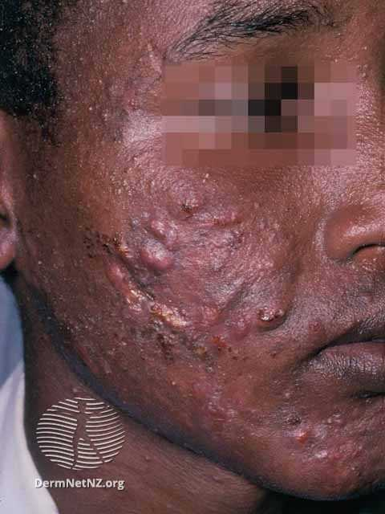
Acne Conglobata
Severe nodulocystic acne
Can result in hypertrophic, atrophic, or keloidal scars
Photo from: https://dermnetnz.org/topics/nodulocystic-acne

Slide 12
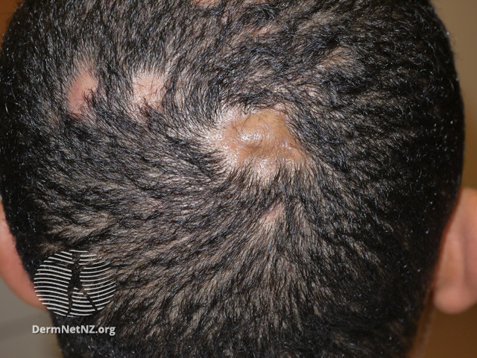
Dissecting Cellulitis of the Scalp
A type of scarring alopecia characterized by perifollicular & follicular pustules and nodules
Most commonly in men of African descent
Photo from: https://dermnetnz.org/topics/perifolliculitis-capitis-abscedens-et-suffodiens
Notes:
Also known as perifolliculitis capitis abscedens et suffodiens or Hoffman disease

Slide 13
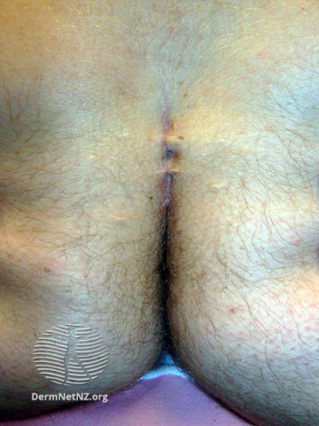
Pilonidal Sinus
Sinus tracts found in the sacrococcygeal region
Narrow cavities filled with nests of hair
“Pilus” = hair & “nidal” = nest
Can lead to a pilonidal cyst or if infected, pilonidal abscess
Photo from: https://dermnetnz.org/topics/pilonidal-disease

Slide 14
Questions?

Slide 15
Comorbidities & Disease Burden of HS
Obesity
Metabolic Syndrome
Inflammatory Bowel Disease: Ulcerative Colitis & Crohn’s
Depression
Cigarette smoking addiction
Notes:
There is a statistically significant association between IBD (UC & Crohn’s) and HS. Therefore, all patients with HS should be screened for signs and symptoms of IBD (Phan et al., 2019).
Both diseases share common pathological factors and clinical manifestations like genetic susceptibility, dysregulated inflammatory response, and altered microbiota. They also both include sterile abscesses in the perineal and inguinal areas, scarring, and sinus tract formation.
Smoking and obesity are known common risk factors for HS and IBD
They both respond well to TNF-A inhibitors.

Slide 16
Clinical Manifestations
HS typically presents in the second or third decades
A helpful diagnostic feature is the chronicity of HS
Often misdiagnosed as other similar presenting diagnoses
Notes:
HS typically manifests after puberty in the second and third decades of life
Patients will often report a longstanding history of recurrent abscesses with multiple visits to urgent care or PCP for I&Ds and antibiotic prescriptions
These patients look miserable and will often report quality of life issues as this significantly interferes with daily activities
Misdiagnosis is common and that is why particular aspects of HS are important to know and identify

Slide 17
Clinical Manifestations
Tender subcutaneous nodules often referred to as abscesses, boils, or pimples
Intermittent pain with marked point tenderness related to abscess
Most commonly located in the axillae, anogenital regions, submammary folds
Classic sign of HS: “double-comedo”
Up to 50% of patients report a burning sensation, pain, pruitus, or warmth 12-24 hours prior to a nodule appearing (Napolitano et al., 2017).
Notes:
Tender subcutaneous nodules referred to as abscesses, boils, pimples – patients will mostly say “painful bump.”
Classic sign of HS: double comedo a blackhead (dilated comedone) with two or more openings that communicate under the skin

Slide 18
Clinical Manifestations
Dermal inflammation & painful abscesses
+/- purulent discharge
Sinus tracts
Bands of scar tissue “bridge scars” & fibrosis
Hypertrophic, keloidal scars, and/or contractures
Notes:
After nodules are present, deep dermal inflammation leads to rupture and formation of additional painful abscesses *and remember pts will present at different stages of this process
Some may have purulent discharge (which you would want to culture)
Within the sinus tracts, foreign material and bacteria become trapped, permanently altering the dermis
These are all things to look for on physical exam
Palpation is important to try to distinguish acute, tender abscesses, from sinus tracts and scarring (you wouldn’t want to go and do an I&D on scar tissue)

Slide 19
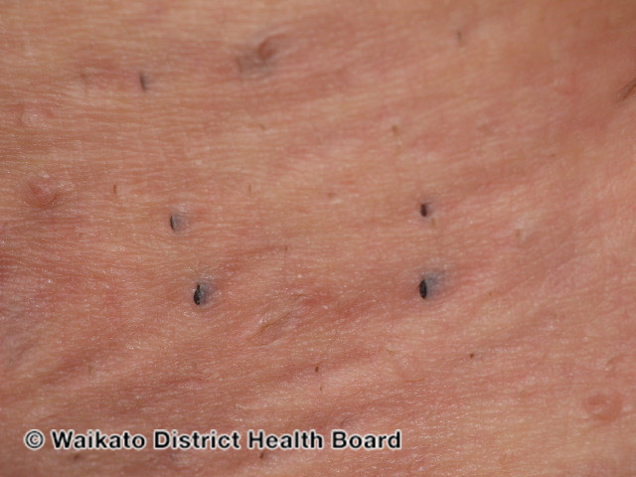
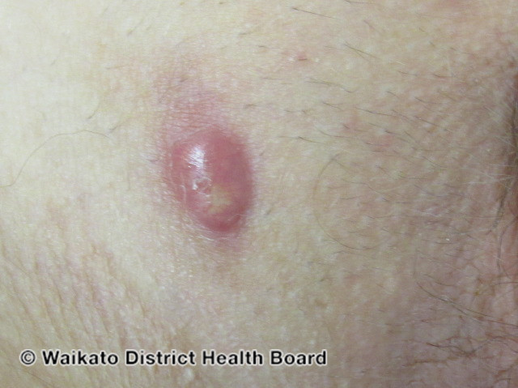
Comedones in HS
Typical Lesion for HS
Photos from: https://dermnetnz.org/topics/hidradenitis-suppurativa

Slide 20
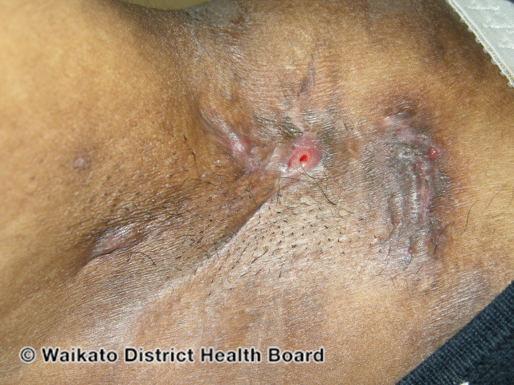
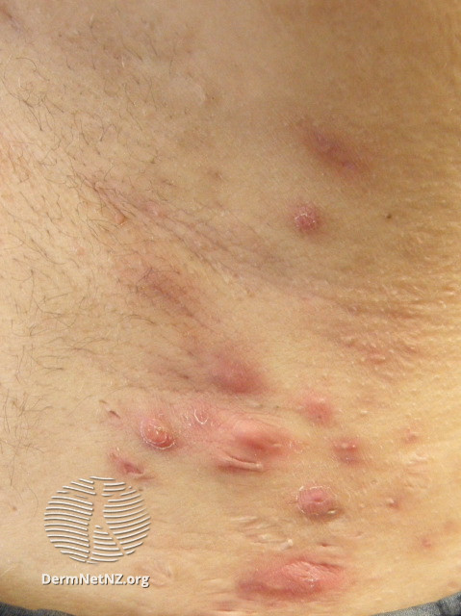
HS of the Axilla
Photos from: https://dermnetnz.org/topics/hidradenitis-suppurativa

Slide 21
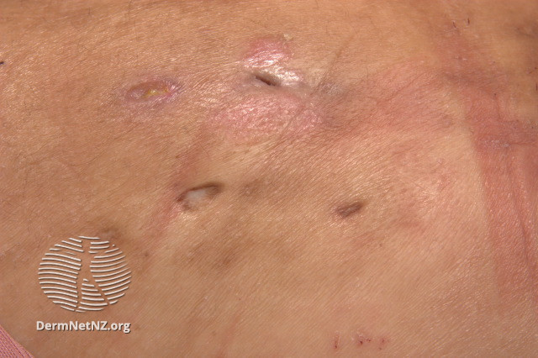
Scarring and Adhesions
Photo from: https://dermnetnz.org/topics/hidradenitis-suppurativa

Slide 22
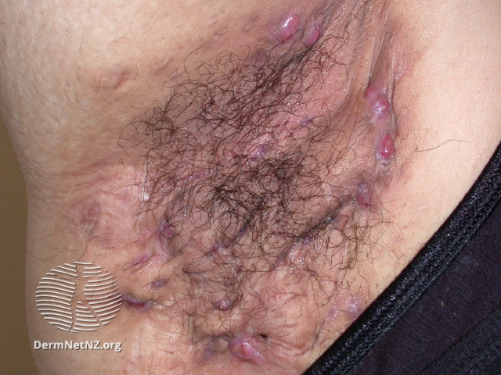
Scarring Folliculitis in HS
Photo from: https://dermnetnz.org/topics/hidradenitis-suppurativa
Notes:
One phenotype of HS

Slide 23
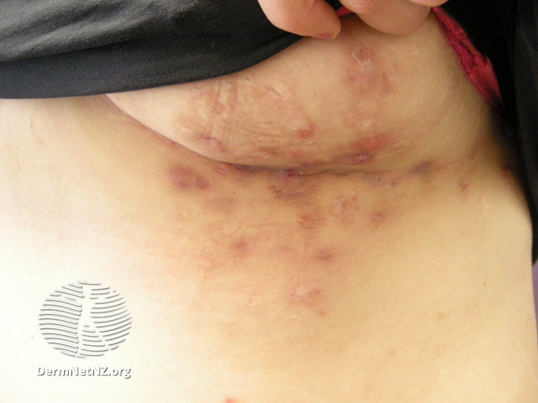
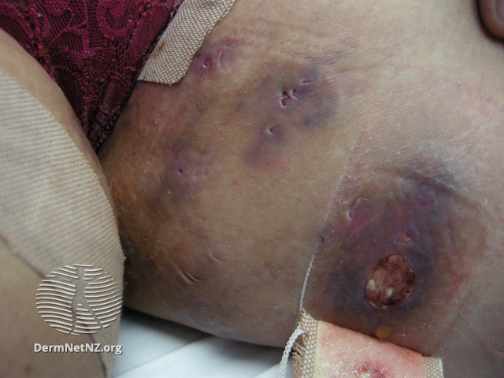
Photos from: https://dermnetnz.org/topics/hidradenitis-suppurativa-images

Slide 24
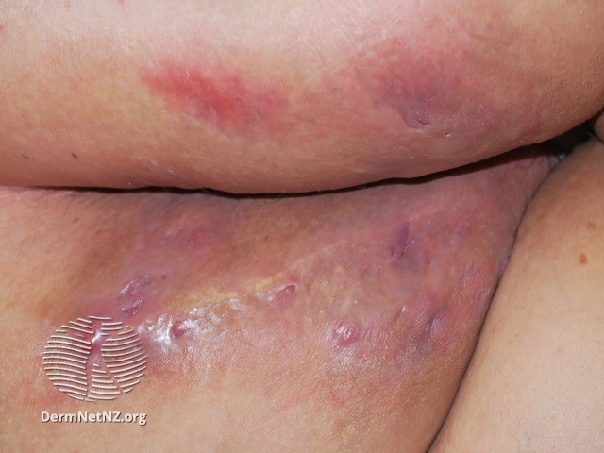
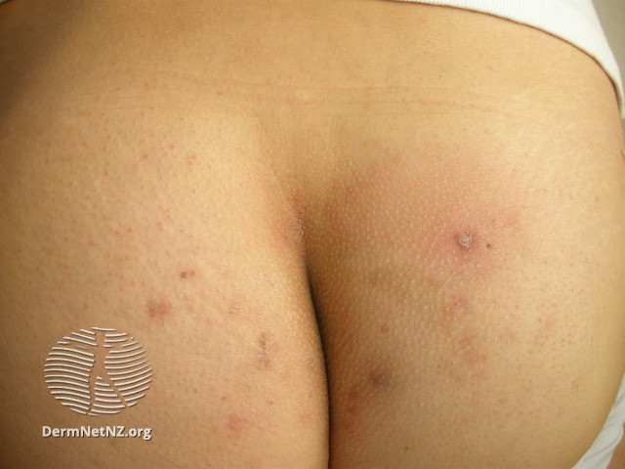
Photos from: https://dermnetnz.org/topics/hidradenitis-suppurativa-images

Slide 25
Hurley Staging
Stage I
Abscess formation, single or multiple without sinus tracts and cicatrization (scarring)
Stage II
Recurrent abscesses with tract formation and cicatrization, single or multiple widely separated lesions
Stage III
Diffuse or near diffuse involvement, or multiple interconnecting tracts and abscesses across an entire area

Slide 26
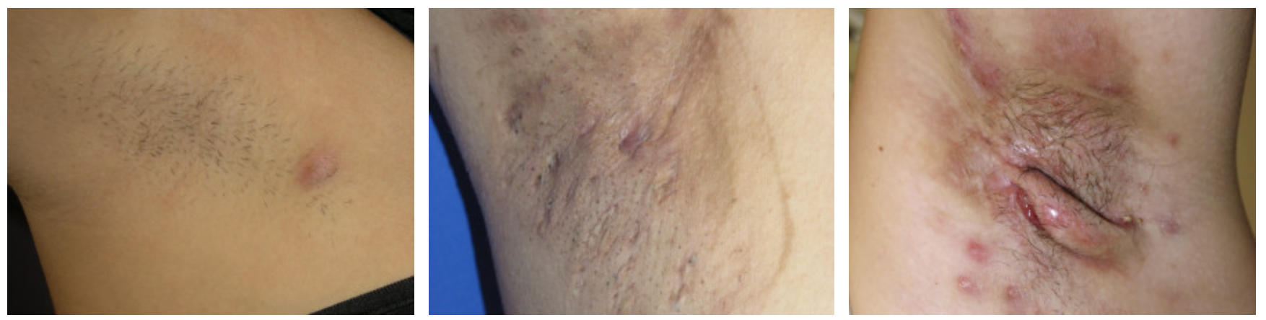
HS of the Axilla
Hurley Stage I
Hurley Stage II
Hurley Stage III
Photo from: https://dermnetnz.org/topics/hidradenitis-suppurativa

Slide 27
Labs
Bacteriology: different pathogens often secondarily colonize lesions:
S. aureus, Streptococci, E. coli, Proteus mirabilis, and Pseudomonas aeruginosa
Dermatopathology: keratin occlusion of hair follicle, ductal/tubular dilation, inflammatory changes limited to follicular apparatus, destruction of apocrine/eccrine/pilosebaceous apparatus, fibrosis, pseudoepitheliomatous hyperplasia in sinuses
Notes:
(Wolff et al., 2017)
Mainly a clinical diagnosis but these are things to consider

Slide 28
Differential diagnosis
Simple abscess
Carbunculosis or Furunculosis
Inflamed epidermal inclusion cyst
Lymphadenitis
Pilonidal cyst
Bartholin’s cyst
Crohn’s disease
Anal or vulvovaginal fistula
STI: Lymphogranuloma Venereum, granuloma inguinale (klebsiella), noduloulcerative syphilis
Cat-scratch disease
Deep fungi: blastomycosis
Mycobacteria – tuberculosis abscess or Scrofuloderma (cutaneous TB)

Slide 29
Psycho-social Considerations
Patients are often very depressed due to pain, soiling of clothing by drainage, odor, and sensitive sites of occurrence (anogenital region)
Great effort is needed to treat the disease using every tool in our toolboxes
Notes:
Story about a patient I saw with gauze in her axillae

Slide 30
Treatment
Notes:
Many different approaches. Mostly depends on the severity of the disease, how long it’s been going on, and patient compliance/willingness

Slide 31
Treatment
Topical Tretinoin 0.05% (topical retinoid)
  May prevent occlusion, but is irritating, only use as tolerated
Topical clindamycin 1%: for superficial lesions like papules, pustules, and folliculitis
Intralesional injection of triamcinolone acetonide (2.5-10 mg/mL)
Incision and drainage: actively draining lesions should be cultured
Unroofing simple procedure
Notes:
Unroofing
-debridement, probing for sinus extensions, +/- electrodessication, then cover with mupirocin and bandage

Slide 32
Treatment
Doxycycline (100mg BID)
Minocycline (100mg BID)
Clindamycin (300mg BID) + Rifampin (300mg BID)
Notes:
Doxycycline (100mg BID) & Minocycline (100mg BID) have shown benefit for prevention of new lesions. Higher doses for active disease and lower doses may prevent a flare (H. & Habif, 2021)
Clindamycin (300mg BID) + Rifampin (300mg BID): 10-week course resulted in remissions for 1-4 years (H. & Habif, 2021).
-Diarrhea was the most common adverse effect

Slide 33
Treatment
Rifampicin–moxifloxacin–metronidazole regimen
  Complete remission in 57.1% of patients with longstanding refractory HS (Napolitano et al., 2017)
Isotretinoin (1 mg/kg/day for 20 weeks)
  Variable and unpredicted response
  Better for earlier on in disease process to prevent follicular plugging
Hormonal
  Decreasing pilosebaceous unit stimulation by dairy hormones and high glycemic loads
  Metformin and Finasteride
Biologics
  Remicade (Infliximab) and Humira (Adalimumab)
Notes:
Rifampicin–moxifloxacin–metronidazole
Rifampicin 10 mg/kg once daily, moxifloxacin 400 mg daily, and metronidazole 500 mg t.i.d. for 6 weeks followed by rifampicin–moxifloxacin
-57.1% long-lasting refractory HS achieving complete remission and 87.5% with Hurley stage I or II disease achieving complete remission
Isotretinoin
-monotherapy for 4-6 months showed 23% completely cleared and 16% maintained clearance
-treatment more successful in milder forms of HS

Slide 34
Treatment
Humira (Adalimumab)
  First FDA-approved biologic treatment for patients ages 12+ with moderate to severe HS
  Starting Humira earlier correlates to more efficient clinical response rates and improved quality of life (Marzano et al., 2020).
  Fully Human IgG1 monoclonal antibody that binds to & neutralizes TNF-α,
  Two phase 3 trials showing higher clinical response rates in treatment group vs. placebo: 41.8% vs. 26% -PIONEER I (p=0.003) & 58.9% vs. 27.7% -PIONEER II (p<0.001) (as cited in Napolitano et al., 2017).
Notes:
Retrospective cohort study examined the ‘window of opportunity’ for starting humira

Slide 35
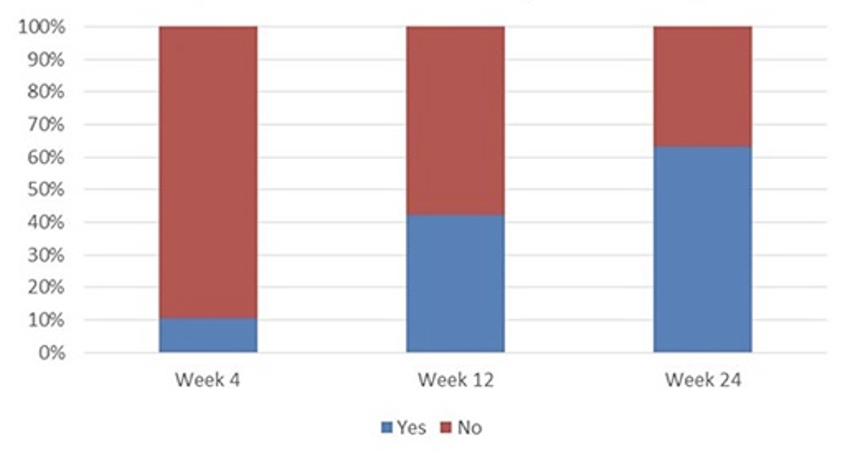
Clinical response rates to adalimumab
63% of patients achieved clinical response by week 24
Graph from: (Kyriakou et al., 2018)

Slide 36
Humira (Adalimumab)
Treatment
Warnings and precautions:
Serious infections (TB, Hepatitis, invasive fungal)
Malignancies
Cytopenias
Worsening heart failure
Most common adverse effects (> 10%):
Upper respiratory infections and sinusitis
Injection site reaction
Headaches
Rash
Notes:
2 injections day 1, then 1 day 15, then weekly or every other week
Adults: Day 1: 160 mg (given in one day or split over two consecutive days)
Day 15: 80 mg, Day 29 and subsequent doses: 40 mg every week or 80 mg every other week
Adolescents 12 years of age and older:
Adolescent Weight Recommended Dosage 30 – 60 kg
Day 1: 80 mg, Day 8 and subsequent doses: 40 mg every other week
60 kg (132 lbs) and greater: Day 1: 160 mg (given in one day or split over two consecutive days), Day 15: 80 mg, Day 29 and subsequent doses: 40 mg every week or 80 mg every other week

Slide 37
Treatment
Electrosurgery
Surgery
  Excision & primary closure for Hurley stage I
  -or-
  Wide local excision of all hair-bearing areas with split-thickness skin grafting or a fasciocutaneous flap for patients with Hurley stage II or III
Notes:
Electrosurgery
-excise areas with nodules and sinuses to the level of the subcutaneous fat tissue and leave area for secondary intention if HS is localized.
Skin-tissue sparing excision with electrosurgical peeling (STEEP). The procedure is performed under general anesthesia; electrosurgery is used to remove all lesional tissue, leaving epithelialized sinus floors and subcutaneous fat intact when possible. Wounds are left to heal by secondary intention.
Surgery
-at times the only solution due to high recurrence rates because indolent sinus tracts are often the cause of chronic inflammation.
No recurrences, no serious complications, and no revision operations when patients are treated aggressively by radical excision of all hair-bearing areas and reconstructed with a graft or flap.

Slide 38
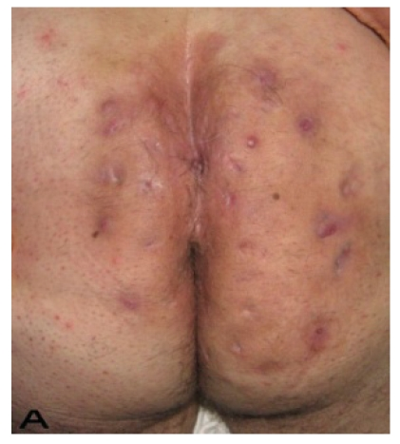
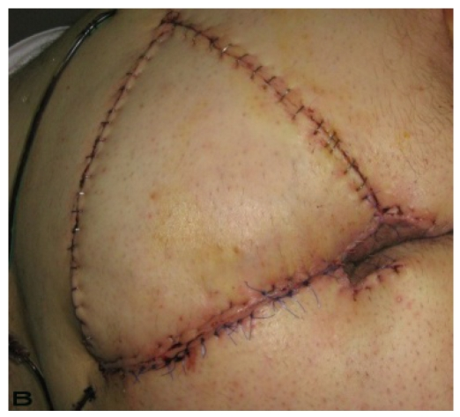
A 58-year-old male patient with severe hidradenitis suppurativa of the gluteal and perianal area. (A) Preoperative view with fistulas in intergluteal area.(B) After excision of the inflammatory region and closed with V-Y advancement fasciacutaneous flap (Menderes et al., 2010).
Photos from: https://www.ncbi.nlm.nih.gov/pmc/articles/PMC2920468/ (Menderes et al., 2010)

Slide 39
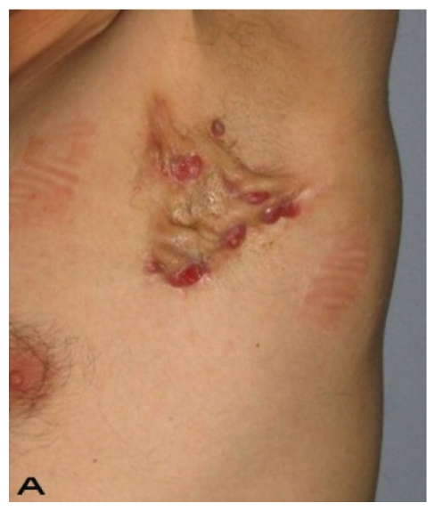
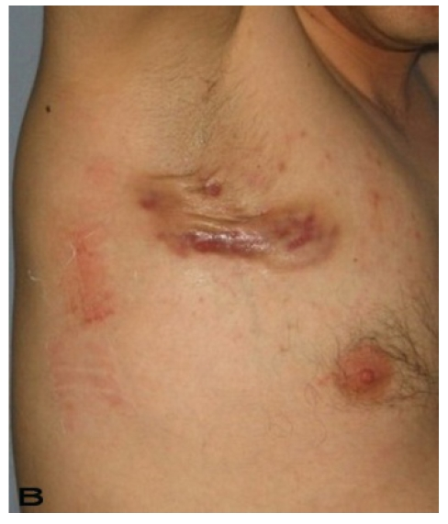
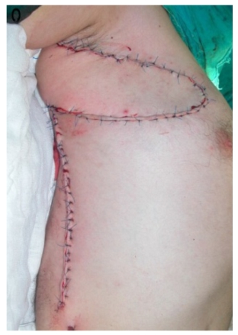
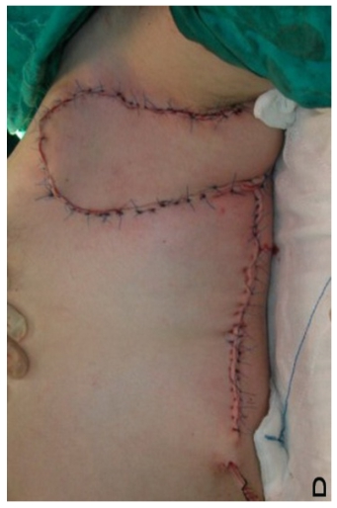
A 24-year-old male. (A,B) Preoperative view of axillary region. (C,D) The axillary defect is covered with thoracodorsal perforator based fasciocutaneous flaps. (Intraoperative view) (Menderes et al., 2010).
Photos from: https://www.ncbi.nlm.nih.gov/pmc/articles/PMC2920468 (Menderes et al., 2010)

Slide 40
Questions?

Slide 41
References
Chen W, Chi C. Association of Hidradenitis Suppurativa With Inflammatory Bowel Disease: A Systematic
Review and Meta-analysis. JAMA Dermatol. 2019;155(9):1022–1027. doi:10.1001/jamadermatol.2019.0891
Hidradenitis Suppurativa. DermNet. (n.d.). Retrieved January 8, 2022, from https://dermnetnz.org/topics/hidradenitis-suppurativa
Hidradenitis suppurativa images. Hidradenitis suppurativa images | DermNet NZ. (n.d.). Retrieved January 8, 2022, from https://dermnetnz.org/topics/hidradenitis-suppurativa-images
H., D. J. G., & Habif, T. P. (2021). Habif's clinical dermatology: A color guide to diagnosis and therapy (7th ed.). Elsevier.
Kyriakou, A., Trigoni, A., Galanis, N., Sotiriadis, D., & Patsatsi, A. (2018, October 1). Efficacy of adalimumab in moderate to severe hidradenitis suppurativa: Real life data. Dermatology reports. Retrieved January 8, 2022, from https://www.ncbi.nlm.nih.gov/pmc/articles/PMC6187007/
Martin, M. D., & Badovinac, V. P. (1AD, January 1). Defining memory CD8 T cell. Frontiers. Retrieved January 17, 2022, from https://www.frontiersin.org/articles/10.3389/fimmu.2018.02692/full
Marzano, A. V., Genovese, G., Casazza, G., Moltrasio, C., Dapavo, P., Micali, G., Sirna, R., Gisondi, P., Patrizi, A., Dini, V., Bianchini, D., Bianchi, L., Fania, L., Prignano, F., Offidani, A., Atzori, L., Bettoli, V., Cannavò, S. P., Venturini, M., … Peris, K. (2020, April 13). Evidence for a 'window of opportunity' in Hidradenitis Suppurativa treated with adalimumab: A retrospective, real‐life multicentre cohort study*. Wiley Online Library. Retrieved January 7, 2022, from https://onlinelibrary.wiley.com/doi/abs/10.1111/bjd.18983
Menderes, A., Sunay, O., Vayvada, H., & Yilmaz, M. (2010, July 19). Surgical management of hidradenitis suppurativa. International journal of medical sciences. Retrieved January 8, 2022, from https://www.ncbi.nlm.nih.gov/pmc/articles/PMC2920468/
Napolitano, M., Megna, M., Timoshchuk, E. A., Patruno, C., Balato, N., Fabbrocini, G., & Monfrecola, G. (2017, April 19). Hidradenitis suppurativa: From pathogenesis to diagnosis and treatment. Clinical, cosmetic and investigational dermatology. Retrieved December 29, 2021, from https://www.ncbi.nlm.nih.gov/pmc/articles/PMC5402905/#b5-ccid-10-105
Phan, K., Tatian, A., Woods, J., Cains, G., & Frew, J. W. (2019, October 20). Prevalence of inflammatory bowel disease (IBD) in Hidradenitis Suppurativa (HS): Systematic Review and adjusted meta‐analysis. Wiley Online Library. Retrieved January 11, 2022, from https://onlinelibrary.wiley.com/doi/10.1111/ijd.14697
Pilonidal disease. Pilonidal disease | DermNet NZ. (n.d.). Retrieved February 26, 2022, from https://dermnetnz.org/topics/pilonidal-disease
Vasanth, V., & Chandrashekar, B. S. (2014, October). Follicular occlusion tetrad. Indian dermatology online journal. Retrieved February 26, 2022, from https://www.ncbi.nlm.nih.gov/pmc/articles/PMC4228650/
Wolff, K., Fitzpatrick, Johnson, R. A., Roh, E., & Saavedra, A. P. (2017). Fitzpatrick's Color Atlas and synopsis of clinical dermatology. McGraw-Hill Education

