Slide 1
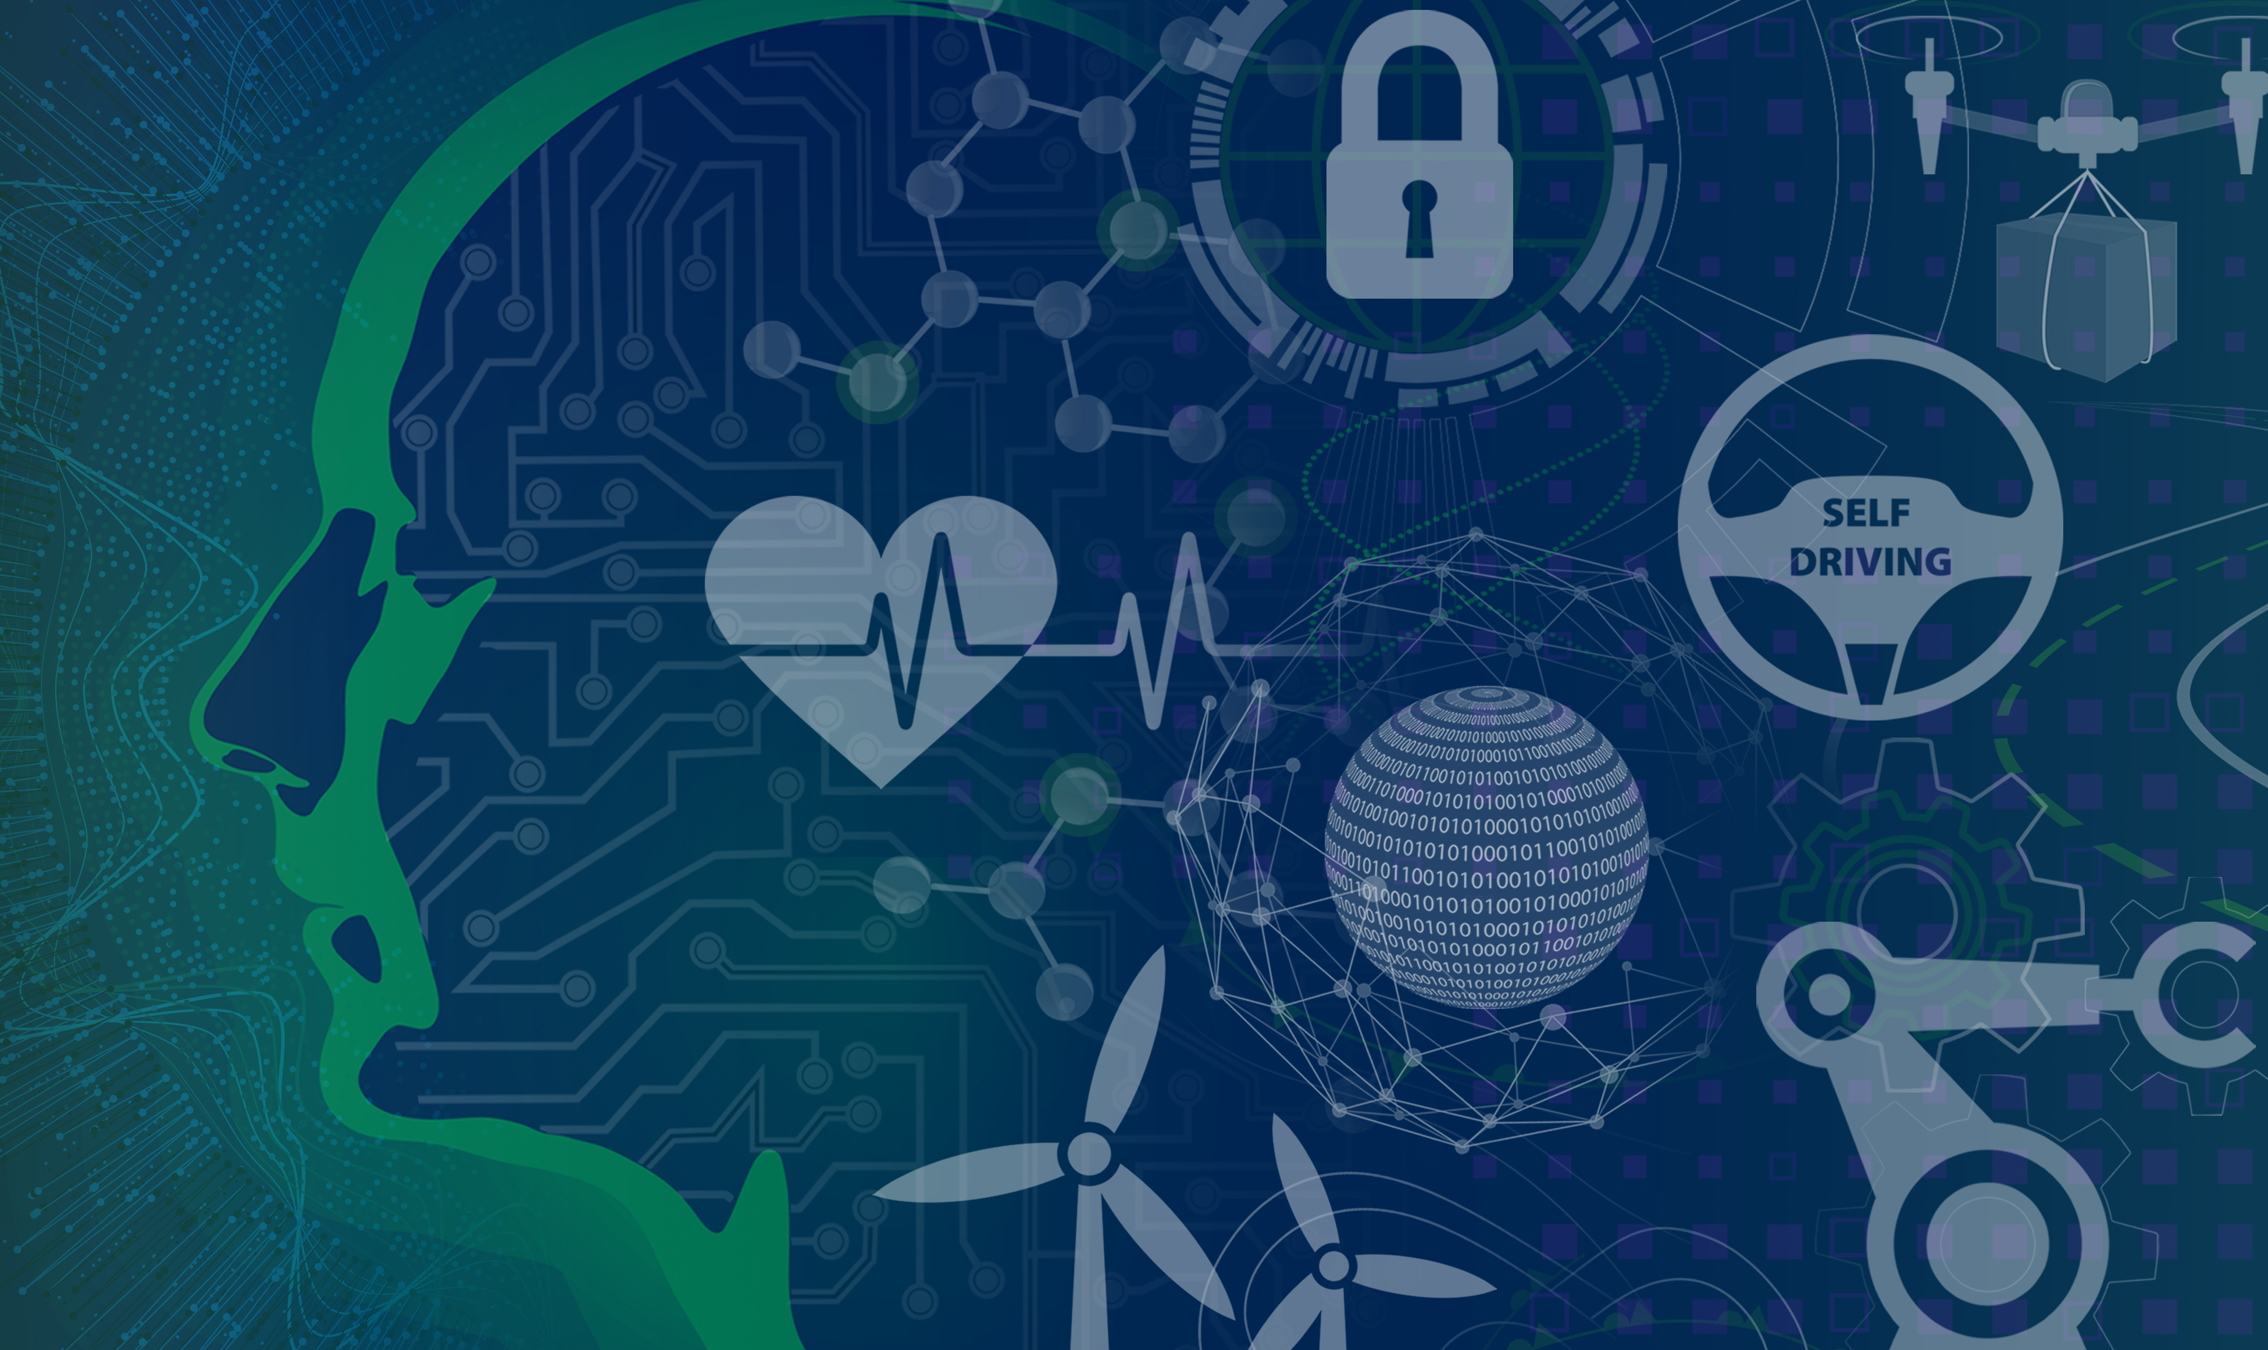
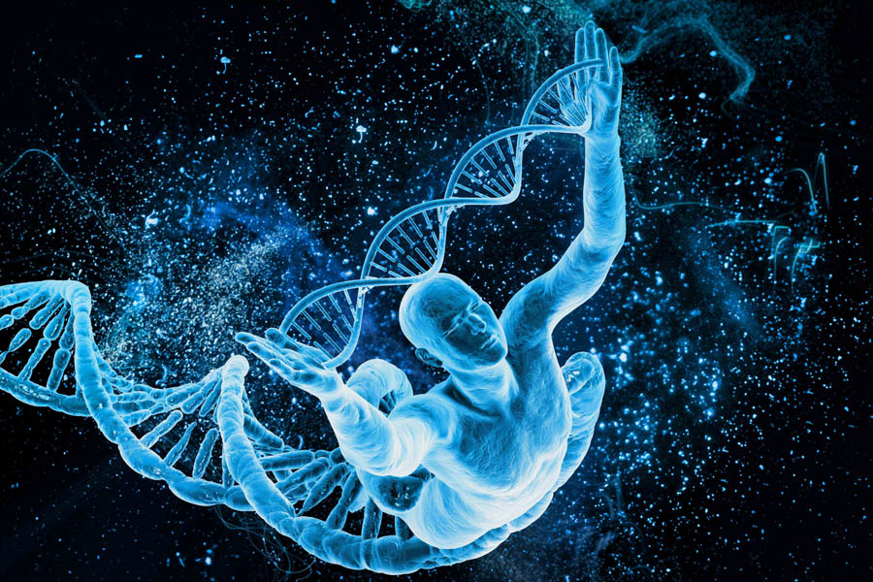
XAI for Biomedical Applications:
Case Studies
Ram D. Sriram
Software and Systems Division
Information Technology Laboratory
National Institute of Standards and Technology
sriram@nist.gov (2019-02-13)
Art courtesy: N.Hanacek/NIST

Slide 2
Outline
AI at NIST
AI in Medicine
Representative Projects in SSD
DARPA’s XAI: A Brief Introduction
First Wave: KAS, MYCIN/EMYCIN and Explanations
Second Wave: CNNs and Explanation
Third Wave: OKNs + NNs
Summary

Slide 3
NIST for AI
Research
TRUSTWORTHY AI
Privacy
Security
Explainabe
Resilience
Reliability
Application
Deployment
MEASURES & STANDARDS
Investigation
Courtesy: Mike Garris
Notes:
What do we mean by Trustworthy AI?
Capabilities / Qualities including: Reliability, Resilience, Explainability (Bias), Security, Privacy, ...
NIST seeks to focus measurement and standardization in these core areas through Foundational Research as well as Evaluations.

Slide 4
AI for NIST
Research
TRUSTWORTHY AI
IoT
Robotics
Material Science
Smart Manufacturing
Biomedical Imaging
…
Application
Deployment
MEASURES & STANDARDS
Investigation
Courtesy: Mike Garris
Notes:
AI is a tool to be applied to applications, and virtually every application domain stands to be impacted by AI.
NIST is seeking to see trustworthy ML/AI leveraged across its measurement science domains. Some of the active projects include those listed here.

Slide 5
Measuring AI Trustworthiness
(Necessary & Challenging)
Probabilistic
  With inherent error rates and uncertainty
Data Driven
  With vulnerability to learning unwanted patterns of bias
Extreme Dimensionality
  In both parameter and solution space
Courtesy: Mike Garris
Notes:
Several key characteristics of ML/AI make measuring the trustworthiness of AI both necessary and challenging.

Slide 6
NIST
5-Year Goals in AI
Applied ML/AI in every relevant area of NIST research
  Routine access to experts and tools
  Policies and procedures for delivery of measurement services
NIST performs state-of-the art foundational ML/AI research
  Factors of trustworthiness
  Support scientific discovery bringing to light latent theories/laws
NIST is the go-to source for evaluating ML/AI technologies
  Data sets and best practices
  Challenge problems, competitions, benchmarks
NIST is a leader in promoting development of ML/AI standards
  Data storage/interchange, knowledge representations, interfaces, performance, explainability
Courtesy: Mike Garris
Notes:
Listed are NIST’s aspirational 5-year goals in AI.

Slide 7
American AI Initiative: 2019-02-11
President’s Executive Order
https://www.whitehouse.gov/articles/accelerating-americas-leadership-in-artificial-intelligence/
3. Setting AI Governance Standards
As part of the American AI Initiative, Federal agencies will foster public trust in AI systems by establishing guidance for AI development and use across different types of technology and industrial sectors. This guidance will help Federal regulatory agencies develop and maintain approaches for the safe and trustworthy creation and adoption of new AI technologies. This initiative also calls for the National Institute of Standards and Technology (NIST) to lead the development of appropriate technical standards for reliable, robust, trustworthy, secure, portable, and interoperable AI systems.

Slide 8
Outline
AI at NIST
AI in Medicine
Representative Projects in SSD
DARPA’s XAI: A Brief Introduction
First Wave: KAS, MYCIN/EMYCIN and Explanations
Second Wave: CNNs and Explanation
Third Wave: OKNs + NNs
Summary

Slide 9
Evolution of AI
Prehistory (Paleolithic: Indian and Greek Philosophies; Neolithic: Hume, Russell, Turing)
The Beginning (1956: AI coined at Dartmouth Conference)
Early years (1957 – 1980: GPS, Dendral, Hearsay, Macsyma, Mycin, Shrdlu, Shakey, etc.)
Knowledge is power & Early Neural Networks (1980 -- 1990: The first wave)
The Silent Period (1990 – 2000: Deep Blue, Rise of Robots, Commercialization of AI technologies, e.g., Speech Recognition)
Neural Networks to the Fore (2000 – 2015: The second wave: Deep Learning)
Symbiosis of Neural and Knowledge Networks (2015 – 2025: Explainable AI, OKN, etc. – The third wave)
The Conscious Machine (2025 -- ?? -- The fourth wave: Tsunami)

Slide 10
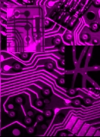
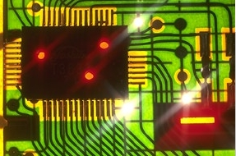

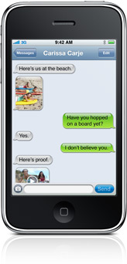
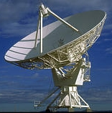
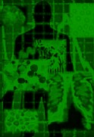
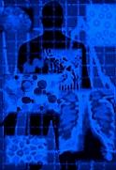
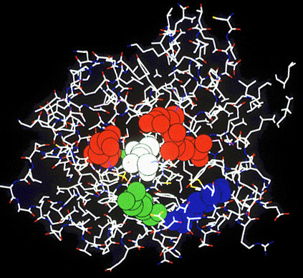
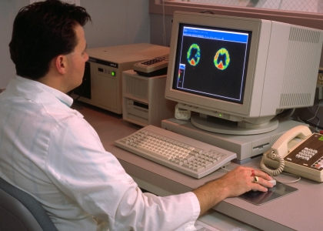
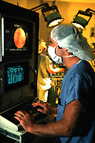
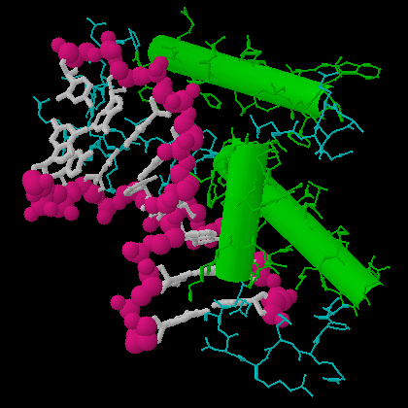
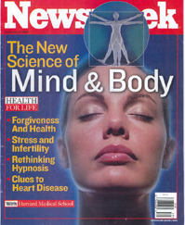
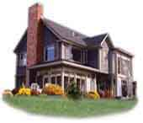

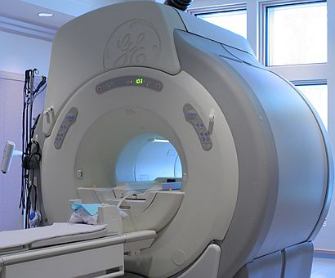



Advances Making Future Health Vision Attainable
Software (Internet,
Cloud,
Data Analytics, Etc.)
Advances in
Computing,
Imaging, and
Information
Technology
Networking
Communications
and Imaging
Speed and
Storage
mPCD
Advances
in
Healthcare
Practice
Future
Health
Vision
Disease
Management
Evidence-Based
Healthcare
Continuum
of Care
Advances in Healthcare
Technology
Pharmaceuticals
and
Nutraceuticals
Medical
Devices
Human Genome
Project
Courtesy: Jack Corley

Slide 11
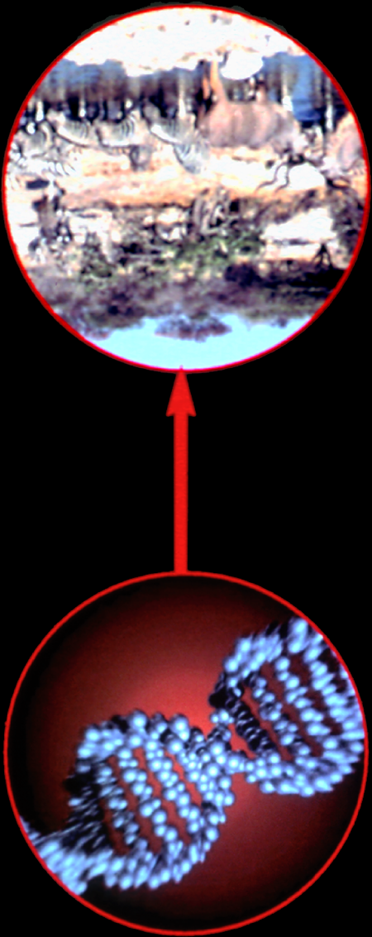
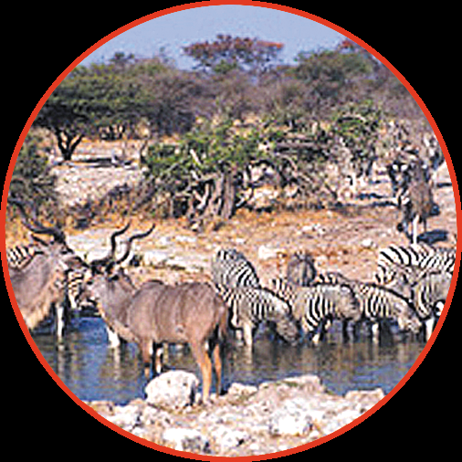
Levels of Biological Information
HEALTH CARE
Ecologies
Societies/Populations
Individuals
Organs
Tissues
Cells
Protein and gene networks
Protein interaction networks
Protein
mRNA
DNA
BIOSCIENCES
Hood

Slide 12
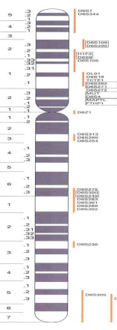
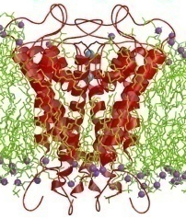
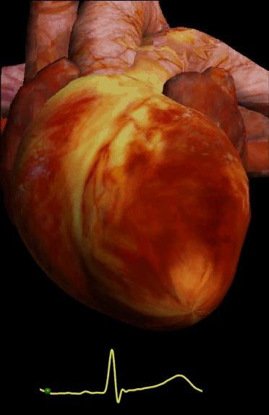
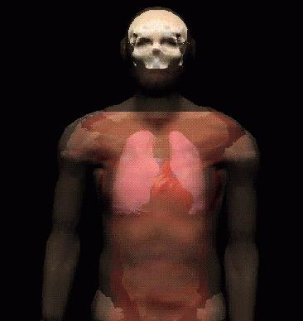
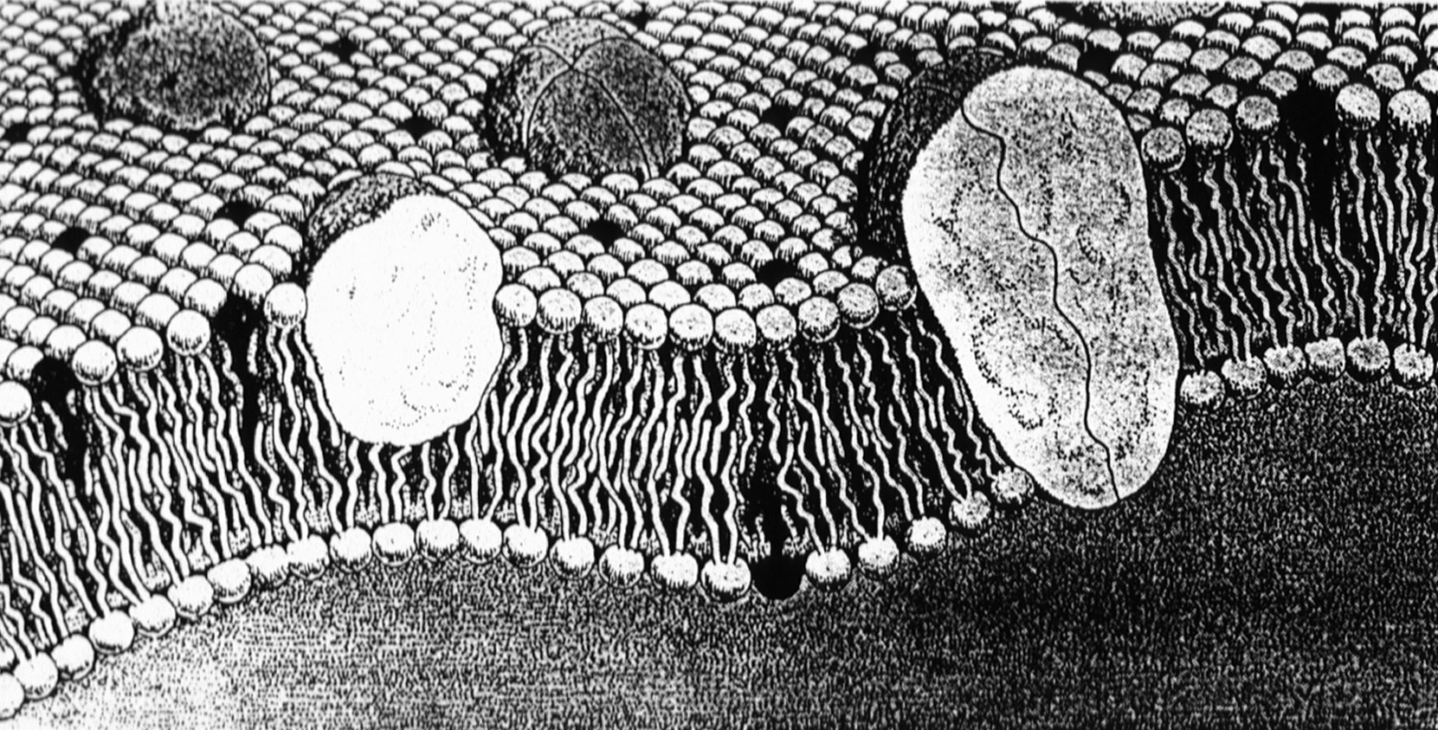
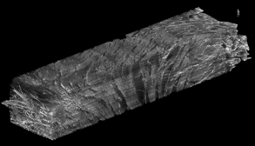
Biological Scales
Genes
mRNA
Proteins
Lipids
Carbohydrates
Cell
structure
-function
Tissue
structure
-function
Organ
structure
-function
Clinical
medicine
…
30,000+
genes
100,000+
proteins
200+ cell
types
4 tissue
types
12 organ
systems
1
body
Courtesy of Peter Hunter
Notes:
Main focus since 2003
Currently there is a growing interest to bridge these scales to population level modeling

Slide 13
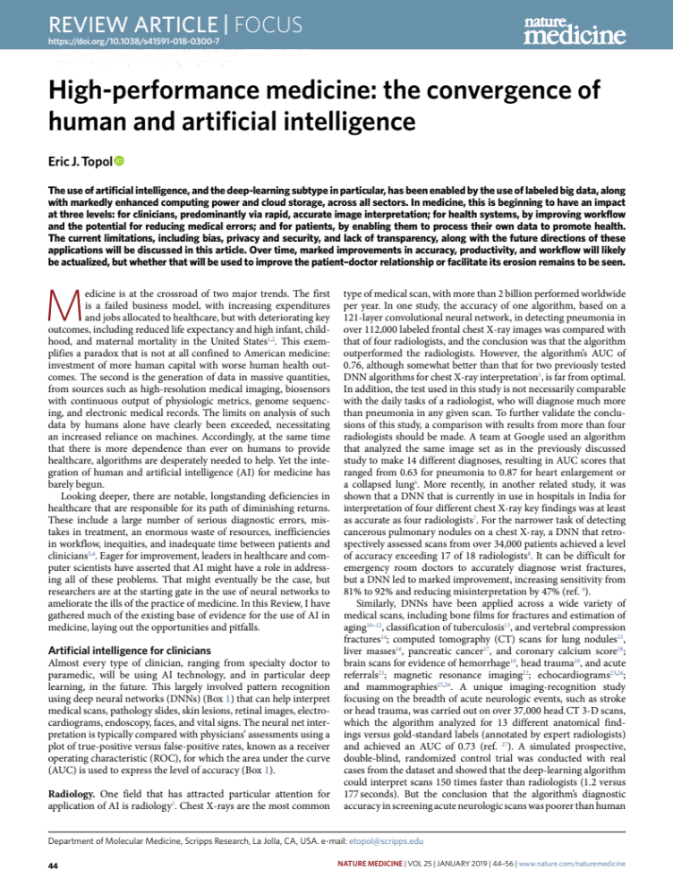

Slide 14
From Eric Topol’s Paper

Slide 15
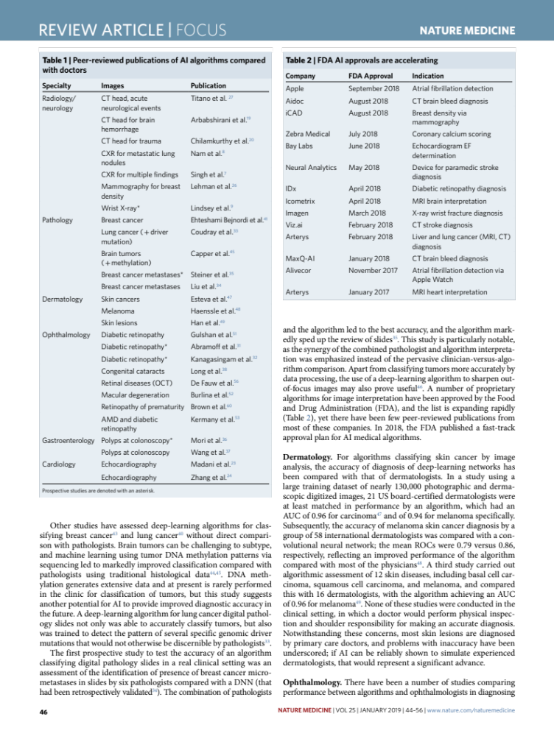

Slide 16
Outline
AI at NIST
AI in Medicine
Representative Projects in SSD
DARPA’s XAI: A Brief Introduction
First Wave: KAS, MYCIN/EMYCIN and Explanations
Second Wave: CNNs and Explanation
Third Wave: OKNs + NNs
Summary

Slide 17
AI For Metrology
Goal: Use machine learning techniques to understand: inter-operable representations of AI models and AI platforms; the factors that are important to consider for the design of convolutional filters in CNN models; the impact of augmentation models and sampling on confidence in accuracy of AI models; and the use of generative adversarial networks (GANs) to improve the confidence in segmentation generalization accuracy.
Use: These techniques were applied in the segmentation of retinal pigment epithelial (RPE) cell implants, and image-based prediction of live tissue functions for RPE cell implants.
Impact: The impact of this research can be seen with the NIST’s Web Image Processing Pipeline system that has been used at NIH for measuring RPE cell implant functions.
Courtesy: Peter Bajcsy and Mary Brady

Slide 18
AI/ML For Image Processing
Goal: Use supervised deep learning (NNs) approaches to detect and classify features in microscopy images.
  Features not easily described by geometry rules
Use: This approach can handle images from material sciences and bio-imaging.
  Requires curating ground truth data
Impact: (1) Enabling or assisting in the automation of processing of difficult-to-process images; (2) High-throughput processing of instrumentation data; (3) Contributing to imaging-based metrology.
Courtesy: Walid Keyrouz

Slide 19
NLP For Q&A (MGI)
Goal: Use machine learning machine learning and natural language processing techniques to analyze fairly large document collections to answer questions about a domain
Use: Analyzed a collection of almost 6000 AI-related conference articles to determine the extent to which ethical concerns related to a set of ACM principles are being addressed by AI researchers. Also working with a major aerospace company to help them extract materials test data from test reports provided by suppliers
Impact: Extracting useful knowledge from unstructured scientific data and to provide synthetic training sets for technical data extraction in situations where training data would otherwise not be available.
Courtesy: Alden Dima

Slide 20
NLP For Search (R&R)
Goal: Use deep learning (NNs) and symbolic processing for terminology generation, information indexing, and searching documents
Use: This method can be used for Domain centric taxonomy generation and searching with auto-completion of terms relevant to the domain. Useful for journal collections, research group collections and expert data bases.
Impact: The impact of this work is widespread in terms of domain based searching. The International Union of Crystallography has embraced this approach to indexing their journal documents. NIST has also indexed the webpages of researchers to create an expertise search capability. Patent application.
Courtesy: Eswaran Subrahmanian

Slide 21
PIE: ML for PPI
Goal: Extend co-occurrence and rule-based methods through ML for extracting protein-protein interactions from literature, including PubMed.
Use: The PIE system accepts plain texts, HTML or PDF documents, as input. Prediction results are listed, highlighting PPI sentences based on their probabilities.
Impact: PIE is currently available through the NIH website http://www.ncbi.nlm.nih.gov/IRET/PIE
Kim, S., Shin, Soo-yong, Lee, In-Hee, Kim, S-J., Sriram, R., and Zhang, B-T., PIE: An Online Prediction System for Protein-Protein Interactions from Text, Nucleic Acid Research, pages 1-5, 2008
Courtesy: Soo-Yong Shin

Slide 22
AI for Bug Finding
Goal: Address infrastructural needs (choice of intermediate representations, neural network architectures, datasets) for applying AI to source code, then use AI for bug finding.
Use: Improve bug finding tools, quickly adapt to new bug classes, different APIs, languages, and application domains. Later uses are to find bugs and fix them as the software is being written.
Impact: Will result in more rapid development of high quality AI-based bug finding tools which will make software more reliable and secure.
Courtesy: Paul Black & Vadim Okun

Slide 23
Outline
AI at NIST
AI in Medicine
Representative Projects in SSD
DARPA’s XAI: A Brief Introduction
First Wave: KAS, MYCIN/EMYCIN and Explanations
Second Wave: CNNs and Explanation
Third Wave: OKNs + NNs
Summary

Slide 24
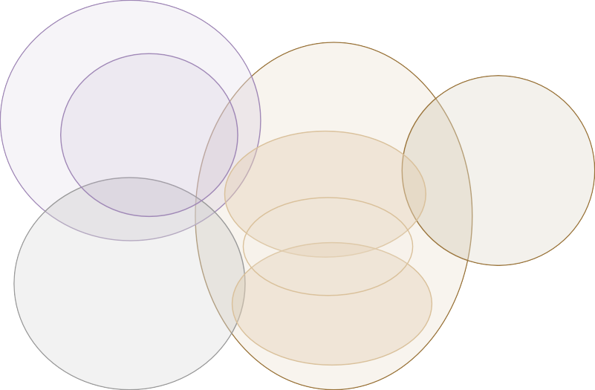

Performance vs. Explainability: DARPA XAI Program
Learning Techniques (today)
Explainability (notional)
Neural Nets
Learning Performance
Graphical Models
Deep Learning
Ensemble Methods
Bayesian Belief Nets
SRL
CRFs HBNs
Random Forests
Statistical Models
AOGs
MLNs
Markov Models
Decision Trees
SVMs
Explainability

Slide 25
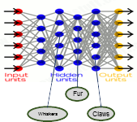
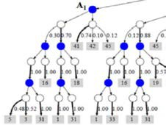
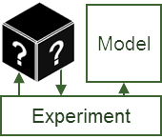
Performance vs. Explainability: DARPA XAI Program
XAI Approach
Learning Techniques (today)
Explainability (notional)
Neural Nets
Learning Performance
Create a suite of machine learning techniques that produce more explainable models, while maintaining a high level of learning performance
Graphical Models
Deep Learning
Ensemble Methods
Bayesian Belief Nets
SRL
CRFs HBNs
Random Forests
Statistical Models
AOGs
MLNs
Markov Models
Decision Trees
SVMs
Explainability
Deep Explanation
Modified deep learning techniques to learn explainable features
Interpretable Models
Techniques to learn more structured, interpretable, causal models
Model Induction
Techniques to infer an explainable model from any model as a black box

Slide 26

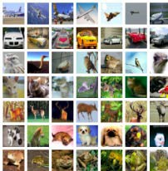
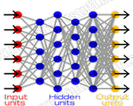





What XAI is Trying To Do?
Today
©Spin South West
©University Of Toronto
Learning Process
http://explainthatstuff.com
This is a cat
(p = .93)
Why did you do that?
Why not something else?
When do you succeed?
When do you fail?
When can I trust you?
How do I correct an error?
Training Data
Learned Function
Output
User with a Task
Tomorrow
©Spin South West
I understand why
I understand why not
I know when you’ll succeed
I know when you’ll fail
I know when to trust you
I know why you erred
©University Of Toronto
New Learning Process
This is a cat:
It has fur, whiskers, and claws.
It has this feature:
Training Data
Explainable Model
Explanation Interface
User with a Task

Slide 27
Outline
AI at NIST
AI in Medicine
Representative Projects in SSD
DARPA’s XAI: A Brief Introduction
First Wave: KAS, MYCIN/EMYCIN and Explanations
Second Wave: CNNs and Explanation
Third Wave: OKNs + NNs
Summary

Slide 28

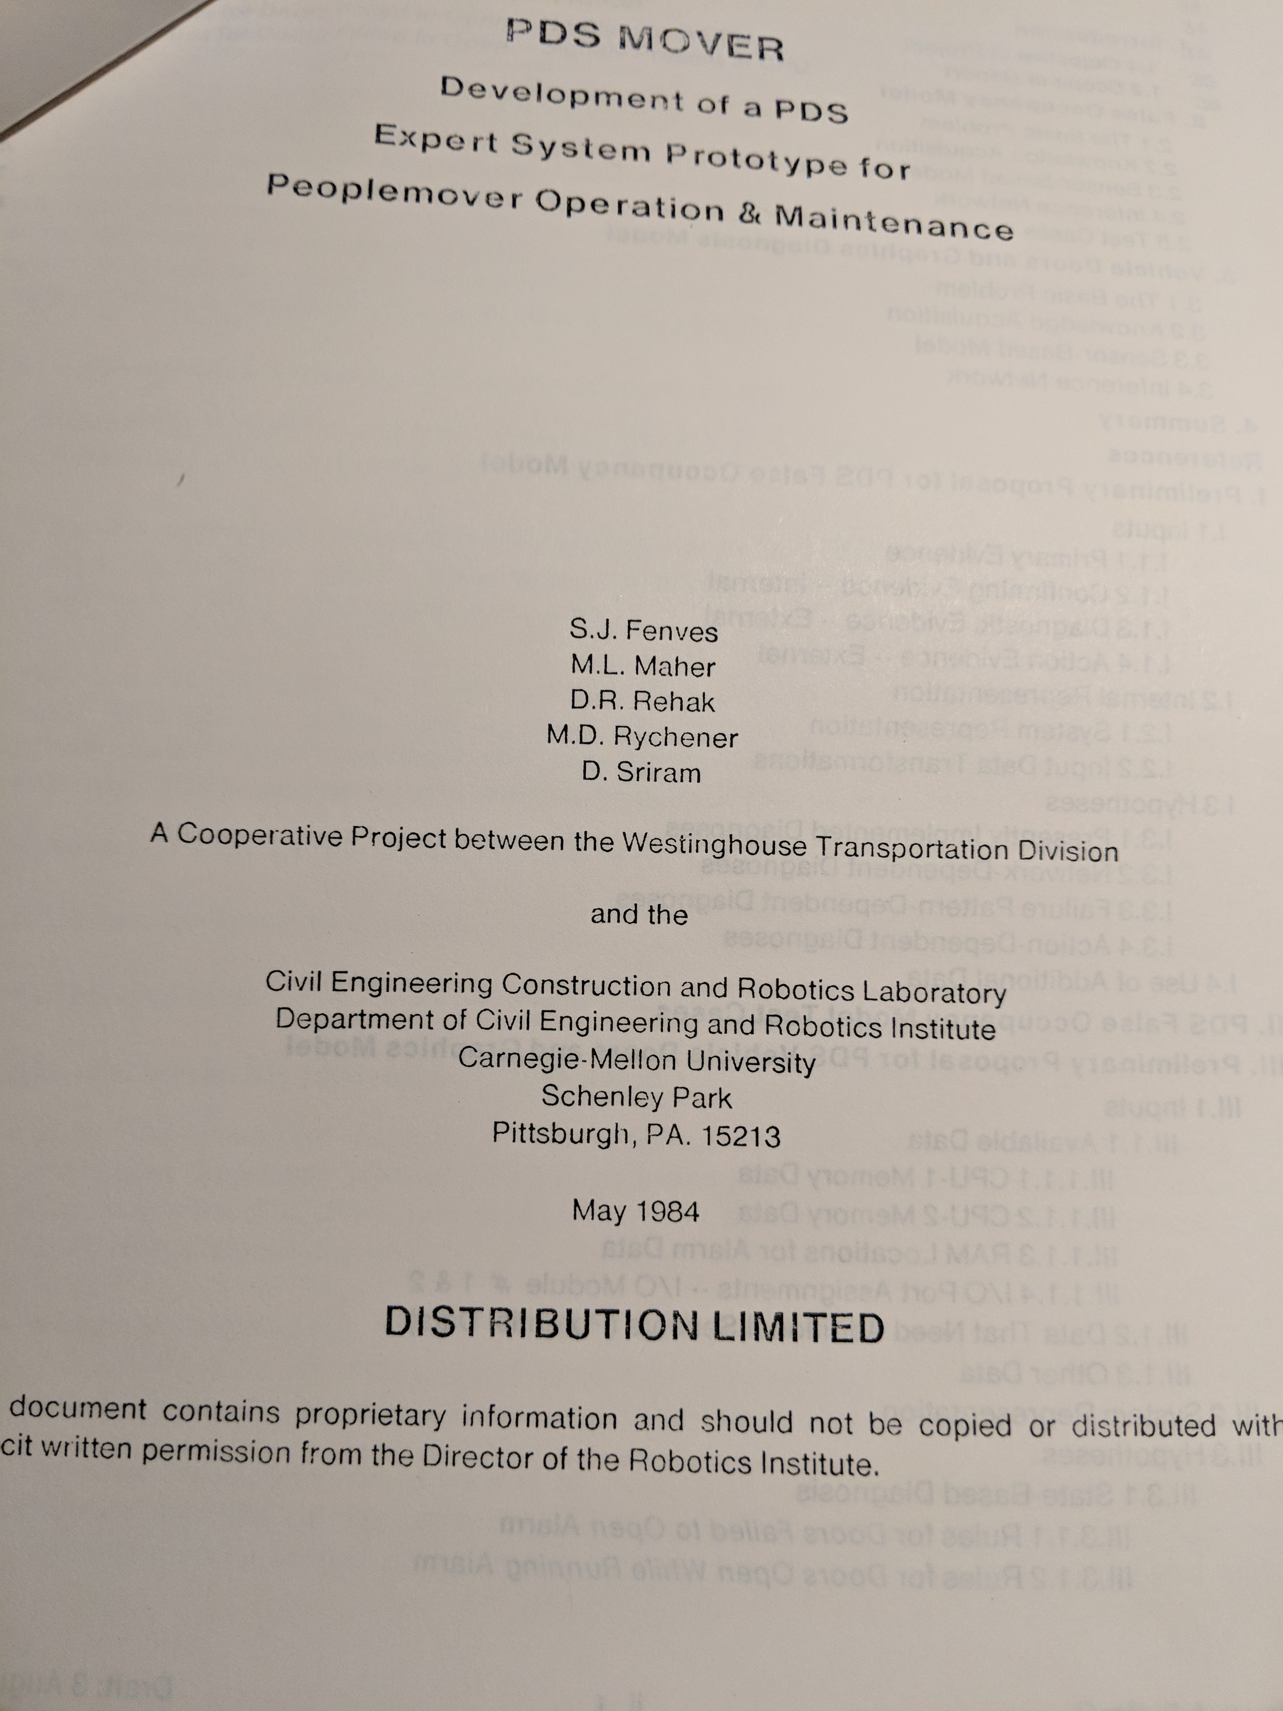
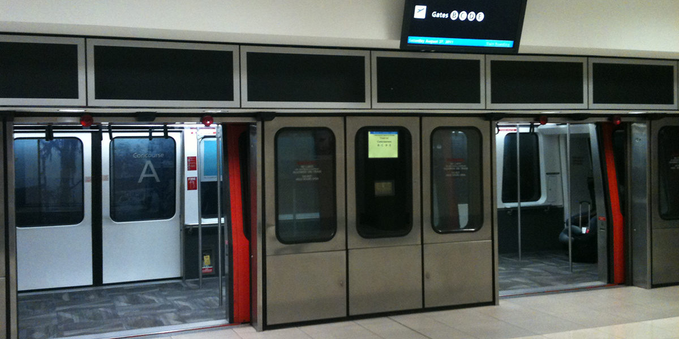
KBeS: A Model & Peoplemover
Context
(Short Term Memory)
Inference Mechanism
(Thinking Process)
Backward Chaining
Forward Chaining
Constraint Propagation
Hierarchical Generate-Test
Etc.
Rules
Frames
Logic
Knowledge-base
(Long Term Memory)
Diagnostic system
implemented in KAS [1982]
and PDS [1984]
Project Participants: S. J. Fenves,
D.Rehak, J. Bielak, M. Rychener, M. Maher,
D. Sriram

Slide 29
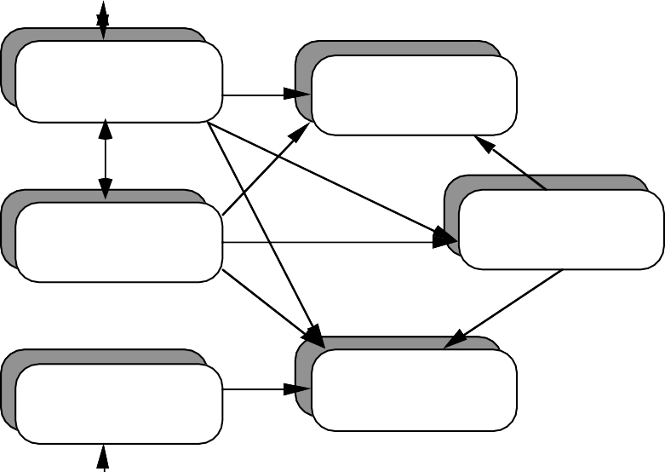
Schematic of a KBES with Explanation and
Knowledge Acquisition Modules
USER
USER INTERFACE
CONTEXT
EXPLANATION
FACILITY
INFERENCE
MECHANISM
KNOWLEDGE
ACQUISITION FACILITY
KNOWLEDGE
BASE
EXPERT
From: Intelligent Systems for Engineering, Ram D. Sriram

Slide 30
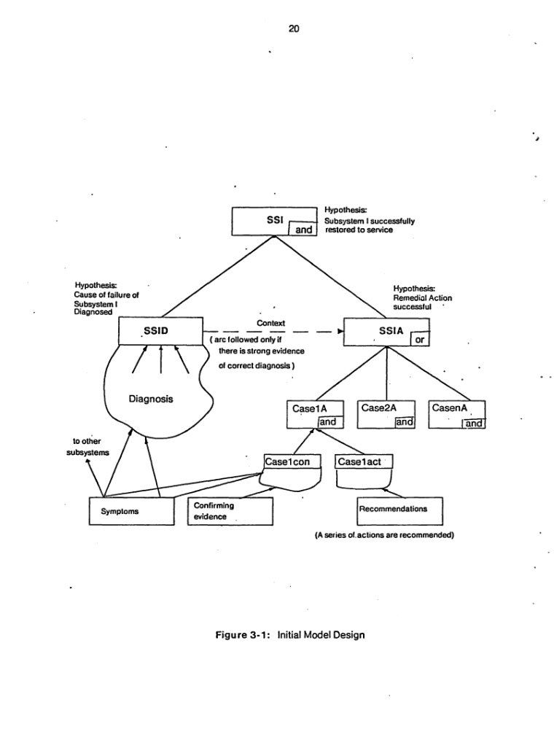

Slide 31
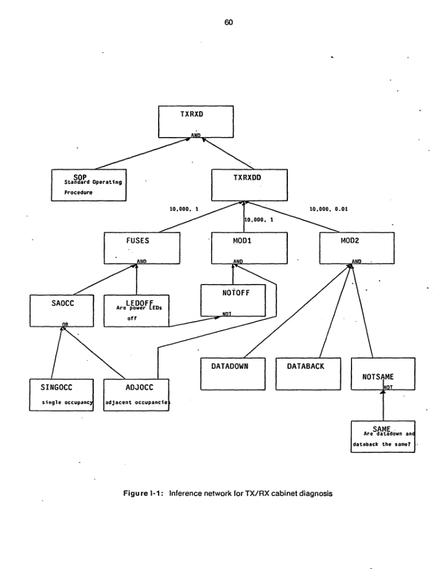
Explaining Inference

Slide 32
Explaining Reasoning in MYCIN: During Consultation
Courtesy: Scott, Clancey. Davis, Shortliffe. in Rule-based Expert Systems; http://www.shortliffe.net/

Slide 33
Explaining Reasoning in MYCIN: Conclusion
Courtesy: Scott, Clancey. Davis, Shortliffe. in Rule-based Expert Systems; http://www.shortliffe.net/

Slide 34
Outline
AI at NIST
AI in Medicine
Representative Projects in SSD
DARPA’s XAI: A Brief Introduction
First Wave: KAS, MYCIN/EMYCIN and Explanations
Second Wave: CNNs and Explanation
Third Wave: OKNs + NNs
Summary

Slide 35
Two Case Studies
From Imaging to Diagnosis in GI
Accurate and Interpretable Classification of Microspectroscopy Pixels Using Artificial Neural Networks

Slide 36
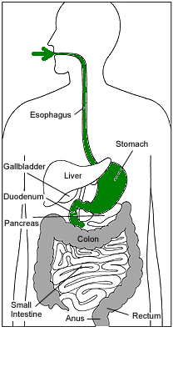
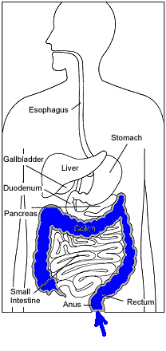
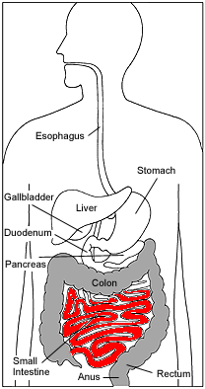
Gastroenteroscopy, Colonoscopy vs. WCE

Slide 37

Animation: Courtesy of GivenImaging

Slide 38
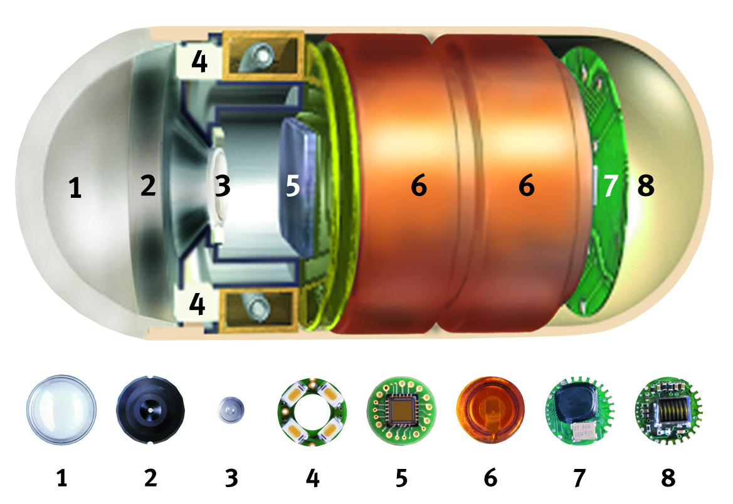
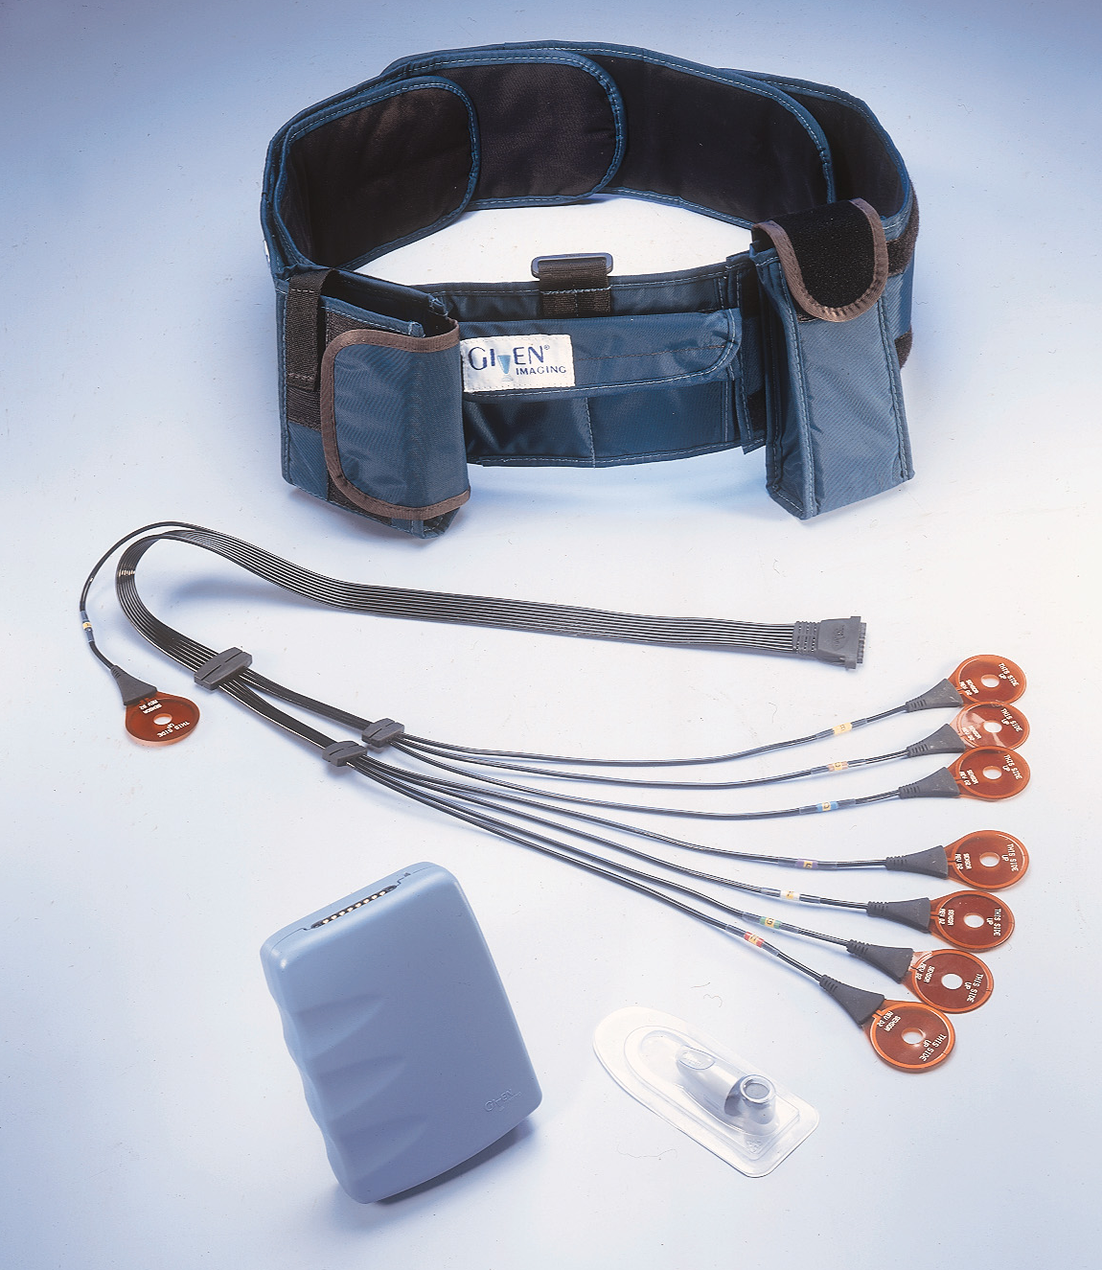
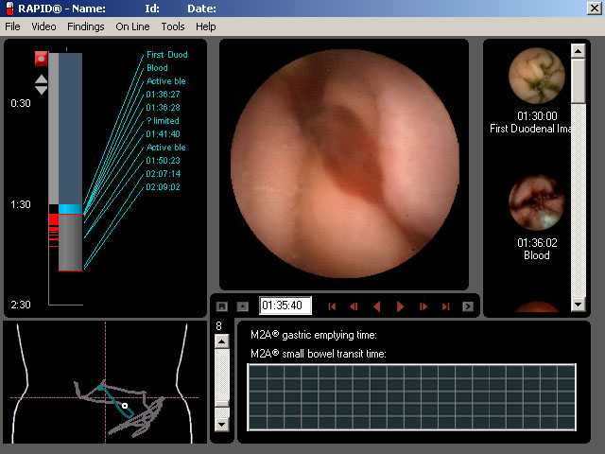
Some Technical Info on WCE
WCE system:
Capsule:
  1. Optical dome
  2. Lens holder
  3. Lens
  4. Illuminating LEDs
  5. CMOS image sensor
  6. Battery
  7. Radio transmitter
  8. Antenna
Receiver
Computer workstation
with software
Height: 11mm, Width: 26mm
Weight: 3.7gr
Images: courtesy of GivenImaging

Slide 39
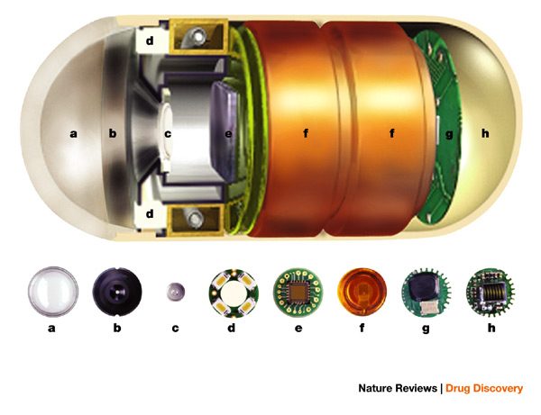
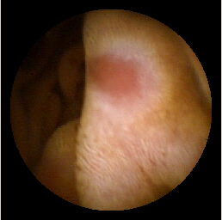
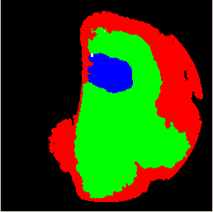
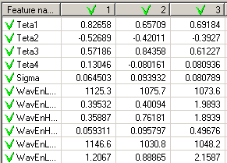
Methodology for Image to Diagnosis Through Disease Ontology
Input Image
Image segmentation
Feature Vectors Computation
Mapping calculated feature
vectors into disease ontology
Highlighting regions with
deviation from normal conditions
problem
normal
normal
Output:
Suggestion of the potential diagnosis
Sugessted diagnosis: Ulcer...
Courtesy: Sub, Mala Ramaiah, DN Reddy, Marcin Kociolek

Slide 40
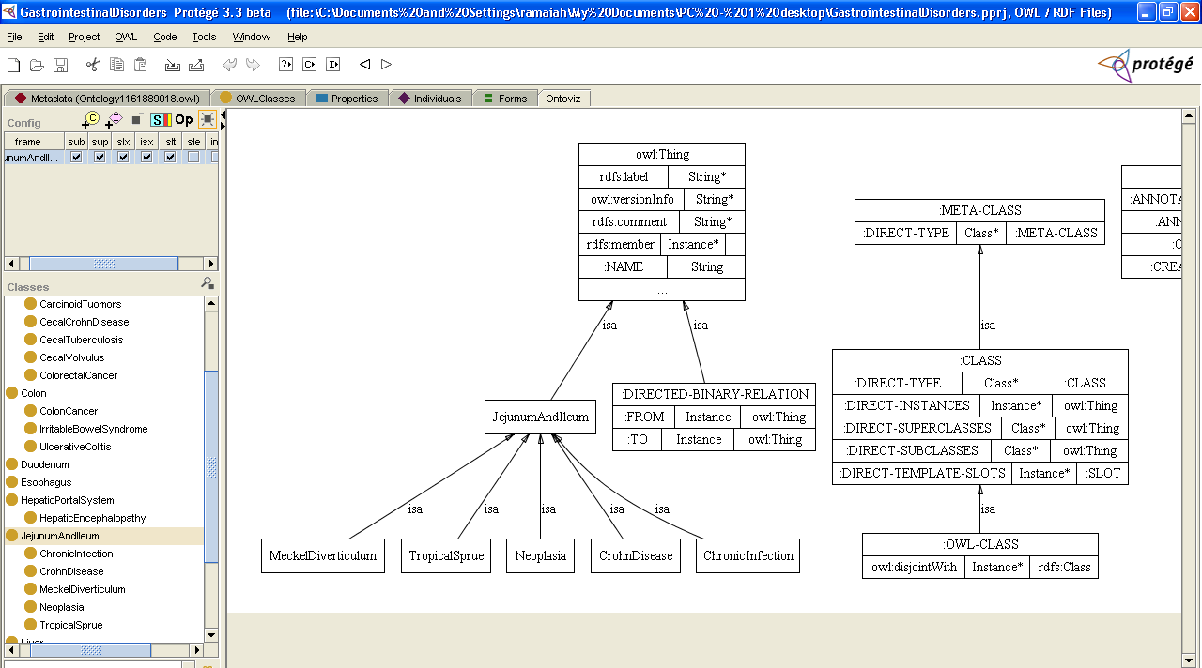
Fragment of Disease Ontology in Protege’-Ontoviz

Slide 41
UML Representation of
Inflammatory Bowel Disease
I
d
i
o
p
a
t
h
i
c
i
n
f
l
a
m
m
a
t
o
r
y
b
o
w
e
l
d
i
s
e
a
s
e
+
e
n
d
o
s
c
o
p
i
c
f
e
a
t
u
r
e
1
:
<
u
n
s
p
e
c
i
f
i
e
d
>
=
u
l
c
e
r
s
+
l
o
c
a
t
i
o
n
:
s
t
r
i
n
g
(
i
d
l
)
=
d
i
s
t
a
l
s
m
a
l
l
i
n
t
e
r
s
t
i
n
e
/
p
r
o
x
i
m
a
l
c
o
l
o
n
/
d
i
s
t
a
l
c
o
l
o
n
/
r
e
c
t
u
m
C
r
o
h
n
s
d
i
s
e
a
s
e
U
l
c
e
r
a
t
i
v
e
c
o
l
i
t
i
s
-
e
n
d
o
s
c
o
p
i
c
f
e
a
t
u
r
e
2
:
<
u
n
s
p
e
c
i
f
i
e
d
>
=
s
t
r
i
c
t
u
r
e
s
-
e
n
d
o
s
c
o
p
i
c
f
e
a
t
u
r
e
2
:
<
u
n
s
p
e
c
i
f
i
e
d
>
=
p
s
e
u
d
o
p
o
l
y
p
s
-
e
n
d
o
s
c
o
p
i
c
3
:
<
u
n
s
p
e
c
i
f
i
e
d
>
=
c
o
b
b
l
e
s
t
o
n
n
i
n
g

Slide 42
Map Feature Vector to Diagnosis
Feature vectors are used to query disease ontology.
Lesion features are mapped to the appropriate disease (Ulcer in our example).

Slide 43
Two Case Studies
From Imaging to Diagnosis in GI
Accurate and Interpretable Classification of Microspectroscopy Pixels Using Artificial Neural Networks

Slide 44
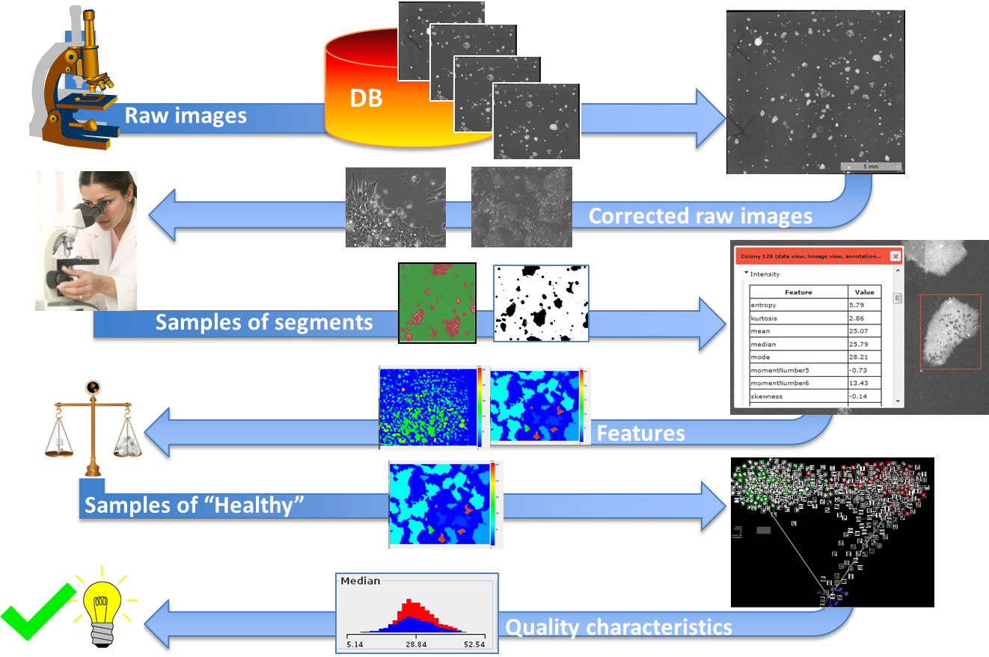
Confidence in CS Metrology & Big Data Measurements
Biological Metrology
Computational Science
-Experimental design
-Specimen preparation
-Image correction
-Stitching
-Image visualization
INTERACTIVITY
SW & HW IMPEDANCE
-Segmentation & tracking & evaluation
-Feature extraction & visualization
-Visual inspection
-Definition of biologically meaningful objects & features
AI/MACHINE LEARNING
-Data-driven hypotheses
-Manual labeling of samples
-Comparisons & classification & cross-validation
-Confidence in models due to data variations and computational parameters
-Interpretation of measurements
-Decisions
Courtesy: Peter Bajcsy and Mary Brady

Slide 45
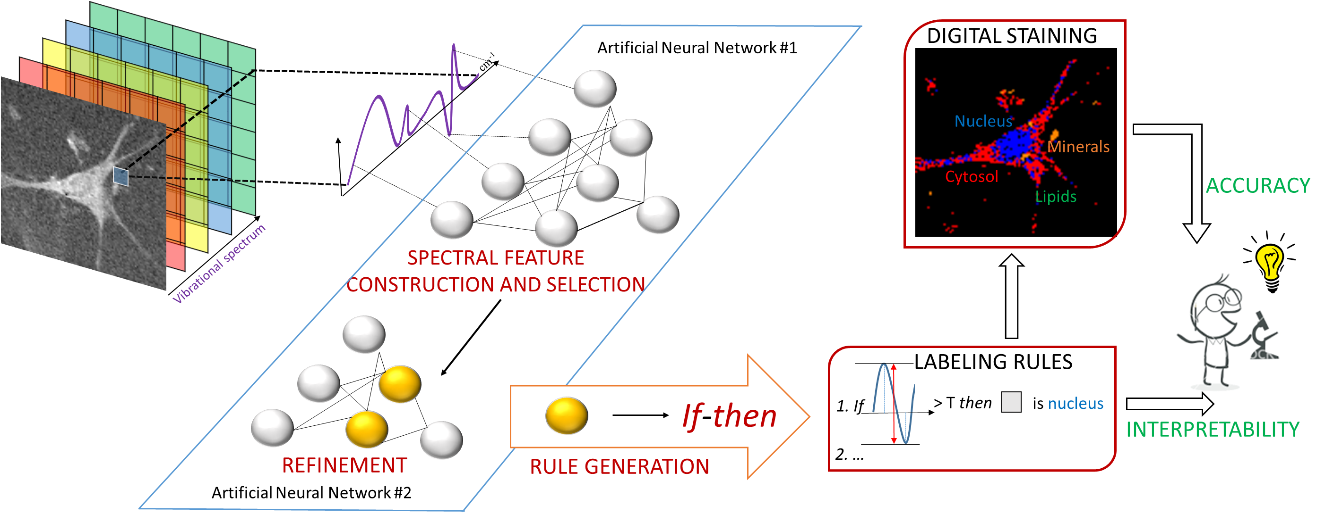
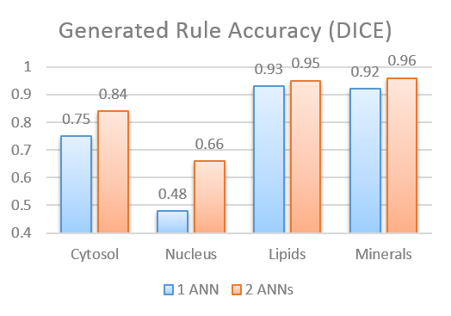




Accurate and Interpretable Classification of Microspectroscopy Pixels Using Artificial Neural Networks
Petre Manescu¹, Young Jong Lee², Charles Camp², Marcus Cicerone², Mary C. Brady¹, Peter Bajcsy¹
¹Software and Systems Division, Information Technology Laboratory National Institute of Standards and Technology Gaithersburg, MD 20899
²Biosystems and Biomaterials Division, Material Measurement Laboratory National Institute of Standards and Technology, Gaithersburg, MD 20899
Context
Raman microspectroscopy and infrared (IR) absorption microspectroscopy are stain-free imaging techniques able to capture spectral information detailing the biochemical composition of cells and tissues.
The majority of chemical identification is usually performed visually by experts, capable of differentiating unique patterns of multiple peaks within the vibrational spectrum. There is a lack of precise mathematical formulations for the majority of existing expert labeling rules. Accurate automated spectral labeling together with discovery and material exploration are important aspects in the context of microspectroscopy.
Problem
Approach
A new method to derive mathematical if-then decision rules for pixel classification from Artificial Neural Networks (ANN).
Results
Manescu et al. Accurate and Interpretable Classification of Microspectroscopy Pixels Using Artificial Neural Networks in Medical Image Analysis, (2017), Volume 37, pp 37-45

Slide 46


Slide 47


Slide 48


Slide 49
Outline
AI at NIST
AI in Medicine
Representative Projects in SSD
DARPA’s XAI: A Brief Introduction
First Wave: KAS, MYCIN/EMYCIN and Explanations
Second Wave: CNNs and Explanation
Third Wave: OKNs + NNs
Summary

Slide 50
Meeting in the Middle
OKNs’ strengths balance NNs’ weaknesses, and vice versa:
OKN | NN
Unstructured data | Identifying patterns
Background knowledge | Training Data
Complex Logic | Explanation
Elicitation | Online learning
Courtesy: Spencer Breiner, Eswaran Subrahmanian
Notes:
Line 1: The most obvious Use NNs to populate/update the data on top of OKNs

Slide 51
Predictive Coding (PC)
Predictive coding is an efficient probabilistic strategy to mediate noisy, bottom-up observations with top-down predictions.
  Recognition (R-)density – Probabilistic estimate of environmental variables ($ev$).
  Generative (G-)density – Joint distribution over EVs and sensory perceptions ($sp$).
Strategy:
Optimize R by conditioning G on $sp$ and minimize the Kullback-Liebler divergence (“surprise”):
  $$KL\left( R\left(ev\right) \right| G\left(ev | sp\right) ) ≔\sum_{ev}{R\left(ev\right)∙\text{ln}\left(\frac{R(ev)}{G(ev|sp)}\right)}$$
Courtesy: Spencer Breiner, Eswaran Subrahmanian

Slide 52


PC meets OKN meets NN
OKN
NN
Data
$$KL\left( R\left(ev\right) \right| G\left(ev | sp\right) )$$
Ontologies generate probabilistic models in (at least) two ways:
  Elicited and encoded directly (e.g., medical ontologies).
  Calculated from structured data (e.g., manufacturing ontology & database).
PC learning algorithm updates both models together, linking black-box NN parameters to explainable OKN values.
Courtesy: Spencer Breiner, Eswaran Subrahmanian

Slide 53
Outline
AI at NIST
AI in Medicine
Representative Projects in SSD
DARPA’s XAI: A Brief Introduction
First Wave: KAS, MYCIN/EMYCIN and Explanations
Second Wave: CNNs and Explanation
Third Wave: OKNs + NNs
Summary

Slide 54
Summary
Metrology for AI and AI for Metrology
Medical diagnosis requires multi-modal reasoning
Standards introduced at the right time will lead to innovation
Testing algorithms will increase trust in AI
Learning programs need to explain reasoning
Public-Private partnerships may help accelerate progress
Challenge problems will improve performance

Slide 55


https://www.ncbi.nlm.nih.gov/pmc/articles/PMC3336915/

Slide 56



Smart Healthcare
  Smart Devices
  Smart Networks
  Smart Processes
  Smart EMRs
  Smart Medicine
  Smart Organizations
  Smart Collaborations
  Smart Society
  Smart Planet
Courtesy: Fred Hosea, Ph.D.
Program Director
Clinical Technology
fred.w.hosea@kp.org

Slide 57

The 21st Century Doc
Courtesy: Rod Grupen & Tihomir Latinovic

Slide 58
Acknowledgments and Disclaimer
This talk is based on the work by several people at NIST. Credit is provided in appropriate slides. My thanks to all those who provided the slides.
Commercial equipment and software, many of which are either registered or trademarked, are identified in order to adequately specify certain procedures. In no case does such identification imply recommendation or endorsement by the National Institute of Standards and Technology, nor does it imply that the materials or equipment identified are necessarily the best available for the purpose.

