Slide 1


Semantic Analytics for Global Health Surveillance
Arash SHABAN-NEJAD, PhD, MPH
¹Population Health Intelligence (PopHI) Lab
UTHSC- Oak-Ridge National Laboratory (ORNL)
Center for Biomedical Informatics

Slide 2
Outline
The Problem
The Framework
The System

Slide 3


PUBLIC/Global HEALTH CYCLE
Surveillance
Population
Health System
Intervention
Adapted from M. Dredze, W3PHI 2015

Slide 4
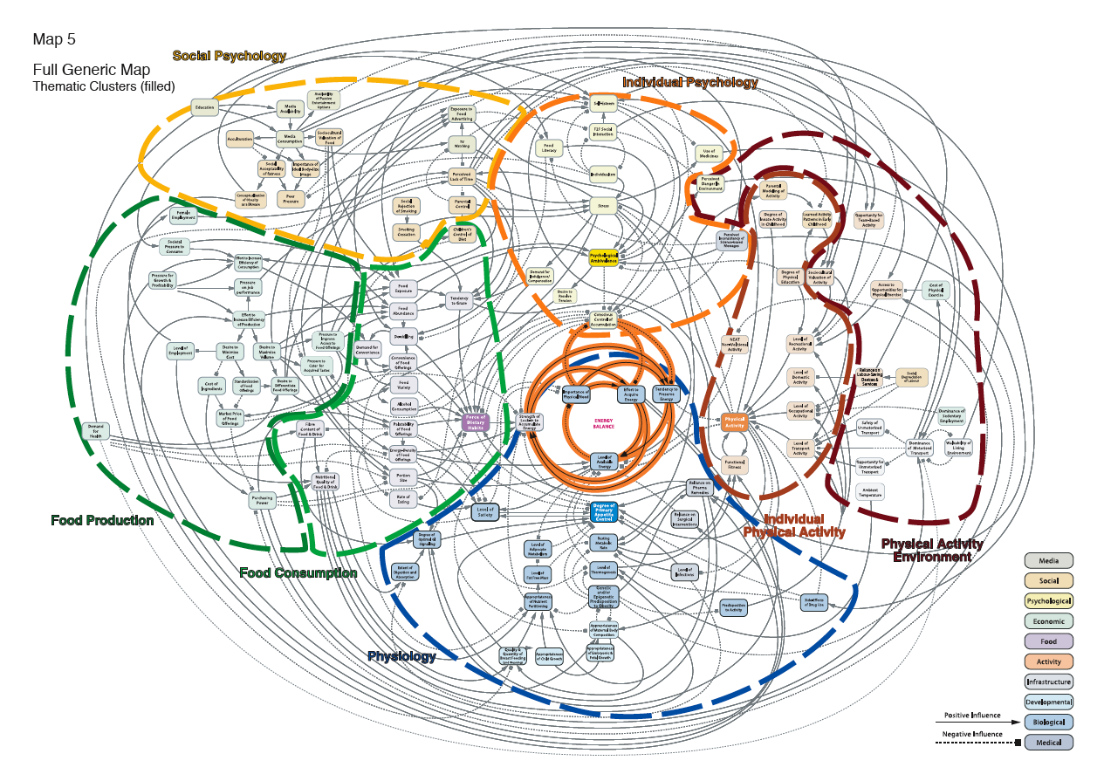
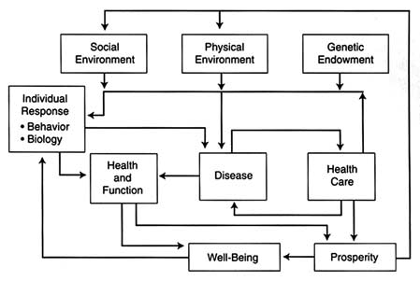
Disease Causal Pathways …
Evans and G.L. Stoddart, 1990, Producing Health, Consuming Health Care, Social Science and Medicine 31:1347–1363.

Slide 5
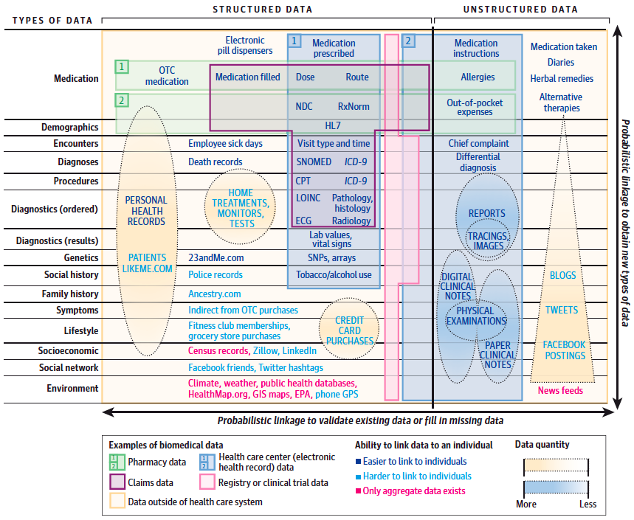
Lots of Relevant Data
Weber GM, Mandl KD, Kohane IS. Finding the Missing Link for Big Biomedical Data. JAMA. 2014;311(24):2479-2480.

Slide 6
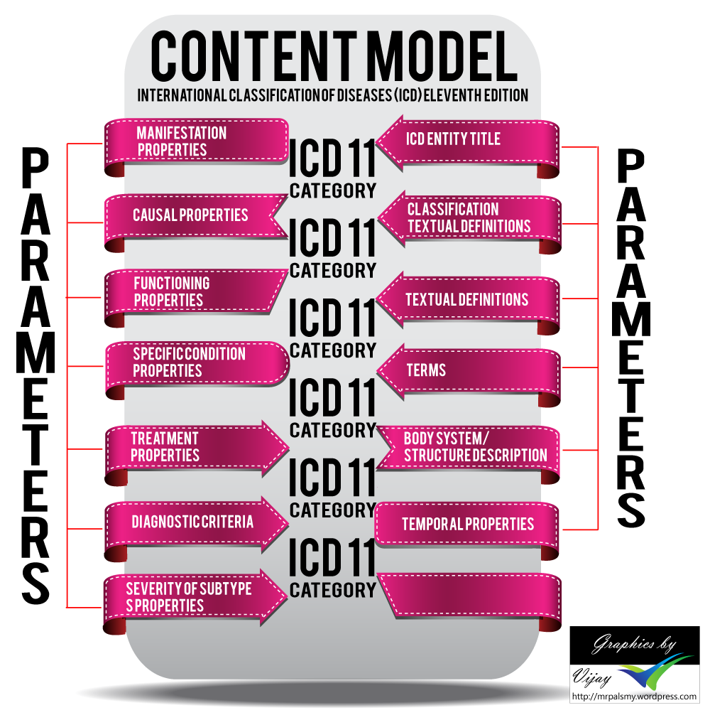

Evidence Based Public Health
- Causal
(Type I) Knowledge
- Intervention Effectiveness
(Type II) Knowledge
- Intervention Implementation
(Type III) Knowledge

Slide 7
Knowledge-based Health Intelligence:
From Data to Insight
By using ontologies and knowledge bases to analyze contextual knowledge

Slide 8
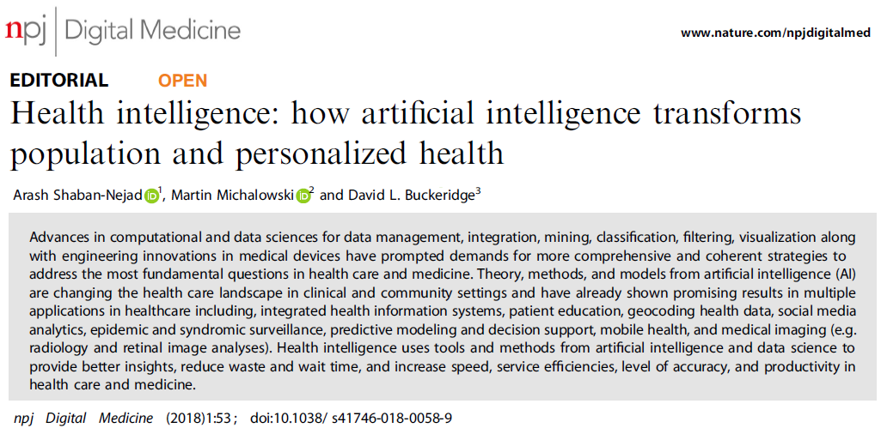

I ) Integrating (large volume of) data
II) Statistical/qualitative Analysis
III) Processing structured and unstructured data to find patterns
IV) Explanatory and Predictive modeling
Health intelligence uses tools and methods from artificial intelligence and data science to provide better insights, reduce waste and wait time, and increase speed, service efficiencies, level of accuracy, and productivity in health care and medicine.

Slide 9
Health Intelligence
Global Health Intelligence
e.g. Data Integration and Interoperability for Malaria Surveillance in Sub- Saharan Africa (Gates Foundation)
Population Health Intelligence
e.g. PopHR and Adverse Childhood Experience (ACEs) Surveillance in Memphis
Urban Health Intelligence
e.g. Memphis Urban Health Observatory and Housing & Health
Clinical Health Intelligence
e.g. Early detection of Hospital Acquired Infections (HAIs) and Sepsis

Slide 10
Malaria
One of the top causes of death in low-income
developing countries
219 million cases and 435,000 deaths in 2017
92% of which occurred in Africa
Mostly young children in Sub-Saharan countries

Slide 11



Slide 12
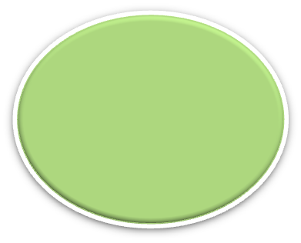
Potential Data Sources
Health Facility Survey Data
Routine Data (HMIS)
Verbal Autopsy Data
Focus Group discussion, Key informant interview
Household Surveys
Meteorological Data
GIS, Satellite Data
Malaria M&E
Rapid Assessment Data
Sentinel Surveillance
Census Data
Activity Monitoring System
Health & Demongraphic surveillance system data
Routine Monitoring at the Community Level Data
Malaria M & E Data Sources https://webcache.googleusercontent.com/search?q=cache:h4RTPVGkqp8J:https://www.measureevaluation.org/resources/training/capacity-building-resources/m-e-of-malaria-programs-1/session-8-data-sources+&cd=1&hl=en&ct=clnk&gl=us&client=firefox-b-d
Notes:
12

Slide 13
Malaria Data
Qualitative
Quantitative
Collected Routinely
Collected Non-Routinely
Temporal
Non-temporal
Various Geographic Types and Granularities
Individual Vs population level
Notes:
13

Slide 14
Challenges
Malaria data contains information relevant to various specialists.
It is spread around the world.
It is expressed in non-mutually intelligible formats.
It uses different granularities, languages, ...

Slide 15
Challenges
Components running on different:
- Hardware platforms
- Operating systems
- Network infrastructure
- Communication protocols
Components using different
- Data representation
- Control model (REST, SOA, API, etc.)
- Semantic interpretation

Slide 16

Global Health Interoperability
https://medcitynews.com/2017/01/redox-9m-series-b/

Slide 17


SIEMA
Semantics, Interoperability & Evolution for Malaria Analytics

Slide 18
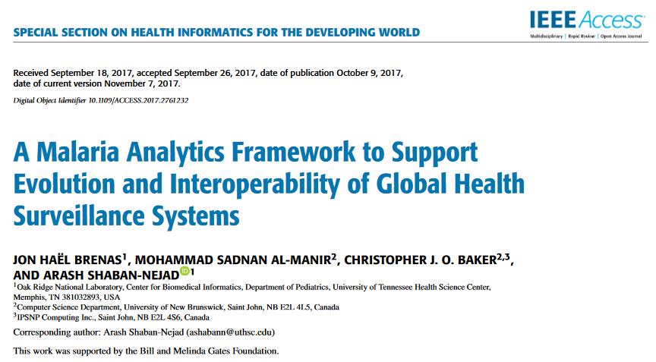

2019, 1st Prize for Outstanding Article (Impact on Field of Biosurveillance)

Slide 19
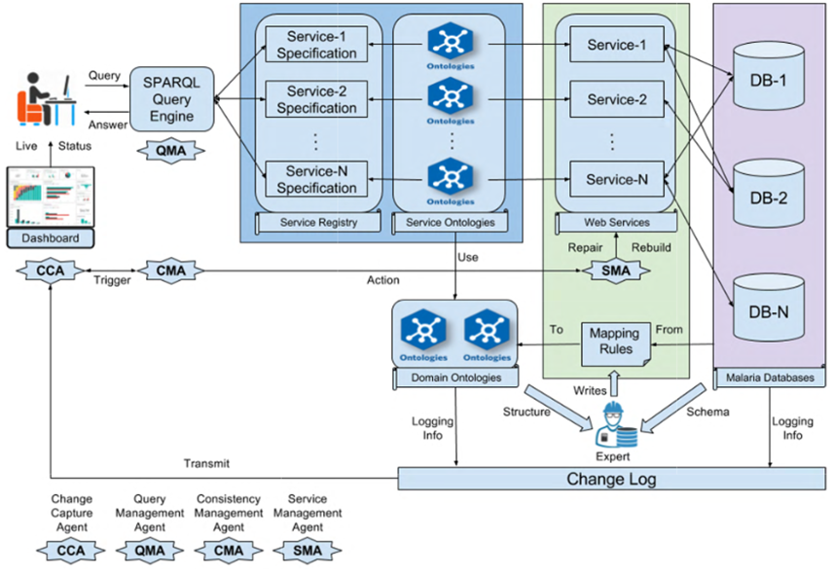

Slide 20
Method
+ Semantic Automated Discovery and Integration (SADI) Semantic Web
Services to enable data access and improve interoperability
+ SHARE: an open source query client that enables end users to discover,
plan, and orchestrate SADI services in a registry and invoke them
automatically from SPARQL queries.
+ HYDRA: the graphical user interface-enabled semantic query engine
+ Algorithms: to detect changes
+ Valet SADI: is used to mitigate the impact of changes by rebuilding
affected services.

Slide 21
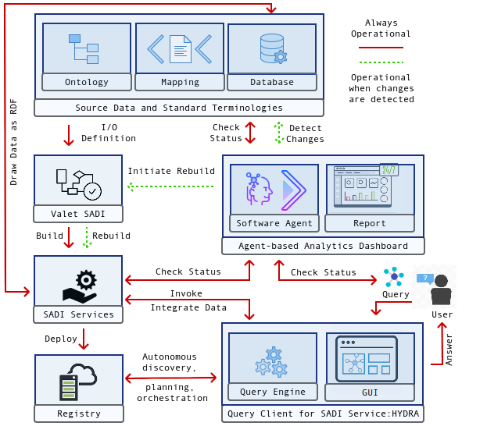

Slide 22
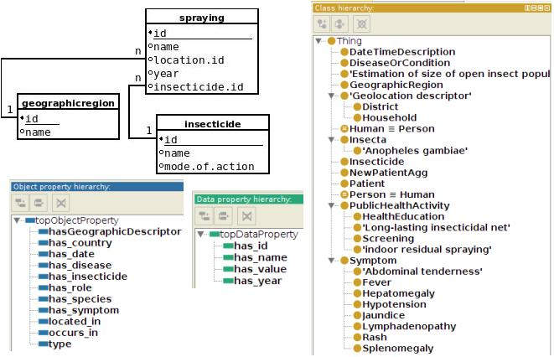
Snapshot of source data schema and domain ontologies

Slide 23
Mapping rules connect databases & ontologies

Slide 24
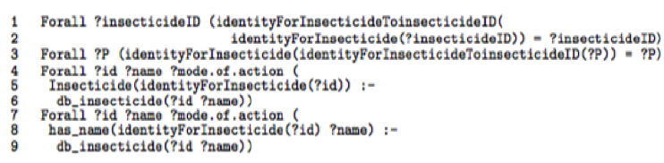
Mapping Rules
Defined by an expert
Interpret the data

Slide 25
Services connect the user to the data

Slide 26
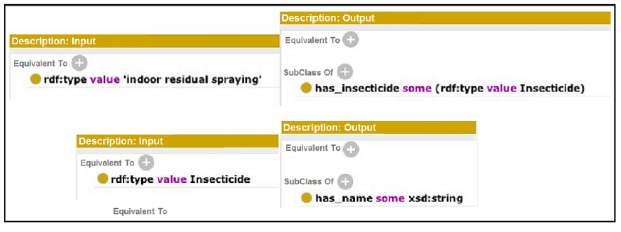
Services
Services take data as input
Services return an output

Slide 27
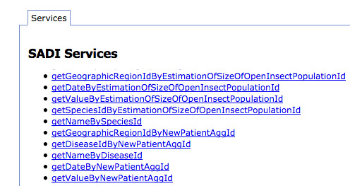

Slide 28
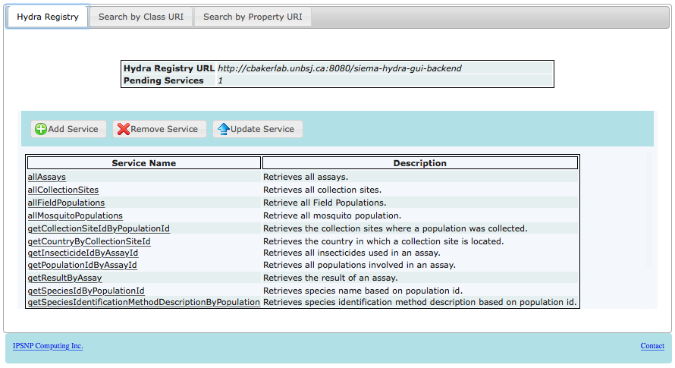
Semantic Automated Discovery & Integration (SADI)
Brenas JH, Al Manir MS, Zinszer K, Baker CJO, Shaban-Nejad A. Exploring Semantic Data Federation to Enable Malaria Surveillance Queries.
Stud Health Technol Inform. 2018;247:6-10.

Slide 29
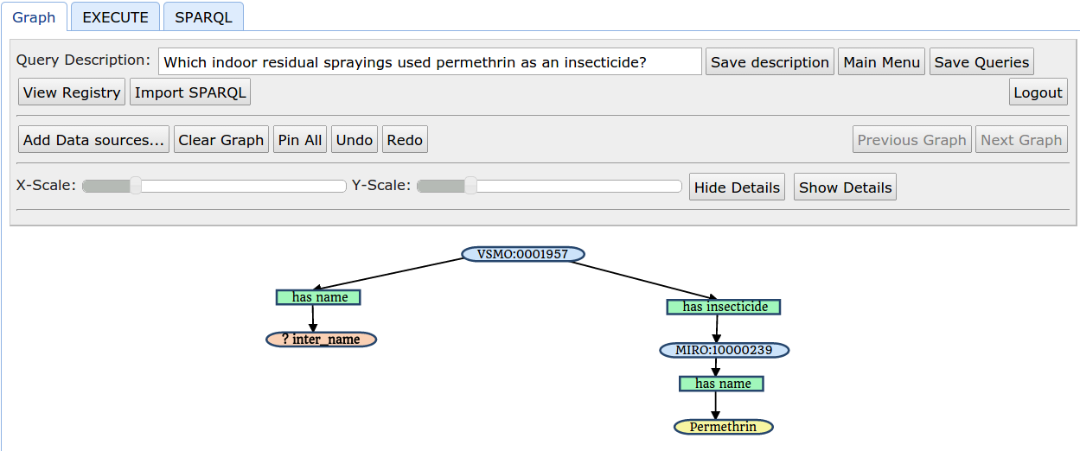
The graph representation of a query for the question:
“Which indoor residual sprayings used permethrin as an insecticide?" prepared on the HYDRA GUI

Slide 30
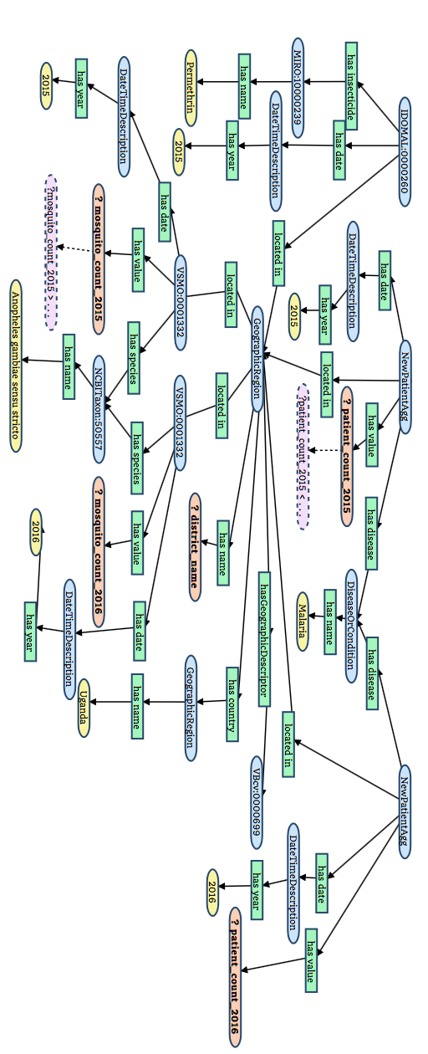
Graph representation of a query: “Which districts of Uganda that used permethrin-based long-lasting insecticide -treated nets in 2015 saw a decrease in anopheles gambiae s.s. population but no decrease of new malaria cases between 2015 and 2016?”.

Slide 31
Key points
Maintaining Interoperability is an important issue in Surveillance.
The goal of the SIEMA project is to create a platform allowing
surveillance expert to access malaria data
This data is distributed, expressed in various languages, granularities, formats
Services and ontologies are used to improve the interoperability

Slide 32
References
Brenas JH, Al-Manir MS, Baker CJO, and Shaban-Nejad, A. A Malaria Analytics Framework to Support Evolution and Interoperability of Global Health Surveillance Systems. IEEE Access, Vol. 5 5: 21605-21619, 2017.
Al-Manir MS, Brenas JH, Baker CJO, and Shaban-Nejad, A. A Surveillance Infrastructure for Malaria Analytics: Provisioning Data Access and Preservation of Interoperability JMIR Public Health Surveill. 2018 Jun 15;4(2):e10218.
Brenas JH, Strecker M, Echahed R, and Shaban-Nejad, A. Applied Graph Transformation and Verification with Use Cased in Malaria Surveillance. IEEE Access 6: 64728-64741 (2018).
Brenas JH, Al Manir MS, Zinszer K, Baker CJO, Shaban-Nejad A. Exploring Semantic Data Federation to Enable Malaria Surveillance Queries. Stud Health Technol Inform. 2018;247:6-10.
Brenas JH, Al-Manir MS, Baker CJO, and Shaban-Nejad, A. A Change Management Dashboard for the SIEMA Global Malaria Surveillance Infrastructure. International Semantic Web Conference (ISWC), 2017.

Slide 33





The SIEMA Team
Jon Brenas
Kate Zinszer
Sadnan Al-Manir
Chris Baker
Arash Shaban-Nejad

Slide 34




Acknowledgements

Slide 35
ashabann@uthsc.edu
Questions?

