Slide 1
Narration Track
March 2019 presentations (planned)

Slide 2

Ontology Design Pattern for Explanations (via Knowledge Graphs)
Ilaria Tiddi
Research Associate
Knowledge Representation and Reasoning group
Vrije Universiteit Amsterdam
“An ontology design pattern to define explanations” source
Thesis work: “ . . . Exploiting Linked Data for Knowledge Discovery. . . Use Linked Data as a background knowledge to explain patterns of data in an automatic way. Combined different Machine Learning and graph techniques to create a framework that could explain patterns automatically using information found in the Linked Data.” Papers http://oro.open.ac.uk/40668/1/paper_127.pdf, http://oro.open.ac.uk/41683/1/cold2014_TiddiDM.pdf

Slide 3
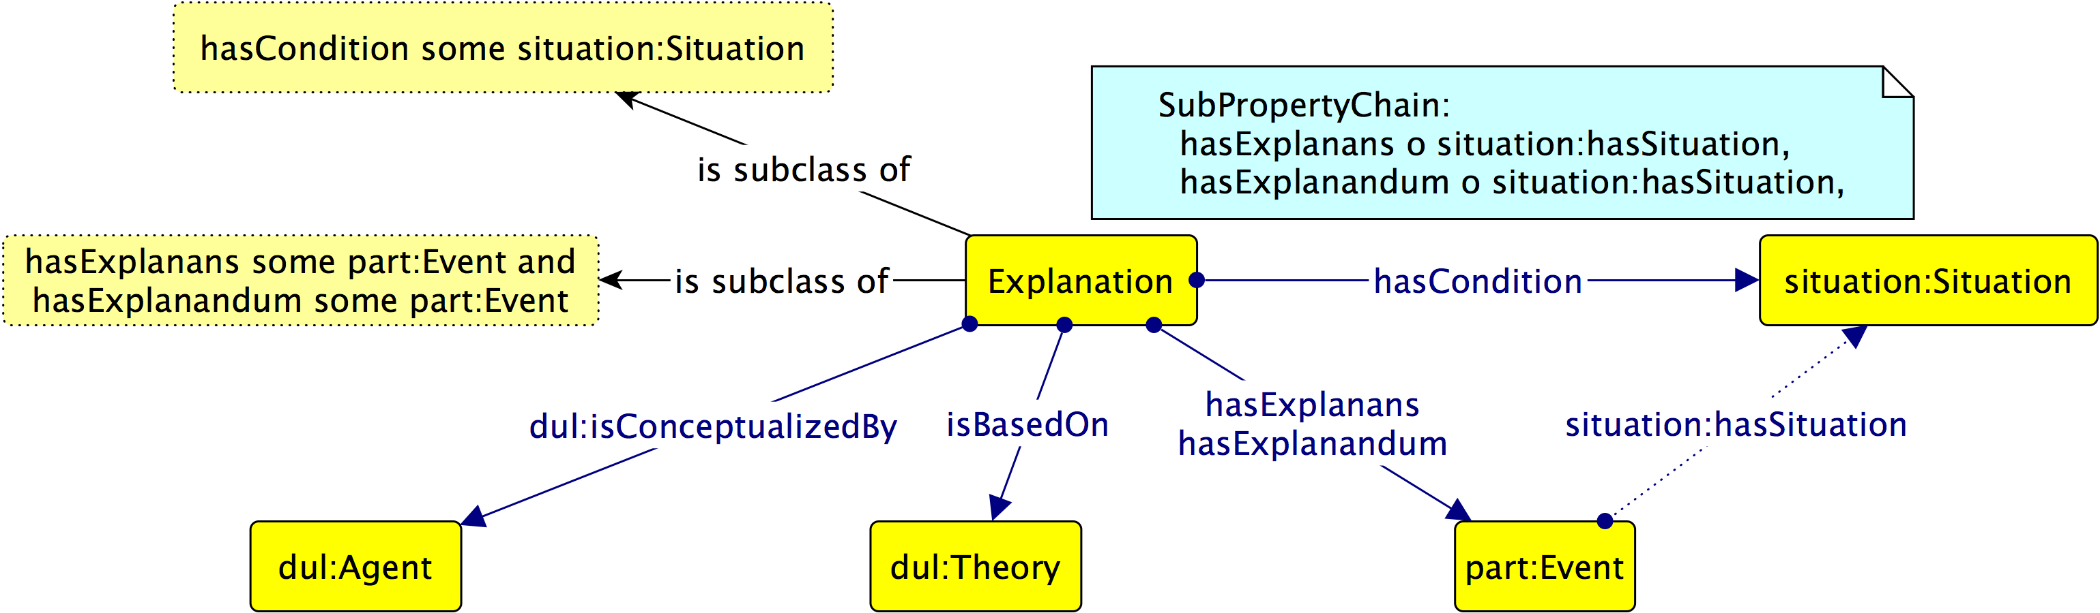
I. Tiddi Design Pattern

Slide 4

ISO 21127 Ontology-related Narration for Cultural Heritage Artifacts
Dennis Wuthrich
CEO and Founder of Farallon, which specializes in geospatial information systems. Farallon developed the leading application to support an ontology for cultural heritage information. That ontology forms the basis of ISO 21127:2014, which organizes this knowledge for museums, libraries and other cultural institutions. Heritage artifacts are not only physical objects; they include events and other constructs relevant to ontology-derived explanation.

