Slide 1
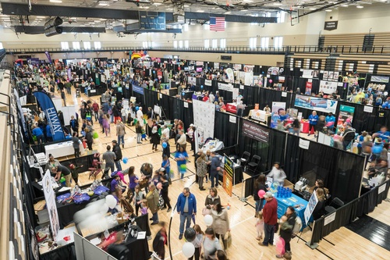

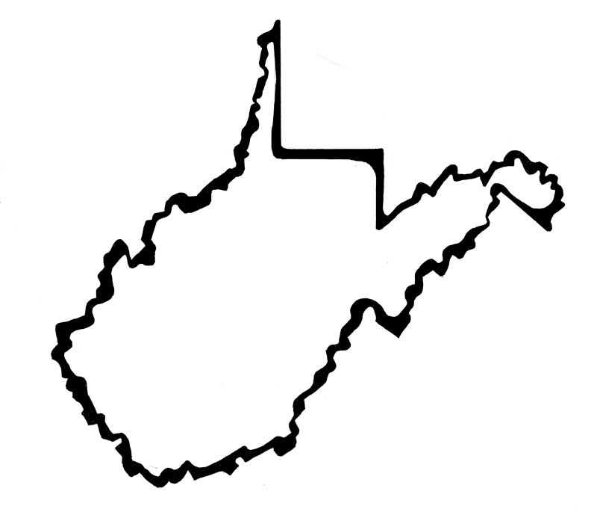
Hosted by Forest Manna Outdoors LLC
Tactical Gear
Fishing Stuff
Survival Gear
Self Reliance Tips
Homesteading Stuff
Generator Systems
Medicinal Plants
Prepping
For Veterans & First Responders
Food Preservation
Homestead Animals
West Virginia Off Grid Living, Survive & Thrive Expo!
“Take a [GO]bag, and if you do not have a
sword, sell your coat and buy one.”
- JESUS
(Luke 22:36)
October 3-5, 2025
WV State Fairgrounds
Fairlea, WV
www.wvoffgridexpo.com
Meat Processing
Farm to Table
Bush Craft Stuff
Hunting/Trapping
Celebrity Experts
Wild Edibles
Overlanding Vehicles

