Slide 1



Public Health Preparedness
Winter Emergency
Paul Kern, MBA, MS-SSEM
Public Health Preparedness Administrator
Dana Novario, MSSW
Community Preparedness Coordinator

Slide 2

Agenda
What is Extreme Cold?
How to Prepare?
Extreme Cold Scenarios
Cold-Related Illness and First Aid
Winterize Your Home and Vehicle
Resources
Start Today

Slide 3
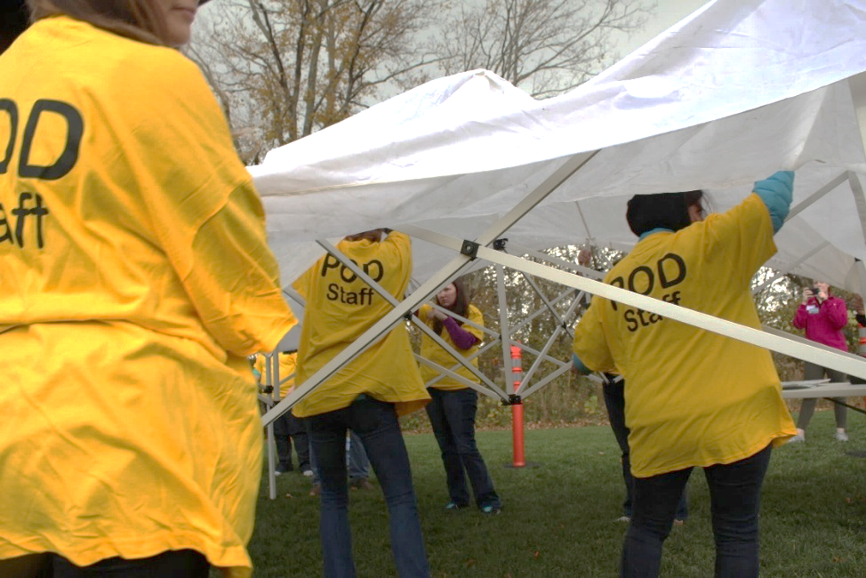
What is a Public Health Emergency?
Release of biological agent or other public health threat
Category A Threat Agents
Smallpox
Plague
Anthrax
Other Threats
Pandemic Influenza
Disease Outbreaks (i.e., Hepatitis A)

Slide 4
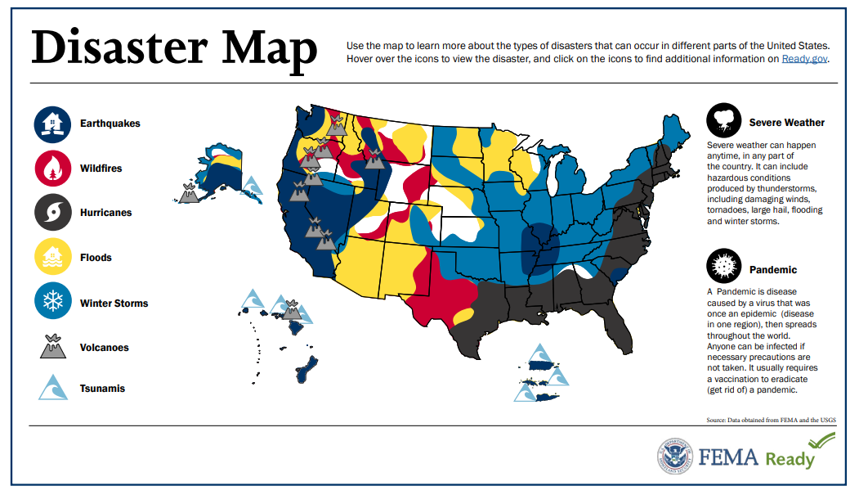

Slide 5
What is Extreme Cold?
Extremely lower outdoor temperatures that can rapidly cause the body to lose heat faster than it can produce it.
Wind chill makes temperatures feel colder.
Prolonged exposure to the cold can cause frostbite or hypothermia and can be life threatening.
Poses risks including frozen pipes, power outages, dangerous travel conditions.
Can be very problematic and dangerous for groups that have been marginalized and groups with higher risk.

Slide 6
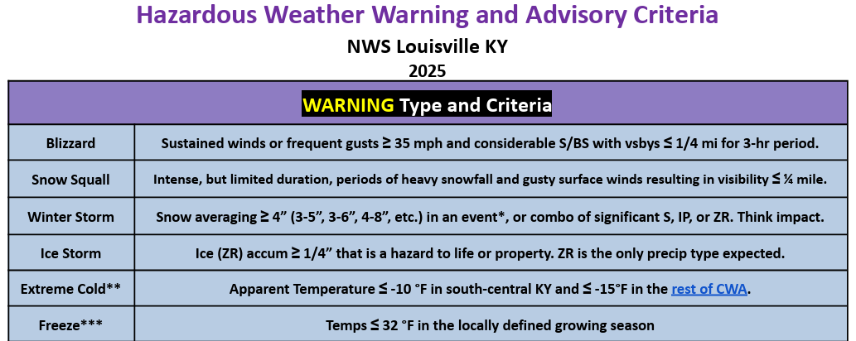
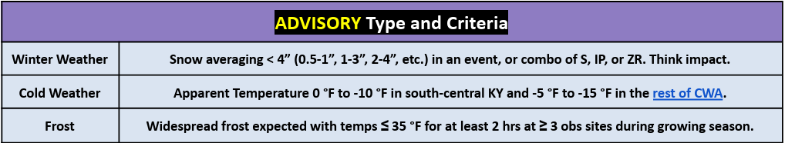
Resource Link

Slide 7

How to Prepare?
Stay up to date on prevention and mitigation techniques.
Be informed by receiving alerts, warnings, and public safety information before, during and after emergencies.
Assemble a Preparedness Kit.
Create, review, and practice family emergency plan.
Monitor trusted media for emergency information and follow instructions from public safety offices.

Slide 8





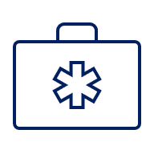
Building a Preparedness Kit
What may we need?
Every preparedness kit is different – it needs to fit the needs of your family!
Notes:
Health Preparedness:
Covid/flu tests
N95 or disposable masks
First aid kit
Medications (write them down)
Hand sanitizer
Soap (liquid, sheets, bar)
Disposable gloves
Disinfecting wipes
Water purification tablets or filter
Personal hygiene kit – toothbrush, paste, menstrual products
Waste disposal bags
Copies of prescriptions
Flash drive with immunization records, medical history, insurance documents, ID copies, medical history, pet records
Backup glasses

Slide 9



Family Communication Plan
Make a plan on Ready.Gov

Slide 10
Extreme Cold Scenario
National weather predicts a Winter Storm Warning
Governor declares a state of emergency
Activity
Read the scenario
Identify what actions you might take with only the supplies listed
Make a list of supplies that you would add to your preparedness kit for a future event

Slide 11
Extreme Cold Scenario #1
Scenario: It is 8 p.m. and you have lost power during the winter storm. You and your family prepared an emergency preparedness plan and kit to be safe prior to the storm.
Items: Shovel, flashlights, blankets, hand warmers, radio, batteries, glow stick, fully charged power block, coloring books with crayons, non-perishable food supplies, first aid kit, family members contact list, list of nearby warming centers, low charge phone.
Symptoms: None.
Actions: It’s getting extremely cold in your home; what actions may you take with the supplies you have on hand?

Slide 12
Extreme Cold Scenario #2
Scenario: It is 8 p.m. and you have lost power during the winter storm. You are unable to leave your home due to mobility issues. Your neighbors are not home to help you; you do not live near a warming center that can support you.
Items: A few water bottles, a few non-perishable snacks, candles, one flashlight, low charge phone.
Symptoms: Slurred speech, pale skin, hallucinations.
Actions: It’s getting extremely cold in your home; what actions may you take with the supplies you have on hand?

Slide 13
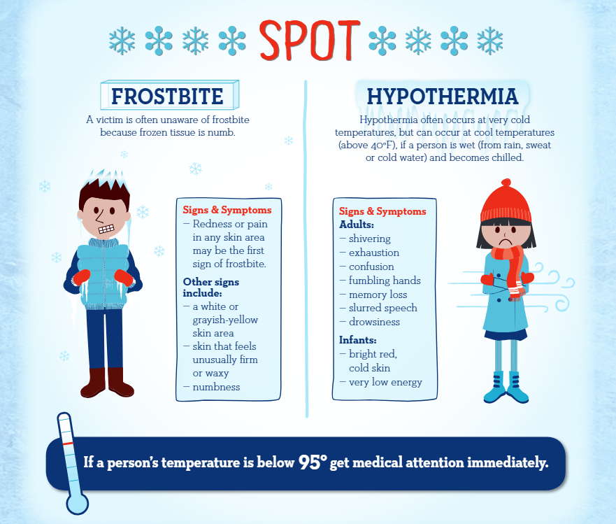
Cold-related Illnesses
Know the signs
Know the response
Have supplies ready
Resource link

Slide 14
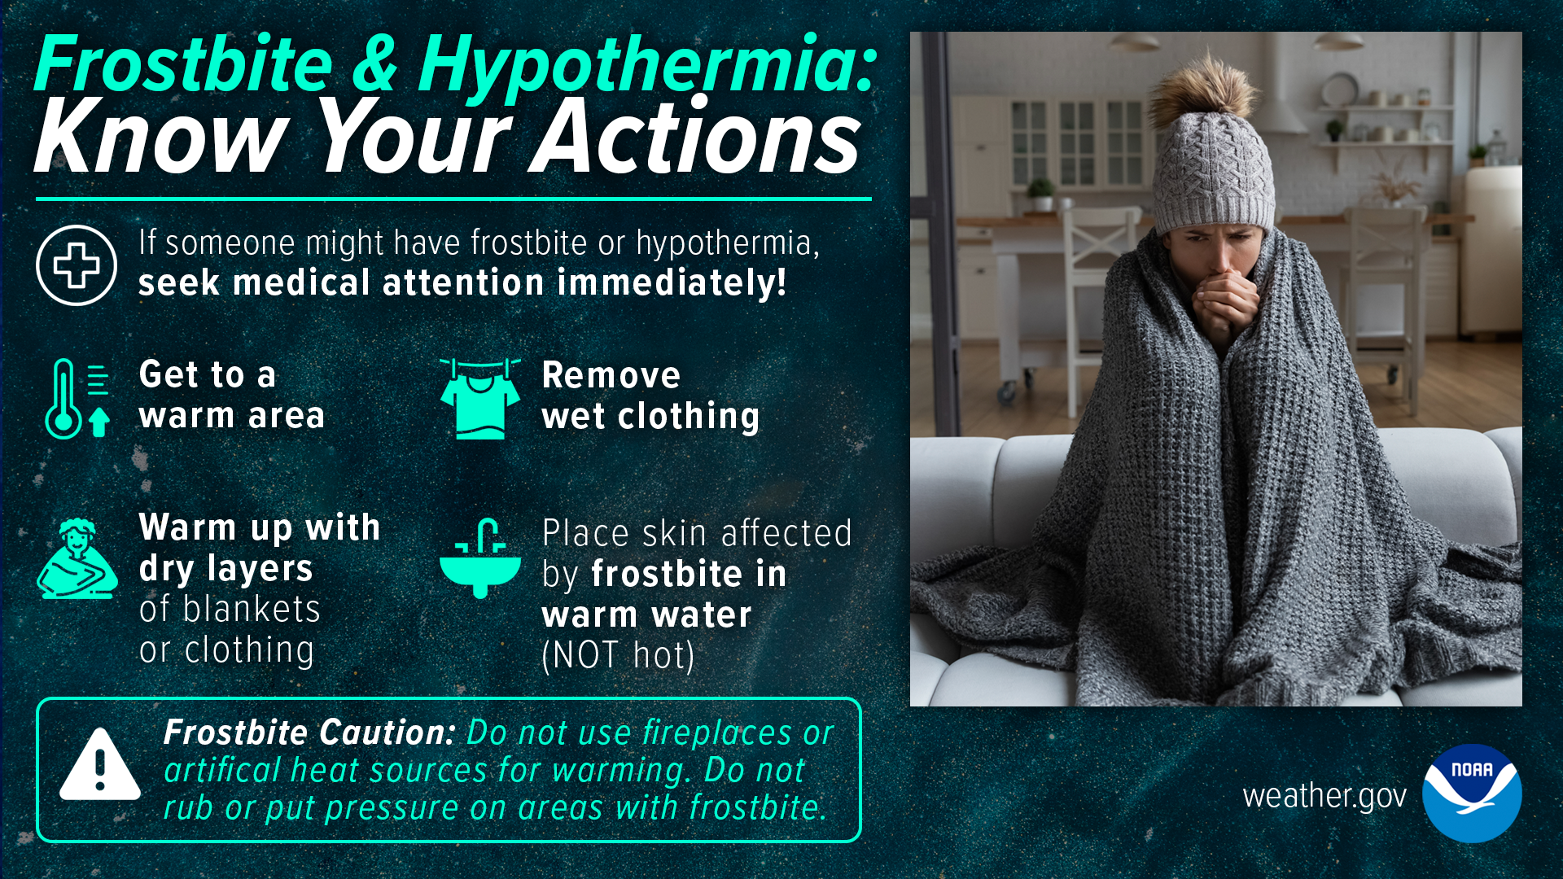

Slide 15
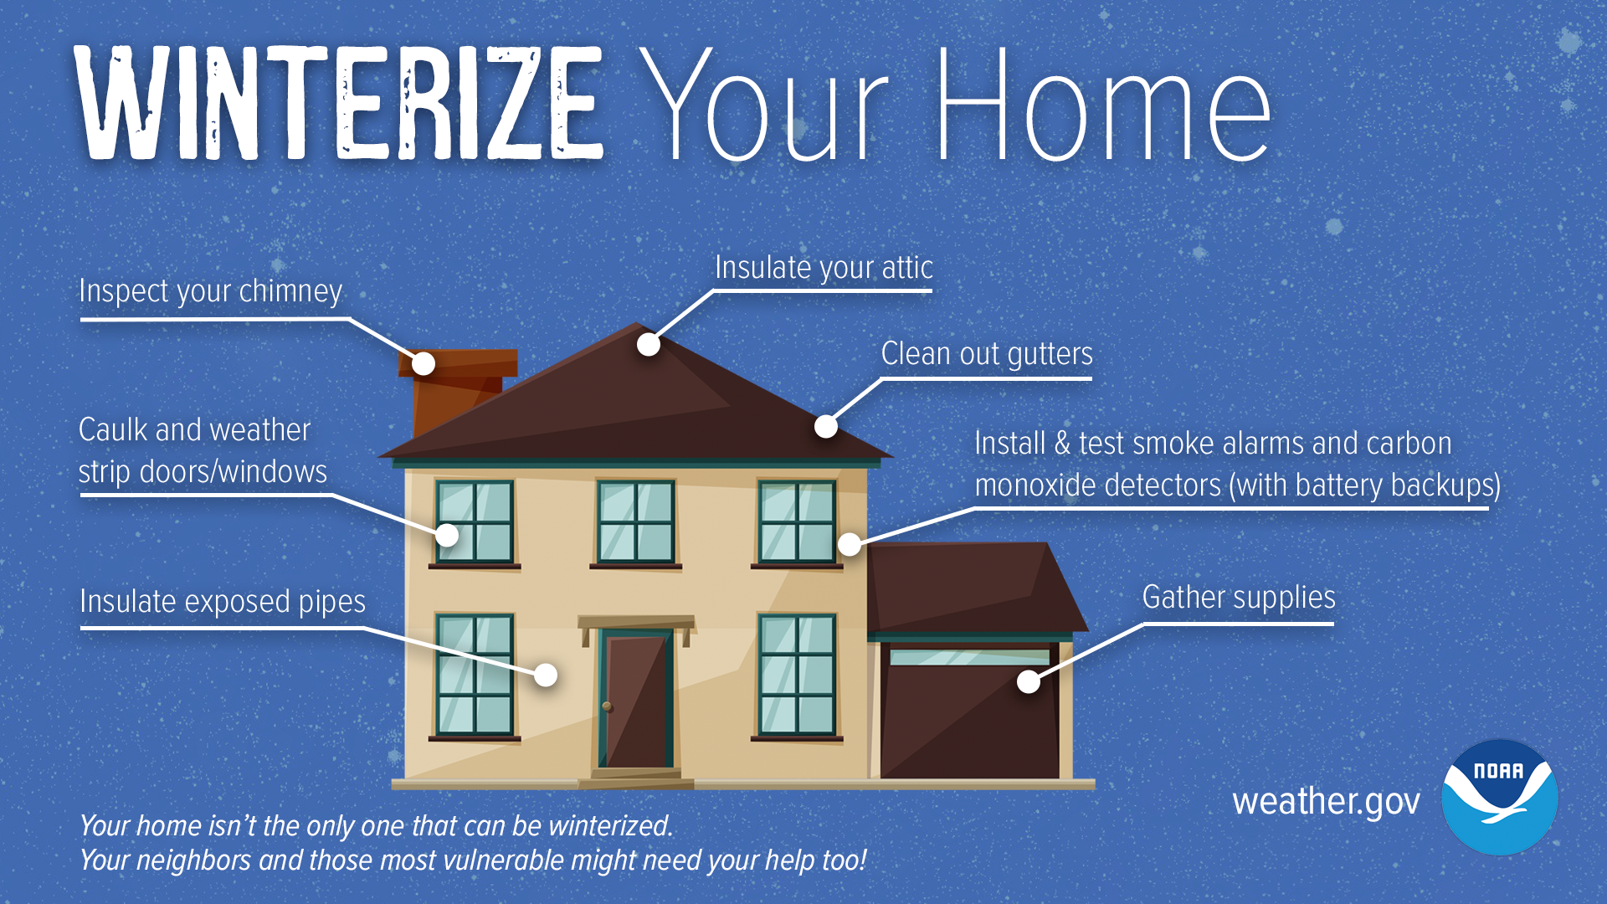
Prepare Your Home for Winter

Slide 16
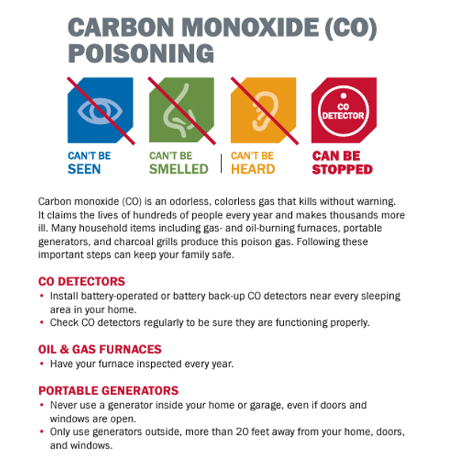
Power Outages
Do not use a gas stove or oven to heat your home.
Do not use a generator inside a home or garage or outside near an open window.
Do not leave any vehicle running inside a garage, even if the garage doors are open.

Slide 17
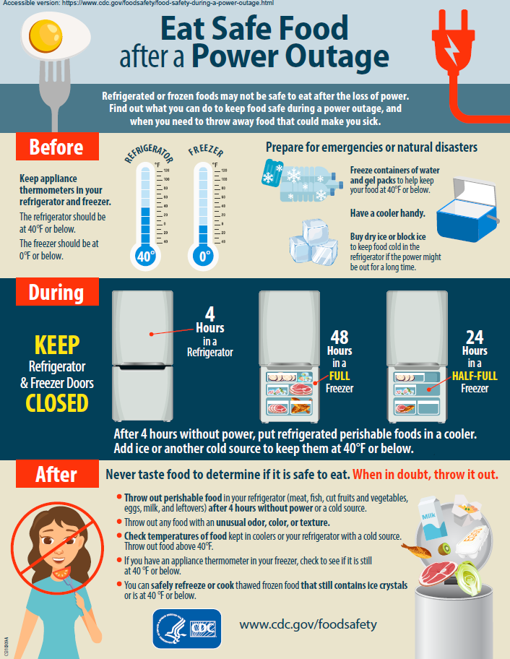
Power Outages
Keep refrigerator and freezer doors closed.
Prepare for emergencies by freezing ice/gel packs and have a cooler handy.
Use a cooler and ice packs to keep meds cold.
When in doubt, throw it out.
Resource link

Slide 18
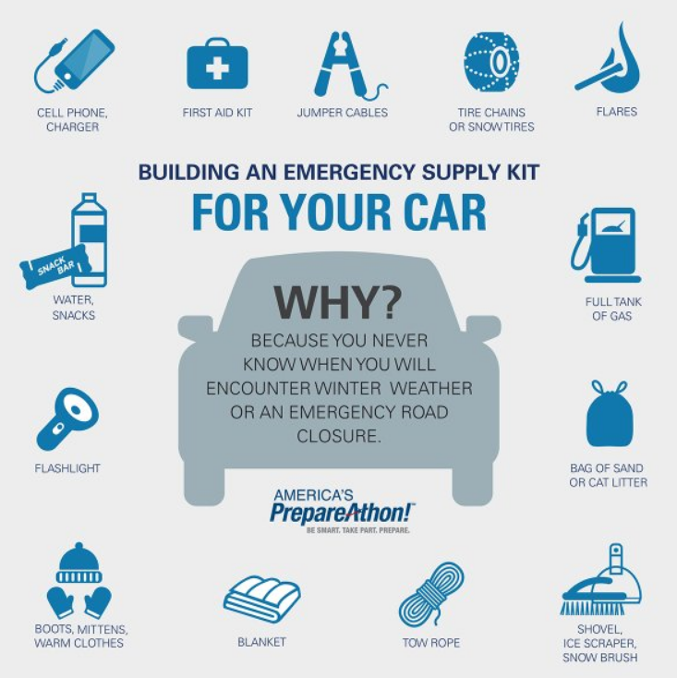
Prepare Your Car for Winter
Have your battery, antifreeze, oil, and tires checked.
Store a preparedness kit.
Plan your trip and let someone know the route.
Keep your gas tank full.
Stay tuned to the latest weather information.
Resource Link

Slide 19
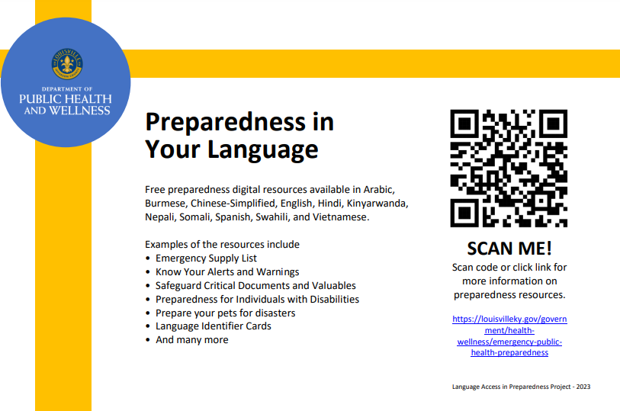

Slide 20
Preparedness Resources
Emergency Supply List
Preparing Makes Sense
Recommended Items to Include in a Basic Emergency Supply Kit.
Document includes a checklist for go-bags.
How well you and your family prepare for a disaster before it happens impacts how quickly you recover.
Know risks, make a plan, take action

Slide 21
Preparedness Resources
Safeguard Critical Documents and Valuables
Prepare your pets for disasters
Think about the priceless personal items you would want to protect from damage or take with you if you had to suddenly evacuate your home.
If you have a plan in place for you and your pets, you will likely encounter less difficulty, stress and worry when you need to make a decision during an emergency.

Slide 22
Preparedness Resources
A guide for alerts and warnings
Know your alerts and warnings
Some hazards may not have an advisory, watch, or warning. This document helps you prepare for the unknown.
This document provides images and steps to take given an emergency alert (tornado, hurricane, storms, weather, etc..)
Receiving timely information about weather conditions or other emergency events can make all the difference in knowing when to take action.
For those with access and functional needs, many messages are Teletypewriters (TTY) and Telecommunications Device for the Deaf (TDD) and many devices have accessible accommodation

Slide 23
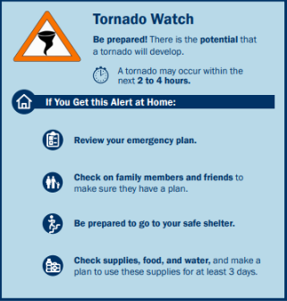
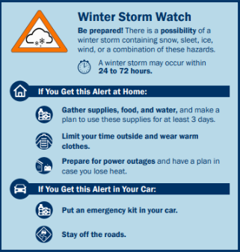
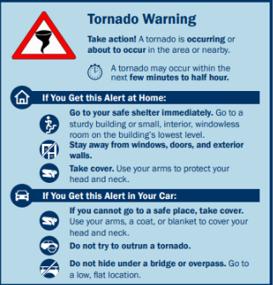
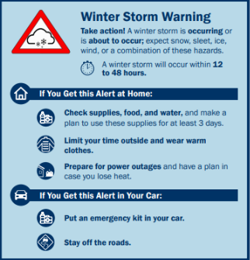
Know Your Alerts and Warnings
Notes:
This is an example of the guide to alerts and warnings. It outlines the difference between a Tornado Watch and a Tornado Warning as well as the steps to take.

Slide 24
Preparedness Resources
LMPHW Preparedness 101
Preparedness for Individuals with Disabilities
Great resource for community members for a quick 101 on preparedness.
How to be informed
Training resources
Our social media and contact information
In addition to having your basic survival supplies, an emergency kit should have items to meet your individual needs in various emergencies.

Slide 25
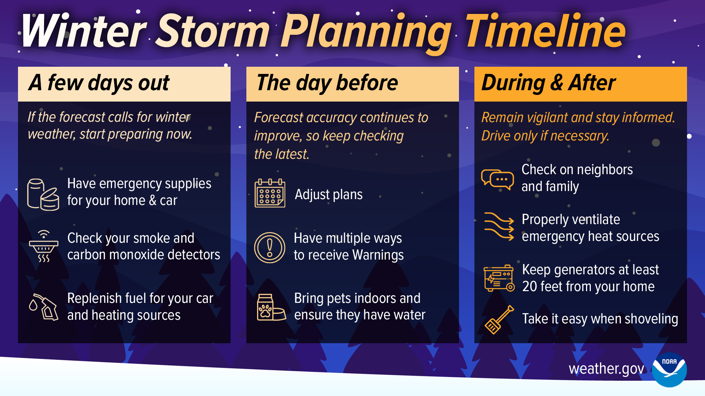
Cold-Related Illnesses

Slide 26
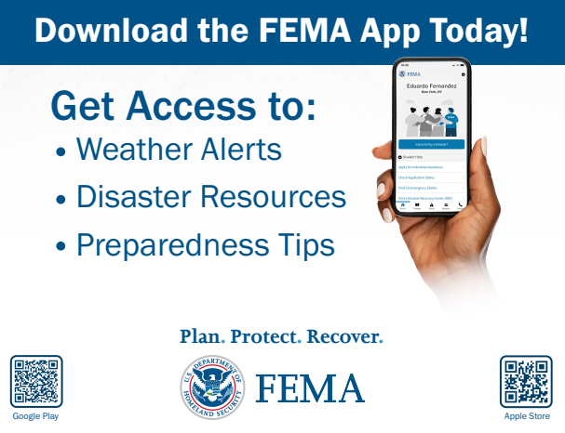

Start today!
Opt-in for LENSAlert with your cell phone.
Text "LENSAlert" to 67283 to start receiving emergency notifications.

Slide 27
Additional Resources
American Red Cross – Winter Storm Safety, Tormenta Invernal (Español)
Centers for Disease Control and Prevention
Winter Weather: Before, During, and After
Preparing for a Winter Storm, Prepárese, Tiempo Invernal (Español)
Preventing Hypothermia, Preventing Frostbite
Working in the Cold, Cold-Related Illnesses in Workers
Carbon Monoxide (CO) Poisoning Fact Sheet (multilingual)
Center for Applied Environmental Health – Emergency Planning Guide
Louisville Metro Public Health and Wellness – Multilingual Digital Library (multilingual)
National Weather Service – Cold Weather Safety, Winter Preparedness Checklist
Occupational Safety and Health Administration – Cold Stress Guide
Ready.Gov – Winter Weather (multilingual)

Slide 28
Questions?
Paul Kern, Public Health Preparedness Administrator
Paul.Kern@LouisvilleKY.Gov
Dana Novario, Community Preparedness Coordinator
Dana.Novario@LouisvilleKY.Gov
www.louisvilleky.gov

