Slide 1
Testifying 101

Slide 2
Testifying 101
Thank you

Slide 3
Testifying 101
Why it matters

Slide 4
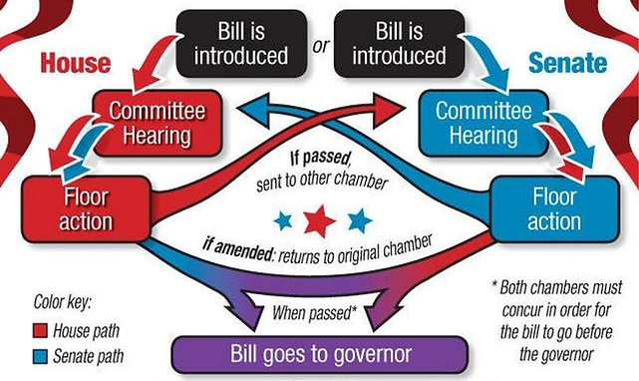
How a bill becomes a law

Slide 5
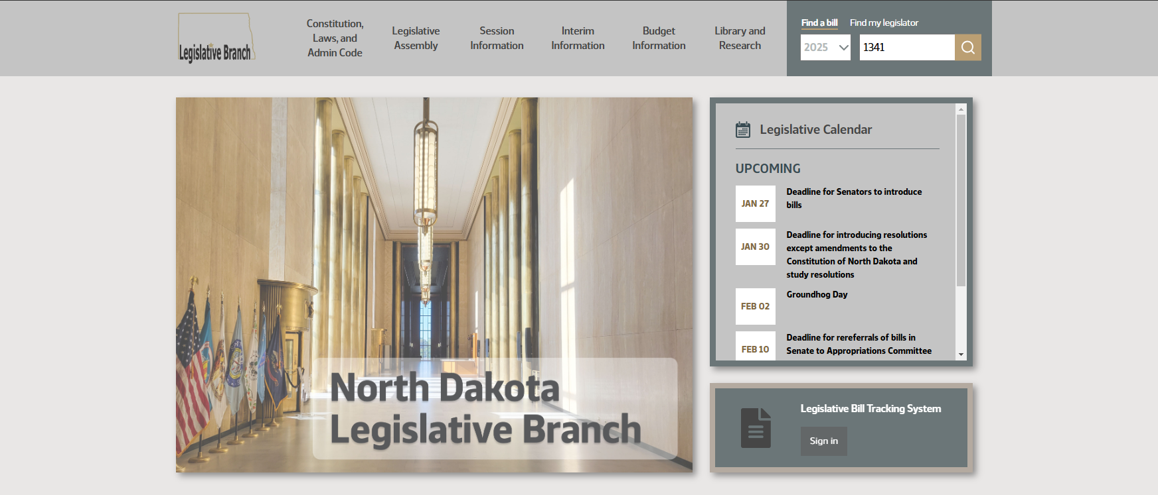
Finding a bill hearing
NDLegis.gov

Slide 6
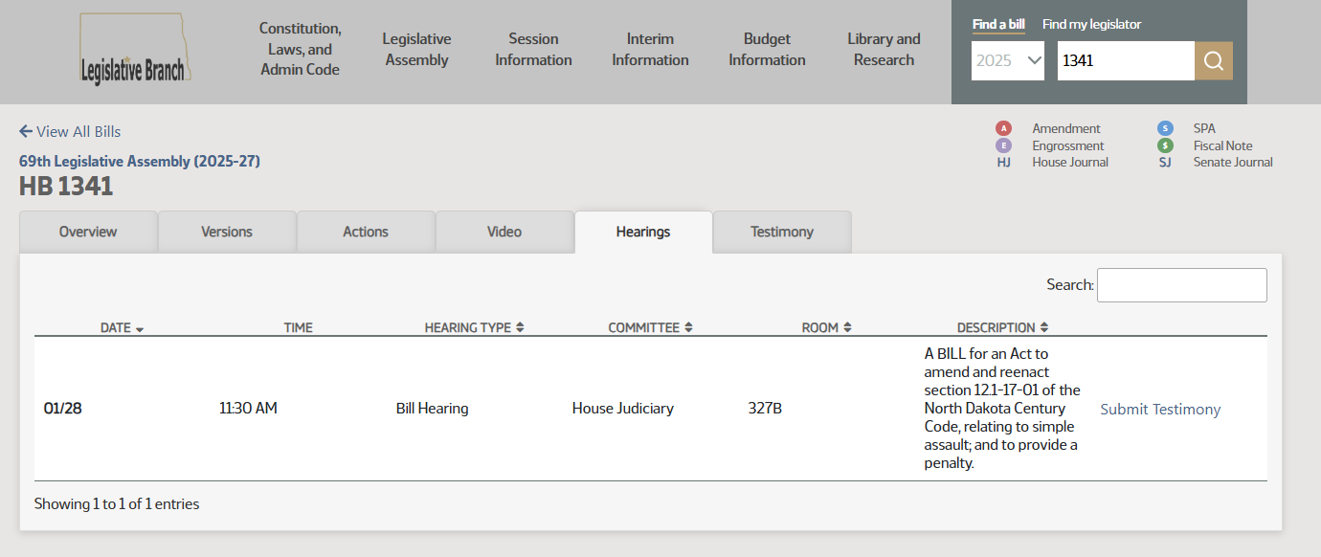
Finding a bill hearing
NDLegis.gov

Slide 7
Written testimony: what to include
Bill #
Address testimony to the committee chair
Introduce yourself
State your position
Explain why you support/oppose
Summarize
Thank you
Contact information

Slide 8
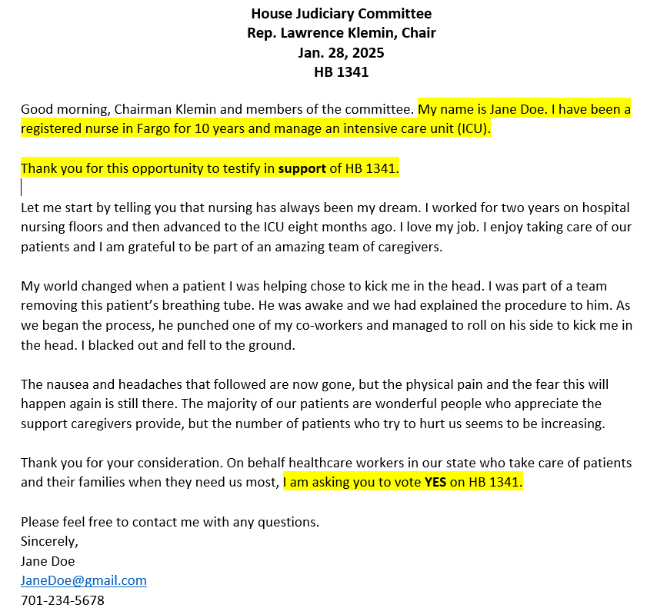

Slide 9
Written testimony: preparation
Understand the legislation
Be courteous and professional
Gather evidence:
  Statistics
  Case studies
  Personal anecdotes to support your arguments
  Data
Be concise
  2-3 talking points, 3-4 minutes testimony

Slide 10

Written testimony

Slide 11
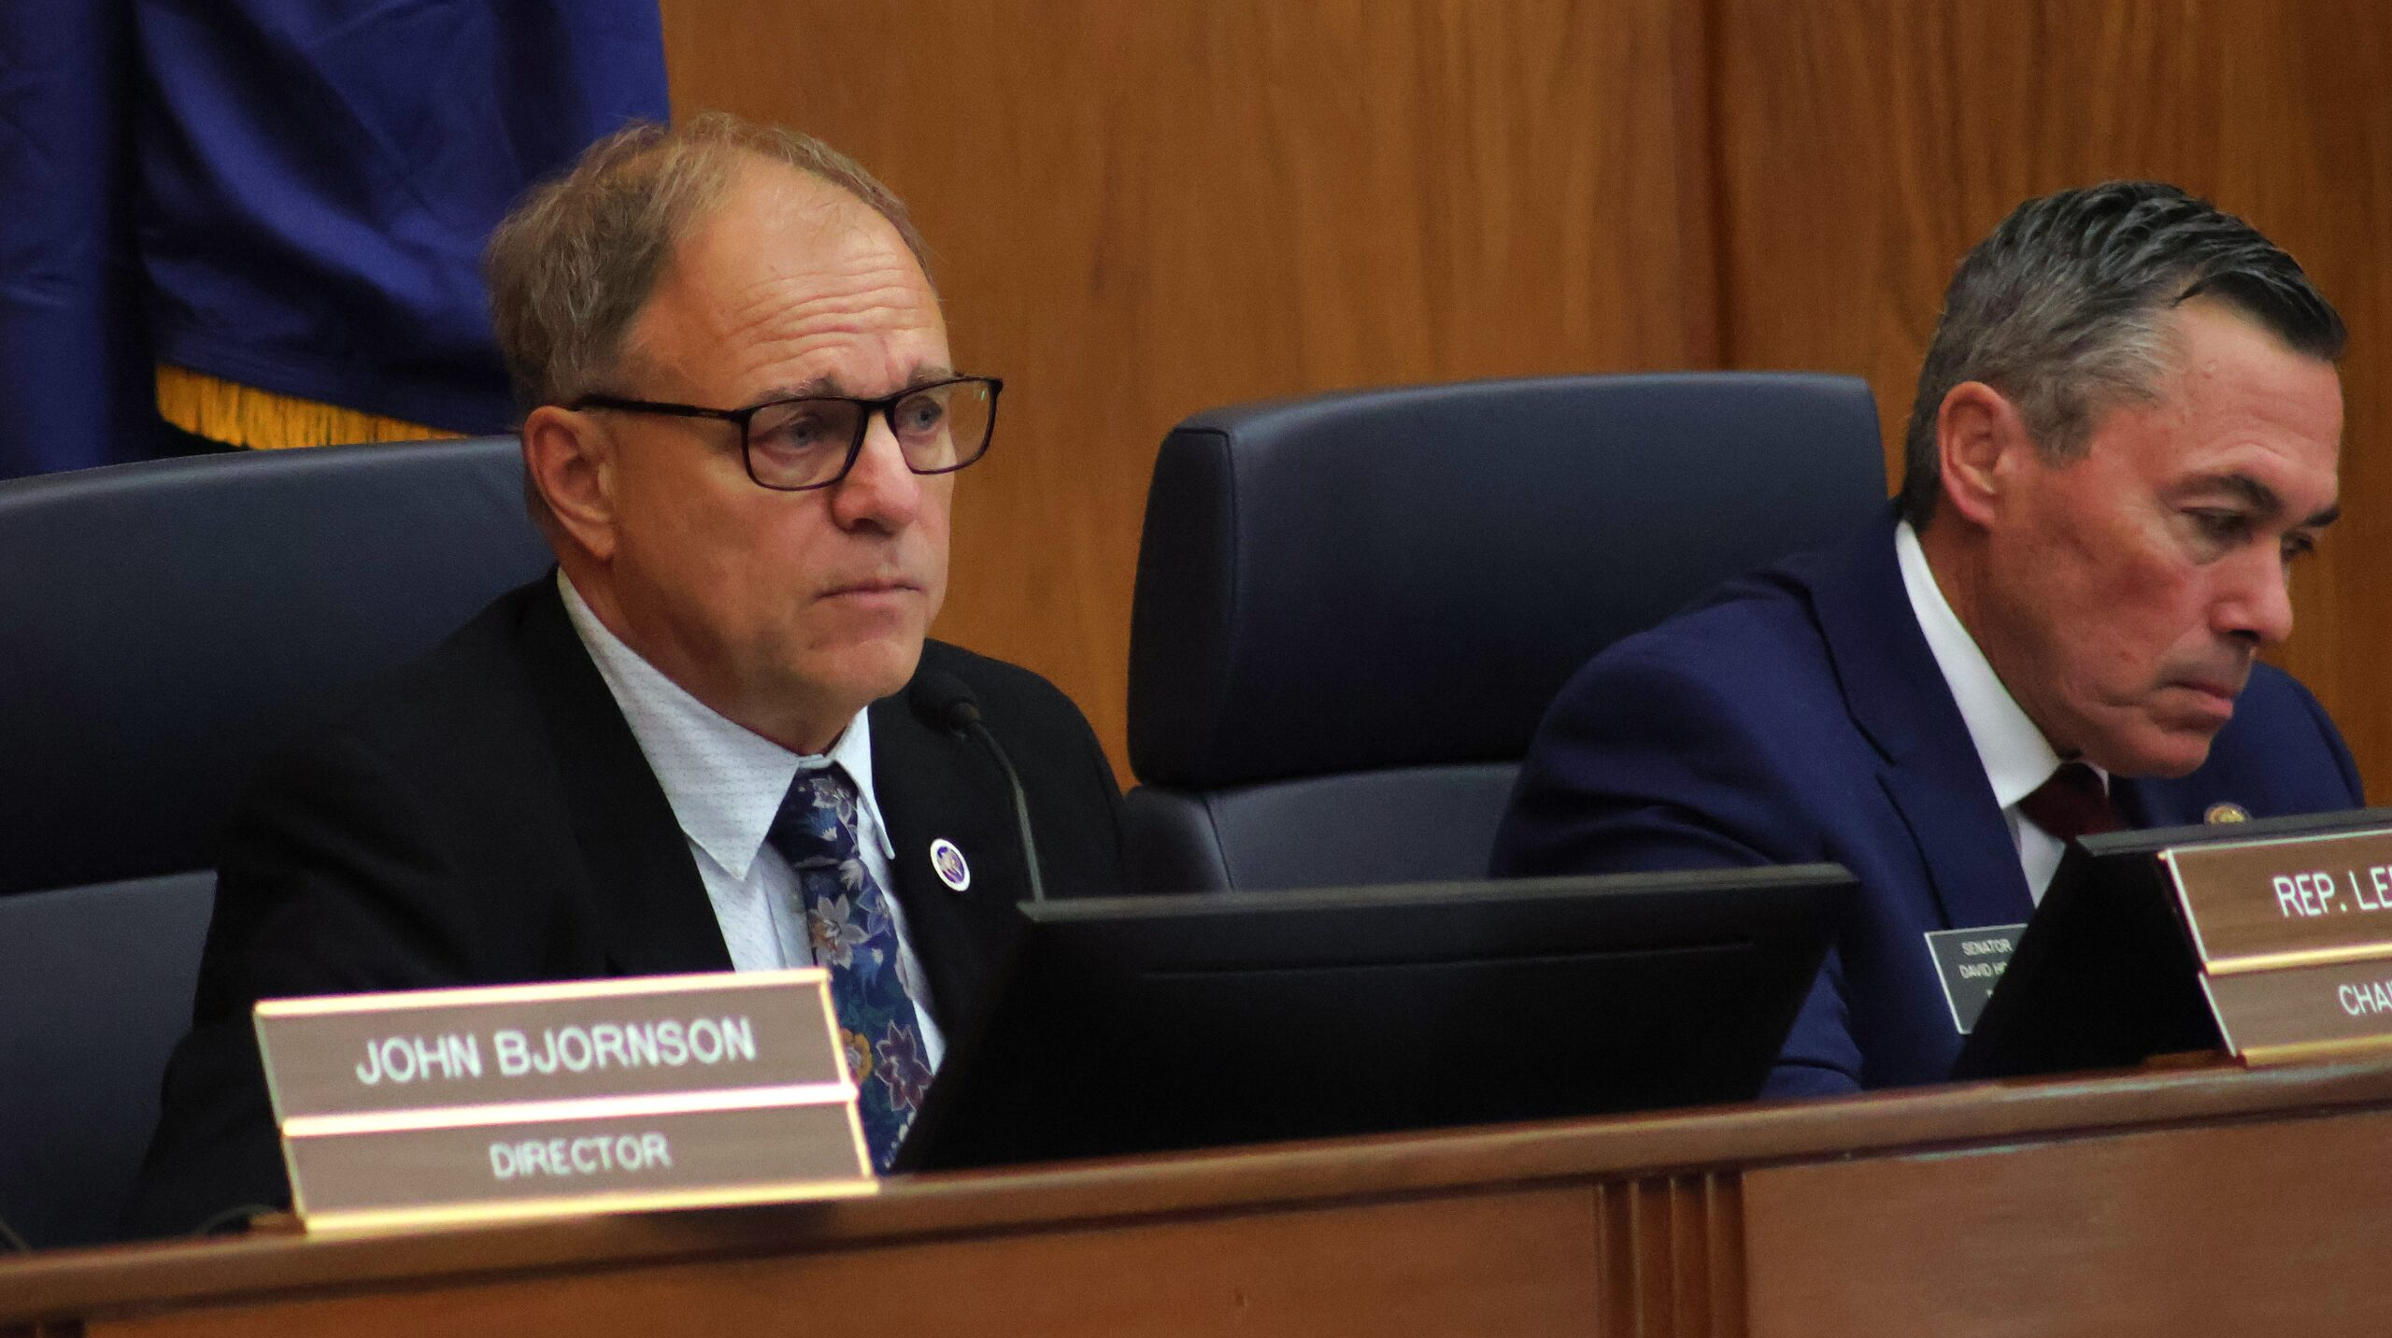
Testifying in person
Bring printed copies of your testimony
Arrive early
Sign in
Bill hearing format
Your testimony: read it?
Addressing the committee
Q&A
Serious room, serious conversations

Slide 12


Slide 13
Miscellaneous tips
Avoid technical jargon and complex terminology
No acronyms
No guessing
Your written testimony: read it or not?
When to say “Ditto.”
Personal stories
Practice and time yourself

Slide 14
Miscellaneous tips
Think about what the opposition is going to say
Watch the committee in advance
Research the committee members
Connect with others planning to testify

Slide 15

Thank you!

