Slide 1

Decreasing Unnecessary EKG and Pulse Oximetry Alarms in the ICU
A quantitative Research Study
By Laura Warburton MSN,CNL,ccrn

Slide 2
Background
A large amount of the noise distracting nurses from daily tasks and adding to patient and family anxiety is unnecessary.
Researchers have found that 80% to 99% of alarms are false or insignificant (Cvach et al., 2015).
This bombardment of alarms has resulted in what has been labeled alarm fatigue and has contributed to sentinel events.
Whalen et al (2014) defines alarm fatigue as “the phrase used to describe the phenomenon of medical providers becoming so desensitized to the constant noise emitted from monitors that they fail to notice alarms or react to alarms in a timely manner” (p.E14).

Slide 3
Background
Ross (2015) noted that noise levels in ICU’s have reached 80 dBA, a weighted sound in decibels, far exceeding the World Health Organization’s recommendation of 35 or less dBA for a hospital unit.

Slide 4
Significance of the Problem
Between Jan 2009 and June 2012 the Joint Commission has collected 98 reports on alarm related incidents. Eighty of the 98 patients died as a result (The Joint Commission, 2013, p. 1).
Cvach, Frank, Doyle, and Stevens (2014) reported that from 2005 to 2008, the Food and Drug Administration MAUDE: Manufacturer and User Facility Device Experience Database, obtained 566 reports of alarm monitoring incidents that resulted in death.

Slide 5
National Patient Safety Goal
According to Funk, Clark, Bauld, Ott, and Coss (2014), the Joint Commission continues to list alarm safety as one of their top ten national patient safety goals. In fact, it has now required hospitals to make alarm management a top priority.
Starting 2016 the Joint Commission expects hospitals to implement unit specific policies and guidelines for alarm management that includes staff education (Funk et al., 2014).

Slide 6
Review of the Literature
A thorough review of the literature was done using CINAHL, COCHRANE, PUBMED, MEDLINE and OVID databases revolving around the topic of alarm management.
The keywords “alarm fatigue”, “artifact”, “electrocardiogram monitoring”, “ICU” and “alarm management” were utilized.
The majority of the literature surrounding alarm management focuses on quality improvement initiatives that yielded great results at reducing alarm fatigue.

Slide 7
Review of Literature
Studies suggest that proper skin preparation can improve the adherence of electrodes to the skin thus reducing the number of nuisance alarms.
Walsh-Irwin and Jurgens (2015) conducted a prospective study on the impact of proper skin preparation and lead placement on the number of false alarms that occurred over a 24 hour time period.
Their findings resulted in a 44% decrease in the number of alarms (P<0.5) after implementing proper skin preparation and lead placement.
Notes:
Their study took place in June 2013 on a telemetry unit at a Veteran Affairs Hospital. The sample size included 15 patients who were chosen using a purposive sampling technique. Researchers counted the number of alarms both prior to and after the utilization of proper skin preparation.

Slide 8
Review of the Literature
A quality improvement project that incorporated multiple interventions to help decrease the number of monitor alarms was done on a 15-bed Medical Progressive Care Unit (MPCU).
These interventions included changing default alarm settings on the monitors, staff education, and individualizing alarm parameters. Pre-intervention baseline alarm data was collected over an 18-day period.
The total of alarms in the 18-day period decreased from 16,953 alarms to 9,647, which was a 43% reduction in alarms post intervention. Grahm and Cvach (2010)

Slide 9
Review of the Literature
In another quality improvement initiative, Cvach, Biggs, Rothwell and Charles-Hudson (2013) found that daily electrode change with skin preparation was effective at reducing the number of EKG alarms in two adult medical units.
The two units included a Medical Progressive Care Unit (MPCU) and a Cardiology Care Unit (CCU). Daily electrode change was trialed over an eight-day period between 8am-12pm.
Alarm data was collected after the intervention and compared with previous alarm data. There was a 32% decrease in the total number of electrode-related technical alarms for MPCU and 56% decrease for CCU.

Slide 10
Review of the Literature
Whalen, Covelle, Piepenbrink, Villanova, Cuneo, and Awtry (2014),performed a quality improvement study on a 24-bed medical/surgical floor with remote telemetry.
A 6-week pilot study was done that included changing default heart rate parameters and changing the alarms for tachycardia and bradycardia to crisis mode.
The low heart rate setting was lowered to 45 BPM and the high heart rate parameter was increased to 130 BPM.
The number of alarms decreased from a total of 87,823 to 9,967 alarms per week. These findings reflect an 89% decrease in the number of audible alarms per week on this pilot unit.

Slide 11
Review of the Literature
Welch (2011) performed a retrospective analysis on 32 million pulse oximetry data points from post-surgical care areas at ten different hospitals over an 11-month period.
Researchers found that by decreasing the SpO2 threshold from 90-88 reduced the average number of alarms by 45%.
This study also showed that adding an alarm delay of 15 seconds reduced the average number of alarms by 70%.
Many O2 saturations that fall below 90% are temporary and the saturation goes back up within a short period of time. (Welch 2011)

Slide 12
Review of the Literature
Qualitative Studies on Alarm Fatigue
According to Christensen, Dodds, Saur and Watts (2014) an open-ended questionnaire was used to explore the nurses’ perceptions of alarm fatigue in the ICU. Results showed that 93% of RN’s felt that alarm fatigue can lead to desensitization.
Honan, Funk, Maynard, Fahs, Clark and David (2015) performed a qualitative study to investigate the nurses’ feelings around clinical alarms. A national survey was distributed to 406 nurses. The following six themes emerged from this study: dissonance and desensitization; pollution, panic, and pathology; calling for accountability; calling for authority of nurses; clinical alarm management is crucial but not a panacea; and hope for the future.

Slide 13
Local Problem
Many nurses in the ICU/PCU at St. Vincent’s were showing signs of alarm fatigue. A staff nurse at St. Vincent’s ICU/PCU stated “nurses aren’t bothering to respond to alarms if it isn’t their own patient.” There are so many alarms that go off between the two units that nurses are starting to tune out the noise. Alarm management needs to be a team approach and the patient must not suffer due to the nurse’s mental exhaustion.

Slide 14
Microsystem/Setting
St. Vincent’s Medical Center located in Bridgeport, Connecticut is a 473-bed community teaching hospital and is part of the Ascension Health network.
There are 14 beds designated to the Intensive Care Unit (ICU) and 15 beds in the Progressive Care Unit (PCU). The acuity of the patients determines the need for PCU beds to be used as temporary ICU beds.
The nursing staff at the time of the study included 76 RNs including part time, full time and per diem. The ICU portion of the unit is a 2:1 patient to nurse ratio and the PCU portion of the unit is a 3:1 patient to nurse ratio.
Notes:
The two units mirror each other forming a large circle and contain 14 beds on the south wing and 16 beds on the north wing. The 16 beds on the north wing are designated as PCU beds and the14 beds on the south wing are designated as ICU beds.

Slide 15
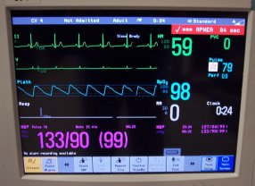
Purpose
The purpose of this study is to decrease the number of false/unnecessary electrocardiogram (ECG) alarms and pulse oximetry alarms that occur in the ICU and PCU at St. Vincent’s Medical Center.

Slide 16
Aim Statement
Global Aim= is to improve alarm management in the ICU and PCU at St. Vincent’s Medical Center using a bundled approach.
Specific Aim=The specific aim is to is to decrease the total number of alarms by 30% in both the ICU and PCU within a six month time frame.

Slide 17
Plan for Improvement/Methodology
IRB Approval
The proposal on decreasing the number of false EKG and pulse oximetry alarms was submitted to the IRB for approval in November 2015. The study was granted approval Dec 2015.

Slide 18
Survey Board
A survey board was posted on the unit in Jan 2015 to get an idea of how the nursing staff felt about the alarms.
Permission was granted from the Healthcare Technology Foundation to use their 2011 survey on alarm fatigue. Select questions were taken from their survey and were posted in the staff break room in survey board format.
Notes:
Take home message: Always get formal permission to use any tool or survey in your research.

Slide 19
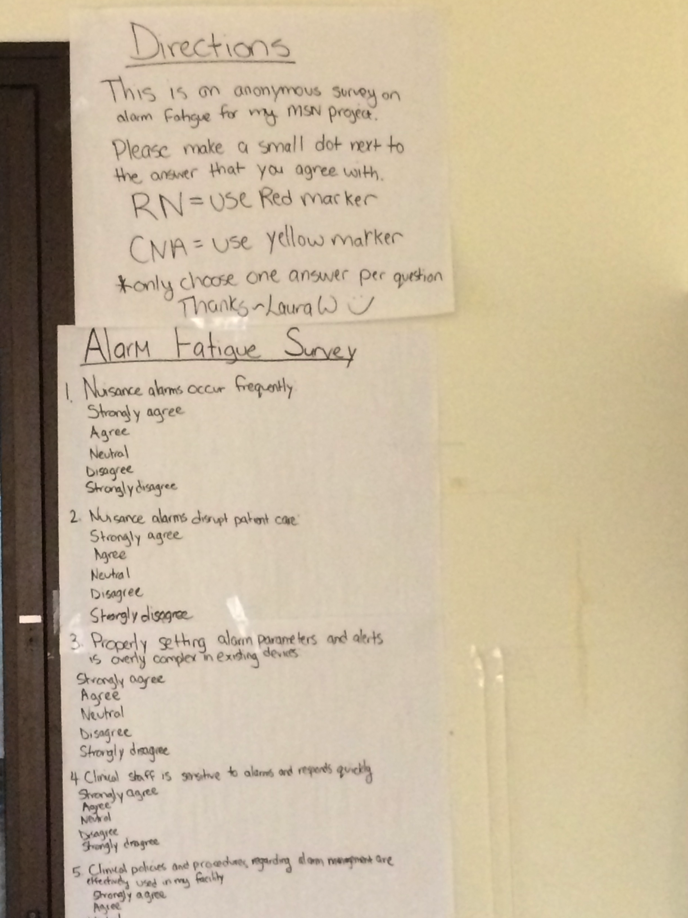

Slide 20
Survey Board Questions
Nuisance alarms occur frequently:
Strongly agree
Agree
Neutral
Disagree
Strongly disagree
Nuisance alarms disrupt patient care:
Strongly agree
Agree
Neutral
Disagree
Strongly disagree
Properly setting alarm parameters and alerts is overly complex in existing devices:
Strongly agree
Agree
Neutral
Disagree
Strongly disagree

Slide 21
Survey Board Questions
Clinical staff is sensitive to alarms and responds quickly
Strongly agree
Agree
Neutral
Disagree
Strongly disagree
Clinical policies and procedures regarding alarm management are effectively used in my facility
Strongly agree
Agree
Neutral
Disagree
Strongly disagree
There is a lack of training on alarm systems
Strongly agree
Agree
Neutral
Disagree
Strongly disagree

Slide 22

Survey Board Results
The pre-intervention survey board results showed that 83% of the participants strongly agreed that nuisance alarms occurred frequently.
Sixty six percent of responders also strongly agreed that nuisance alarms disrupt patient care.
More than 50 percent of responders agreed that there is a lack of training on the alarm systems showing that education was needed.
Notes:
These results suggest that staff is aware that there are a multitude of unnecessary alarms and that they also feel that these alarms are compromising patient care.

Slide 23
Plan for Improvement/Methodology
Stakeholders
An Alarm Management team was formed that included several staff RNs from the ICU/PCU, the Nurse Manager of the ICU/PCU, the Clinical Nurse Leader, Nurse Educator, an ICU APRN, a CNA, and a Respiratory Therapist.
Meeting were held every other month to discuss progress.

Slide 24
Plan for Improvement/Methodology
A Bundled Approach
The proposed interventions include
changing electrodes every 24 hours using a skin prep technique
educating staff on tailoring alarm parameters to meet the individual needs of their patients.
changing default settings on the EKG monitors if applicable
Notes:
The steps for proper skin preparation are listed in the AACN’s Practice Alert on Alarm Management (2013) and include washing the isolated electrode area with soap and water, wiping the electrode area with a rough washcloth or gauze, and/or using the sandpaper on the electrode to roughen a small area of the skin.

Slide 25
Plan for Improvement/Methodology
The hypothesis was that the implementation of these three interventions will decrease the total number of EKG and pulse oximetry alarms in the ICU and PCU.

Slide 26
Proper Skin Prep
The steps for proper skin preparation are listed in the AACN’s Practice Alert on Alarm Management (2013) and include washing the isolated electrode area with soap and water, wiping the electrode area with a rough washcloth or gauze, and/or using the sandpaper on the electrode to roughen a small area of the skin.

Slide 27
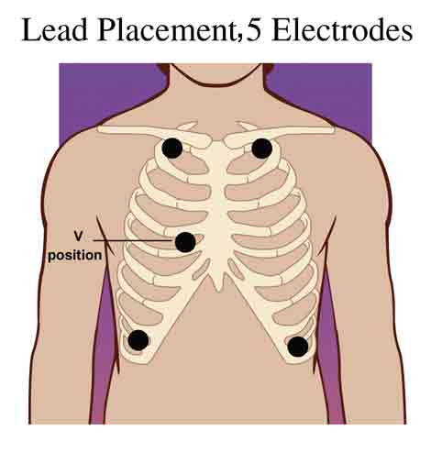
Proper Lead Placement
Remember to prep skin and change electrodes with every bath (q24 hr)
Notes:
Education was giving on proper skin prep and changing electrodes daily. Wash skin with soap and water. Clip hair if needed. Dry with a towel or gauze. No alcohol!

Slide 28

Proper Storage of Electrodes
After meeting with the Philip’s alarm representative in Jan 2015 it was brought to our attention that we were not storing our electrodes properly.
Solution- ordered electrodes in packs of five instead of bulk packaging.
Notes:
The bulk packaging was leaving the electrodes open to air and drying them out. This Can contribute to false alarms.

Slide 29
Alarm Parameter Education
All nursing staff was educated on tailoring their EKG alarm parameters to meet the need of their patient.
Alarm management guidelines were created which incorporated the current alarm management policy plus added tips on altering alarms.
Two nurses from the alarm team as well as myself did all the education and handed out a copy of the guidelines for each nurse to keep.

Slide 30
Changing the Default Settings
Unfortunately making changes to the default settings was unable to be completed.
The hospital is in the process of purchasing new monitors. The time and effort it would take to have clinical engineering alter the current monitors did not make sense when they are going to be replaced.
For this reason this intervention was not included in my study.

Slide 31
Data Collection
A data collection tool was created to identify the total number of EKG and pulse oximetry alarms and the alarms that occur the most frequently.
Data was collected from the Philip’s central monitor where patient alarms are recorded. Data was collected without any patient information.

Slide 32
Data Collection
Data was collected during a seven-day time frame. The first set of data was collected prior to any interventions. Data was collected after each intervention was implemented. The last set of data was collected after all the interventions were implemented.
The data was collected using the attached data collection tool and entered into Excel.

Slide 33
Data Collection Tool

Slide 34
Alarm Data Results ICU
Pre-intervention
The total number of alarms that occurred in a 7-day time frame in the ICU was 14,041.
Descriptive statistics were used to analyze the results.
After the first two interventions were completely implemented the total alarms in a 7-day time frame decreased to 8150 which is a 42% decrease from the baseline data.

Slide 35
Survey Board Results
The post-intervention survey board showed that 79% of the participants strongly agreed that nuisance alarms occurred frequently.
Fifty five percent of the participants in the post survey strongly agreed that nuisance alarms disrupt patient care.
These results show a slight decrease in the perceived amount of nuisance alarms that occur and a decrease in the alarms disrupting patient care. This suggests that the interventions from this study have made a difference in decreasing the overall noise in the unit.

Slide 36
ICU Alarm Data Results

Slide 37
Average Alarms Per Bed Per Day ICU
Notes:
MEAN NUMBER OF ALARMS PER BED PER DAY WEEK 1 201 WEEK 2 209 WEEK 3 192 WEEK 4 146 73 PERCENT DECREASE IN ALARMS PER BED IN ICU

Slide 38
Pulse Oximetry Alarms
There was a decrease in the pulse oximetry alarms in the ICU.
The number of desaturation alarms decreased from 143 to 92 after education was given on individualizing alarm parameters.
Staff may be setting individualized Sao2 alarms after receiving the education.
Staff was also told not to place the pulse oximetry probe on the same arm that the blood pressure cuff is on.

Slide 39
ST Elevation Alarms
The total number of ST elevation alarms also decreased in the ICU from 83 to 25 after the interventions were implemented. Broadening the ST elevation alarm from >1.0 mm to >2.0 mm was explained in the educational handout provided.

Slide 40
Alarm Data Results PCU
In the PCU the total number of alarms that occurred in a 7-day time frame was 11,292.
After the two interventions were implemented the total number of alarms in a 7-day time frame was 5198 which is a 54% decrease from baseline.

Slide 41
PCU Alarm Data Results

Slide 42
AVERAGE NUMBER OF ALARMS PER BED PER DAY PCU
Notes:
MEAN NUMBER OF ALARMS PER BED PER DAY WEEK 1 161 WEEK 2 88 WEEK 3 124 WEEK 4 93 58% DECREASE

Slide 43
Discussion/Limitations
Alarm survey board was anonymous so pre and post survey may not have had the same responders.
The third intervention-changing the default settings was unable to be completed.
This study depended a lot on bedside RN compliancy which can often times be inconsistent.
Collecting alarm data is a long and tedious process. Having a larger team collecting the data would have allowed for more data points to be produced.

Slide 44
Discussion/Limitations
Data was collected from the Philip’s Monitor and recorded on excel sheet. Some of the calculations were made manually and could contain error.
Focusing on just the ICU or PCU instead of taking on both units at once may have been easier to control the outcomes.
Doing a pilot study on a smaller unit with less staff would make the education process easier and it may also lead to greater consistency with the interventions.

Slide 45
Recommendations
Using a bundled approach to decrease the number of EKG and pulse oximetry alarms is effective and transferrable to other telemetry units.
Forming an alarm management team on your unit will help energize staff and bring about better results.
Make sure electrodes are properly stored on you unit so that they don’t dry out.
Educate staff on skin prep and proper placement of electrodes.

Slide 46
Take Home Points
What can you do on your unit to decrease false alarms?
Remember to use proper skin prep and placement on telemetry units including when using remote telemetry devices.
Properly store electrodes to prevent them from drying out and contributing to false readings.
If applicable set alarm parameters to the need of the patient.

Slide 47
References
Christensen, M., Dodds, A., Sauer, J., & Watts, N. (2014) Alarm setting for the critically ill patient: A descriptive pilot survey of nurses’ perceptions of current practice in an Australian regional critical care unit. Intensive and Critical Care Nursing, 30, 204-210. doi:10.1016/j.iccn.2014.02.003
Cvach, M., M., Frank, J. F., Doyle, P., & Stevens, K. Z. (2014) Use of pagers with an alarm escalation system to reduce cardiac monitor alarm signals. Journal of Nursing Care Quality, 29(1), 9-18.
Funk, M., Clark J. T., Bauld, J. T., Ott, C. J., & Coss, Paul. (2014). Attitudes and
practices related to clinical alarms. American Journal of Critical Care, 23(3), 9-18. doi: 10.4037/ajcc2014315
Graham, K., Cvach, M. (2010). Monitor alarm fatigue: standardizing use of
physiological monitors and decreasing nuisance alarms. American Journal Of Critical Care. 19(1), 28-35.

Slide 48
References
Honan, L., Funk, M., Maynard, M. Fahs, D., Clark, T & Yadin, D. (2015).
Nurses perspectives on clinical alarms. American Journal of Critical Care, 24(5), 387-395. doi: http://dx.doi.org/10.4037/ajcc2015552
Joint Commission. The Joint Commission sentinel event alert. (2013). Medical device
alarm safety in hospitals. (Issue 50)Retrieved from http://www.jointcommission.org
Walsh-Irwin, C. & Jurgens, Y.C. (2015). Proper skin preparation and
electrode placement decreases alarms on a telemetry unit. Dimensions of Critical Care Nursing.34(3), 134-139. doi: 10.1097/DCC.0000000000000108
Whalen, D., Covelle, P. M., Piepenbrink, C. J., Villanova, L. K., Cuneo, L. C. & Awtry, H. E. (2014). Novel approach to cardiac alarm management on telemetry units. Journal of Cardiovascular Nursing. 29(5), E13-E22. doi:10.1097/JCN.0000000000000114
Welch, J. (2011). An evidence- based approach to reduce nuisance
alarms and alarm fatigue. Horizons. 46-52.

Slide 49
Quick Tips for Research
Identify a problem.
Decide whether your project is quality improvement using EBP or a research project.
If you are doing research you need to complete NIH course on Protecting Human Research Participants.
If you are planning on collecting data on patients you most likely will have to submit an application to the IRB for approval or exemption.

Slide 50
Quick Tips for Research
The Research Council meets once a month and is a great resource for starting a project.
Streamline your plan as much as possible before beginning data collection.
Don’t take on more than you can handle.
Develop a timeline to help guide you through your project.
Plan for hurdles along the way.

