Slide 1
The Benefit of Family Presence for Patients’ Family Members During a Code
Rebecca Sanchez, BSN, RN

Slide 2
Clinical Question
In families of patients receiving life-saving measures during a code, how does family presence compared to waiting outside the room affect the grief/closure process within one year?

Slide 3
Summary of the Problem
Effects of family presence during CPR have been studied for over 15 years
As nurses, the care of family members is just as important as the care of patients
The grief caused by the loss of a family member can be traumatic

Slide 4
Search Strategy
Databases: CINAHL, Clinical Key, Science Direct
Search terms: Resuscitation, Family, Family presence during CPR, Family presence
Inclusion criteria: Full text, abstract available, 1995-current, English
Exclusion criteria: Guidelines, patient education, first consults, only looking at health care providers prospective, non-English
Results:
  RCT-5
  Mixed-method-3
  Qualitative- 2

Slide 5
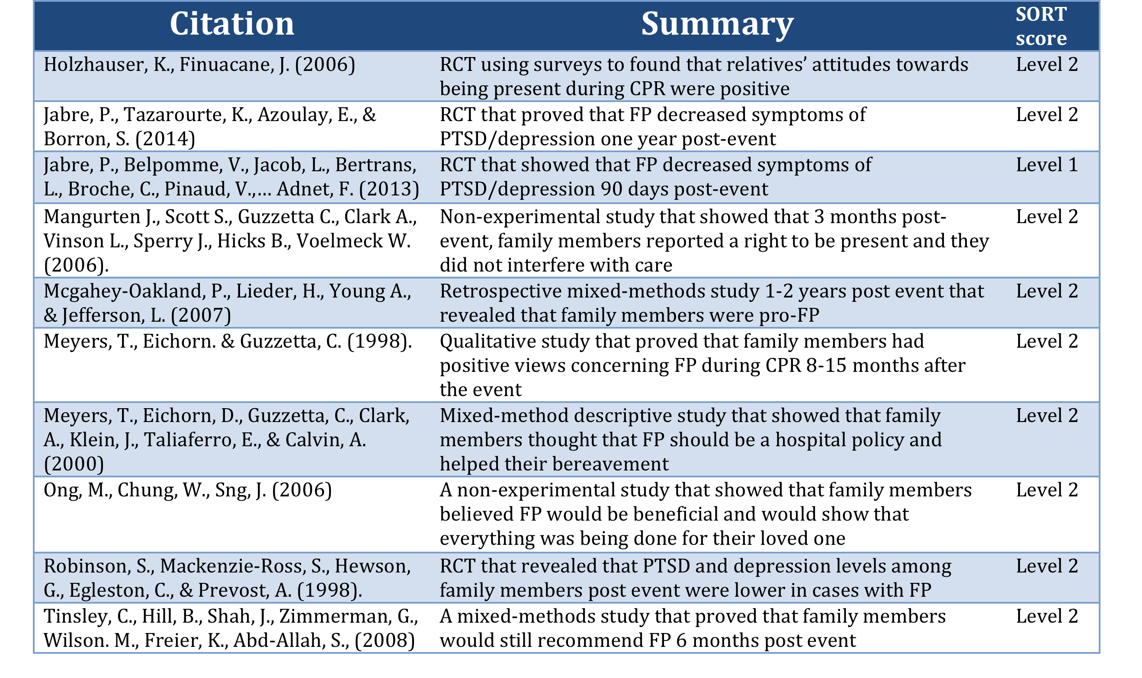

Slide 6
Recommended Changes
Family presence is a simple intervention that has been proven to assist in the grieving process
A nurse or a spiritual guide can stay with the family member during this time to explain the interventions being done to their loved one
If family members are unaware of the benefits of family presence, a nurse or spiritual guide can assist in education

Slide 7
Components of Change
Key stakeholders: RN, NP, MD, PA, PCA, social work, and spiritual support staff
Barriers: Provider running the code who believe the family will be a distraction or increase stress, Family members who believe that witnessing will be too traumatic for them
Facilitators of Change: Any stakeholder who promotes the change

Slide 8
Practice Implications
Family presence provides psychological benefits
  It assists family members’ grieving process
  It is proven to decrease symptoms of:
    PTSD
    Depression
It does not cause increased stress or distraction for HCP running the code

Slide 9
References
Ebell, M. H., Siwek, J., Weiss, B. D., Woolf, S. H., Susman, J., Ewigman, B., &Bowman, M. (2004). Strength of recommendation taxonomy (SORT): A patient-centered approach to grading evidence in the medical literature. Am Fam Physician, 69(3), 548-556.
Holzhauser, K., Finucane, J., & Vries, S. (2006). Family presence during resuscitation: a randomized controlled trial of the impact of family presence. Australasian Emergency Nursing Journal, 8(4), 139-147. Retrieved from http://www.sciencedirect.com.proxy.library.georgetown.edu/science/article/pii/S1574626705000352
Jabre, P., Tazarourte, K., Azoulay, E., & Borron, S. (2014). Offering the opportunity for family to be present during cardiopulmonary resuscitation: 1-year assessment.Intensive Care Med, 981-7. Retrieved from https://www-clinicalkey-com.proxy.library.georgetown.edu/#!/content/medline/2s2.0-24852952
Jabre, P., Belpomme, V., Jacob, L., Bertrand, L., Broche, C., Pinaud, V., . . . Adnet, F. (2013). Family presence during cardiopulmonary resuscitation. The New England Journal of Medicine.368(11), 1008-1018. Retrieved from https://www-clinicalkey-com.proxy.library.georgetown.edu/#!/content/journal/1-s2.0-S0196064412008700
Mangurten, J., Scott, S., Guzzetta, C., Clark, A., Vinson, L., Sperry, J., Hicks, B., &Voelmeck, W. (2006). Effects of family presence during resuscitation and invasive procedures in a pediatric emergency department. Journal of Emergency Nursing. 32(3) 225-233. Retrieved October 11, 2015, from http://www.sciencedirect.com.proxy.library.georgetown.edu/science/article/pii/S0099176706000742
Mcgahey-Oakland, P., Lieder, H., Young, A., & Jefferson, L. (2007). Family Experiences

Slide 10
References
During Resuscitation at a Children’s Hospital Emergency Department. Journal of Pediatric Health Care, 21(4), 217-225. Retrieved from http://www.sciencedirect.com.proxy.library.georgetown.edu/science/article/pii/S0099176706000742http://www.sciencedirect.com.proxy.library.georgetown.edu/science/article/pii/S0891524506007310
Meyers, T., Eichorn. & Guzzetta, C. (1998). Do families want to be present during CPR? A retrospective study. Journal of Emergency Nursing. 24 (5), 400-405. Retrieved October 11, 2015, from http://www.sciencedirect.com.proxy.library.georgetown.edu/science/article/pii/S0099176798700054
Meyers, T., Eichorn, D., Guzzetta, C., Clark, A., Klein, J., Taliaferro, E., & Calvin, A. (2000). Family presence during invasive procedures and resuscitation: the experience of family members, nurses, and physicians. American Journal of Nursing. 100 (2), 32-43. Retrieved October 11, 2015, from http://web.b.ebscohost.com.proxy.library.georgetown.edu/ehost/command/detail?sid=8d84059d-23d1-41e4-a4af-66162e3375a9%40sessionmgr115&vid=3&hid=118&bdata=JkF1dGhUeXBlPWlwLHVpZCZzaXRlPWVob3N0LWxpdmUmc2NvcGU9c2l0ZQ%3d%3d#AN=2000014853&db=cin20
Ong, M., Chung, W., & Mei, J. (2007). Comparing attitudes of the public and medical staff towards witnessed resuscitation in an Asian population. Resuscitation, 73(1), 103-108. http://www.sciencedirect.com.proxy.library.georgetown.edu/science/article/pii/S030095720600520X
Robinson, S., Mackenzie-Ross, S., Hewson, G., Egleston, C., & Prevost, A. (1998).
Psychological effect of witnessed resuscitation on bereaved relatives. The Lancet, 352(9128), 614-617. Retrieved from http://www.sciencedirect.com.proxy.library.georgetown.edu/science/article/pii/S0140673697121791
Tinsley, C., Hill, J., Shah, J., Aimmerman, G., Wilson, M., Freier, K., & Abd-Allah, S.(2008). Experience of families during cardiopulmonary resuscitation in a pediatric intensive care unit. Pediatrics, 122(4). ), e799-804 1p. https://dml-tdnetdiscover-com.proxy.library.georgetown.edu/resolver/full?output=full&genre=article&atitle=Experience+of+families+during+cardiopulmonary+resuscitation+in+a+pediatric+intensive+care+unit.&title=Pediatrics&issn=0031-4005&eissn=1098-4275&volume=122&au=Tinsley&issue=4&spage=e799&date=2008

