Slide 1
All the Comforts of Home
Transformation to a comfort environment in critical care
Betsey S. Dreher MSN, RN, CCRN

Slide 2
Background…….
Despite our best efforts, approximately 20% of adult patients die in a critical care setting
(Society of Critical Care Medicine, 2015)
Suddenly changing from life-sustaining treatment to end-of-life care can be stressful for patients, families, and the nursing staff.
The distress comes from the environment in which we work; fast-paced, noisy, even chaotic. Hardly comforting at a time when comfort is the goal.
Patients and families would want to be home if they could…. Where it is more comfortable

Slide 3
It started with an idea at a staff meeting….. How to enhance death with dignity….by providing a quiet, calm, peaceful atmosphere for patient, family and caregivers.
The unit council co-chair brought the idea to the staff. She donated the initial quilt, table, and lamp.
Once the staff saw the room set-up, they immediately embraced the concept… the wheels were in motion
Quickly items were donated….
Two more quilts and pillow shams
CD player and a variety of soft music choices
6 lightly-scented battery-operated candles
The door to the room is closed, and curtain drawn to add another layer of privacy

Slide 4
The process…..
The items are kept on a cart. Once the patient’s code status has been changed to “comfort measures only”, the staff asks the family to step out for just a few minutes. In comes the cart, and in a matter of less than 5 minutes, the bedding is changed, lights are dimmed, candles are arranged around the room. CD player is on the counter. This is a team effort.
Notes:
There are many steps that precede the decision to withdraw care. However, once the decision is made to focus on comfort care, the next step is to prepare the surroundings. This should be orchestrated with grace and individualized to meet patient and family needs⁴

Slide 5
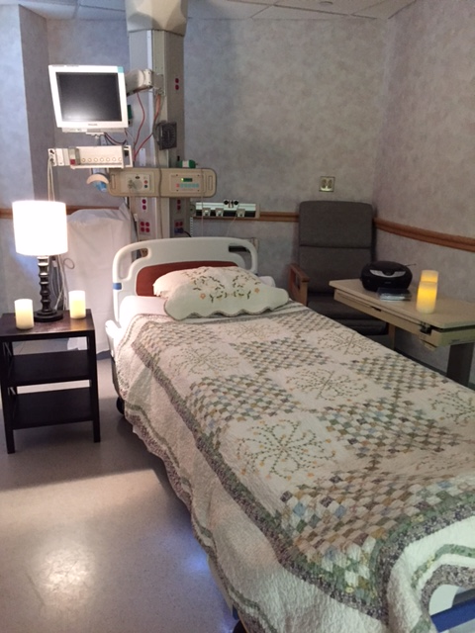
We now have 4 quilts, with colors suitable for both male and female patients. Also, a variety of soft music CD’s are available to comfort both patient and family. Once the patient has died, the quilt is sent to the laundry, and then returned to the unit.

Slide 6
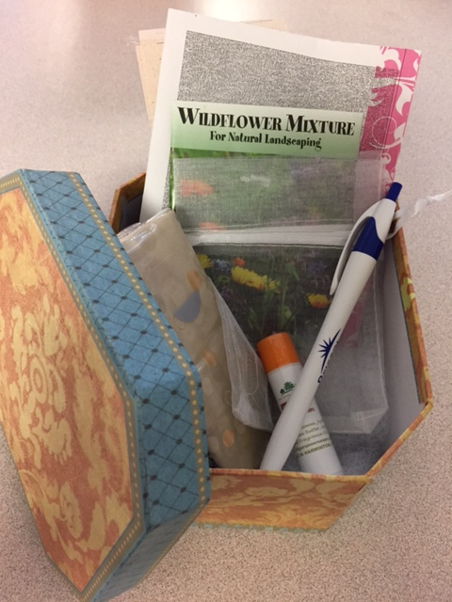
Each family is given a “memory box” , which contains an angel pin, tissues, mints, flower seeds, a little silk pouch to put a lock of hair, blotter paper for finger or thumb prints, pen, lip balm, pen, and small note pad.

Slide 7
Care/ Memory boxes
An idea that everyone has embraced!!
Items can be purchased inexpensively at a dollar-type store. The hospital donated pens and lip balm.
All staff have participated; nurses, aides, secretaries
Contents;
Angel pin
Tissues ; mints
Note pad and pen
Small drawstring bag for lock of hair.
Blotter paper for fingerprints
Poem/ what to expect
Lip balm, hand cream

Slide 8
Taking care of the family…
This is an integral part of our responsibility! We must ensure dignity for the family as well as the patient. (Cook & Rocker, 2014)
This includes refreshments; our hospital provides a “comfort cart” for the family. Muffins, sandwiches, coffee, soda, snacks. We also provide a small conference room space for privacy and respite.

Slide 9
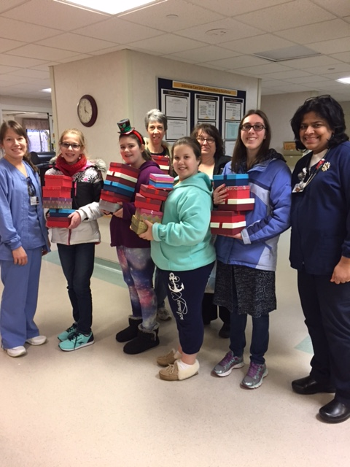
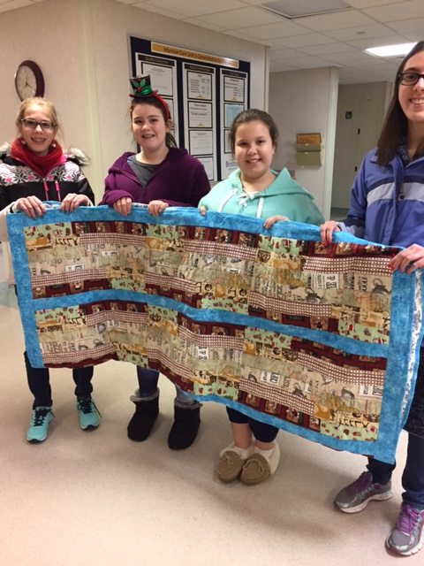
Community involvement …
The confirmation class from a local church recently donated 25 care boxes, all filled, and a handmade quilt. We were able to share some boxes with our hospice nurse for use in other areas of the hospital.

Slide 10
ACKNOWLEDGEMENTS
The author would like to acknowledge the staff of the Bristol Hospital Intensive Care Unit for their compassion and dedication to honoring both patient and family in this process. It is their commitment to providing the best possible care that makes this comfort transformation possible.

Slide 11
Implications for practice
This is a process that is relatively easy and inexpensive to implement and can be replicated in other hospitals.
Expanding to other units within our hospital.
Increased support from ICU to the hospice nurse by sharing care boxes

Slide 12
It Matters…….
“If anything matters, then everything matters. Because you are important, everything you do is important…. Every time you reach out and touch a heart or a life; with every kindness or service, seen or unseen, the world changes…. And nothing will ever be the same again”
Wm. Paul Young “The Shack”

Slide 13
References
Society of Critical Care Medicine, ed. Critical Care Statistics. 2015 http://www.sccm.org/communications/pages/CriticalCareStats.aspx. Accessed September 20, 2016.
Efstathiou N., Walker, W. Intensive care nurses' experiences of providing end-of-life care after treatment withdrawal: a qualitative study. Journal of Clinical Nursing. 2014;23:3188-3196. doi:10.1111/jocn.12565.
Holmes N., Milligan S., Kydd A. A Study of the lived experiences of registered nurses who have provided end-of-life care within an intensive care unit. International Journal of Palliative Nursing. 2014;20(11):549-556.
Cook D., Rocker, G. Dying with dignity in the intensive care unit. New England Journal of Medicine. June 2014;370(26):2506-2514.

