Slide 1
Putting Together the Patient Experience Puzzle
Brandon Jones, MSN, RN, CEN
Unit Director – Emergency Department
Carilion Clinic’s Roanoke Campus Magnet Facility
2016 President-Elect ENA Roanoke Roadrunners Chapter

Slide 2
Disclosure
I have no actual or potential conflict of interest in relation to this presentation
Elements of this presentation will discuss work done with Carilion Clinic, however all elements of this presentation do not necessarily reflect the views of Carilion Clinic

Slide 3
Objectives
Define the patient experience
Discuss your role in the patient experience
Discuss the topic of engagement and strategies for engaging patient/customers

Slide 4
Patient Experience
Satisfaction

Slide 5
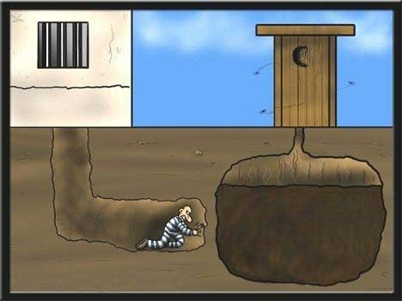
We must know where we are going!
Defining Patient Experience

Slide 6
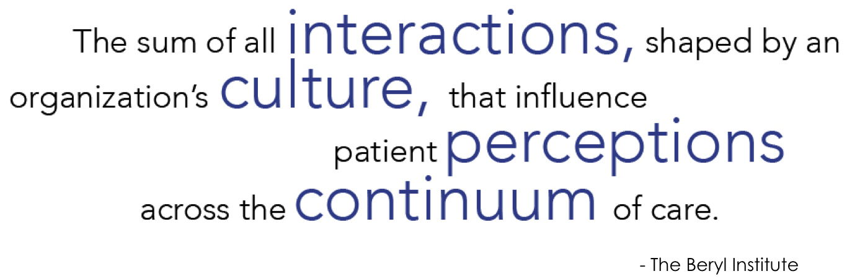
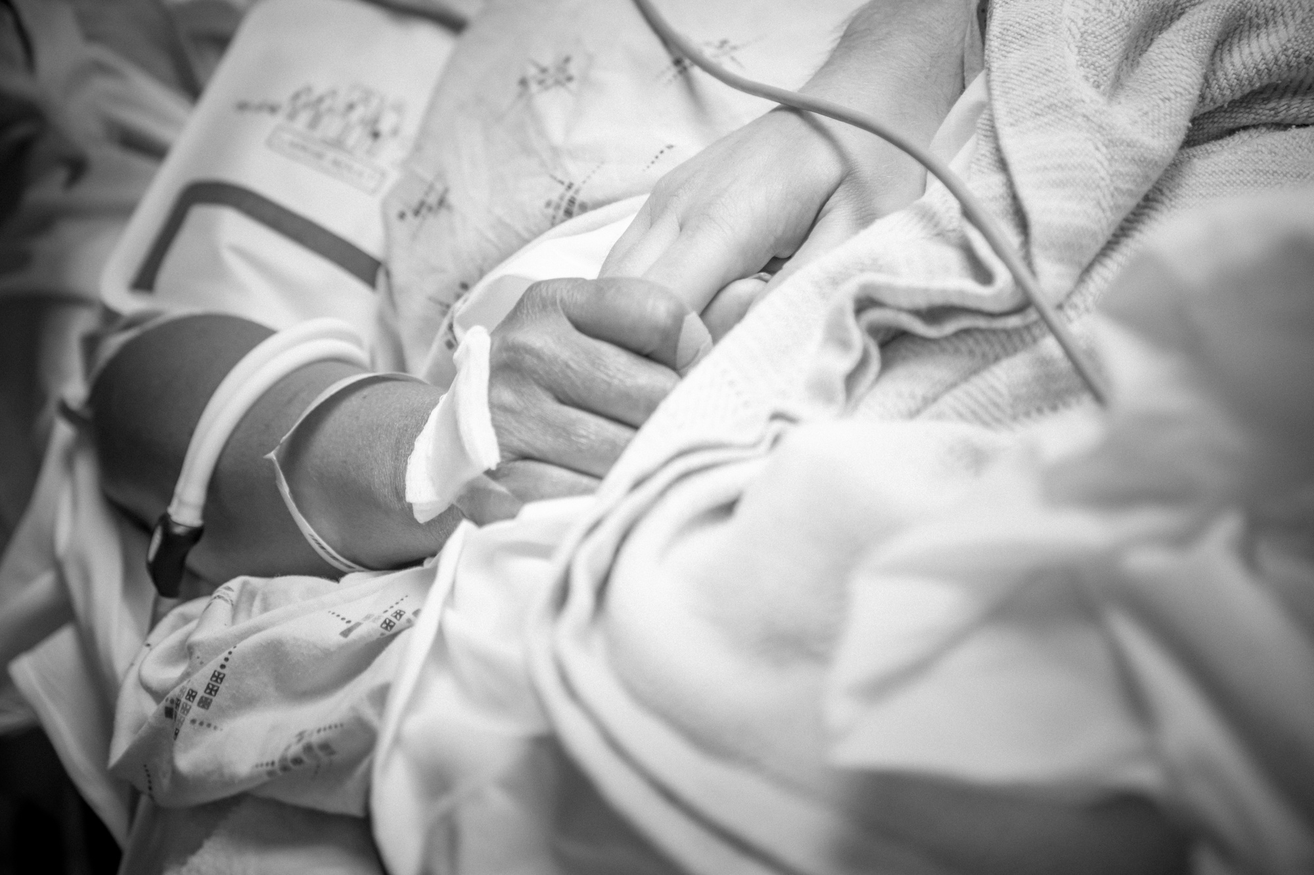
“Patient Experience” is about just that, experience: all that is perceived, understood, & remembered

Slide 7

WHY???
RIGHT
THING
TO DO!

Slide 8
World Class Medical Care + World Class Service = World Class Experience

Slide 9
We are here to SERVE
and provide SERVICE
BUT
we are not in the
SERVICE INDUSTRY

Slide 10
To provide a
WORLD CLASS experience,
we must
ENGAGE
our patients

Slide 11
Service
Purpose

Slide 12
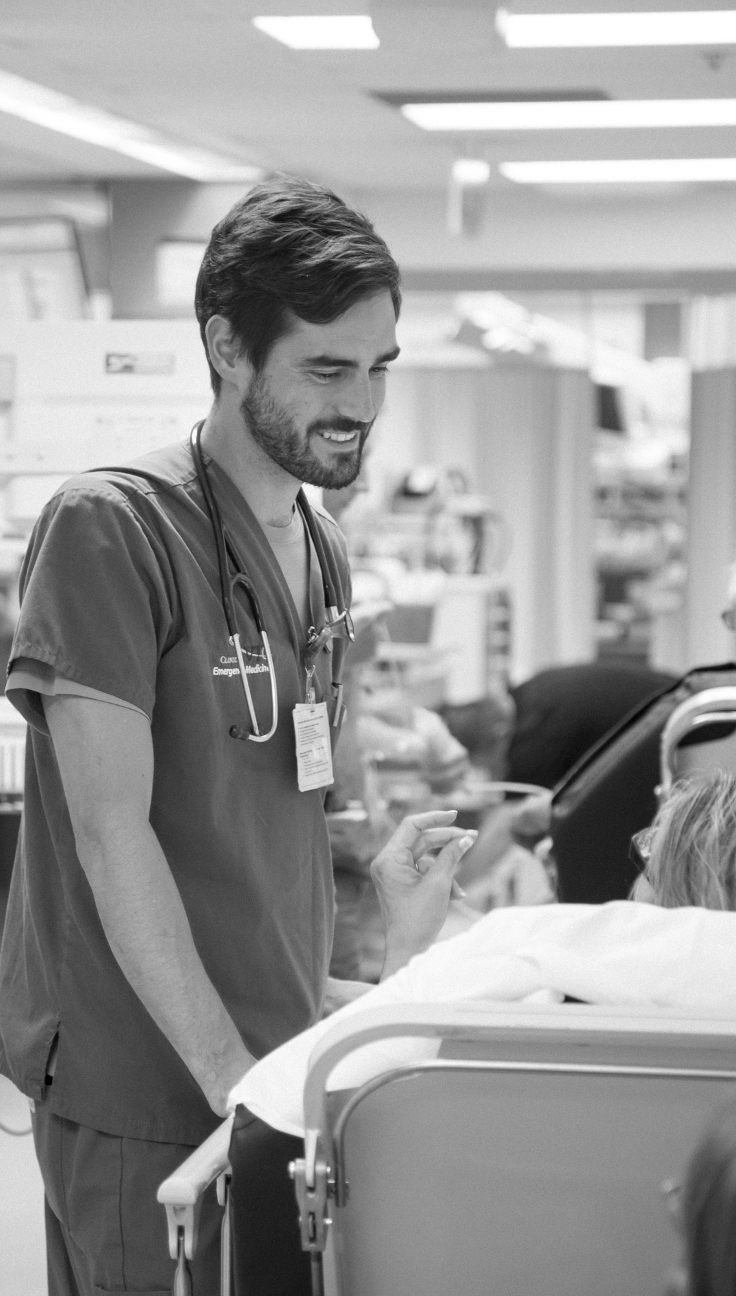
Universal Service Rules
✗
The Golden Rule
The Platinum Rule
The Double-Platinum Rule
✗

Slide 13
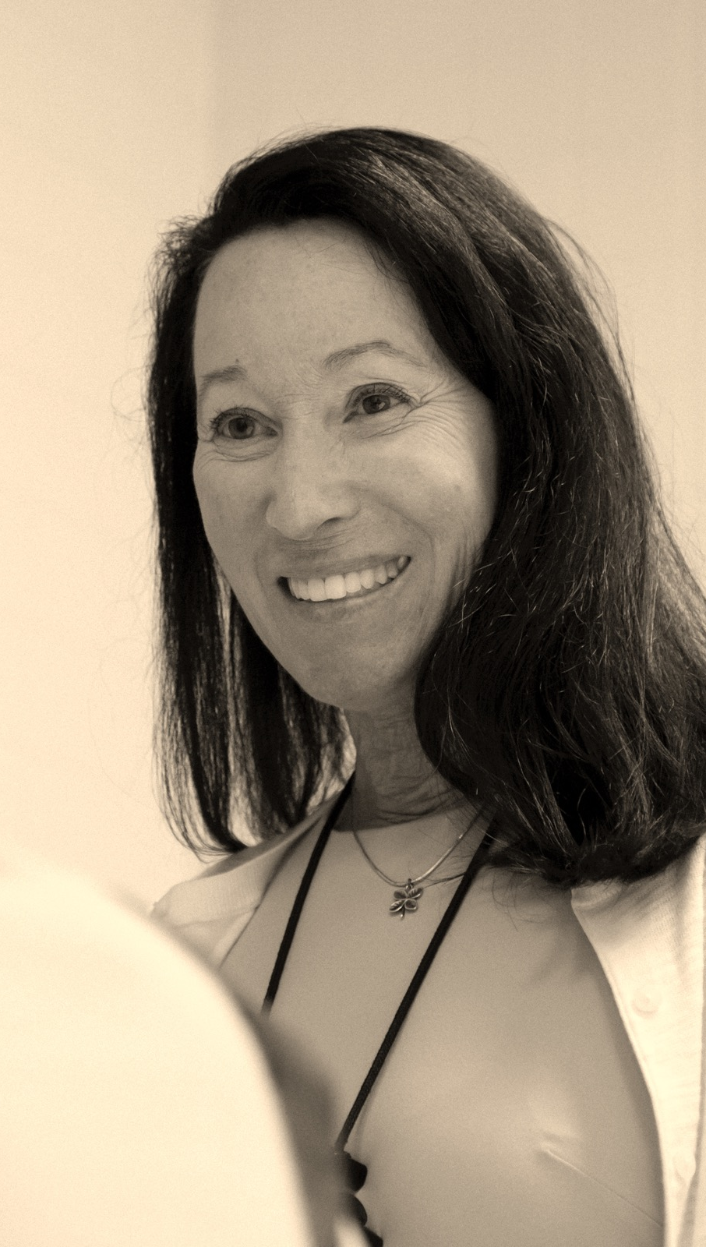
Service Key-Steps
Be Welcoming
(Use their name!)
Be Inclusive
Be Appreciative
(Use their name!)

Slide 14
Purpose NOT Function

Slide 15
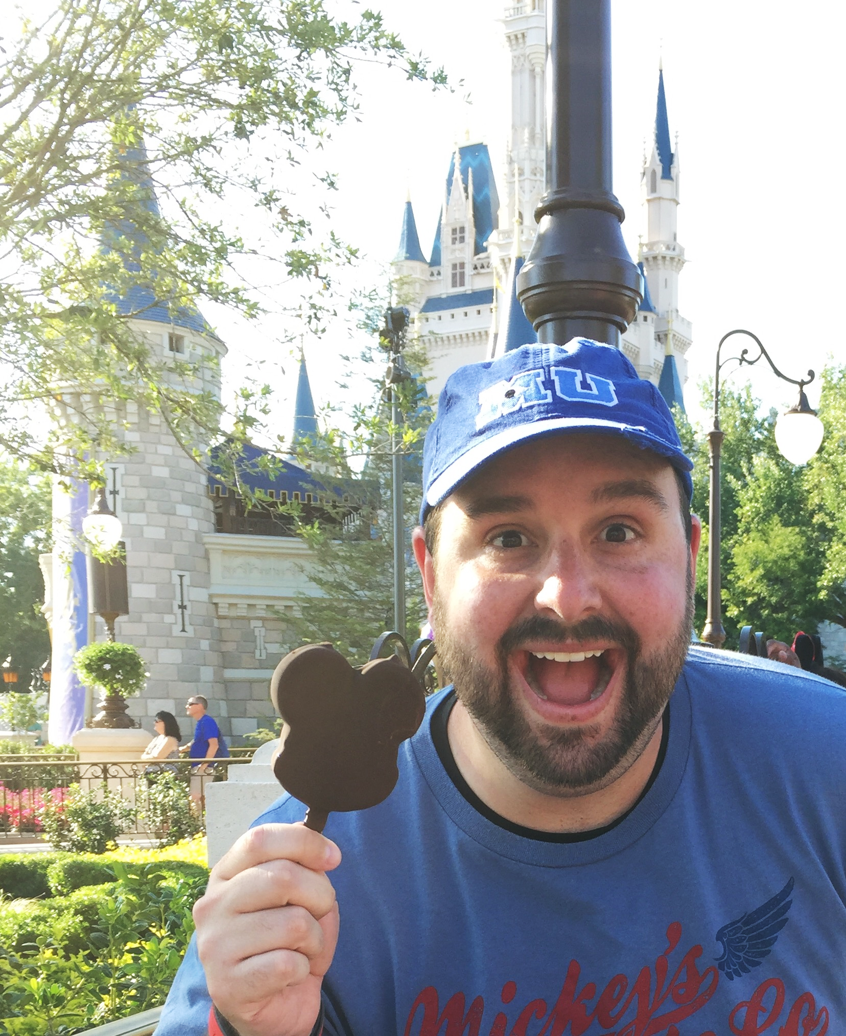
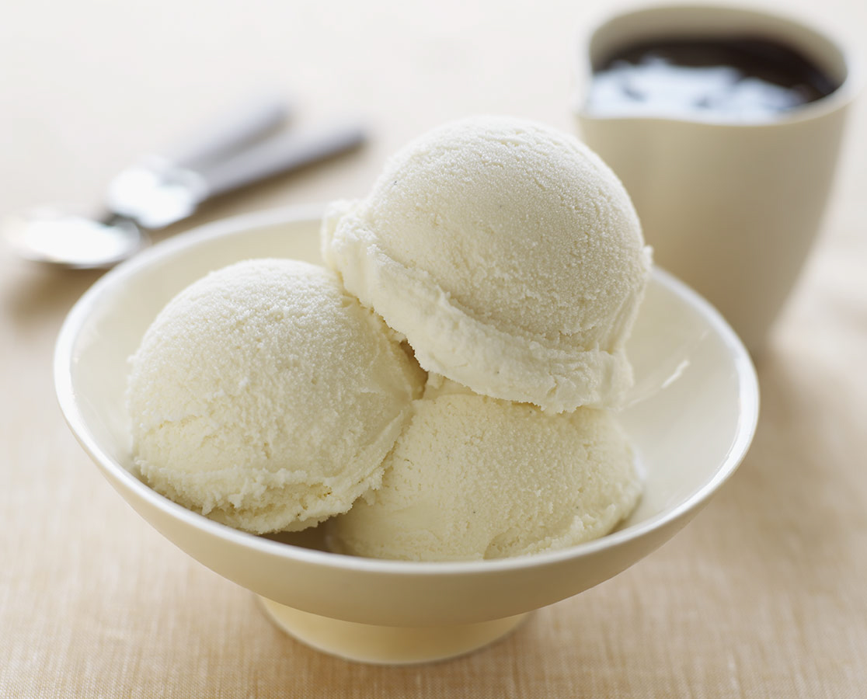
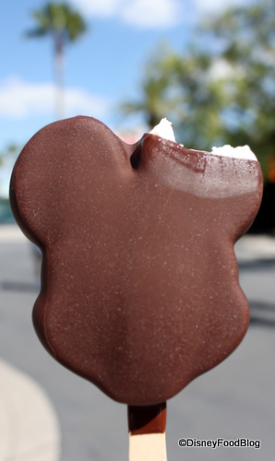



Slide 16

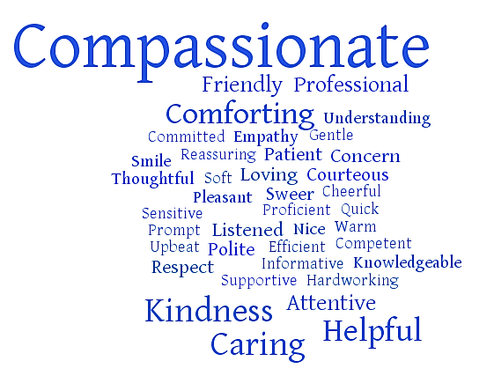

Slide 17
Compassion
Care for others as they would like to be treated
Listen actively and keep an open mind
Make everyone feel valued and appreciated
Embrace and respect diversity

Slide 18
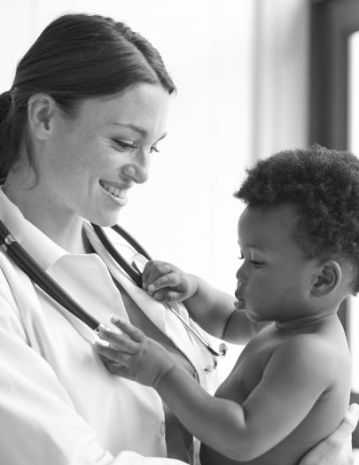
Exceeding
Expectations…
WHY BOTHER??
Give Anyway

Slide 20
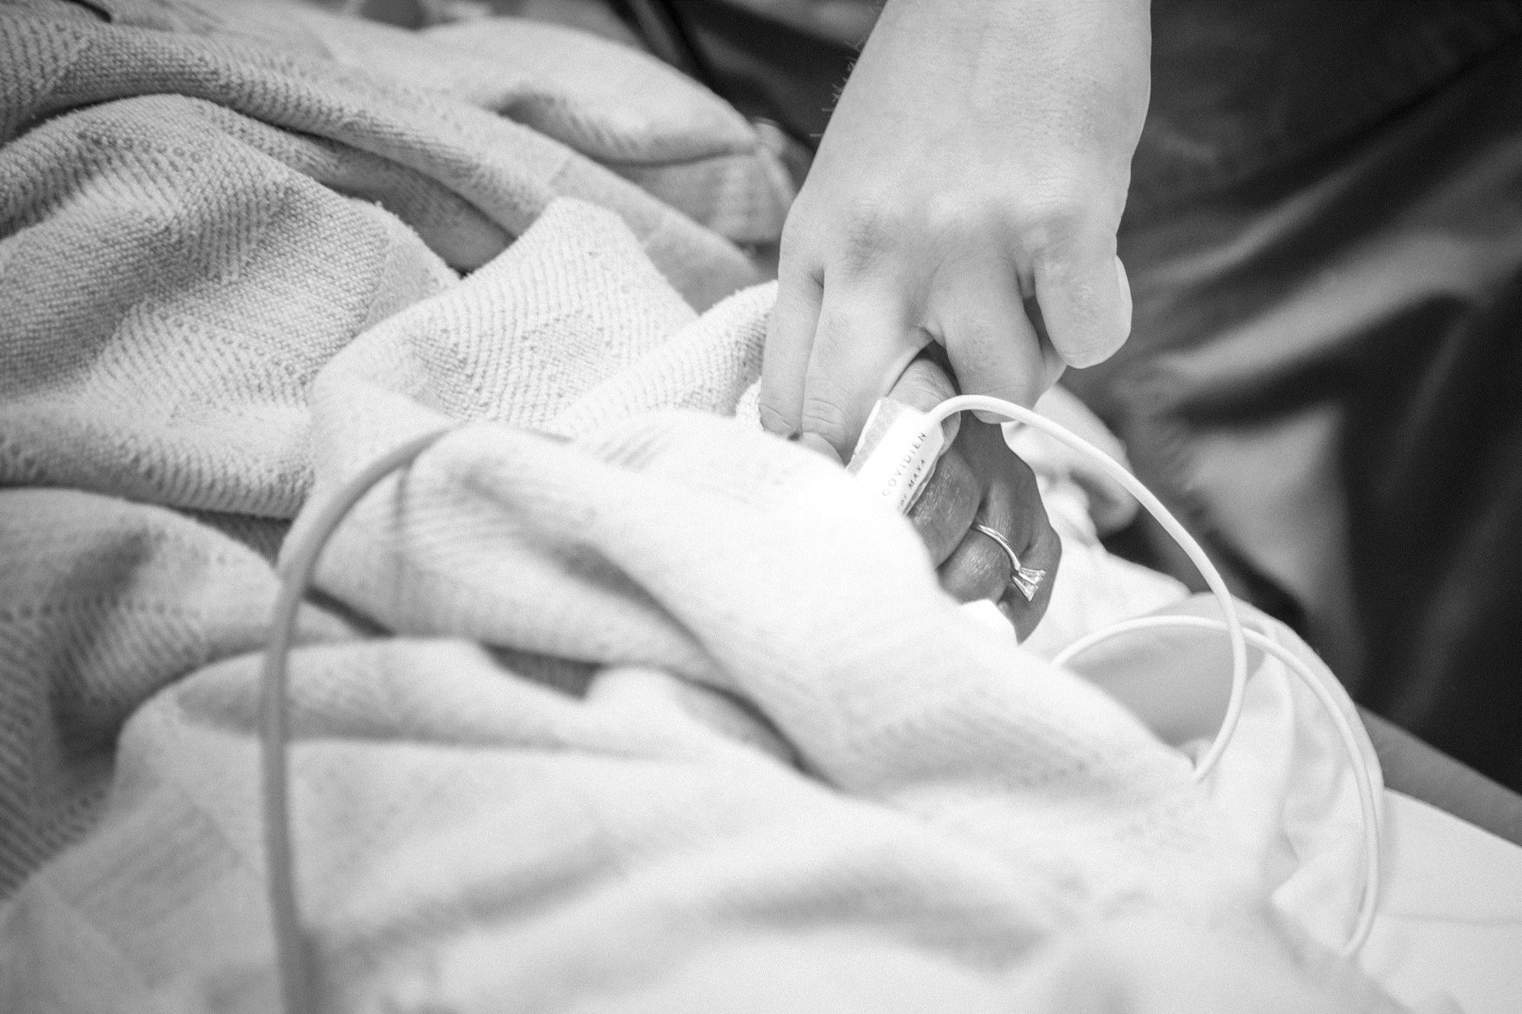
Remember
Your patient…
Is SCARED
Has LOST almost all control
HURTS and they are the only judge that matters
You are likely their ONLY means of information
They NEED and DESERVE
compassion and empathy.

Slide 21
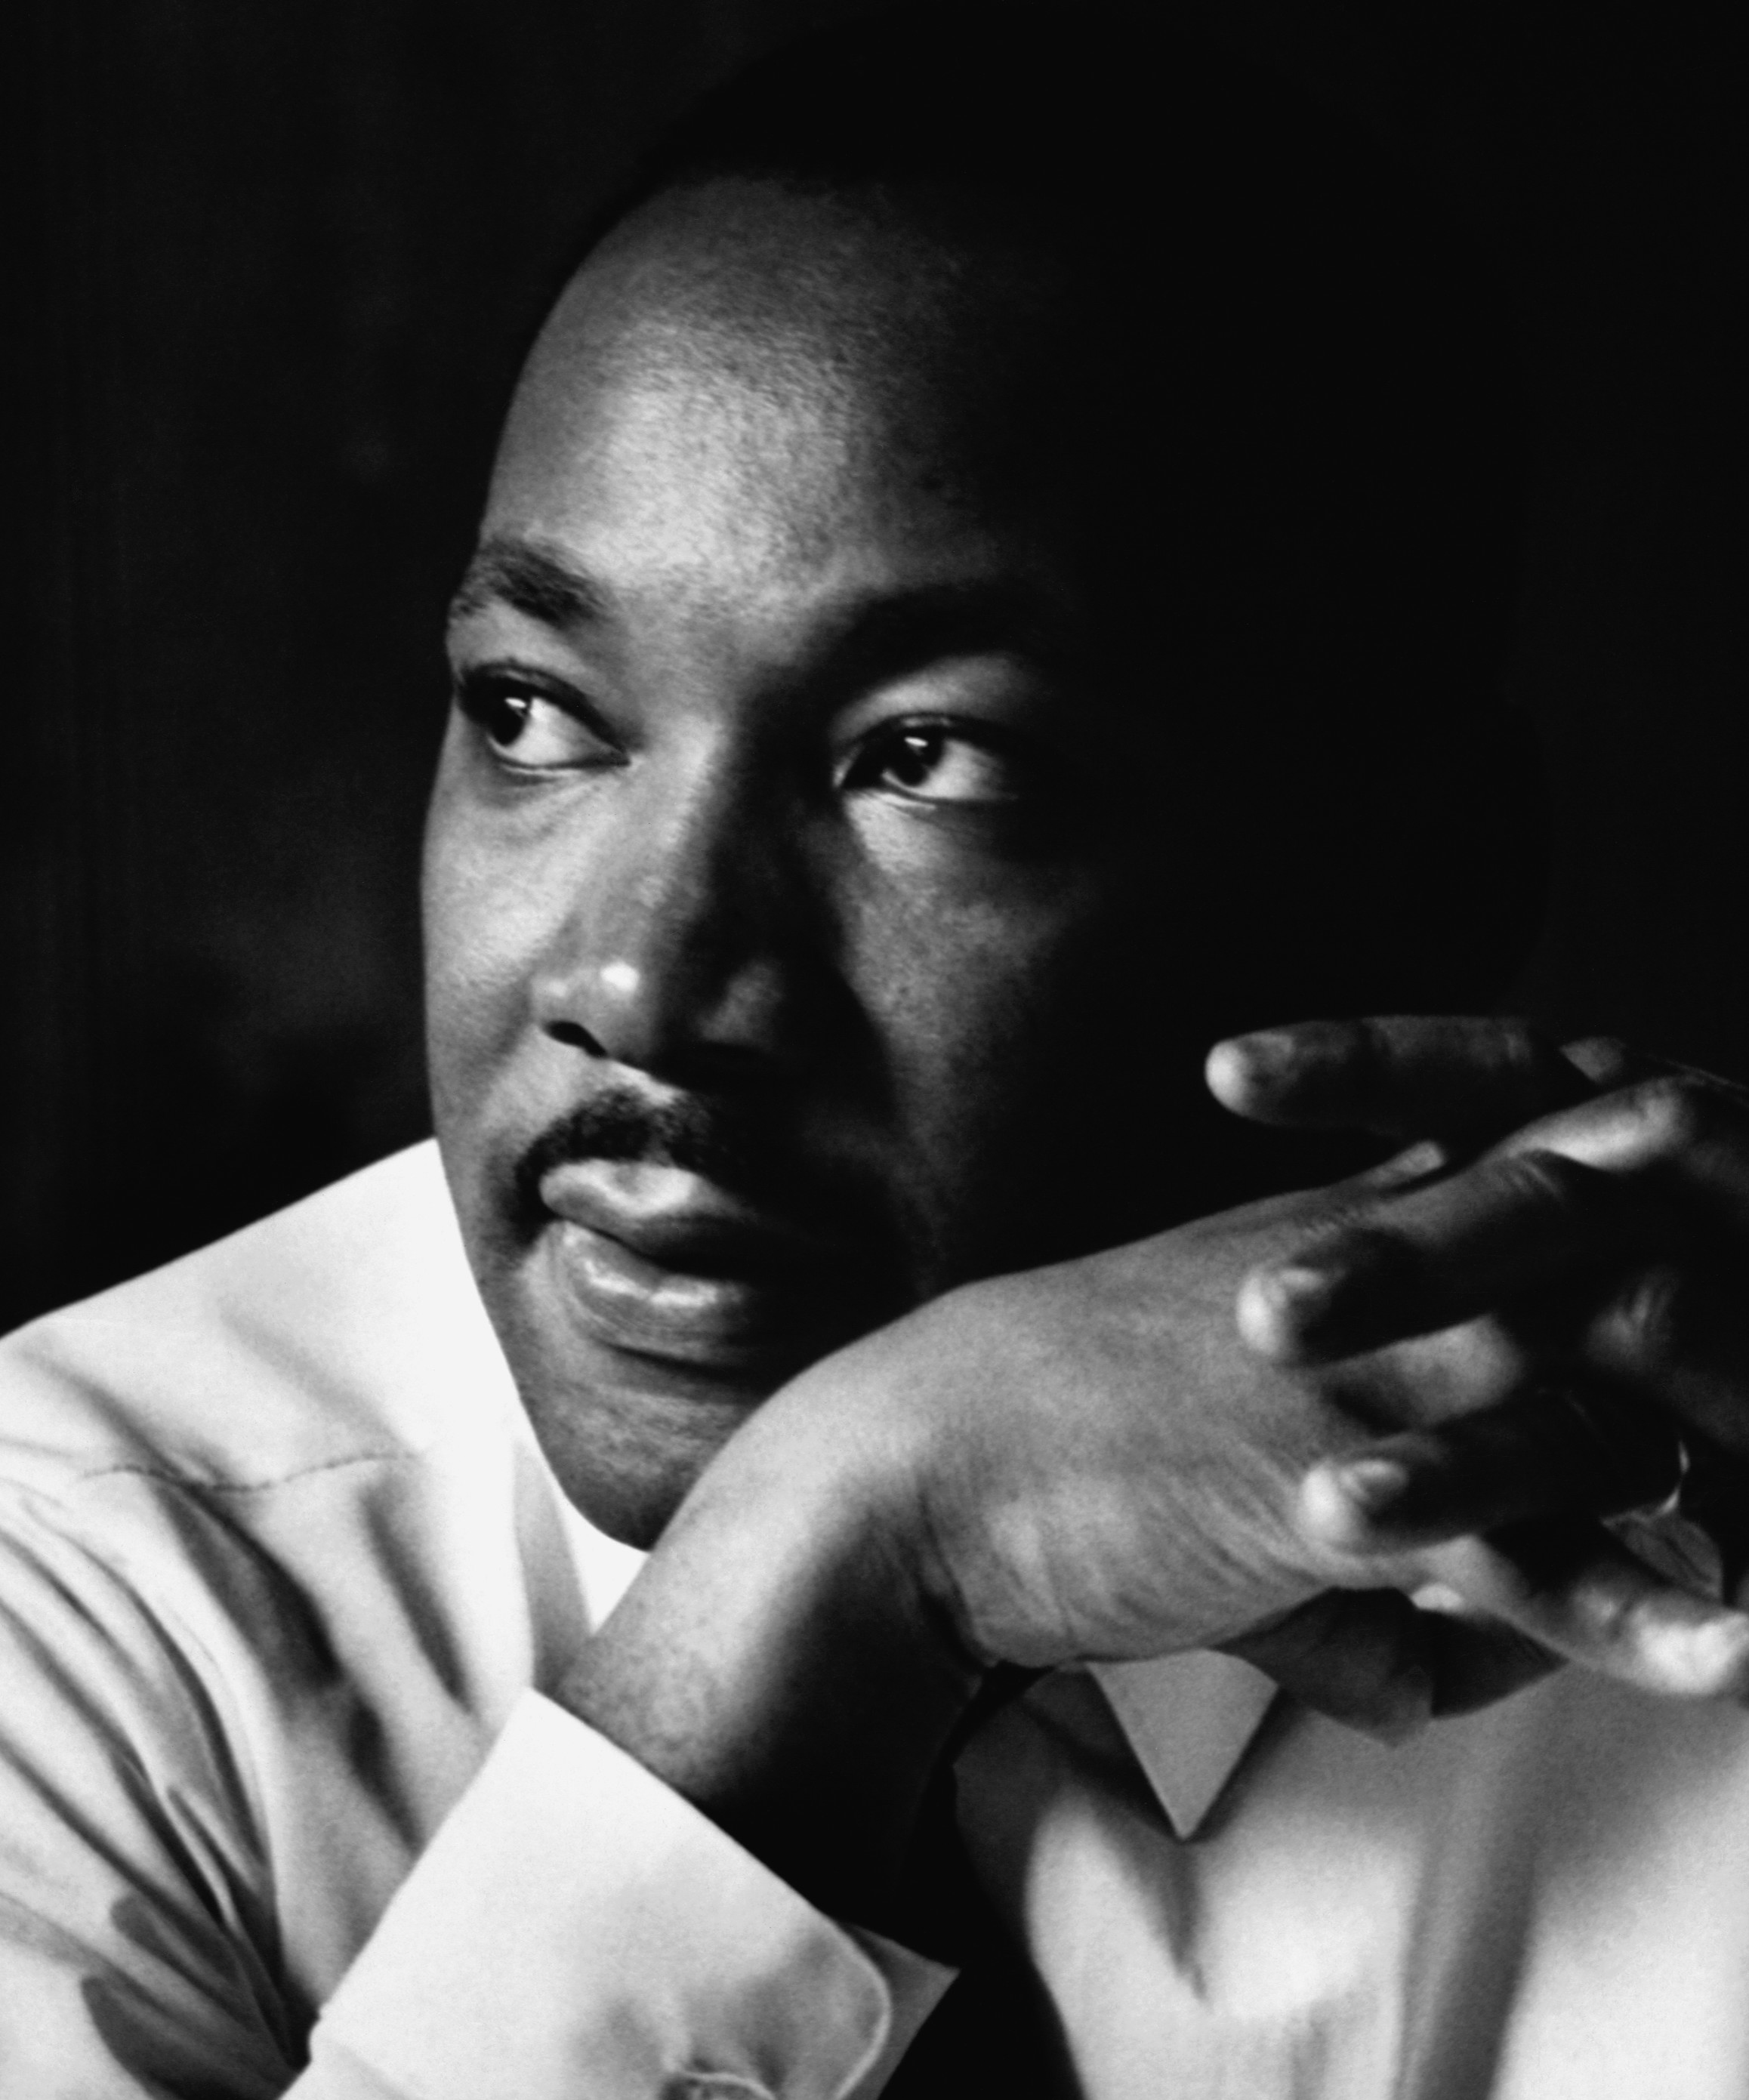
“Everybody can be great because anybody can serve…You only need a heart full of grace and a soul generated by love.”
- Dr. Martin Luther King, Jr.

Slide 22

Choice…

Slide 23
#IMPX

Slide 24


Thank You
Brandon Jones, MSN, RN, CEN
bajones@carilionclinic.org
@tdyRNbr

