Slide 1

Philippine Nurses Association of Central California
PNACC Executive Board
2026- 2028

Slide 2
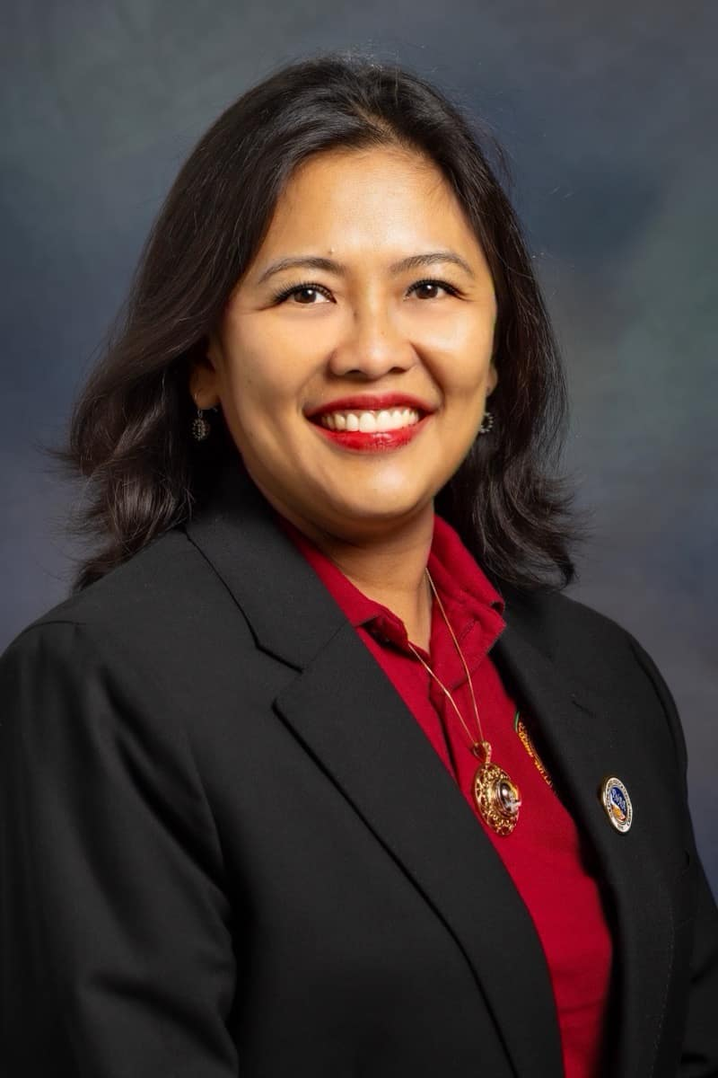
President
Rizza Elep
BSN, RN, PCCN
Professional Profile: Staff Nurse IV, Telemetry, Inpt RNQL
Elected PPC – Professional Performance Committee Chair
Kaiser Permanente Medical Center. AACN Ambassador 2011-2026. CNA Delegate 2026-2028
PNACC Position: President Elect 2024-2026. Assumed different roles, I started as Board of Directors in 2014-2016, worked my way up as Secretary, PRO, and Vice President. Secretary 2022-2024. Served as Chairperson for Education Committee, speaker on PNACC’s educational events x2, collaborated with CNSNA – California Nursing Student Association of Fresno State for educational event via Zoom. Supported all activities/events of PNACC. Recipient of CSJVC – Central San Joaquin Valley Coalition RN of the Year in Education category 2022.
PNAA/PNAAF: PNAA Community Outreach member (2024-2026), Run Coordinator Two Cities Marathon (2026). PNAA iLDP graduate in 2021. Media Training graduate, 1st place in iPNAA writer in July 2026 with the most written articles submitted. KEWP member, attended 2 PNAA Western Region Camp Aruga. Leadership Bootcamp. Delegate to 3 National Convention in Long Beach July 2024, Colorado 2026 and Las Vegas, 2 Western Region Conference in Carlsbad (2025)and Yosemite, CA. Delegate to the International Global Conference in the Phils and Medical Mission in Camiling, Tarlac 2026.
PNAAF Board of Directors (2025-2027).
Personal Statement: Engage, Encourage and Empower Nurses through application of knowledge and experiences as evidenced by healthy individuals in society.
Rizza Elep
BSN, RN, PCCN

Slide 3
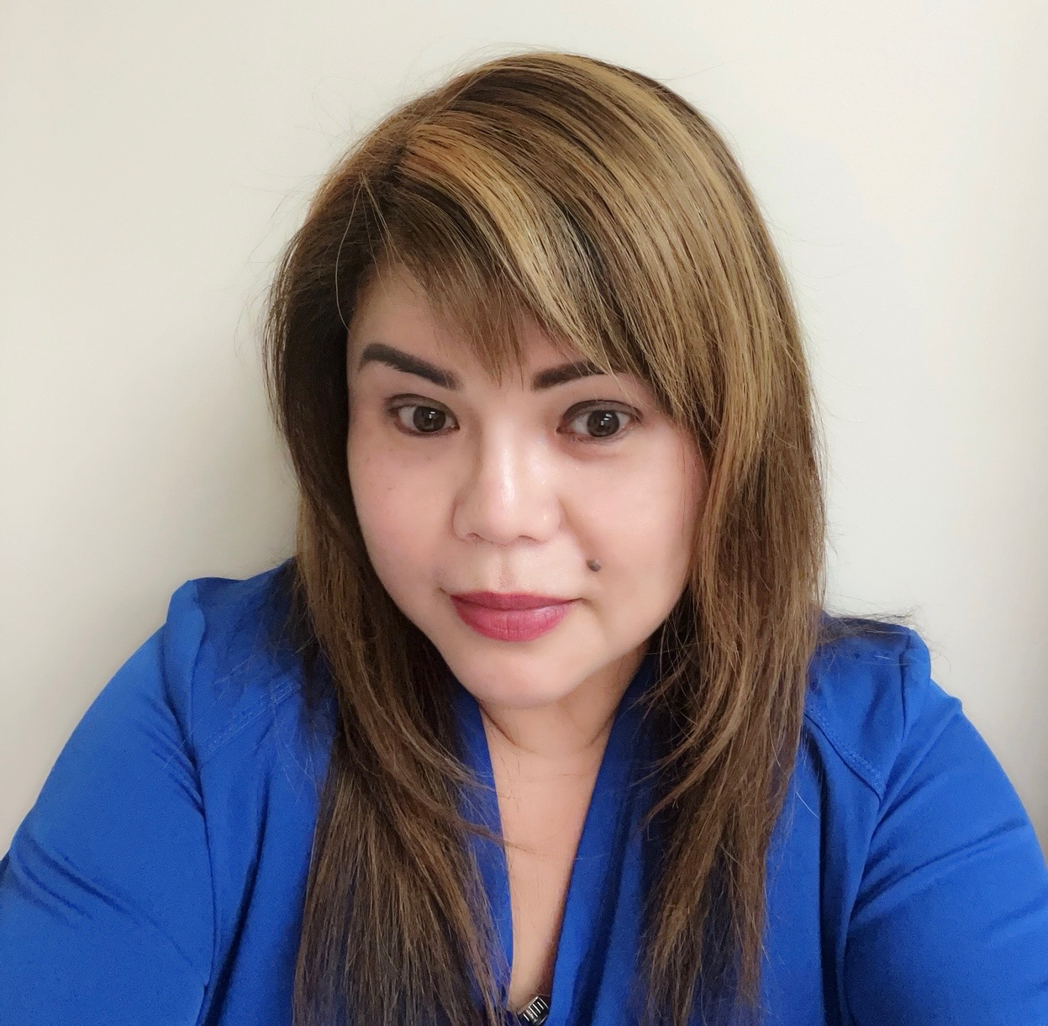
President Elect
Marie M. Baybay
MSN, RN, AGPCNP-BC
Professional Profile: Nurse Practitioner - Primary Care
VA Central California Healthcare System
PNACC Position: 2024-2026 – Board of Director. Nurse Excellence and Scholarship Awards Committee Chair. Nominee for Excellence in Clinical Nursing category 2023.
PNAA Activities: Delegate to the PNAA National Convention in Colorado 2026, PNAA Western Regional Conference in Carlsbad, CA in May 2025 and PNAA Western Camp Aruga Leadership Bootcamp in Orange County, March 2026 and September 2025 in Oregon .
Personal Statement: I am committed to advancing PNACC through collaborative leadership, professional excellence, and unwavering advocacy for our members and the communities we serve. My philosophy centers on integrity, inclusiveness, and continues growth. As President Elect, I aim to strengthen organizational unity, elevate nursing practice, and promote meaningful engagement across all levels of membership. I will work to expand educational opportunities, support innovative initiatives, and uphold the values that define our organization. Together, we will foster a culture of empowerment and compassion, and share purpose, ensuring PNACC remains a trusted and forward thinking voice within the nursing profession.
Marie M. Baybay
MSN, RN, AGPCNP-BC

Slide 4
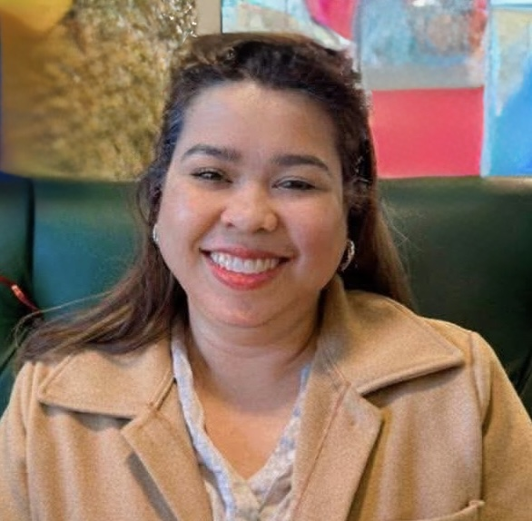
Vice President
Ma Victoria De Castro
BSN, RN, MAN, CCM
Professional Profile: Patient Care Coordinator, Case Manager – Case Management & Utilization Review Department. Kaiser Permanente Medical Center.
Passed Certified Case Manager Exam.
PNACC Position: 2024-2026 – Board Member/PRO. Initiated the first PNACC Got Talent in 2025 and PNACC Got Beauty and Got Talent 2 in May 2026. Continue to support PNACC programs and advocacies, contributes articles in PNACC/PNAA Newsletter.
PNAA Activities: Delegate to the PNAA Western Regional Conference in Carlsbad, CA, May 2025
Professional Statement: Nursing in case management is a collaborative process where a Registered Nurse assesses, plan, facilitate and advocates for health services to meet a patient’s complex medical and psychological needs. Case Managers coordinates care of patients with complex, chronic or long term health needs. Joining PNACC is a great way to deliver or provide services and support to our fellow nurses and community at large and to coordinate and collaborate with the Team to achieve success of every advocacy and program that lies ahead. Together we will Rise, we will have our voices heard and we will definitely Engage in PNACC’s unlimited programs and initiatives for our future members and for our community.
Ma. Victoria De Castro
BSN, MAN, RN, CCM

Slide 5
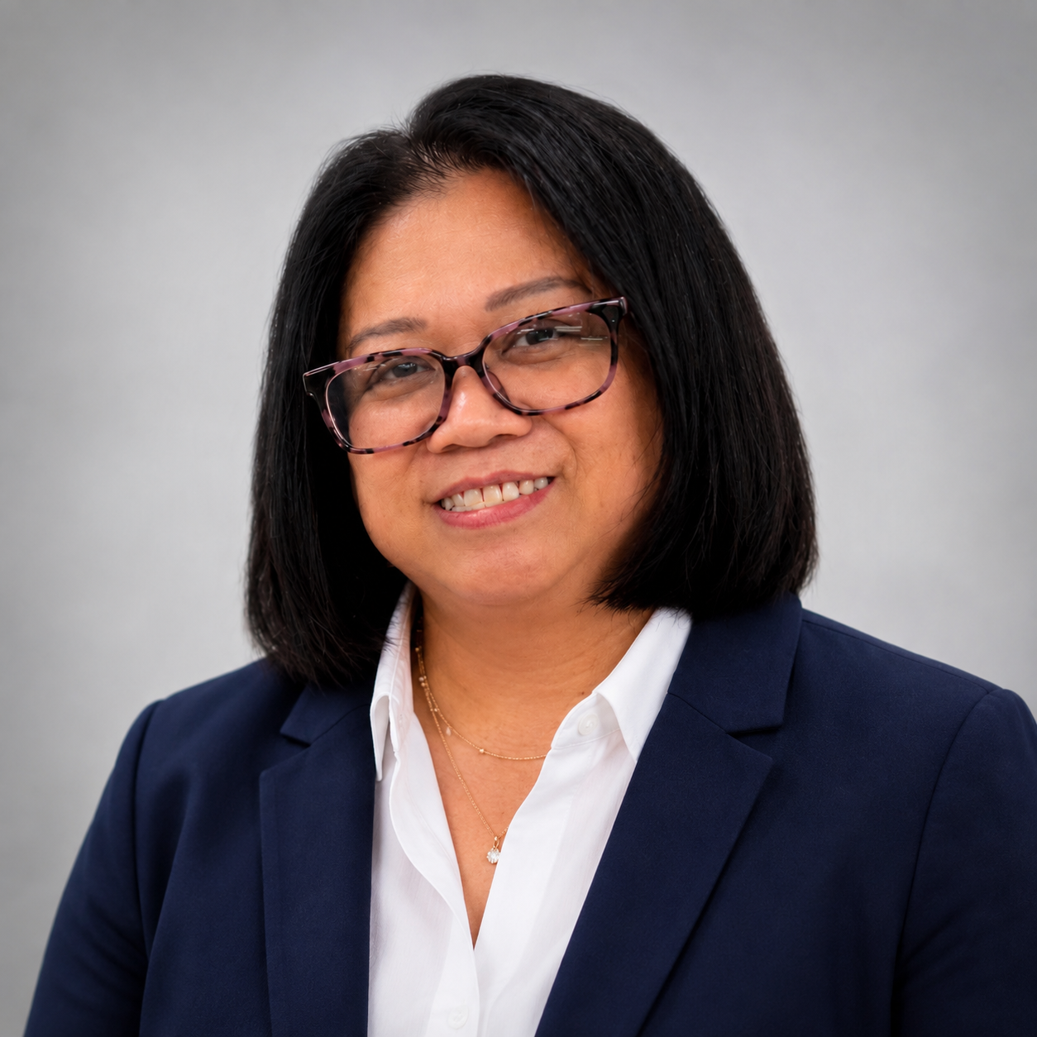
Secretary
Jenniver M. Westfall
BSN, RN
Professional Profile: Staff Nurse II – Medical-Surgical Unit
Kaiser Permanente Medical Center.
PNACC Position: PNACC Secretary in 2024-2026, 2020-2022, 2018-2020 – Secretary. Assistant Secretary 2016-2018. Headed the Decoration and Newsletter Committee which PNACC revived in 2025. Supported all annual events, community outreach programs, education and fundraising events of PNACC.
PNAA Activities: Delegate to the PNAA National Convention in Colorado, July 2026, Western Regional Conference in Carlsbad, CA May 2025, PNAA Western Region Camp Aruga Leadership Bootcamp in Oregon, September 2025, PNAA International/Global Convention in Manila, 2016.
Professional Statement: If elected as Secretary, I will continue to ensure accurate documentation, timely communication, and organized record-keeping to support the Executive Board and its members. I’m committed to advancing PNACC’s mission of professional excellence, leadership, and community service while preserving the proud legacy of Filipino nurses. I’ll do my best to serve PNACC in all my capabilities effectively. I will strive to uphold the positive image of the organization and actively participate in professional and cultural activities that help promote professional excellence and the welfare of all its members.
Jenniver M. Westfall
BSN, RN

Slide 6
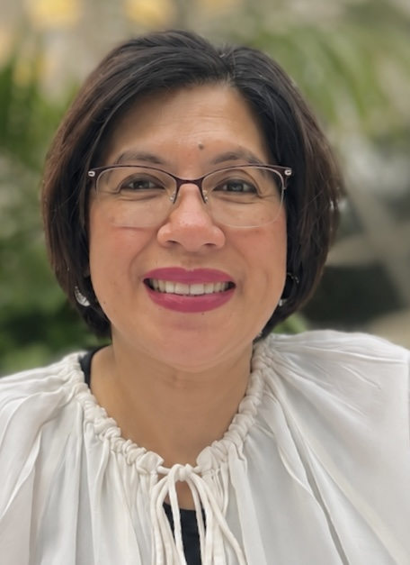
Treasurer
Lorna R. Romero
BSN, RN, CFCS, DWC
Professional Profile: RN 111 – Podiatry Department, Kaiser Permanente
Day Shift
PNACC Position: 2024-2026 – Assistant Treasurer/Budget Committee. Budget Chair for PNACC Nurse Excellence and Scholarship Event.
PNAA Activities: Delegate to the PNAA National Convention in Colorado, July 2026, PNAA Western Regional Conference in Carlsbad, CA May 2025, PNAA Western Camp Aruga Leadership Bootcamp in Oregon September 2025, PNAA National Convention in New York July 2022.
Professional Statement: I am committed to assist, serve and uplift the organization as part of the Executive Board to the best of my ability
Lorna R. Romero
BSN, RN, CFCS, DWC

Slide 7
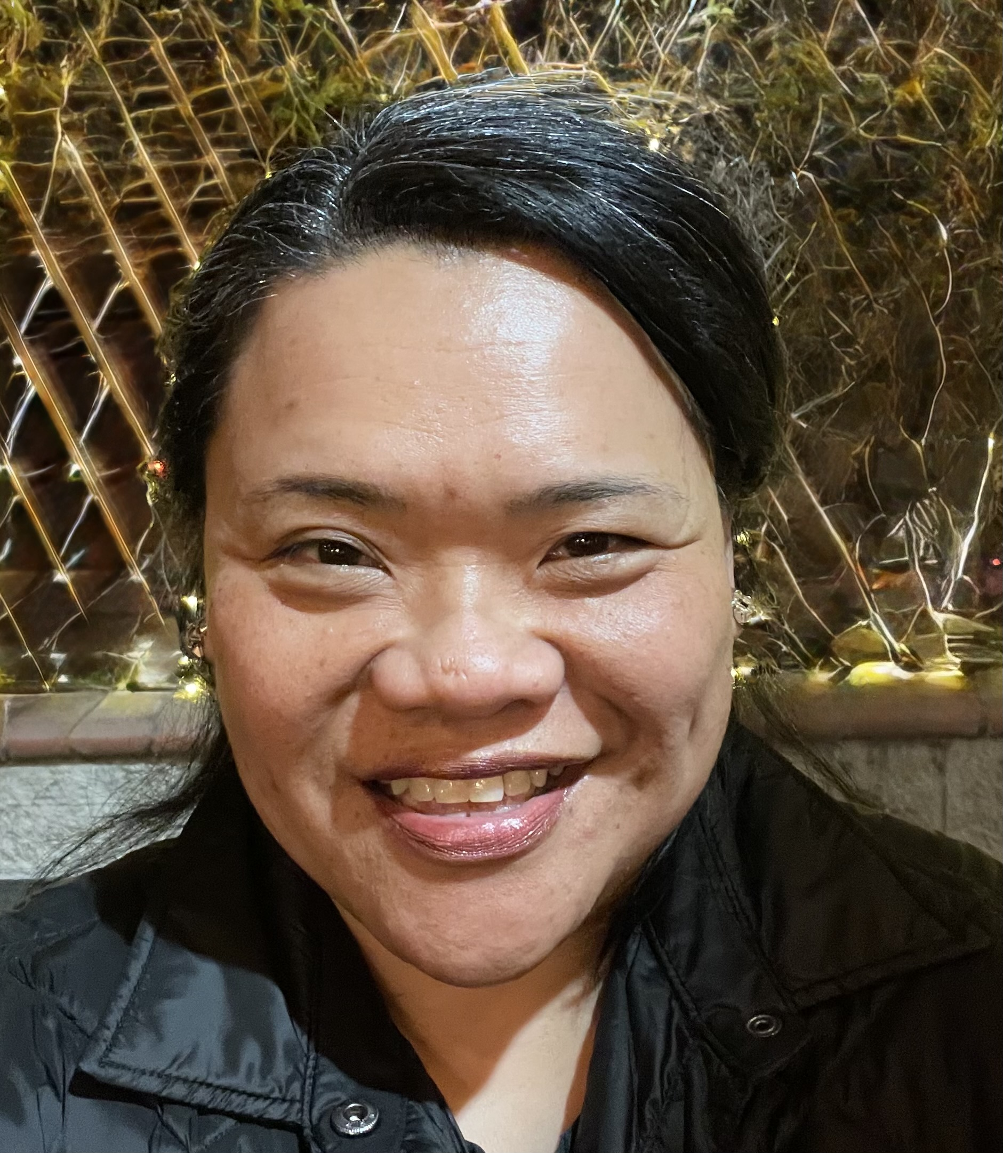
Auditor
Carolyn S. Perez
BSN, RN, CCRN
Professional Profile: Acute Care RN, Resource Team - Saint Agnes Medical Center, Clinical Adjunct Instructor – Lemoore Nursing College
PNACC Position: Board of Director since 2020-2022 up to the present. Initiated the development of PNACC website, Chairperson and Co-Chair of the Website and Education Committee in 2020-2022, 2024-2026. Speaker on Sepsis Updates x2 - PNACC educational events in collaboration with CNSA – California Nursing Students Association of Fresno State. Recipient of PNACC’s Excellence Awards in Education.
Professional Statement: As a bedside RN with a deep commitment to the nursing profession, my philosophy centers on the belief that continuous learning and knowledge-sharing are key to advancing our field. In my role with the PNACC, I am dedicated to serving by continuing to be a speaker in educational seminars and actively supporting our education committee. By doing so, I hope to inspire and empower our members to pursue excellence in their practice, ensuring that we, as a community, continue to grow and thrive together.
Carolyn S. Perez
BSN, RN, CCRN

Slide 8
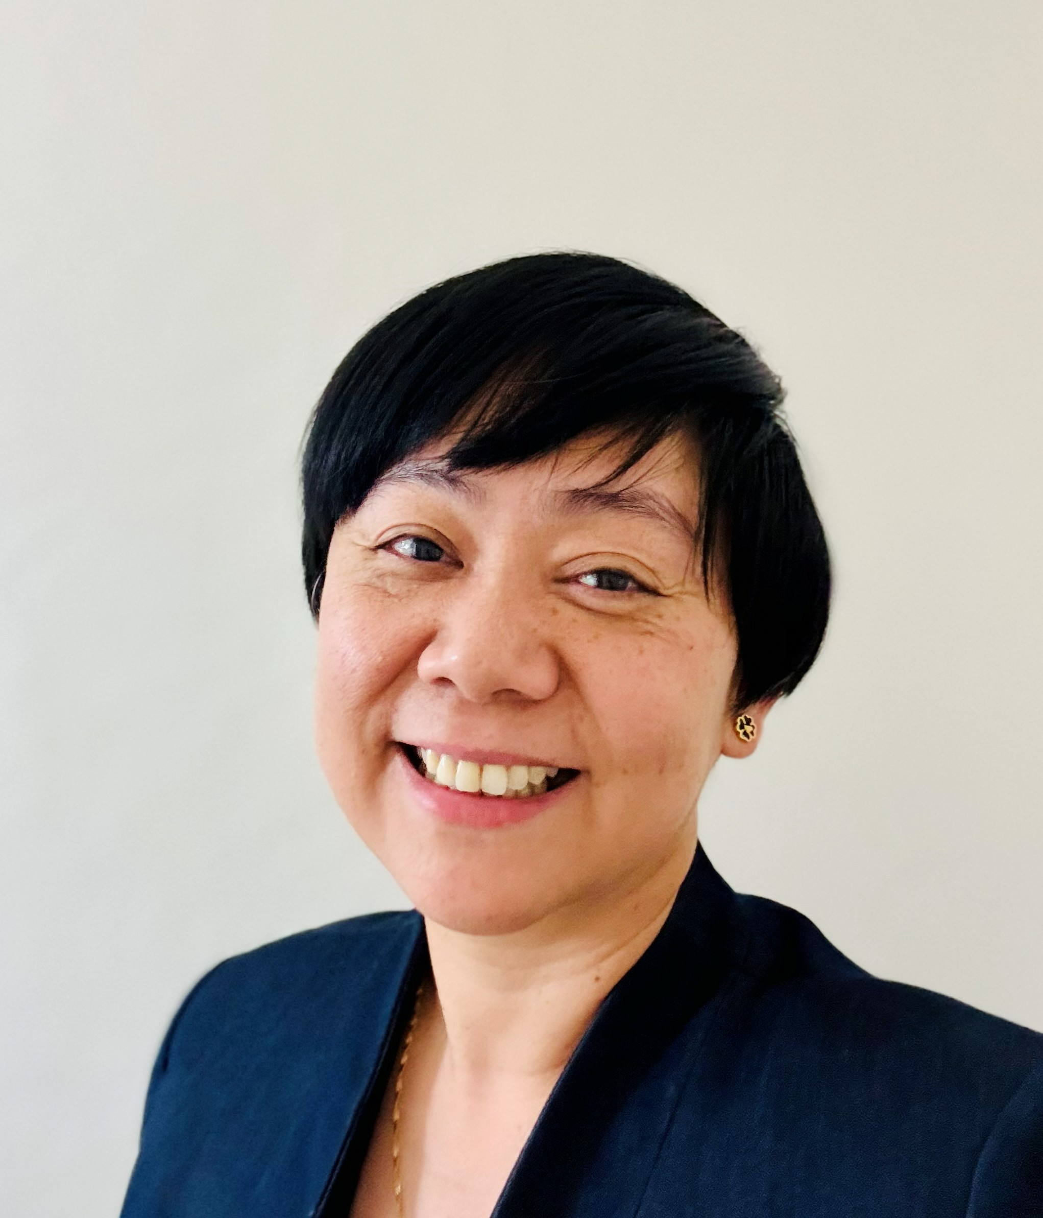
Board Member
Jennifer S. Martizano
BSN, RN
Professional Profile: RN Educator - VA Central California Healthcare System
Adjunct Assistant Clinical Instructor - Samuel Merritt University Fresno
Candidate for Master of Science in Nursing in Education at Aspen University
PNACC Position: 2024-2026 – Auditor, Chair – Scholarship Awards Committee, Co-Chair - Education Committee. November 2025 – Recipient of PNACC Nurse Excellence Award in Education.
2022-2024 – Board Member, Co-Chair Nurse Excellence and Scholarship Awards Committee, Board Leadership/Executive Committee Member. Contributed to initiatives recognizing nursing excellence and supporting professional development and scholarship opportunities.
PNAA Activities: 2024-2026 – Member PNAA NOMELEC Committee. Delegate to the PNAA National Convention in Colorado Springs, July 2026, PNAA Camp Aruga Leadership Bootcamp in 2023, 2024, and 2025, PNAA International/Global Convention in Iloilo, January 2024, facilitated the first PNACC Medical Mission in collaboration with PNAOW and PNAH, Medical Mission of PNAA/PNACC in January 2026 in Camiling, Tarlac. First time attendee of PNAA Western Regional Conference in Maui, April 2023, and in Carlsbad, CA May 2025.
Professional Statement: If elected Board Member I will continue to uplift the organization and support all activities to the best of my ability. Throughout my nursing career, I have demonstrated a strong commitment to nursing education and staff development. In my role as an RN Educator, I have contributed to the development and implementation of orientation and competency programs, including the use of the Donna Wright Competency Assessment Model. I also support staff through mentorship, preceptorship, continuing education, and facility-wide educational initiatives. As a recipient of the PNACC Nurse Excellence Award in Education I will continue to contribute to nursing education, professional development and the advancement of nursing excellence.
Jennifer S. Martizano
BSN, RN

Slide 9
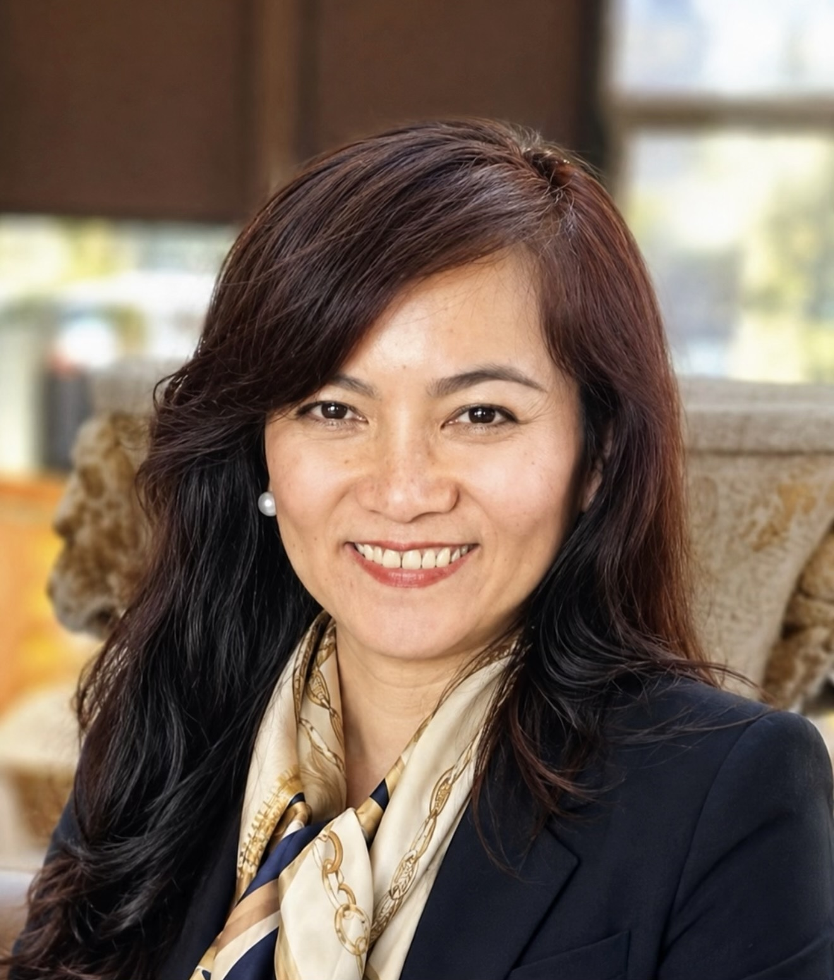
Board Member
Raumelia S. Bautista
BSN, RN, PCCN
Professional Profile: RN Charge – Centralized Patient Monitoring Department
Clovis Community Medical Center, NOC Shift
PNACC Position: 2024-2026 Executive Board member, Chair Human Rights and Sunshine Committee. 2020-2022 Executive Board member. Supported all activities of PNACC including annual events, community outreach programs.
PNAA Activities: Delegate to the PNAA Western Regional Conference in Carlsbad, CA May 2025, and PNAA Western Region Camp Aruga Leadership Boot Camp in Oregon March 2025.
Professional Statement: As a registered nurse with more than 2 decades of experience across intensive care, progressive care, telemetry, operating room, and medical surgical settings, I am eager to serve the Philippine Nurses Association of Central California. My career has been guided by compassion, high standards of practice and a commitment to caring for diverse patient populations.
As a Board Member, I will support PNACC’s mission by promoting professional development, encouraging evidence based practice, and strengthening the bonds within our Filipino nursing community. I believe in leading through service, listening to my colleagues, and helping fellow nurses reach their full potential. It would be a privilege to give back to an organization that champions our profession and honors our shared heritage.
Raumelia S. Bautista
BSN, RN, PCCN

Slide 10
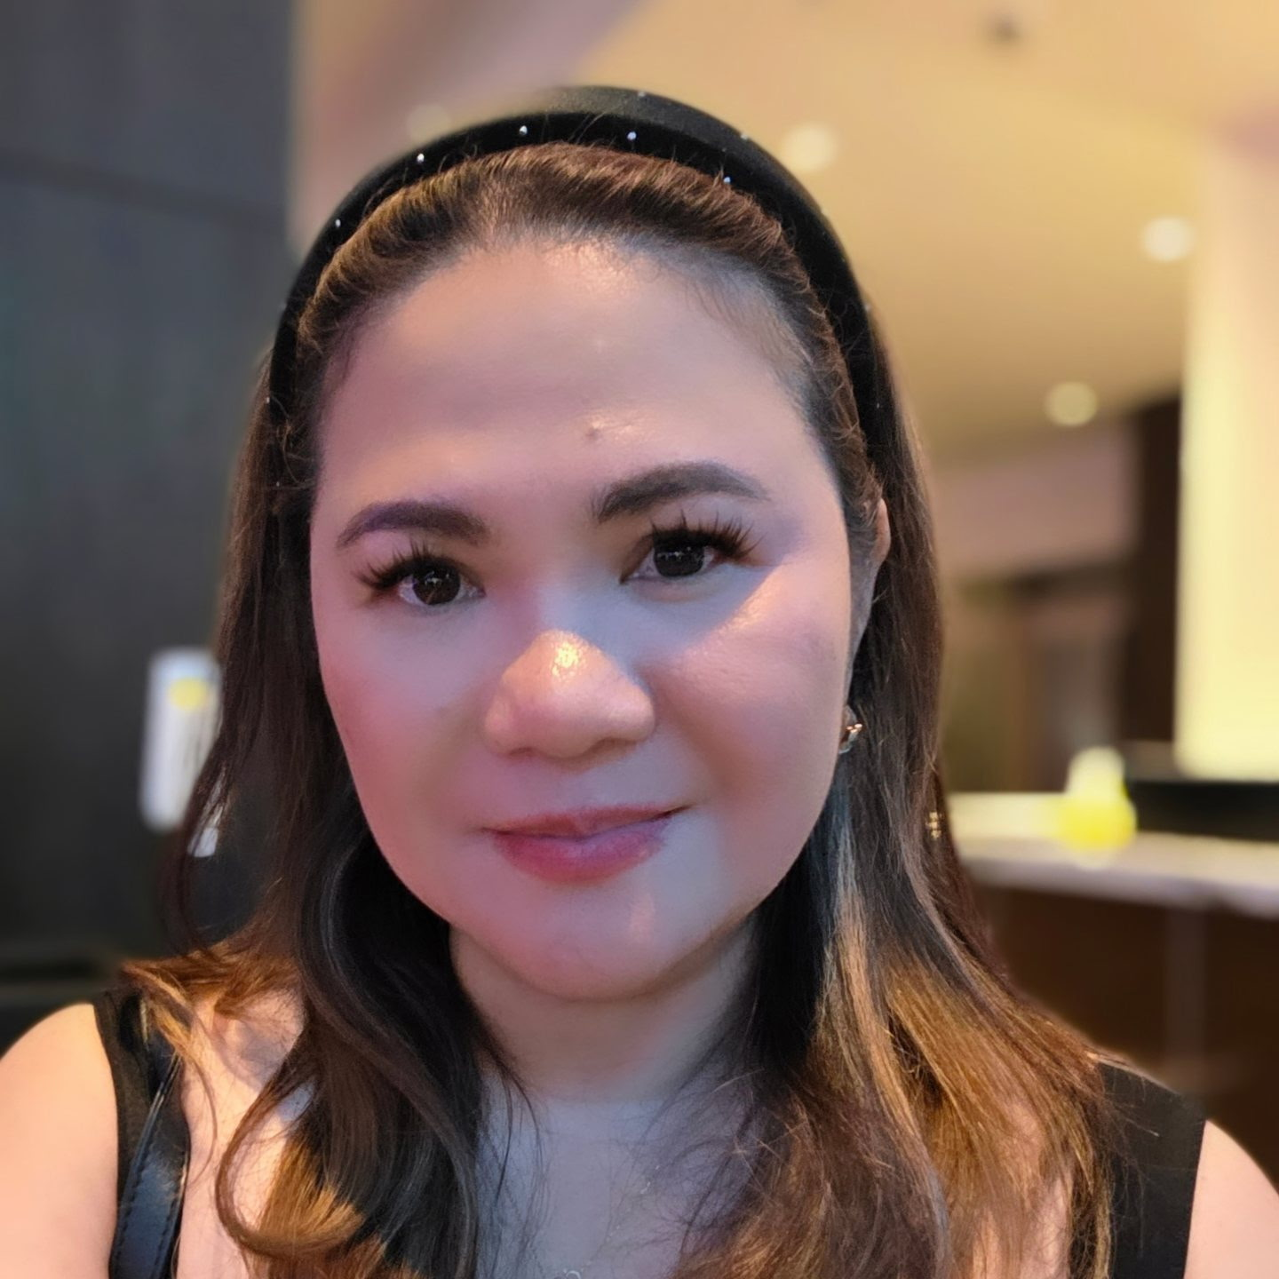
Board Member
Athena M. Oliquiano
MSN, AGNP-C, RN, CFCS, WCC
Professional Profile: Geriatric Nurse Practitioner, Community Living Center
VA Central California Healthcare System
PNACC Position: 2024-2026 - Public Relations Officer, PRO, Co-Chair Scholarship Committee, Social/FB. 2022- 2024 - Executive Board member, active member in the events committee, spearheaded the “Zumbathon” in May 2023. Joined the “Fun Run” in 2021. Recognized by PNACC as Nurse Excellence in Advance Practice in 2019.
PNAA Activities: Delegate to the PNAA Western Region Camp Aruga Leadership Bootcamp in March 2026 in Orange County, September 2025 in Oregon, October 2023 in San Francisco, PNAA National Convention in Colorado Springs July 2026, and PNAA Western Regional Conference in Carlsbad, CA May 2025,
Professional Statement: As a nurse practitioner with nearly two decades of clinical and leadership experience, I am committed to serving the PNACC with dedication, integrity, and a patient centered spirit. My background in geriatric, critical, and rehabilitative care has taught me the value of collaboration, evidence based practice, and mentorship. As a board member, I will support PNACC’s mission by strengthening professional development, advocating for our members, and fostering unity within our Filipino nursing community. I believe in leading by example, listening with humility, and empowering fellow nurses to grow and thrive. It would be an honor to give back to an organization that uplifts our profession and celebrates our shared heritage.
Athena M. Oliquiano
MSN, AGNP-C, RN, CFCS, WCC

Slide 11
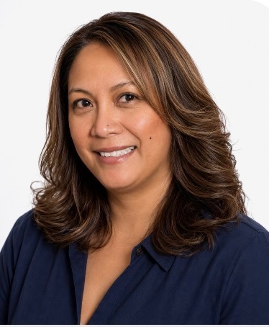
Board Member
Guia Arceo
BSN, RN
Professional Profile: Clinical Nurse II, Charge Nurse – Med –Surg Oncology
Clovis Community Medical Center
PNACC Position: 2024-2026 Executive Board Member, Chair Archive Committee. Recipient of PNACC’s Nurse Excellence Award in Community Service in May 2022. Board of Director 2018-2020, received Meritorious Award (Sept. 2020) for significant contributions in achieving PNACC’s mission, vision, and goals. Active in the monthly community service/food distribution “Daniel’s Pantry at HGFFA – Holy Ground Family Fellowship of America. Supports PNACC’s annual Dinner Dance as the “Master of Ceremony”.
Professional Statement : With 3 decades of nursing experience spanning oncology, dialysis, and clinical education, I am honored to continue my service to the Philippine Nurses Association of Central California. Having previously served on the Board of Directors and been recognized for community service, I understand the dedication required to advance our shared mission.
As a Board Member, I will work to strengthen professional growth, promote evidence based practice, and expand community outreach that reflects the values of our Filipino nursing heritage. I am committed to mentoring fellow nurses, supporting our members, and fostering collaboration across our community. It would be a profession. privilege to give back to an organization that has shaped my journey and continues to uplift our profession.
Guia Arceo
BSN, RN

Slide 12
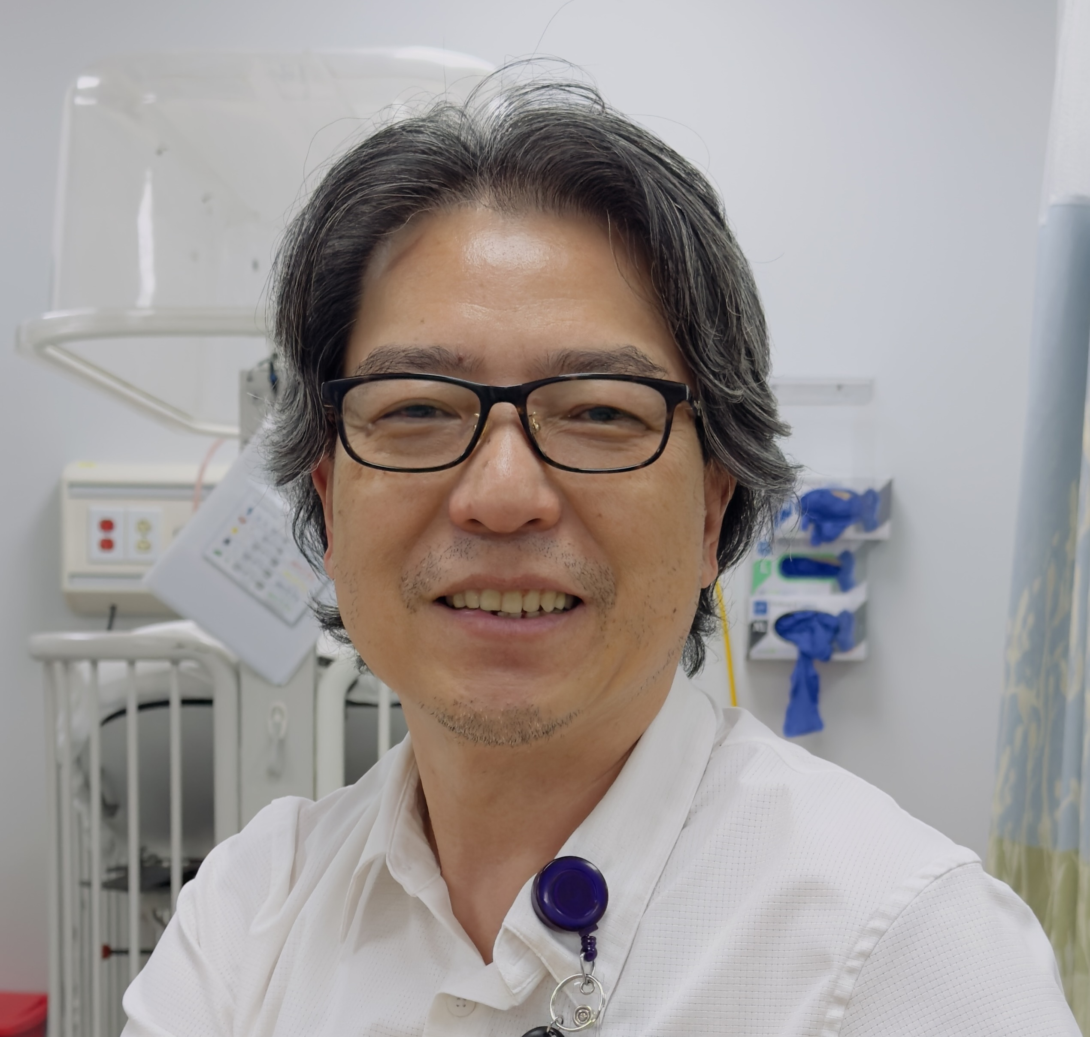
Board Member
Bernard V. Payongayong
MSN-Ed, RN, CNOR
Professional Profile: Nurse Manager – Community Living Center
VA Central California Healthcare System.
Assistant Professor of Nursing – Samuel Merritt University.
PNACC Position: 2024-2026 – Board Member, Chairman - Education Committee.
2020-2023 Active member and supported all the activities of the year and provided monetary support to all the initiatives. Recipient of PNACC’s Excellence in Nursing Education Award in 2023.
PNAA Activities; First time delegate at the PNAA National Convention in Colorado Springs July 2026.
Professional Statement: Approximately 7 years ago, I joined PNACC while working with current President Cecilia Utleg at the Fresno VA Hospital where I served as Educator for Critical and Peri-operative services. I am currently employed as a nurse manager in the Community Living Center. My background as an OR nurse reflects strong clinical expertise and leadership. I consistently earn the respect of peers and demonstrate confidence in my practice. As the 2024-2026 PNACC Education Chair, I headed several conferences and was instrumental in securing CE provider status from the California BRNS. PNACC is deeply meaningful to me, and I am committed to contributing through service and education.
Bernard V. Payongayong
MSN-Ed, RN, CNOR

Slide 13
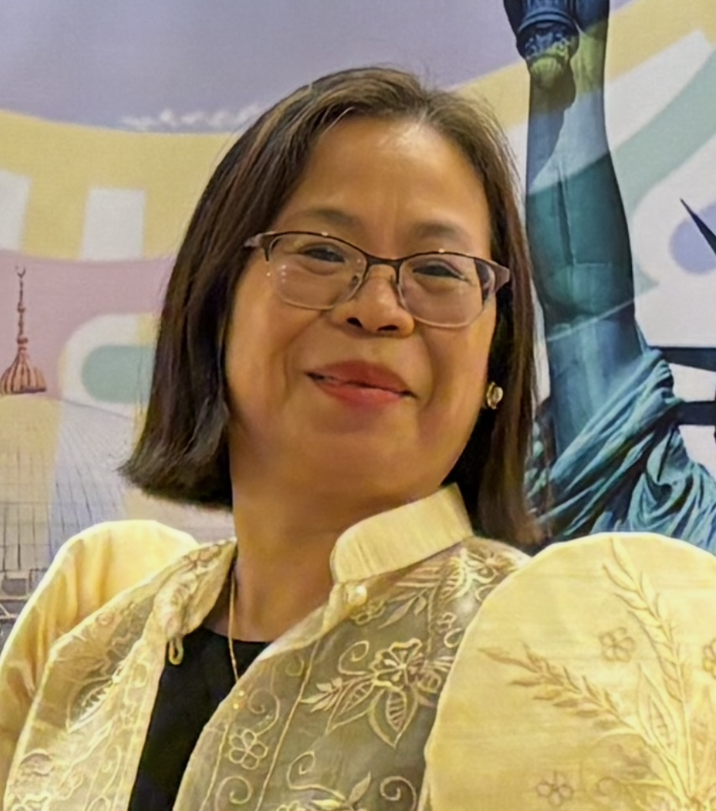
Board Member
Fatima T. Estacio
BSN, RN
Professional Profile: Staff Nurse, Relief Charge Nurse – Discovery Unit, Day Shift Valley Children's Hospital (VCH)
PNACC Position: 2024 – 2026 – Assistant Secretary, Co-Chair of Membership Committee and member of Decoration Committee.
PNAA Activities: Delegate to the PNAA National Convention in Colorado Springs July 2026, PNAA International and Global Convention in Manila, Philippines in January 2026 and joined the Medical Mission headed by PNACC in Camiling, Tarlac, and Gawad Kalinga in Bulacan, PNAA Western Regional Conference in Carlsbad, CA in May 2025 and PNAA Western Region Camp Aruga Leadership Bootcamp in Oregon, September 2025.
Professional Statement: If elected as a Board Member, I will actively support the Executive Board in advancing PNACC’s mission through collaboration, leadership, and service. I am committed to promoting professional excellence, fostering member engagement, and strengthening our impact in the community while preserving the proud legacy of Filipino nurses.
Fatima T. Estacio
BSN, RN

Slide 14
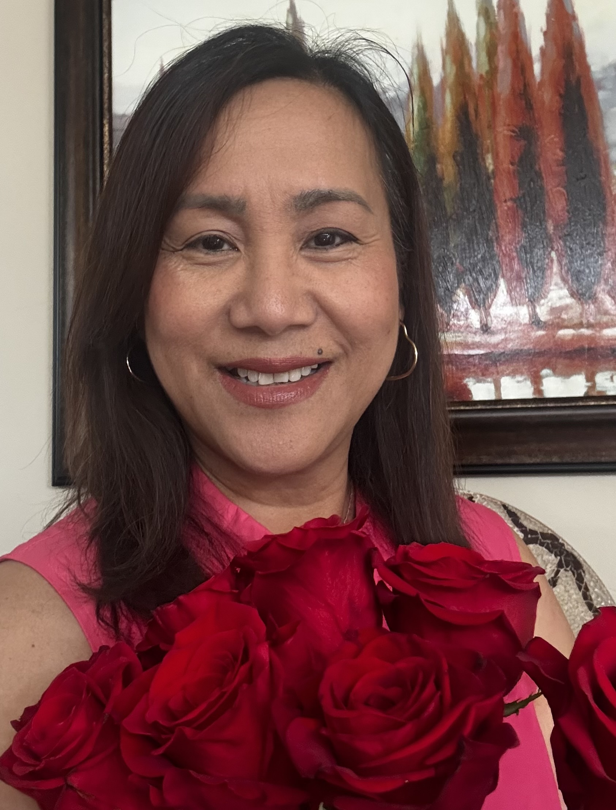
Board Member
Susan P Ariola
BSN, RN
Professional Profile: Practice Coordinator, 5 North, Day Shift
Saint Agnes Medical Center
PNACC Position: Active Member
PNAA Activities: First time delegate to the PNAA Western Region Camp Aruga Leadership Bootcamp in Orange County, March 2026.
Professional Statement: I am seeking the opportunity to serve as a Board Member of PNACC with a commitment to serve, unite, empower, and inspire Filipino-American Nurses. With my years of experience in nursing and passion for leadership, I hope to contribute my knowledge, dedication, and heart for the service to strengthen our organization and our nursing community.
Susan Ariola
BSN, RN

Slide 15
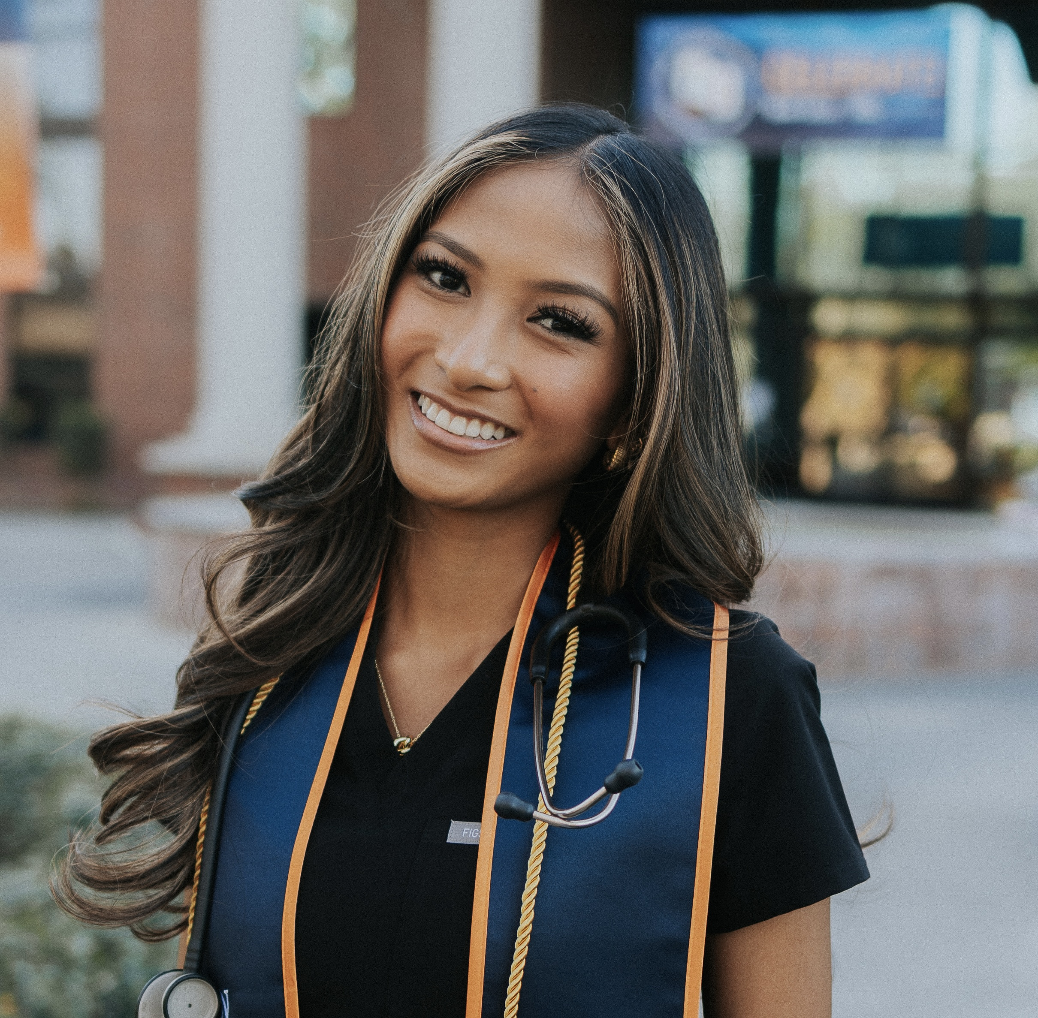
Board Member
Americus A. Cayabyab
BSN, RN
Professional Profile: Neonatal Intensive Care Unit, NICU
Community Medical Regional Center, CRMC
PNACC Position: Active Member since 2023 and Scholarship recipient in November 2023.
Professional Statement: I am a second-generation nurse currently working in the NICU, and I am
honored to serve as a candidate for the PNACC Executive Board. My connection to PNACC is personal, as I have family members and friends who are part of the organization, and I was also a scholarship recipient 3 years ago as a nursing student. That experience showed me firsthand the impact PNACC can have on the lives and careers of Filipino nurses. As a board member, I hope to give back by supporting professional growth, mentoring the next generation of nurses, strengthening connections within our Filipino nursing community, and promoting service and unity. I want to bring the perspective and energy of the younger generation while helping PNACC continue to create meaningful opportunities, build strong connections, and support Filipino nurses in our community.
Americus A. Cayabyab
BSN, RN

Slide 16
PNACC Nomination and Election
Committee
Submitted by:
Mila E. Nino
PNACC Past President 2020-2022
Nomination and Election Committee

