Slide 1
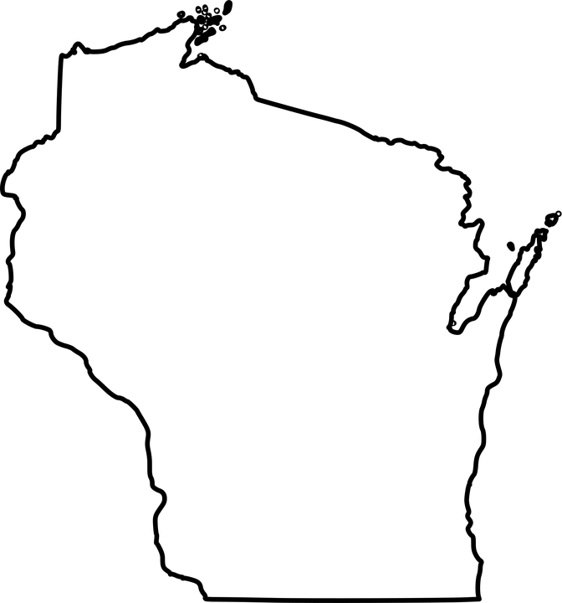
Greater Milwaukee Area Chapter-AACN
Vitals and Vibes:
What you need to know…
Sepsis 101
Presentation | Dinner | Q&A | Networking & Discussion
Nov 11th , 2026 Hot House Tavern
Wednesday Sponsored by
5pm Convatec
Please register at MilwaukeeAACN@gmail.com

