Slide 1

AANN Chapter Meeting
Member Updates & Upcoming Events

Slide 2
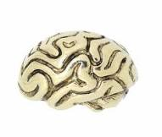
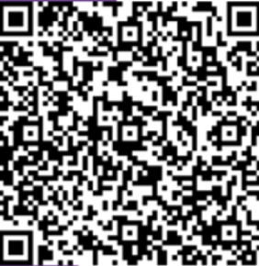
Membership & Chapter Updates
Join today and receive a pin for free at our next dinner event on October 15th.
Board of Directors agreed to keep dinner events on Thursdays for continuity.

Slide 3
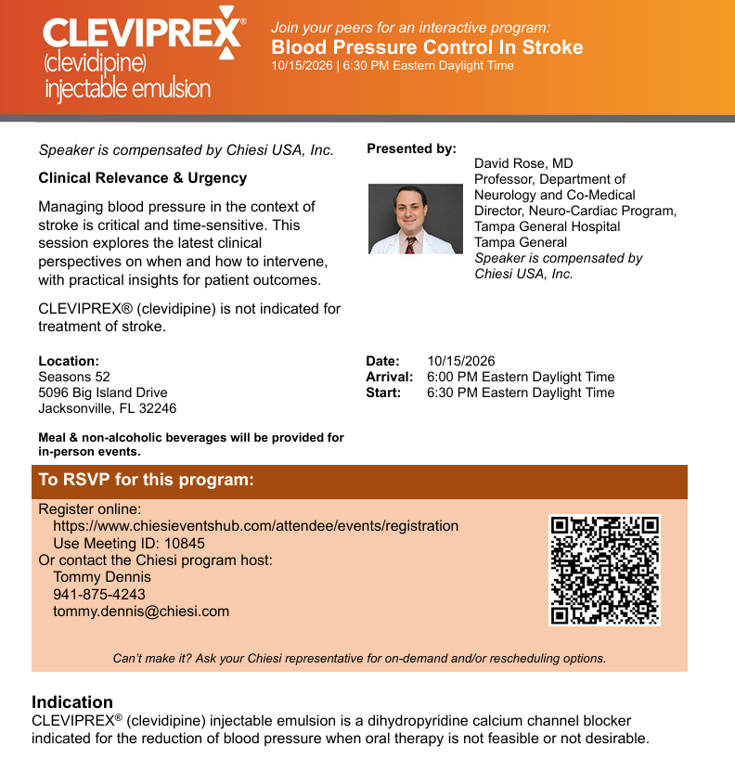
Upcoming Dinner Event
Sponsored presentation: Cleviprex with Dr. Rose.
  Date: October 15
  Location: Seasons 52
  Registration: Website and sponsors QR code
Questions about blood pressure control in stroke are welcome in advance. Email questions to Katy Ann or any Board member (neflaann@outlook.com) for Dr. Rose to address during the session.

Slide 4
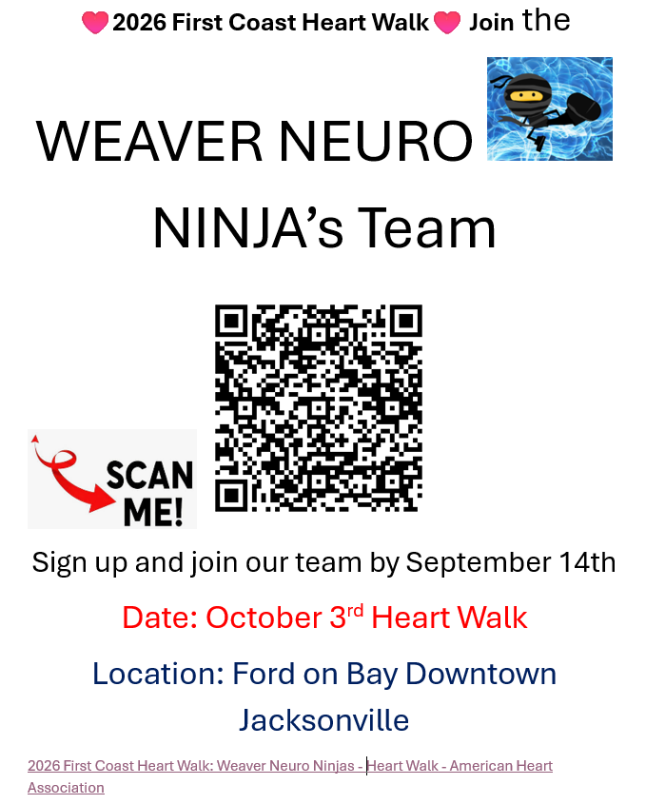
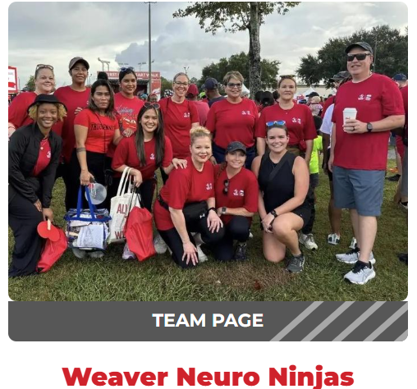
Upcoming Events
Heart Walk: October 3. Join the Weaver Neuro Ninjas

Slide 5

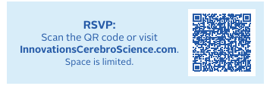
Upcoming Events
Innovations Conference: September 9-11
  Nursing table featured on September 9

Slide 6

Upcoming Events
Stroke Amelia: October 14-17

Slide 7

Upcoming Events
AANN Amplify Virtual Symposium: September 10

Slide 8

Continuing Education Opportunities
AANN CE Program: Hydrocephalus
October 2, 1:00 PM to 2:00 PM
Information posted on the AANN website.

Slide 9
Thank You

