Slide 1
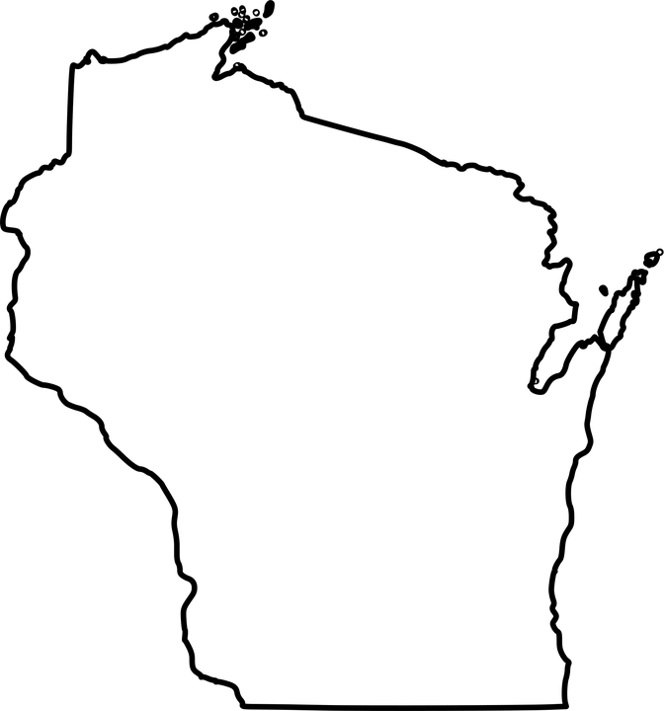
Greater Milwaukee Area Chapter-AACN
Vitals and Vibes:
What you need to know…
Heart Valves and therapies
Presentation | Dinner | Q&A | Networking & Discussion
Sept 15, 2026 Hot House Tavern
Tuesday Sponsored by
5pm Edwards Lifescience
Please register at MilwaukeeAACN@gmail.com

