Slide 1
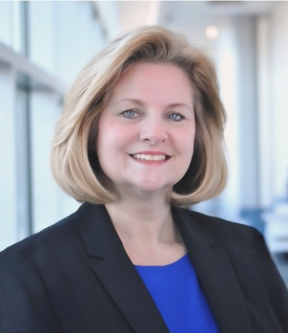
KONL Fall 2026 Scholarship
Audrey Poston, a Registered Nurse (RN) from Poole, Kentucky, is a Doctor of Nursing Practice (DNP) student in the Clinical Leadership program at the University of Kentucky. Audrey represented the DNP program at the AACN Student Policy Summit in March 2026, advocating for the nursing profession on Capitol Hill. She holds dual certification as an Oncology Certified Nurse (OCN) and Certified Nurse Educator (CNE) through the National League for Nursing. Audrey was selected by the AACN to serve in two Graduate Nursing Student Academy (GNSA) roles: Kentucky's Advocacy Leader, building federal policy skills and amplifying student voices, and GNSA Liaison for the University of Kentucky. In these roles, she shares GNSA resources through her position as a Graduate Nursing Activities and Advisory Council (GNAAC) officer at the UK College of Nursing. Audrey Poston is honored to receive the KONL scholarship as she continues her journey toward earning her DNP.

