Slide 1
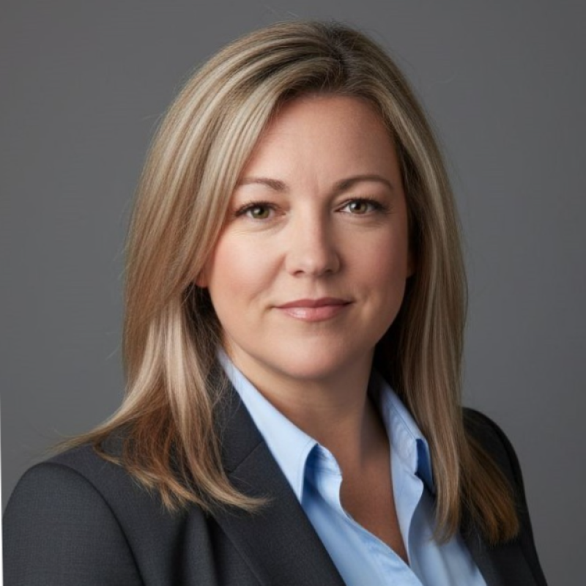
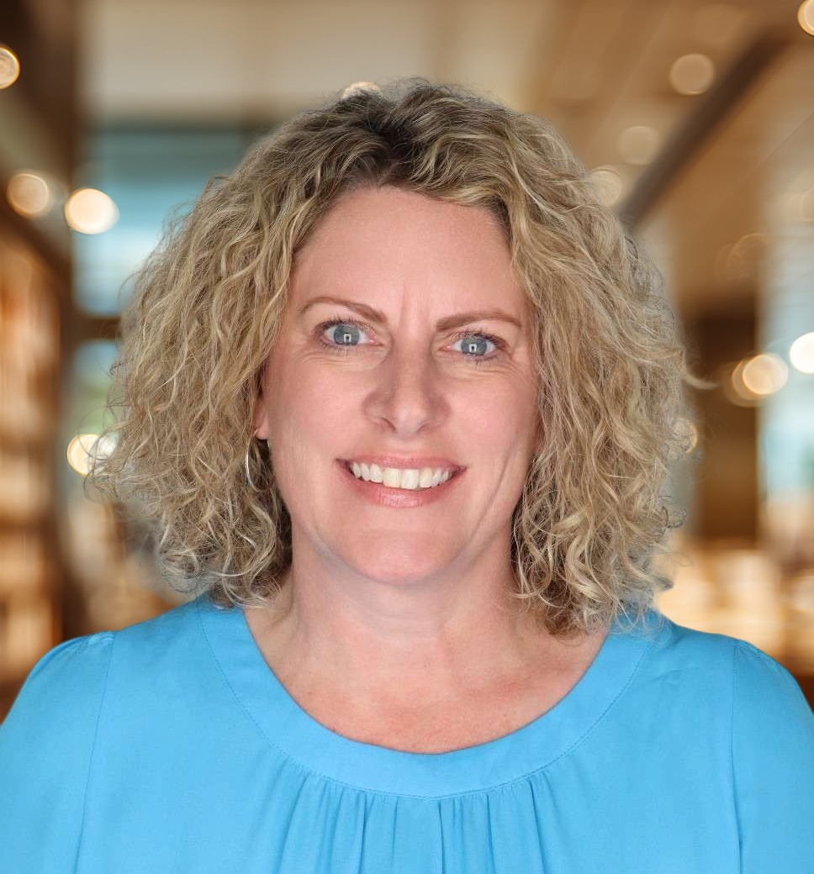
LIVE WEBINAR
Advocacy in Action:
Legislative Updates for Nurse Leaders
AUGUST 27, 2026 | 12:00 PM – 1:00 PM MT
FEATURED SPEAKERS
Sarah Gardiner
Danielle Schloffman
DNP, RN, CENP
MSN, RN, NE-BC
Secretary of Legislative Affairs
CONL Legislative Affairs Committee Member
SESSION OVERVIEW
Join the Colorado Organization of Nurse Leaders for a timely review of healthcare legislation and policy developments impacting nurses, healthcare organizations, and patients across Colorado. This session equips nurse leaders with practical insights into the 2026 Colorado legislative session, emerging policy trends, and opportunities to influence healthcare decisions through advocacy and engagement.
Key legislation from the 2026 Colorado session
Policy trends affecting nursing leadership and workforce
Advocacy opportunities and legislative engagement strategies
REGISTRATION
QR
CODE
PRICING
Opening Soon
$0 CONL Members
$25 Non-CONL Members
$150 Webinar + Membership
conl.nursingnetwork.com
Scan the QR code once
registration opens.
Colorado Organization of Nurse Leaders • Mentorship. Partnership. Leadership.
This activity has been submitted to the Colorado Nurses Association for approval to award contact hours.

